Slide 1
LING 696G: Syntax and Computation
Lecture 2
Sandiway Fong
University of Arizona
sandiway.arizona.edu
sandiway@arizona.edu

Slide 2
Course Outline
Today (Lecture 2):
  Knowledge of Language
  SMT Parser (696A course version, less buggy)
  has some English and Spanish
  should work on macOS, Windows 11 and Linux
  how to install, run and modify LEX: read the tutorial and manual
  hope you have a laptop!
Heads up: Sept 7th is Labor Day (no classes)

Slide 3
Course Outline
Next time (Lecture 3):
  let's get deeper into background and theory!
  Collaborator Guest spot: Jason Ginsburg (Kyoto University)
    Serial verbs (Japanese)
  Background
    Minimalism: Where Are We Now, and Where Can We Hope to Go, Chomsky N. A.
    GENGO KENKYU 2021 Volume 160 Pages 1-41
    Download and read (as much as you can):
      https://www.jstage.jst.go.jp/article/gengo/160/0/160_1/_article

Slide 4
Lecture 1: Recap of Main Points
Workspace (WS): is needed for recursion
recursion: SBOs output can (later) feed SBOs
Minimal Search (MS): a property of certain atoms of syntax, e.g. INFL_{φ}, C_{Q}. (Also, relativization C_{rel} ?)
MS can have EXT effects (the option to spell at the left edge)
EXT: locus of language variation
Process Model: hear something, LEX atoms into WS, SBOs fire, INT on converged syntactic objects (SOs), (optionally) EXT fires.
Parsing: if what you heard is what is EXT'd, that SO is valid.
Multiple WSs possible. Multiple SOs possible. Multiple EXTs possible.

Slide 5
Knowledge of Language
Knowledge (explicit):
  you know how to read and write a computer program
  you know how to work the computer
  conscious propositional knowledge
  explicitly learned skills (could include an implicit component)
Knowledge of Language (implicit):
  You obviously wouldn't expect the native speaker of the language to be able to tell you anything very sensible about it, or for that matter, to tell you anything very sensible about any other aspect of his knowledge. He might, on occasion, be able to, but he might very well not be able to.
I-Language

Slide 6
Knowledge of Language
From the same talk:
  As a speaker of English, everyone knows that there's something wrong with this sentence:
    *John's certainty to leave
    John is certain to leave (that Bill will leave)
  In fact, people who've never seen either of these things will understand them instantaneously in just the right fashion if they know English.
  Linguist: some condition on Nominalization? How is it acquired?
  [Bruening 2018: I for one as a native speaker of English have always found [..] perfectly acceptable.]
  Whatever it is that the linguist, say, knows about is knowledge that he knows about the knowledge of the speaker, and that knowledge is not consciously extricable.

Slide 7
Knowledge of Language
From the same talk:
  John is eager to please
  John is easy to please
  1'. John's eagerness to please (Nominalization)
  2'. *John's easiness to please
  3. John is certain to leave
  3'. *John's certainty to leave
  [Knowledge] not available to consciousness, and there's no particular reason to suppose that it could ever be conscious. It doesn't become available through introspection.
  No particular reason why a person should be able to introspect and ultimately sort of see the principles upon which his decisions about his understanding of sentences and his decisions about their character are based.

Slide 8
Knowledge of Language
There's a difference between the notion of certain, which is a property of people …
and the notion of certain, which is a logical property of propositions.
Aside:
  reinterpret Chomsky's Remarks on Nominalization (1970)
  John is certain to win the prize / It is certain that John will win the prize
  {certain_{v}, {John {v, {win, prize_{the}}}} (θ-configuration)
  {INFL_{φ}, {be, {certain_{v}, {John {v, {win, prize_{the}}}}}}}
  John is certain
  {certain_{θ}, John} (θ-configuration)
  {INFL_{φ}, {be, {certain_{θ}, John}}}
  John is certain that Bill will win the prize
  {certainty_{θ}, John}
  John's certainty that Bill will win the prize / *John's certainty to win the prize

Slide 9
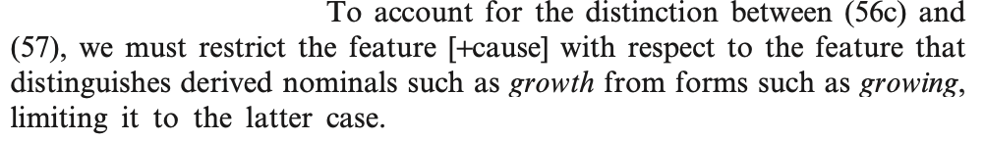
Knowledge of Language
Chomsky 1970:
  John is eager (for us) to please
  John's being eager to please (Gerundive nominals)
  the shooting of the hunters (ambiguous)
  the growling of lions (unambiguous)
  John's eagerness to please (Derived nominals)
  the growth of tomatoes (unambiguous)

Slide 10
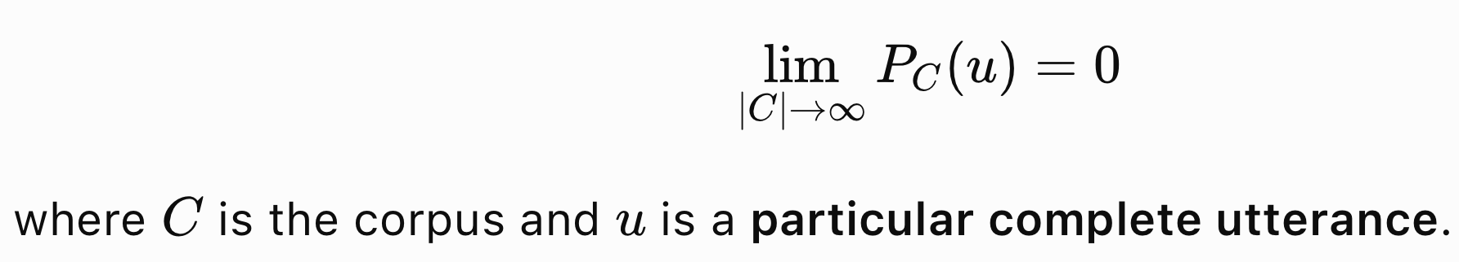
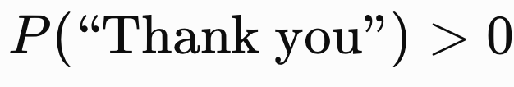
Knowledge of Language
On "never seen before":
  … each of these [cases] has exactly the same probability on any empirical grounds for detecting probability.
  In other words, the probability of finding probability in English is zero in the really technical sense.
  That is, if you look at larger and larger segments of English text, the probability of finding either of these reduces without limit, clearly.
"language is generative"

Slide 11
Knowledge of Language
From the same talk:
  I don't see any way to avoid the conclusion that knowledge of a language involves some sort of internal representation.
  … a system of rules, of what is called nowadays a generative grammar, meaning a system of principles somehow mentally represented.
  Nobody knows anything about [the] physical representation, but which we can describe abstractly that expresses what the speaker of the language intuitively knows, the kind of knowledge that underlies his performance, though it's not the kind of knowledge that he can tell you about very often.

Slide 12
Knowledge of Language
From the same talk:
  So, in particular, a generative grammar will say for each sentence that it has such and such a phonetic shape, that it has such and such a meaning, and that it has such and such a syntactic structure, the latter being, again, a kind of an abstract representation that relates phonetic shape and meaning in some fashion.
  And a generative grammar should say that for every utterance of the language.
  [a person with a mental representation of a set of rules] may be able to detect the conclusions without being able to have any insight into the principles that he uses to arrive at these conclusions.

Slide 13
Use of Knowledge of Language
From the same talk:
  Well, if it is correct to describe knowledge of language, to offer a generative grammar as an explication of the notion of knowledge of a language, then the next question you want to ask is how is that knowledge put to use?
  For example, you might want to ask the question, can I construct a model, a theory if you want, which accounts for the ability of an ordinary human to accept some sort of signal written or spoken, let's say, and to produce the sort of structural description,…
The SMT Parser is a model, a computer model of the knowledge of language (in these terms)
  non-probabilistic (because that knowledge is non-probabilistic)

Slide 14
Structure dependent/independent operations
From the same talk:
  Language uses structure dependent operations only, e.g. for question formation
  It's an operation that doesn't depend on the substantive content of the string of elements in question, but rather on an abstract structure associated with it.
  Structure-dependence:
    John's having been here yesterday was a surprise
    the boy who was here was sick

Slide 15
Structure dependent/independent operations
From the same talk:
  Structure-independent:
    you could imagine a language which formed questions by taking, let's say, by taking a declarative and reading it backwards, [e.g. sick was here was who boy the]
    Or you could imagine a language which has a structure-independent operation of forming a question by taking a declarative by taking, let's say, the leftmost occurrence of the verbal element and moving that to the front, [e.g. was the boy who here was sick]
    In fact, there's plenty of [simple] mathematics that deals with structure-independent operations like shuffling and reflection and inversion and all sorts of things.

Slide 16
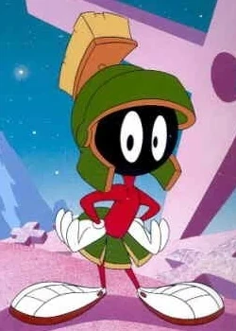
Structure dependent/independent operations
From the same talk:
  And in fact, if there's any sense to the notion of simplicity of theory, then such a theory would be much simpler, by any considerations that we know about, much simpler than natural language.
  Because, as I say, the notion of structure-dependent operation is a very complex notion.
  If the Martians come along, they're likely to have structure-independent operations, and that'll be perfectly fine for a communication system, you know, simpler mathematics and errors and so on and so forth.
  Yet, no language, you know, you can be quite certain no language does form questions in the latter fashion. [inverting the sequence]
  And more generally, no language has any operation at all that operates in the latter fashion.
  All operations in all languages […] are structure-dependent.

Slide 17
Structure dependent/independent operations
From the same talk:
  We could easily, let's say, to understand the language as cryptanalysts.
  You know, as soon as I explain to you that in this language they're forming questions by writing declarers backwards, you could immediately carry out the appropriate cryptanalytic operations and interpret what those people are saying.
  But you would be using a different faculty of the mind than the faculty that you use when you acquire knowledge of a language.
  I'm saying that a child put into a situation where people are forming questions by putting declarers backwards would have one hell of a time learning that language.
  Whereas when he uses the, in some sense, much more complex rule of English, he learns it instantaneously.

Slide 18
Acquisition and Knowledge of Language
From the same talk:
  what kind of a system must be postulated in order to account for the ability of the person to blend the grammar?
  We could find out a great deal about that data if we wanted. We could make recordings of everything the person's ever heard and the situations they've been in and so on and so forth. And it would be fairly small, this amount of data.
  But on the basis of whatever data he has available, he's come out with a grammar that has certain peculiar properties.
  So, we could argue that nominalization is possible in one case, but not in the other case up here.
  Obviously, nobody's taught him that because nobody knew it to teach him and so on and so forth in the narrow sense of know.
  So, we could ask the question, what kind of a system must be presupposed, postulated, in order to account for the transition from data to knowledge?

Slide 19
Induction and Knowledge of Language
From the same talk:
  I think you find that many of the principles that are present in the functioning of the grammar are not many... are not obtainable from the data by any imaginable induction.
  No inductive process that anyone can dream of or has dreamt of could lead from the kind of data that's available to principles of the required abstractness, for example, the principles that account for normalization in these cases.
  If you really look at grammar, you can say that the following set of principles, which we have evidence to say are known by every speaker, normal speakers of English, are not determined by the data by any inductive process.
  And furthermore, I think one can say not only that these principles are common to all normal speakers of English, but that very similar principles, if you move to the right level of abstractness, are also true of every other language that we know of them.

Slide 20
Innateness and Knowledge of Language
From the same talk:
  If, say, a biologist or an engineer were faced with such a situation, and it was not the human being that was involved, but rather some other organism or some automaton, let's say, he would immediately conclude that these principles are part of the internal structure of the device.
  And that is used as the basis for developing specific knowledge on the basis of whatever data is available.
  Now, if the theories are widely enough spread in the sense that not too many of them are compatible with small amounts of data, then the process of acquiring a very rich theory on the basis of very degenerate and restrictive data is possible.

Slide 21
W. von Humboldt (1836)
Chomsky (1964), Logical Basis of Linguistic Theory (LSLT), cites von Humboldt extensively
On Language (1836):
  "Language is an involuntary emanation of the mind, no work of nations, but a gift fallen to them by their inner destiny."
  "Every language is produced by the original tendency or 'original talent' shared by all human beings."

Slide 22
Peirce and Human Learning (Discovery)
Background:
  Charles Sanders Peirce (abduction): https://plato.stanford.edu/entries/abduction/peirce.html
From the same talk:
  If you had an automaton, let's say, which had to come out with a very rich and highly articulated and specific and extensive theory and only had small degenerate data available to it, it would be able to do that only if it had an initial characterization of the form of the theory that was quite restrictive and that made available only a fairly small number of possible hypotheses.
  And it seems to me that the study of language leads to the, suggests very strongly, that that's the way that the human mind works, at least in this domain.
  And that does recall very, well, almost in word for word paraphrase, some very interesting lectures of Peirce on abduction, where he proposed, on very weak grounds actually, that all human learning is of this sort.
  In fact, you may remember he argued even that there's only a very small number of possible theories, that human beings will ever be able to acquire.
  he argued that if you look at the history of science, you see that when people have asked certain questions, then almost immediately something rather like what is taken to be the right answer came out.

Slide 23
Acquisition and Innateness
And it can be shown false by somebody solving the problem of constructing general techniques, heuristic techniques, or techniques of induction that don't have those two properties.
From the same talk:
  On what grounds is the data in the acquisition of language held to be so limited that only the theory of innate knowledge can account for the acquisition of language?
  One person has a certain, reasonably small number of seconds of lifetime. And in that number, there's a certain number of seconds he's had a certain number of utterances presented to him in particular situations.
  And if you characterize all of that in any fashion that you like, it's not the basis for induction by any specifiable principles of induction that don't incorporate the generative grammar.
  I would argue two things. First of all, that those principles of induction have absolutely no generality, that they would be unique [to] language acquisition, as far as we know.
  And secondly, that the principles of induction would, in fact, be just what I described, namely, they would list, in some manner, a set of attainable theories.
  And maybe a technique for choosing among them, and a technique for judging confirmation.

Slide 24
Piantadosi (2024) vs. Chomsky
Modern language models refute Chomsky’s approach to language (Piantadosi, lingbuzz 2023; 2024)
The rise and success of [LLMs] undermines virtually every strong claim for the innateness of language that has been proposed by generative linguistics.
Modern machine learning has subverted and bypassed the entire theoretical framework of Chomsky's approach, including its core claims to particular insights, principles, structures, and processes.
Fong (2025) IJL Volume 37, Issue 1, pp. 59-74.

Slide 25
Futrell and Mahowald (2025)
How Linguistics Learned to Stop Worrying and Love the Language Models, Behavioral & Brain Sciences (BBS) (2025)
  Formal linguistics has not presented an alternative model with the demonstrated practical language-learning capabilities of neural models.
  The direction of developments in machine learning suggests that the gap between human and machine learning is more likely to be closed not through built-in domain-specific formal restrictions, but rather through more powerful domain-general learning algorithms.
  Finding these internal mechanisms is not a prerequisite for the reality of linguistic structure — the mechanisms may be irreducibly complex.
  It is rare in the history of science for a scientific theory to turn out as disconnected from a corresponding engineering application as formal generative linguistics has turned out to be for language models.
?
?
Einstein's Miracle Creed
Notes:
Proposal for commentary on the BBS paper just submitted

Slide 26
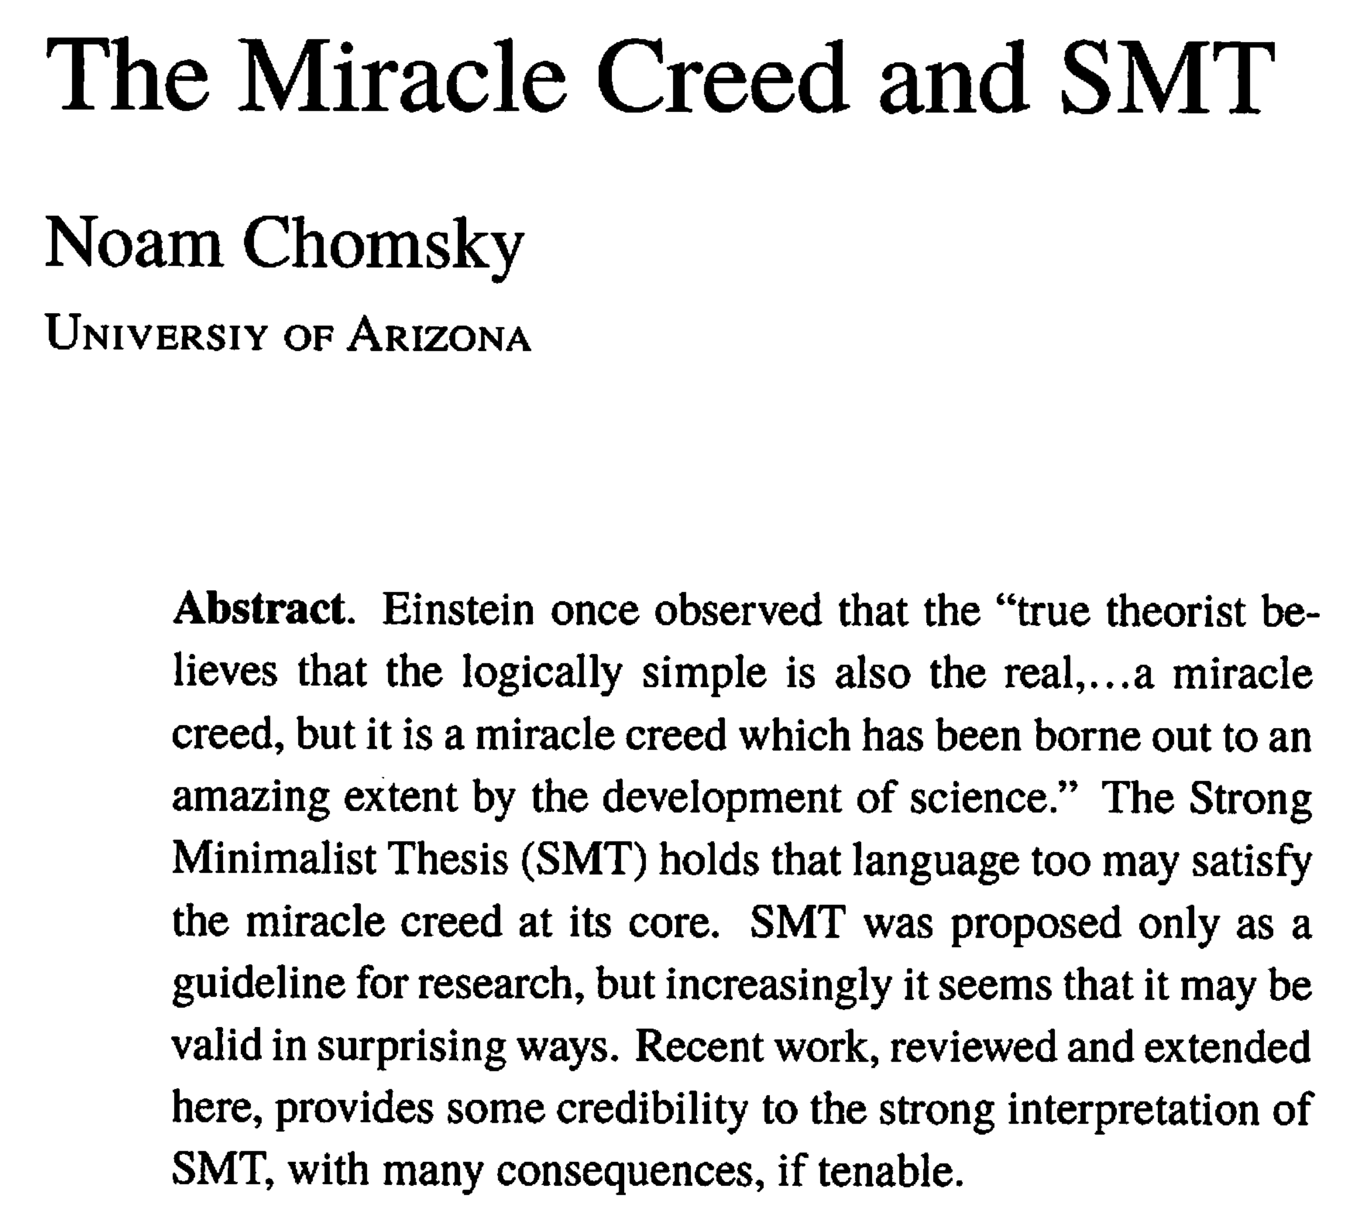
(Chomsky 2024)

Slide 27
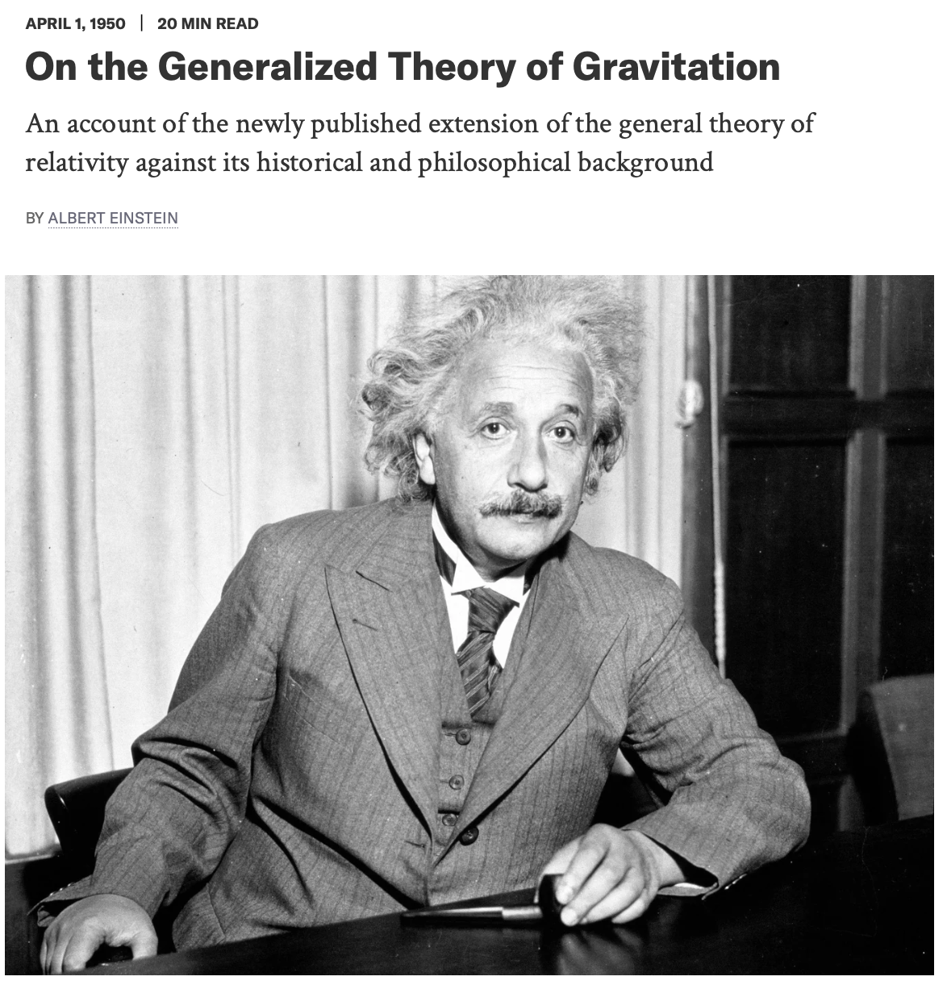
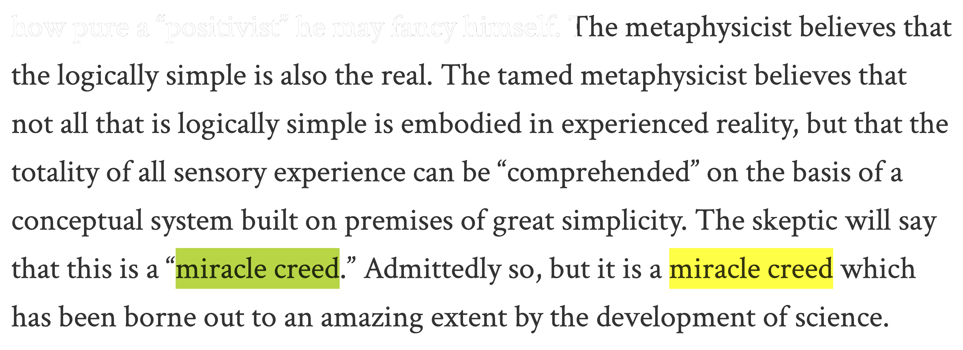
Miracle Creed
LLMs: GPT-4 1,760 billion parameters
(G. Holz, cited in Wikipedia) GPT-5.6?
A. Einstein in Scientific American Vol. 182 No. 4 (1950)
Notes:
Relativity: the special and general theory (1916) (translated into English 1921) 135 pages for the non-mathematically sophisticated reader
I believe that every true theorist is a kind of tamed metaphysicist, no matter how pure a “positivist” he may fancy himself. The metaphysicist believes that the logically simple is also the real.
French word positivisme, derived from positif in its philosophical sense of 'imposed on the mind by experience'.
Atomism. Equations for gravitational theory: 10 to 6 general relativity
generative pre-trained transformer
unlabeled training data

Slide 28
The Tamed Metaphysicist
I believe that every true theorist is a kind of tamed metaphysicist, no matter how pure a “positivist” he may fancy himself.
(Einstein 1950)
positivist (e.g. Mach): empiricist – observables/measurables only.
[A] metaphysicist believes that the logically simple is also the real.
  imagine a simple, underlying model of the universe
[A] tamed metaphysicist believes that not all that is logically simple is embodied in experienced reality, but that the totality of all sensory experience can be “comprehended” on the basis of a conceptual system built on premises of great simplicity.
  there's a testable, simple, underlying model of the universe
The skeptic will say that this is a “miracle creed.” Admittedly so, but it is a miracle creed which has been borne out to an amazing extent by the development of science.

Slide 29
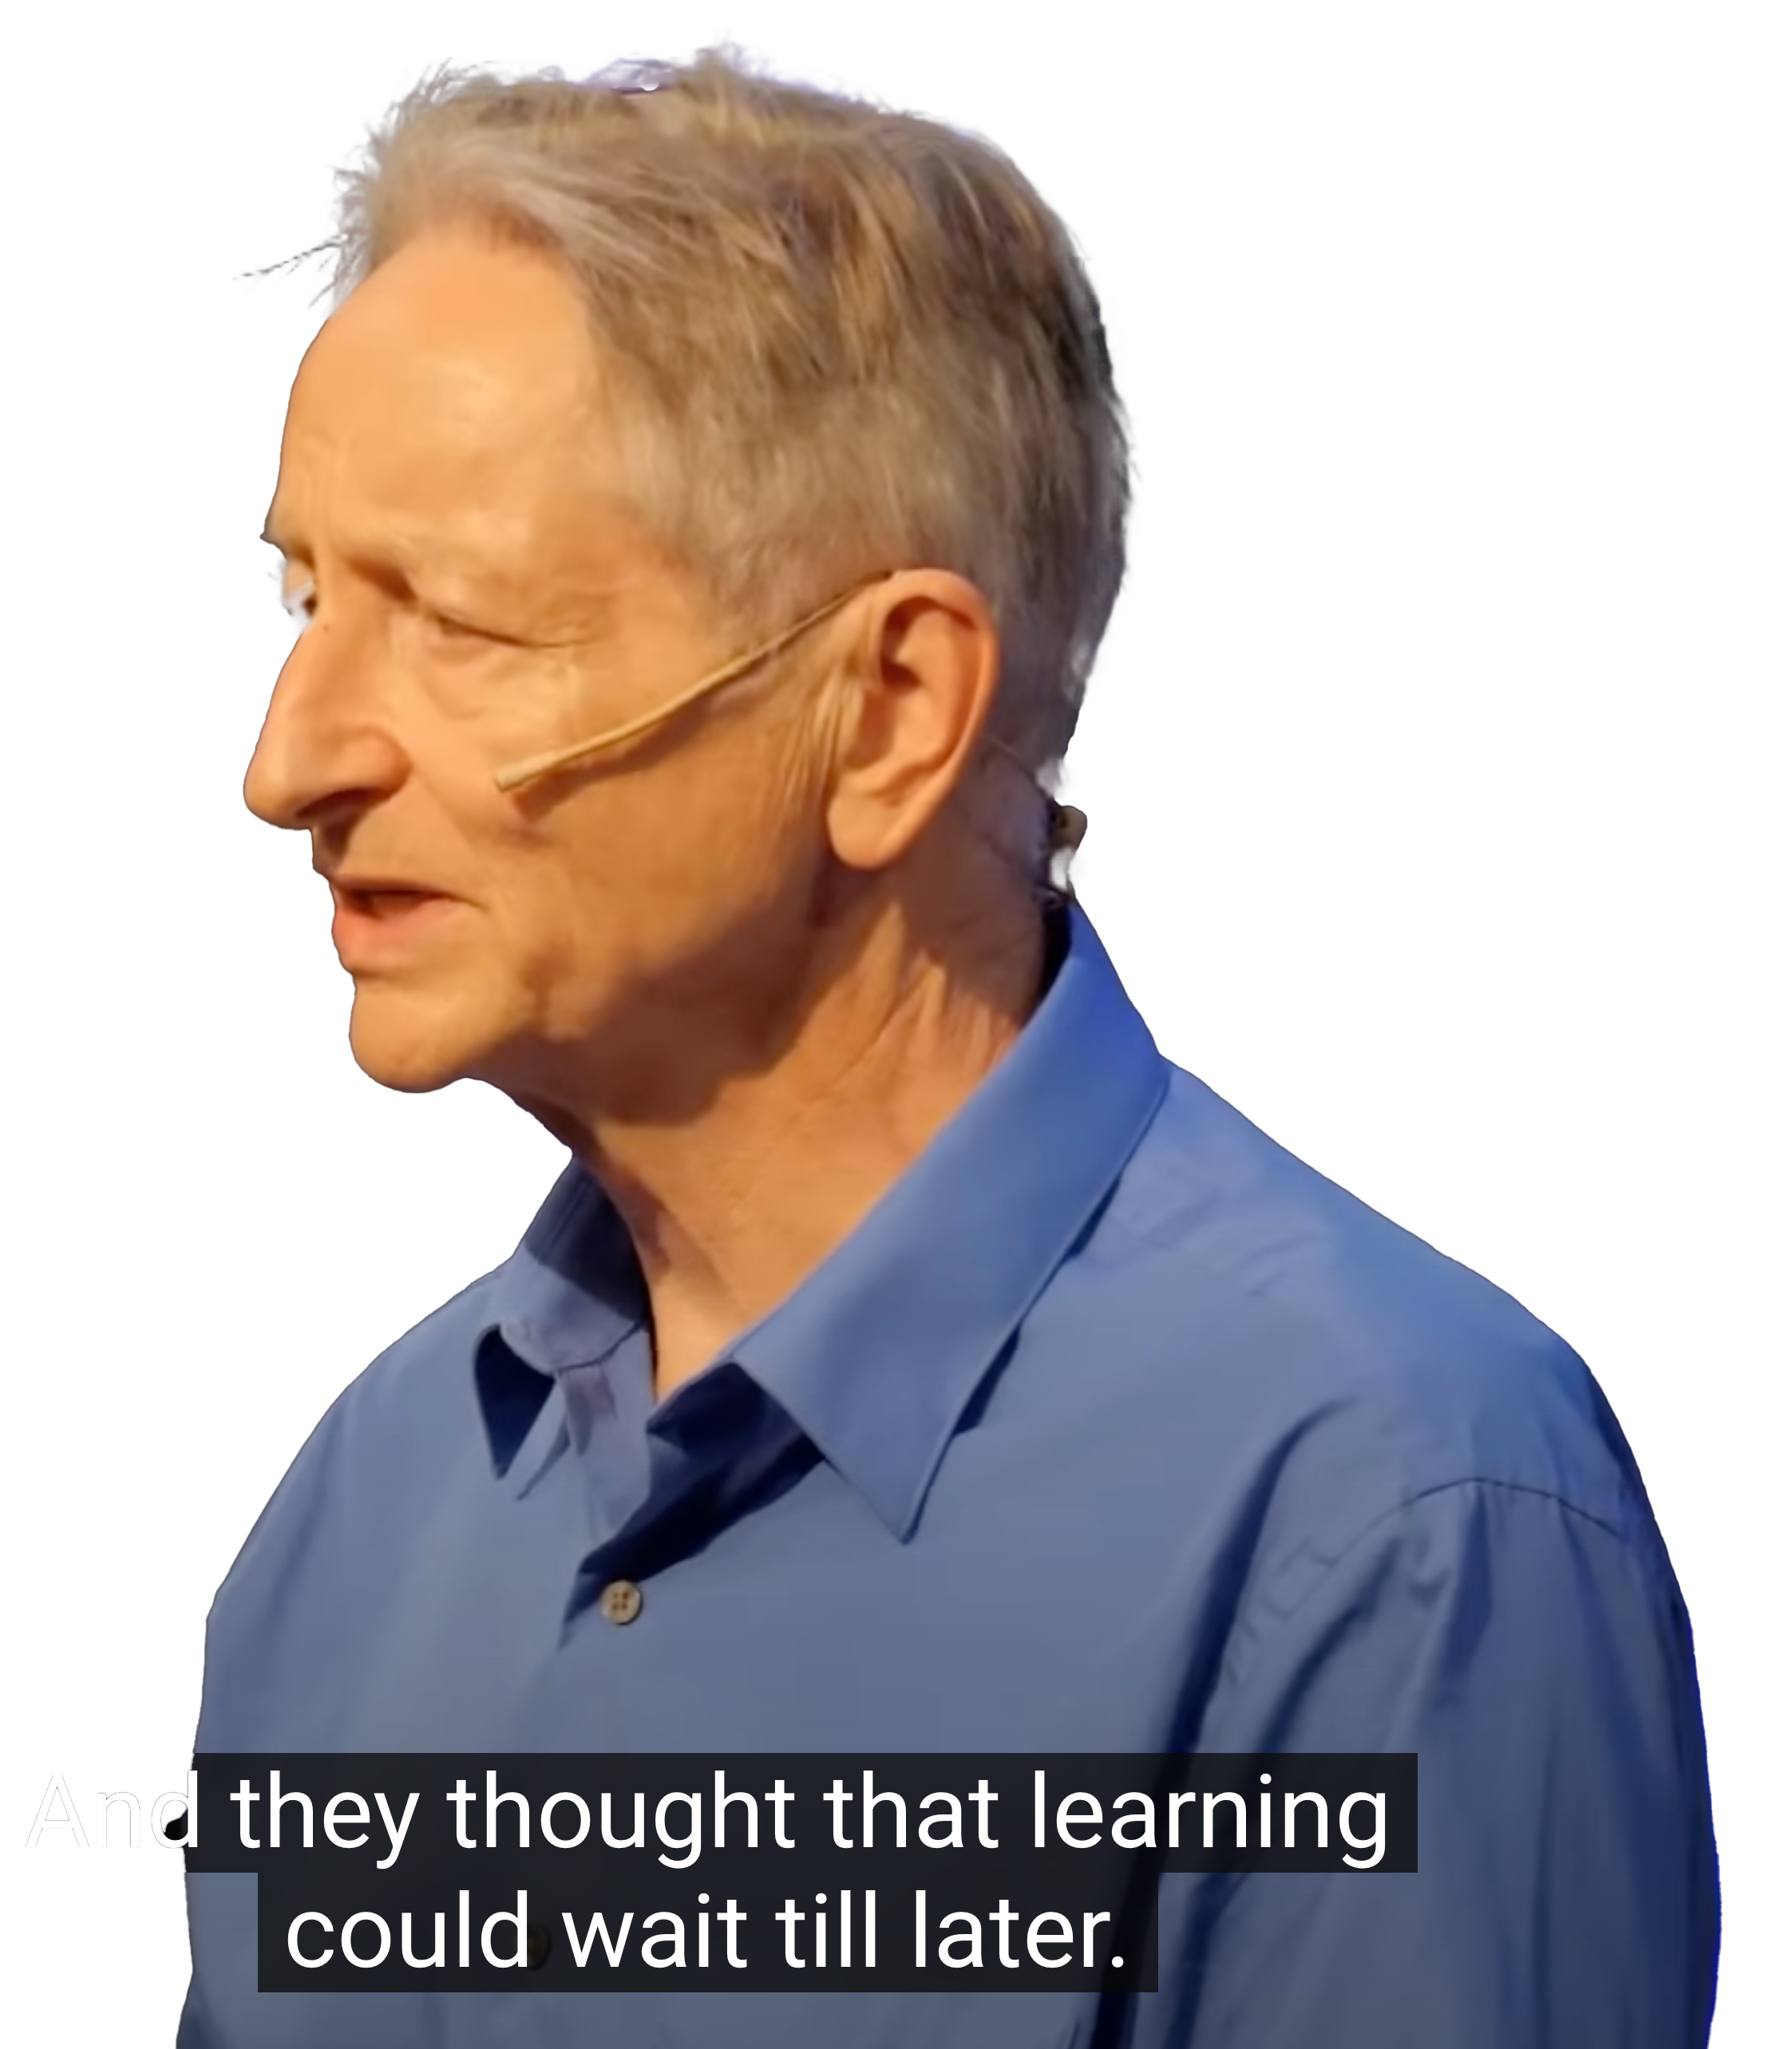
Hinton vs. Chomsky
Hinton Royal Institution lecture (2025):
  youtu.be/IkdziSLYzHw
  That's what understanding is when you understand language and when these [LLMs] understand language. We understand in just the same way.
  And that's a much better model of what language is than anything the linguists ever had.
  The linguists of course hate it.
  [Linguists] also thought that knowledge of language was innate, knowledge of syntax was innate, which is just stupid.

Slide 30
Hinton vs. Chomsky
It's the sign of a cult, that in order to join the cult, you have to believe something that is obviously silly, like language isn't learned.
There's a guy called Chomsky, when they say things like, "These things don't understand anything, they're just a statistical trick," they don't actually have a model of what understanding is, because they never really had a model of what understanding was.

Slide 31
Acquisition and Correction
From the same talk:
  The problem is to understand how the child had come to know that certain expressions are correct and others are incorrect.
  It's not corrections. It must be something beyond corrections, some either analogy or some principles that he used to support the correction support or something of that kind.
  What is the nature of the principles with the corrections support that leads to this tremendous proliferation?
  And incidentally, we know for a fact that the correction from the environment is almost irrelevant.

Slide 32
Acquisition and Correction
From the same talk:
  And incidentally, we know for a fact that the correction from the environment is almost irrelevant.
  That if children learn just as fast, in every experiment that's been done, exactly as fast, if they never get corrected, they do get corrected.
  So whatever kind of interaction there is, is first of all small because of the bound of time, and secondly, even smaller because we know that it has almost marginal impact.
  Technically: you have been […] making up a language on the basis of inadequate data and have been informed that your data is inadequate and you therefore made up the wrong grammar.

Slide 33
Empiricism and Learning
From the same talk:
  It seems to me [concrete empiricist theories] immediately collapse as soon as they go beyond the level of few examples.
  let me put it as strongly as I can, that empiricism as an approach to either epistemology or psychology is of purely historical interest, has no rational basis
  I really think it's just an extreme form of, well, superstition, basically.
  And that it's inconsistent with the approach that any scientist would take towards the problem, if one was asking how a highly structured final state emerges from a brief interaction with an environment.

Slide 34
Quine and Learning
Learn John's certainty that Bill will leave
Fail to learn John's certainty to leave
From the same talk:
  If you remember, what [Quine] says is that there are exactly three ways of doing what he calls learning sentences [expressions].
  One, you can learn them by stimulus to expression association.
  Two, by a process of expression to expression association.
  And three, by analogy.
  But if it suggests that analogy is a matter of substitution of similar items in fixed frames, then you might as well forget about it, because it's not going to take you from the trivial data available to the potentially infinite data to which knowledge extends.

Slide 35
Quine and Learning
From the same talk:
  He says that analogy serves only to speed the process up. He seems to imply that you could really do the whole thing only by the first of the methods, but it would take much longer.
  Tell me what the basis for the analogy is.
  If you can't tell me the basis for the analogy, you're not saying anything.
  If you can tell me the basis for the analogy, then you're talking about the innate structure of his mind.

Slide 36
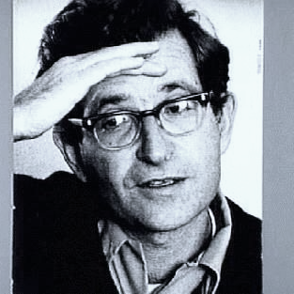
What Chomsky talk was that?
UW-Milwaukee talk, July 16th 1968
nearly 60 years ago!
Willem Diepraam (1968)

Slide 37
Communication and Thought
Language organ is designed to construct thoughts efficiently
Language is not designed for efficient communication
If that makes expressions harder to process and even makes some thoughts impossible to express without circumlocution, too bad. Nature doesn’t care. [Chomsky GK (2021), pg.11]
  EXT cannot have come before Merge.
  The modern doctrine that language may have evolved from animal communication seems quite untenable. [pg.10, Chomsky GK (2021)]
It makes no sense to say that some system evolved for X
  “the spine evolved for keeping us upright,” or “language evolved for communication”
too bad. Nature doesn’t care. [Chomsky GK (2021), pg.11]

Slide 38
Communication and Thought
Communicative efficiency is always sacrificed
  The most serious cases involve deletion of copies in accord with computational efficiency, leading to some of the hardest parsing problems. [pg.10, fn.12, Chomsky (2021)]
    see possible solutions in the SMT Parser …
  Externalization: John or the men *is/*are in the room
    … unproblematic for expression of thought if feature valuation kept to late insertion so that only the bare copula reaches the thought level (as in some spoken dialects)
  Note that statistical information is irrelevant to I-language as a matter of principle, though as has always been assumed in the generative enterprise (see Chomsky 1957), it can be highly relevant to processing and acquisition.

Slide 39
696A SMT Parser
Download english.zip from the course website.
  You need to install SWI Prolog
  You need Python
  You need nltk
Download the Tutorial and Manual for LEX also.
  Installation is covered in Section 1
  You should try Sections 2 and 3.
  (Sorry: Section 4 is missing.)
(There is also a spanish.zip.)

Slide 40
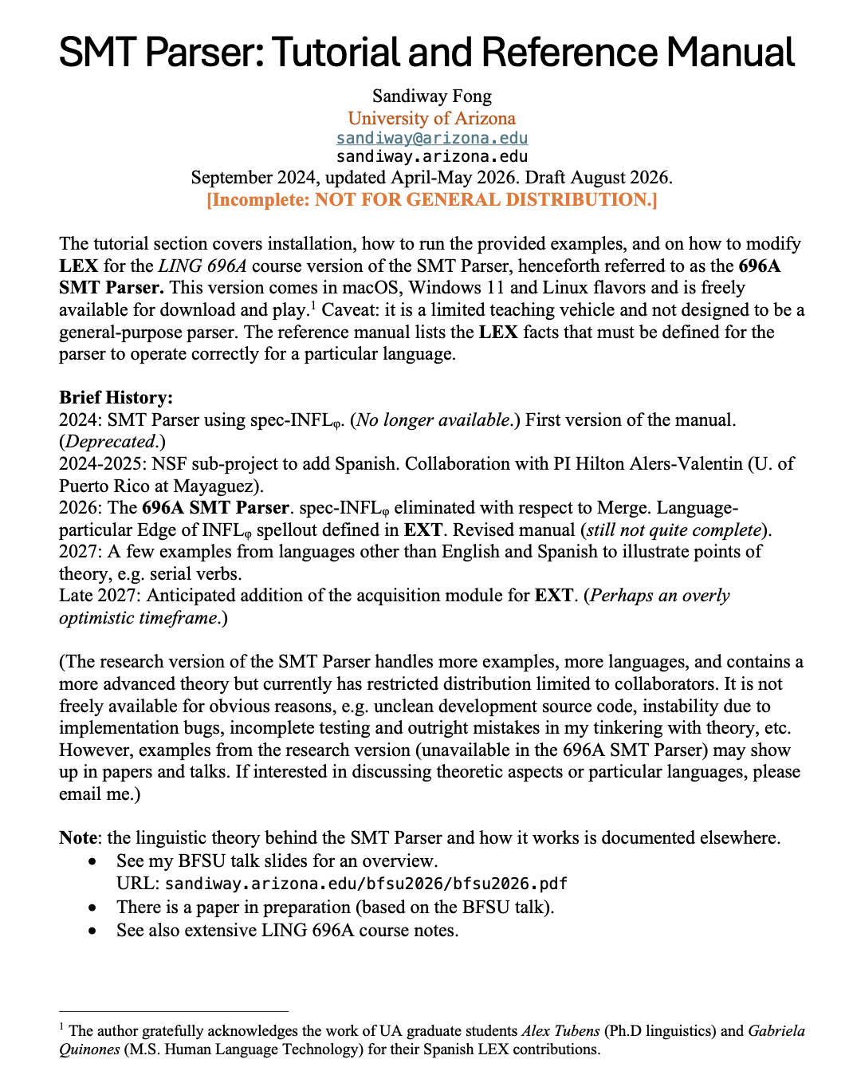
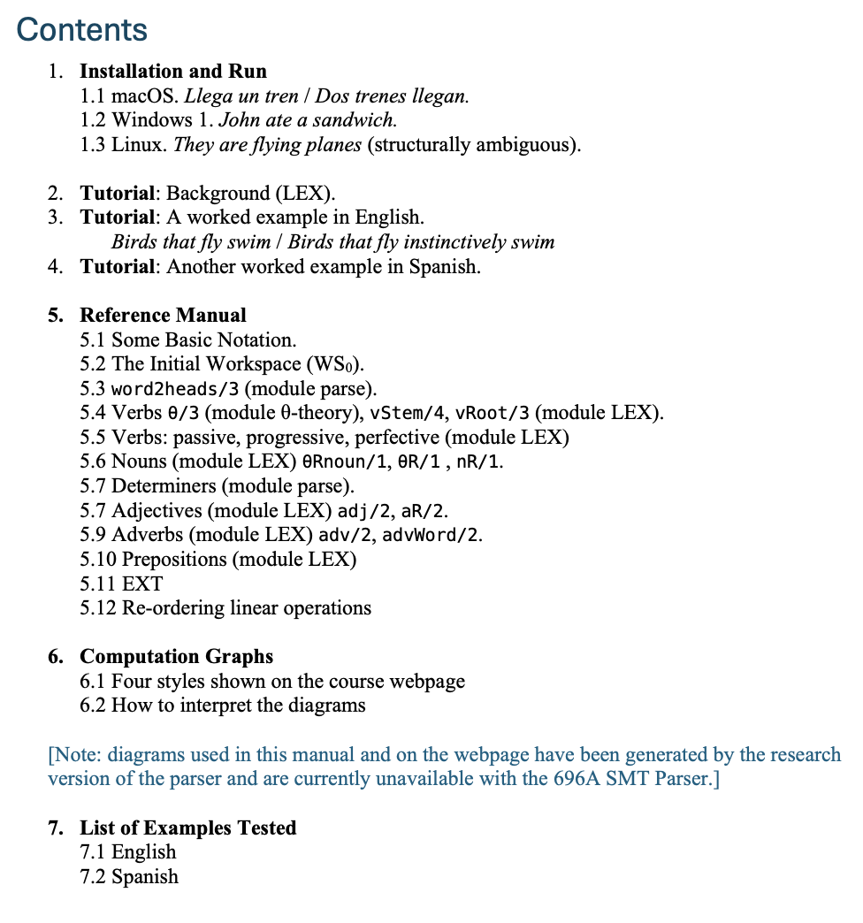
696A SMT Parser

Slide 41
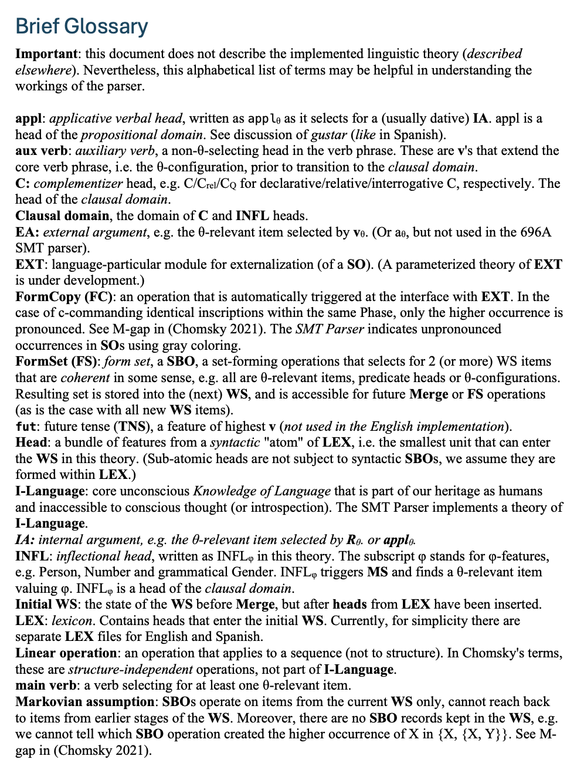
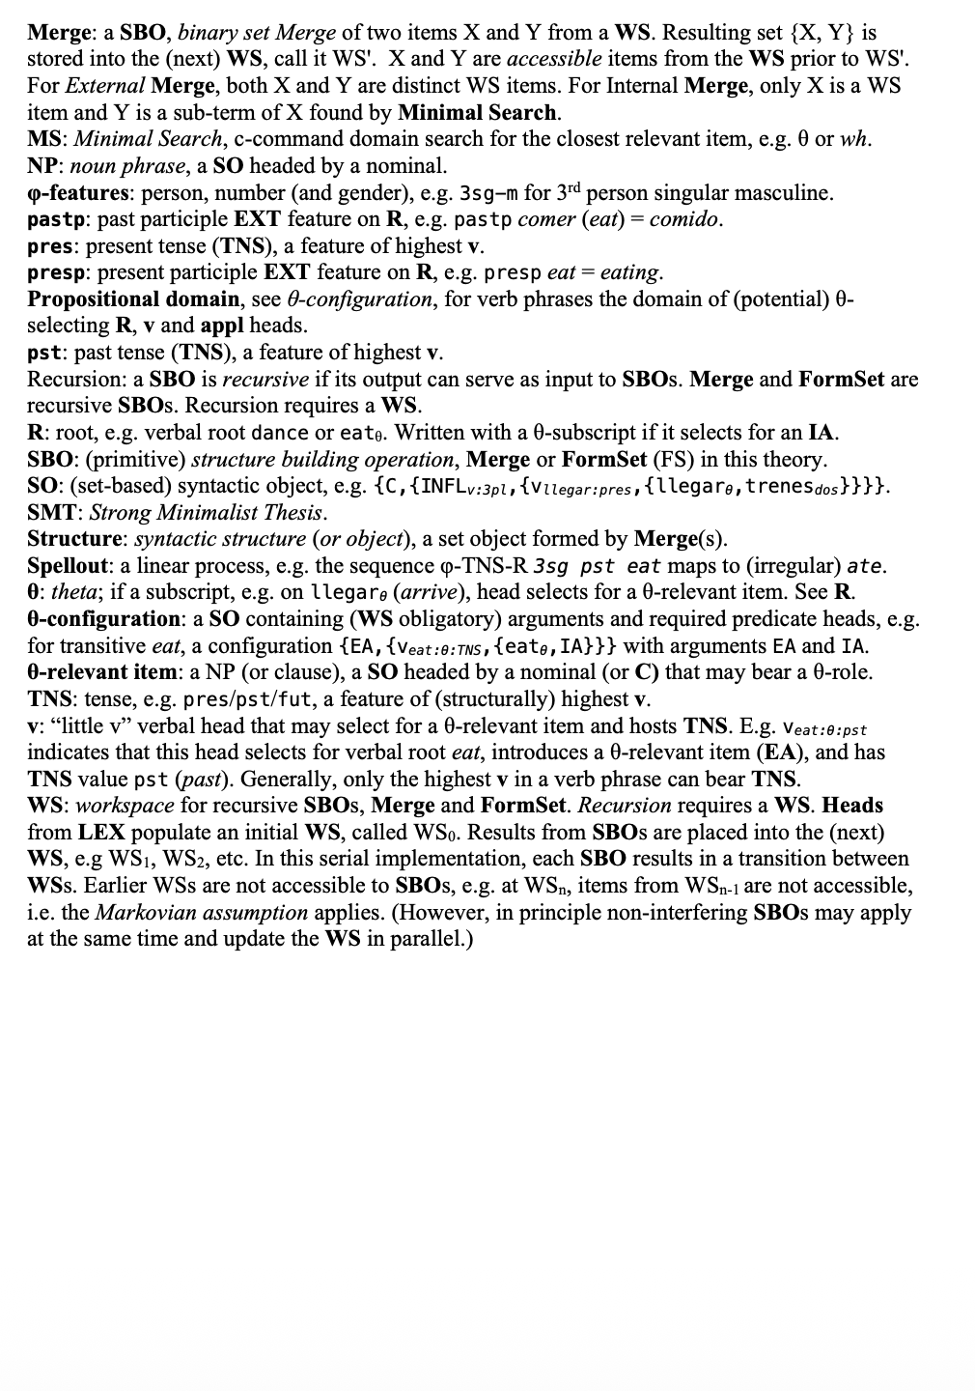
696A SMT Parser

Slide 42
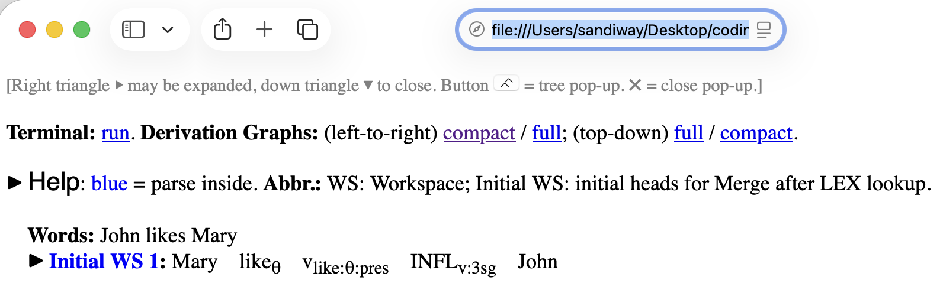
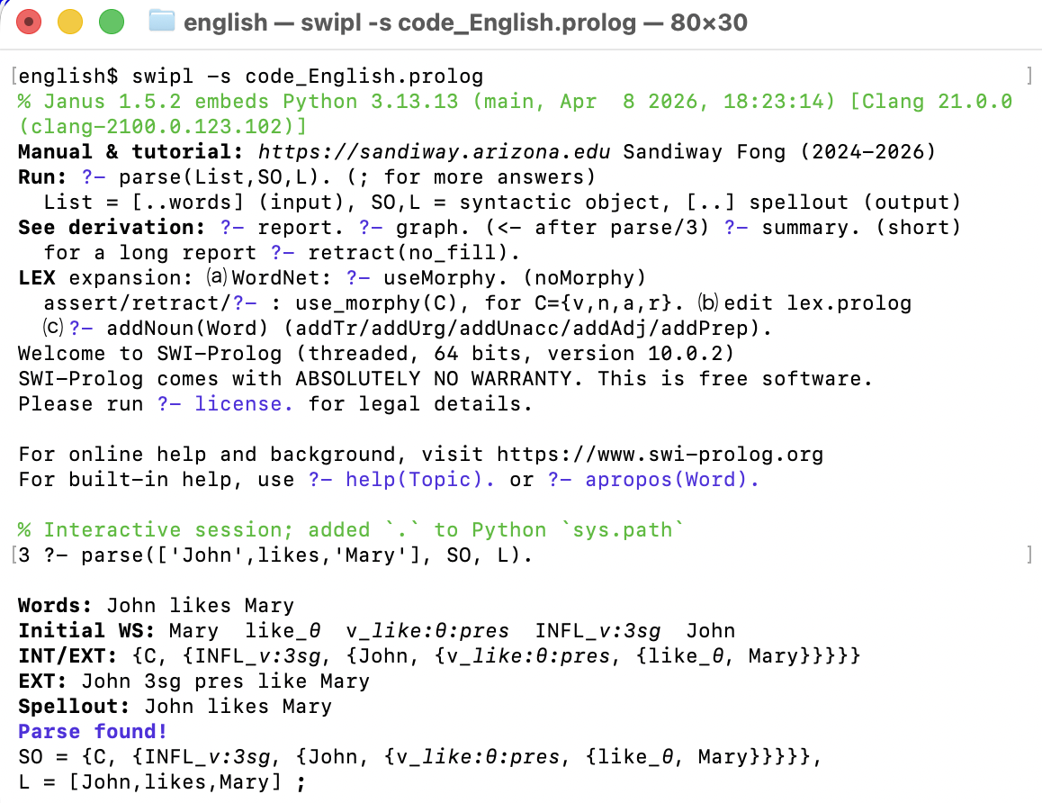
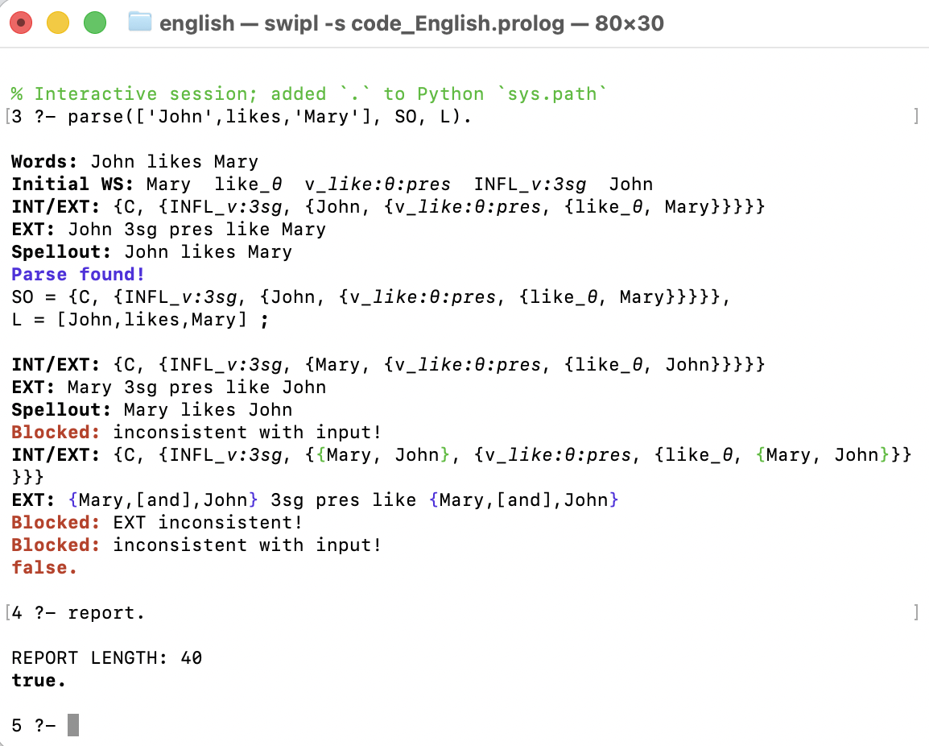
696A SMT Parser

Slide 43
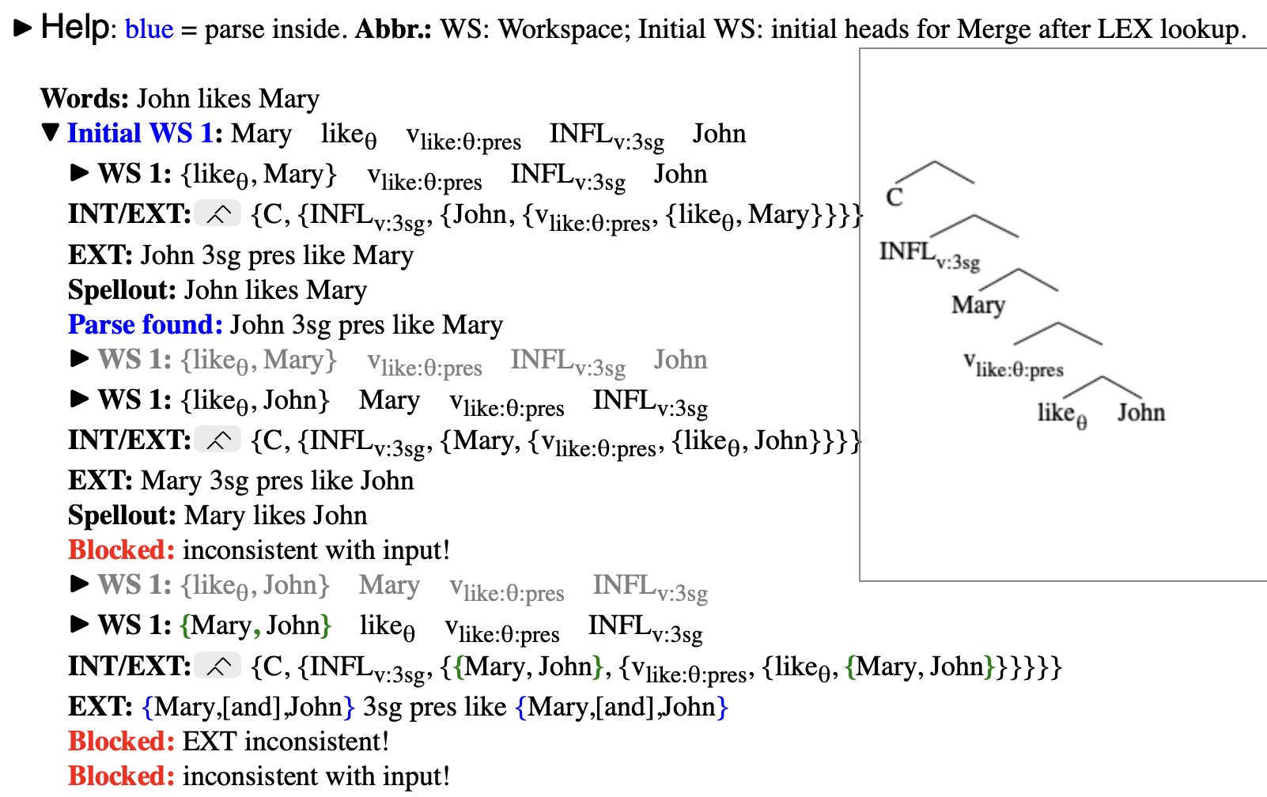
696A SMT Parser

