Slide 1
LING/C SC 581: Advanced Computational Linguistics
Lecture 9
Prof. Sandiway Fong
grateful acknowledgements to Riny Huybregts for his help and contribution
all remaining errors are mine

Slide 2
Today's Topics
Homework 5 Review
An example of context-sensitivity in natural language

Slide 3
Homework 5 Review
Question 1:
Give a revised version grammar that counts a's up, b's and c's down.
Original: abc_count.prolog
s --> a(X), b(X), c(X).
a(1) --> [a].
a(N) --> [a], a(M), {N is M+1}.
Note: X is valued by a/1, b/1 (and c/1) receive a natural number
b(1) --> [b].
Subtract 1 from N, but make sure we don't over-subtract.
b(N) --> [b], {M is N-1, M>=1}, b(M).

Slide 4
Homework 5 Review
?- [abc_count].
true.
?- time(s([a,a,b,b,b,b,b,b,b,b,b,b,c,c],[])).
% 63 inferences, 0.000 CPU in 0.000 seconds (67% CPU, 1235294 Lips)
false.
?- time(s([a,a,b,b,b,b,b,b,b,b,b,b,b,b,b,b,b,b,b,b,b,b,c,c],[])).
% 217 inferences, 0.000 CPU in 0.000 seconds (77% CPU, 1486301 Lips)
false.
?- time(s([a,a,b,b,c,c,c,c,c,c,c,c,c,c,c,c,c,c,c,c,c,c,c,c],[])).
% 220 inferences, 0.000 CPU in 0.000 seconds (77% CPU, 1366460 Lips)
false.

Slide 5
Homework 5 Review
?- [hw5q1].
true.
?- time(s([a,a,b,b,b,b,b,b,b,b,b,b,c,c],[])).
% 11 inferences, 0.000 CPU in 0.000 seconds (81% CPU, 647059 Lips)
false.
?- time(s([a,a,b,b,b,b,b,b,b,b,b,b,b,b,b,b,b,b,b,b,b,b,c,c],[])).
% 10 inferences, 0.000 CPU in 0.000 seconds (88% CPU, 476190 Lips)
false.
?- time(s([a,a,b,b,c,c,c,c,c,c,c,c,c,c,c,c,c,c,c,c,c,c,c,c],[])).
% 13 inferences, 0.000 CPU in 0.000 seconds (54% CPU, 520000 Lips)
false.

Slide 6
Homework 5 Review
Question 2: enumeration.
?- s(S,[]).
S = [a, b, c] ;
S = [a, a, b, b, c, c] ;
S = [a, a, a, b, b, b, c, c, c] ;
S = [a, a, a, a, b, b, b, b, c|...] ;
S = [a, a, a, a, a, b, b, b, b|...] ;
S = [a, a, a, a, a, a, b, b, b|...] [write]
S = [a, a, a, a, a, a, b, b, b, b, b, b, c, c, c, c, c, c] .

Slide 7
Relevant Slide from an earlier lecture
Extra arguments are powerful
they allow us to impose (grammatical) constraints and change the expressive power of the system
if used as read-able memory
Example:
a^{n}b^{n}c^{n} n>0 is not a context-free language (type-2, Chomsky hierarchy)
i.e. you cannot write rules of the form X --> RHS that generate this language
in fact, it's context-sensitive (type-1, Chomsky hierarchy)

Slide 8
Homework 5 Review
w
?- [fibonacci].
?- f(_,L,[]), length(L,N).
L = [],
N = 0 ;
L = [a],
N = 1 ;
L = [a],
N = 1 ;
L = [a, a],
N = 2 ;
L = [a, a, a],
N = 3 ;
L = [a, a, a, a, a],
N = 5 ;
L = [a, a, a, a, a, a, a, a],
N = 8 ;
L = [a, a, a, a, a, a, a, a, a|...],
N = 13 [write]
L = [a, a, a, a, a, a, a, a, a, a, a, a, a],
N = 13 ;
L = [a, a, a, a, a, a, a, a, a, a, a, a, a, a, a, a, a, a, a, a, a],
N = 21 ;
L = [a, a, a, a, a, a, a, a, a, a, a, a, a, a, a, a, a, a, a, a, a, a, a, a, a, a, a, a, a, a, a, a, a, a],
N = 34 ;
L = [a, a, a, a, a, a, a, a, a, a, a, a, a, a, a, a, a, a, a, a, a, a, a, a, a, a, a, a, a, a, a, a, a, a, a, a, a, a, a, a, a, a, a, a, a, a, a, a, a, a, a, a, a, a, a],
N = 55 ;
L = [a, a, a, a, a, a, a, a, a, a, a, a, a, a, a, a, a, a, a, a, a, a, a, a, a, a, a, a, a, a, a, a, a, a, a, a, a, a, a, a, a, a, a, a, a, a, a, a, a, a, a, a, a, a, a, a, a, a, a, a, a, a, a, a, a, a, a, a, a, a, a, a, a, a, a, a, a, a, a, a, a, a, a, a, a, a, a, a, a],
N = 89 ;
L = [a, a, a, a, a, a, a, a, a, a, a, a, a, a, a, a, a, a, a, a, a, a, a, a, a, a, a, a, a, a, a, a, a, a, a, a, a, a, a, a, a, a, a, a, a, a, a, a, a, a, a, a, a, a, a, a, a, a, a, a, a, a, a, a, a, a, a, a, a, a, a, a, a, a, a, a, a, a, a, a, a, a, a, a, a, a, a, a, a, a, a, a, a, a, a, a, a, a, a, a, a, a, a, a, a, a, a, a, a, a, a, a, a, a, a, a, a, a, a, a, a, a, a, a, a, a, a, a, a, a, a, a, a, a, a, a, a, a, a, a, a, a, a, a],
N = 144 ;
L = [a, a, a, a, a, a, a, a, a, a, a, a, a, a, a, a, a, a, a, a, a, a, a, a, a, a, a, a, a, a, a, a, a, a, a, a, a, a, a, a, a, a, a, a, a, a, a, a, a, a, a, a, a, a, a, a, a, a, a, a, a, a, a, a, a, a, a, a, a, a, a, a, a, a, a, a, a, a, a, a, a, a, a, a, a, a, a, a, a, a, a, a, a, a, a, a, a, a, a, a, a, a, a, a, a, a, a, a, a, a, a, a, a, a, a, a, a, a, a, a, a, a, a, a, a, a, a, a, a, a, a, a, a, a, a, a, a, a, a, a, a, a, a, a, a, a, a, a, a, a, a, a, a, a, a, a, a, a, a, a, a, a, a, a, a, a, a, a, a, a, a, a, a, a, a, a, a, a, a, a, a, a, a, a, a, a, a, a, a, a, a, a, a, a, a, a, a, a, a, a, a, a, a, a, a, a, a, a, a, a, a, a, a, a, a, a, a, a, a, a, a, a, a, a, a, a, a, a, a, a, a, a, a],
N = 233 ;

Slide 9
Homework 5 Review
L = [a, a, a, a, a, a, a, a, a, a, a, a, a, a, a, a, a, a, a, a, a, a, a, a, a, a, a, a, a, a, a, a, a, a, a, a, a, a, a, a, a, a, a, a, a, a, a, a, a, a, a, a, a, a, a, a, a, a, a, a, a, a, a, a, a, a, a, a, a, a, a, a, a, a, a, a, a, a, a, a, a, a, a, a, a, a, a, a, a, a, a, a, a, a, a, a, a, a, a, a, a, a, a, a, a, a, a, a, a, a, a, a, a, a, a, a, a, a, a, a, a, a, a, a, a, a, a, a, a, a, a, a, a, a, a, a, a, a, a, a, a, a, a, a, a, a, a, a, a, a, a, a, a, a, a, a, a, a, a, a, a, a, a, a, a, a, a, a, a, a, a, a, a, a, a, a, a, a, a, a, a, a, a, a, a, a, a, a, a, a, a, a, a, a, a, a, a, a, a, a, a, a, a, a, a, a, a, a, a, a, a, a, a, a, a, a, a, a, a, a, a, a, a, a, a, a, a, a, a, a, a, a, a, a, a, a, a, a, a, a, a, a, a, a, a, a, a, a, a, a, a, a, a, a, a, a, a, a, a, a, a, a, a, a, a, a, a, a, a, a, a, a, a, a, a, a, a, a, a, a, a, a, a, a, a, a, a, a, a, a, a, a, a, a, a, a, a, a, a, a, a, a, a, a, a, a, a, a, a, a, a, a, a, a, a, a, a, a, a, a, a, a, a, a, a, a, a, a, a, a, a, a, a, a, a, a, a, a, a, a, a, a, a, a, a, a, a, a, a, a, a, a, a, a, a, a, a, a, a, a, a, a, a, a, a, a, a, a, a, a, a, a, a, a, a, a, a],
N = 377 ;
L = [a, … a],
N = 610 ;
L = [a, a, a, a, a, a, a, a, a, a, a, a, a, a, a, a, a, a, a, a, a, a, a, a, a, a, a, a, a, a, a, a, a,…, a],
N = 987 ;
L = [a, …, a],
N = 1597 ;
L = [a, a, a, a, a, a, a, a, a, a, a, a, a, a, a, a, a, a, a, a, a, a, a, a, a, a, a, a, a, a, a, a, a, …, a],
N = 2584 ;
L = [a, … a],
N = 4181 .

Slide 10
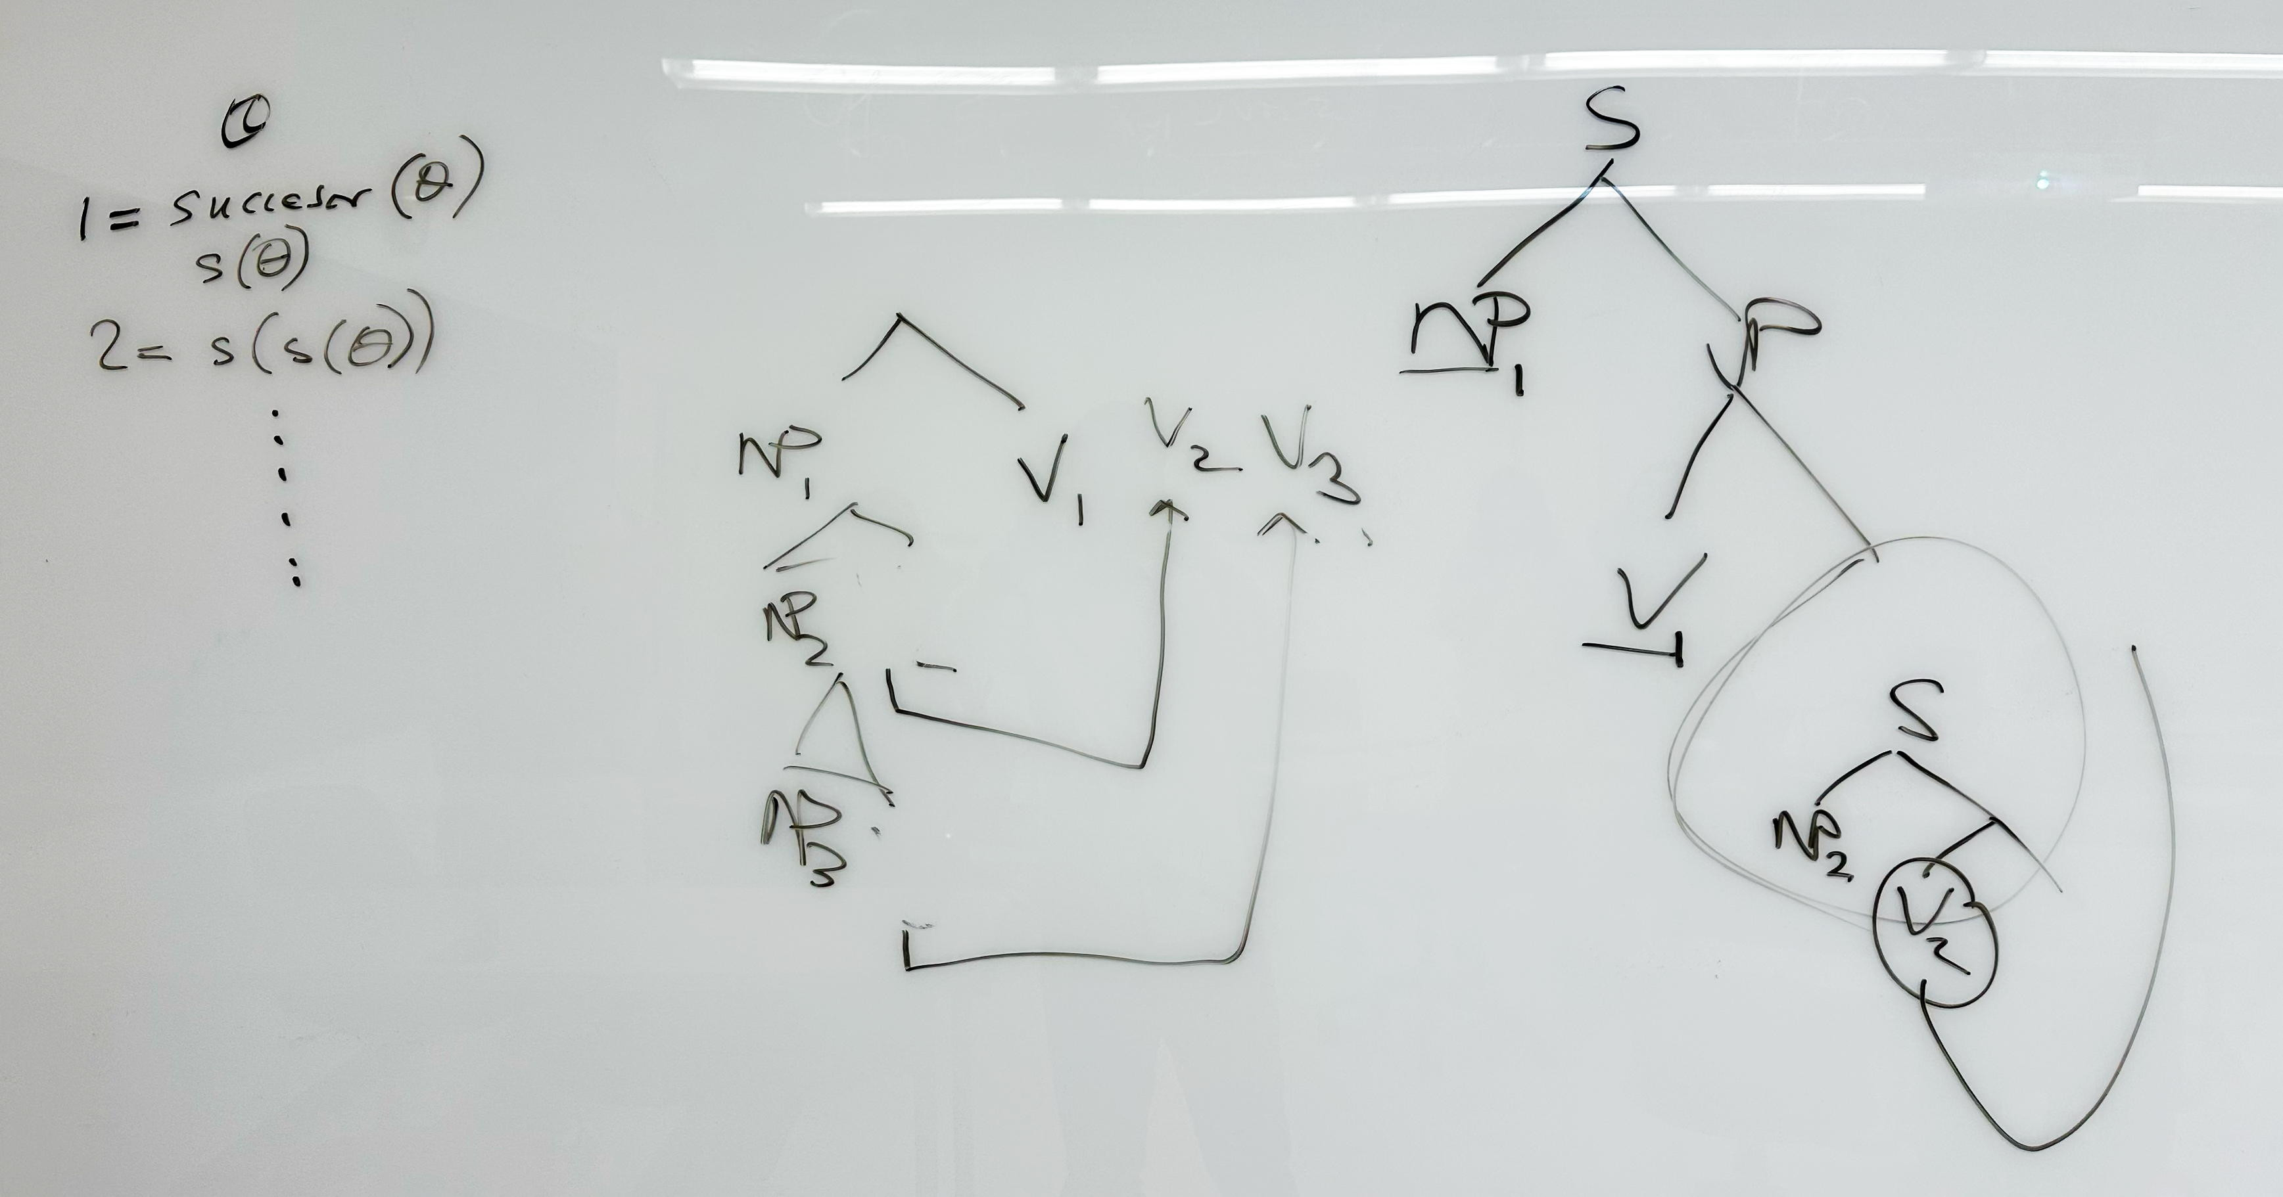
From the whiteboard

Slide 11
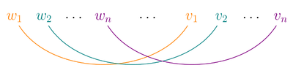
Cross Serial Dependencies
Wikipedia:
In linguistics, cross-serial dependencies (also called crossing dependencies by some authors) occur when the lines representing the dependency relations between two series of words cross over each other.
By this fact, Dutch and Swiss-German have been proven to be non-context-free.
https://en.wikipedia.org/wiki/Cross-serial_dependencies
References (Wikipedia ones are inadequate)
M.A.C. Huybregts, 1976, Overlapping dependencies in Dutch. Utrecht Working papers in Linguistics 1: 24-65.
M.A.C. Huybregts, 1984. The weak inadequacy of context-free phrase structure grammars. In: G. de Haan, M. Trommelen, & W. Zonneveld (eds.), Van Periferie naar Kern, 81-99. Dordrecht: Foris.

Slide 12
Cross Serial Dependencies
First discussed in (Huybregts 1976), Dutch has Verb Raising (VR):
… dat we je de gevangenen zagen helpen ontsnappen
… that we you the prisoners saw help escape
… that we_{θ-saw} you_{θ-help} the prisoners_{θ-escape} saw help escape
argument to predicate dependencies do not appear to respect nesting.
VR is obligatory for modal verbs:
let, see, hear, feel, learn, teach, help.
Verbs like help, teach, learn can take bare VP (VR) or to-VP complements (undergo Extraposition).
Swiss German has the same word order as Dutch (different from German), but Case differences are visible (unlike in Dutch, only nominative/non-nominative Case marking).
that Arg-V1 Arg-V2 Arg-V3 V1 V2 V3
but these associations are not visible in the surface sentence

Slide 13
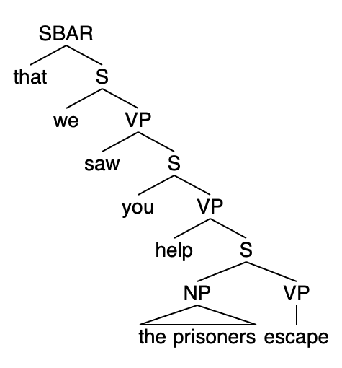
Underlying form and surface form
Surface form (anglicized):
dat we je de gevangenen zagen helpen ontsnappen
that we you the prisoners saw help escape
Underlying hierarchical form:
[that [we [saw [you [help [the prisoners escape]]]]]]
Simplified grammar (context-free) g1.prolog:
sbar --> [that], s.
s --> subject, vp.
subject --> [we] | [you] | [the, prisoners].
vp --> verb, s.
vp --> iverb.
verb --> [saw] | [help].
iverb --> [escape].
To be more precise, the prisoners is the dative argument of Control verb help

Slide 14
g1.prolog
Grammar (context-free) g1.prolog:
?- [g1].
true.
?- sbar([that,we,saw,you,help,the,prisoners,escape], []).
true ;
false.
?- sbar([that,we,you,the,prisoners,saw,help,escape], []).
false.
CFG can't do Dutch surface word order!

Slide 15
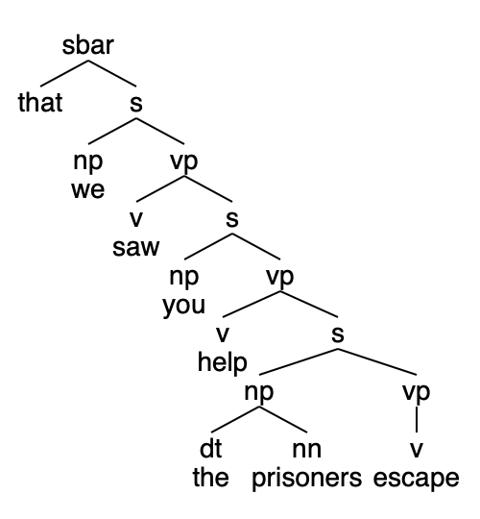
g2.prolog
Context-Free Grammar (CFG) g2.prolog:
same as g1.prolog but reporting a parse tree
dat we je de gevangenen zagen helpen
ontsnappen[that,we,saw,you,help,the,prisoners,escape]
?- [g2].
true.
?- sbar(Parse, [that,we,saw,you,help,the,prisoners,escape], []).
Parse = sbar(that, s(np(we), vp(v(saw), s(np(you), vp(v(help), s(np(dt(the), nn(prisoners)), vp(v(escape)))))))) ;
false.
?- sbar(Parse, [that,we,you,the,prisoners,saw,help,escape], []).
false.

Slide 16
g2.prolog
Extra argument for each non-terminal holds the parse (for each phrase) – recall concept from earlier lecture (and last semester)
sbar(sbar(that,S)) --> [that], s(S).
s(s(SBJ,VP)) --> subject(SBJ), vp(VP).
subject(np(we)) --> [we].
subject(np(you)) --> [you].
subject(np(dt(the),nn(prisoners))) --> [the,prisoners].
vp(vp(V,S)) --> verb(V), s(S).
vp(vp(V)) --> iverb(V).
verb(v(saw)) --> [saw].
verb(v(help)) --> [help].
iverb(v(escape)) --> [escape].

Slide 17
So far
Grammars g1.prolog and g2.prolog are context-free grammars
limited to a single nonterminal on the LHS of a rule (-->)
they do not encode the word order found in Dutch (and Swiss German)
Let's introduce g3.prolog, a context-sensitive grammar
will have a slightly more complex rule LHS

Slide 18
g3.prolog
Context-Sensitive Grammar (CSG) (ternary branching):
simplified for exposition: replaced the prisoners with him.
sbar(sbar(that,S2)) --> [that], s(S2).
s(s(him,vp(Verb))) --> [him], iverb(Verb).
s(s(we,vp(Verb,S2))) --> [we], verb(Verb), s(S2).
s(s(you,vp(Verb,S2))) --> [you], verb(Verb), s(S2).
verb(Verb), [we] --> [we], verb(Verb).
verb(Verb), [you] --> [you], verb(Verb).
verb(Verb), [him] --> [him], verb(Verb).
verb(v(saw)) --> [saw].
verb(v(help)) --> [help].
iverb(v(escape)) --> [escape].
Context-sensitive rules!

Slide 19
g3.prolog trace
Sentence:
[that, we, you, him, saw, help, escape]
[trace] ?- sbar(Parse,[that, we, you, him, saw, help, escape], []).
Call: (10) sbar(_92970, [that, we, you, him, saw, help, escape], []) ? creep
Call: (11) s(_94400, [we, you, him, saw, help, escape], []) ? creep
Call: (12) verb(_95224, [you, him, saw, help, escape], _95228) ? creep
Call: (13) verb(_95224, [him, saw, help, escape], _96044) ? creep
Call: (14) verb(_95224, [saw, help, escape], _96860) ? creep
Exit: (14) verb(v(saw), [saw, help, escape], [help, escape]) ? creep
Call: (14) _96044=[him, help, escape] ? creep
Exit: (14) [him, help, escape]=[him, help, escape] ? creep
Exit: (13) verb(v(saw), [him, saw, help, escape], [him, help, escape]) ? creep
Call: (13) _95228=[you, him, help, escape] ? creep
Exit: (13) [you, him, help, escape]=[you, him, help, escape] ? creep
Exit: (12) verb(v(saw), [you, him, saw, help, escape], [you, him, help, escape]) ? creep
Call: (12) s(_95226, [you, him, help, escape], []) ? creep
Call: (13) verb(_104196, [him, help, escape], _104200) ? creep
Call: (14) verb(_104196, [help, escape], _105016) ? creep
Exit: (14) verb(v(help), [help, escape], [escape]) ? creep
Call: (14) _104200=[him, escape] ? creep
Exit: (14) [him, escape]=[him, escape] ? creep
Exit: (13) verb(v(help), [him, help, escape], [him, escape]) ? creep
Call: (13) s(_104198, [him, escape], []) ? creep
Call: (14) iverb(_109912, [escape], []) ? creep
Exit: (14) iverb(v(escape), [escape], []) ? creep
Exit: (13) s(s(him, vp(v(escape))), [him, escape], []) ? creep
Exit: (12) s(s(you, vp(v(help), s(him, vp(v(escape))))), [you, him, help, escape], []) ? creep
Exit: (11) s(s(we, vp(v(saw), s(you, vp(v(help), s(him, vp(v(escape))))))), [we, you, him, saw, help, escape], []) ? creep
Exit: (10) sbar(sbar(that, s(we, vp(v(saw), s(you, vp(v(help), s(him, vp(v(escape)))))))), [that, we, you, him, saw, help, escape], []) ? creep
Parse = sbar(that, s(we, vp(v(saw), s(you, vp(v(help), s(him, vp(v(escape)))))))) ;

Slide 20
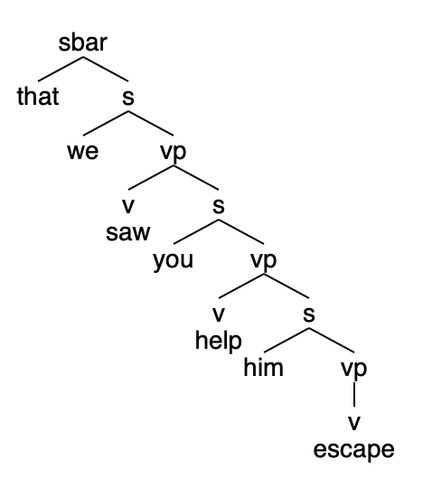
Parse
Dutch surface word order but correct underlying form is retrieved:
dat we je hem zagen helpen ontsnappen
[that, we, you, him, saw, help, escape]
sbar(that, s(we, vp(v(saw), s(you, vp(v(help), s(him, vp(v(escape))))))))

Slide 21
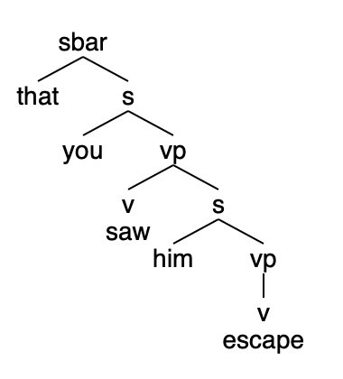
g3.prolog
Why two ways to derive this?
Verb Raising (VR) is optional in g3.prolog
Problem: two surface word orders, one parse:
dat je hem zag ontsnappen
[that, you, him, saw, escape]
?- [g3].
true.
?- sbar(Parse, [that, you, saw, him, escape], []).
Parse = sbar(that, s(you, vp(v(saw), s(him, vp(v(escape)))))).
?- sbar(Parse, [that, you, him, saw, escape], []).
Parse = sbar(that, s(you, vp(v(saw), s(him, vp(v(escape)))))).

Slide 22
g4.prolog
Force pronoun verb order swap at least once
verb_swap flips pronoun verb order, then calls verb_swap2
verb_swap2 optionally swaps
Furthermore, let's generalize the pronouns used in g3.prolog
Grammar:
sbar(sbar(that,S2)) --> [that], s(S2).
s(s(NP,vp(Verb,S2))) --> nom_pronoun(NP), verb_swap(Verb), nnom_s(S2).
nnom_s(s(NP,vp(Verb,S2))) --> nnom_pronoun(NP), verb_swap(Verb), acc_s(S2).
nnom_s(s(NP,vp(Verb))) --> nnom_pronoun(NP), iverb(Verb).
verb_swap(Verb), [Pronoun] --> pronoun(np(Pronoun)), verb_swap2(Verb).
verb_swap2(Verb), [Pronoun] --> pronoun(np(Pronoun)), verb_swap2(Verb).
verb_swap2(Verb) --> verb(Verb).

Slide 23
g4.prolog
Verbs:
verb(v(see)) --> [see].
verb(v(let)) --> [let].
verb(v(help)) --> [help].
iverb(v(escape)) --> [escape].
Pronouns:
pronoun(np(i)) --> [i].
pronoun(np(me)) --> [me].
pronoun(np(we)) --> [we].
pronoun(np(us)) --> [us].
pronoun(np(you)) --> [you].
pronoun(np(he)) --> [he].
pronoun(np(him)) --> [him].
pronoun(np(she)) --> [she].
pronoun(np(her)) --> [her].
pronoun(np(they)) --> [they].
pronoun(np(them)) --> [them].

Slide 24
g4.prolog
Nominative pronouns:
nom_pronoun(np(i)) --> [i].
nom_pronoun(np(we)) --> [we].
nom_pronoun(np(you)) --> [you].
nom_pronoun(np(he)) --> [he].
nom_pronoun(np(she)) --> [she].
nom_pronoun(np(they)) --> [they].
Non-nominative pronouns:
nnom_pronoun(np(me)) --> [me].
nnom_pronoun(np(us)) --> [us].
nnom_pronoun(np(you)) --> [you].
nnom_pronoun(np(him)) --> [him].
nnom_pronoun(np(her)) --> [her].
nnom_pronoun(np(them)) --> [them].

Slide 25
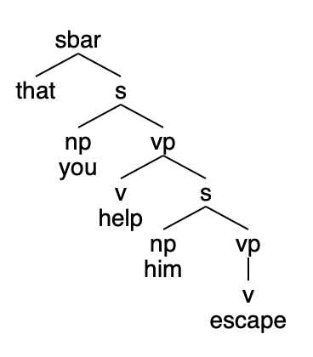
g4.prolog
Example:
dat je hem helpt ontsnappen
[that, you, him, help, escape]
?- sbar(Parse, [that, you, him, help, escape], []).
Parse = sbar(that, s(np(you), vp(v(help), s(np(him), vp(v(escape)))))) ;
false.
?- sbar(Parse, [that, you, help, him, escape], []).
false.

Slide 26
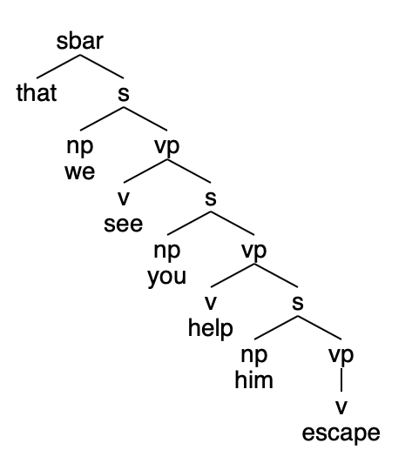
g4.prolog
Example:
dat we je hem zien helpen ontsnappen
[that, we, you, him, see, help, escape]
?- sbar(Parse, [that, we, you, him, see, help, escape], []).
Parse = sbar(that, s(np(we), vp(v(see), s(np(you), vp(v(help), s(np(him), vp(v(escape)))))))) ;
false.
?- sbar(Parse, [that, we, see, you, help, him, escape], []).
false.

Slide 27
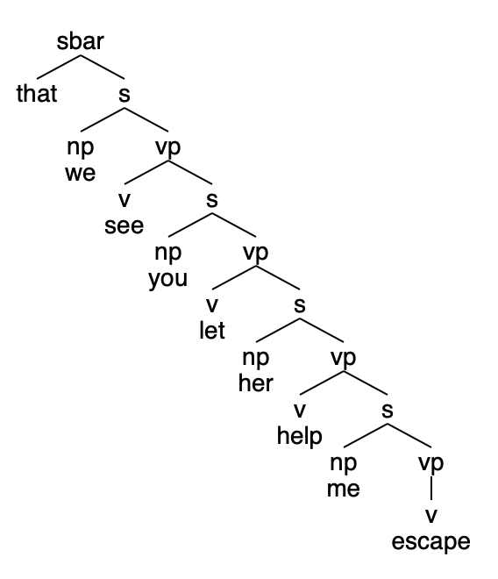
g4.prolog
Example:
dat we je haar mij zien laten helpen ontsnappen
[that, we, you, her, me, see, let, help, escape]
?- sbar(Parse, [that, we, you, her, me, see, let, help, escape], []).
Parse = sbar(that, s(np(we), vp(v(see), s(np(you), vp(v(let), s(np(her), vp(v(help), s(np(me), vp(v(...)))))))))) [write]
Parse = sbar(that, s(np(we), vp(v(see), s(np(you), vp(v(let), s(np(her), vp(v(help), s(np(me), vp(v(escape)))))))))) ;
false.
?- sbar(Parse, [that, we, see, you, let, her, help, me, escape], []).
false.
w = write out in full

Slide 28
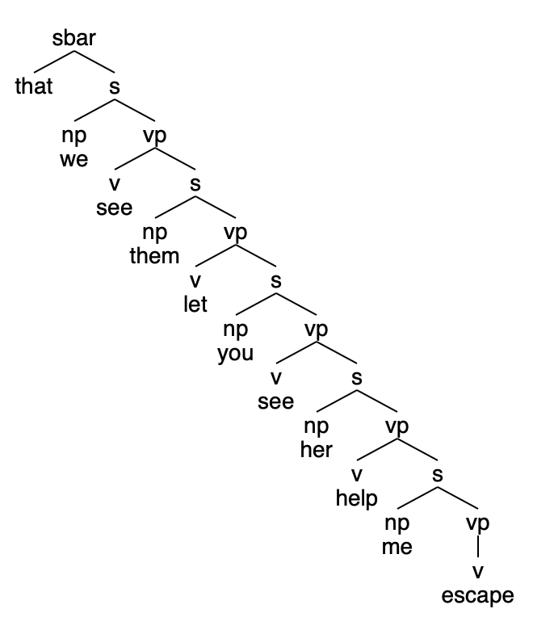
g4.prolog
Example:
dat we hen je haar mij zien laten zien helpen ontsnappen
[that, we, them, you, her, me, see, let, see, help, escape]
?- sbar(Parse, [that, we, them, you, her, me, see, let, see, help, escape], []).
Parse = sbar(that, s(np(we), vp(v(see), s(np(them), vp(v(let), s(np(you), vp(v(see), s(np(her), vp(v(help), s(np(me), vp(v(escape)))))))))))) ;
false.
?- sbar(Parse, [that, we, see, them, let, you, help, me, escape], []).
false.
Huybregts: of course, these [last] two cases become very hard to understand in language use.

