Slide 1
LING/C SC 581: Advanced Computational Linguistics
Lecture 28
Prof. Sandiway Fong

Slide 2
Continuing on from last time
So far:
Einstein's Miracle Creed:
there's a simple basis (although things looks complicated)
Biology:
from the outside, we ain't that special (brain size etc.)
Disruptive event:
small mutation unlocks Merge.
I-Language:
doesn't use pre-existing linear system, operations rely on structure
Not evolved for communication
Nature prioritized thought (not well-designed for communication)

Slide 3
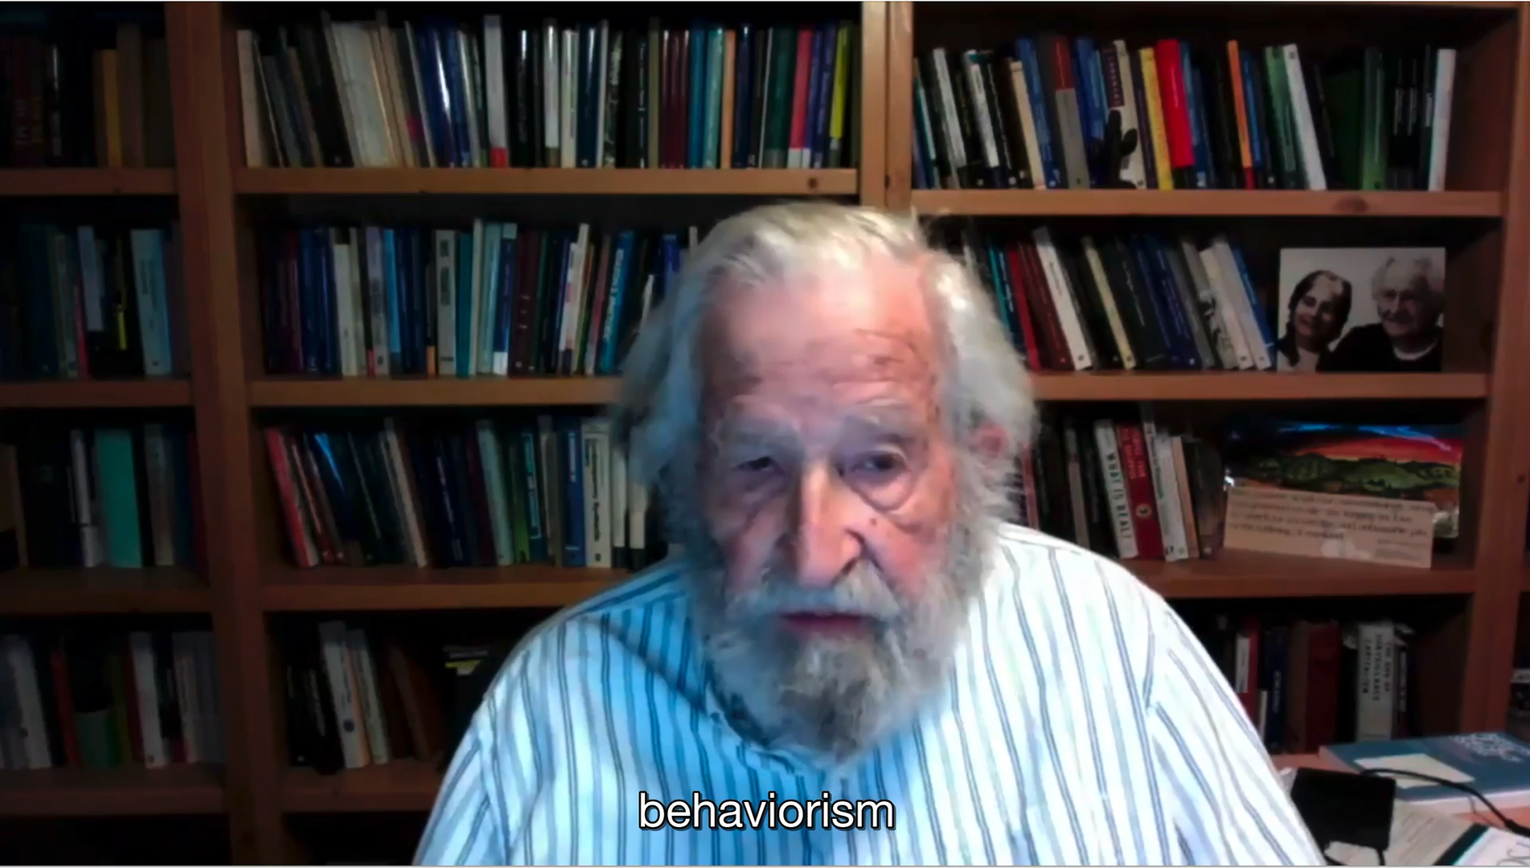
Aside: Behaviorism and Corpus Linguistics
2 min clip

Slide 4
Aside: Behaviorism and Corpus Linguistics
Einstein's Miracle Creed:
there's a simple basis (e.g. for physical laws)
can't be done by (ingesting) corpora
LLM-style

Slide 5
Three Factors in Language Design
(Chomsky 2005)
"I-language develops in the individual through the interaction of three factors: (1) biological endowment, (2) external data, (3) natural law, including general principles of computational efficiency, of crucial significance for a computational system such as language."
"… accessing principles of efficient computation, understood as “third factor” principles of natural law."

Slide 6
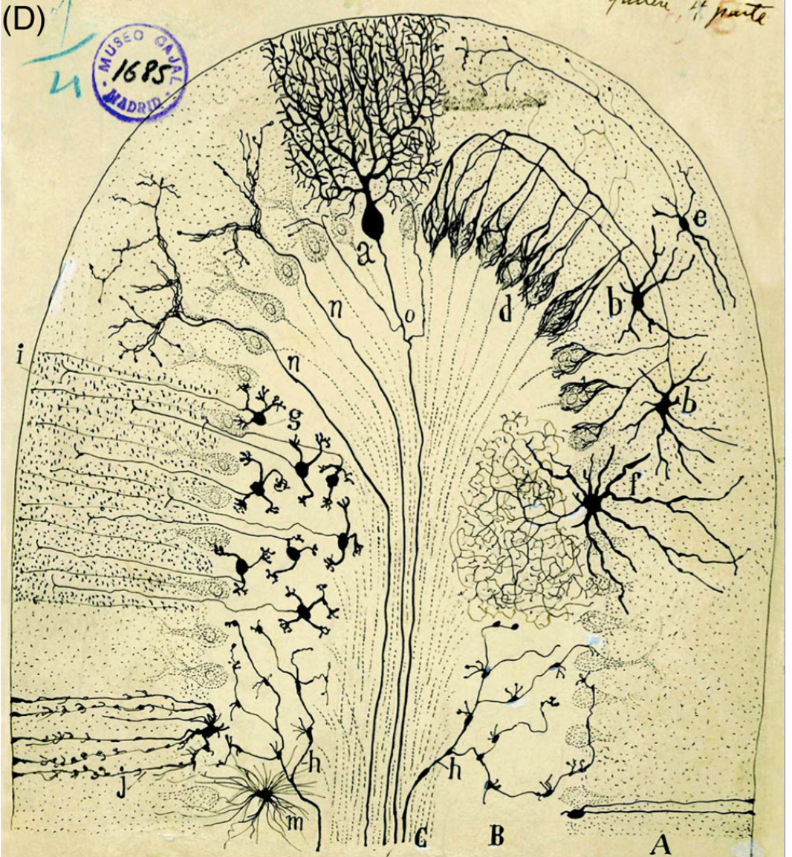
Slow Brain Bottleneck
(Sotelo 2020)
"The first diffculty was to imagine how the brain could communicate with muscles and organs and, at the same time, take on all the responsibilities of our mental life."
A timeline:
Aristotle: pneuma, or divine breath, the driving force of the brain.
Descartes: “animal spirits" flowed in nerves between the brain and the body.
Galvani (1791): electrical charge caused a frog's leg to contract.
Du Bois-Reymond (1848): sensitive galvanometer recorded neural action potential (voltage change).
Cajal (1890): nerve structures are formed by independent cells that communicate with each other.
Waldeyer (1891): neuron. Sherrington (1897): synapse.

Slide 7
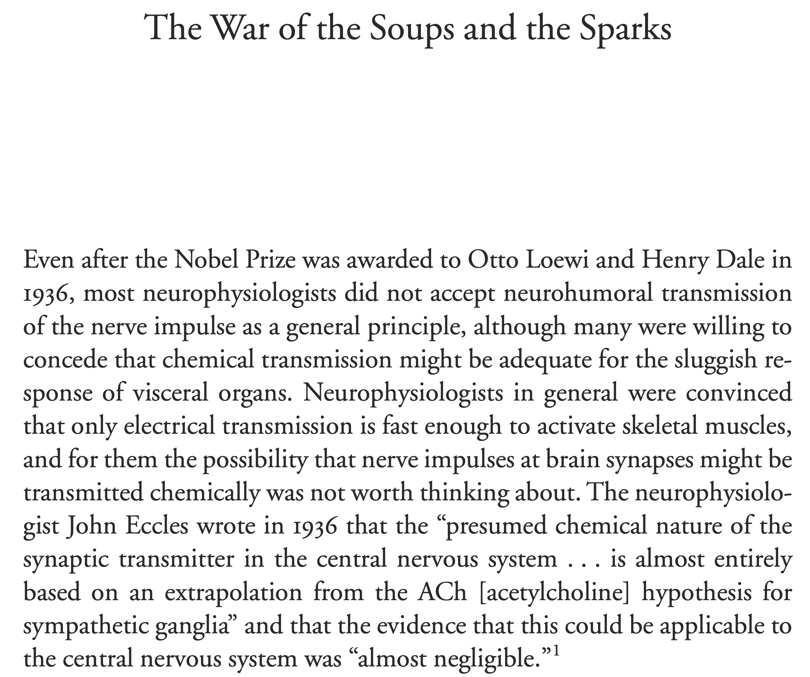
Slow Brain Bottleneck
(Valenstein, 2005)
“How can the electragonist explain the 0.2–0.4 millisecond delay that everyone agrees occurs at synapses?”
(Cannon)
chemical neurotransmitters

Slide 8
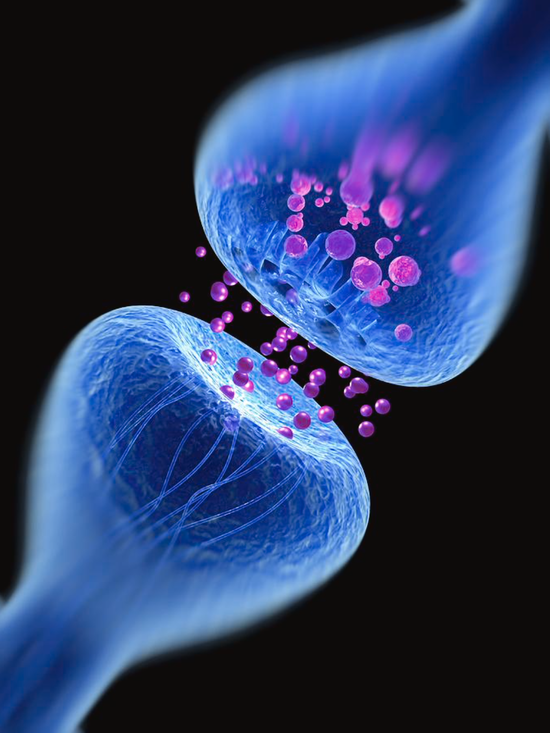
Slow Brain Bottleneck
3rd Factor (computational efficiency)
Sensor/brain mismatch
slow brain limits what sensory inputs can be analyzed
mid-20th C: chemical neural communication, not electrical
The War of Soups and Sparks (Valenstein, 2005)
Example: can we "see" a single photon?
Adaptation: neural filters only allow a signal to pass to the brain to trigger a conscious response when at least 5-9 arrive within < 100 ms. (Gibbs 1996)
Yes (Tinsley et al. 2016) vs. No ~5-7 (Hecht, Schlaer & Pirenne 1942)
Single photon priming effect (peak ~3.5 secs)
neurotransmitters
predates evolution of neurons
Alfred Pasieka
20-40nm synaptic cleft
between two neurons
Notes:
amino acids (like glutamate and GABA), monoamines (such as dopamine and serotonin), and peptides (chains of amino acids called neuropeptides)
order of a millisecond: Fast-acting neurotransmitters
Our sensors are sensitive and can ship a lot of information, overwhelming the slow brain

Slide 9
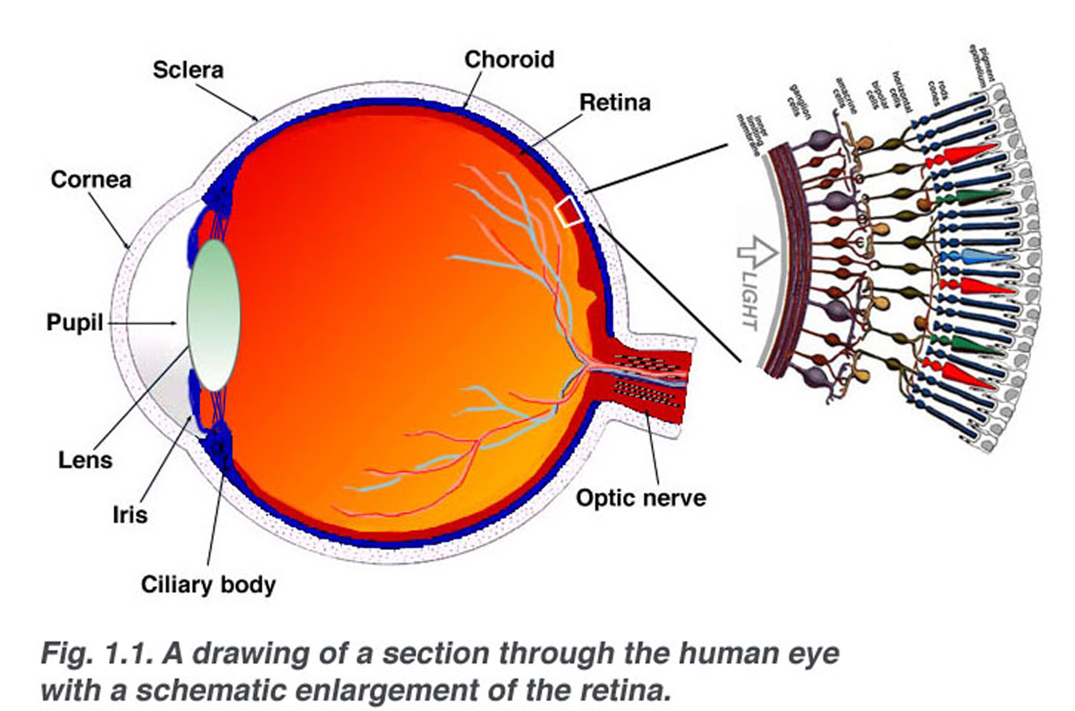
Human Eye
Non-optimal design: inverted eye (vertebrates)
cf. cuttlefish (sensors in front, no blind spot)
retina (0.5mm thick): 90% of the area is peripheral vision; 50% of the nerve fibers
saccadic movement
light
fovea pit (0.2mm diameter)
tightly-packed cones (20/20 vision; color)
50% of the nerve fibers
limited bandwidth
webvision.med.utah.edu/

Slide 10
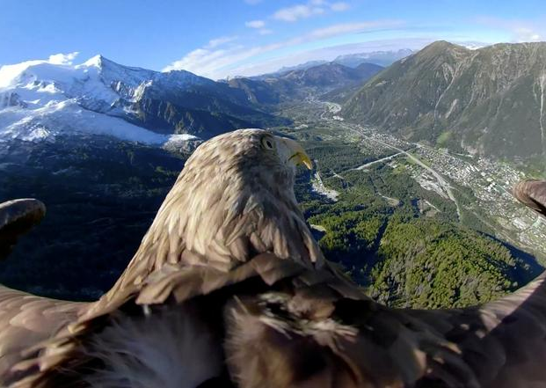
Sensor/Brain Mismatch
source: Reuters
Sensor performance is incredibly good:
sensitivity down to the single photon level (Tinsley et al., 2016)
resolution (77 cycles/degree) (Curcio et al. 1990)
within a factor of 3 of an eagle's
we don't need/use it for scene analysis
Other sensors:
olfactory thresholds at parts per billion (ppb) (Wackermannová et al., 2016)
eardrums can detect tiny vibrations: down to the size of a hydrogen atom (Fletcher & Munson, 1933)
brain doesn't need/use this either
Avians: same architecture but souped-up:
one/two foveae (also denser)
higher flicker fusion rates
more types of cones

Slide 11
Sensor/Brain Mismatch
Language is an organic system
The brain is highly pre-wired in parts (evolution)
A slow brain (mostly chemical) constrains what is possible
Computational efficiency and bandwidth are important considerations for all organic subsystems
We (selectively) throw out almost all of the signal

Slide 12
Contrasting Models of Language
Chomsky: part out
hierarchy (core syntax) using simplest conceivable operations
e.g. memoryless Binary Merge : BM(A, B) replaces A and B with {A, B} and nothing more
ideally unparameterized (universal)
linear order relegated to externalization to sensorimotor systems
a locus of language variation
automatically acquired by the language learner
General Purpose Deep Neural Networks:
inspired by biology: artificial neurons with connections to other neurons
deep means stacked in multiple layers
machine learning: data intensive and compute intensive (made recently practical)
e.g. GPT-2 48 layer Transformer Neural Net Model with 1.5 billion parameters.

Slide 13
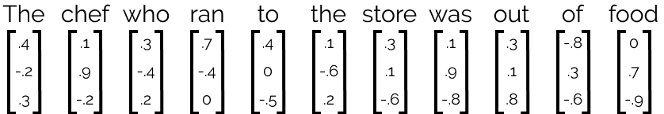
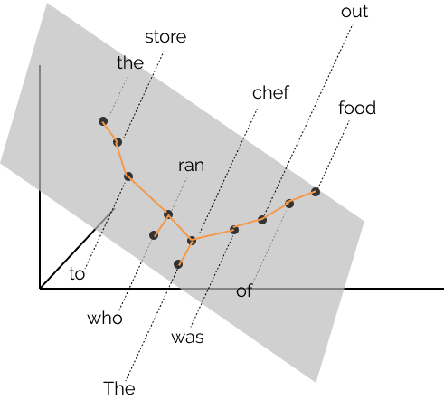
Syntax Distance Hypothesis
Words are contextual vectors (ELMo; BERT):
Hewitt and Manning (2019):
The syntax distance hypothesis: There exists a linear transformation B of the word representation space under which vector distance encodes parse trees.
https://nlp.stanford.edu/~johnhew/structural-probe.html

Slide 14
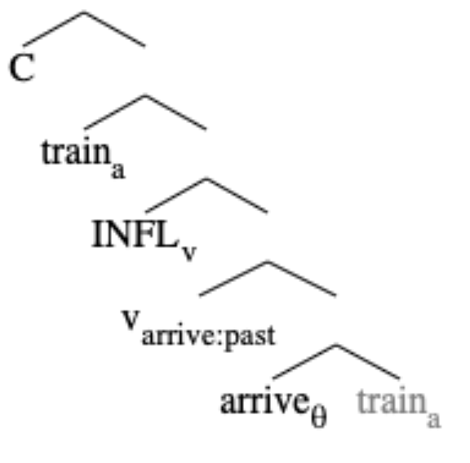
(Simplest) Merge
Basic Property of I-Language: structural dependency
not linear order! (surprising: even simpler)
SMT:
what is the simplest mechanism that results in structure?
(Mathematical) Merge: (Marcoli et al. 2025)
two items X and Y (binary)
create {X, Y} (set: no order)
recurse: Merge can feed Merge (WS)
no embellishments!
non-recursive precursors?
Core-Merge (Fujita 2014)
Conjoin (Progovac 2015)
Notes:
The simplest operation is certainly within the cognitive repertoire. A child has no problem picking the first bead on a string.
Feed is not immediate

Slide 15
(Simplest) Merge
Nature makes Merge available for cognition
Natural Numbers (ℕ)
lexicon (LEX): h (lexical item: LI, a head h)
Workspace (WS): {h} (suppose WS items: sets)
Merge:
select WS item X and Y, a (sub-)term of X
create {X, Y}
WS': {{h}, h} (WS': state of WS after 1 Merge)
WS'': {{{h}, h}, h} (h a term of {{h}, h} in WS')
or {{{h}, h}, {h}} ({h} a term of {{h}, h} in WS')
or {{{h₁}, h₂}, h₁} (h a term of {{h}, h} in WS')
{h}
h
Internal Merge (IM)
"simplest case"
{{h}, h}

Slide 16
Symbolic Model: Merge
recall example: mechanic
carefully fix - pack
Simplest I-language-specific primitive
simpler linear concatenation primitive not available
Recursive operation (Merge feeds Merge)
Markovian assumption
no access to history by Merge or external systems
compute without knowledge of the steps before
3rd factor: keep object building to a minimum
Two conceptually necessary cases:
External Merge (EM): needed to encode predicate-argument structure
Internal Merge (IM): needed for discourse/information-related functions

Slide 17
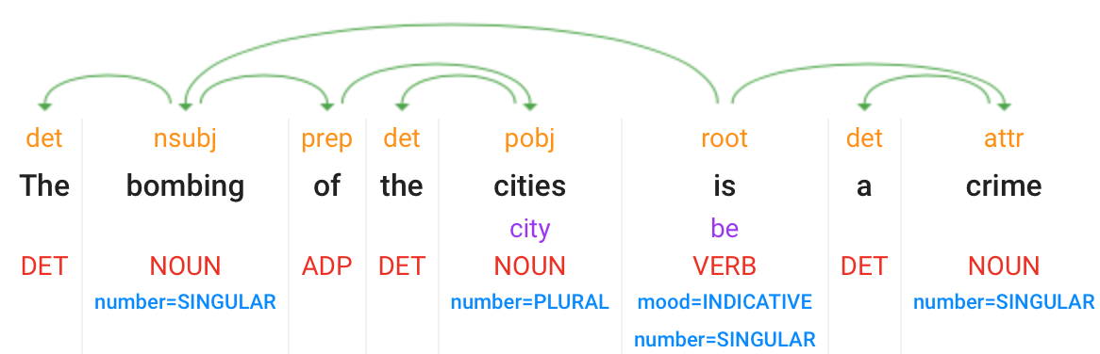
Agreement: linear model inadequate
Examples (Chomsky, OLLI lecture, Oct 2021):
The bombing of the cities is a crime
sg. pl. sg.
*The bombing of the cities are a crime
Google Natural Language parse:
4

Slide 18
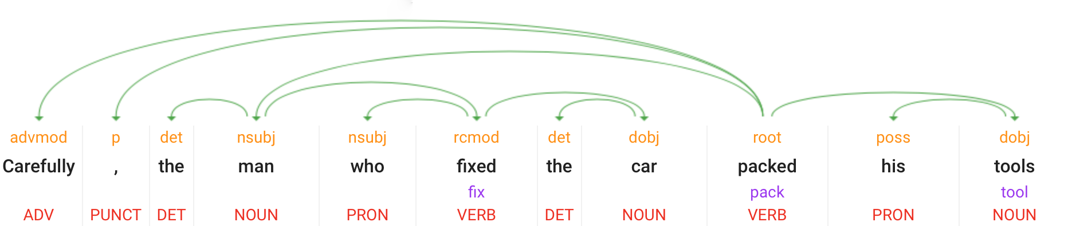
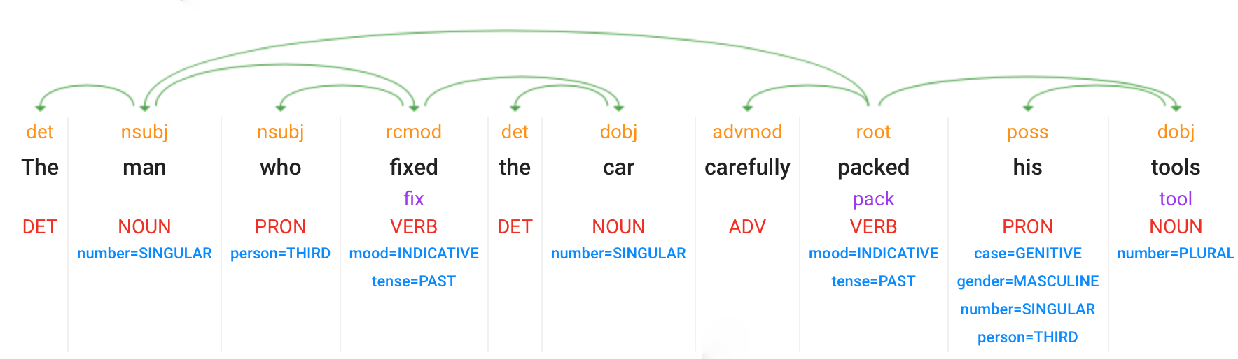
Agreement: linear model inadequate
Examples (Chomsky, OLLI lecture, Oct 2021):
The man who fixed the car carefully packed his tools
Carefully, the man who fixed the car packed his tools
Google Natural Language parse:
3
1
4
7
Note: edges don't cross

Slide 19
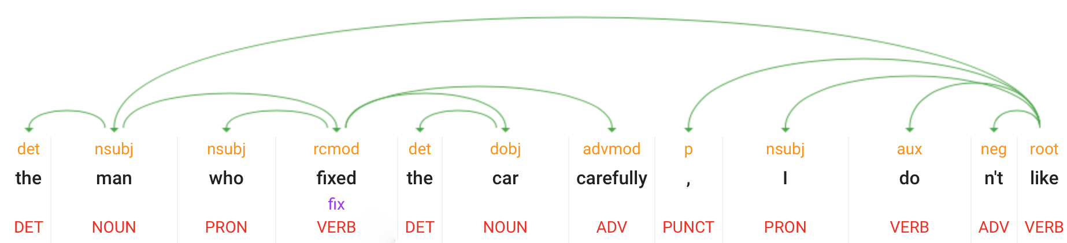
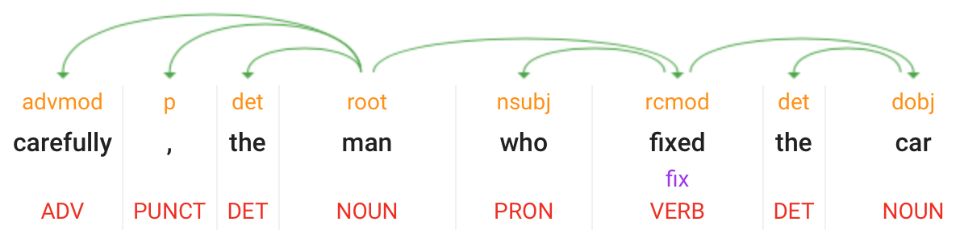
Agreement: linear model inadequate

Slide 20
Workspace (WS)
EM is more complex than IM (Chomsky)
but required by FL for thought construction
For I-Language
LEX contains (> 1) heads
IM is basic, term-of is the simplest relation
Need also some θ-configurations:
{v, {R, IA }} unaccusative
{EA , {v, {R, IA }} transitive
{EA , {v, R}} unergative
assume v & R are heads (LEX)
EA & IA could be complex objects
External Merge (EM), brings sister-of relation
{X, Y}
BinaryMerge
θ
known to INT
θ
θ
θ
WS item: X
X has term Y
WS item: Y
Note: assume X & Y are distinct,
i.e. can't draw the same item twice

