Slide 1
LING/C SC 581:
Advanced Computational Linguistics
Lecture 25

Slide 2
Today's Topic
Explaining the code used last time for the experiment:
  Let’s look inside the file
  find_scfg.py
Homework 11

Slide 3
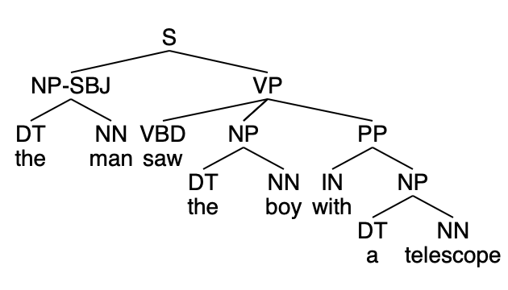
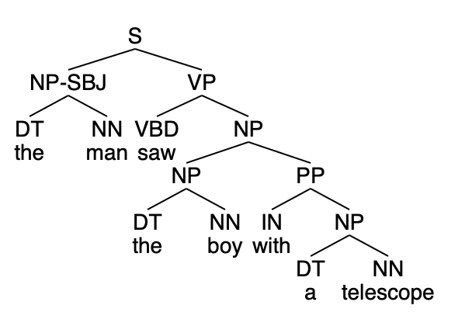
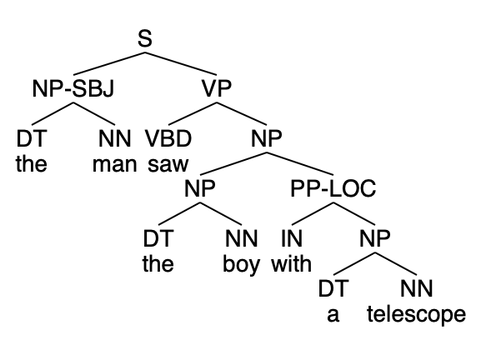
Smallest grammar for a sentence
desired structural ambiguity appears here
2nd parse appears here: but it's not the one we want
first parse appears here

Slide 4
find_scfg.py
Setup:
  ps = [p for t in ptb.parsed_sents() for p in t.productions()]
  print(f"Productions: {len(ps):,}")
Productions: 3,131,242
>>> ps[:30]
[S -> S : S ., S -> PP , NP-SBJ-2 VP, PP -> IN NP, IN -> 'In', NP -> JJ NN, JJ -> 'American', NN -> 'romance', , -> ',', NP-SBJ-2 -> RB NN, RB -> 'almost', NN -> 'nothing', VP -> VBZ S, VBZ -> 'rates', S -> NP-SBJ ADJP-PRD, NP-SBJ -> -NONE-, -NONE- -> '*-2', ADJP-PRD -> ADJP PP, ADJP -> JJR, JJR -> 'higher', PP -> IN SBAR-NOM, IN -> 'than', SBAR-NOM -> WHNP-1 S, WHNP-1 -> WP, WP -> 'what', S -> NP-SBJ VP, NP-SBJ -> DT NN NNS, DT -> 'the', NN -> 'movie', NNS -> 'men', VP -> VB VP]

Slide 5
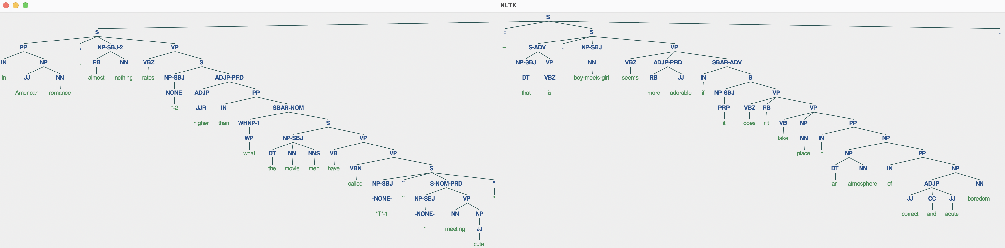
find_scfg.py
>>> ptb.parsed_sents()[0].draw()

Slide 6
find_scfg.py
>>> ptb.parsed_sents()[0]
Tree('S', [Tree('S', [Tree('PP', [Tree('IN', ['In']), Tree('NP', [Tree('JJ', ['American']), Tree('NN', ['romance'])])]), Tree(',', [',']), Tree('NP-SBJ-2', [Tree('RB', ['almost']), Tree('NN', ['nothing'])]), Tree('VP', [Tree('VBZ', ['rates']), Tree('S', [Tree('NP-SBJ', [Tree('-NONE-', ['*-2'])]), Tree('ADJP-PRD', [Tree('ADJP', [Tree('JJR', ['higher'])]), Tree('PP', [Tree('IN', ['than']), Tree('SBAR-NOM', [Tree('WHNP-1', [Tree('WP', ['what'])]), Tree('S', [Tree('NP-SBJ', [Tree('DT', ['the']), Tree('NN', ['movie']), Tree('NNS', ['men'])]), Tree('VP', [Tree('VB', ['have']), Tree('VP', [Tree('VBN', ['called']), Tree('S', [Tree('NP-SBJ', [Tree('-NONE-', ['*T*-1'])]), Tree('``', ['``']), Tree('S-NOM-PRD', [Tree('NP-SBJ', [Tree('-NONE-', ['*'])]), Tree('VP', [Tree('NN', ['meeting']), Tree('NP', [Tree('JJ', ['cute'])])])]), Tree("''", ["''"])])])])])])])])])])]), Tree(':', ['--']), Tree('S', [Tree('S-ADV', [Tree('NP-SBJ', [Tree('DT', ['that'])]), Tree('VP', [Tree('VBZ', ['is'])])]), Tree(',', [',']), Tree('NP-SBJ', [Tree('NN', ['boy-meets-girl'])]), Tree('VP', [Tree('VBZ', ['seems']), Tree('ADJP-PRD', [Tree('RB', ['more']), Tree('JJ', ['adorable'])]), Tree('SBAR-ADV', [Tree('IN', ['if']), Tree('S', [Tree('NP-SBJ', [Tree('PRP', ['it'])]), Tree('VP', [Tree('VBZ', ['does']), Tree('RB', ["n't"]), Tree('VP', [Tree('VB', ['take']), Tree('NP', [Tree('NN', ['place'])]), Tree('PP', [Tree('IN', ['in']), Tree('NP', [Tree('NP', [Tree('DT', ['an']), Tree('NN', ['atmosphere'])]), Tree('PP', [Tree('IN', ['of']), Tree('NP', [Tree('ADJP', [Tree('JJ', ['correct']), Tree('CC', ['and']), Tree('JJ', ['acute'])]), Tree('NN', ['boredom'])])])])])])])])])])]), Tree('.', ['.'])])

Slide 7
find_scfg.py
Divides the productions into lexical rules and syntax rules
Organizes them by frequency of occurrence
with concurrent.futures.ThreadPoolExecutor(max_workers=4) as executor:
executor.submit(make_lexicalrules, ps)
executor.submit(make_syntaxrules, ps)
make_lexicalrules
["NNP -> 'Mary'", "VBD -> 'saw'", "PRP -> 'I'", "DT -> 'the'", "NN -> 'boy'"]
make_syntaxrules
"S -> NP-SBJ VP", "PP -> IN NP", "NP-SBJ -> NONE", "NP -> DT NN", "NP-SBJ -> PRP", "NP -> NP PP", "VP -> TO VP", "NP -> NN", "NP -> NONE", "PP-LOC -> IN NP", …]

Slide 8
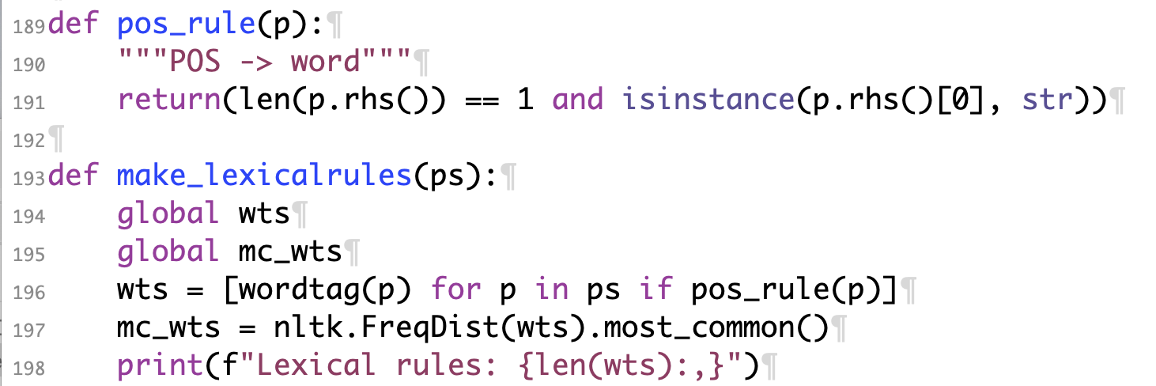
make_lexicalrules
>>> wts[:30]
[('In', 'IN'), ('American', 'JJ'), ('romance', 'NN'), (',', ','), ('almost', 'RB'), ('nothing', 'NN'), ('rates', 'VBZ'), ('*-2', 'NONE'), ('higher', 'JJR'), ('than', 'IN'), ('what', 'WP'), ('the', 'DT'), ('movie', 'NN'), ('men', 'NNS'), ('have', 'VB'), ('called', 'VBN'), ('*T*-1', 'NONE'), ('``', '``'), ('*', 'NONE'), ('meeting', 'NN'), ('cute', 'JJ'), ("''", "''"), ('--', ':'), ('that', 'DT'), …]
>>> mc_wts[:30]
[((',', ','), 84260), (('the', 'DT'), 73202), (('.', '.'), 70385), (('of', 'IN'), 39294), (('to', 'TO'), 37024), (('a', 'DT'), 32606), (('and', 'CC'), 30415), (('in', 'IN'), 24902), (('*-1', 'NONE'), 20268), (('*', 'NONE'), 17363), (('*T*-1', 'NONE'), 17346), (('0', 'NONE'), 15504), (('``', '``'), 13750), (("''", "''"), 13487), (('for', 'IN'), 12669), (("'s", 'POS'), 12006), (('is', 'VBZ'), 10919), (('The', 'DT'), 10653), (('was', 'VBD'), 10394), (('*U*', 'NONE'), 9255), (('it', 'PRP'), 9079), (('$', '$'), 8875), (('on', 'IN'), 8497), (('that', 'IN'), 8353), (('said', 'VBD'), 8248), …]

Slide 9
Some Symbol Filtering: nltk
Eliminate:
  numeric suffixes (indexing),
    e.g. -1
  punctuation (terminals)*
    e.g. , .
Replace:
  $ in POS tag names, signifies possessive form, by S*
    e.g. WP$ whose PRP$ his
  -NONE- by NONE*
    also -LRB- -RRB-*
'SBAR-PRP -> IN , S'
'WHNP-1 -> WP$ NNP NNP NN'
'SINV -> PP-LOC-TPC-1 VBD VP NP-SBJ'
'NX -> JJ NN'
'S -> NP-SBJ , PP-TMP VP'
'VP -> S-ADV , VBD ADJP-PRD'
'S -> S CC S ADVP'
'VP -> ADVP VBD SBAR-NOM'
'S-TPC-1 -> ADVP-TMP , S , CC S'
'S-IMP -> INTJ , NP-SBJ VP .'
ValueError: Unable to parse line 2: WHNP -> WP$ NNP NNP NN
Expected a nonterminal, found: $ NNP NNP NN
ValueError: Unable to parse line 8: NP-SBJ -> -NONE-
Expected a nonterminal, found: -NONE-
*due to nltk CFG limitations

Slide 10
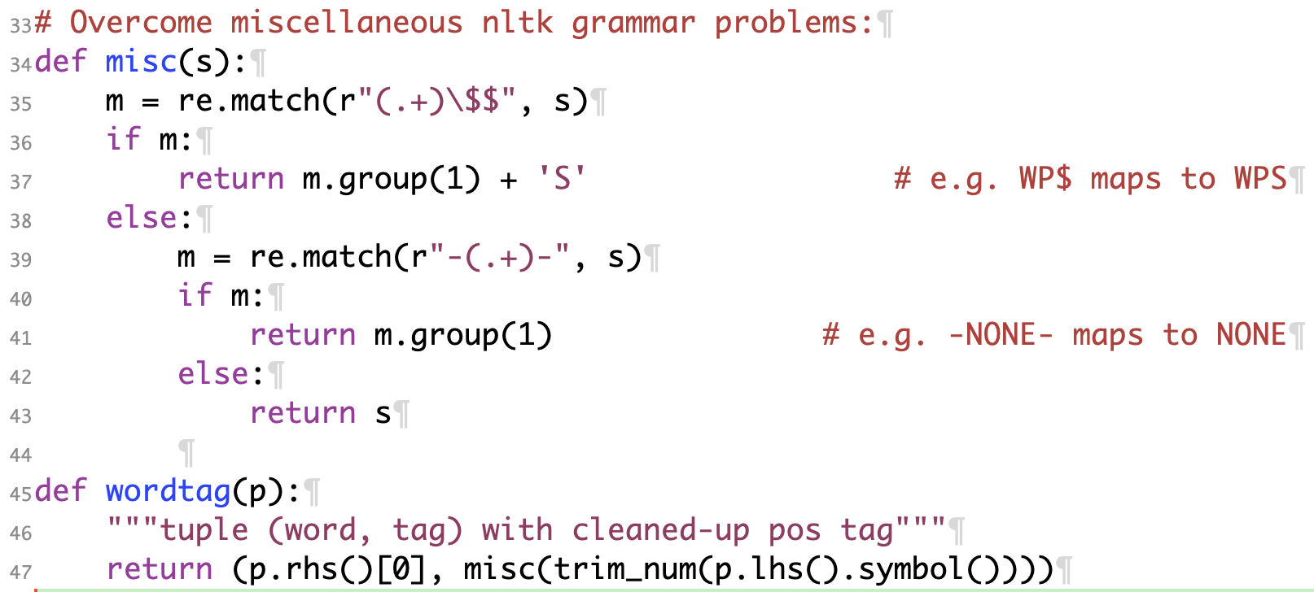
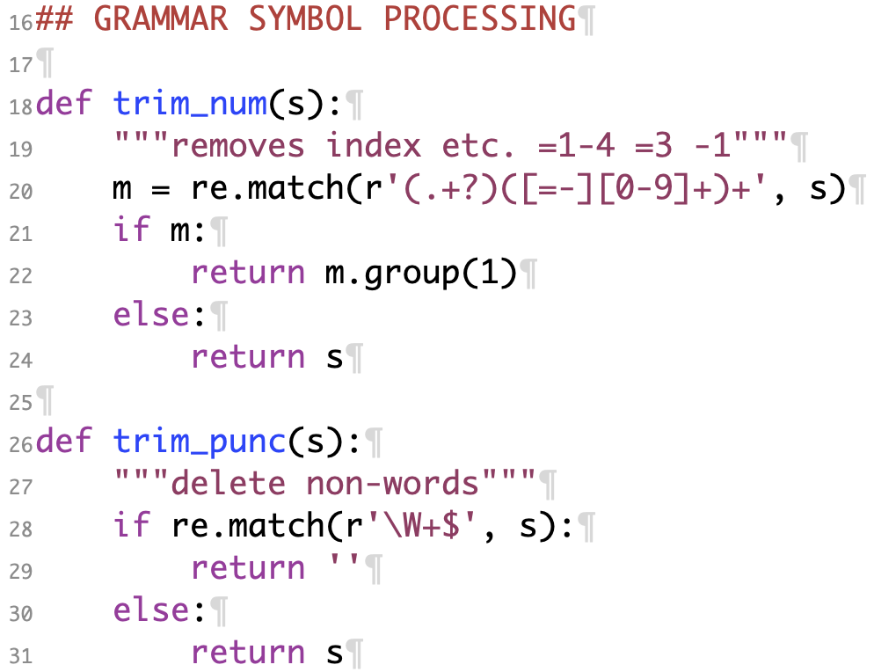
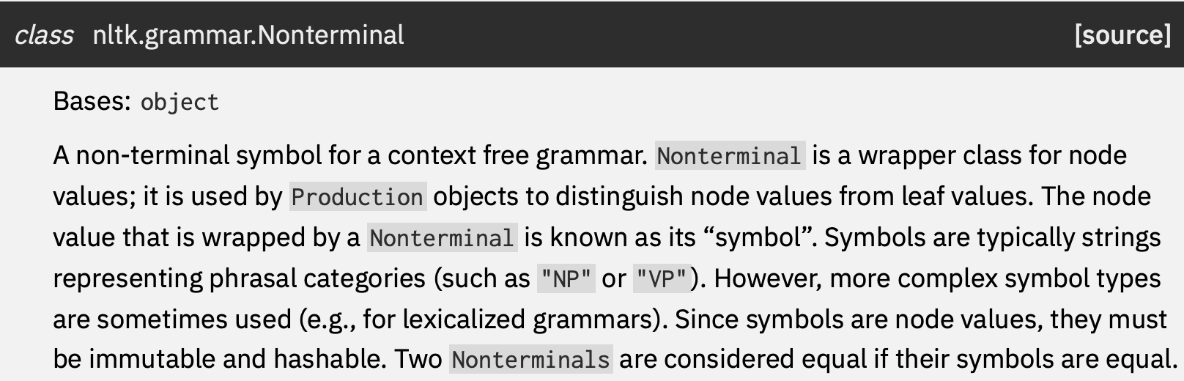
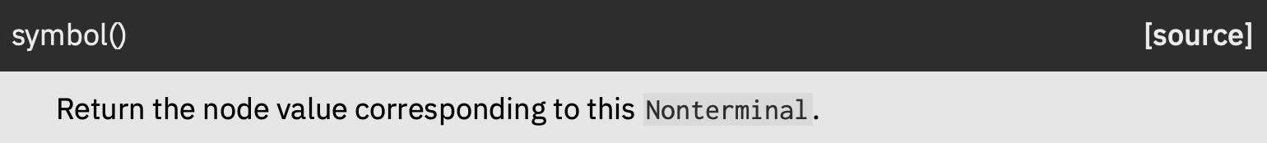
make_lexicalrules

Slide 11
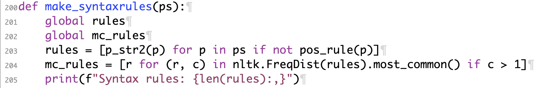
make_syntaxrules
>>> rules[:30]
['S -> S S', 'S -> PP NP-SBJ VP', 'PP -> IN NP', 'NP -> JJ NN', 'NP-SBJ -> RB NN', 'VP -> VBZ S', 'S -> NP-SBJ ADJP-PRD', 'NP-SBJ -> NONE', 'ADJP-PRD -> ADJP PP', 'ADJP -> JJR', 'PP -> IN SBAR-NOM', 'SBAR-NOM -> WHNP S', 'WHNP -> WP', 'S -> NP-SBJ VP', 'NP-SBJ -> DT NN NNS', 'VP -> VB VP', 'VP -> VBN S', 'S -> NP-SBJ S-NOM-PRD', 'NP-SBJ -> NONE', 'S-NOM-PRD -> NP-SBJ VP', 'NP-SBJ -> NONE', 'VP -> NN NP', 'NP -> JJ', 'S -> S-ADV NP-SBJ VP', 'S-ADV -> NP-SBJ VP', 'NP-SBJ -> DT', 'VP -> VBZ', 'NP-SBJ -> NN', 'VP -> VBZ ADJP-PRD SBAR-ADV', 'ADJP-PRD -> RB JJ']

Slide 12
make_syntaxrules
>>> mc_rules[:40]
['S -> NP-SBJ VP', 'PP -> IN NP', 'NP-SBJ -> NONE', 'NP -> DT NN', 'NP-SBJ -> PRP', 'NP -> NP PP', 'VP -> TO VP', 'NP -> NN', 'NP -> NONE', 'PP-LOC -> IN NP', 'ADVP -> RB', 'NP -> DT JJ NN', 'NP -> NNS', 'VP -> MD VP', 'SBAR -> WHNP S', 'NP -> NNP', 'VP -> VB NP', 'NP -> PRP', 'PP-TMP -> IN NP', 'SBAR -> NONE S', 'PP-CLR -> IN NP', 'NP -> NNP NNP', 'NP-SBJ -> DT NN', 'NP -> JJ NNS', 'NP -> NP SBAR', 'SBAR -> IN S', 'NP-SBJ -> NP PP', 'VP -> VBD VP', 'NP-SBJ -> NNP', 'VP -> VBD SBAR', 'ADVP-TMP -> RB', 'VP -> VBD NP', 'PP -> TO NP', 'QP -> CD CD', 'S -> NONE', 'WHNP -> WDT', 'NP -> DT NNS', 'VP -> VBZ VP', 'VP -> VBG NP', 'NP-SBJ -> NNP NNP']

Slide 13
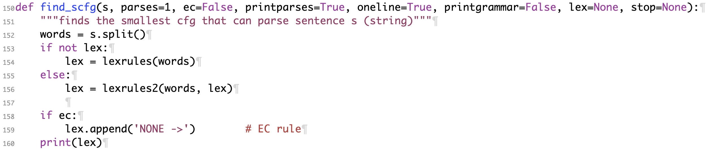
find_scfg.py
>>> find_scfg("Mary persuaded John to leave")
["TO -> 'to'", "NNP -> 'Mary'", "NNP -> 'John'", "VB -> 'leave'", "VBN -> 'persuaded'"]
lex: list of lexical rules to use (overrides default)
example lexical rule: "DT -> 'the'"

Slide 14
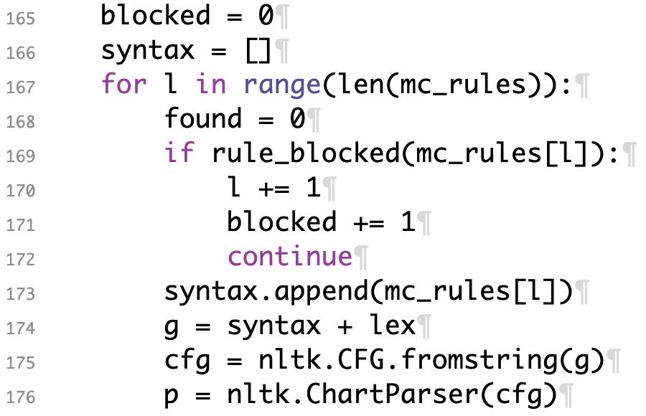
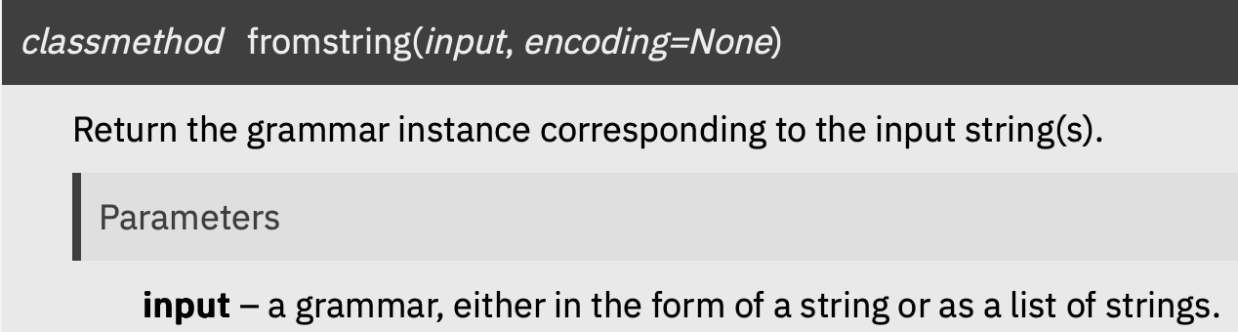
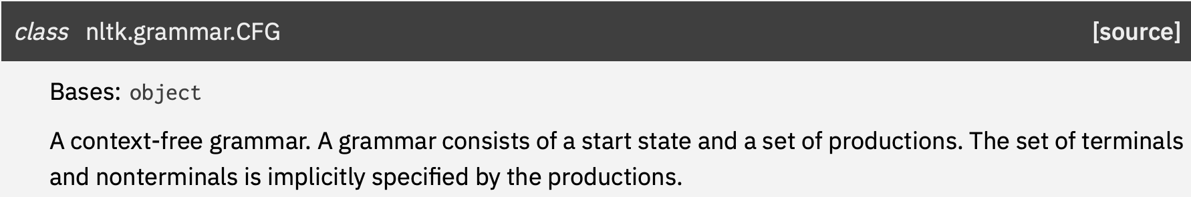
find_scfg.py
>>> len(mc_rules)
13485

Slide 15
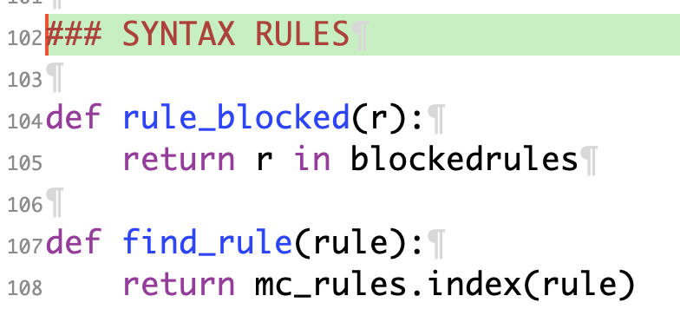
find_scfg.py

Slide 16
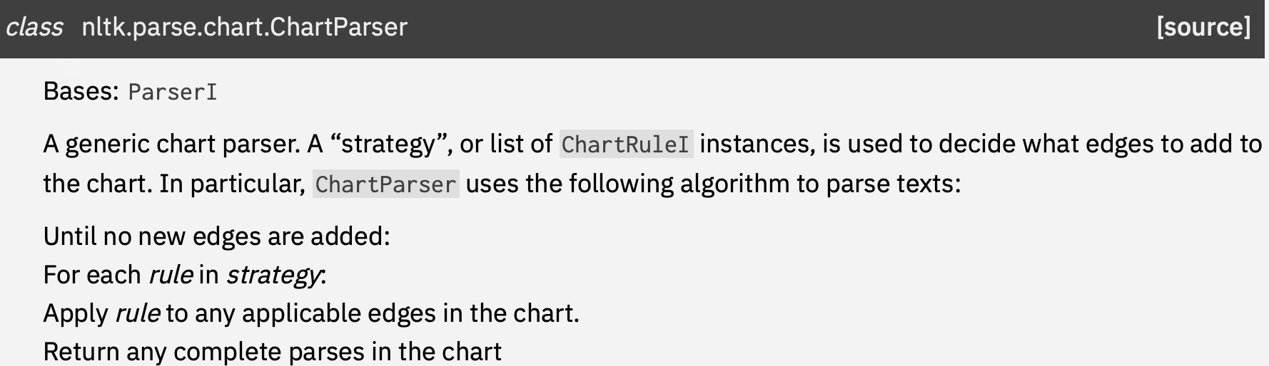
find_scfg.py

Slide 17
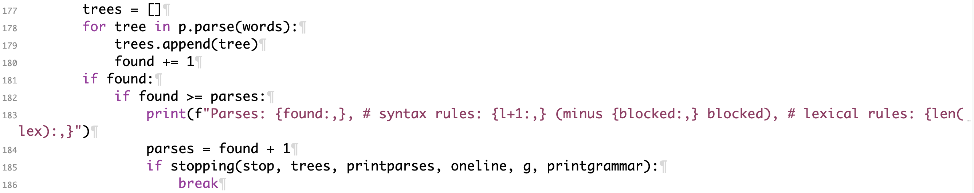
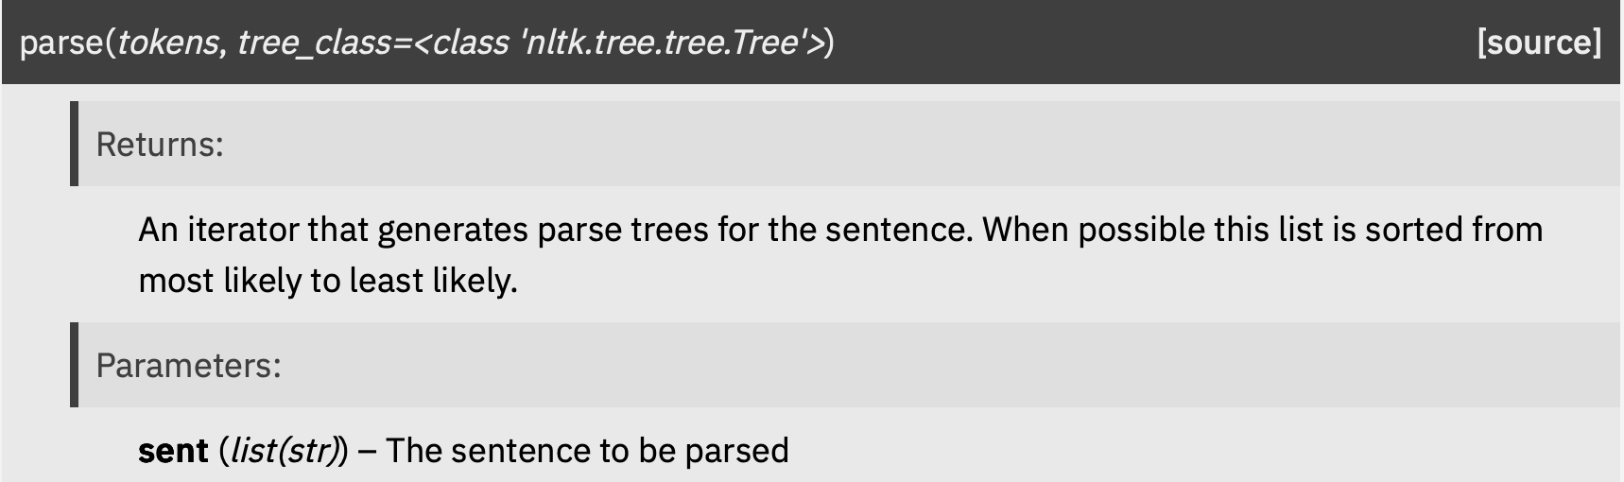
find_scfg.py

Slide 18
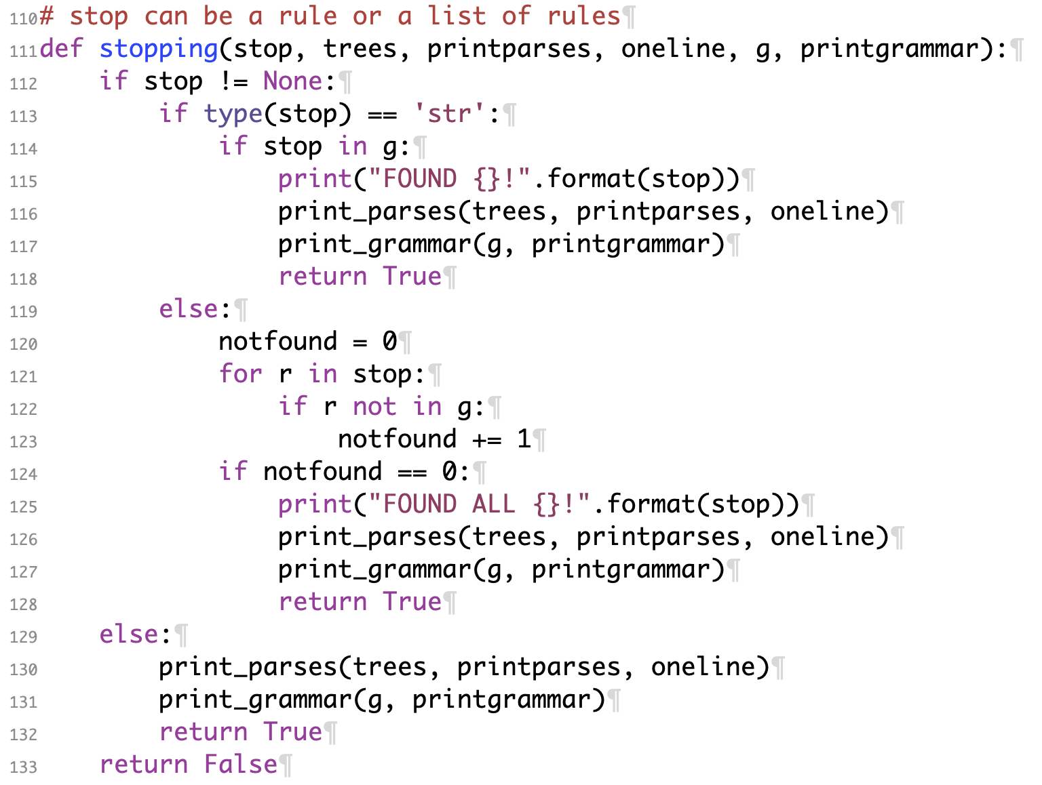
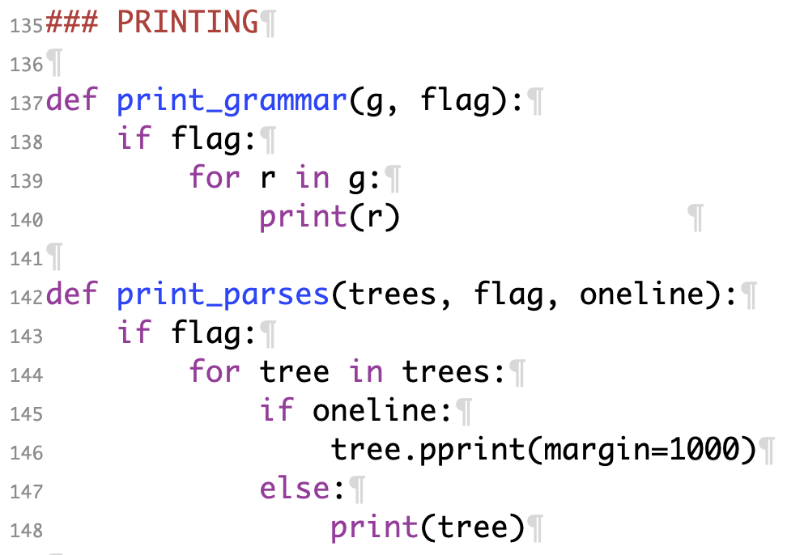
find_scfg.py

Slide 19
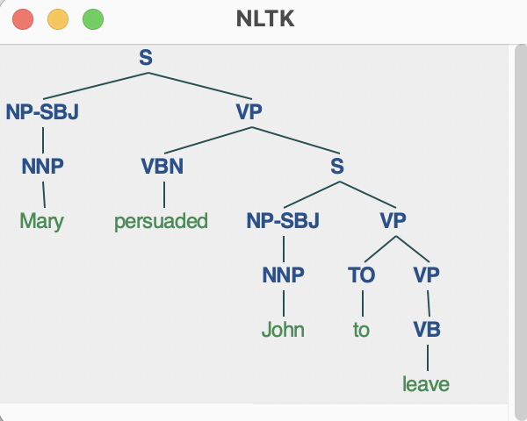
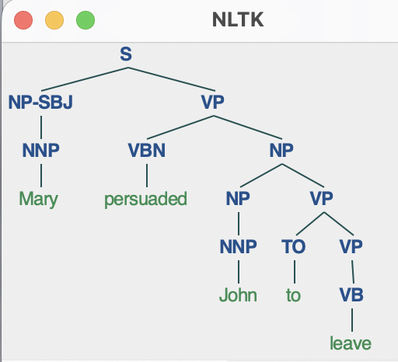
find_scfg.py
>>> find_scfg("Mary persuaded John to leave")
["TO -> 'to'", "NNP -> 'Mary'", "NNP -> 'John'", "VB -> 'leave'", "VBN -> 'persuaded'"]
Begin CFG grow
Parses: 2, # syntax rules: 115 (minus 4 blocked), # lexical rules: 5
(S (NP-SBJ (NNP Mary)) (VP (VBN persuaded) (NP (NP (NNP John)) (VP (TO to) (VP (VB leave))))))
(S (NP-SBJ (NNP Mary)) (VP (VBN persuaded) (S (NP-SBJ (NNP John)) (VP (TO to) (VP (VB leave))))))
grow CFG time: 0.08 (s)
>>> s = "(S (NP-SBJ (NNP Mary)) (VP (VBN persuaded) (S (NP-SBJ (NNP John)) (VP (TO to) (VP (VB leave))))))"
>>> t = nltk.Tree.fromstring(s)
>>> t.draw()

Slide 20
Homework 11
Run the Python code (-i interactive mode):
$ python3 -i find_scfg.py
Creates lexical and syntactic rules from ptb: stored in mc_wts, mc_rules
find_scfg(string) finds the smallest CFG that can parse string.
rules are added to the grammar in order of frequency: high > low.
optional parameters:
parses=1, ec=False, printparses=True, printgrammar=False, lex=None, …
parses: # of parses for string the smallest CFG must produce.
ec: True, permits -NONE- -> ''
printparses: True, prints the parses found.
printgrammar: True, prints the CFG found.
lex: list of lexical rules to use (overrides default)
example lexical rule: "DT -> 'the'"

Slide 21
Homework 11
Setup:
20:53:51
Productions: 3,131,242
Lexical rules: 1,740,895
Syntax rules: 1,390,347
Total time: 23 (s)
>>> mc_wts[:10]
[((',', ','), 84260), (('the', 'DT'), 73202), (('.', '.'), 70385), (('of', 'IN'), 39294), (('to', 'TO'), 37024), (('a', 'DT'), 32606), (('and', 'CC'), 30415), (('in', 'IN'), 24902), (('*-1', 'NONE'), 20268), (('*', 'NONE'), 17363)]
>>> mc_rules[:10]
['S -> NP-SBJ VP', 'PP -> IN NP', 'NP-SBJ -> NONE', 'NP -> DT NN', 'NP-SBJ -> PRP', 'NP -> NP PP', 'VP -> TO VP', 'NP -> NN', 'NP -> NONE', 'PP-LOC -> IN NP']
top-10 most_common word tags
top-10 most_common syntax rules

Slide 22
Homework 11
T1:
  run find_scfg(s) on "John saw Mary" vs. "John likes Mary"
Q1:
  which grammar is smaller?
Q2:
  why (is one smaller than the other)?
  (To see the CFG used, add the parameter printgrammar=True)

Slide 23
Homework 11
T2:
  run find_scfg(s) on "Mary saw the boy who I saw " vs. " Mary saw the boy I saw "
Q3:
  which grammar is smaller?
Q4:
  are the parses correct? Explain.
  (you can 2D render the trees using nltk.Tree.fromstring() or tregex)

Slide 24
Homework 11
T3:
  run find_scfg(s) on "Mary saw the boy who I saw " vs. " Mary saw the boy I saw ", but adding the parameter ec=True
  Note: parameter ec: True, permits -NONE- -> ''
Q5:
  which grammar is smaller? Why?
Q6:
  are the parses correct? Explain.

Slide 25
Homework 11
Submit to sandiway@arizona.edu
SUBJECT: 581 Homework 11 YOUR NAME
One PDF file (for grading)
  include your screenshots
  include your Python code
Usual Deadline:
  midnight Saturday
  to be grade Sunday
  we will review the homework next Monday

