Slide 1
LING/C SC 581: Advanced Computational Linguistics
Lecture 24

Slide 2
Today's Topic
Last Time:
t.productions() (= phrase structure rules)
p.lhs()/p.rhs()
len(p.rhs()) (= # children)
p.is_nonlexical()/p.is_lexical()
p.lhs().symbol() (nonterminal symbol)
A CFG experiment with the ptb:
CFG = Context-free Grammar
How many common ptb rules do we need to parse a sentence?

Slide 3
Distribution of Productions
>>> import matplotlib.pyplot as plt
>>> import numpy as np
>>> from scipy.stats import norm
>>> from statistics import mean, stdev
>>> from nltk.corpus import ptb
>>> trees = ptb.parsed_sents()
>>> len(trees)
73451
>>> lrulec = [len(t.productions()) for t in trees]
>>> sum(lrulec)
3131242
lrulec: list of rule counts

Slide 4
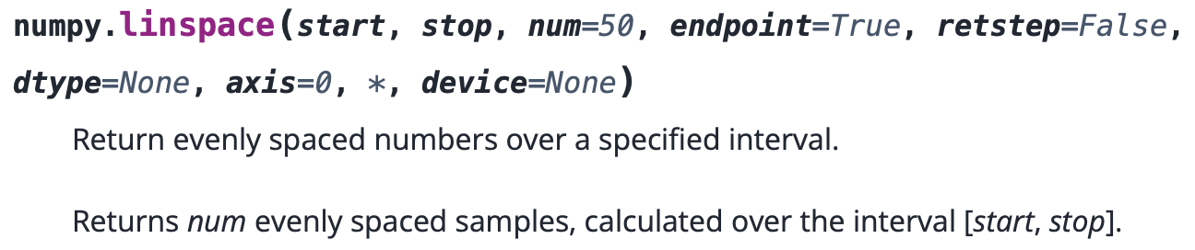
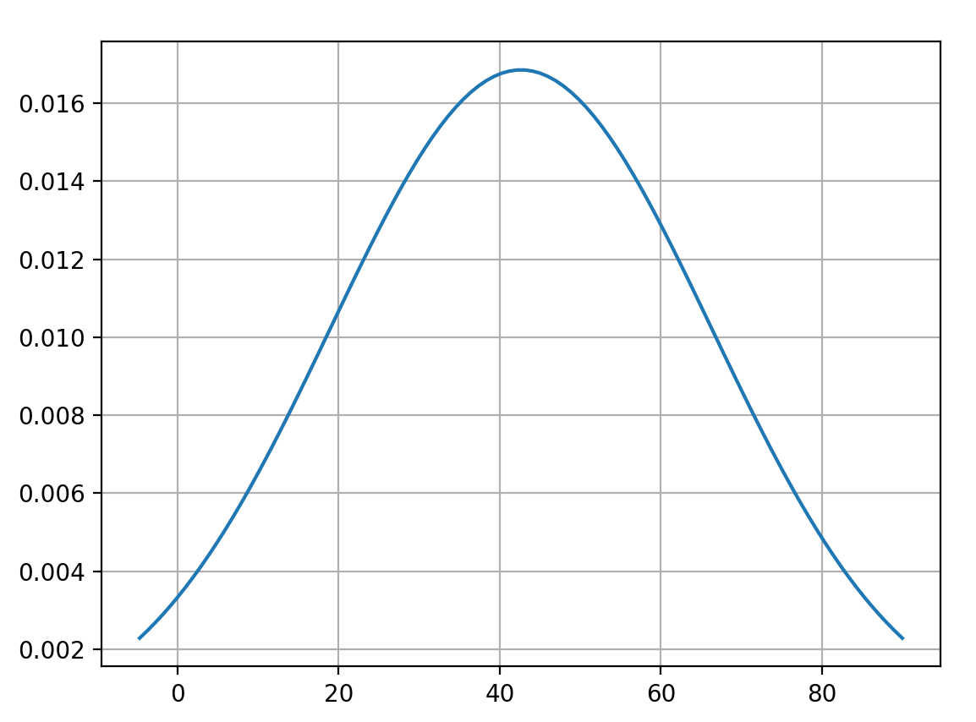
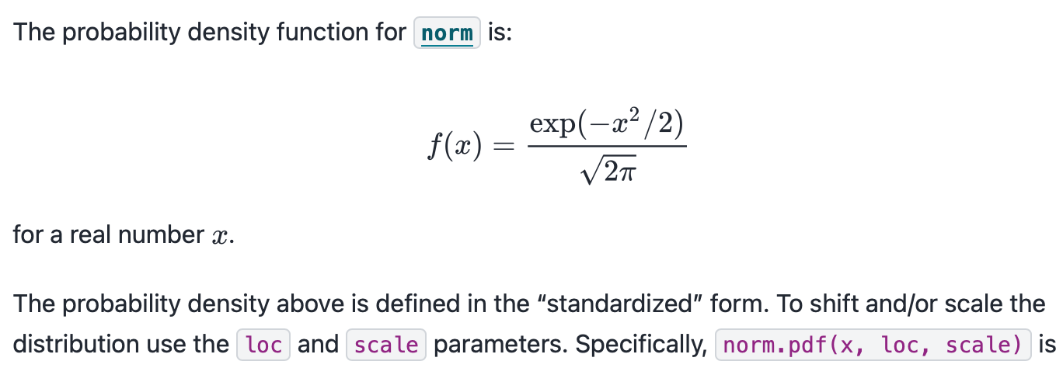
Distribution of Productions
>>> mean(lrulec)
42.63035220759418
>>> stdev(lrulec)
23.671107782972243
>>> m = mean(lrulec)
>>> sd = stdev(lrulec)
>>> x = np.linspace(m-2*sd,m+2*sd,100)
>>> plt.plot(x,norm.pdf(x,m,sd))
>>> plt.grid()
>>> plt.show()
Normal Distribution
Mean: 42.6 SD: 23.7

Slide 5
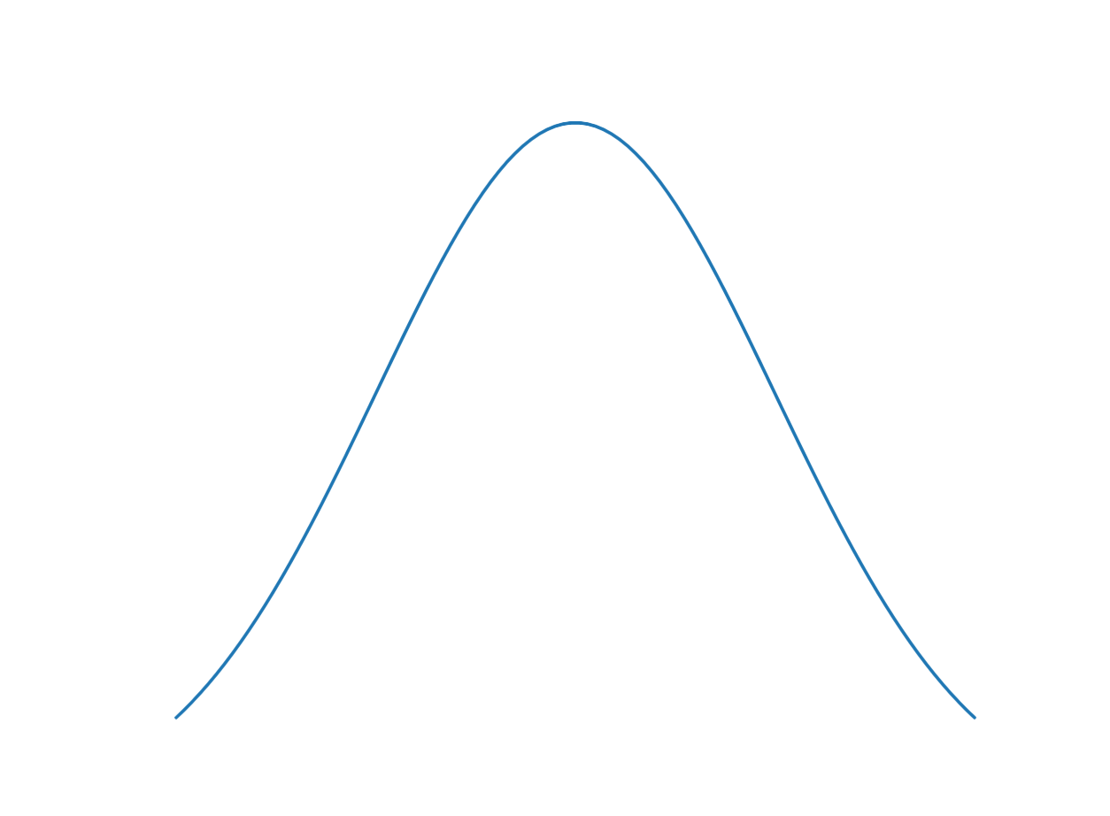
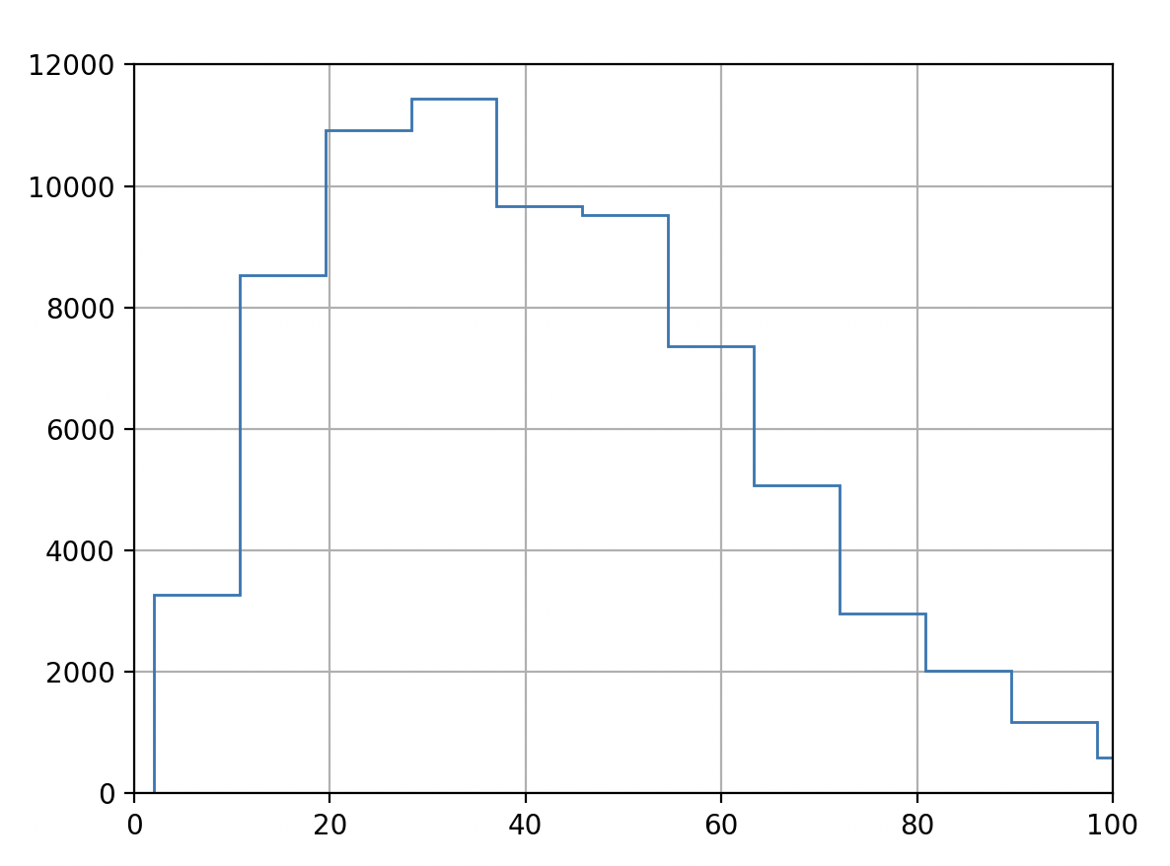
Distribution of Productions
>>> plt.hist(lrulec,histtype='step',bins=50)
>>> plt.xlim(0,100)
>>> plt.grid()
>>> plt.show()
overlaid
Normal Distribution

Slide 6
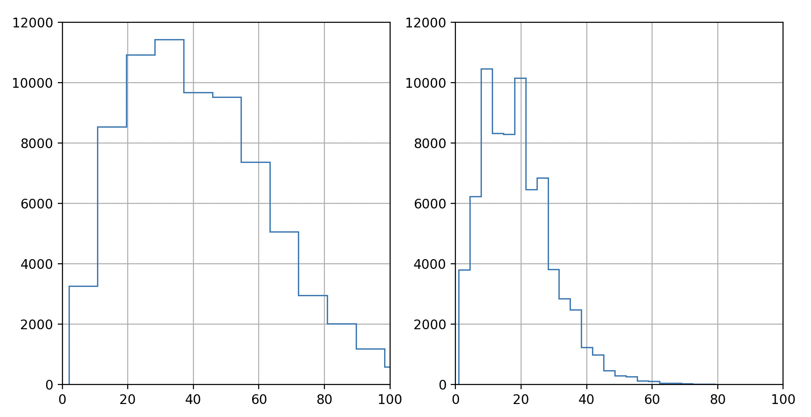
Distribution of Productions
with (left) and without (right) (word POS) nodes
mean:42.63 sd:23.67
mean:18.93 sd:11.04

Slide 7
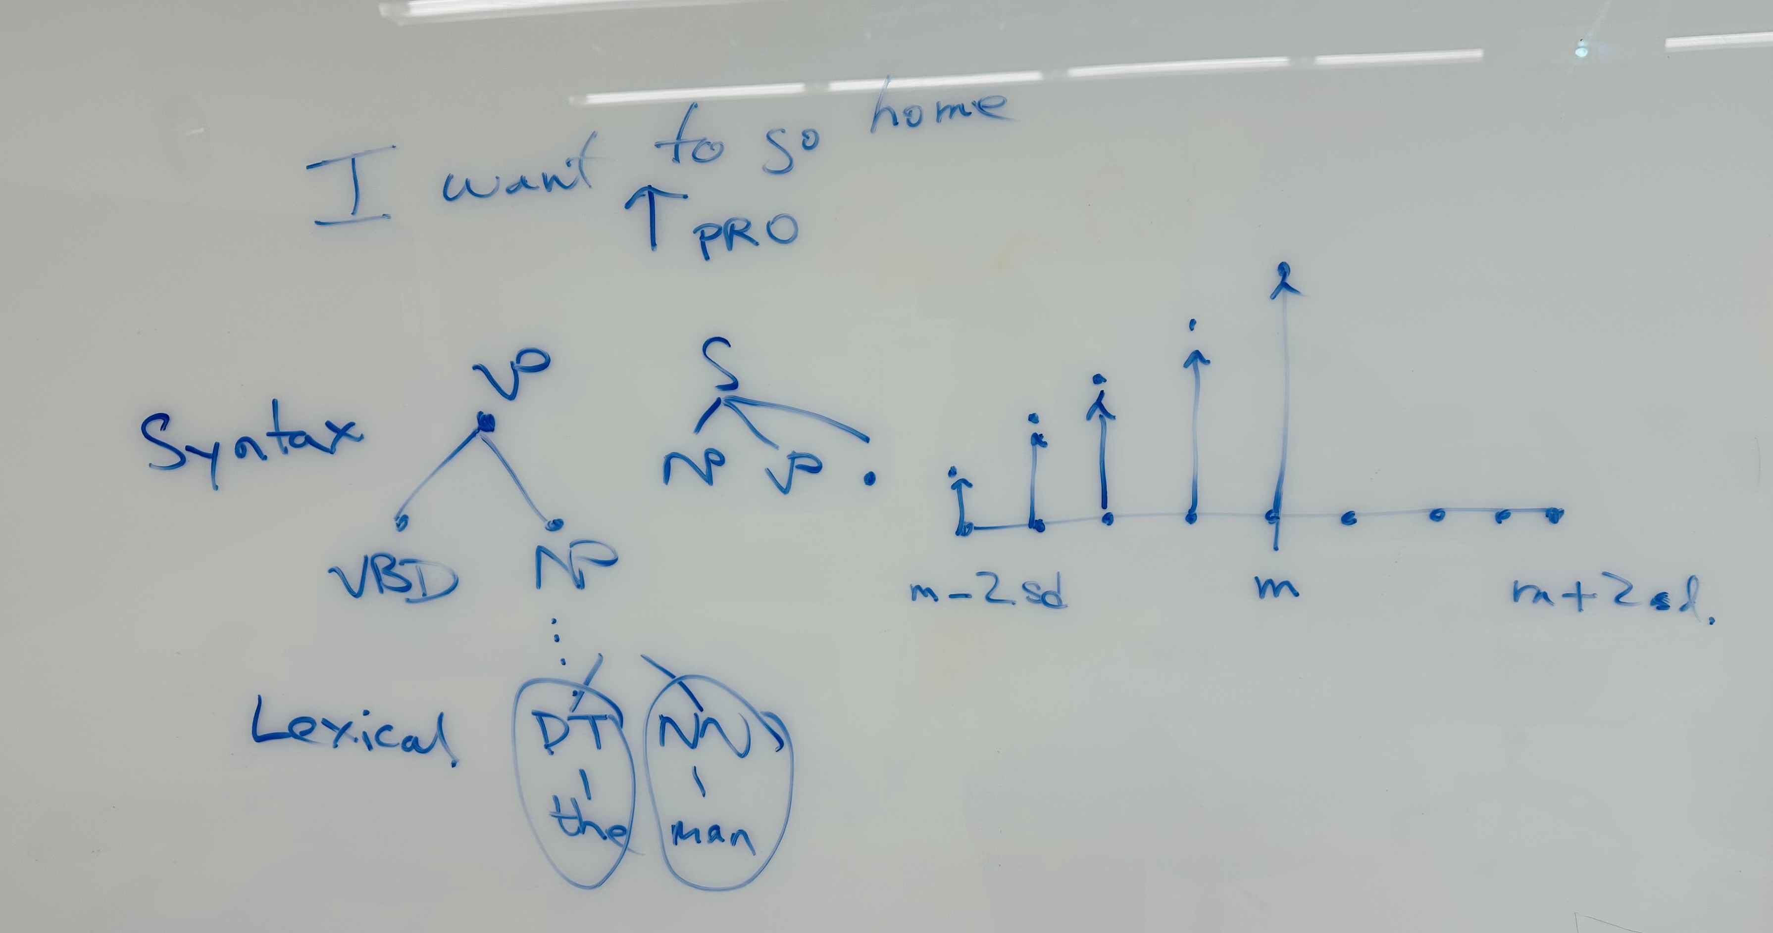
Distribution of Productions

Slide 8
# of Productions
Suppose list rules be all the rules in the ptb.
>>> rules = [p for t in trees for p in t.productions()]
>>> len(rules)
3131242
Then let srules be all the (syntax), i.e. nonlexical, rules:
>>> srules = [r for r in rules if not(len(r.rhs()) == 1 and isinstance(r.rhs()[0], str)]
>>> len(srules)
1390347

Slide 9
# of Productions
top-5 highlighted there: interesting!
>>> fd = nltk.FreqDist(srules)
>>> fd
FreqDist({PP -> IN NP: 78040, S -> NP-SBJ VP: 63335, NP -> DT NN: 40876, NP-SBJ -> -NONE-: 39712, NP -> NP PP: 35819, NP-SBJ -> PRP: 31272, S -> NP-SBJ VP .: 24467, VP -> TO VP: 21899, NP -> NN: 20798, NP -> -NONE-: 20312, ...})
>>> len(fd)
52134
>>> fd.N()
1390347
Is this # cognitively plausible?

Slide 10
# of Productions
>>> fd.most_common(20)
[(PP -> IN NP, 78040),
(S -> NP-SBJ VP, 63335),
(NP -> DT NN, 40876),
(NP-SBJ -> -NONE-, 39712),
(NP -> NP PP, 35819),
(NP-SBJ -> PRP, 31272),
(S -> NP-SBJ VP ., 24467),
(VP -> TO VP, 21899),
(NP -> NN, 20798),
(NP -> -NONE-, 20312),
(PP-LOC -> IN NP, 18021),
(ADVP -> RB, 15449),
(NP -> DT JJ NN, 14898),
(NP -> NNS, 14875),
(VP -> MD VP, 13714),
(NP -> NNP, 12767),
(VP -> VB NP, 12730),
(PP-TMP -> IN NP, 11032),
(NP -> PRP, 10988),
(SBAR -> -NONE- S, 10774)]

Slide 11
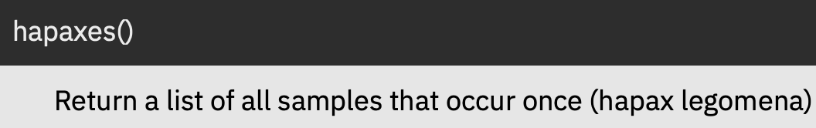
# of Productions
Most syntax rules only occur once:
>>> len(fd)
52134
>>> fd.N()
1390347
>>> len(fd.hapaxes())
33631
How do they get learnt?

Slide 12
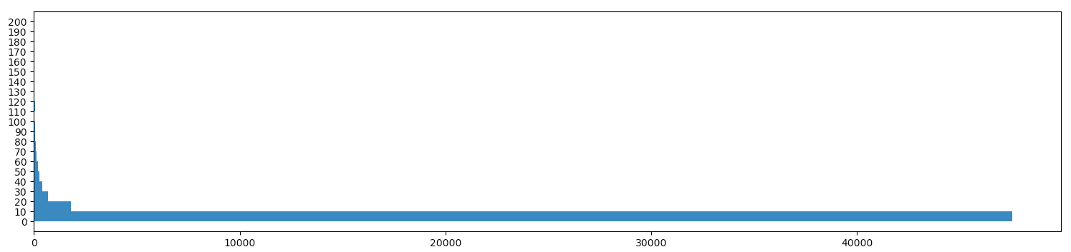
# of Productions: histogram
binned: # of times rule occurs
# of rules

Slide 13
Smallest grammar for a sentence
Propose an Experiment:
suppose we start with an empty CFG (no rules)
take PTB rules in order of frequency (highest first)
add them one at a time to the grammar
how many PTB rules before we can parse this sentence?*
the man saw the boy with a telescope
how many PTB rules do we need to obtain the structural ambiguity?
*some simplifications applied, explained later.

Slide 14
Smallest grammar for a sentence
desired structural ambiguity appears here
2nd parse appears here: but it's not the one we want
first parse appears here

Slide 15
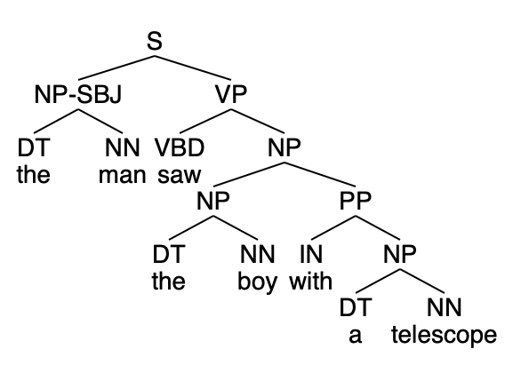
Smallest grammar for a sentence
>>> find_scfg(s)
the DT 73202
man NN 886
saw VBD 329
the DT 73202
boy NN 191
with IN 7953
a DT 32606
telescope NN 3
(S
(NP-SBJ (DT the) (NN man))
(VP
(VBD saw)
(NP
(NP (DT the) (NN boy))
(PP (IN with) (NP (DT a) (NN telescope))))))
Parses: 1,
# rules: 32,
# lexical rules: 7

Slide 16
Smallest grammar for a sentence
Parses: 1, # rules: 32, # lexical rules: 7
S -> NP-SBJ VP
PP -> IN NP
NP-SBJ -> NONE
NP -> DT NN
NP-SBJ -> PRP
NP -> NP PP
VP -> TO VP
NP -> NN
NP -> NONE
PP-LOC -> IN NP
ADVP -> RB
NP -> DT JJ NN
NP -> NNS
VP -> MD VP
SBAR -> WHNP S
NP -> NNP
VP -> VB NP
NP -> PRP
PP-TMP -> IN NP
SBAR -> NONE S
PP-CLR -> IN NP
NP -> NNP NNP
NP-SBJ -> DT NN
NP -> JJ NNS
NP -> NP SBAR
SBAR -> IN S
NP-SBJ -> NP PP
VP -> VBD VP
NP-SBJ -> NNP
VP -> VBD SBAR
ADVP-TMP -> RB
VP -> VBD NP
DT -> 'a'
NN -> 'telescope'
IN -> 'with'
DT -> 'the'
NN -> 'man'
NN -> 'boy'
VBD -> 'saw'

Slide 17
Smallest grammar for a sentence
Parses: 2, # rules: 45, # lexical rules: 7
S -> NP-SBJ VP
PP -> IN NP
NP-SBJ -> NONE
NP -> DT NN
NP-SBJ -> PRP
NP -> NP PP
VP -> TO VP
NP -> NN
NP -> NONE
PP-LOC -> IN NP
ADVP -> RB
NP -> DT JJ NN
NP -> NNS
VP -> MD VP
SBAR -> WHNP S
NP -> NNP
VP -> VB NP
NP -> PRP
PP-TMP -> IN NP
SBAR -> NONE S
PP-CLR -> IN NP
NP -> NNP NNP
NP-SBJ -> DT NN
NP -> JJ NNS
NP -> NP SBAR
SBAR -> IN S
NP-SBJ -> NP PP
VP -> VBD VP
NP-SBJ -> NNP
VP -> VBD SBAR
ADVP-TMP -> RB
VP -> VBD NP
PP -> TO NP
QP -> CD CD
S -> NONE
WHNP -> WDT
NP -> DT NNS
VP -> VBZ VP
VP -> VBG NP
NP-SBJ -> NNP NNP
NP -> NP CC NP
NP -> JJ NN
NP -> PRPS NN
VP -> VP CC VP
NP -> NP PP-LOC
NN -> 'man'
IN -> 'with'
DT -> 'a'
DT -> 'the'
NN -> 'boy'
VBD -> 'saw'
NN -> 'telescope'
always look at the last rule added!

Slide 18
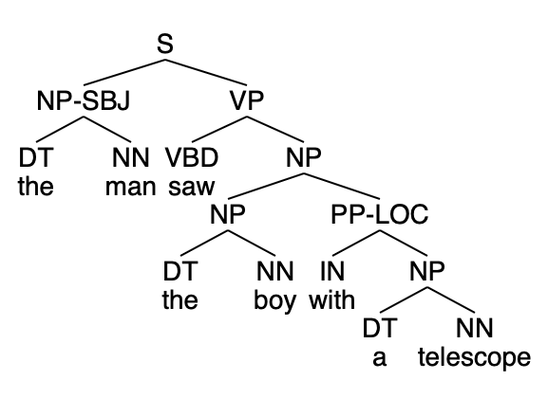
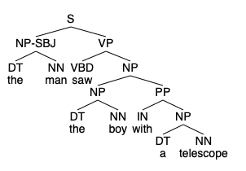
Smallest grammar for a sentence
(S
(NP-SBJ (DT the) (NN man))
(VP
(VBD saw)
(NP
(NP (DT the) (NN boy))
(PP-LOC (IN with) (NP (DT a) (NN telescope))))))
(S
(NP-SBJ (DT the) (NN man))
(VP
(VBD saw)
(NP
(NP (DT the) (NN boy))
(PP (IN with) (NP (DT a) (NN telescope))))))
Parses: 2, # rules: 45, # lexical rules: 7
not what you'd expect for the 2nd parse!

Slide 19
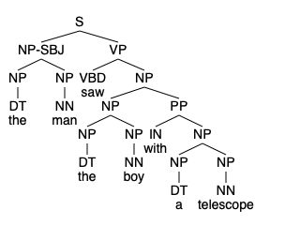
Smallest grammar for a sentence
After two parses, it explodes combinatorially:
many more than 3 parses
can you spot why?

Slide 20
Smallest grammar for a sentence
Parses: 88, # rules: 92, # lexical rules: 7
S -> NP-SBJ VP
PP -> IN NP
NP-SBJ -> NONE
NP -> DT NN
NP-SBJ -> PRP
NP -> NP PP
VP -> TO VP
NP -> NN
NP -> NONE
PP-LOC -> IN NP
ADVP -> RB
NP -> DT JJ NN
NP -> NNS
VP -> MD VP
SBAR -> WHNP S
NP -> NNP
VP -> VB NP
NP -> PRP
PP-TMP -> IN NP
SBAR -> NONE S
PP-CLR -> IN NP
NP -> NNP NNP
NP-SBJ -> DT NN
NP -> JJ NNS
NP -> NP SBAR
SBAR -> IN S
NP-SBJ -> NP PP
VP -> VBD VP
NP-SBJ -> NNP
VP -> VBD SBAR
ADVP-TMP -> RB
VP -> VBD NP
PP -> TO NP
QP -> CD CD
S -> NONE
WHNP -> WDT
NP -> DT NNS
VP -> VBZ VP
VP -> VBG NP
NP-SBJ -> NNP NNP
NP -> NP CC NP
NP -> JJ NN
NP -> PRPS NN
VP -> VP CC VP
NP -> NP PP-LOC
NP -> NP NP
VP -> VBD S
NP -> QP NONE
NP -> DT NN NN
S-NOM -> NP-SBJ VP
PRT -> RP
VP -> VBP VP
WHNP -> WP
NP -> CD
NP -> NP VP
ADJP-PRD -> JJ
VP -> VB VP
NP -> NNP POS
S -> S CC S
WHADVP -> WRB
VP -> VBN NP
NP-SBJ -> NNS
NP -> NN NNS
SBAR-ADV -> IN S
NP-SBJ -> NP NP
S-ADV -> NP-SBJ VP
NP -> CD NNS
VP -> VBN NP PP
PP -> IN NP-LGS
VP -> VBZ NP
ADVP-MNR -> RB
PP-DIR -> TO NP
WHNP -> NONE
S-TPC -> NP-SBJ VP
NP-PRD -> NP PP
NP -> CD NN
NP -> NP NN
VP -> VBZ NP-PRD
NP -> NNP NNP NNP
VP -> VBZ S
VP -> VB S
ADVP-TMP -> NONE
S -> S-TPC NP-SBJ VP
NP -> DT NN POS
NP-SBJ -> NP SBAR
SBAR -> WHADVP S
NP -> PRPS NNS
NP-SBJ -> DT NNS
S -> PP NP-SBJ VP
PP -> IN S-NOM
PP-DIR -> IN NP
NP -> DT
IN -> 'with'
DT -> 'a'
VBD -> 'saw'
DT -> 'the'
NN -> 'boy'
NN -> 'man'
NN -> 'telescope'
always look at the last rule added!

Slide 21
Smallest grammar for a sentence
Parses: 106, # rules: 97, # lexical rules: 7
S -> NP-SBJ VP
PP -> IN NP
NP-SBJ -> NONE
NP -> DT NN
NP-SBJ -> PRP
NP -> NP PP
VP -> TO VP
NP -> NN
NP -> NONE
PP-LOC -> IN NP
ADVP -> RB
NP -> DT JJ NN
NP -> NNS
VP -> MD VP
SBAR -> WHNP S
NP -> NNP
VP -> VB NP
NP -> PRP
PP-TMP -> IN NP
SBAR -> NONE S
PP-CLR -> IN NP
NP -> NNP NNP
NP-SBJ -> DT NN
NP -> JJ NNS
NP -> NP SBAR
SBAR -> IN S
NP-SBJ -> NP PP
VP -> VBD VP
NP-SBJ -> NNP
VP -> VBD SBAR
ADVP-TMP -> RB
VP -> VBD NP
PP -> TO NP
QP -> CD CD
S -> NONE
WHNP -> WDT
NP -> DT NNS
VP -> VBZ VP
VP -> VBG NP
NP-SBJ -> NNP NNP
NP -> NP CC NP
NP -> JJ NN
NP -> PRPS NN
VP -> VP CC VP
NP -> NP PP-LOC
NP -> NP NP
VP -> VBD S
NP -> QP NONE
NP -> DT NN NN
S-NOM -> NP-SBJ VP
PRT -> RP
VP -> VBP VP
WHNP -> WP
NP -> CD
NP -> NP VP
ADJP-PRD -> JJ
VP -> VB VP
NP -> NNP POS
S -> S CC S
WHADVP -> WRB
VP -> VBN NP
NP-SBJ -> NNS
NP -> NN NNS
SBAR-ADV -> IN S
NP-SBJ -> NP NP
S-ADV -> NP-SBJ VP
NP -> CD NNS
VP -> VBN NP PP
PP -> IN NP-LGS
VP -> VBZ NP
ADVP-MNR -> RB
PP-DIR -> TO NP
WHNP -> NONE
S-TPC -> NP-SBJ VP
NP-PRD -> NP PP
NP -> CD NN
NP -> NP NN
VP -> VBZ NP-PRD
NP -> NNP NNP NNP
VP -> VBZ S
VP -> VB S
ADVP-TMP -> NONE
S -> S-TPC NP-SBJ VP
NP -> DT NN POS
NP-SBJ -> NP SBAR
SBAR -> WHADVP S
NP -> PRPS NNS
NP-SBJ -> DT NNS
S -> PP NP-SBJ VP
PP -> IN S-NOM
PP-DIR -> IN NP
NP -> DT
PP-CLR -> TO NP
NP -> NN NN
S -> NP-SBJ ADVP VP
VP -> VBP NP
VP -> VBD NP-PRD
IN -> 'with'
DT -> 'a'
VBD -> 'saw'
DT -> 'the'
NN -> 'boy'
NN -> 'man'
NN -> 'telescope'

Slide 22
Smallest grammar for a sentence
Parses: 124, # rules: 155, # lexical rules: 7
S -> NP-SBJ VP
PP -> IN NP
NP-SBJ -> NONE
NP -> DT NN
NP-SBJ -> PRP
NP -> NP PP
VP -> TO VP
NP -> NN
NP -> NONE
PP-LOC -> IN NP
ADVP -> RB
NP -> DT JJ NN
NP -> NNS
VP -> MD VP
SBAR -> WHNP S
NP -> NNP
VP -> VB NP
NP -> PRP
PP-TMP -> IN NP
SBAR -> NONE S
PP-CLR -> IN NP
NP -> NNP NNP
NP-SBJ -> DT NN
NP -> JJ NNS
NP -> NP SBAR
SBAR -> IN S
NP-SBJ -> NP PP
VP -> VBD VP
NP-SBJ -> NNP
VP -> VBD SBAR
ADVP-TMP -> RB
VP -> VBD NP
PP -> TO NP
QP -> CD CD
S -> NONE
WHNP -> WDT
NP -> DT NNS
VP -> VBZ VP
VP -> VBG NP
NP-SBJ -> NNP NNP
NP -> NP CC NP
NP -> JJ NN
NP -> PRPS NN
VP -> VP CC VP
NP -> NP PP-LOC
NP -> NP NP
VP -> VBD S
NP -> QP NONE
NP -> DT NN NN
S-NOM -> NP-SBJ VP
PRT -> RP
VP -> VBP VP
WHNP -> WP
NP -> CD
NP -> NP VP
ADJP-PRD -> JJ
VP -> VB VP
NP -> NNP POS
S -> S CC S
WHADVP -> WRB
VP -> VBN NP
NP-SBJ -> NNS
NP -> NN NNS
SBAR-ADV -> IN S
NP-SBJ -> NP NP
S-ADV -> NP-SBJ VP
NP -> CD NNS
VP -> VBN NP PP
PP -> IN NP-LGS
VP -> VBZ NP
ADVP-MNR -> RB
PP-DIR -> TO NP
WHNP -> NONE
S-TPC -> NP-SBJ VP
NP-PRD -> NP PP
NP -> CD NN
NP -> NP NN
VP -> VBZ NP-PRD
NP -> NNP NNP NNP
VP -> VBZ S
VP -> VB S
ADVP-TMP -> NONE
S -> S-TPC NP-SBJ VP
NP -> DT NN POS
NP-SBJ -> NP SBAR
SBAR -> WHADVP S
NP -> PRPS NNS
NP-SBJ -> DT NNS
S -> PP NP-SBJ VP
PP -> IN S-NOM
PP-DIR -> IN NP
NP -> DT
PP-CLR -> TO NP
NP -> NN NN
S -> NP-SBJ ADVP VP
VP -> VBP NP
VP -> VBD NP-PRD
VP -> VBN S
VP -> VBZ SBAR
NP-SBJ -> NN
NP -> DT NNP
S-PRP -> NP-SBJ VP
SBAR-TMP -> IN S
S -> CC NP-SBJ VP
NP-SBJ -> DT
NP -> DT JJ NNS
VP -> VBD ADJP-PRD
NP -> CD NONE
VP -> VBN NP PP-CLR
NP-SBJ -> EX
VP -> VBP SBAR
S -> PP-TMP NP-SBJ VP
SBAR-TMP -> WHADVP S
NP-ADV -> DT NN
VP -> VB
NP -> DT ADJP NN
VP -> MD RB VP
ADJP -> RB JJ
VP -> VBZ ADJP-PRD
NP -> NNP NNP POS
S -> ADVP NP-SBJ VP
NP-SBJ -> DT JJ NN
SINV -> S-TPC VP NP-SBJ
VP -> VBG S
NP -> NP NP-ADV
S -> S S
VP -> VBN VP
NP -> PRPS JJ NN
NP -> DT JJ NN NN
NP-SBJ -> JJ NNS
S -> NP-SBJ ADVP-TMP VP
NP -> DT NNP NNP
NP -> DT NNP NN
NP -> QP NNS
VP -> VB NP PP
VP -> VB SBAR
ADJP -> JJ
VP -> VBD RB VP
S -> SBAR-ADV NP-SBJ VP
NP -> JJ NN NNS
S -> PP-LOC NP-SBJ VP
NP-SBJ -> NP PP-LOC
NP-SBJ -> PRPS NN
PP-PRD -> IN NP
NP -> DT JJ JJ NN
ADJP-PRD -> JJ PP
NP -> NP PP PP
VP -> VB ADJP-PRD
SBAR-PRP -> IN S
VP -> VB PP-CLR
VP -> VBD
VP -> VBP RB VP
NP-SBJ -> NN NNS
VP -> VBP S
VP -> VBD NP PP
DT -> 'a'
NN -> 'boy'
VBD -> 'saw'
DT -> 'the'
IN -> 'with'
NN -> 'man'
NN -> 'telescope'

Slide 23
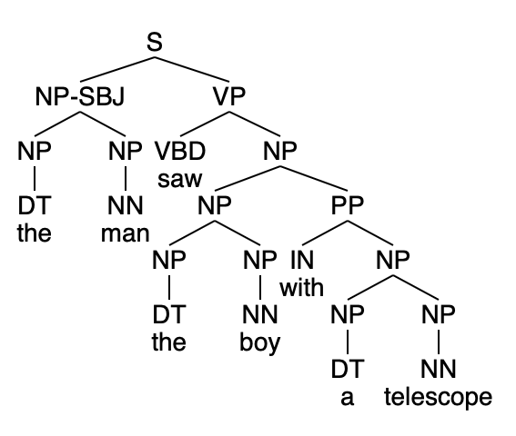
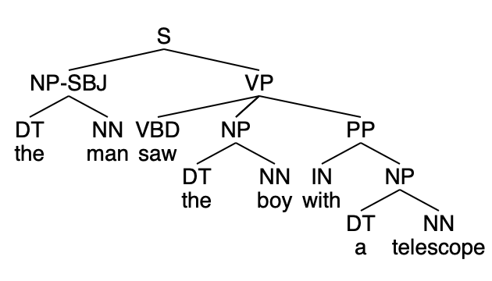
Smallest grammar for a sentence
Finally, we get the parse we wanted!

Slide 24
Smallest grammar for a sentence
plus a whole bunch of similar ones …
(S
(NP-SBJ (DT the) (NN man))
(VP
(VBD saw)
(NP (NP (DT the)) (NN boy))
(PP (IN with) (NP (NP (DT a)) (NN telescope)))))
(S
(NP-SBJ (DT the) (NN man))
(VP
(VBD saw)
(NP (NP (DT the)) (NN boy))
(PP (IN with) (NP (DT a) (NN telescope)))))
(S
(NP-SBJ (DT the) (NN man))
(VP
(VBD saw)
(NP (NP (DT the)) (NN boy))
(PP (IN with) (NP (NP (DT a)) (NP (NN telescope))))))
(S
(NP-SBJ (DT the) (NN man))
(VP
(VBD saw)
(NP (DT the) (NN boy))
(PP (IN with) (NP (NP (DT a)) (NN telescope)))))
(S
(NP-SBJ (DT the) (NN man))
(VP
(VBD saw)
(NP (DT the) (NN boy))
(PP (IN with) (NP (DT a) (NN telescope)))))

