Slide 1
LING/C SC 581:
Advanced Computational Linguistics
Lecture 22
Prof. Sandiway Fong

Slide 2
Today's Topic
Homework 10 Review
  in particular, the Extra Credit part
Follow-up to Homework 10
  Language Acquisition
  a look at the Childes Database wrt. frames of break
  compare with PTB

Slide 3
Catalog break verb frames: T1
Collect signature strings into a list, count the number of occurrences.
>>> break_sigs
['break ADVP SBAR', 'break NP', 'break PP SBAR', 'break PRT PP', 'break PRT', 'break NP', 'break PRT NP', 'break NP', 'break', 'break , SBAR', 'break PRT', 'break PP', 'break PRT NP', 'break NP PP', 'break NP', 'break PRT NP', 'break PRT ADVP', 'break ADVP PP', 'break S', 'break PP', 'break PP ADVP', 'break NP PP', 'break NP', 'break PP', 'break NP', 'break PRT PP , PP', 'VBP CC break NP PP', 'break NP', "`` break '' CONJP VBZ SBAR", 'break PP ADVP', 'break PRT NP', 'break PRT PP ADVP', 'break ADVP', 'break ADVP', 'break NP', 'break NP PRT', 'break PP', 'break PP', 'break NP', 'break PRT NP PP', 'break NP ADVP', 'break NP S', 'break PP', 'ADVP break PRT ADVP', 'break NP ADVP', 'break NP PP', 'break NP', 'break NP', 'break PP , S', 'break PRT', 'break PRT PP SBAR', 'break NP', 'break NP', 'break NP', 'break PP PP', 'break NP', 'break PP', 'break NP', 'break NP', 'break ADVP', 'break NP PRT', 'break PP , S', 'break PP PP', 'break NP PP', 'break S PP , VP', 'break PP PP', 'break PP', 'break NP PP', 'break NP', 'break PP NP', 'break PRT , S', 'break PRT PP', 'break PRT ADVP : `` NP', 'break ADVP', 'break NP', 'break NP PP', 'break NP S , S', 'break NP PP', 'break PRT NP', 'break PRT , S', 'break PRT PP', 'break NP PP', 'ADVP break NP', 'break NP', 'break PRT S', 'break ADVP NP PP', 'break NP', 'break NP', 'break ADVP', 'break NP ADVP', 'break PRT', 'break NP', 'break NP', 'break', 'break ADVP PP SBAR ADVP', 'break', 'break NP', 'break NP', 'break NP NP', 'break PRT NP', 'break NP', 'break PRT PP', 'break NP ADVP', 'break PP PP', 'break PP PP', 'break PRT NP , SBAR', 'break PRT NP PP', 'break PP', 'break PP , S', 'break PP', 'break PRT NP', 'break NP SBAR', 'break NP', 'break NP', "break ADVP '' PP", 'break PP , S', 'break NP', 'break NP', 'ADVP break NP S', 'break NP', 'break PRT PP', 'ADVP break ADVP PP', 'break NP NP', 'break PRT NP', 'break PRT', 'break PRT ADVP', 'break NP', 'break ADVP', 'break NP', 'break NP', 'break ADVP PP', 'break PRT NP PP', 'break NP SBAR', 'break ADVP', 'break NP SBAR', 'break NP', 'break NP', 'break ADVP PP', 'break NP', 'break PRT NP', 'break PRT NP', 'break', 'ADVP break ADJP NP , SBAR', 'break', 'break ADVP PP PP', 'break PRT', 'break PRT NP ADVP', 'break', 'break PRT NP', 'break PRT', 'break PRT NP', 'break PRT NP', 'ADVP break ADVP PP', 'break ADVP ADVP', 'break NP', 'break NP PP', 'RB VB CC break NP', 'break PRT', 'break NP PP', 'break PRT NP SBAR', 'break PRT', 'break NP PP', 'break NP', 'break PRT NP', 'break PP', 'break NP', 'break NP PP', 'break PRT NP', 'break PP', 'break NP', 'break PRT NP PP , S', 'break PRT', 'break PRT NP SBAR', 'break NP , S', 'break NP', 'break PRT', 'break PRT NP', 'break PP S', 'break PRT', 'break NP', 'break S', 'break PRT NP', 'break PP', 'break NP S', 'break PRT PP', 'break ADVP', 'break NP ADVP', 'break NP', 'break NP PP', 'break NP', 'break NP ADVP', 'break NP', 'break NP PP', 'break NP', 'break NP', 'break NP', 'break NP', 'break PP', 'break PRT UCP', 'break PRT', 'break NP PP', 'break ADJP PP', 'break NP', 'break PRT PP', 'break PP', 'break ADVP', 'break NP', 'ADVP break ADVP', 'break PRT ADVP', 'break NP PP', 'break PRT NP S', 'break PRT PP', 'break PRT PP', 'break PRT NP', 'break NP', 'break PP', 'break PP ADVP ADVP', 'break ADVP', 'break NP PP', 'break NP', 'break PRT PP', 'break PRT', 'break PP SBAR', 'break PRT NP ADVP PP , SBAR']

Slide 4
Catalog break verb frames: T2-T3
>>> import nltk
>>> fd = nltk.FreqDist(break_sigs)
>>> fd
FreqDist({'break NP': 55, 'break PRT NP': 18, 'break NP PP': 17, 'break PP': 16, 'break PRT': 14, 'break PRT PP': 10, 'break ADVP': 10, 'break': 6, 'break NP ADVP': 6, 'break PP PP': 5, ...})
>>> fd.most_common(10)
[('break NP', 55), ('break PRT NP', 18), ('break NP PP', 17), ('break PP', 16), ('break PRT', 14), ('break PRT PP', 10), ('break ADVP', 10), ('break', 6), ('break NP ADVP', 6), ('break PP PP', 5)]

Slide 5
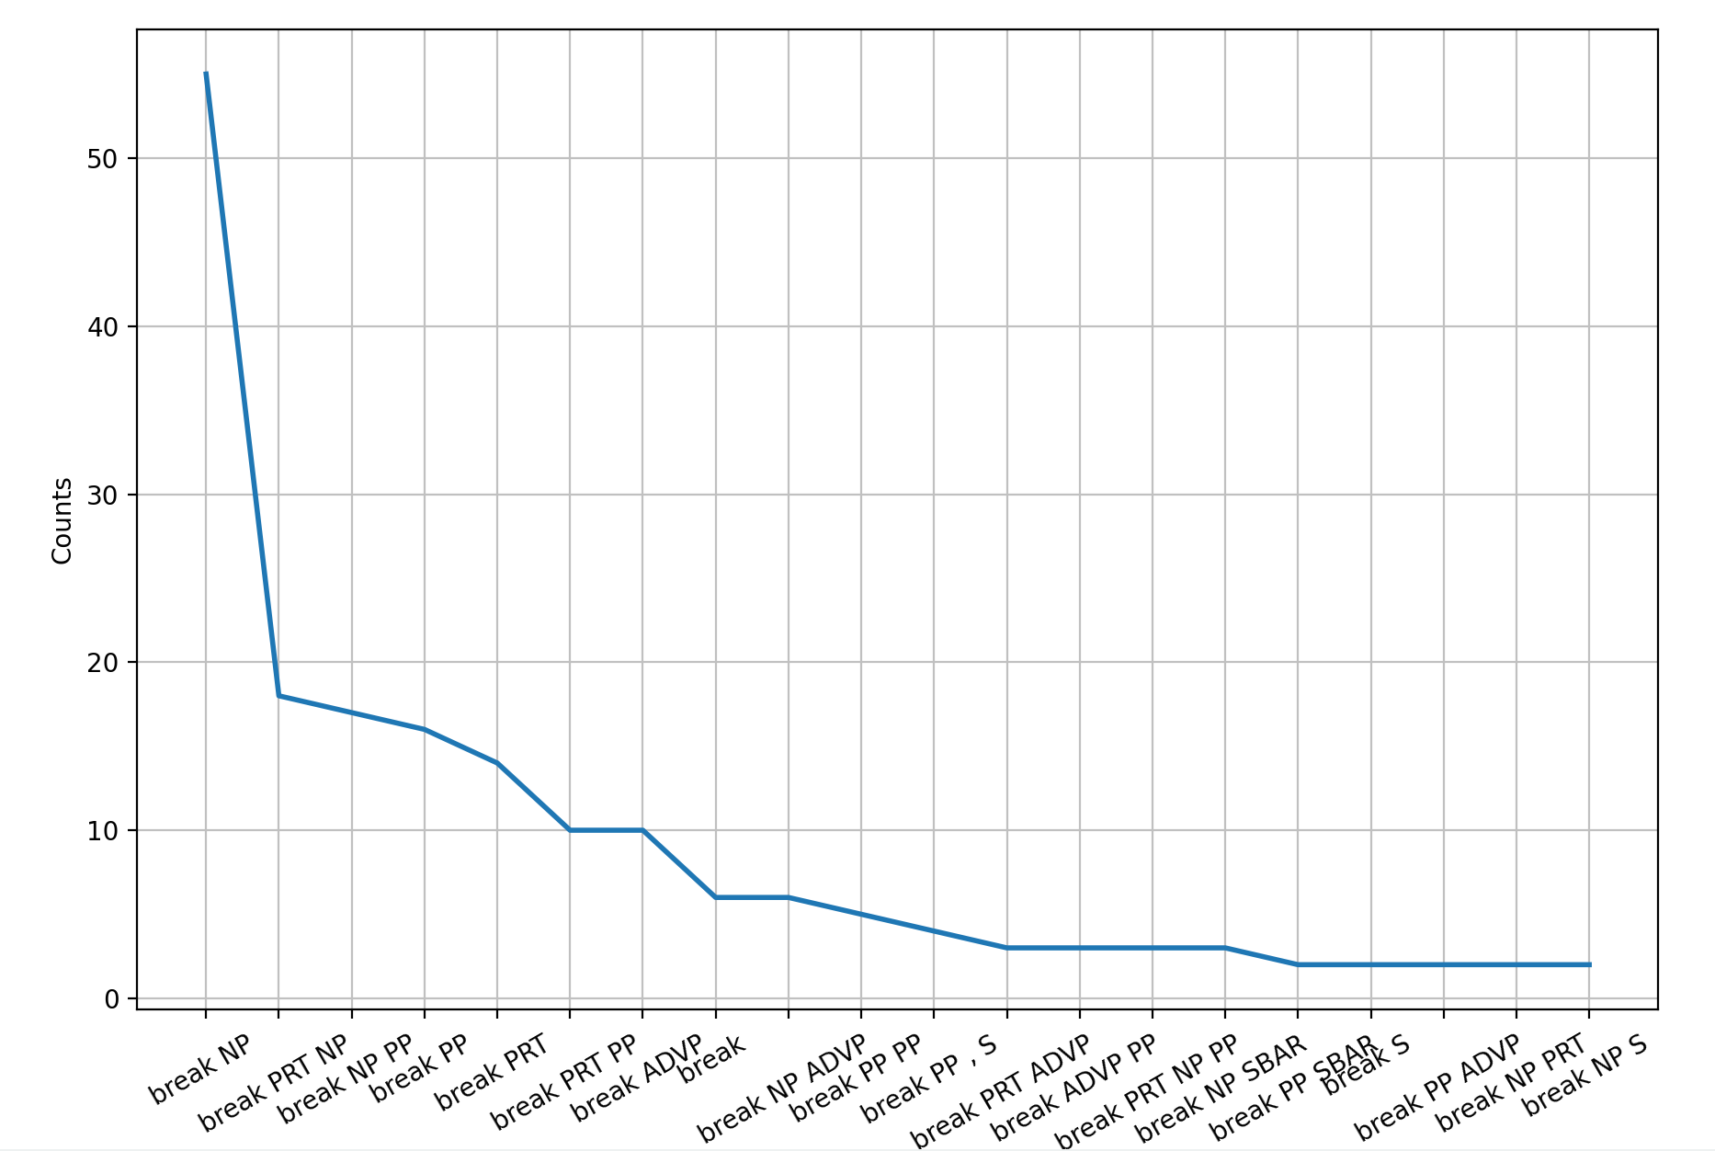
Catalog break verb frames: T4
>>> fd.plot(20)
<Axes: xlabel='Samples', ylabel='Counts'>
>>> plt.xticks(rotation=30)
…
>>> plt.show()
30º means more room

Slide 6
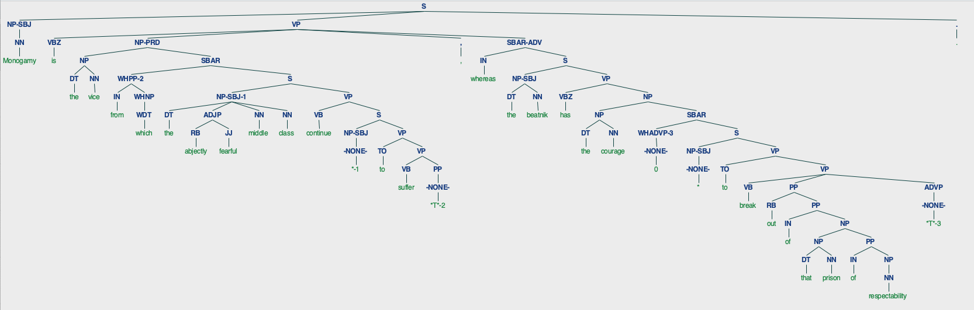
Find all break verb frames
what is this?
23 break/VB PP *T*-3/ADVP
>>> break_trees[23].draw()

Slide 7
Homework 10: Part 2
Extra Credit Task 5:
  Use the Stanza parser in nltk to parse the PTB break sentences
  Compare the distribution of verb frame signature strings to that obtained from the PTB.

Slide 8
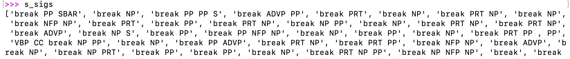
Homework 10: Part 2
Workflow:
$ python3 -i hw10ec.py
13 (s), sents: 244 initialize pipeline, extracts sentences
93 (s), stanza_trees: 244 parse sentences
s_fs: 236 get all frames
s_vfs: 216 limit to verb frames only
s_sigs: 216 convert to signatures

Slide 9
Homework 10: Part 2
>>> s_sigs
['break PP SBAR', 'break NP', 'break PP PP S', 'break ADVP PP', 'break PRT', 'break NP', 'break PRT NP', 'break NP', 'break NFP NP', 'break PRT', 'break PP', 'break PRT NP', 'break NP PP', 'break NP', 'break PRT NP', 'break PRT NP', 'break ADVP', 'break NP S', 'break PP', 'break PP NFP NP', 'break NP', 'break PP', 'break NP', 'break PRT PP , PP', 'VBP CC break NP PP', 'break NP', 'break PP ADVP', 'break PRT NP', 'break PRT PP', 'break NFP NP', 'break ADVP', 'break NP', 'break NP PRT', 'break PP', 'break PP', 'break NP', 'break PRT NP PP', 'break NP NFP NP', 'break', 'break PP', 'break PRT ADVP', 'break NP NFP NNP CD', 'break NP PP', 'break NP PP', 'break', 'break PP , SYM S', 'break ADVP', 'break PRT PP SBAR', 'break NP', 'break NP', 'break NFP NP', 'break PP PP', 'break NP', 'break', 'break PRT PP', 'break NP', 'break NP', 'break PRT', 'break NP PRT', 'break PP', 'break PP , PP NFP PP , PP', 'break NP PP', 'break NP PP , S', 'break PP PP', 'break PP', 'break NP PP', 'break NP', 'break PP NP', 'break PRT , S', 'break PRT PP', 'break PRT NP', 'break PP', 'break NP', 'break NFP PP', 'break NP NP , S', 'break NP PP', 'break PRT NP', 'break PRT , S', 'break PRT PP', 'break NP PP', 'break NP', 'break NP', 'break PRT NP', 'break PRT NP NFP NP', 'break NP PP', 'break', 'break NP', 'break NP NP', 'break PRT', 'break NP', 'break NP', "`` break '' ''", 'break ADVP PP S', 'break PP', 'break NP', 'break NP NP', 'break PRT NP', 'break NP', 'break PRT PP', 'break NP ADJP', 'break PP PP', 'break PRT NP , SBAR', 'break PRT NP PP', 'break PP', 'break PP', 'break PP', 'break PRT NP', 'break NP', 'break NP', 'break ADVP', 'break PP , NFP S', 'break NP', 'break NP', 'break NP NP S', 'break NP', 'break ADVP PP', 'break ADVP PP', 'break NP NP', 'break PRT NP', 'break PRT', 'break PRT ADVP', 'break NP', 'break ADVP', 'break NP', 'break NP', 'break PRT NP PP', 'break NP SBAR', 'break ADVP', 'break NP SBAR', 'break NP', 'break NP NFP NP', 'break ADVP PP', 'break NP', 'break PRT NP', 'break PRT NP', 'break', 'break ADVP NP , SBAR', 'break', 'break ADVP PP PP', 'break PRT', 'break PRT NP ADVP', 'break', 'break PRT NP', 'break PRT', 'break PRT NP', 'break PRT NP', 'break ADVP', 'break NP', 'break NP PP', 'VB CC break NP', 'break PRT', 'break NFP PP NFP NP', 'break PRT NP SBAR', 'break PRT', 'break NP PP', 'break NP', 'break PRT NP', 'break PP', 'break NP NP', 'break NP PP', 'break PRT NP', 'break PP', 'break NFP NP', 'break PRT NP PP', 'break PRT', 'break PRT NP SBAR', 'break NP , NFP S', 'break', 'break PRT', 'break PRT NP', 'break PP S', 'break PRT', 'break NP', 'break ADVP', 'break PRT NP', 'break PP', 'break PRT PP', 'break ADVP', 'break NP PP', 'break NP', 'break NP PP', 'break NP', 'break NP ADVP', 'break NP', 'break', 'break NP', 'break', 'break NP', 'break NP', 'break PP', 'break PRT SBAR : NP', 'break PRT', 'break NP PP', 'break ADJP PP', 'break NP', 'break PRT PP', 'break PP', '`` break ADVP CC VP', 'break NP', 'break ADVP', 'break PRT ADVP', 'break NP PP', 'break PRT NP NP S', 'break PRT NFP NP', 'break PRT PP', 'break PRT NP', 'break NP', 'break PP', 'break PP ADVP NFP NP', 'break NP', 'break NP PP', 'break NP', 'break PRT PP', 'break PRT', 'break PP SBAR', 'break PRT NP PP']

Slide 10
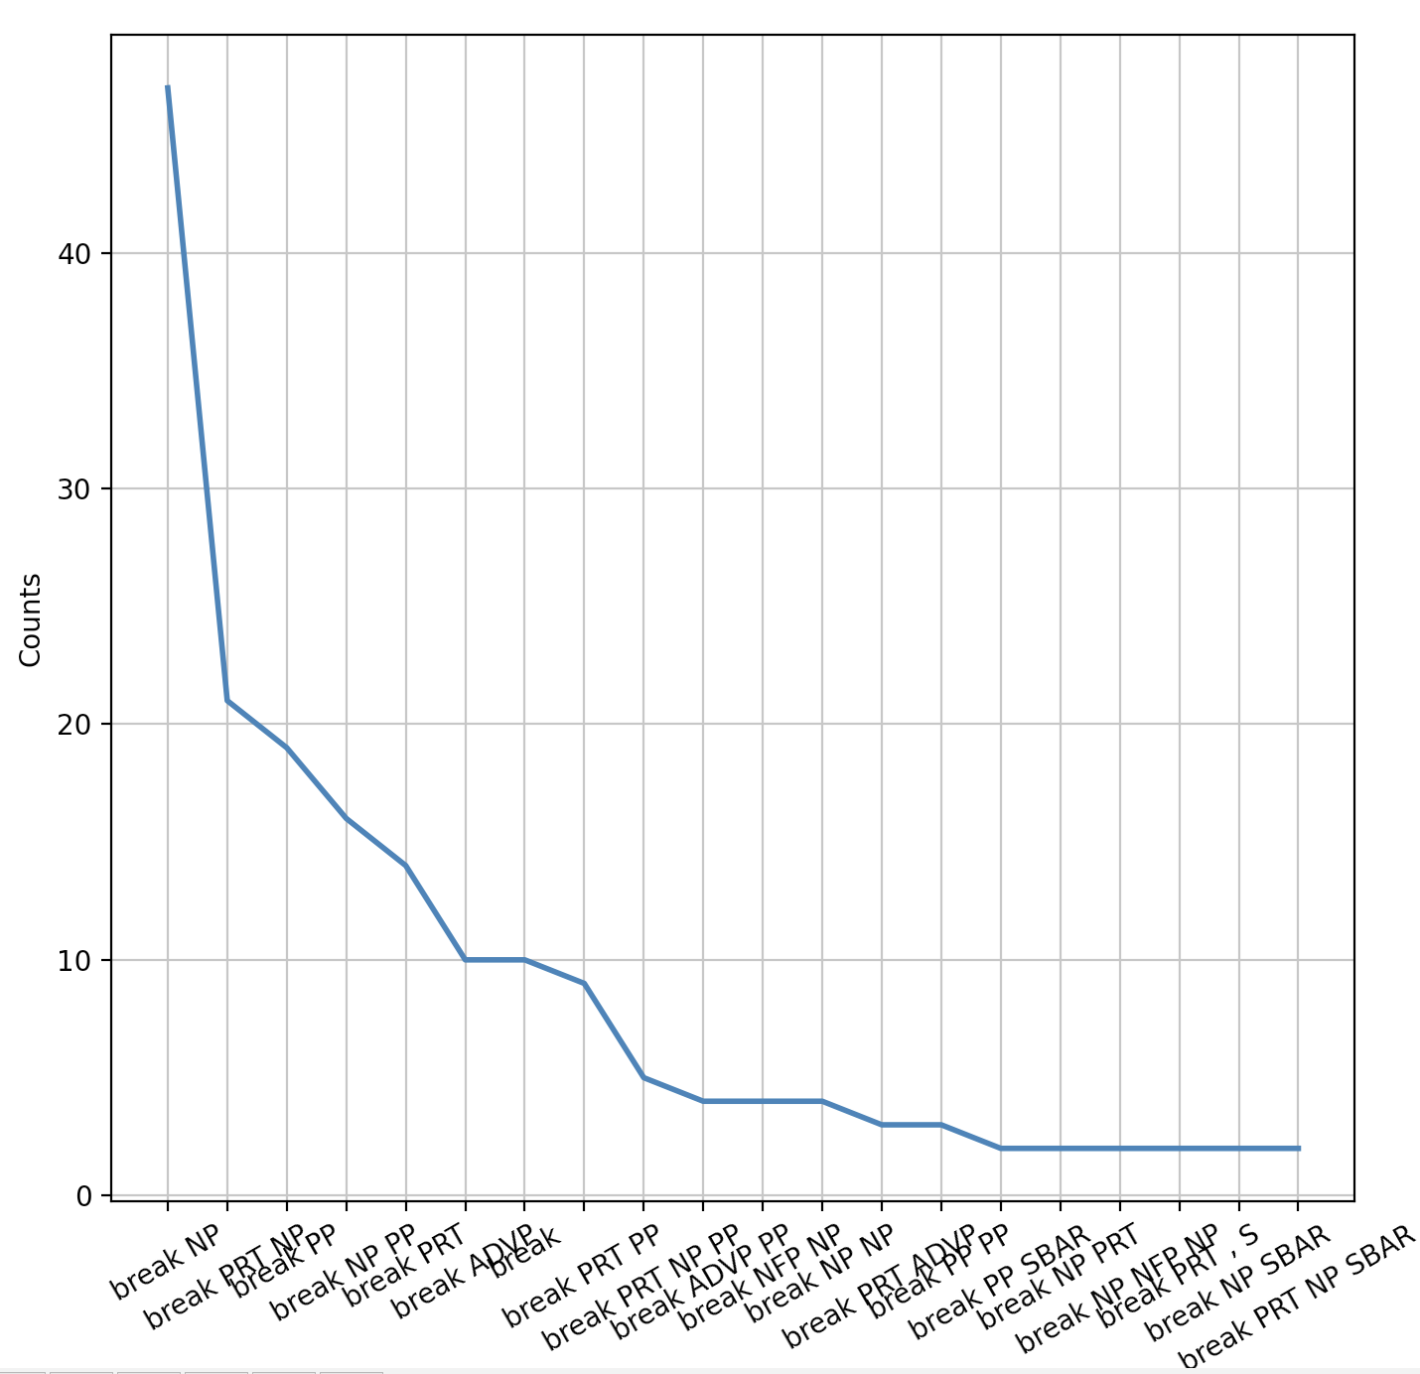
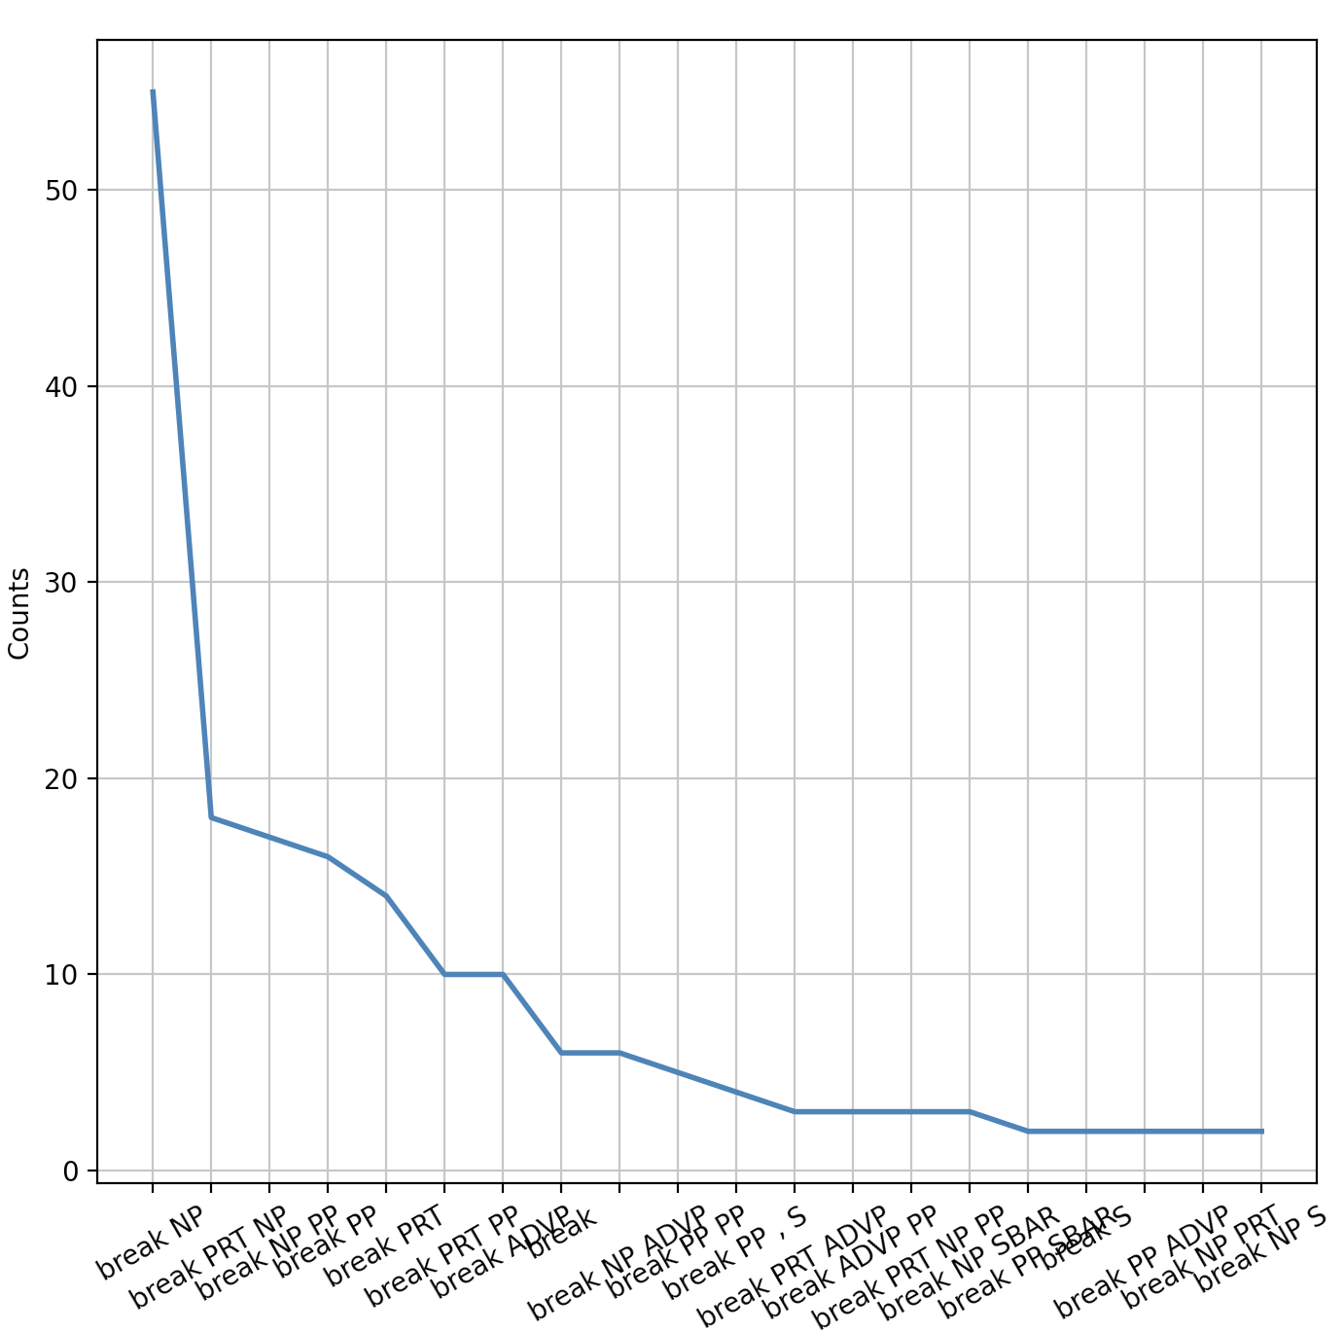
Homework 10: Part 2

Slide 11
Homework 10: Part 2
>>> fd = nltk.FreqDist(s_sigs)
>>> fd
FreqDist({'break NP': 47, 'break PRT NP': 21, 'break PP': 19, 'break NP PP': 16, 'break PRT': 14, 'break ADVP': 10, 'break': 10, 'break PRT PP': 9, 'break PRT NP PP': 5, 'break ADVP PP': 4, ...})
>>> fd.most_common(10)
[('break NP', 47), ('break PRT NP', 21), ('break PP', 19), ('break NP PP', 16), ('break PRT', 14), ('break ADVP', 10), ('break', 10), ('break PRT PP', 9), ('break PRT NP PP', 5), ('break ADVP PP', 4)]
>>> fd = nltk.FreqDist(break_sigs)
>>> fd
FreqDist({'break NP': 55, 'break PRT NP': 18, 'break NP PP': 17, 'break PP': 16, 'break PRT': 14, 'break PRT PP': 10, 'break ADVP': 10, 'break': 6, 'break NP ADVP': 6, 'break PP PP': 5, ...})
>>> fd.most_common(10)
[('break NP', 55), ('break PRT NP', 18), ('break NP PP', 17), ('break PP', 16), ('break PRT', 14), ('break PRT PP', 10), ('break ADVP', 10), ('break', 6), ('break NP ADVP', 6), ('break PP PP', 5)]

Slide 12
Language Acquisition
What exposure do kids get for verb frames for break ?
  Compared to the variety attested in the PTB?
    Compared to that in WordNet
      Compared to that in the OED
General Q:
  how do we acquire the variety of verb frames we see?
  let's take a look at the Childes Database wrt. frames of break
  and compare with PTB

Slide 13
Revisiting the verb break
Big unanswered question:
  why does break have so many different senses?
Is the data out there rich?
ptb corpus:
  ptb = Brown + Wall Street Journal (1.7m words)
  73K sentences: 244 with break used in a verb frame (VP)
  121 different verb frames
Childes database:
  non-parsed: we'll parse them
  231 with break used in a verb frame
  22 different verb frames
We can compare the ptb to what children hear or produce

Slide 14
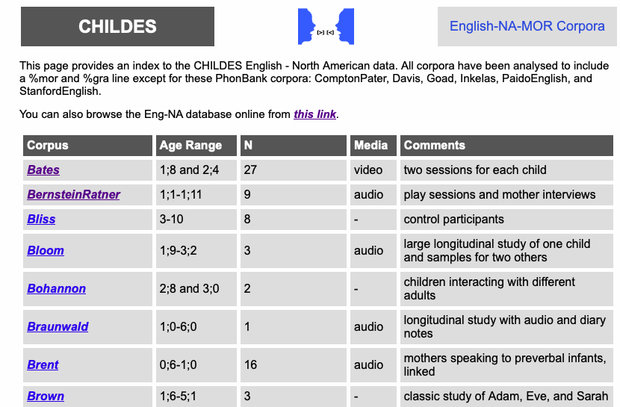
Childes Database
https://childes.talkbank.org/access/Eng-NA/

Slide 15
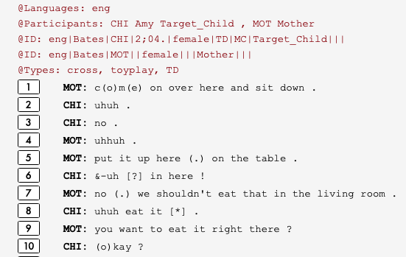
Childes Database
Data is unparsed, but we want to find verb frames!
Note: similarly, HW10 EC Part
Break:
break&PAST,81,Section10.6 Section40.8.3 Section45.1 Section48.1.1 , car broke ?, what kind of car broke ?, you broke your horn ., see where you broke your horn ?, yes (.) you broke it ., yes (.) you fell down and broke your horn (.) didn't you ?, you put them in your bank (.) remember and it broke your bank ?, he broke his bank and he's showing it to you ., but Adam broke the wagon (.) didn't he ?, oh (.) broke a pencil ., he broke ?, he broke his leg ?, you broke another wheel ., I think you broke it ., I don't know why you broke it ., you fell and broke your head ., maybe it broke (.) Adam ., maybe Robin broke that one ., you broke another one ?, you broke it (.) didn't you ?, you broke that thing off ?, you broke it ., yes (.) you broke it ., because you broke it .

Slide 16
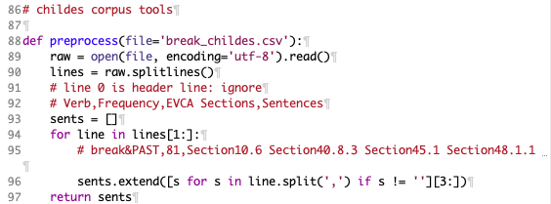
Childes Database
File: break_childes.csv
preprocess(): grab examples from csv file

Slide 17
Childes Database
>>> sents
[' car broke ?', ' what kind of car broke ?', ' you broke your horn .', ' see where you broke your horn ?', ' yes (.) you broke it .', " yes (.) you fell down and broke your horn (.) didn't you ?", ' you put them in your bank (.) remember and it broke your bank ?', " he broke his bank and he's showing it to you .", " but Adam broke the wagon (.) didn't he ?", ' oh (.) broke a pencil .', ' he broke ?', ' he broke his leg ?', ' you broke another wheel .', ' I think you broke it .', " I don't know why you broke it .", ' you fell and broke your head .', ' maybe it broke (.) Adam .', ' maybe Robin broke that one .', ' you broke another one ?', " you broke it (.) didn't you ?", ' you broke that thing off ?', ' you broke it .', ' yes (.) you broke it .', ' because you broke it .', " I don't know why he broke his leg .", ' you broke the boat .', ' I think you broke it .', ' the milk broke too .', " I think you broke these off the horse (.) didn't you ?", ' Adam (.) I think Mommy broke the dolly .', ' broke the leg off .', ' Jack fell down and broke his crown .', " I don't know who broke it .", ' it broke ?', ' it broke ?', ' it looks like it broke .', ' she looked at this yesterday and kept saying (.) â\x80\x9cshoe brokeâ\x80\x9d +...', " yes (.) â\x80¡ captain's boot broke .", ' yes (.) â\x80¡ the ping+pong broke .', ' it broke ?', " Pap'll have_to fix the box (.) (be)cause it broke .", ' you broke it .', ' remember when you broke my glasses ?', " I broke my cream pitcher so I'll just give it to you .", ' it broke (.) yeah .', ' &hmm ?', ' &hmm ?', ' you broke it (.) yeah .', ' right there (.) see where you broke it .', ' who broke that ?', ' see (.) he sat on the house and he broke it all down .', ' you broke it .', " I don't know why you broke it (.) you broke it .", … ' if you bounce it (.) you break it .', " you'll break it .", " no (.) you'll break your neck carryin(g) that .", " Sarah (.) don't break [?] .", " you're gonna break your neck ."]

Slide 18
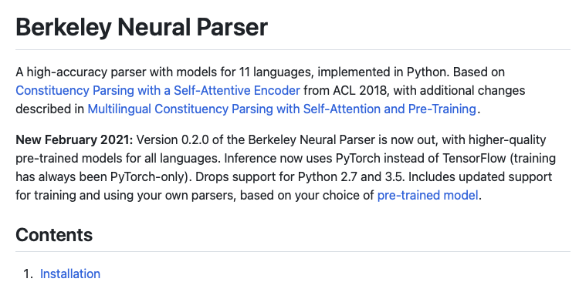
Constituency Parser
We could use Stanza with nltk (as in HW10 EC)
or we could use in nltk / spaCy the Berkeley Neural Parser
https://github.com/nikitakit/self-attentive-parser

Slide 19
benepar
$ pip3 install benepar
Collecting benepar
Downloading benepar-0.2.0.tar.gz (33 kB)
Requirement already satisfied: benepar in /Library/Frameworks/Python.framework/Versions/3.13/lib/python3.13/site-packages (0.2.0)
Collecting spacy>=2.0.9 (from benepar)
Collecting torch>=1.6.0 (from benepar)
Collecting torch-struct>=0.5 (from benepar)
Collecting tokenizers>=0.9.4 (from benepar)
Collecting transformers>=4.2.2 (from transformers[tokenizers,torch]>=4.2.2->benepar)
Collecting protobuf (from benepar)
Collecting sentencepiece>=0.1.91 (from benepar)
…
Successfully installed MarkupSafe-2.1.5 accelerate-0.29.3 annotated-types-0.6.0 benepar-0.2.0 blis-0.7.11 catalogue-2.0.10 certifi-2024.2.2 charset-normalizer-3.3.2 cloudpathlib-0.16.0 confection-0.1.4 cymem-2.0.8 filelock-3.13.4 fsspec-2024.3.1 huggingface-hub-0.22.2 idna-3.7 jinja2-3.1.3 langcodes-3.4.0 language-data-1.2.0 marisa-trie-1.1.0 mpmath-1.3.0 murmurhash-1.0.10 networkx-3.3 packaging-24.0 preshed-3.0.9 protobuf-5.26.1 psutil-5.9.8 pydantic-2.7.1 pydantic-core-2.18.2 pyyaml-6.0.1 requests-2.31.0 safetensors-0.4.3 sentencepiece-0.2.0 setuptools-69.5.1 smart-open-6.4.0 spacy-3.7.4 spacy-legacy-3.0.12 spacy-loggers-1.0.5 srsly-2.4.8 sympy-1.12 thinc-8.2.3 tokenizers-0.19.1 torch-2.3.0 torch-struct-0.5 transformers-4.40.1 typer-0.9.4 typing-extensions-4.11.0 urllib3-2.2.1 wasabi-1.1.2 weasel-0.3.4

Slide 20
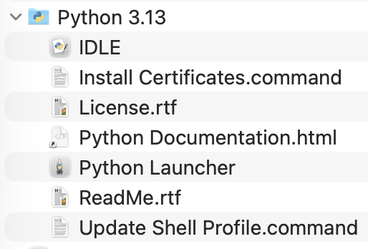
benepar
>>> import benepar
>>> benepar.download('benepar_en3')
[nltk_data] Error loading benepar_en3: <urlopen error [SSL:
[nltk_data] CERTIFICATE_VERIFY_FAILED] certificate verify failed:
[nltk_data] unable to get local issuer certificate (_ssl.c:1018)>
False
macOS: /Applications/Python 3.13
works on one mac I have but not the other!
~$ /Applications/Python\ 3.13/Install\ Certificates.command ; exit;
-- pip install --upgrade certifi
Requirement already satisfied: certifi in /Library/Frameworks/Python.framework/Versions/3.13/lib/python3.13/site-packages (2024.12.14)
Collecting certifi
Downloading certifi-2026.2.25-py3-none-any.whl.metadata (2.5 kB)
Downloading certifi-2026.2.25-py3-none-any.whl (153 kB)
Installing collected packages: certifi
Attempting uninstall: certifi
Found existing installation: certifi 2024.12.14
Uninstalling certifi-2024.12.14:
Successfully uninstalled certifi-2024.12.14
Successfully installed certifi-2026.2.25

Slide 21
benepar vs stanza
import nltk
import benepar
# benepar.download('benepar_en3')
import spacy
nlp = spacy.load('en_core_web_md')
nlp.add_pipe("benepar", config={"model": "benepar_en3"})
doc = nlp(sents)
sent = list(doc.sents)[0]
tree = nltk.Tree.fromstring(sent._.parse_string)
import nltk
import stanza
# stanza.download('en')
nlp = stanza.Pipeline(lang='en', processors='tokenize,pos,constituency')
nlp(sent). sentences[0].constituency

Slide 22
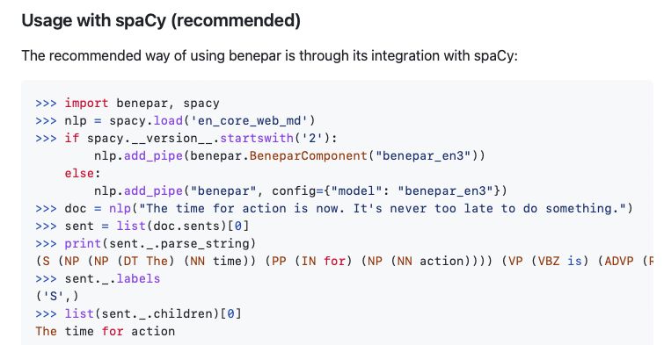
spaCy: benepar usage

Slide 23
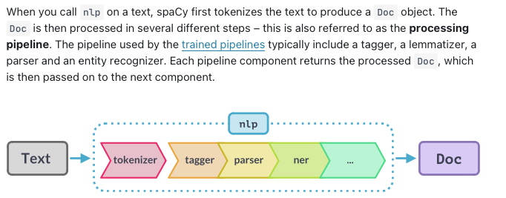
spaCy pipeline
Installation via pip: https://spacy.io/usage
benepar

Slide 24
benepar
$ python3 -i break_childes.py
verbforms: {'broken', 'breaks', 'breaking', 'break', 'broke'}
loaded Childes data: 238 sentences
benepar failed for << you broke your horn .>>
benepar failed for << you put them in your bank (.) remember and it broke your bank ?>>
benepar failed for << I think you broke it .>>
benepar failed for << you fell and broke your head .>>
benepar failed for << because you broke it .>>
benepar failed for << I think you broke it .>>
benepar failed for << I think you broke these off the horse (.) didn't you ?>>
benepar failed for << broke the leg off .>>
benepar failed for << she looked at this yesterday and kept saying (.) âshoe brokeâ +...>>
benepar failed for << I broke my cream pitcher so I'll just give it to you .>>
benepar failed for << who broke that ?>>
benepar failed for << I broke it .>>
benepar failed for << who broke it ?>>
benepar failed for << broke her front tooth .>>
benepar failed for << you know you broke it .>>
benepar failed for << broke it .>>
benepar failed for << who broke it ?>>
benepar failed for << broke her heart .>>
benepar failed for << (a)n(d) you didn't break any (.) huh ?>>
Benepar VP frames (benepar_vfs): 215
fd2: Childes verb frame distribution: total: 215, types: 16

Slide 25
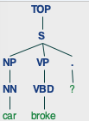
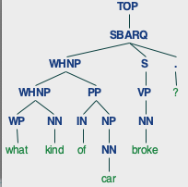
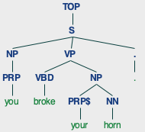
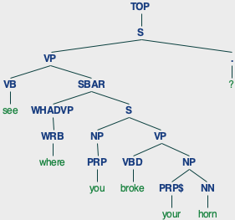
Childes Database: nltk tokenization 1
>>> wtl = tokenize(preprocess())
>>> len(wtl)
236
parser = benepar.Parser("benepar_en3")
>>> for wt in wtl[:10]:
... parse(wt).draw()
no subj, no obj under S
broke verb is NN!

Slide 26
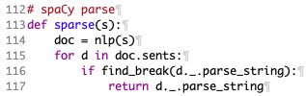
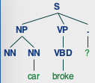
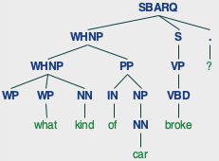
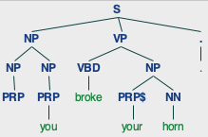
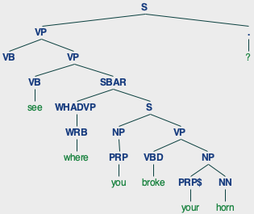
Childes Database: spacy tokenization 1
>>> sents = preprocess()
>>> for s in sents:
... Tree.fromstring(sparse(s)).draw()
no subj, no obj under S
but verb is VBD now!
spaCy is better than nltk

Slide 27
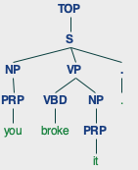
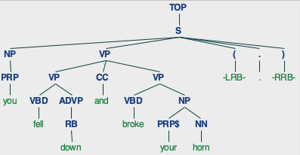
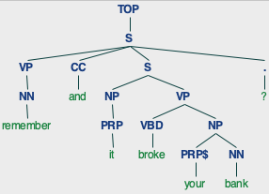
Childes Database: nltk tokenization 2

Slide 28
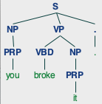
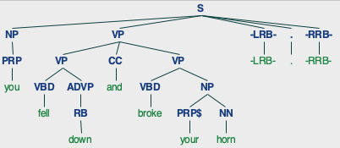
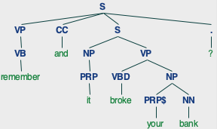
Childes Database: spacy tokenization 2

Slide 29
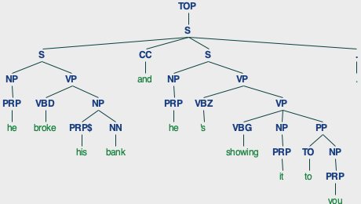
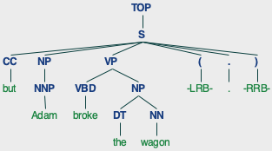
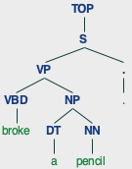
Childes Database: nltk tokenization 3

Slide 30
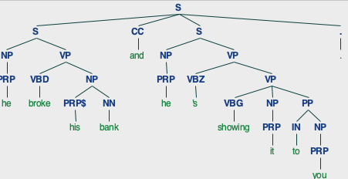
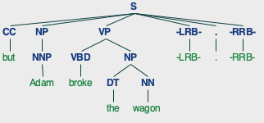
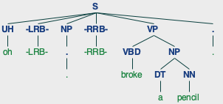
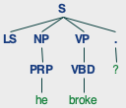
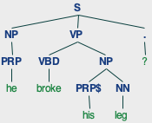
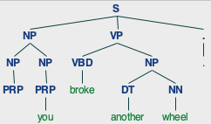
Childes Database: spacy tokenization 3

Slide 31
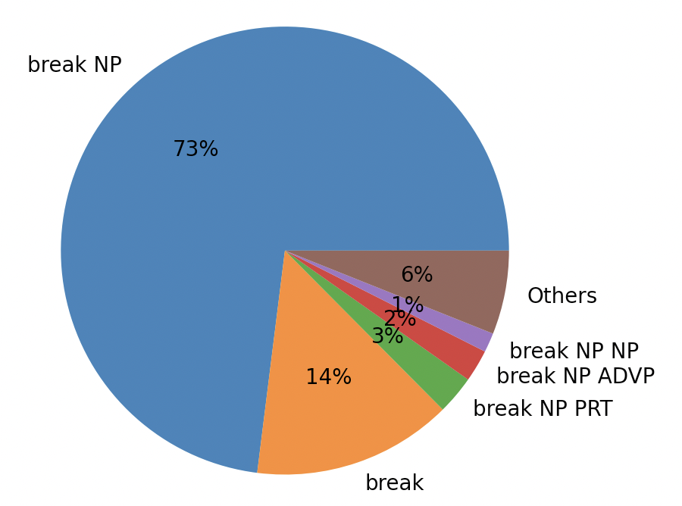
Childes Database: frame distribution

Slide 32
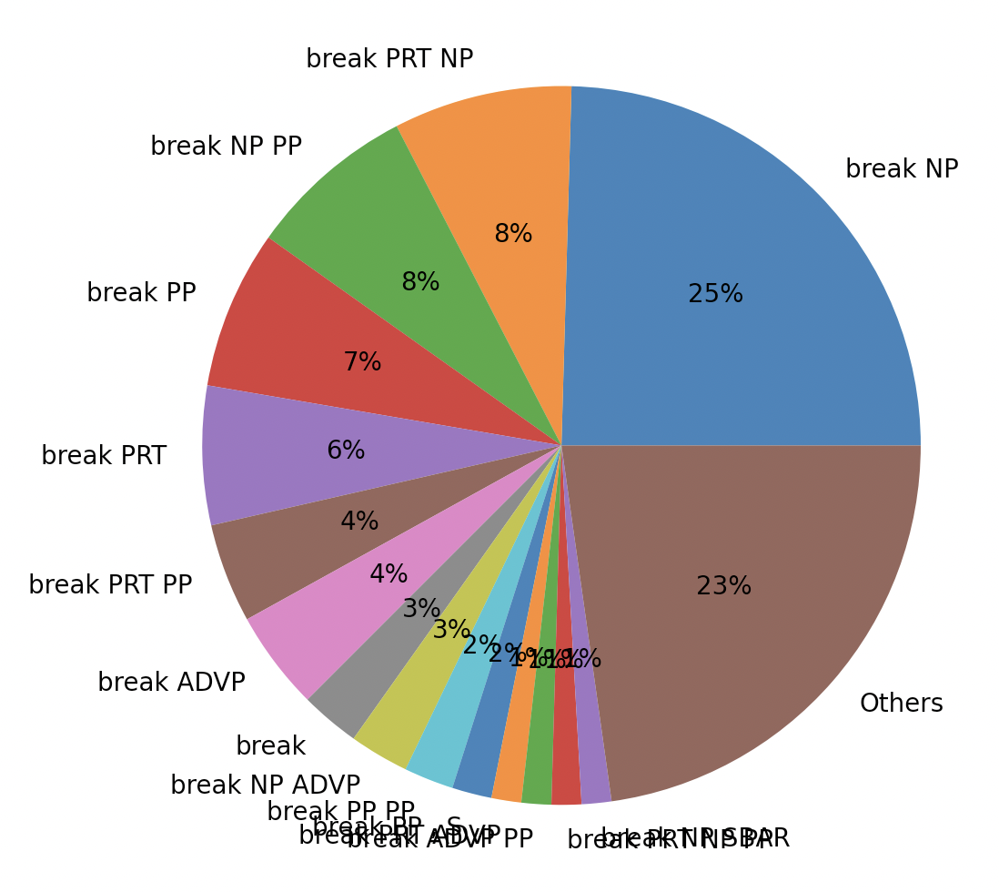
Break verb frames
Childes database
ptb

Slide 33
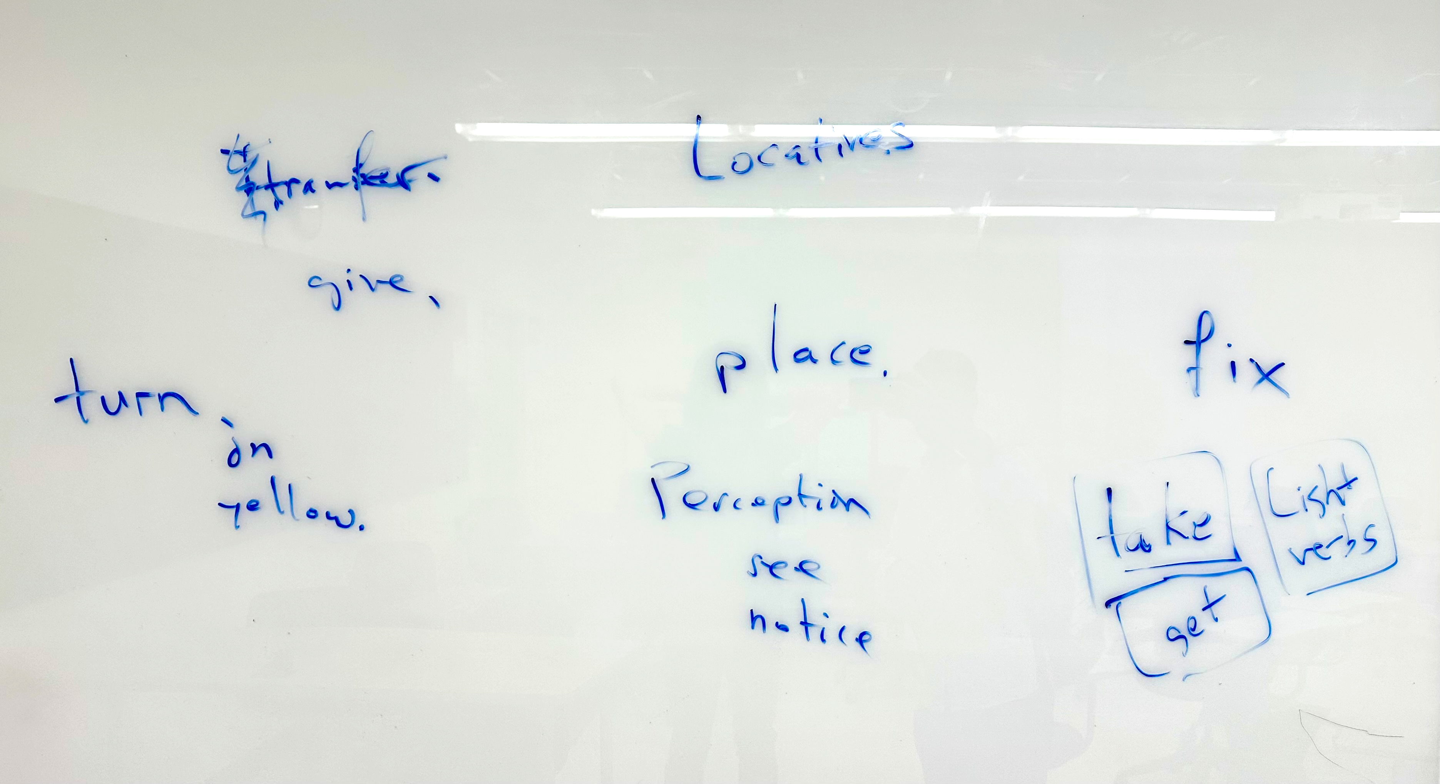
What other verbs? Class discussion

