Slide 1
LING/C SC 581: Advanced Computational Linguistics
Lecture 21
Prof. Sandiway Fong

Slide 2
Today's Topic
Case study (contd.):
looking at the verb frames of break
continue our live programming
Homework 10
you get to finish off the programming tasks!

Slide 3
Last time
(VP (VB break) (ADVP (IN through)) (SBAR-LOC …))
(VP (VBD broke) (NP (DT the) (NN language) (NN barrier)))
(VP (VBN broken) (PP (IN with) (NP (PRP$ his) (NNS parents)))(SBAR-PRP …))
(VP (VBD broke) (PRT (RP down)) (PP (IN into) (NP …)))
(VP (VBD broke) (PRT (RP up)))
(VP (VBG breaking) (NP (DT the) (JJ thick) (NN sod)))
(VP (VB break) (PRT (RP up)) (NP (NP (DT the) (NN whole)) (PP …))))
(VP (VB break) (NP (-NONE- *T*-2)))
(VP (VBP break))
…
How many verb frames are there?
>>> len(break_vfs)
224
Catalog by type:
break ADV SBAR-LOC
break NP
break PP SBAR-PRP
break PRT PP
break PRT
break NP
break PRT NP
break NP
break

Slide 4
Recall pickle .dump()/.load()
Save results:
>>> import pickle
>>> with open("frames.pkl",'wb') as f:
... pickle.dump(break_vfs,f)
...
Read pickled data:
>>> with open("frames.pkl",'rb') as f:
... break_vfs = pickle.load(f)
...
b = binary
Python-specific format (not JSON)
Example:
>>> len(break_vfs)
224
>>> break_vfs[0]
Tree('VP', [Tree('VB', ['break']), Tree('ADVP', [Tree('IN', ['through'])]), Tree('SBAR-LOC', [Tree('WHADVP-2', [Tree('WRB', ['where'])]), Tree('S', [Tree('NP-SBJ', [Tree('NP', [Tree('DT', ['some']), Tree('NN', ['feature'])]), Tree('PP', [Tree('IN', ['of']), Tree('NP', [Tree('DT', ['the']), Tree('NN', ['winter']), Tree('NN', ['landscape'])])])]), Tree('VP', [Tree('MD', ['would']), Tree('VP', [Tree('VB', ['be']), Tree('ADJP-PRD', [Tree('JJ', ['recognizable'])]), Tree('ADVP-LOC', [Tree('-NONE-', ['*T*-2'])])])])])])])

Slide 5
Catalog break verb frames
Examples:
(VP (VBD broke) (NP (DT the) (NN language) (NN barrier)))
break NP
(VP (VBN broken) (PP (IN with) (NP (PRP$ his) (NNS parents)))(SBAR-PRP …))
break PP SBAR
Idea: for each break_vfs frames
print break when we have any inflectional form
print phrase label of each sister of break
Let's write the Python code!
first, let's do the print version
then, could collect the strings into a list

Slide 6
Catalog break verb frames: step 1
>>> for t in break_vfs:
... for i in range(len(t)):
... print(t[i].label(), end=" ")
... print()
...
VB ADVP SBAR-LOC
VBD NP
VBN PP SBAR-PRP
VBD PRT PP
VBD PRT
VBG NP
VB PRT NP
VB NP
VBP
VBG , SBAR-ADV
VBD PRT
VBD PP
VBD PRT NP
VBN NP PP
VB NP
VBD PRT NP
VBD PRT ADVP-TMP
VB ADVP PP
VB S
VBZ PP
VB PP ADVP
VBD NP PP
VB NP
VBZ PP
…
Next:
VB
VBD
VBN
VBG
VBP
should come out as break

Slide 7
Catalog break verb frames: step 2
Define subtree label printing:
write a function plabel(t)
print 'break' if t.label().startswith('VB') and t[0] in verbforms
otherwise print t.label()
Call this string the "verb frame signature"
break ADVP SBAR-LOC
break NP
break PP SBAR-PRP
break PRT PP
break PRT
break NP
break PRT NP
break NP
break
break , SBAR-ADV
break PRT
break PP
break PRT NP
break NP PP
…

Slide 8
Catalog break verb frames: step 3
Refine the subtree label plabel2() to omit subtags (-LOC etc)
for vf in break_vps:
for i in range(len(vf)):
print(plabel2(vf[i]), end=" ")
print()
break ADVP SBAR
break NP
break PP SBAR
break PRT PP
break PRT
break NP
break PRT NP
break NP
break
break , SBAR
break PRT
break PP
break PRT NP
break NP PP
break NP
break PRT NP
break PRT ADVP
break ADVP PP
break S
break PP
break PP ADVP
break NP PP
break NP
break PP
break NP
break PRT PP , PP
VBP CC break NP PP
break NP
`` break '' CONJP VBZ SBAR
…

Slide 9
Homework 10: Part 1
There are four tasks: T1-T4

Slide 10
Homework 10
HW10 begins here!
t.label()
plabel(t)
VB ADVP SBAR-LOC
VBD NP
VBN PP SBAR-PRP
VBD PRT PP
VBD PRT
VBG NP
VB PRT NP
VB NP
VBP
VBG , SBAR-ADV
VBD PRT
VBD PP
VBD PRT NP
VBN NP PP
VB NP
VBD PRT NP
VBD PRT ADVP-TMP
VB ADVP PP
VB S
break ADVP SBAR-LOC
break NP
break PP SBAR-PRP
break PRT PP
break PRT
break NP
break PRT NP
break NP
break
break , SBAR-ADV
break PRT
break PP
break PRT NP
break NP PP
break NP
break PRT NP
break PRT ADVP-TMP
break ADVP PP
break S
'break ADVP SBAR'
'break NP'
'break PP SBAR'
'break PRT PP'
'break PRT '
'break NP '
'break PRT NP '
'break NP '
'break '
'break , SBAR '
'break PRT '
'break PP '
'break PRT NP '
'break NP PP '
'break NP '
'break PRT NP '
'break PRT ADVP '
'break ADVP PP '
'break S '

Slide 11
Homework 10
Tasks:
continue the code development from today and last time
Instead of just printing a label at a time, create a string for each verb frame:
'break ADVP SBAR'
'break NP'
'break PP SBAR'
call this a signature.
Hint: ' '.join(list)

Slide 12
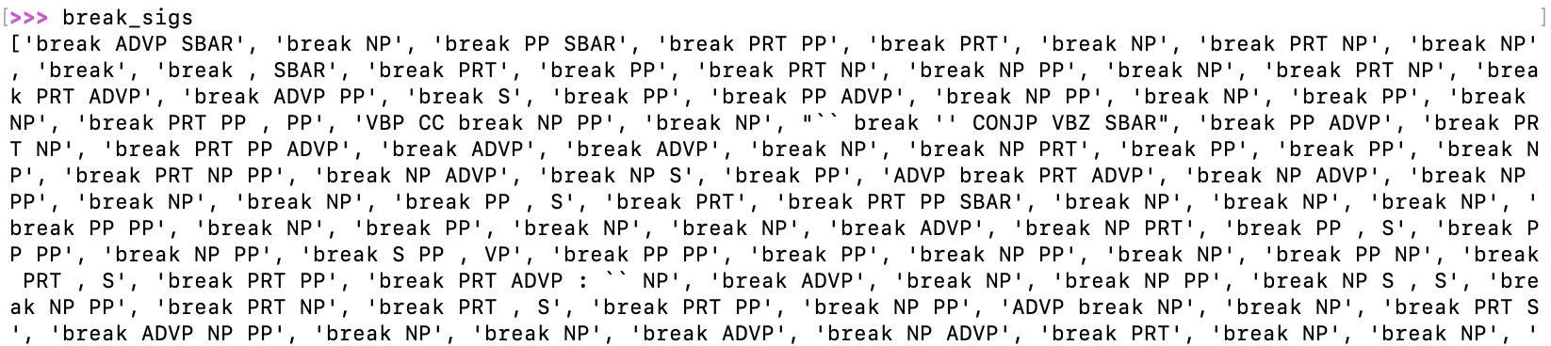
Homework 10
T1: collect signature strings into a list.

Slide 13
Homework 10
T2: count the number of occurrences using nltk.FreqDist()
https://www.nltk.org/api/nltk.probability.FreqDist.html
>>> import nltk
>>> fd = nltk.FreqDist(break_sigs)
>>> fd
FreqDist({'break NP': … 'break PP PP': 🁢, ...})

Slide 14
Homework 10
T3: give the top 10 most frequent signatures (and values)
e.g. 'break NP' occurs X times
e.g. use fd.most_common() or fd.tabulate()

Slide 15
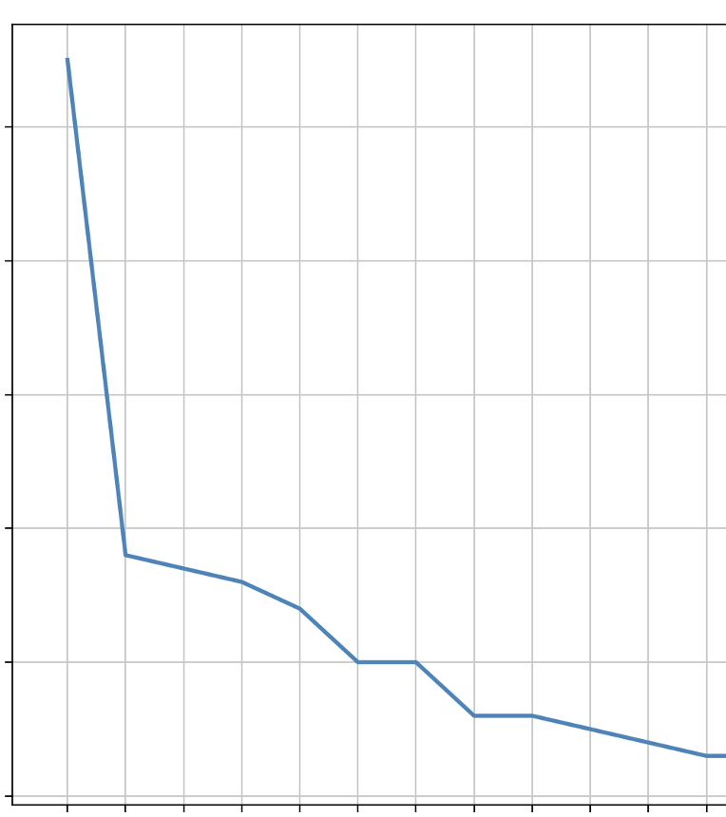
Homework 10
T4: plot the top-20 graph

Slide 16
Homework 10: Part 2
Extra Credit Task 5:
Use the Stanza parser in nltk to parse the PTB break sentences
Compare the distribution of verb frame signature strings to that obtained from the PTB.

Slide 17
Homework 10: Part 2
Procedure:
from break.py we have the list break_trees
convert trees into words, excluding those with POS tag –NONE-
' '.join() those words into a sentence string
run the Stanza constituency parser on the sentence strings
Use the code developed in class to extract the Stanza break verb phrases (just like we did for the PTB)

Slide 18
Homework 10: Part 2
Example for Task 5: steps 1-5
>>> s = ' '.join([tuple[0] for tuple in break_trees[0].pos() if tuple[1] != '-NONE-'])
'Dr. H.V. Hilprecht , Professor of Assyrian at the University of Pennsylvania , dreamed that a Babylonian priest , associated with the king Kurigalzu , -LRB- 1300 B.C. -RRB- escorted him to the treasure chamber of the temple of Bel , gave him six novel points of information about a certain broken relic , and corrected an error in its identification .'
>>> import stanza
>>> stanza.download('en')
>>> nlp = stanza.Pipeline(lang='en', processors='tokenize,pos,constituency')
>>> doc = nlp(s)
>>> t = doc.sentences[0].constituency
(ROOT (S (NP (NP (NNP Dr.) (NNP H.V.) (NNP Hilprecht)) (, ,) (NP (NP (NNP Professor)) (PP (IN of) (NP (NNP Assyrian))) (PP (IN at) (NP (NP (DT the) (NNP University)) (PP (IN of) (NP (NNP Pennsylvania)))))) (, ,)) (VP (VBD dreamed) (SBAR (IN that) (S (NP (NP (DT a) (JJ Babylonian) (NN priest)) (, ,) (VP (VP (VBN associated) (PP (IN with) (NP (NP (DT the) (NN king)) (NP (NNP Kurigalzu) (, ,) (HYPH -) (NNP LRB) (HYPH -) (CD 1300) (NNP B.C.) (HYPH -) (NNP RRB))))) (, -) (VP (VBD escorted) (NP (PRP him)) (PP (IN to) (NP (NP (DT the) (NN treasure) (NN chamber)) (PP (IN of) (NP (NP (DT the) (NN temple)) (PP (IN of) (NP (NNP Bel))))))))) (, ,)) (VP (VP (VBD gave) (NP (PRP him)) (NP (NP (CD six) (JJ novel) (NNS points)) (PP (IN of) (NP (NP (NN information)) (PP (IN about) (NP (DT a) (JJ certain) (VBN broken) (NN relic))))))) (, ,) (CC and) (VP (VBD corrected) (NP (NP (DT an) (NN error)) (PP (IN in) (NP (PRP$ its) (NN identification))))))))) (. .)))

Slide 19
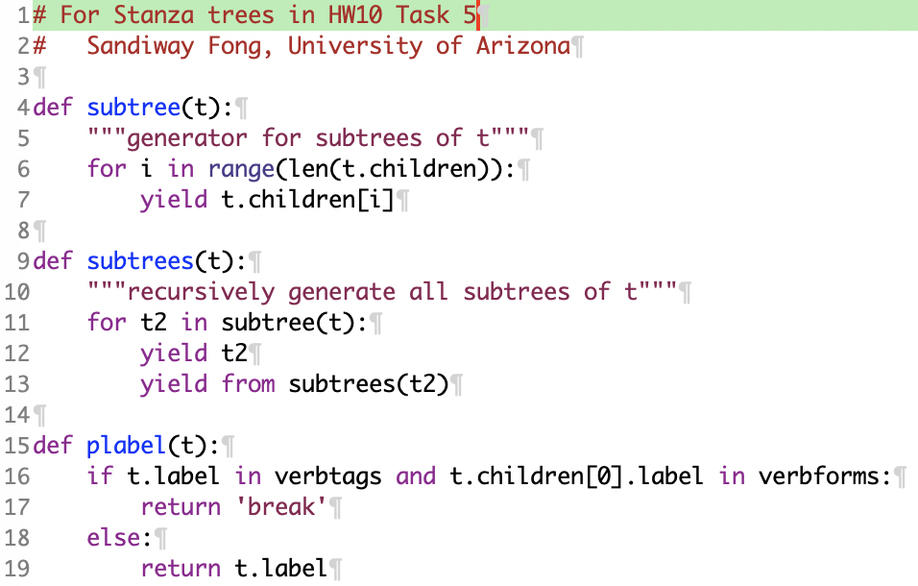
Homework 10: Part 2
Note:
Stanza trees are not the same as nltk trees!
Given tree t:
t.label vs. t.label()
t.children[0] vs. t[0]
len(t.children) vs. len(t)
no convenient t.subtrees()!
I've provided code task5.py
defines generator functions subtree(t) and subtrees(t) for Stanza trees

Slide 20
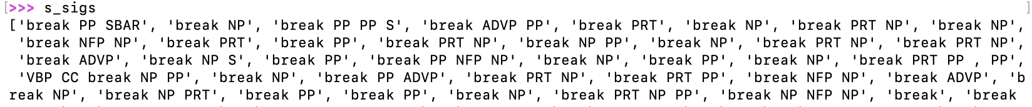
Homework 10: Part 2
Workflow:
$ python3 -i hw10ec.py
13 (s), sents: 244 initialize pipeline, extracts sentences
93 (s), stanza_trees: 244 parse sentences
s_fs: 236 get all frames
s_vfs: 216 limit to verb frames only
s_sigs: 216 convert to signatures

Slide 21
Homework 10
Submit to sandiway@arizona.edu
SUBJECT: 581 Homework 10 YOUR NAME
One PDF file (for grading)
include your screenshots
include your Python code
Usual Deadline:
midnight Saturday
to be grade Sunday
we will review the homework next Monday

