Slide 1
LING/C SC 581:
Advanced Computational Linguistics
Lecture 20
Prof. Sandiway Fong

Slide 2
Today's Topic
We have studied:
  Word senses: WordNet, Word Embeddings
  nltk: PTB, also wordnet
  Parsers: dependency and constituency-based
Putting things together …
Case study:
  verb frames of break

Slide 3
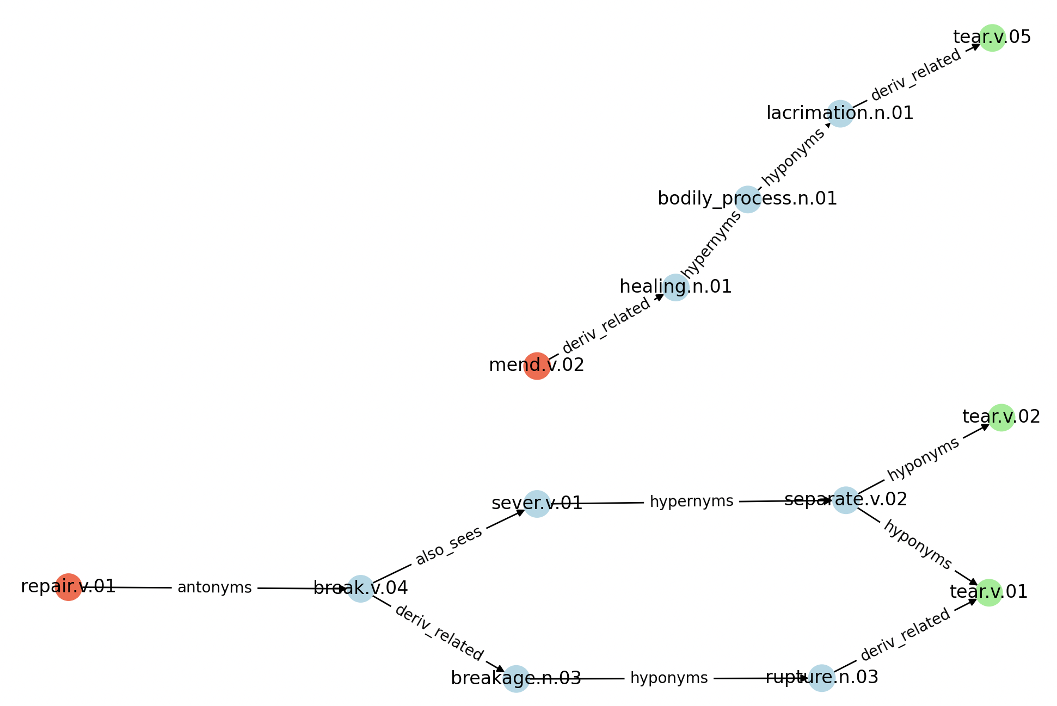
Last Time
(recently introduced) bug in my code:
edge labels were improperly reported
now fixed
Demo: 2D vs. 3D

Slide 4
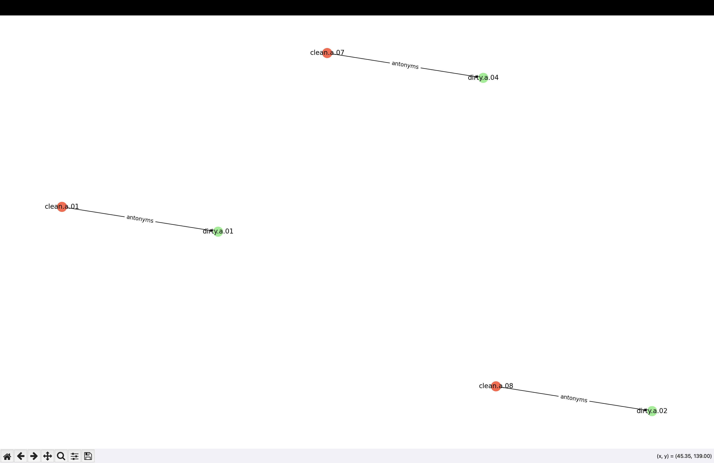
clean-dirty
>>> wn.synset('clean.a.01').definition()
'free from dirt or impurities; or having clean habits'
>>> wn.synset('clean.a.07').definition()
'not spreading pollution or contamination; especially radioactive contamination'
>>> wn.synset('clean.a.08').definition()
'(of behavior or especially language) free from objectionable elements; fit for all observers'
>>> wn.synset('dirty.a.01').definition()
'soiled or likely to soil with dirt or grime'
>>> wn.synset('dirty.a.02').definition()
'(of behavior or especially language) characterized by obscenity or indecency'
>>> wn.synset('dirty.a.04').definition()
'spreading pollution or contamination; especially radioactive contamination'
search limit:
2 links max.

Slide 5
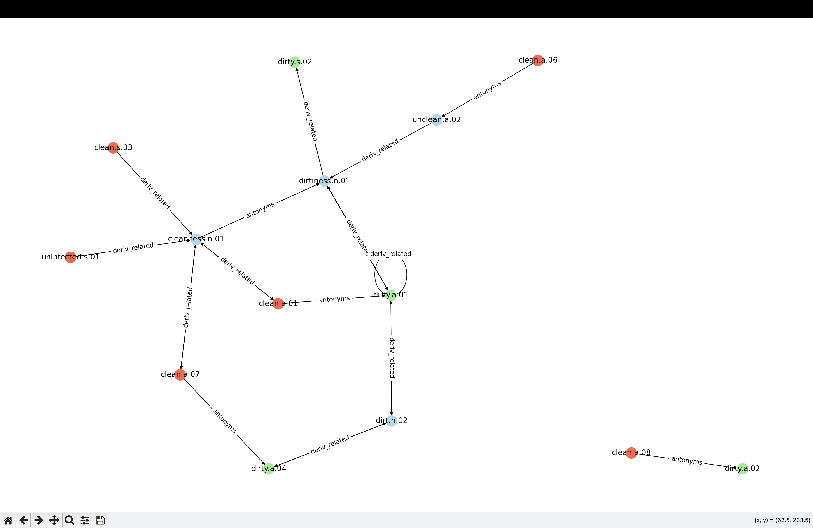
clean-dirty
>>> wn.synset('clean.a.03').definition()
'(of sound or color) free from anything that dulls or dims'
>>> wn.synset('clean.a.06').definition()
'ritually clean or pure'
>>> wn.synset('clean.s.01').definition()
'free of restrictions or qualifications'
>>> wn.synset('dirty.s.02').definition()
'contaminated with infecting organisms; ; - Jane Austen'
search limit:
3 links max.

Slide 6
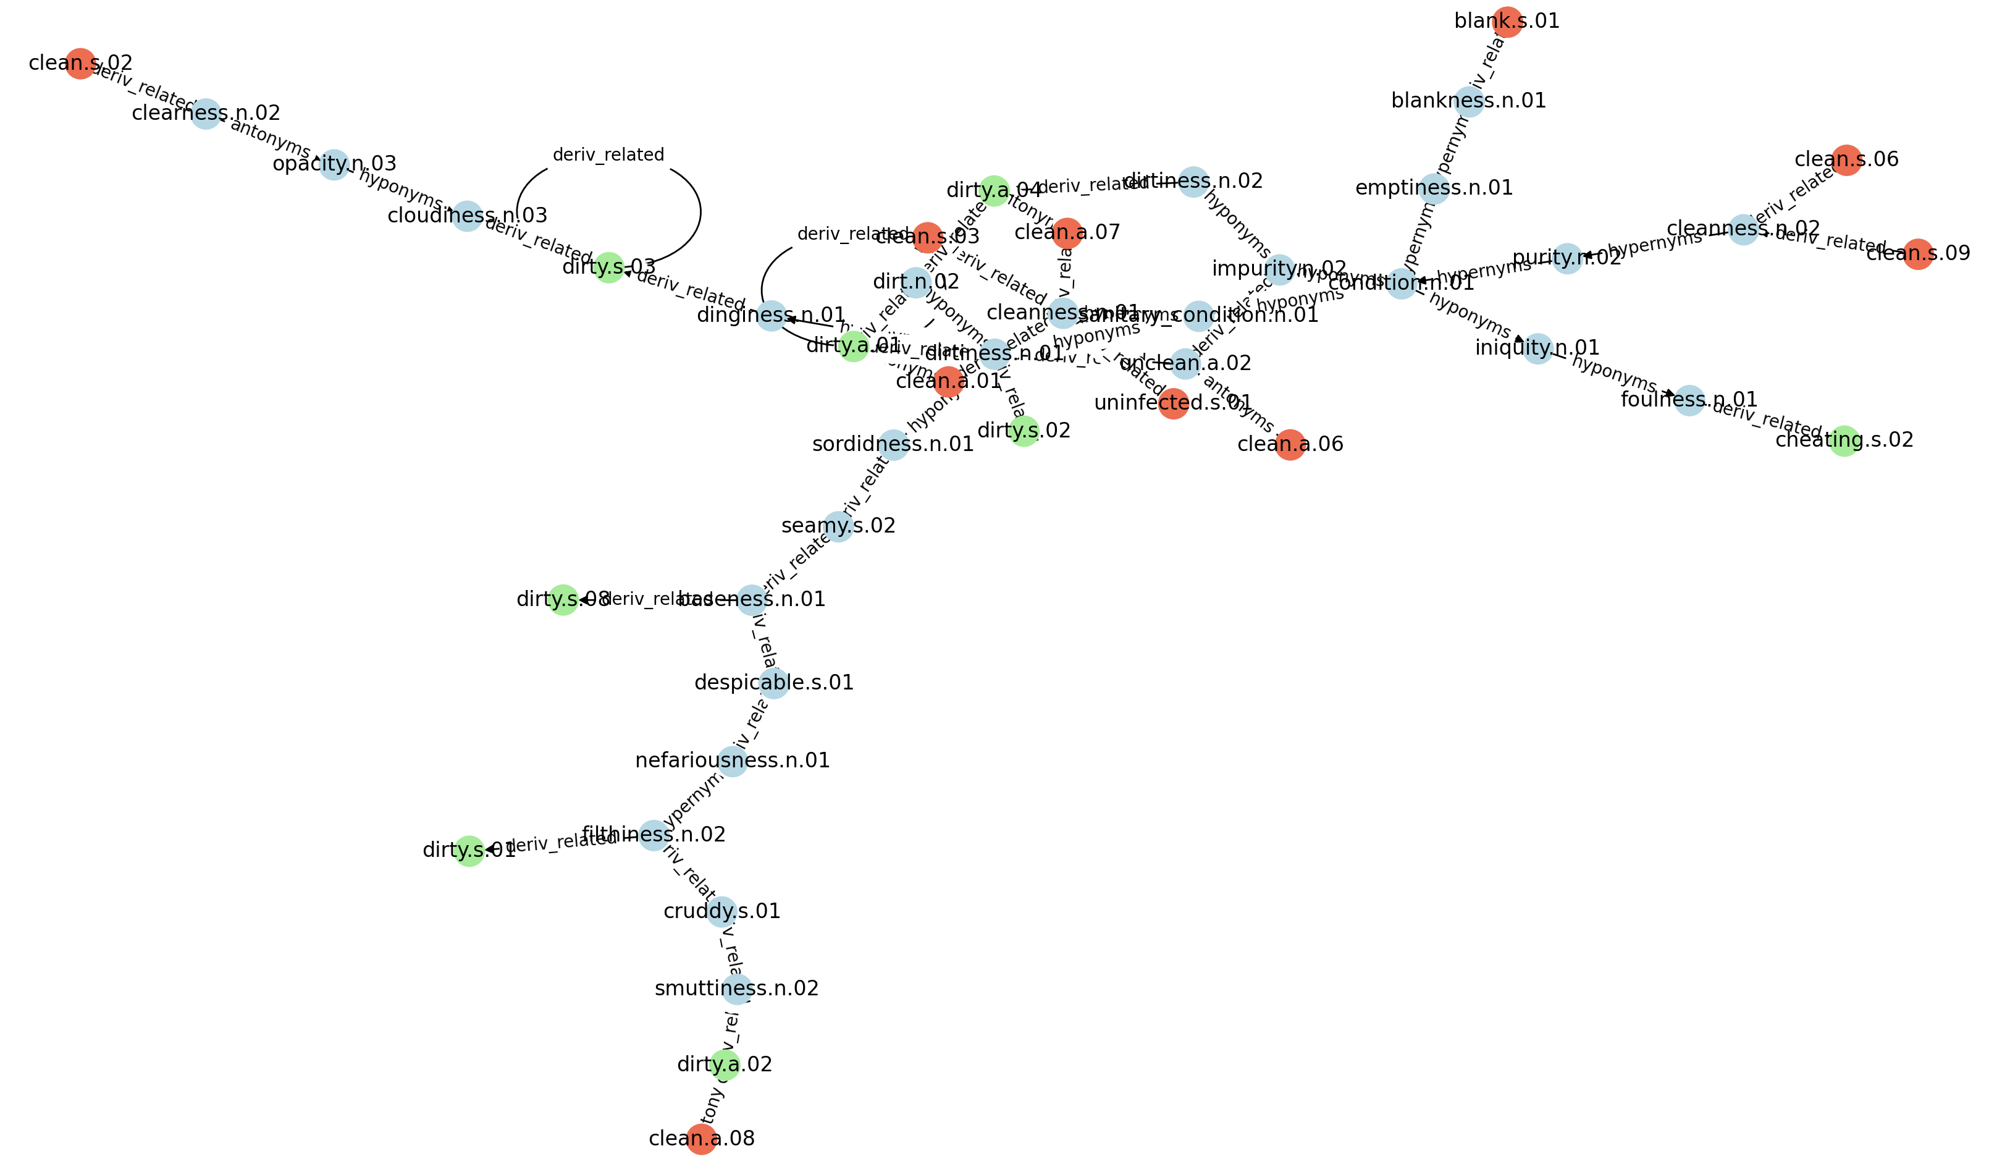
clean-dirty
search limit:
all shortest links only

Slide 7
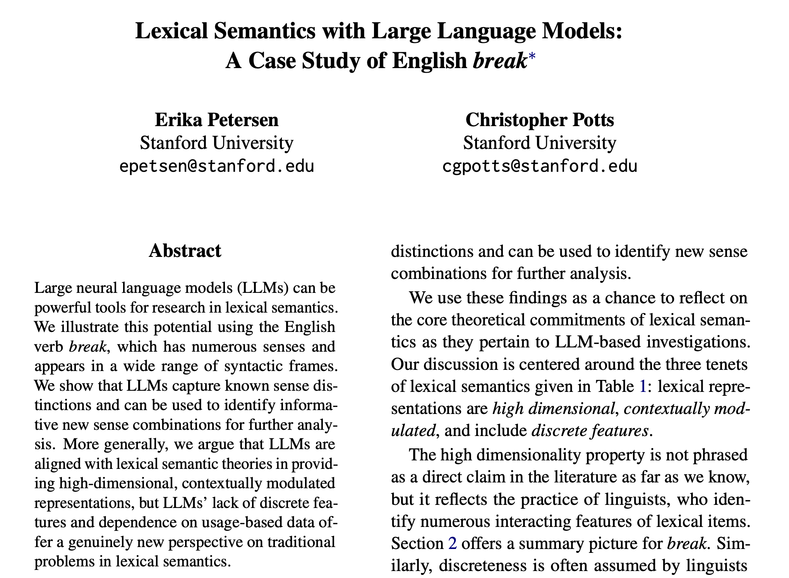
Senses of break

Slide 8
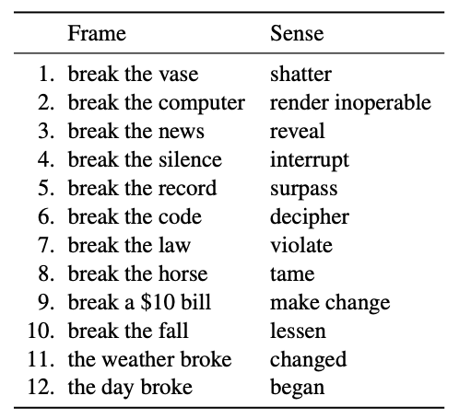

Senses of break
(Petersen & Potts) https://ling.auf.net/lingbuzz/006859
Change-of-state verb that undergoes the causative alternation:
  John broke the window
  the window broke
"senses 1–4 all alternate, senses 5–10 are all strictly transitive, … also strictly intransitive uses, as in 11– 12"
  *the law broke (present in corpus)
  careful: need to expand for context:
J. hit the tree
*the tree hit
Central Law Journal, vol. 36, 1893.

Slide 9
Unaccusative
Change-of-state verb that undergoes the causative alternation:
  John broke the window
    agent causes patient/theme to undergo change of state (become broken)
  the window broke
    window not an agent (usually an external argument)
  *the window broke the ball
    window undergoes change of state
  [_{vP} past [_{VP} break the window]] is the underlying structure
    the window raises to subject position (in the absence of an external argument) and is pronounced there ("original copy" not pronounced)

Slide 10
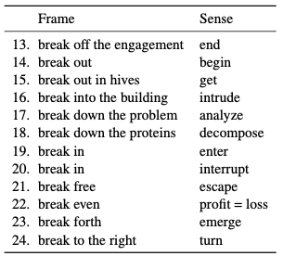
More senses of break
"Except for 13, 17, and 18, these uses are all intransitive"
Verb particles:
  off
  out
  down
  free
  even
  forth
particle + NP or PP?:
  off the engagement
  out in hives
  into the building
  down the problem/proteins
  to the right

Slide 11
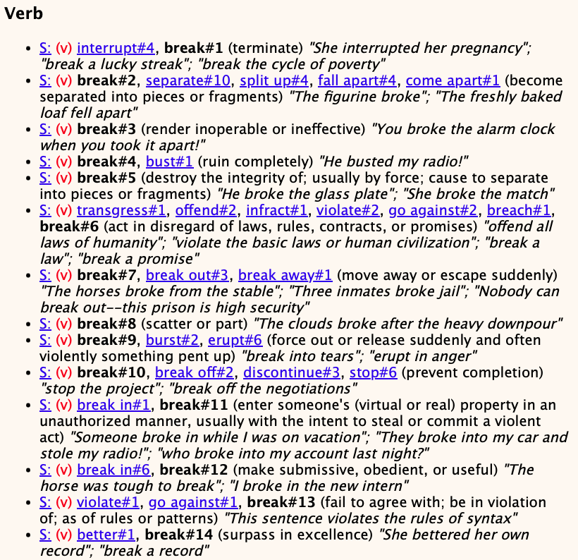
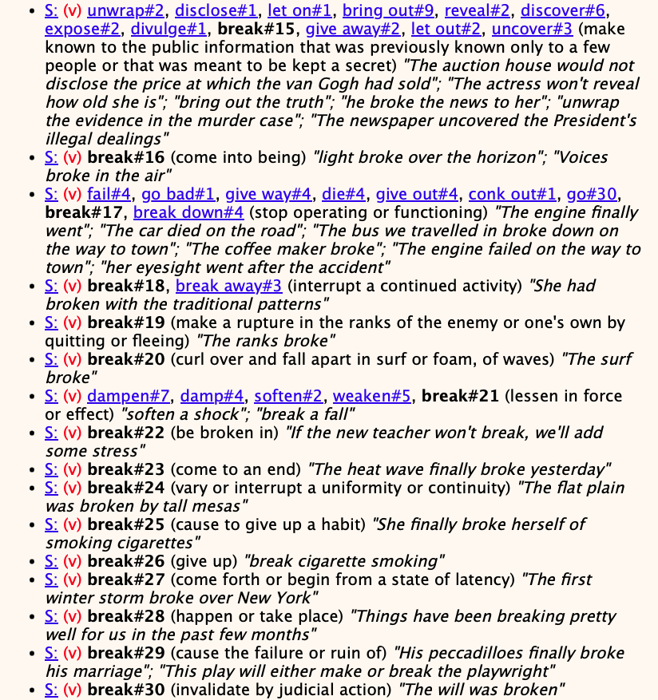
WordNet: verb senses of break
#2-#5

Slide 12
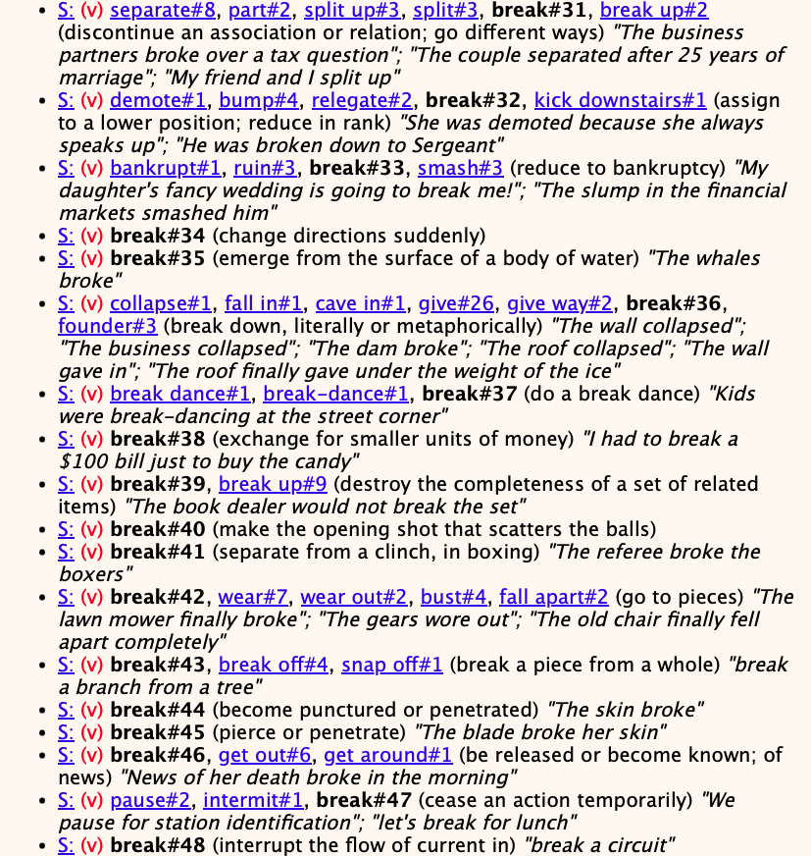
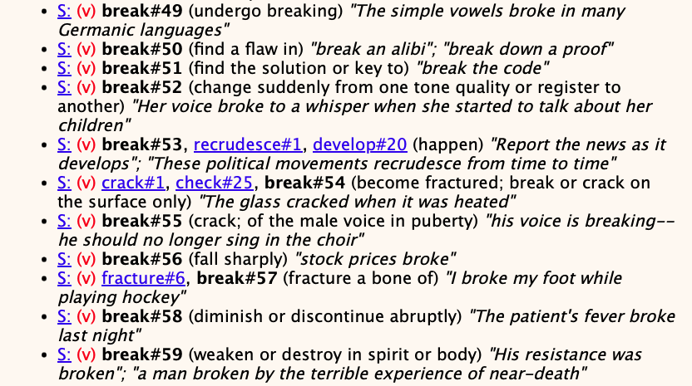
WordNet: verb senses of break
down a proof
to a whisper
unaccusative: subject is affected
for lunch

Slide 13
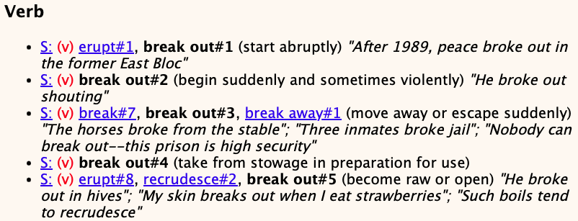
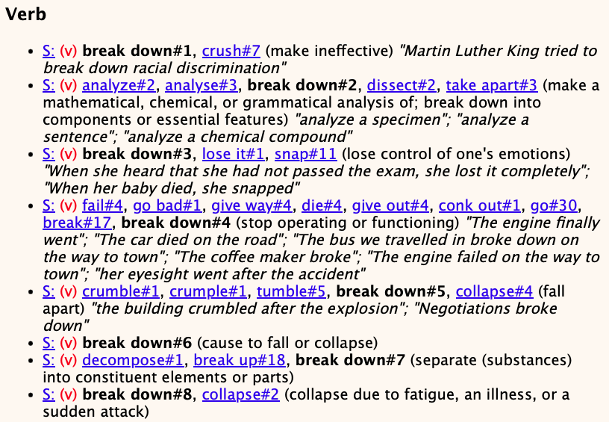
WordNet: senses of break out and break down

Slide 14
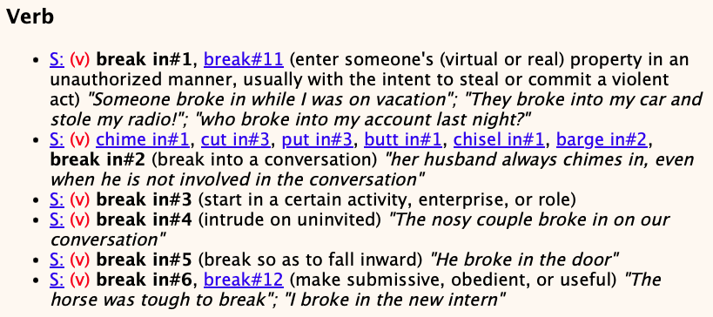
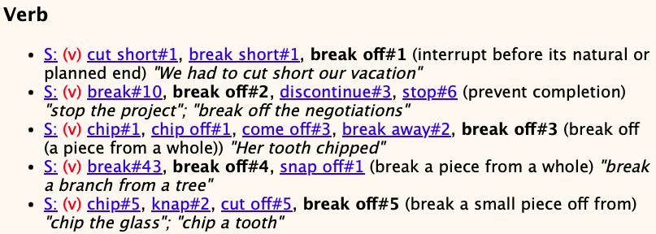
WordNet: senses of break in and break off

Slide 15
Let's ask ChatGPT (3.5 & 5 Mini)
Verb synsets are arranged into hierarchies as well
  depends on the semantic field: volume, speed, intensity of emotion etc.
break > pulverize > obliterate (my intuition)
>>> wn.synsets('pulverize')
[Synset('powderize.v.02'), Synset('demolish.v.01'), Synset('powderize.v.01')]
>>> wn.synsets('obliterate')
[Synset('kill.v.12'), Synset('obscure.v.05'), Synset('obliterate.v.03'), Synset('obliterate.v.04'), Synset('blotted_out.s.01')]

Slide 16
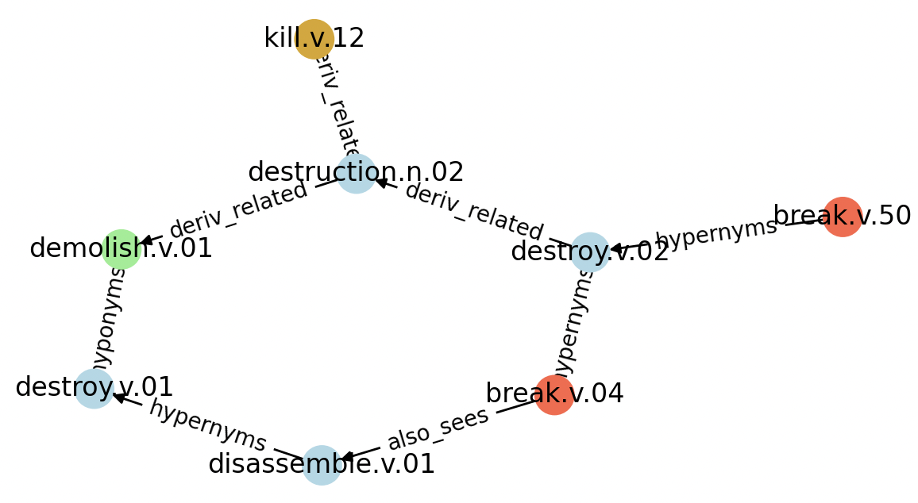
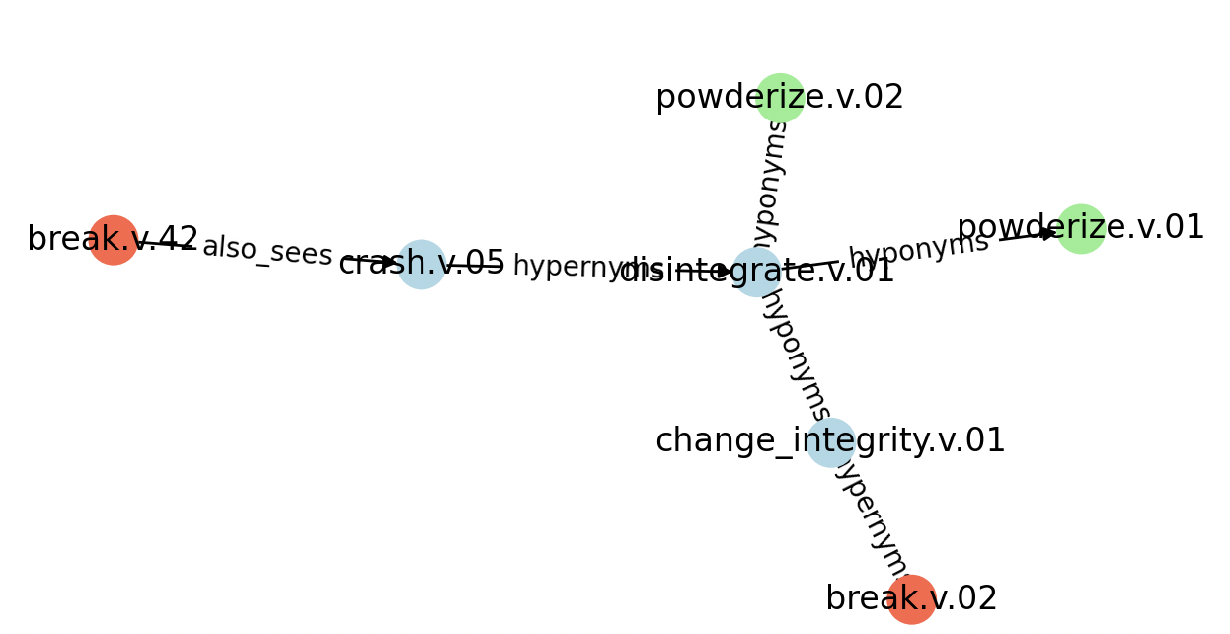
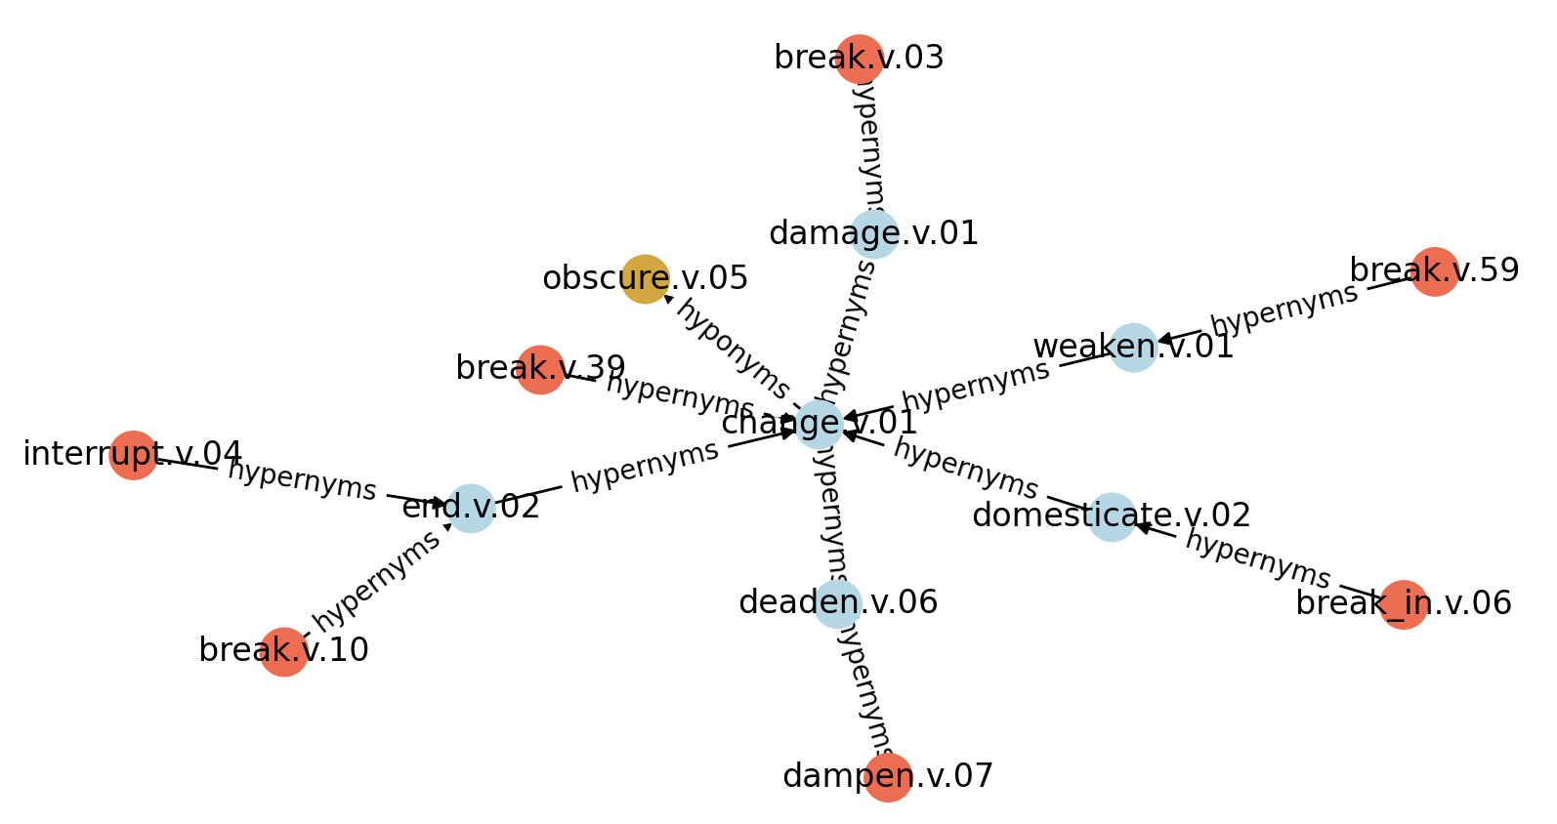
break > pulverize > obliterate
obliterate
pulverize
pulverize
break
break
obliterate
break
search limit:
3 links max.

Slide 17
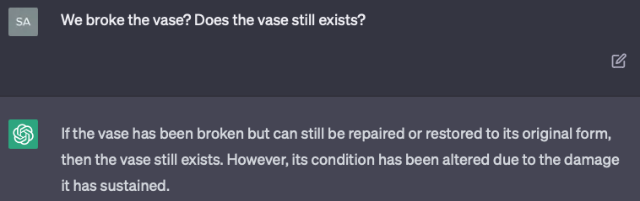
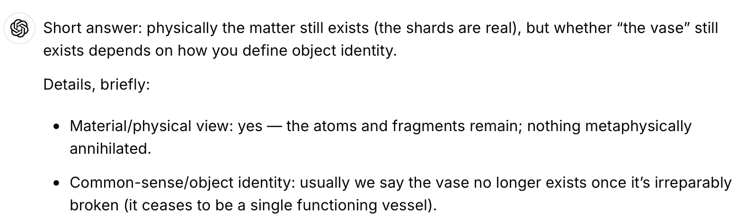
Let's ask ChatGPT (3.5 & 5 Mini)
Does the object still exist after being broken?
GPT-5 mini

Slide 18
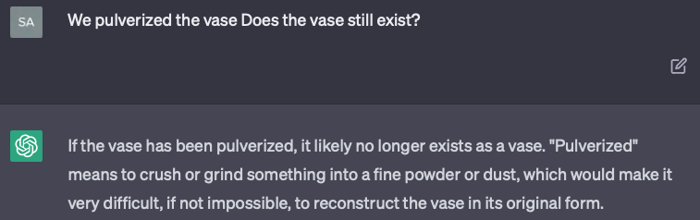
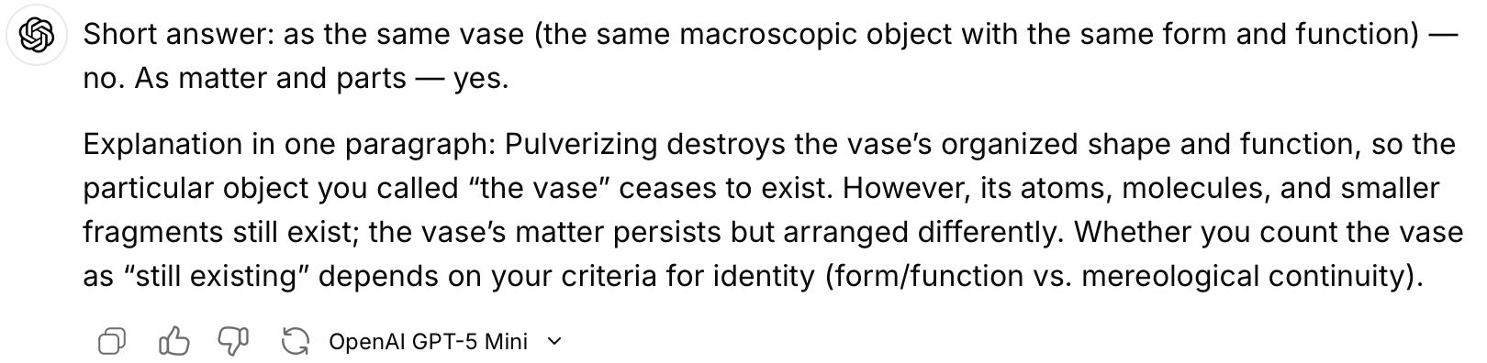
Let's ask ChatGPT (3.5 & 5 Mini)
Does the object still exist after being broken?
GPT-5 mini

Slide 19
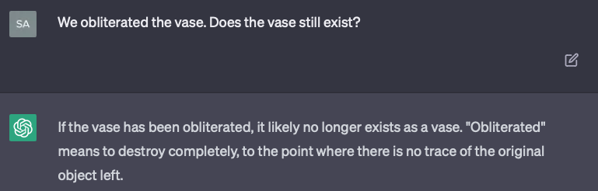
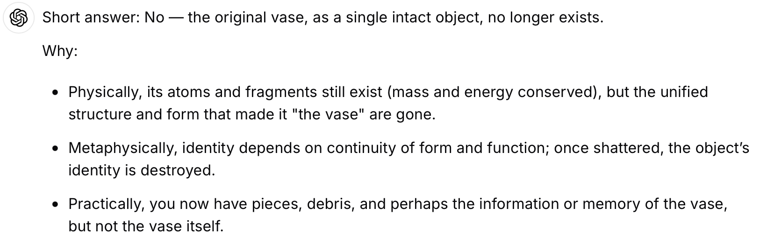
Let's ask ChatGPT
Does the object still exist after being broken?
GPT-5 mini

Slide 20
nltk ptb
Recall we installed this a while ago:
>>> from nltk.corpus import ptb
>>> type(ptb)
<class 'nltk.corpus.util.LazyCorpusLoader'>
>>> ptb.fileids()
['BROWN/CF/CF01.MRG','BROWN/CF/CF02.MRG', … ,'WSJ/24/WSJ_2453.MRG','WSJ/24/WSJ_2454.MRG']
>>> len(ptb.fileids())
2504
>>> len(ptb.parsed_sents())
73451
>>> len(ptb.words())
1740895

Slide 21
nltk ptb.parsed_sents()
nltk Tree objects:
  https://www.nltk.org/api/nltk.tree.tree.html
Tree printing:
  t.pretty_print() ascii graphics
  t.pprint() parentheses
  t.draw() window
Recall Tree objects are recursively defined. Given a nltk tree t:
  t.label() category label of t
  len(t) number of children of t
  t[i] ith child of t, could be Tree or string: isinstance(t[i],str)
  t.subtrees() all possible subtrees in t
  t.pos() list of (word, postag) in t
Note: Stanza Tree objects are different
more on this next time …
be using this one first

Slide 22
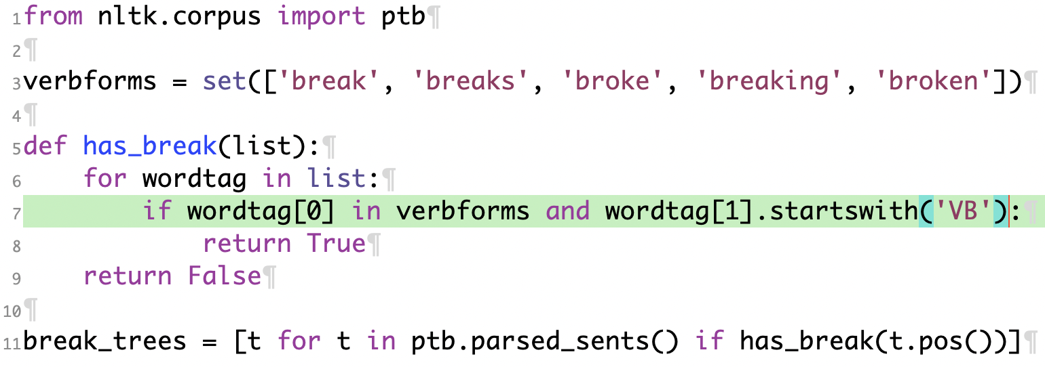
Find all ptb break sentences
break.py

Slide 23
Find all ptb break sentences
run code, drop into interpreter
$ python3 -i break.py
>>> len(break_trees)
244
Let's write Python code to show the phrases in which break appears!

Slide 24
Programming: all ptb break phrases
Idea:
  use nltk Tree methods to drill down until
  find phrase that immediately dominates a node with pos tag VB*
  node must immediately dominate (a form of) break in verbforms
Code sketch:
  loop over all break_trees (from break.py)
    loop over each subtree st
      if st not a string
        loop over each child stc of st
          if stc not a string
            if stc has pos tag VB* and 0th child of stc in verbforms
              print st
t.subtrees() all possible subtrees in t
t[i] ith child of t, Tree or string
len(t) number of children of t
isinstance(t[i],str)

Slide 25
Programming: all ptb break phrases
Code output
note: instead of printing, we could accumulate these subtrees into a list
(NP (DT a) (JJ certain) (VBN broken) (NN relic))
(NP (VBN broken) (NNS bridges))
(NP (DT the) (VBN broken) (NN railroad))
(VP (VB break) (ADVP (IN through)) (SBAR-LOC (WHADVP-2 (WRB where)) (S (NP-SBJ (NP (DT some) (NN feature)) (PP (IN of) (NP (DT the) (NN winter) (NN landscape)))) (VP (MD would) (VP (VB be) (ADJP-PRD (JJ recognizable)) (ADVP-LOC (-NONE- *T*-2)))))))
(VP (VBD broke) (NP (DT the) (NN language) (NN barrier)))
(VP (VBN broken) (PP (IN with) (NP (PRP$ his) (NNS parents))) (SBAR-PRP (IN in) (NN order) (S (NP-SBJ (-NONE- *-3)) (VP (TO to) (VP (VB keep) (NP (NP (NP (DT the) (NN company)) (SBAR (WHNP-2 (-NONE- 0)) (S (NP-SBJ (PRP he)) (VP (VBD preferred) (NP (-NONE- *T*-2)))))) (: --) (NP (NNS pimps) (, ,) (NNS panders) (CC and) (NNS whores))))))))
(VP (VBD broke) (PRT (RP down)) (PP (IN into) (NP (DT a) (JJ general) (, ,) (JJ wordy) (NN argument))))
(VP (VBD broke) (PRT (RP up)))
(VP (VBG breaking) (NP (DT the) (JJ thick) (NN sod)))
(VP (VB break) (PRT (RP up)) (NP (NP (DT the) (NN whole)) (PP (IN of) (NP (DT that) (JJ unfortunate) (NN establishment)))))
(VP (VB break) (NP (-NONE- *T*-2)))
(VP (VBP break))
(VP (VBG breaking) (, ,) (SBAR-ADV (IN as) (S (NP-SBJ (JJ rigid) (NN surface) (NNS rocks)) (VP (VBP do)))))
(VP (VBD broke) (PRT (RP out)))
(VP (VBD broke) (PP (PP (IN into) (NP (DT a) (NN trot))) (CONJP (CC and) (RB then)) (PP (IN into) (NP (DT a) (NN run)))))
(VP (VBD broke) (PRT (RP up)) (NP (NP (DT the) (NN timing)) (PP (IN of) (NP (DT the) (JJ entire) (NN enemy) (NN attack)))))
(VP (VBN broken) (NP (-NONE- *-3)) (PP (IN for) (NP (NP (DT the) (NN superintendent) (POS 's)) (NN home))))

Slide 26
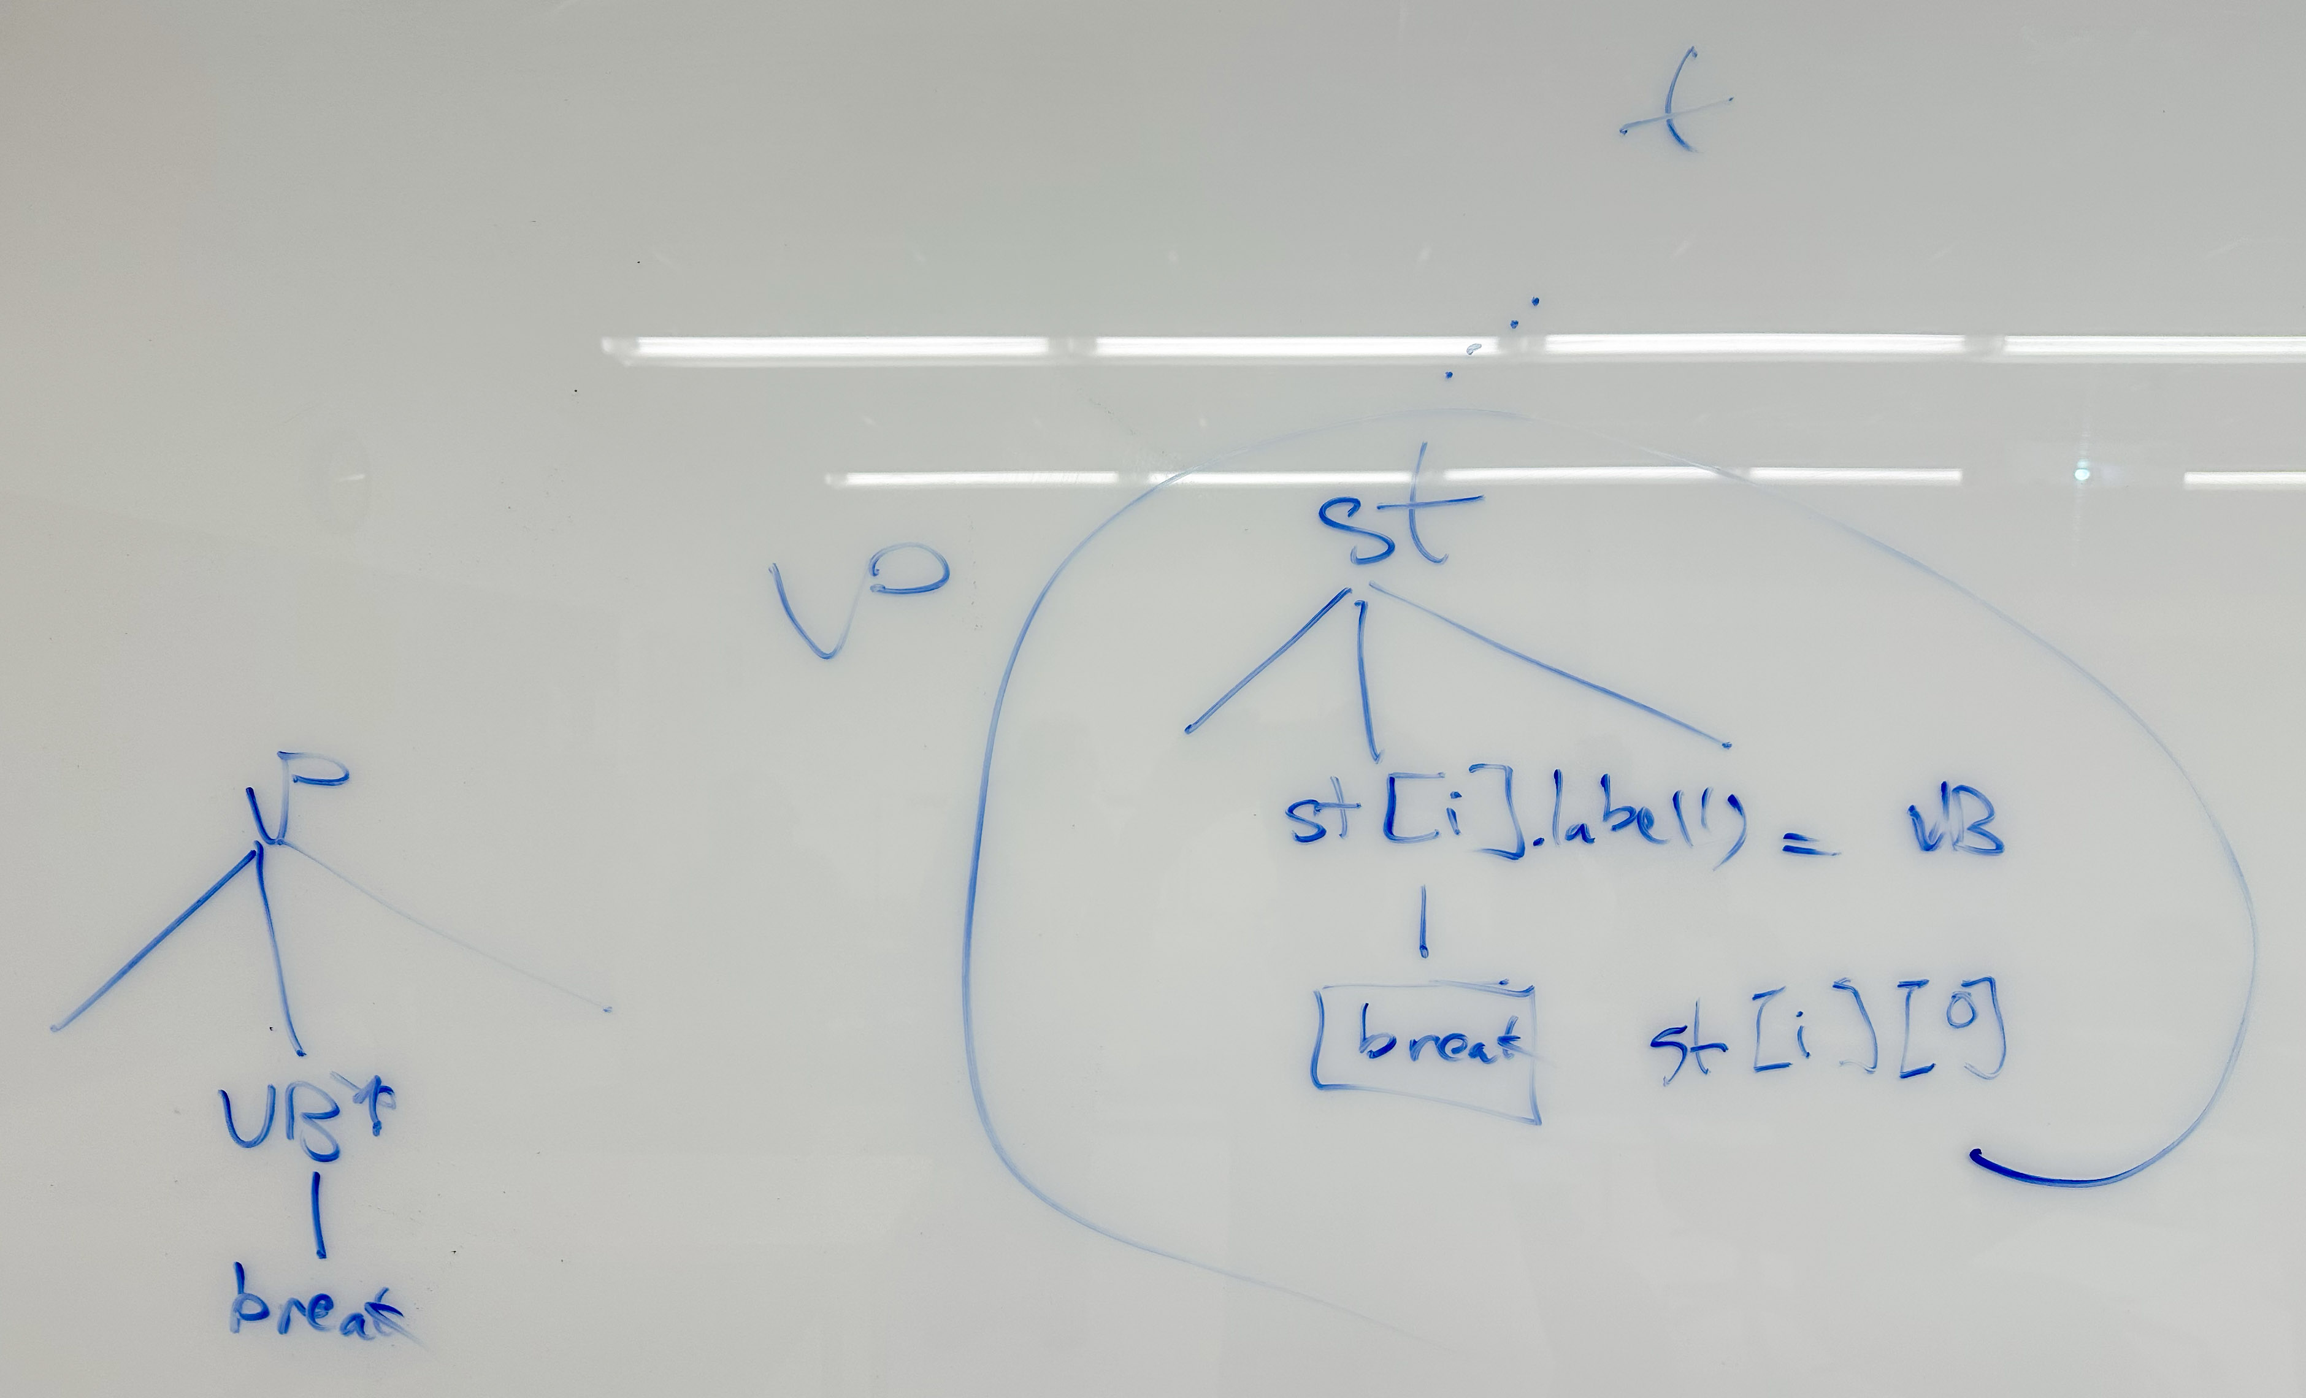
Whiteboard

Slide 27
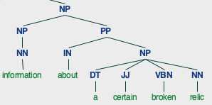


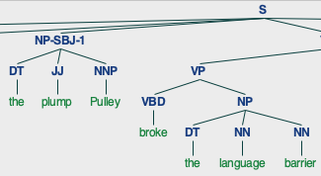
Find all break sentences
Could draw all trees of course:
  >>> break_trees[0].draw()
adjectival modification with VBN broken
break NP

Slide 28
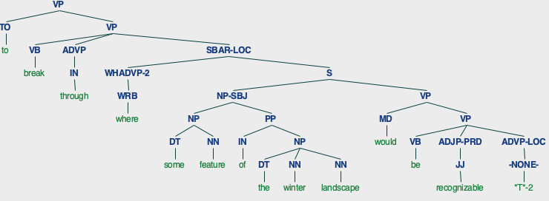
Find all break sentences
break through/ADVP

Slide 29
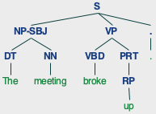
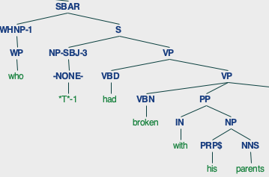
Find all break sentences
break up/PRT
break PP[with]
RP | Particle

Slide 30
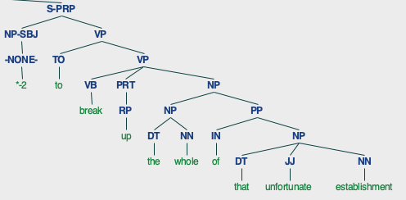
Find all break sentences
break up/PRT NP
RP | Particle

Slide 31
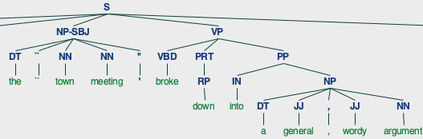
Find all break sentences
break down/PRT PP[into]
RP | Particle

Slide 32
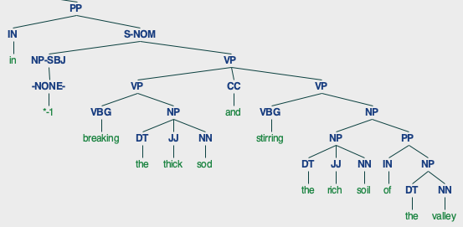
Find all break sentences

Slide 33
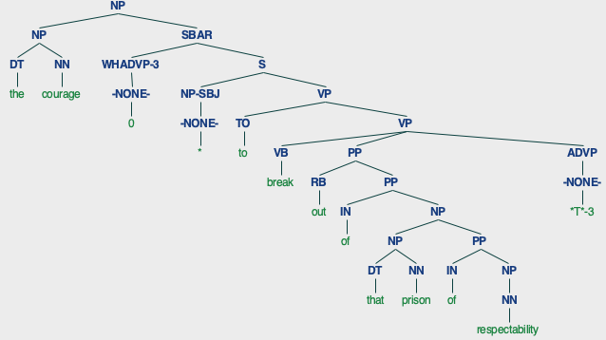
Find all break sentences
break out of NP

Slide 34
Programming: all ptb break phrases
We are interested in verb frames only (VP): how many are there?
(NP (DT a) (JJ certain) (VBN broken) (NN relic))
(NP (VBN broken) (NNS bridges))
(NP (DT the) (VBN broken) (NN railroad))
(VP (VB break) (ADVP (IN through)) (SBAR-LOC …))
(VP (VBD broke) (NP (DT the) (NN language) (NN barrier)))
(VP (VBN broken) (PP (IN with) (NP (PRP$ his) (NNS parents)))(SBAR-PRP …))
(VP (VBD broke) (PRT (RP down)) (PP (IN into) (NP …)))
(VP (VBD broke) (PRT (RP up)))
(VP (VBG breaking) (NP (DT the) (JJ thick) (NN sod)))
(VP (VB break) (PRT (RP up)) (NP (NP (DT the) (NN whole)) (PP …))))
(VP (VB break) (NP (-NONE- *T*-2)))
(VP (VBP break))
…

Slide 35
Programming: all ptb break phrases
Let's write Python code to keep only the VP frames!
  subtree.label().startswith('VP')
  also, instead of printing, let save them into a list of Trees break_vfs
>>> len(break_vfs)
224
(VP (VB break) (ADVP (IN through)) (SBAR-LOC (WHADVP-2 (WRB where)) (S (NP-SBJ (NP (DT some) (NN feature)) (PP (IN of) (NP (DT the) (NN winter) (NN landscape)))) (VP (MD would) (VP (VB be) (ADJP-PRD (JJ recognizable)) (ADVP-LOC (-NONE- *T*-2)))))))
(VP (VBD broke) (NP (DT the) (NN language) (NN barrier)))
(VP (VBN broken) (PP (IN with) (NP (PRP$ his) (NNS parents))) (SBAR-PRP (IN in) (NN order) (S (NP-SBJ (-NONE- *-3)) (VP (TO to) (VP (VB keep) (NP (NP (NP (DT the) (NN company)) (SBAR (WHNP-2 (-NONE- 0)) (S (NP-SBJ (PRP he)) (VP (VBD preferred) (NP (-NONE- *T*-2)))))) (: --) (NP (NNS pimps) (, ,) (NNS panders) (CC and) (NNS whores))))))))
(VP (VBD broke) (PRT (RP down)) (PP (IN into) (NP (DT a) (JJ general) (, ,) (JJ wordy) (NN argument))))
(VP (VBD broke) (PRT (RP up)))
(VP (VBG breaking) (NP (DT the) (JJ thick) (NN sod)))
…
$ python3 -i break.py
>>> len(break_trees)
244

Slide 36
Using pickle .dump()/.load()
Save results using pickle:
>>> import pickle
>>> with open("frames.pkl",'wb') as f:
... pickle.dump(break_vfs,f)
...
Read pickled data:
>>> with open("frames.pkl",'rb') as f:
... break_vfs = pickle.load(f)
...
Example:
>>> len(break_vfs)
224
>>> break_vfs[0]
Tree('VP', [Tree('VB', ['break']), Tree('ADVP', [Tree('IN', ['through'])]), Tree('SBAR-LOC', [Tree('WHADVP-2', [Tree('WRB', ['where'])]), Tree('S', [Tree('NP-SBJ', [Tree('NP', [Tree('DT', ['some']), Tree('NN', ['feature'])]), Tree('PP', [Tree('IN', ['of']), Tree('NP', [Tree('DT', ['the']), Tree('NN', ['winter']), Tree('NN', ['landscape'])])])]), Tree('VP', [Tree('MD', ['would']), Tree('VP', [Tree('VB', ['be']), Tree('ADJP-PRD', [Tree('JJ', ['recognizable'])]), Tree('ADVP-LOC', [Tree('-NONE-', ['*T*-2'])])])])])])])

