Slide 1
LING/C SC 581: Advanced Computational Linguistics
Lecture 2
Prof. Sandiway Fong

Slide 2
Today's Topics
HW 1 Review
Penn Treebank (PTB)
I assume everyone has downloaded TREEBANK_3.zip
installing the full PTB into nltk (Homework 2)
from nltk.corpus import treebank (3,914 sample)
from nltk.corpus import ptb (full)
tregex
see Appendix for macOS TimesRoman FontBook problem

Slide 3
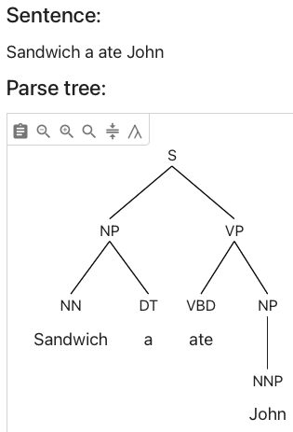
Homework 1 Review
Q1: what rule of English syntax is violated?
Note:
an utterance can be semantically odd but syntactically fine

Slide 4
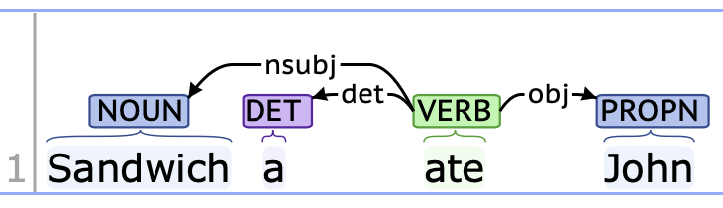
Homework 1 Review
Q2: what's wrong here? Also compare with Q1.

Slide 5
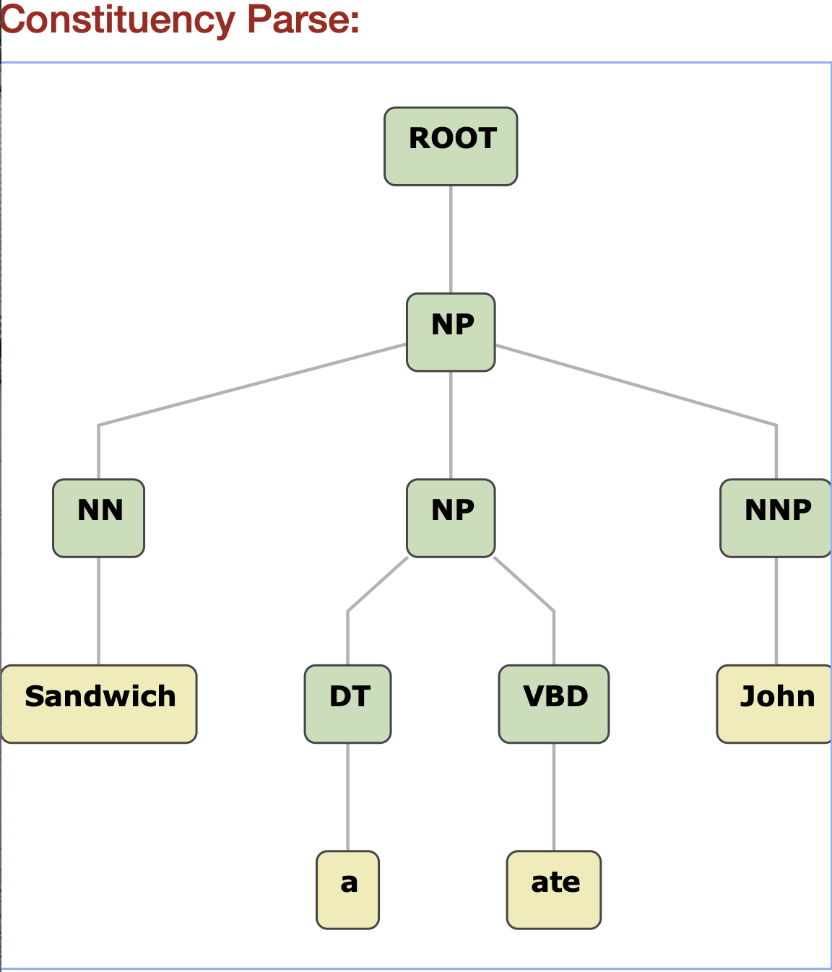
Homework 1 Review
Q3: What's wrong with the phrase labels built by the conversion?

Slide 6
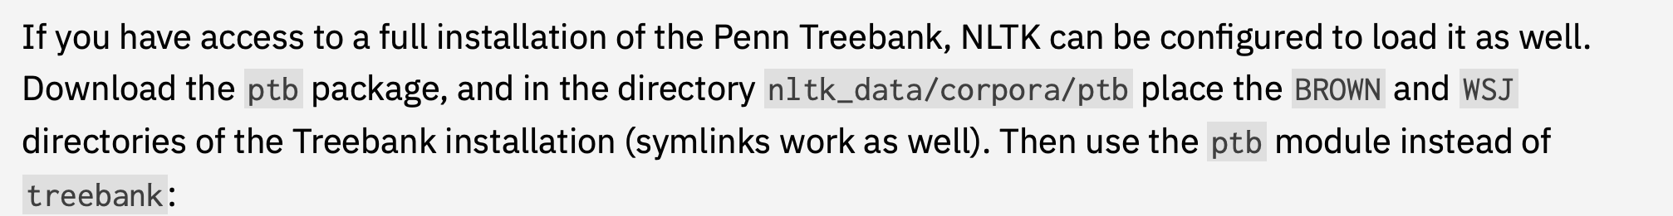
nltk: Corpus Readers
http://www.nltk.org/howto/corpus.html#parsed-corpora
nltk.download('ptb')
>>> from nltk.corpus import ptb
>>> print(ptb.fileids()) # doctest: +SKIP ['BROWN/CF/CF01.MRG', 'BROWN/CF/CF02.MRG', 'BROWN/CF/CF03.MRG', 'BROWN/CF/CF04.MRG', ...]
>>> print(ptb.words('WSJ/00/WSJ_0003.MRG')) # doctest: +SKIP ['A', 'form', 'of', 'asbestos', 'once', 'used', '*', ...]
>>> print(ptb.tagged_words('WSJ/00/WSJ_0003.MRG')) # doctest: +SKIP [('A', 'DT'), ('form', 'NN'), ('of', 'IN'), ...]

Slide 7
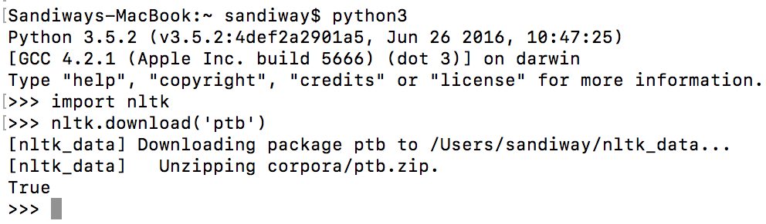
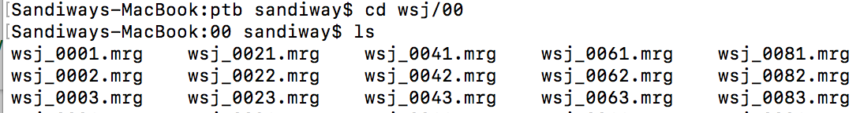
Penn Treebank (PTB) with nltk
TREEBANK_3.zip
Put your wsj directory (from mrg) here ~/nltk_data/corpora/ptb
Filename case problem!

Slide 8
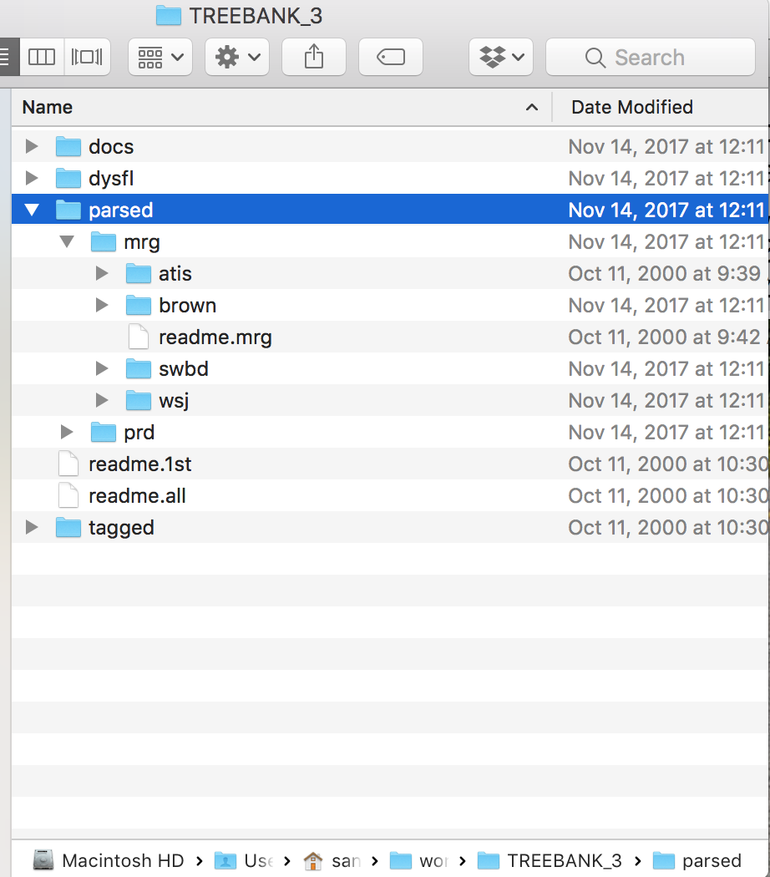
Penn Treebank (PTB) with nltk
COPY
~/nltk_data/corpora/ptb

Slide 9
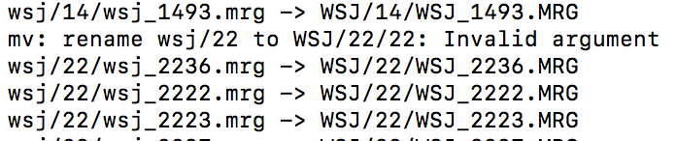
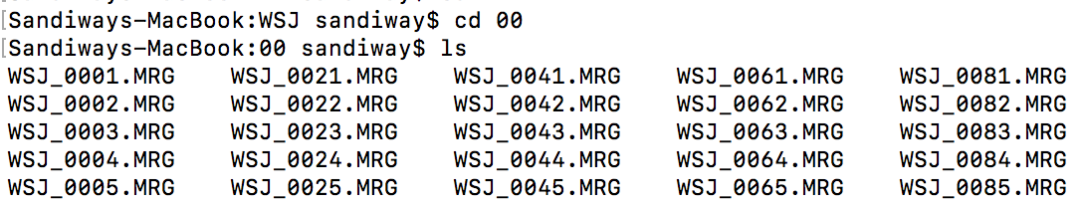
Penn Treebank (PTB) with nltk
Rename files to uppercase
for f in `find wsj`; do mv -v "$f" "`echo $f | tr '[a-z]' '[A-Z]'`"; done
(found on stackoverflow.com)
seems to work but not clean
directory name needs to be uppercased too!

Slide 10
Penn Treebank (PTB) with nltk
Note: you may run into problems with file permissions when renaming:
Change permissions (recursively):
chmod -R u+w atis

Slide 11
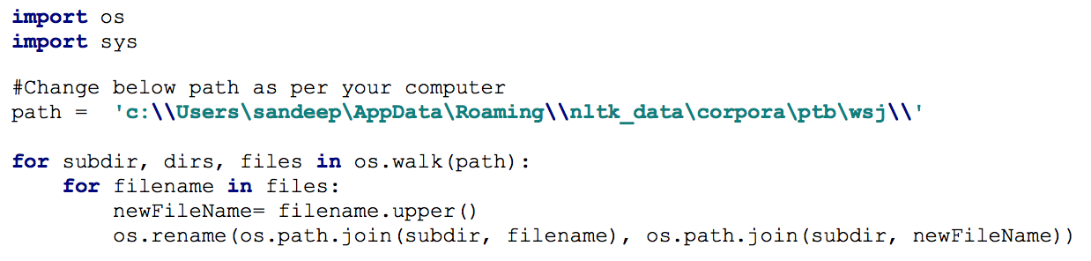
Penn Treebank (PTB) with nltk
Renaming script courtesy of Sandeep Suntwal (from 2018's class):

Slide 12
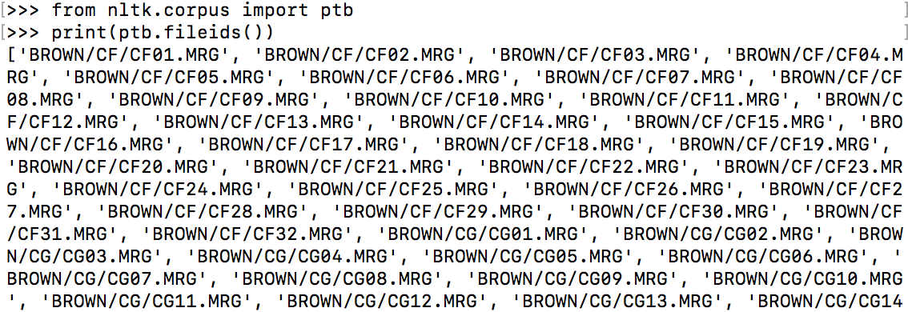
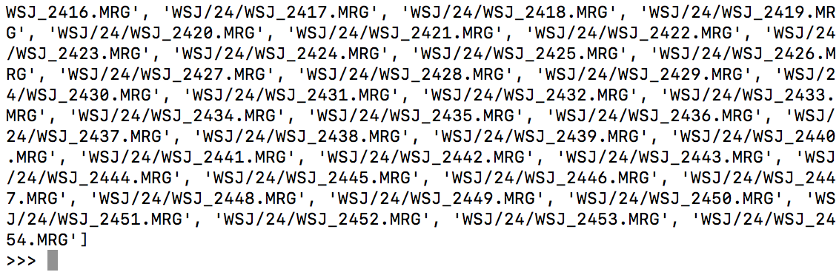
Penn Treebank (PTB) with nltk
Checking the install:
class BracketParseCorpusReader
seems to be the Brown corpus +
the Wall Street Journal corpus
…

Slide 13
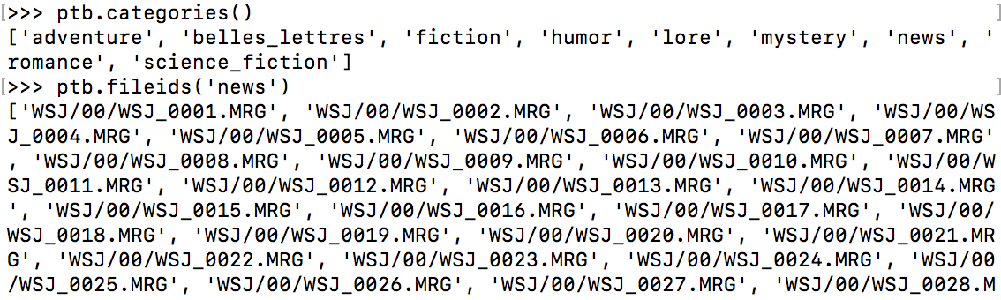
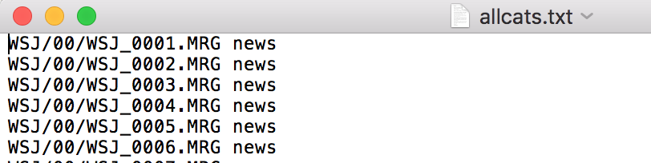
Penn Treebank (PTB) with nltk
WSJ only (news = WSJ):
Defined in ~/nltk_data/corpora/ptb/allcats.txt:

Slide 14
Penn Treebank (PTB) with nltk
Got it working? Check the numbers below (proper install).
>>> import nltk
>>> from nltk.corpus import ptb
>>> parses = ptb.parsed_sents()
>>> len(parses)
73451
>>> wsj = ptb.parsed_sents(categories=['news'])
>>> len(wsj)
49208
>>> len(ptb.words())
1740895
>>> len(ptb.words(categories=['news']))
1253013

Slide 15
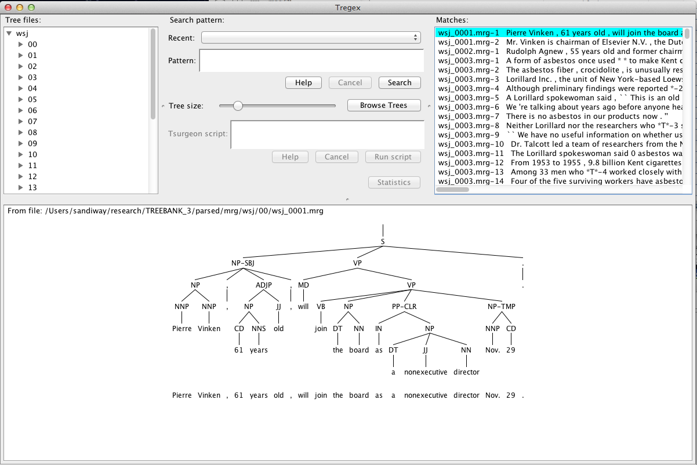
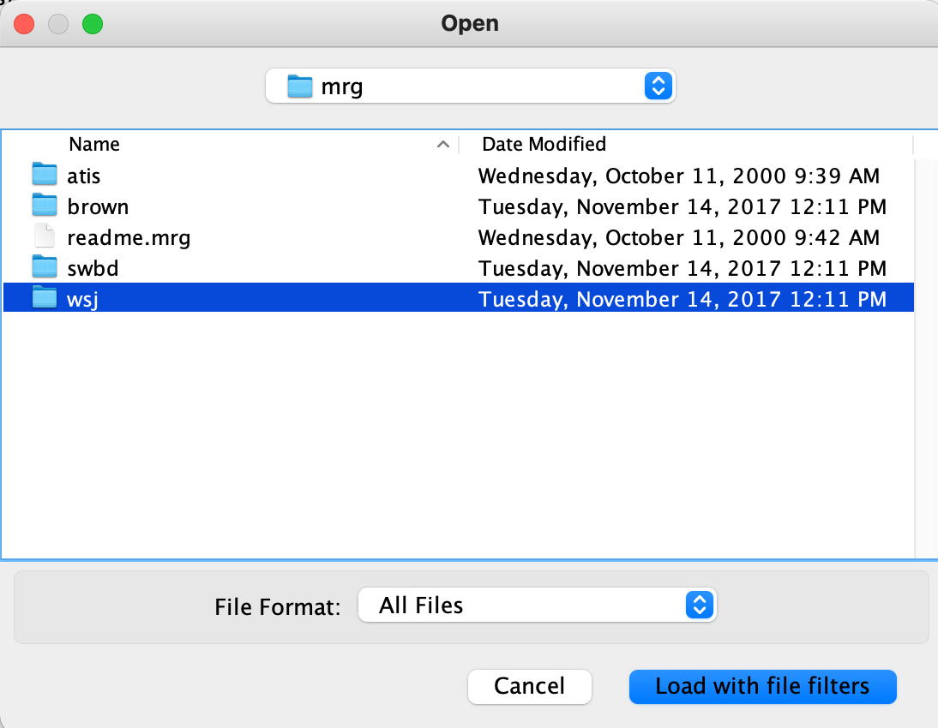
tregex
Shell file (edit 300m to give it more memory, e.g. 2000m):
Select the PTB directory
TREEBANK_3/parsed/mrg/wsj/
you can select more directories
Browse Trees

Slide 16
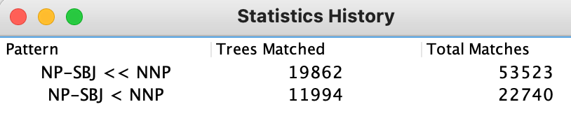
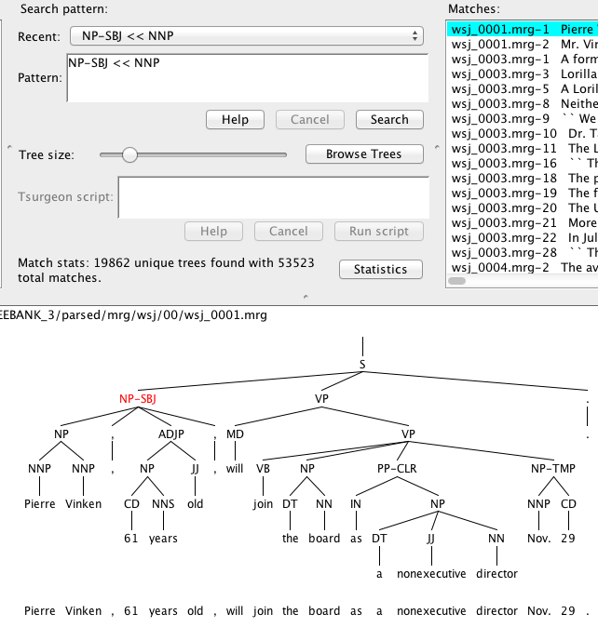
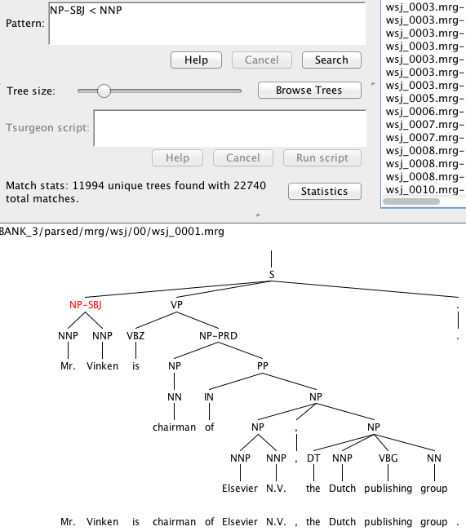
tregex
Search
NP-SBJ << (dominates) vs. < (immediately dominates) NNP

Slide 17
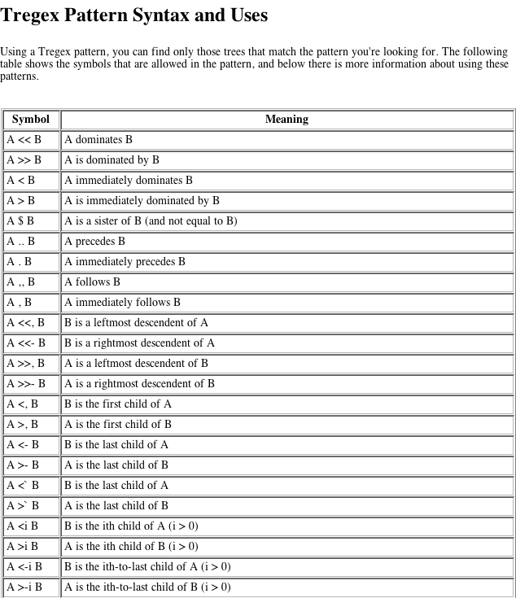
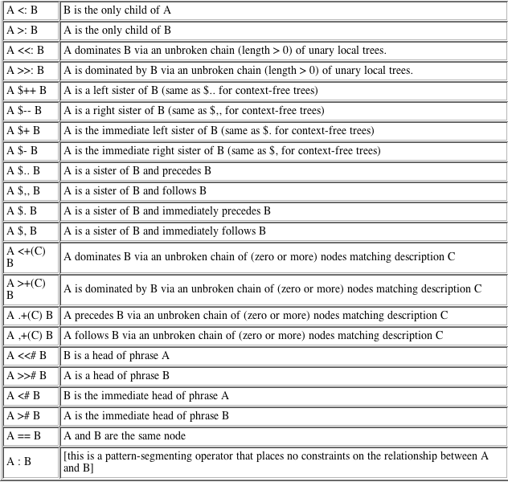
tregex
README-tregex.txt

Slide 18

tregex
Useful:
The (best) introduction to Tregex is the brief powerpoint tutorial for Tregex by Galen Andrew.
https://nlp.stanford.edu/software/tregex/The_Wonderful_World_of_Tregex.ppt

Slide 19
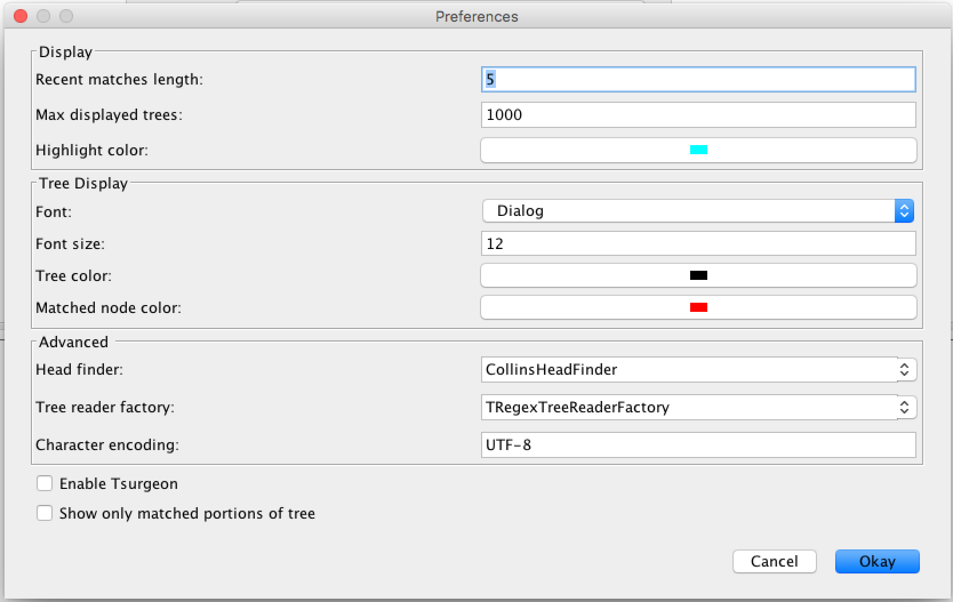
tregex
Adjust Max displayed trees if needed:

Slide 20

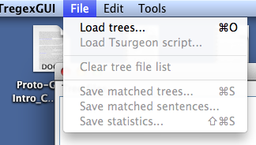
tregex
useful command line tool:
diff <file1> <file2>

Slide 21
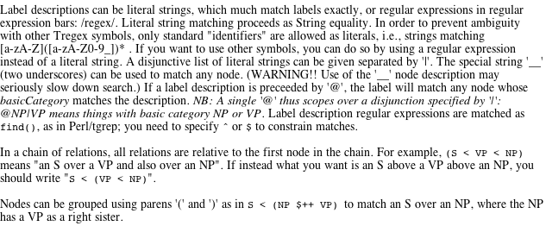
tregex
Help: tregex expression syntax is non-standard wrt bracketing
S < VP
S < NP

Slide 22
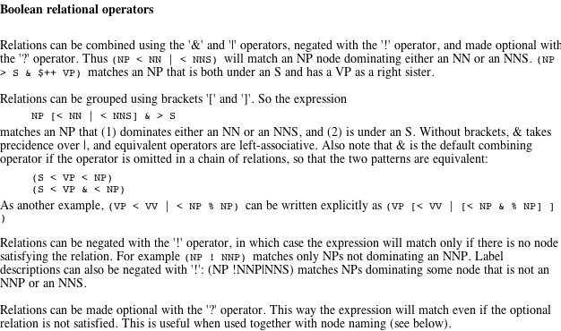
tregex
Help: tregex boolean syntax is also non-standard

Slide 23
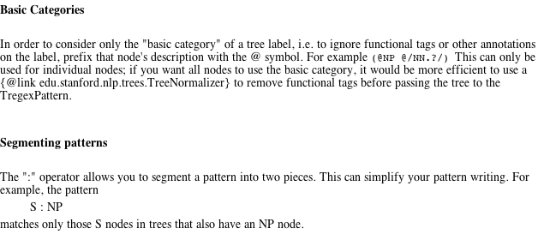
tregex
Help

Slide 24
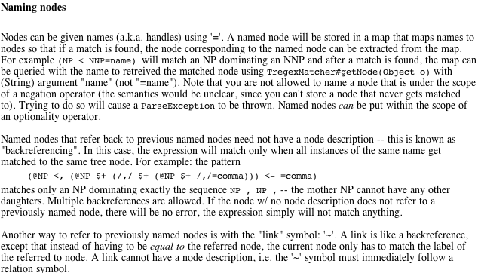
tregex
x <, y, 1st child y; x <- y, last child y;
x $+ y, x immediate left sister of y

Slide 25
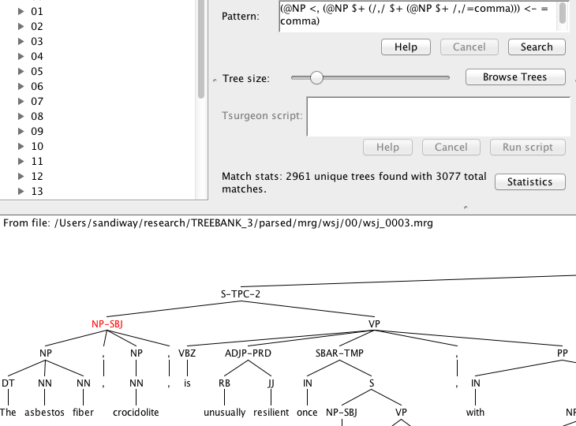
tregex
must be same node
Pattern:
(@NP <, (@NP $+ (/,/ $+ (@NP $+ /,/=comma))) <- =comma)
Key:
<, first child
$+ immediate left sister
<- last child

Slide 26
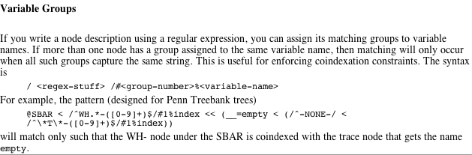
tregex
Recall regex grouping using parentheses:
e.g. (a+)(b+) defines groups 1 and 2
Help

Slide 27
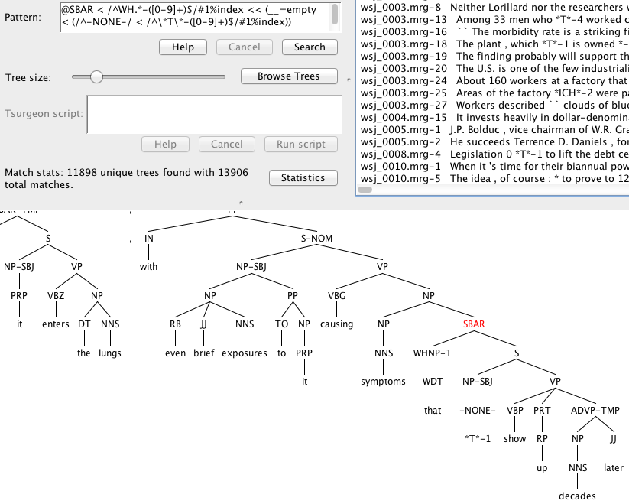
tregex

Slide 28
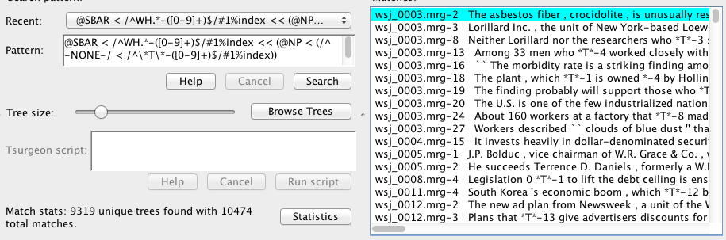
tregex
Different results from:
@SBAR < /^WH.*-([0-9]+)$/#1%index << (@NP < (/^-NONE-/ < /^\*T\*-([0-9]+)$/#1%index))

Slide 29
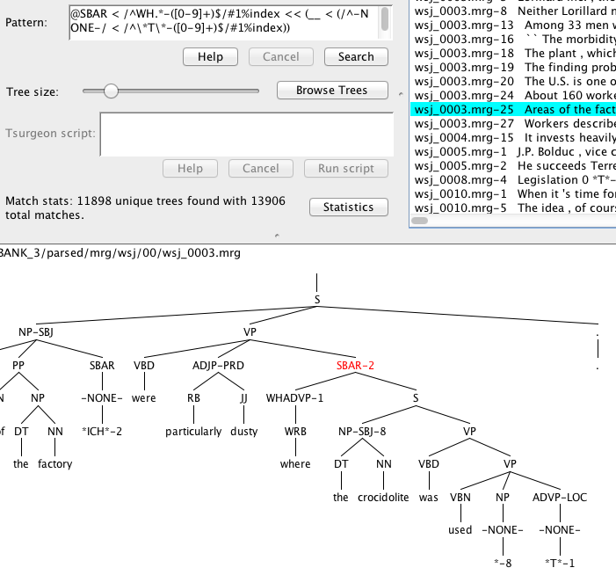
tregex
Reason for difference
Example:
WHADVP also possible (not just WHNP)

Slide 30
Appendix
macOS Times Roman FontBook problem

Slide 31
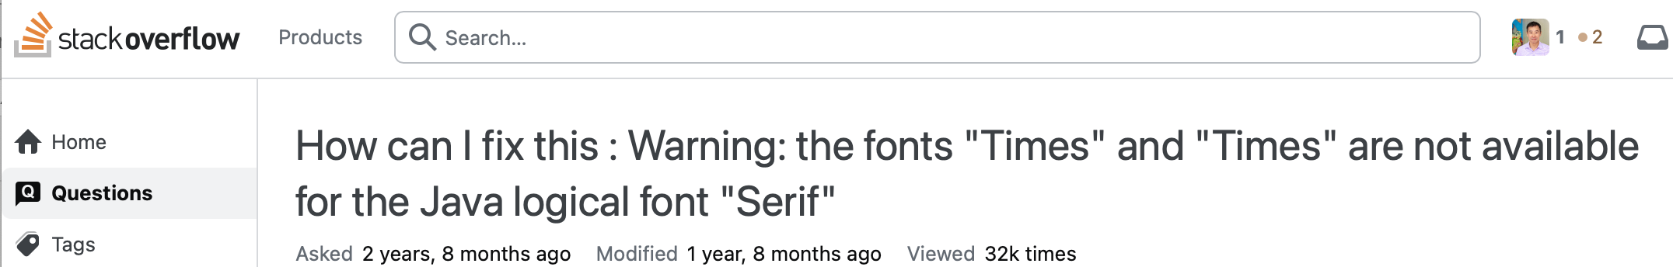
Times font restore
https://stackoverflow.com/questions/68608157/how-can-i-fix-this-warning-the-fonts-times-and-times-are-not-available-fo

Slide 32
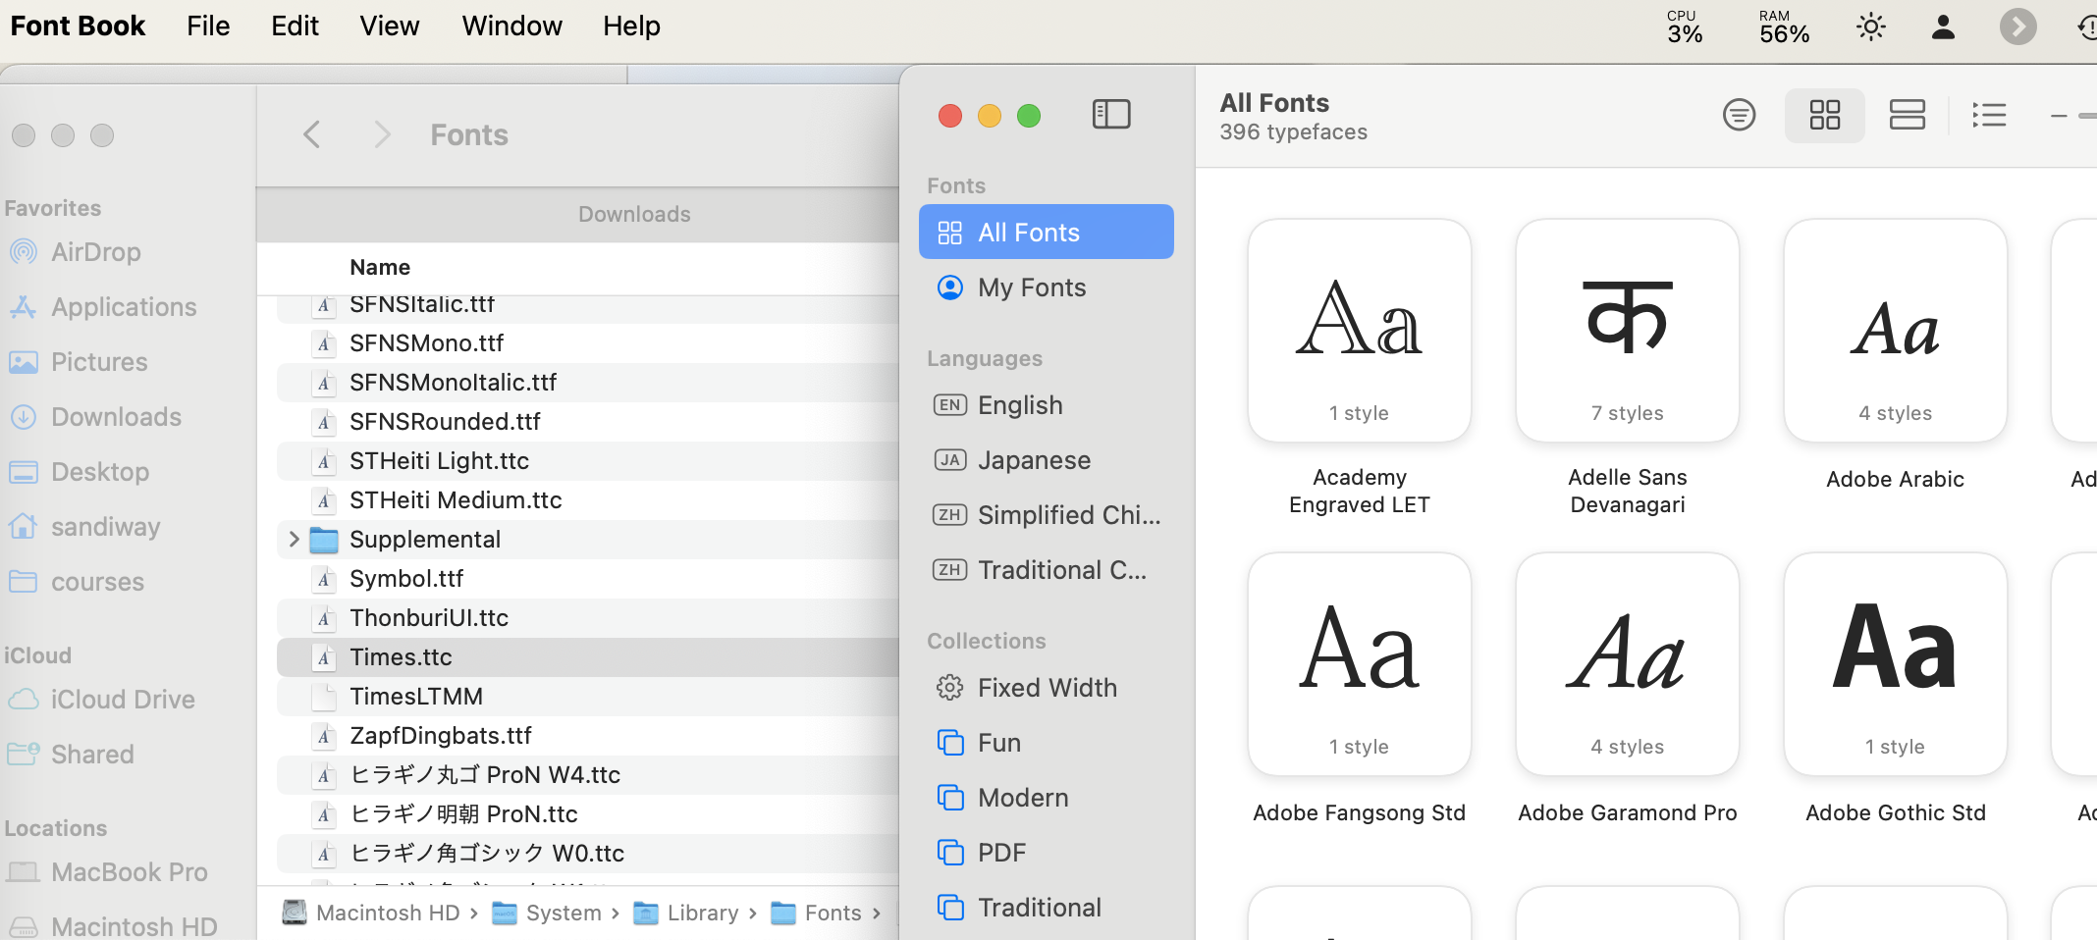
/System/Library/Fonts/Times.ttc

Slide 33
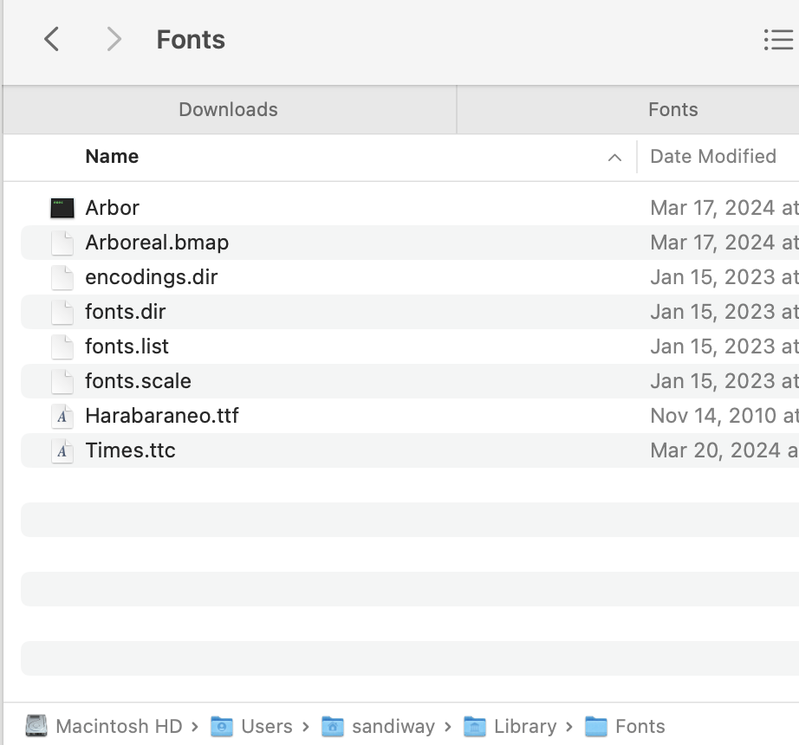
Font Book
Drag Times.ttc to Font Book
Now appears in ~/Library/Fonts

Slide 34
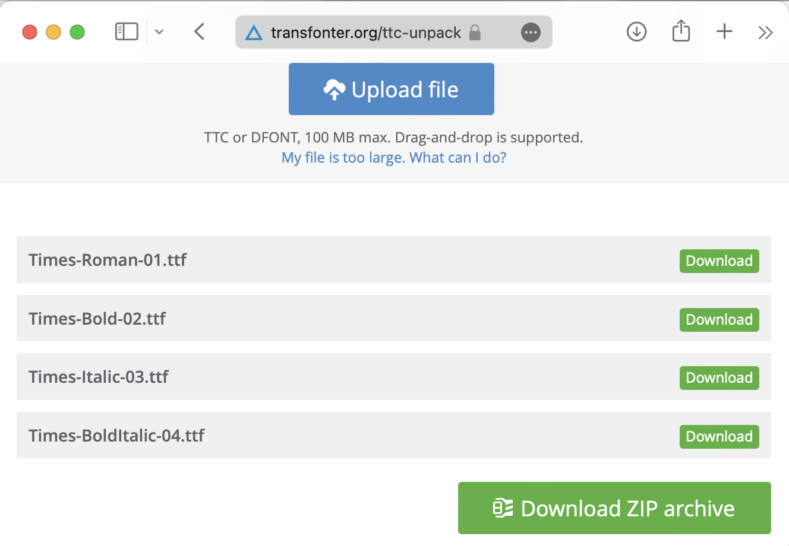
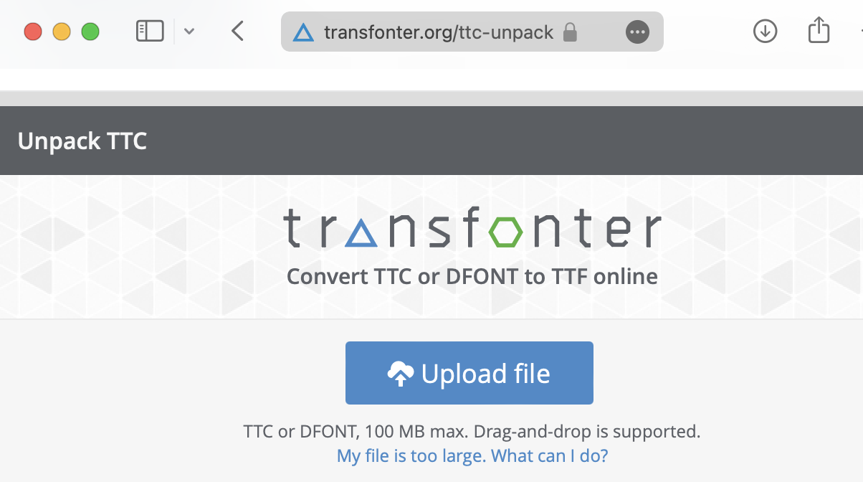
transfonter.org
upload Times.ttc

Slide 35
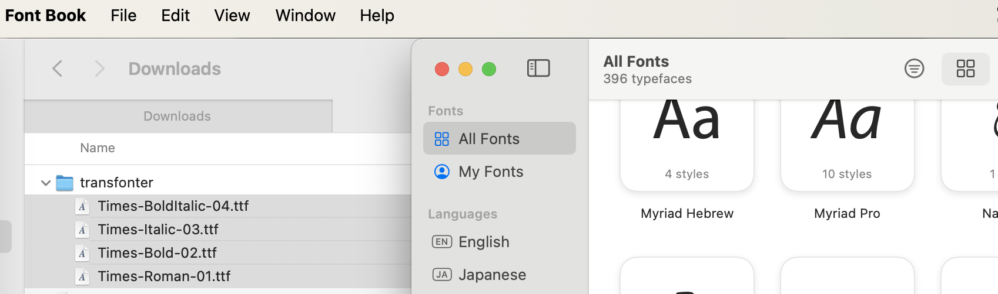
Font Book
Drag downloaded files to Font Book

Slide 36
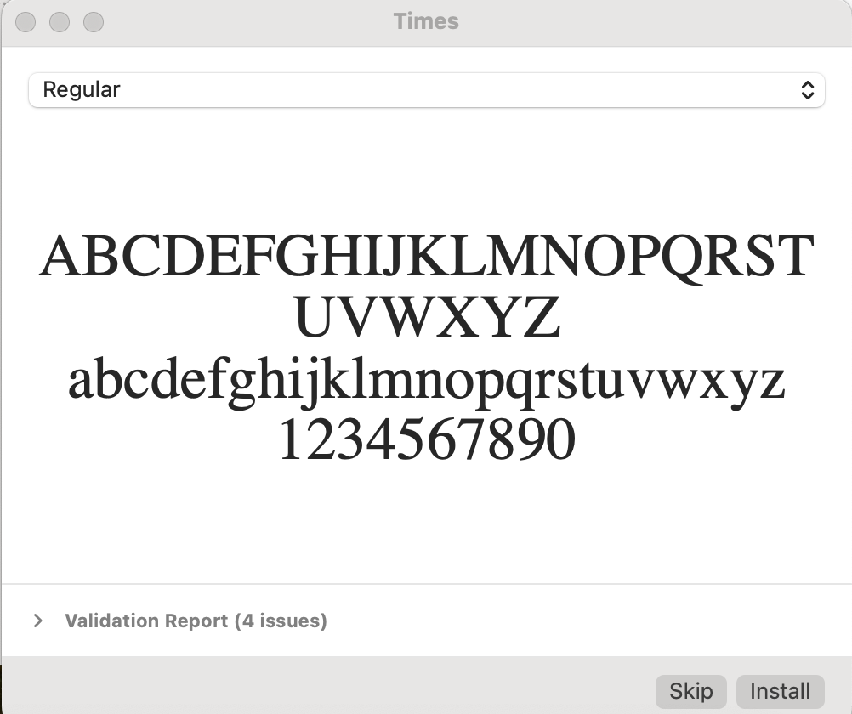
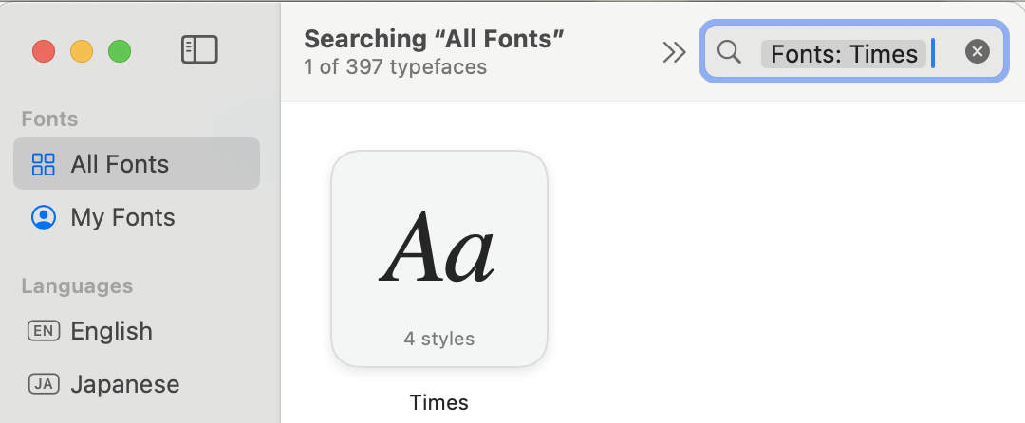
Font Book
install, Times now appears

