Slide 1
LING/C SC 581: Advanced Computational Linguistics
Lecture 19
Prof. Sandiway Fong

Slide 2
Today's Topic
Some lemma methods:
.derivationally_related_forms() (n ⇒ a)
.pertainyms() (a ⇒ n)
WordNet size:
how many words, maximum number of senses, total number of synsets etc.
word2vec: inflectional morphology
Semantic Opposition and WordNet

Slide 3
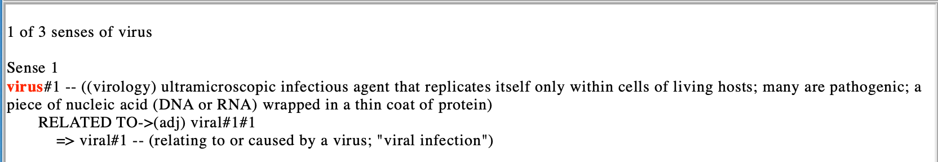
WordNet Relations
Derivationally related to (different parts of speech):
>>> for ss in wn.synsets('virus'):
... for lm in ss.lemmas():
... print(lm, lm.derivationally_related_forms())
...
Lemma('virus.n.01.virus') [Lemma('viral.a.01.viral')]
Lemma('virus.n.02.virus') []
Lemma('virus.n.03.virus') []
Lemma('virus.n.03.computer_virus') []
defined for lemmas only!
>>> wn.synset('virus.n.02').definition()
'a harmful or corrupting agency'

Slide 4
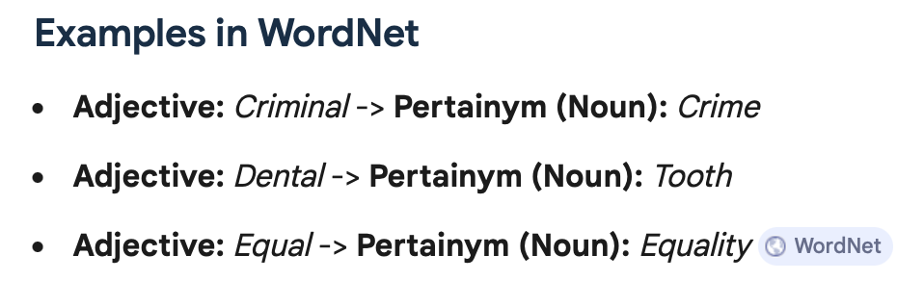
WordNet Relations
Lemma method (from adjective to noun): .pertainyms()
>>> for lm in wn.synset('viral.a.01').lemmas():
... print(lm, lm.pertainyms())
...
Lemma('viral.a.01.viral') [Lemma('virus.n.01.virus')]
>>> for ss in wn.synsets('dental'):
... for lm in ss.lemmas():
... print(lm, lm.pertainyms())
...
Lemma('alveolar_consonant.n.01.alveolar_consonant') []
Lemma('alveolar_consonant.n.01.dental_consonant') []
Lemma('alveolar_consonant.n.01.alveolar') []
Lemma('alveolar_consonant.n.01.dental') []
Lemma('dental.a.01.dental') [Lemma('tooth.n.01.tooth')]
Lemma('dental.a.02.dental') [Lemma('dentistry.n.01.dentistry')
❌
❌

Slide 5
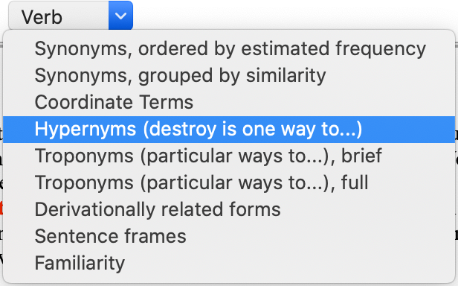
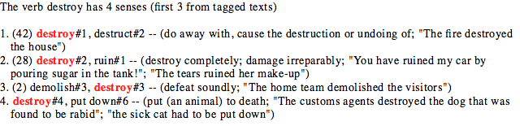
WordNet Relations: verbs
hypernym
troponym
Verbs
destroy (one way to):
destroy#1 => unmake#1, undo#2
destroy#3 => get the better of#1, overcome#1, defeat#1
destroy#4 => kill#1

Slide 6
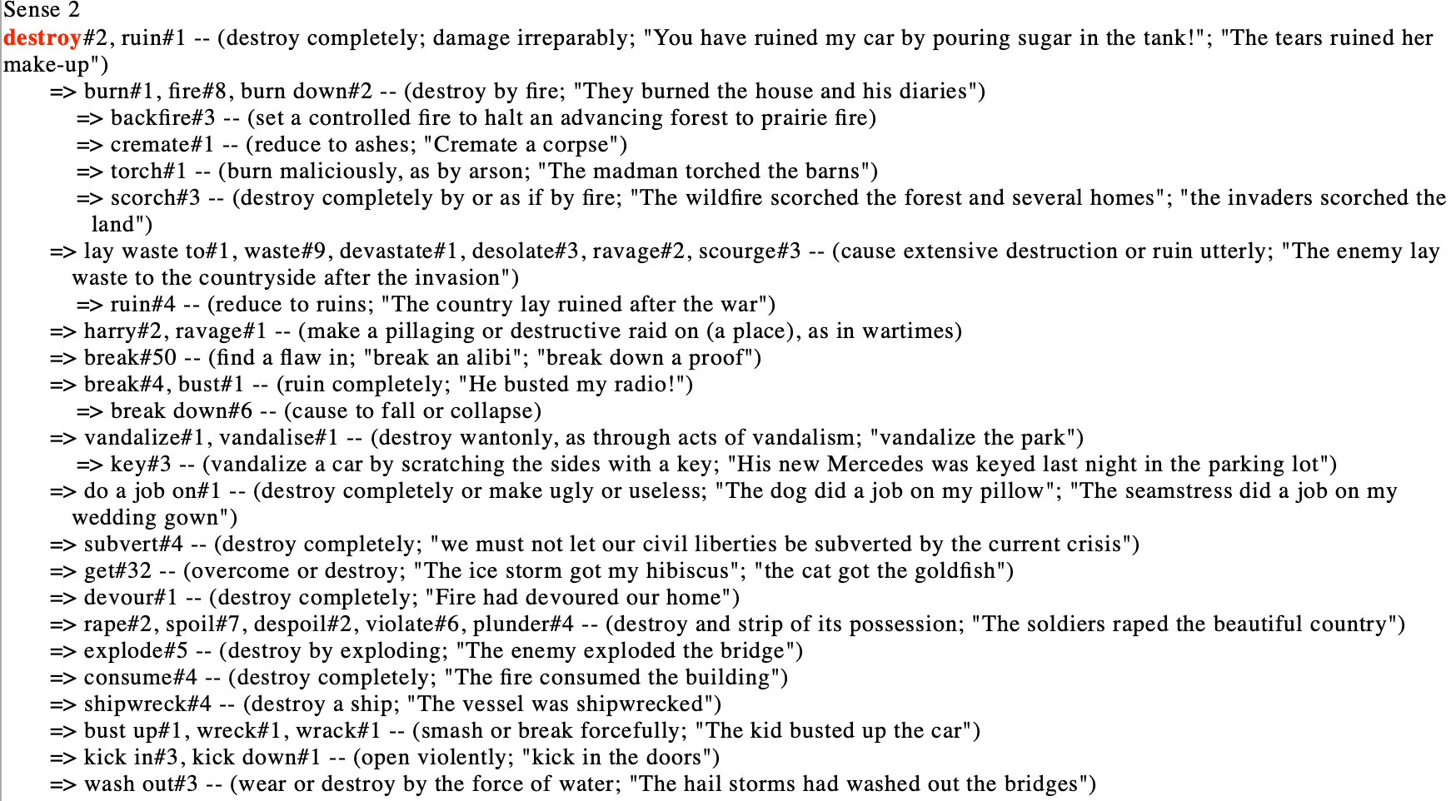
WordNet Relations: verbs
hypernym
troponym
Troponyms (particular ways to destroy#v#2):
e.g. you have ruined my car!

Slide 7
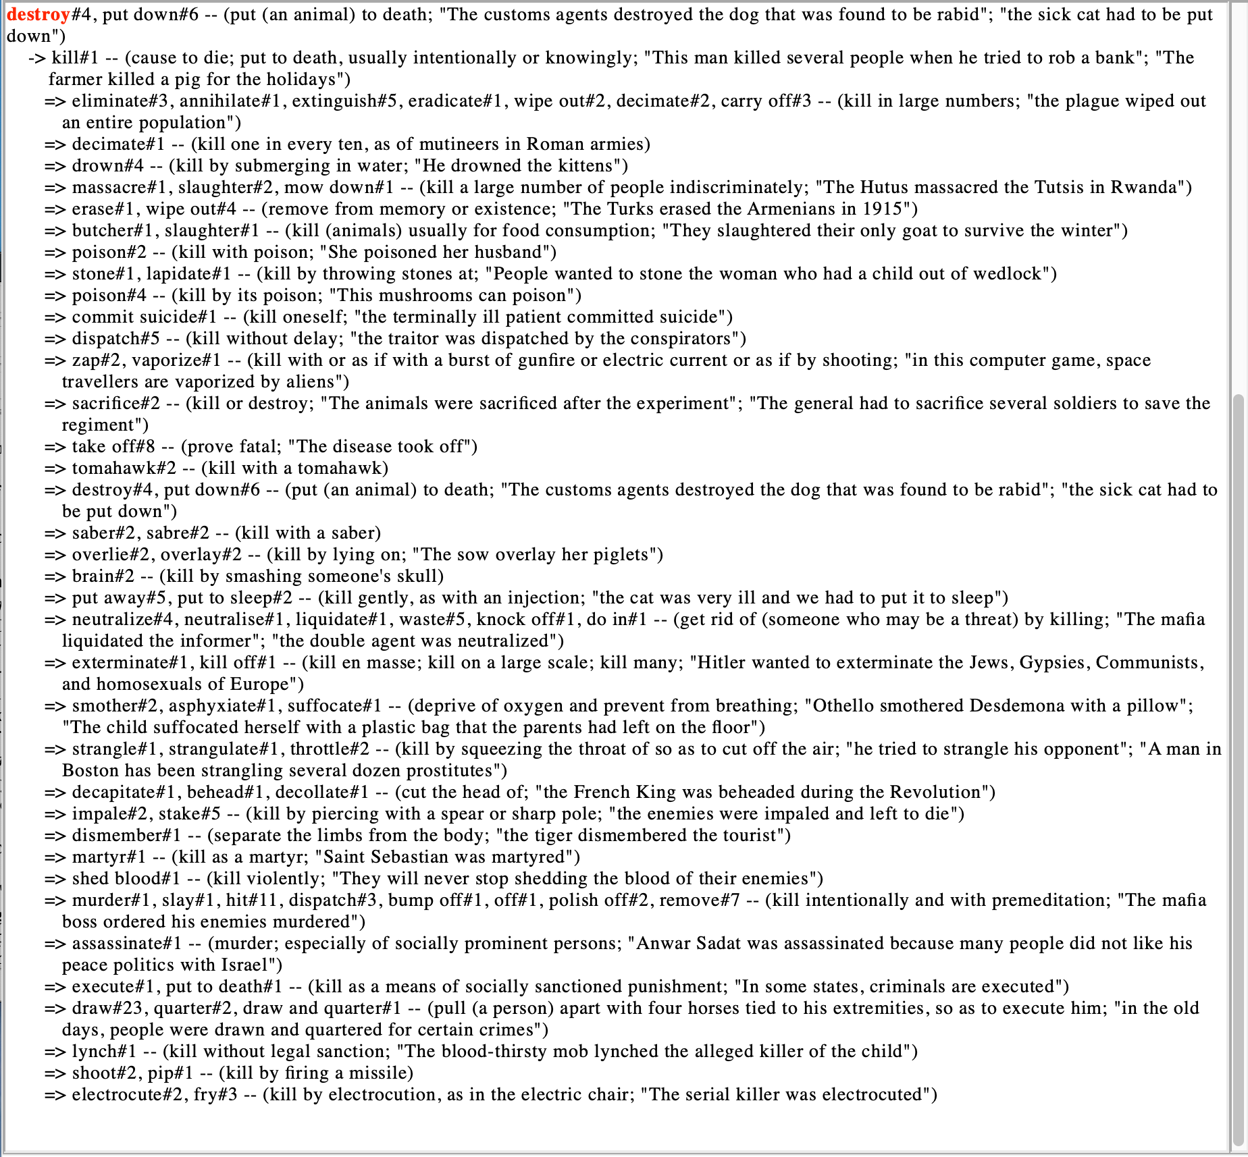
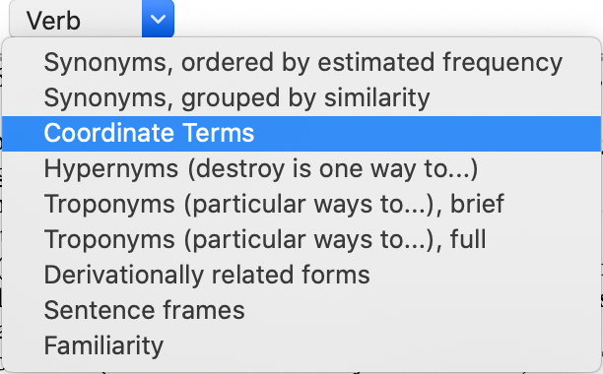
WordNet Relations: verbs
destroy#v#4
destroy#v#4 –up-> kill#v#1 -down-> …

Slide 8
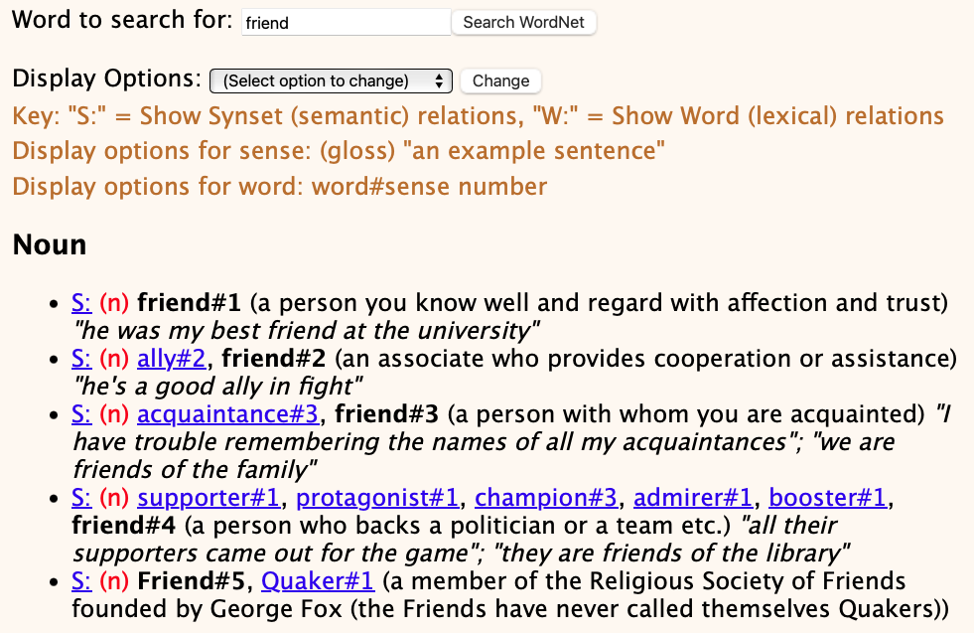
WordNet senses are incomplete
But language is highly productive, and WordNet pre-dates Facebook.

Slide 9
WordNet senses are incomplete
Question: Which word do you think has the most senses?
NPR Pop Culture:
One three-letter word does much of the heavy lifting in the English language. The little word "run" — in its verb form alone — has 645 distinct meanings.
Top three verbs: run, put, set.
https://www.npr.org/2011/05/30/136796448/has-run-run-amok-it-has-645-meanings-so-far

Slide 10
WordNet: run
>>> wn.synsets('run')
[Synset('run.n.01'), Synset('test.n.05'), Synset('footrace.n.01'), Synset('streak.n.01'), Synset('run.n.05'), Synset('run.n.06'), Synset('run.n.07'), Synset('run.n.08'), Synset('run.n.09'), Synset('run.n.10'), Synset('rivulet.n.01'), Synset('political_campaign.n.01'), Synset('run.n.13'), Synset('discharge.n.06'), Synset('run.n.15'), Synset('run.n.16'), Synset('run.v.01'), Synset('scat.v.01'), Synset('run.v.03'), Synset('operate.v.01'), Synset('run.v.05'), Synset('run.v.06'), Synset('function.v.01'), Synset('range.v.01'), Synset('campaign.v.01'), Synset('play.v.18'), Synset('run.v.11'), Synset('tend.v.01'), Synset('run.v.13'), Synset('run.v.14'), Synset('run.v.15'), Synset('run.v.16'), Synset('prevail.v.03'), Synset('run.v.18'), Synset('run.v.19'), Synset('carry.v.15'), Synset('run.v.21'), Synset('guide.v.05'), Synset('run.v.23'), Synset('run.v.24'), Synset('run.v.25'), Synset('run.v.26'), Synset('run.v.27'), Synset('run.v.28'), Synset('run.v.29'), Synset('run.v.30'), Synset('run.v.31'), Synset('run.v.32'), Synset('run.v.33'), Synset('run.v.34'), Synset('ply.v.03'), Synset('hunt.v.01'), Synset('race.v.02'), Synset('move.v.13'), Synset('melt.v.01'), Synset('ladder.v.01'), Synset('run.v.41')]
>>> len(wn.synsets('run'))
57
>>> len(wn.synsets('put'))
10
>>> len(wn.synsets('set'))
45

Slide 11
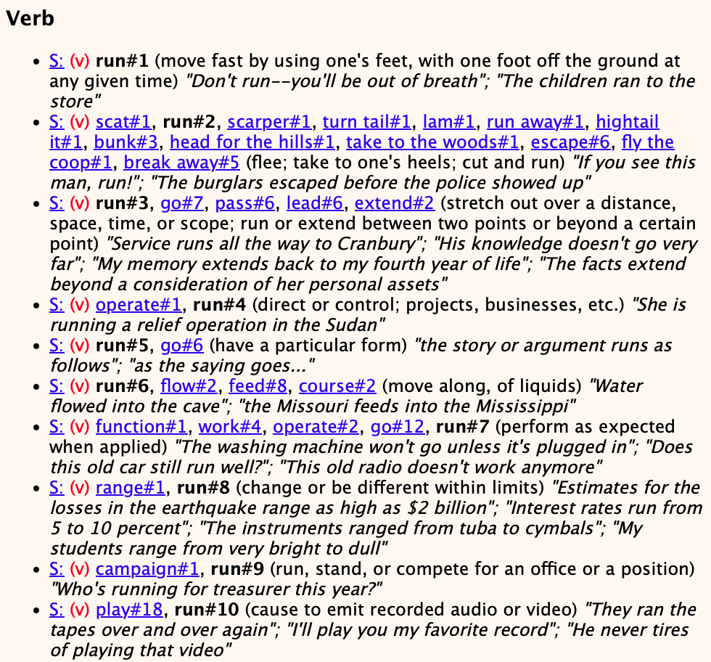
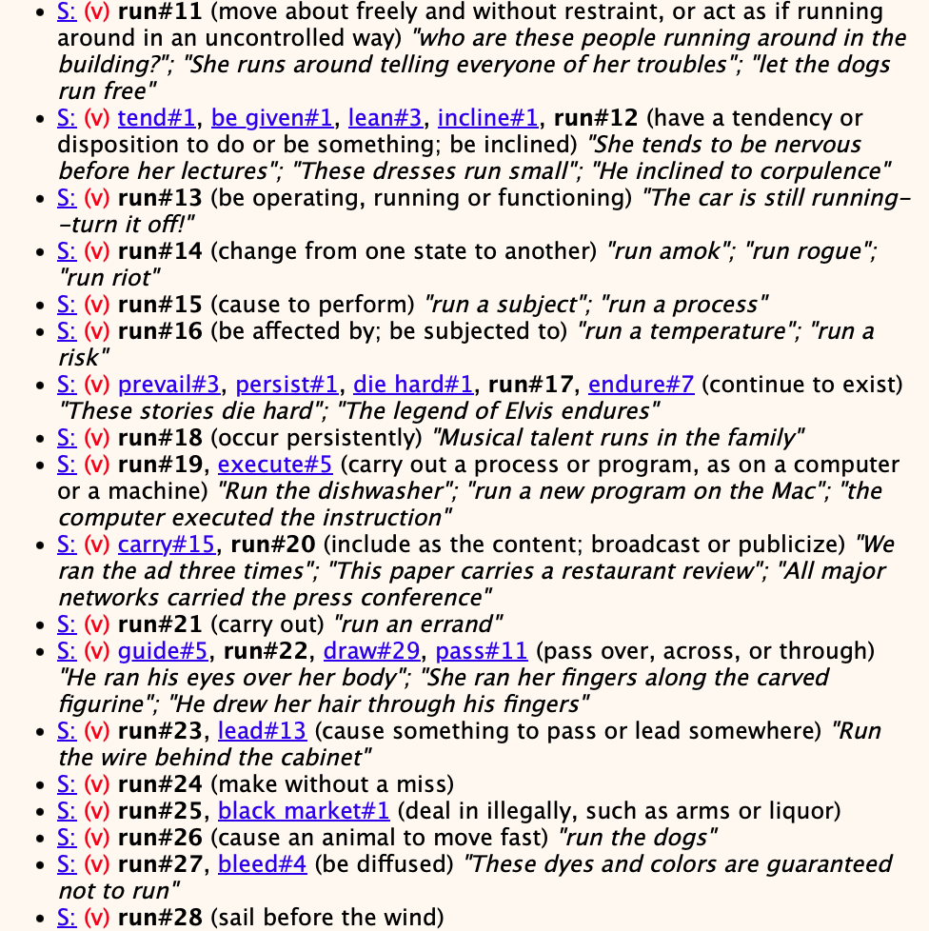
WordNet: run

Slide 12
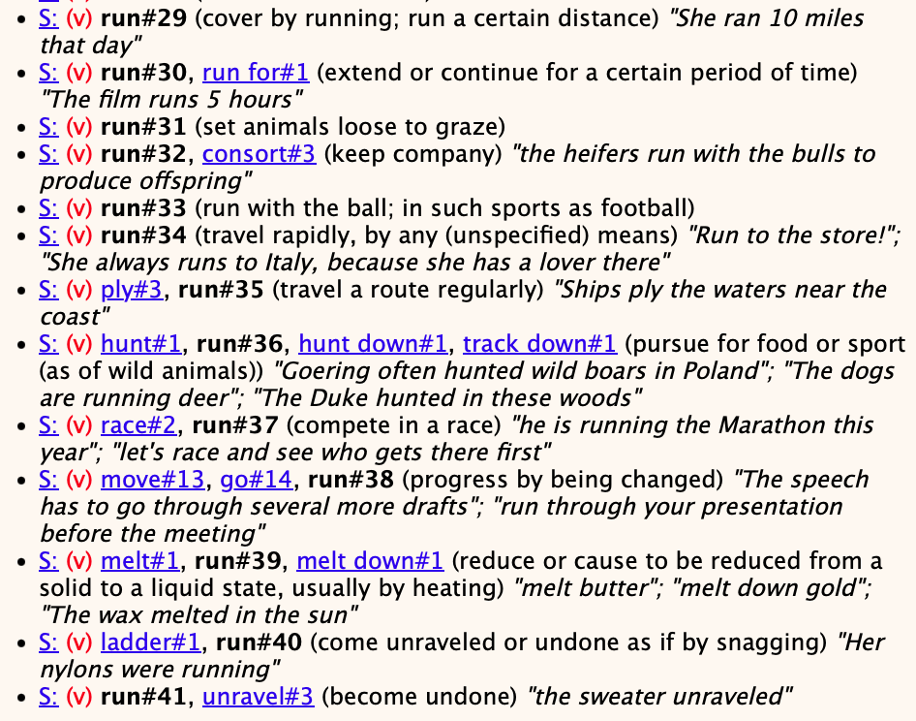
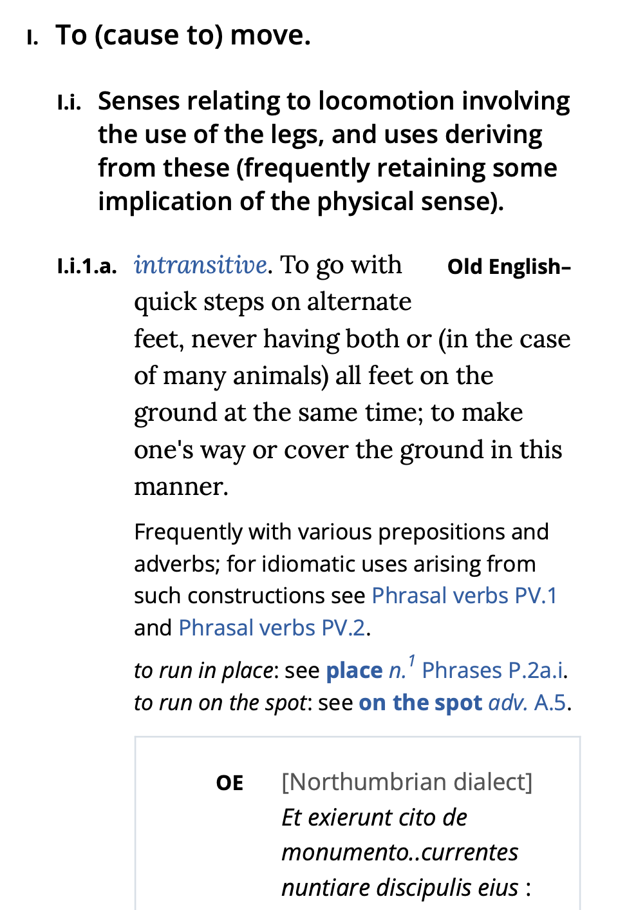
WordNet: run
OED: over 800 pages long!
Also, run has 16 senses as a noun.

Slide 13
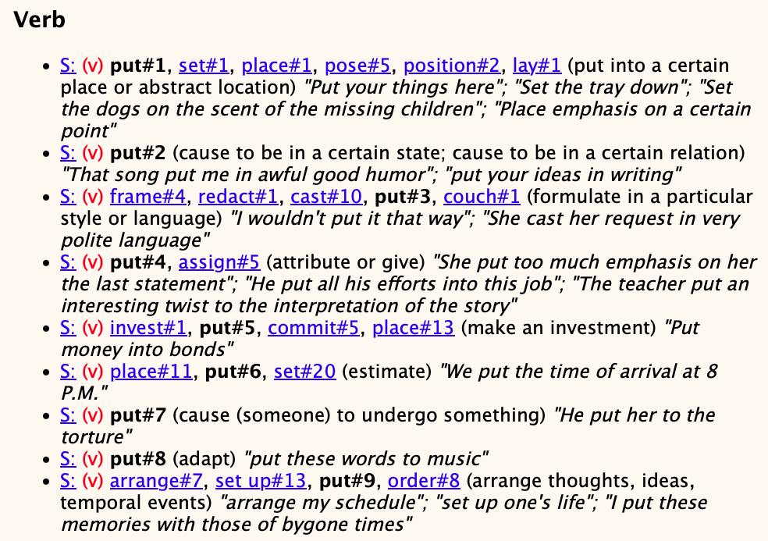
WordNet: put
Plus 1 as a noun

Slide 14
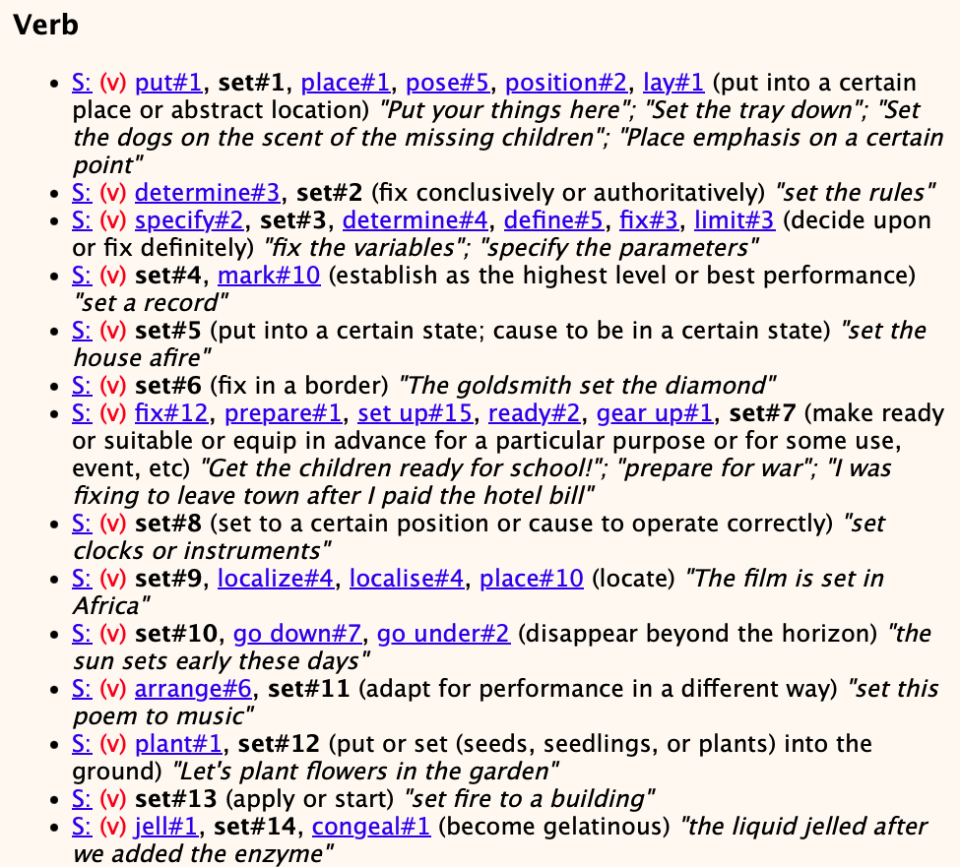
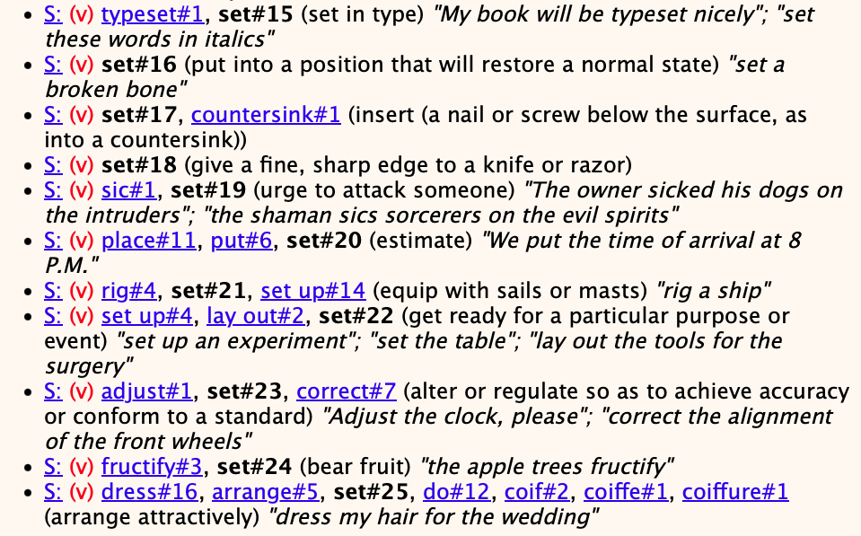
WordNet: set
Plus 13 as a noun and 7 senses as an adjective

Slide 15
WordNet: words()
>>> len(list(wn.words()))
147306
>>> list(wn.words())[0]
'.22-caliber'
>>> list(wn.words())[-1]
'zoom_in'
>>> sum([len(wn.synsets(word)) for word in wn.words()])
227368
>>> max = 0; maxword = ""
>>> for word in wn.words():
... n = len(wn.synsets(word))
... if n > max:
... max = n; maxword = word
...
>>> max
75
>>> maxword
'break'

Slide 16
word2vec
Examples (inflectional morphology):
model.most_similar(positive=['tables','bicycle'],negative=['bicycles'],topn=3)
[('table', 0.5977630019187927), ('Tables', 0.520125687122345), ('napkin', 0.4212760031223297)]
model.most_similar(positive=['table','geese'],negative=['goose'],topn=3)
[('tables', 0.5640795826911926), ('Tables', 0.3900391459465027), ('seated', 0.3859478235244751)]
model.most_similar(positive=['sheep','geese'],negative=['goose'],topn=3)
[('cows', 0.6649561524391174), ('cattle', 0.6110979318618774), ('lambs', 0.609976053237915)]
Let's test a few more?

Slide 17
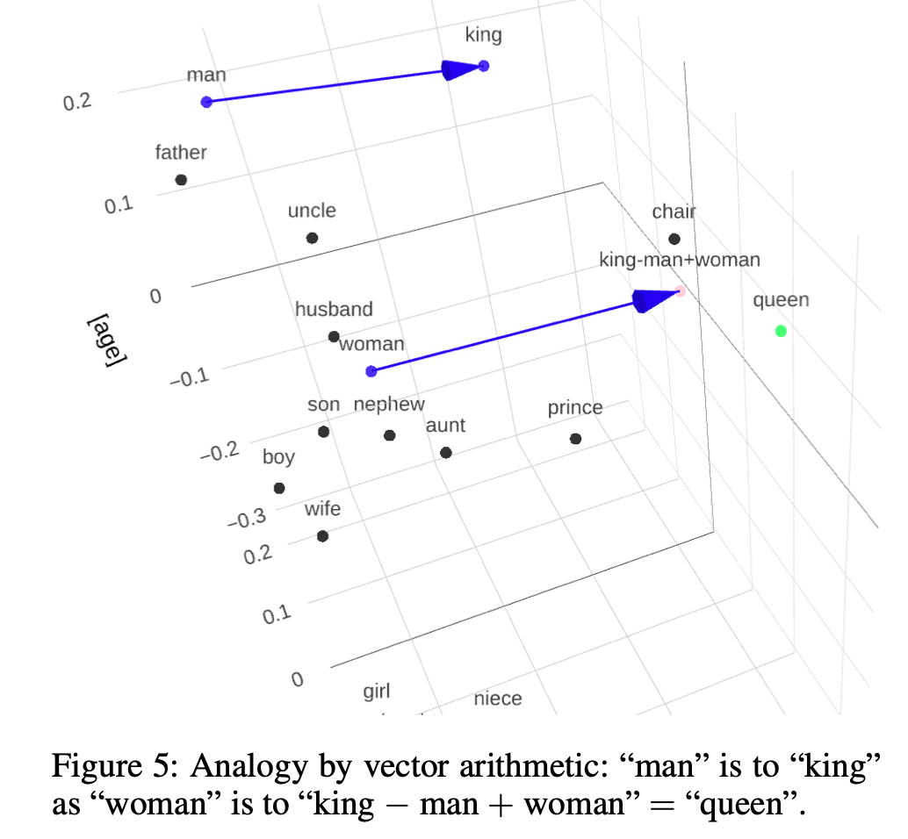
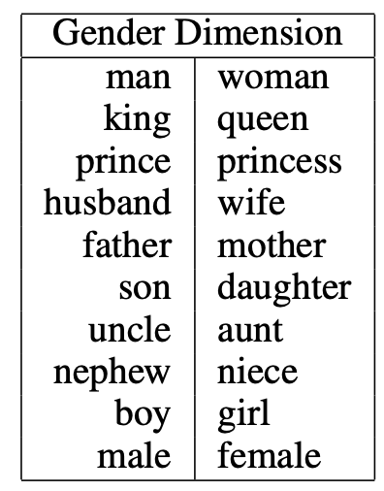
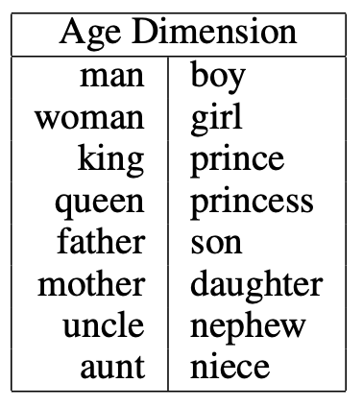
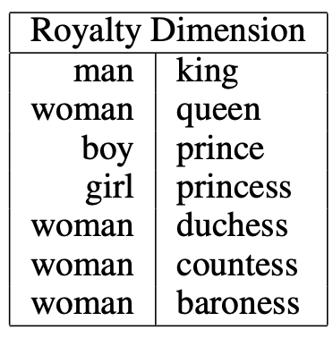
word2vec
Semantic dimensions:
https://www.cs.cmu.edu/~dst/WordEmbeddingDemo/EAAI-2022-Word-Embedding.pdf
given the word “king”, we measure its position along the gender axis by taking the dot product of its embedding vector with a “gender” unit vector.

Slide 18
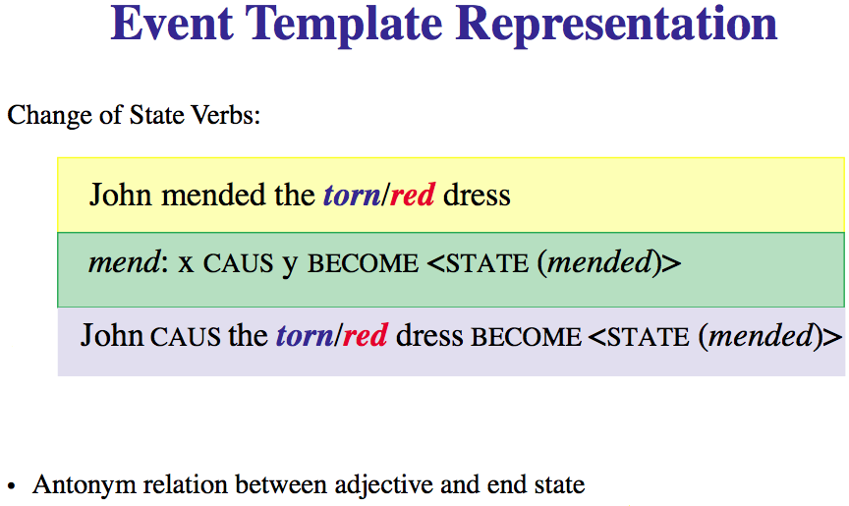
Using WordNet: Example

Slide 19
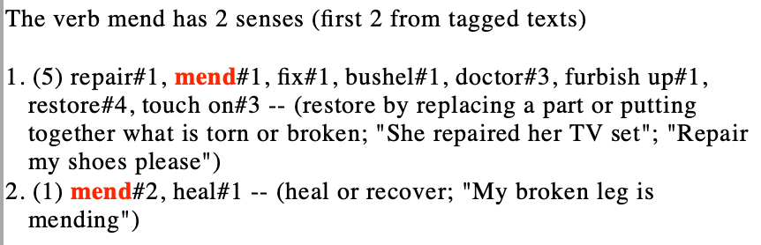
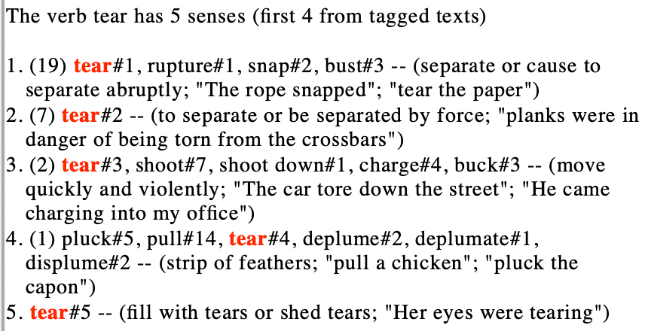
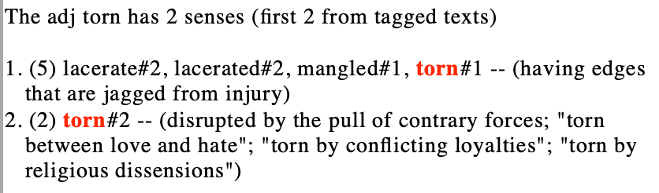
Semantic Opposition: mend vs. tear/torn

Slide 20
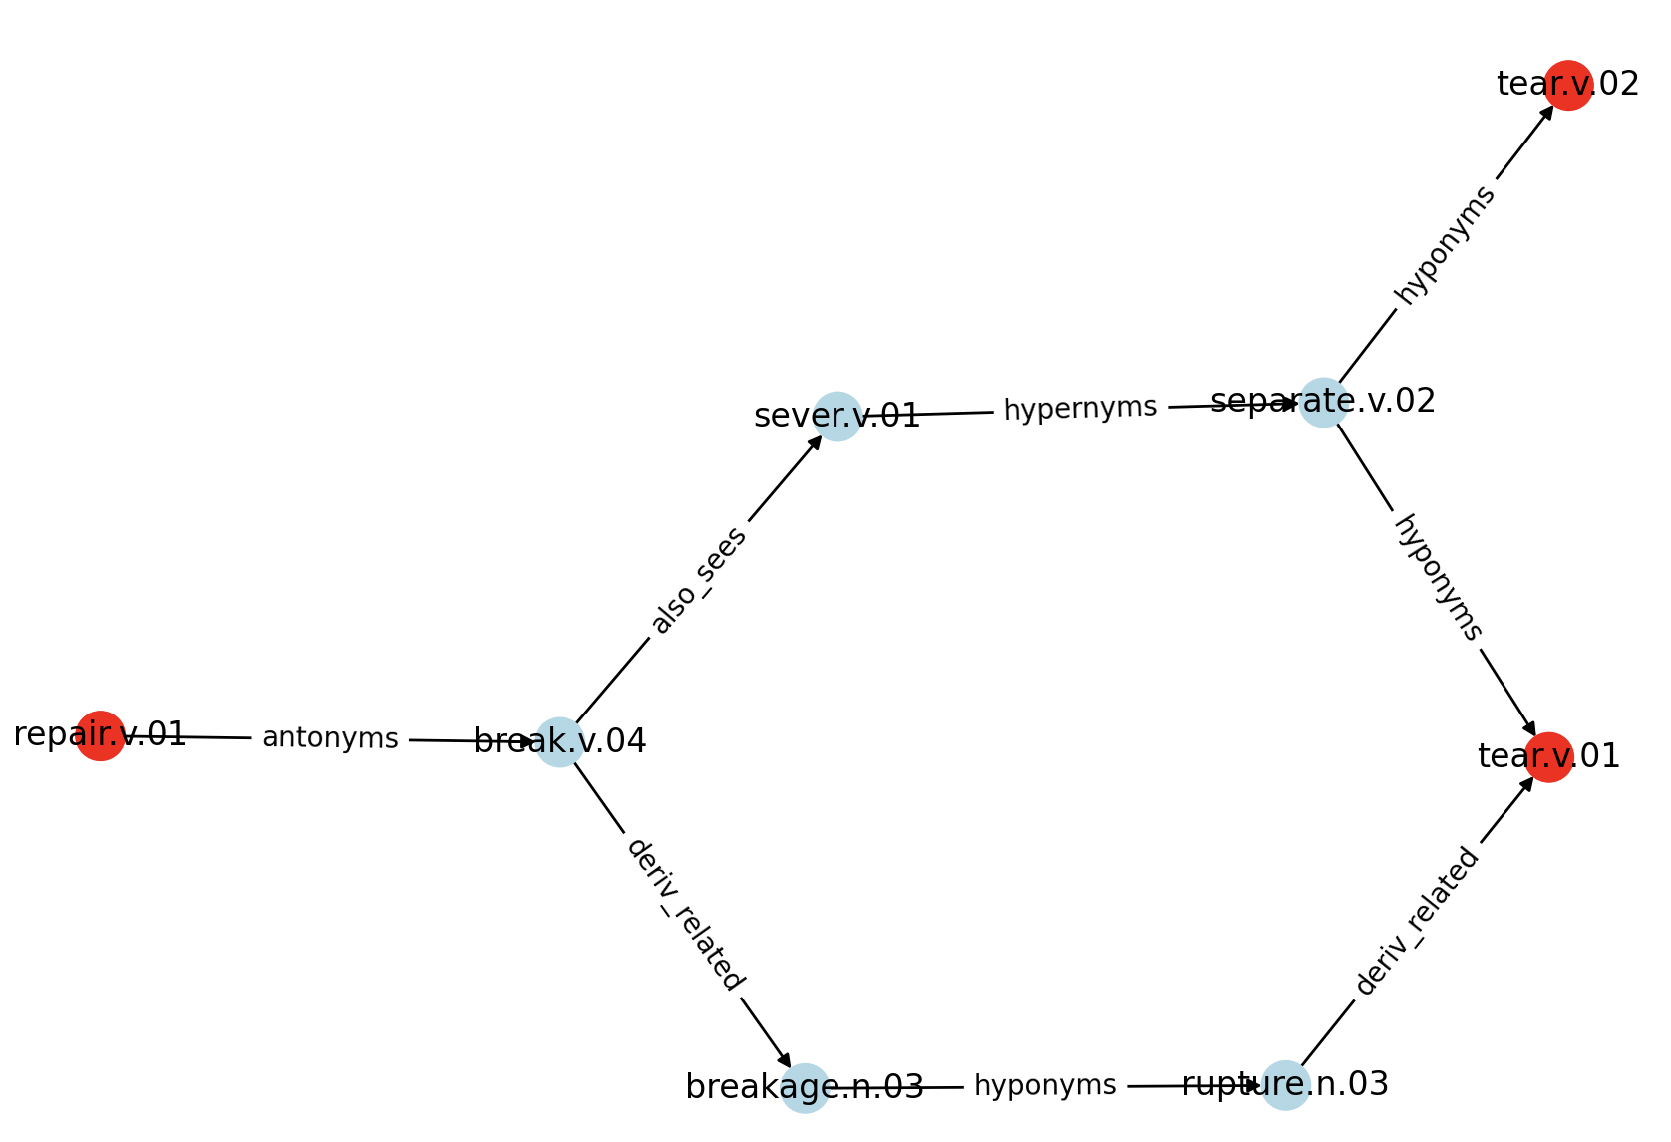
Semantic Opposition: mend vs. tear/torn
5 possibilities:
Two connections found!

Slide 21
Semantic Opposition: mend vs. tear/torn
Do a minimal distance search for a graph connection between two synsets
using breadth-first search (bfs)
$ python3 bfs.py mend.v.01 tear.v.01 mend.v.01 tear.v.02
start: mend.v.01 is in synset repair.v.01
end: tear.v.01 is in synset tear.v.01
Found at distance 4 (13614 nodes expanded)
tear.v.01 deriv_related rupture.n.03 hyponyms breakage.n.03 deriv_related break.v.04 antonyms repair.v.01
Found at distance 4 (13856 nodes expanded)
tear.v.01 hyponyms separate.v.02 hypernyms sever.v.01 also_sees break.v.04 antonyms repair.v.01
Search space complete
DiGraph with 7 nodes and 7 edges
start: mend.v.01 is in synset repair.v.01
end: tear.v.02 is in synset tear.v.02
Found at distance 4 (13847 nodes expanded)
tear.v.02 hyponyms separate.v.02 hypernyms sever.v.01 also_sees break.v.04 antonyms repair.v.01
Search space complete
DiGraph with 8 nodes and 8 edges
$ python3 bfs.py mend.v.01 tear.v.03
start: mend.v.01 is in synset repair.v.01
end: tear.v.03 is in synset tear.v.03
Not found (distance 5 and 100175 nodes expanded)
$ python3 bfs.py mend.v.01 tear.v.04
start: mend.v.01 is in synset repair.v.01
end: tear.v.04 is in synset pluck.v.05
Not found (distance 5 and 100124 nodes expanded)
$ python3 bfs.py mend.v.01 tear.v.05
start: mend.v.01 is in synset repair.v.01
end: tear.v.05 is in synset tear.v.05
Not found (distance 5 and 100128 nodes expanded)

Slide 22
Semantic Opposition: mend vs. tear/torn
Cross-category searching is fragile:
4 sub-networks for nouns, verbs, adjectives and adverbs are not well-connected
$ python3 bfs.py -m 300000 tear.v.01 torn.a.01 tear.v.02 torn.a.02
start: tear.v.01 is in synset tear.v.01
end: torn.a.01 is in synset lacerate.s.02
Not found (distance 6 and 300098 nodes expanded)
start: tear.v.02 is in synset tear.v.02
end: torn.a.02 is in synset torn.s.02
Not found (distance 6 and 300017 nodes expanded)

Slide 23
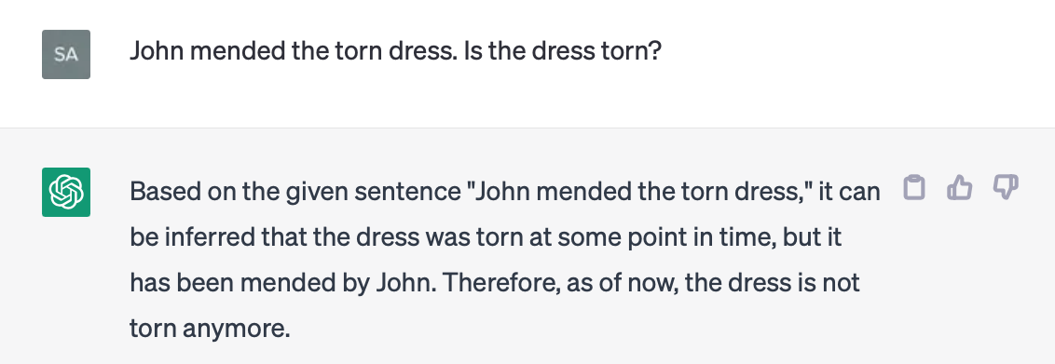
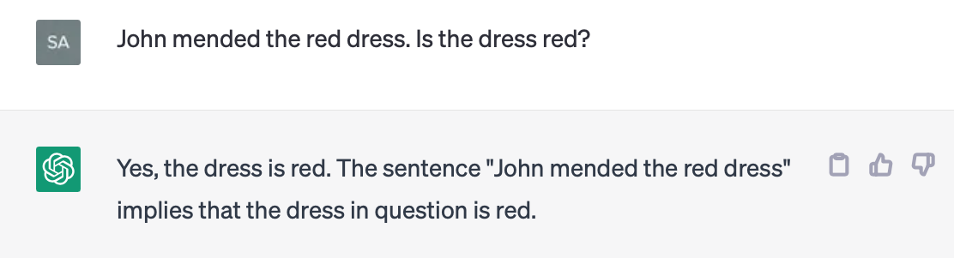
Semantic Opposition and ChatGPT

Slide 24
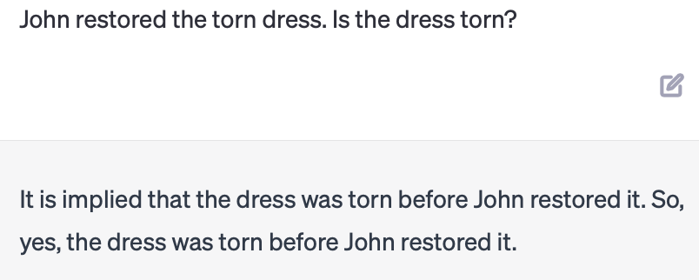
Semantic Opposition and ChatGPT
Synset: {repair, fix, restore, mend, … }
Presupposition only

Slide 25
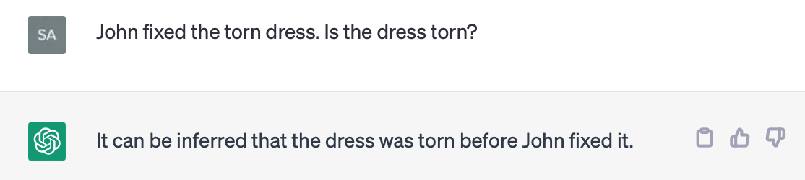
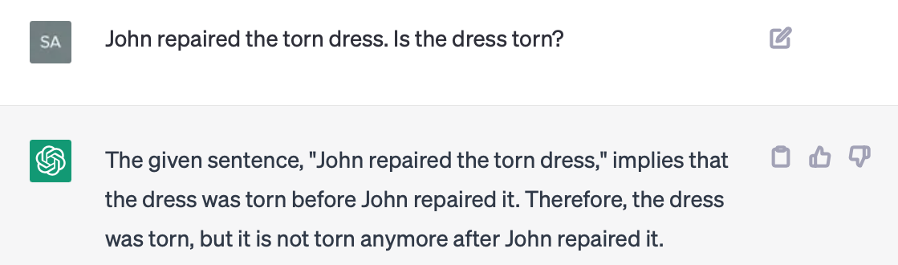
Semantic Opposition and ChatGPT
Synset: {repair, fix, restore, mend, … }
Presupposition only

Slide 26
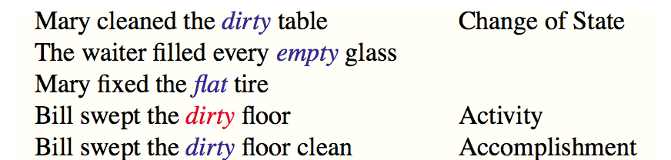
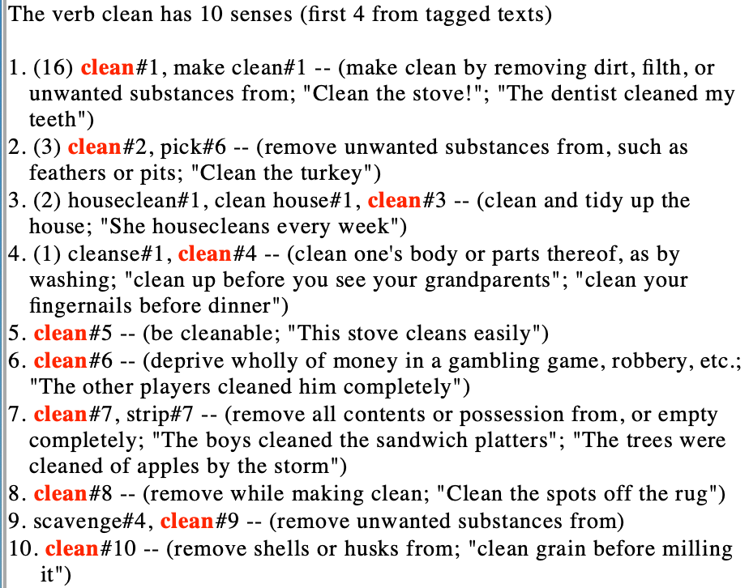
Semantic Opposition: clean vs. dirty
resultative

Slide 27
More examples
Event-based Models of Change and Persistence in Language (Pustejovsky, 2000).
Adapted examples:
The waiter filled every empty glass
Mary fixed the flat tire
Mary fixed the leaky tire
John comforted the crying child
John rescued the drowning man
The nurse mixed the powdered milk
Which ones work?
Can you think of others?

Slide 28
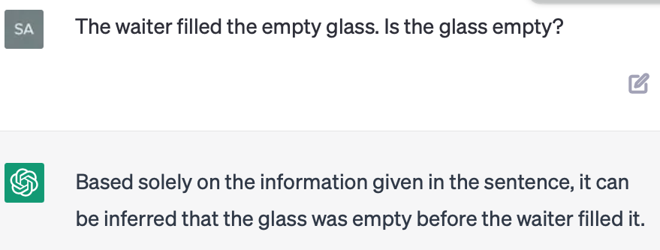
Semantic Opposition
Other accomplishment verbs:
The waiter filled the empty glass
Mary fixed the flat tire
Presupposition only

Slide 29
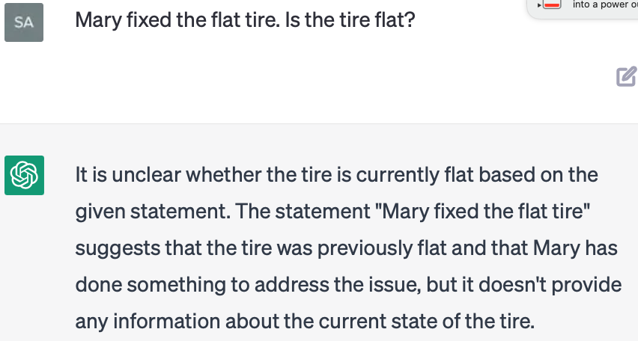
Semantic Opposition and ChatGPT
Other accomplishment verbs:
The waiter filled the empty glass
Mary fixed the flat tire

Slide 30
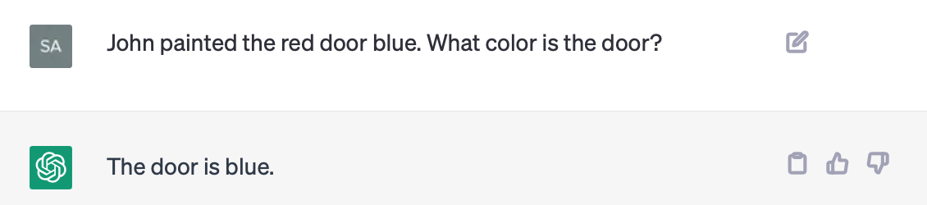
Semantic Opposition and ChatGPT
Activity verbs and resultatives:
John painted the red door blue
John swept the dirty floor
John swept the dirty floor clean

Slide 31
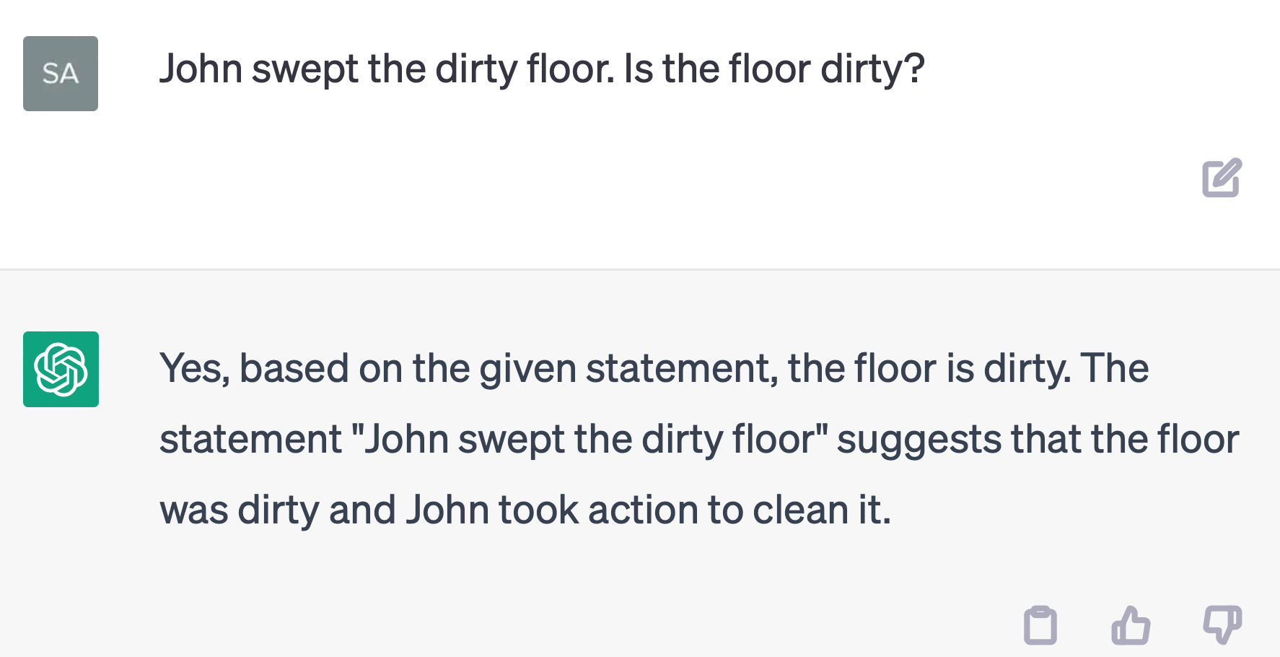
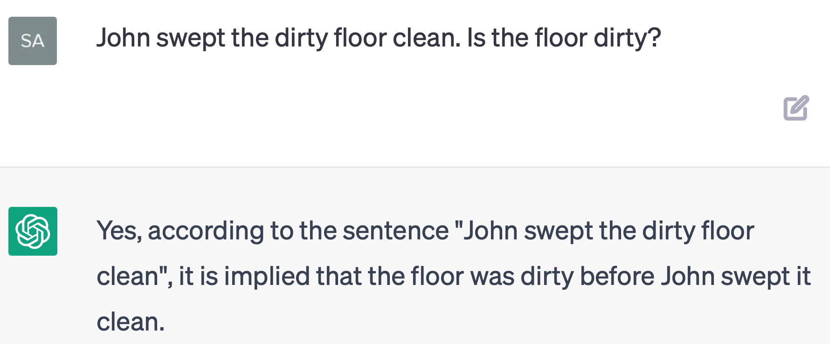
Semantic Opposition and ChatGPT
Activity verbs and resultatives:
John swept the dirty floor
John swept the dirty floor clean

Slide 32
