Slide 1
LING/C SC 581:
Advanced Computational Linguistics
Lecture 18
Prof. Sandiway Fong

Slide 2
Today's Topic
Homework 9 Review
A look at similarity
  WordNet vs. Word Embeddings

Slide 3
Homework 9 Review
Q1: automobile (46) vs. aeroplane (25) vs. motorcycle (3)
>>> list(wn.synset('automobile.n.01').closure(lambda x:x.part_meronyms()))
[Synset('air_bag.n.01'), Synset('hood.n.09'), Synset('luggage_compartment.n.01'), Synset('automobile_engine.n.01'), Synset('roof.n.02'), Synset('auto_accessory.n.01'), Synset('gasoline_engine.n.01'), Synset('sunroof.n.01'), Synset('automobile_horn.n.01'), Synset('buffer.n.06'), Synset('fender.n.01'), Synset('rear_window.n.01'), Synset('floorboard.n.02'), Synset('glove_compartment.n.01'), Synset('grille.n.02'), Synset('car_window.n.01'), Synset('accelerator.n.01'), Synset('first_gear.n.01'), Synset('car_mirror.n.01'), Synset('stabilizer_bar.n.01'), Synset('car_door.n.01'), Synset('reverse.n.02'), Synset('bumper.n.02'), Synset('car_seat.n.01'), Synset('high_gear.n.01'), Synset('third_gear.n.01'), Synset('window.n.02'), Synset('tail_fin.n.02'), Synset('running_board.n.01'), Synset('hood_ornament.n.01'), Synset('exhaust.n.02'), Synset('inlet_manifold.n.01'), Synset('horn_button.n.01'), Synset('hinge.n.01'), Synset('armrest.n.01'), Synset('doorlock.n.01'), Synset('bumper_guard.n.01'), Synset('back.n.08'), Synset('headrest.n.01'), Synset('seat_belt.n.01'), Synset('exhaust_pipe.n.01'), Synset('exhaust_manifold.n.01'), Synset('tailpipe.n.01'), Synset('silencer.n.02'), Synset('exhaust_valve.n.01'), Synset('pintle.n.01')]
>>> list(wn.synset('airplane.n.01').closure(lambda x:x.part_meronyms()))
[Synset('windshield.n.01'), Synset('accelerator.n.01'), Synset('pod.n.04'), Synset('landing_gear.n.01'), Synset('radome.n.01'), Synset('wing.n.02'), Synset('hood.n.09'), Synset('navigation_light.n.01'), Synset('fuselage.n.01'), Synset('escape_hatch.n.01'), Synset('nosewheel.n.01'), Synset('rib.n.01'), Synset('aileron.n.01'), Synset('flap.n.05'), Synset('hood_ornament.n.01'), Synset('porthole.n.01'), Synset('tail.n.07'), Synset('deadlight.n.01'), Synset('horizontal_tail.n.01'), Synset('vertical_tail.n.01'), Synset('stabilizer.n.02'), Synset('horizontal_stabilizer.n.01'), Synset('elevator.n.02'), Synset('rudder.n.01'), Synset('vertical_stabilizer.n.01')]
>>> list(wn.synset('motorcycle.n.01').closure(lambda x:x.part_meronyms()))
[Synset('kick_starter.n.01'), Synset('kickstand.n.01'), Synset('mudguard.n.01')]

Slide 4
Homework 9 Review
Question 2: part meronym inheritance
>>> for ss in wn.synset('armchair.n.01').closure(lambda x:x.hypernyms()):
... print(ss.part_meronyms())
...
[Synset('back.n.08'), Synset('leg.n.03')]
[Synset('upholstery.n.01'), Synset('seat.n.04')]
[]
[]
[]
[]
[Synset('section.n.04'), Synset('part.n.02')]
[]
[]
[]
Synset('artifact'.n.01')
Synset('whole.n.02')

Slide 5
Homework 9 Review
Question 3: items with arms
>>> wn.synset('arm.n.01').part_holonyms()
[Synset('body.n.01'), Synset('homo.n.02')]
>>> for ss in wn.synset('arm.n.01').part_holonyms():
... print(list(ss.closure(lambda x:x.hyponyms())))
...
[Synset('life_form.n.01'), Synset('live_body.n.01'), Synset('human_body.n.01'), Synset('system.n.08'), Synset('adult_body.n.01'), Synset('juvenile_body.n.01'), Synset('male_body.n.01'), Synset('female_body.n.01'), Synset('person.n.02'), Synset('adult_male_body.n.01'), Synset('adult_female_body.n.01'), Synset('child's_body.n.01')]
[Synset('homo_habilis.n.01'), Synset('homo_soloensis.n.01'), Synset('neandertal_man.n.01'), Synset('rhodesian_man.n.01'), Synset('world.n.08'), Synset('homo_sapiens.n.01'), Synset('homo_erectus.n.01'), Synset('solo_man.n.01'), Synset('homo_sapiens_sapiens.n.01'), Synset('cro-magnon.n.01'), Synset('boskop_man.n.01'), Synset('java_man.n.01'), Synset('peking_man.n.01')]
>>> wn.synset('world.n.08').definition()
'all of the living human inhabitants of the earth'

Slide 6
Homework 9 Review
Question 3: items with arms
>>> for ss in wn.synset('arm.n.04').part_holonyms():
... print(list(ss.closure(lambda x:x.hyponyms())))
...
[Synset('easy_chair.n.01'), Synset('recliner.n.01'), Synset('captain's_chair.n.01'), Synset('morris_chair.n.01'), Synset('fauteuil.n.01'), Synset('wing_chair.n.01')]

Slide 7
Homework 9 Review
Question 3: items with arms
>>> s = set()
>>> for ss in wn.synset('arm.n.06').part_holonyms():
... s.update(set(ss.closure(lambda x:x.hyponyms())))
...
>>> len(s)
271

Slide 8
Homework 9 Review
Question 3: items with arms
>>> for ss in wn.synset('arm.n.06').part_holonyms():
... print(list(ss.closure(lambda x:x.hyponyms())))
[Synset('peplos.n.01'), Synset('silks.n.01'), Synset('haik.n.01'), Synset('jump_suit.n.01'), Synset('reversible.n.01'), Synset('hose.n.02'), Synset('robe.n.01'), Synset('romper.n.02'), Synset('shirt.n.01'), Synset('sweater.n.01'), Synset('burqa.n.01'), Synset('overgarment.n.01'), Synset('weeds.n.01'), Synset('scarf.n.01'), Synset('sweat_suit.n.01'), Synset('leotard.n.01'), Synset('straitjacket.n.02'), Synset('undergarment.n.01'), Synset('stomacher.n.01'), Synset('hand-me-down.n.01'), Synset('separate.n.02'), Synset('fur.n.03'), Synset('sealskin.n.02'), Synset('wet_suit.n.01'), Synset('breechcloth.n.01'), Synset('trouser.n.02'), Synset('neckwear.n.01'), Synset('kanzu.n.01'), Synset('swimsuit.n.01'), Synset('head_covering.n.01'), Synset('camlet.n.01'), Synset('vest.n.01'), Synset('legging.n.01'), Synset('mending.n.01'), Synset('raglan.n.01'), Synset('skirt.n.02'), Synset('suit.n.01'), Synset('swaddling_clothes.n.01'), Synset('trouser.n.01'), Synset('ironing.n.01'), Synset('sackcloth.n.01'), Synset('wraparound.n.01'), Synset('gown.n.04'), Synset('laundry.n.01'), Synset('sunsuit.n.01'), Synset('scapular.n.02'), Synset('motley.n.02'), Synset('diaper.n.01'), Synset('dressing_gown.n.01'), Synset('abaya.n.01'), Synset('kimono.n.01'), Synset('bathrobe.n.01'), Synset('polo_shirt.n.01'), Synset('dress_shirt.n.01'), Synset('dashiki.n.01'), Synset('camise.n.01'), Synset('work-shirt.n.01'), Synset('jersey.n.03'), Synset('hair_shirt.n.01'), Synset('tank_top.n.01'), Synset('kurta.n.01'), Synset('cardigan.n.01'), Synset('pullover.n.01'), Synset('turtleneck.n.01'), Synset('izar.n.01'), Synset('aba.n.01'), Synset('cloak.n.02'), Synset('coat.n.01'), Synset('snowsuit.n.01'), Synset('muffler.n.02'), Synset('kerchief.n.01'), Synset('rebozo.n.01'), Synset('sable.n.04'), Synset('stole.n.01'), Synset('feather_boa.n.01'), Synset('fichu.n.01'), Synset('lambrequin.n.01'), Synset('tudung.n.01'), Synset('mantilla.n.01'), Synset('patka.n.01'), Synset('brassiere.n.01'), Synset('foundation_garment.n.01'), Synset('singlet.n.01'), Synset('garter_belt.n.01'), Synset('chemise.n.01'), Synset('petticoat.n.01'), Synset('underwear.n.01'), Synset('body_stocking.n.01'), Synset('long_underwear.n.01'), Synset('underpants.n.01'), Synset('camisole.n.01'), Synset('dhoti.n.01'), Synset('necktie.n.01'), Synset('cravat.n.01'), Synset('swimming_trunks.n.01'), Synset('maillot.n.01'), Synset('bikini.n.02'), Synset('yashmak.n.01'), Synset('face_veil.n.01'), Synset('chador.n.01'), Synset('bulletproof_vest.n.01'), Synset('spat.n.02'), Synset('chap.n.04'), Synset('puttee.n.01'), Synset('gaiter.n.03'), Synset('overskirt.n.01'), Synset('miniskirt.n.01'), Synset('ballet_skirt.n.01'), Synset('sarong.n.01'), Synset('grass_skirt.n.01'), Synset('full_skirt.n.01'), Synset('maxi.n.01'), Synset('gathered_skirt.n.01'), Synset('hoopskirt.n.01'), Synset('hobble_skirt.n.01'), Synset('lavalava.n.01'), Synset('culotte.n.01'), Synset('kilt.n.01'), Synset('single-breasted_suit.n.01'), Synset('slack_suit.n.01'), Synset('double-breasted_suit.n.01'), Synset('zoot_suit.n.01'), Synset('business_suit.n.01'), Synset('pinstripe.n.01'), Synset('churidars.n.01'), Synset('slacks.n.01'), Synset('chino.n.01'), Synset('jodhpurs.n.01'), Synset('jean.n.01'), Synset('long_trousers.n.01'), Synset('pantaloon.n.03'), Synset('short_pants.n.01'), Synset('pedal_pusher.n.01'), Synset('trews.n.01'), Synset('bellbottom_trousers.n.01'), Synset('pajama.n.01'), Synset('salwar.n.01'), Synset('stretch_pants.n.01'), Synset('breeches.n.01'), Synset('flannel.n.03'), Synset('sweat_pants.n.01'), Synset('cords.n.01'), Synset('flatwork.n.01'), Synset('sweatshirt.n.01'), Synset('pallium.n.04'), Synset('capote.n.02'), Synset('jellaba.n.01'), Synset('poncho.n.01'), Synset('cape.n.02'), Synset('dolman.n.02'), Synset('wrap.n.01'), Synset('tunic.n.02'), Synset('capuchin.n.01'), Synset('shawl.n.01'), Synset('domino.n.02'), Synset('burnous.n.01'), Synset('cope.n.02'), Synset('toga.n.01'), Synset('caftan.n.02'), Synset('opera_cloak.n.01'), Synset('box_coat.n.01'), Synset('jacket.n.01'), Synset('sheepskin_coat.n.01'), Synset('topper.n.05'), Synset('coatee.n.01'), Synset('greatcoat.n.01'), Synset('surcoat.n.01'), Synset('duffel_coat.n.01'), Synset('frock_coat.n.01'), Synset('cutaway.n.02'), Synset('lab_coat.n.01'), Synset('raincoat.n.01'), Synset('sack_coat.n.01'), Synset('fur_coat.n.01'), Synset('newmarket.n.01'), Synset('mackinaw.n.01'), Synset('headscarf.n.01'), Synset('neckerchief.n.01'), Synset('uplift.n.02'), Synset('corset.n.01'), Synset('roll-on.n.02'), Synset('crinoline.n.02'), Synset('skivvies.n.01'), Synset('long_johns.n.01'), Synset('bvd.n.01'), Synset('lingerie.n.01'), Synset('drawers.n.01'), Synset('briefs.n.01'), Synset('bikini_pants.n.01'), Synset('thong.n.02'), Synset('bloomers.n.01'), Synset('pantie.n.01'), Synset('windsor_tie.n.01'), Synset('four-in-hand.n.01'), Synset('string_tie.n.01'), Synset('bolo_tie.n.01'), Synset('old_school_tie.n.01'), Synset('bow_tie.n.01'), Synset('neckcloth.n.01'), Synset('ascot.n.01'), Synset('niqab.n.01'), Synset('dirndl.n.01'), Synset('pants_suit.n.01'), Synset('two-piece.n.01'), Synset('three-piece_suit.n.01'), Synset('levi's.n.01'), Synset('lederhosen.n.01'), Synset('bermuda_shorts.n.01'), Synset('hot_pants.n.02'), Synset('britches.n.01'), Synset('trunk_hose.n.01'), Synset('plus_fours.n.01'), Synset('buckskins.n.01'), Synset('mantelet.n.02'), Synset('pelisse.n.01'), Synset('tippet.n.01'), Synset('chlamys.n.02'), Synset('chiton.n.01'), Synset('kirtle.n.01'), Synset('tabard.n.01'), Synset('gymslip.n.01'), Synset('kameez.n.01'), Synset('surcoat.n.02'), Synset('prayer_shawl.n.01'), Synset('serape.n.01'), Synset('toga_virilis.n.01'), Synset('bush_jacket.n.01'), Synset('mao_jacket.n.01'), Synset('jumper.n.06'), Synset('norfolk_jacket.n.01'), Synset('blazer.n.01'), Synset('sack.n.05'), Synset('single-breasted_jacket.n.01'), Synset('parka.n.01'), Synset('dolman.n.01'), Synset('banyan.n.02'), Synset('jerkin.n.01'), Synset('donkey_jacket.n.01'), Synset('dressing_sack.n.01'), Synset('lumberjack.n.02'), Synset('hug-me-tight.n.01'), Synset('bolero.n.02'), Synset('mess_jacket.n.01'), Synset('double-breasted_jacket.n.01'), Synset('bed_jacket.n.01'), Synset('pea_jacket.n.01'), Synset('doublet.n.01'), Synset('bomber_jacket.n.01'), Synset('eton_jacket.n.01'), Synset('swallow-tailed_coat.n.01'), Synset('capote.n.01'), Synset('surtout.n.01'), Synset('ulster.n.02'), Synset('chesterfield.n.03'), Synset('prince_albert.n.02'), Synset('trench_coat.n.01'), Synset('macintosh.n.02'), Synset('burberry.n.01'), Synset('sable_coat.n.01'), Synset('mink.n.02'), Synset('khimar.n.01'), Synset('babushka.n.01'), Synset('hijab.n.01'), Synset('panty_girdle.n.01'), Synset('undies.n.01'), Synset('nightgown.n.01'), Synset('black_tie.n.02'), Synset('white_tie.n.01'), Synset('ski_parka.n.01'), Synset('cagoule.n.01'), Synset('oilskin.n.01')]

Slide 9
How do we compute similarity?
A look at WordNet vs. Word Embeddings

Slide 10
WordNet: table and stool
Class Exercise: the relation between two senses
noun table has 6 senses (first 3 from tagged texts)
  1. (52) table#1, tabular array#1 -- (a set of data arranged in rows and columns; "see table 1")
  2. (25) table#2 -- (a piece of furniture having a smooth flat top that is usually supported by one or more vertical legs; "it was a sturdy table")
  3. (5) table#3 -- (a piece of furniture with tableware for a meal laid out on it; "I reserved a table at my favorite restaurant")
  4. mesa#1, table#4 -- (flat tableland with steep edges; "the tribe was relatively safe on the mesa but they had to descend into the valley for water")
  5. table#5 -- (a company of people assembled at a table for a meal or game; "he entertained the whole table with his witty remarks")
  6. board#4, table#6 -- (food or meals in general; "she sets a fine table"; "room and board")
noun stool has 4 senses (first 1 from tagged texts)
  1. (3) stool#1 -- (a simple seat without a back or arms)
  2. fecal matter#1, faecal matter#1, feces#1, faeces#1, BM#1, stool#2, ordure#1, dejection#2 -- (solid excretory product evacuated from the bowels)
  3. stool#3 -- ((forestry) the stump of a tree that has been felled or headed for the production of saplings)
  4. toilet#2, can#5, commode#1, crapper#1, pot#2, potty#1, stool#4, throne#2 -- (a plumbing fixture for defecation and urination)

Slide 11
WordNet: table and stool
Class Exercise: the relation between two senses
Consider the following:
    >>> for ss1 in wn.synsets('table','n'):
    ... for ss2 in wn.synsets('stool','n'):
    ... print(ss1,ss2,ss1.lowest_common_hypernyms(ss2))
    ...
what do you expect to see?

Slide 12
Lowest common hypernym
Synset | Synset | common hypernym
'table.n.01' | 'stool.n.01' | 'entity.n.01'
'table.n.01' | 'fecal_matter.n.01' | 'abstraction.n.06'
'table.n.01' | 'stool.n.03' | 'entity.n.01'
'table.n.01' | 'toilet.n.02' | 'entity.n.01'
'table.n.02' | 'stool.n.01' | 'furniture.n.01'
'table.n.02' | 'fecal_matter.n.01' | 'physical_entity.n.01'
'table.n.02' | 'stool.n.03' | 'whole.n.02'
'table.n.02' | 'toilet.n.02' | 'artifact.n.01'
'table.n.03' | 'stool.n.01' | 'furniture.n.01'
'table.n.03' | 'fecal_matter.n.01' | 'physical_entity.n.01'
'table.n.03' | 'stool.n.03' | 'whole.n.02'
'table.n.03' | 'toilet.n.02' | 'artifact.n.01'
'mesa.n.01' | 'stool.n.01' | 'object.n.01'
'mesa.n.01' | 'fecal_matter.n.01' | 'physical_entity.n.01'
'mesa.n.01' | 'stool.n.03' | 'object.n.01'
'mesa.n.01' | 'toilet.n.02' | 'object.n.01'
'table.n.05' | 'stool.n.01' | 'entity.n.01'
'table.n.05' | 'fecal_matter.n.01' | 'abstraction.n.06'
'table.n.05' | 'stool.n.03' | 'entity.n.01'
'table.n.05' | 'toilet.n.02' | 'entity.n.01'
'board.n.04' | 'stool.n.01' | 'physical_entity.n.01'
'board.n.04' | 'fecal_matter.n.01' | 'matter.n.03'
'board.n.04' | 'stool.n.03' | 'physical_entity.n.01'
'board.n.04' | 'toilet.n.02' | 'physical_entity.n.01'
furniture.n.01
table.n.02
table.n.03
seat.n.03
stool.n.01
>>> wn.synset('table.n.02').definition()
'a piece of furniture having a smooth flat top that is usually supported by one or more vertical legs'
>>> wn.synset('table.n.03').definition()
'a piece of furniture with tableware for a meal laid out on it'

Slide 13

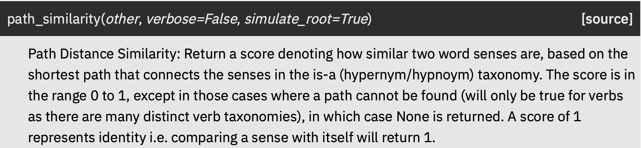
.path_similarity()
furniture.n.01
table.n.02
table.n.03
seat.n.03
Examples:
wn.synset('table.n.02').path_similarity(wn.synset('stool.n.01'))
0.25
wn.synset('table.n.02').path_similarity(wn.synset('seat.n.03'))
0.33
wn.synset('furniture.n.01').path_similarity(wn.synset('seat.n.03'))
0.5
wn.synset('table.n.02').path_similarity(wn.synset('table.n.03'))
0.33
stool.n.01
Other similarity metrics:
.lch_similarity()
.wup_similarity()
.res_similarity()
.jcn_similarity()
.lin_similarity()

Slide 14
Word Embeddings: similarity
Install gensim
  Gensim is a Python library for topic modelling, document indexing and similarity retrieval with large corpora.
  https://radimrehurek.com/gensim/
  pip3 install gensim
Use with nltk:
  https://www.nltk.org/howto/gensim.html

Slide 15
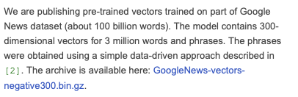
Word Embeddings: similarity
NLTK includes a pre-trained model which is part of a model that is trained on 100 billion words from the Google News Dataset.
  https://code.google.com/archive/p/word2vec/
Python:
>>> import gensim
>>> from nltk.data import find
>>> word2vec_sample = str(find('models/word2vec_sample/pruned.word2vec.txt'))
>>> word2vec_sample
'/Users/sandiway/nltk_data/models/word2vec_sample/pruned.word2vec.txt'
>>> model = gensim.models.KeyedVectors.load_word2vec_format(word2vec_sample, binary=False)
>>> len(model)
43981
>>> len(model['stool'])
300
#words
word vector length

Slide 16
Word Embeddings: similarity
>>> for word,score in model.most_similar(positive=['stool'], topn=10):
... print(f"{word:10} {score:.2f}")
...
worktable 0.49
sofa 0.49
footstool 0.48
couch 0.45
mat 0.42
banister 0.41
chair 0.41
uncurled 0.41
chaise 0.40
hammock 0.40
>>> model.similarity('stool','table')
np.float32(0.37125772)

Slide 17
Word Embeddings: similarity
stool gensim WordNet path_similarity
worktable 0.49 0.2
sofa 0.49 0.33
footstool 0.48 0.5
couch 0.45 0.33
mat 0.42 0.11
banister 0.41 0.1
chair 0.41 0.33
uncurled 0.41 0.07
chaise 0.40 0.25
hammock 0.40 0.17

Slide 18
WordNet: coordinate terms (sister term)
stool#1 -- (a simple seat without a back or arms)
-> seat#3 -- (furniture that is designed for sitting on; "there were not enough seats for all the guests")
=> bench#1 -- (a long seat for more than one person)
=> bench#7 -- ((law) the seat for judges in a courtroom)
=> box#8, box seat#2 -- (the driver's seat on a coach; "an armed guard sat in the box with the driver")
=> box seat#1 -- (a special seat in a theater or grandstand box)
=> chair#1 -- (a seat for one person, with a support for the back; "he put his coat over the back of the chair and sat down")
=> ottoman#3, pouf#2, pouffe#1, puff#6, hassock#1 -- (thick cushion used as a seat)
HAS INSTANCE=> Siege Perilous#1 -- (the legendary seat at King Arthur's Round Table reserved for the knight who would find the Holy Grail; it was fatal for anyone else to sit in it)
=> sofa#1, couch#1, lounge#1 -- (an upholstered seat for more than one person)
=> stool#1 -- (a simple seat without a back or arms)
=> toilet seat#1 -- (the hinged seat on a toilet)
0.33
0.33

Slide 19
WordNet: hyponyms (full)
stool#1 -- (a simple seat without a back or arms)
=> campstool#1 -- (a folding stool)
=> cutty stool#1 -- (a low stool; formerly in Scotland, a seat in a church where an offender was publicly rebuked)
=> footstool#1, footrest#1, ottoman#4, tuffet#1 -- (a low seat or a stool to rest the feet of a seated person)
=> milking stool#1 -- (low three-legged stool with a half round seat; used to sit on while milking a cow)
=> music stool#1, piano stool#1 -- (a stool for piano players; usually adjustable in height)
=> step stool#1 -- (a stool that has one or two steps that fold under the seat)
=> taboret#1, tabouret#1 -- (a low stool in the shape of a drum)
0.5

Slide 20
Case: hammock and stool
The noun hammock has 2 senses (no senses from tagged texts)
  1. knoll#1, mound#2, hillock#1, hummock#1, hammock#1 -- (a small natural hill)
  2. hammock#2, sack#6 -- (a hanging bed of canvas or rope netting (usually suspended between two trees); swings easily)
WordNet:
  from nltk.corpus import wordnet as wn
  wn.synset('stool.n.01').path_similarity(wn.synset('hammock.n.02'))
  0.167
  Synset('hammock.n.02') Synset('stool.n.01') have lowest common hypernym Synset('furniture.n.01')

Slide 21
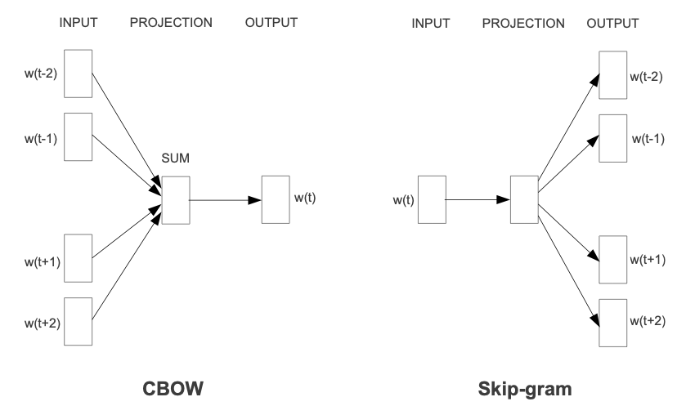
Word Embeddings: similarity
word2vec (Mikolov et al., 2013): representing words as vectors
2-layer neural net model trained on large corpora
more advanced models: e.g. GloVe, BERT
In models using large corpora and a high number of dimensions, the skip-gram model yields the highest overall accuracy, and consistently produces the highest accuracy on semantic relationships, as well as yielding the highest syntactic accuracy in most cases. However, the CBOW is less computationally expensive and yields similar accuracy results. (Wikipedia)
CBOW = Continuous Bag of Words

Slide 22
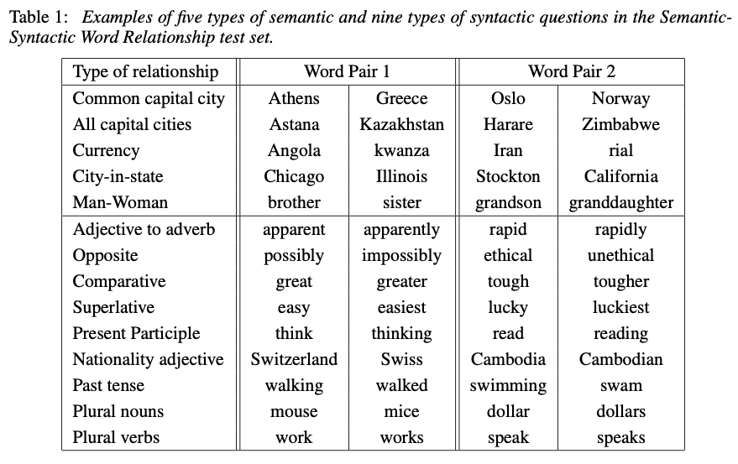
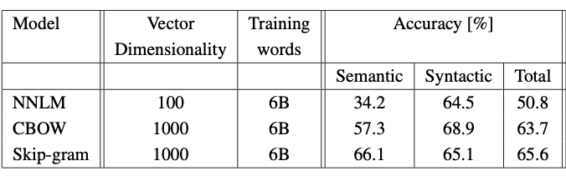
Word Embeddings: similarity

Slide 23
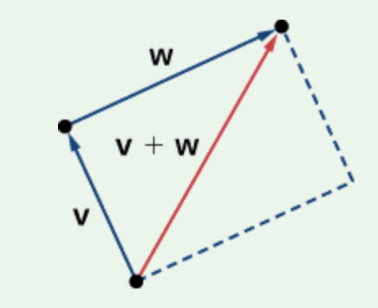
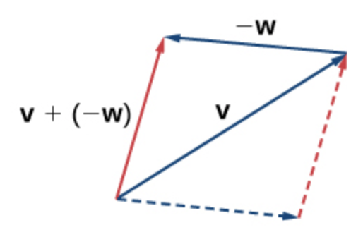
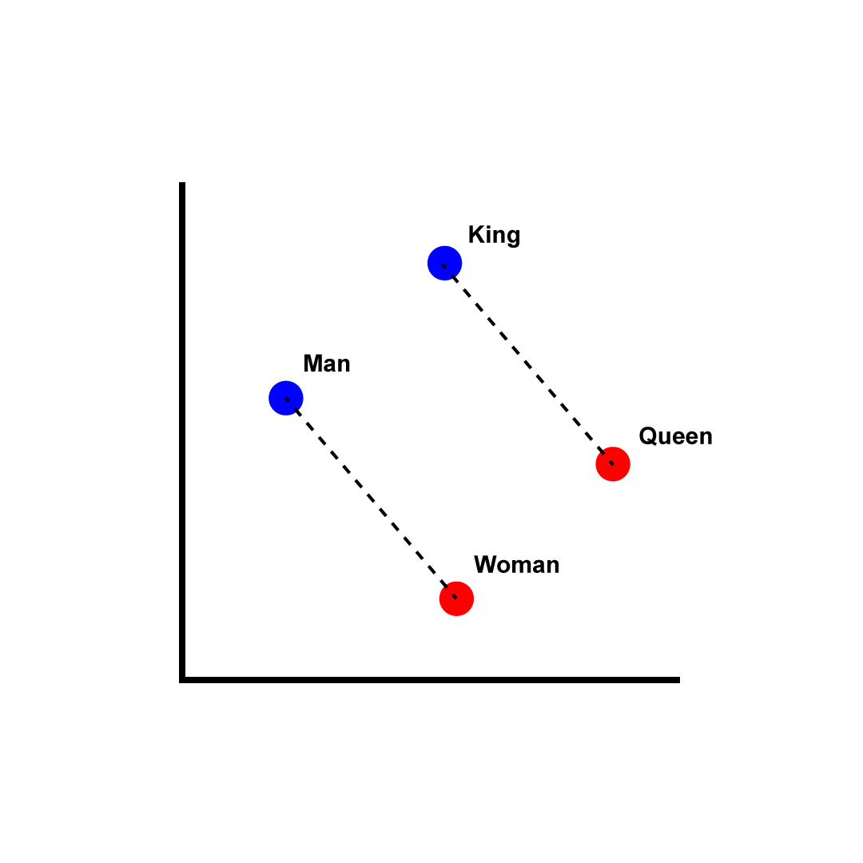
.most_similar()
Vector Arithmetic Semantics (not possible with WordNet)
Example:
the vector ‘King - Man + Woman’ is close to ‘Queen’
>>> model.most_similar(positive=['woman','king'], negative=['man'], topn=3)
[('queen', 0.7118193507194519), ('monarch', 0.6189674139022827), ('princess', 0.5902430415153503)]
[wikipedia]

Slide 24
word2vec
Examples:
  https://medium.com/plotly/understanding-word-embedding-arithmetic-why-theres-no-single-answer-to-king-man-woman-cd2760e2cb7f
  [Y]ou have to include some ‘cheating’. The actual result [is] King - Man + Woman = King. So, the resulting vector would be more similar to King than to Queen. The […] example only works because […] the algorithm will exclude the original vector from the possible results! Second comes Queen, which is what the routine will then pick.
  model.most_similar(positive=['woman','king'], topn=3)
  [('man', 0.6628608107566833), ('queen', 0.6438565254211426), ('girl', 0.6136073470115662)]
  model.most_similar(positive=['programmer','woman'],negative=['man'], topn=3)
  [('designer', 0.4621824622154236), ('librarian', 0.45112138986587524), ('copywriter', 0.42773979902267456)]
  model.most_similar(positive=['surgeon','woman'],negative=['man'], topn=3)
  [('gynecologist', 0.6832519173622131), ('doctor', 0.6073117256164551), ('hysterectomy', 0.5785969495773315)

Slide 25
.most_similar()
Example:
‘Germany - Berlin + Paris’ is close to ‘France’.
>>> model.most_similar(positive=['Paris','Germany'], negative=['Berlin'], topn=3)
[('France', 0.7884091138839722), ('Belgium', 0.6197876930236816), ('Spain', 0.5664774179458618)]

Slide 26
.most_similar()
Semantic Examples:
granddaughter – sister + brother ⟹ grandson
>>> model.most_similar(positive=['brother','granddaughter'], negative=['sister'], topn = 3)
[('grandson', 0.8567124605178833), ('nephew', 0.8048675656318665), ('son', 0.8035288453102112)]
grandmother – sister + brother ⟹ uncle
>>> model.most_similar(positive=['brother','grandmother'], negative=['sister'], topn = 3)
[('uncle', 0.7744704484939575), ('father', 0.7595500349998474), ('grandfather', 0.7549421787261963)]

Slide 27
.most_similar()
Syntactic Examples:
bigger - small + big ⟹ biggest
>>> model.most_similar(positive=['big','bigger'], negative=['small'], topn = 3)
[('biggest', 0.5590152740478516), ('huge', 0.5318294167518616), ('helluva', 0.4900902211666107)]
quicker - slow + quick ⟹ quickest
>>> model.most_similar(positive=['quick','quicker'], negative=['slow'], topn = 3)
[('quickest', 0.48321864008903503), ('faster', 0.4744618833065033), ('easier', 0.4644150733947754)]
colder - warm + cold ⟹ warmer
>>> model.most_similar(positive=['cold','colder'], negative=['warm'], topn = 3)
[('warmer', 0.5285316109657288), ('Cold', 0.5240233540534973), ('frigid', 0.5069639086723328)]

Slide 28
Word Embeddings: similarity
furniture
>>> model.similarity('table','stool')
0.37
>>> model.similarity('mesa','stool')
KeyError: "Key 'mesa' not present"
>>> model.similarity('table','toilet')
0.21
>>> model.similarity('table','house')
0.19
object
artifact
The noun mesa has 2 senses (no senses from tagged texts)
1. mesa#1, table#4 -- (flat tableland with steep edges; "the tribe was relatively safe on the mesa but they had to descend into the valley for water")
2. Mesa#2 -- (a city in Arizona just to the east of Phoenix; originally a suburb of Phoenix)

