Slide 1
LING/C SC 581: Advanced Computational Linguistics
Lecture 16
Prof. Sandiway Fong

Slide 2
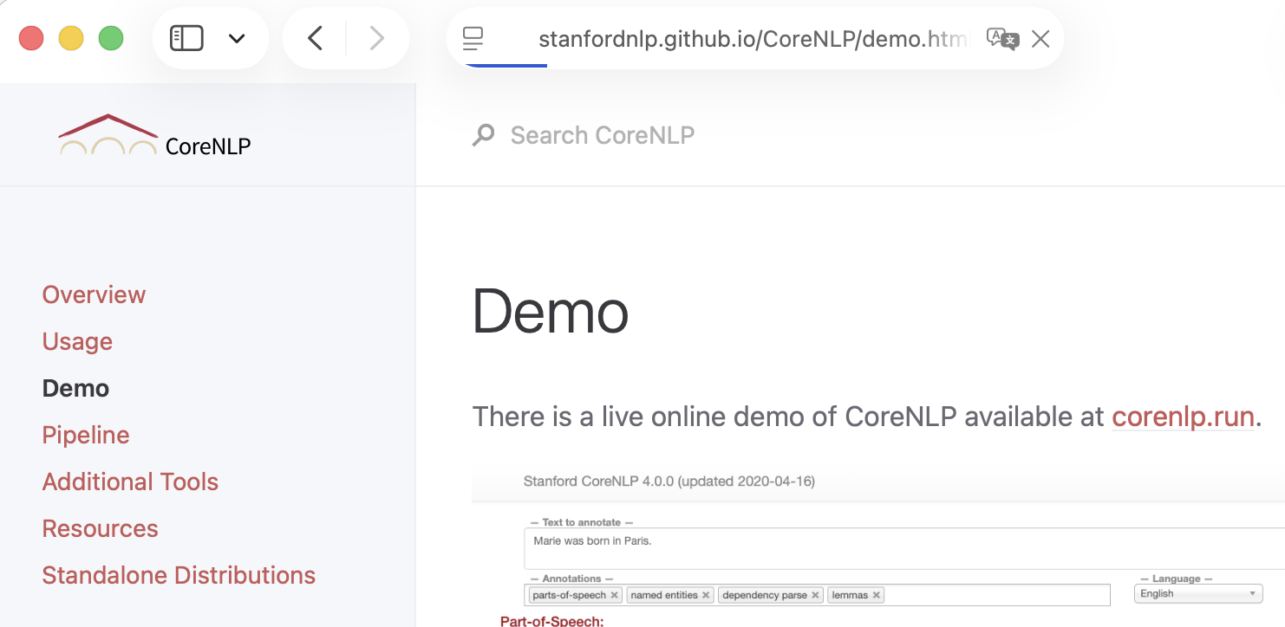
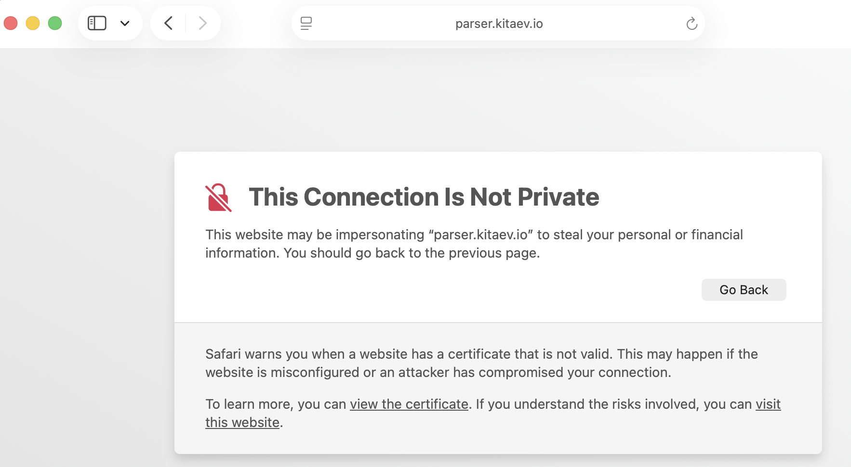
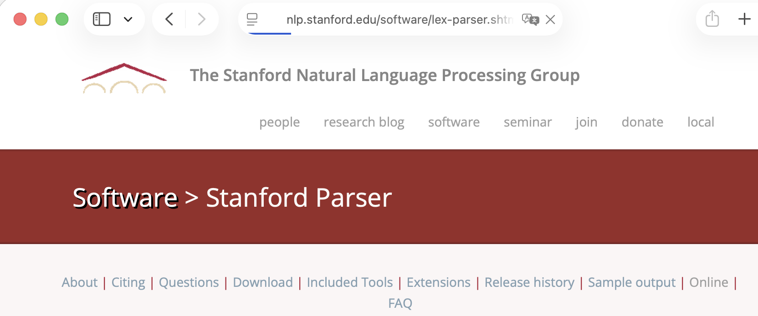
Online Parser Access
CoreNLP
Berkeley Neural Parser
Stanford Parser

Slide 3
Today's Topic
WordNet: introduction using nltk
synsets
relations
morphy
Later: a look at similarity
WordNet
Word Embeddings

Slide 4
nltk: WordNet
References
Browser: http://wordnetweb.princeton.edu/perl/webwn
nltk: http://www.nltk.org/howto/wordnet.html
https://www.nltk.org/api/nltk.corpus.reader.wordnet.html
Python
>>> from nltk.corpus import wordnet as wn
>>> wn.synsets('table')
[Synset('table.n.01'), Synset('table.n.02'), Synset('table.n.03'), Synset('mesa.n.01'), Synset('table.n.05'), Synset('board.n.04'), Synset('postpone.v.01'), Synset('table.v.02')]
>>> wn.synset('table.n.02')
Synset('table.n.02')
No longer supported

Slide 5
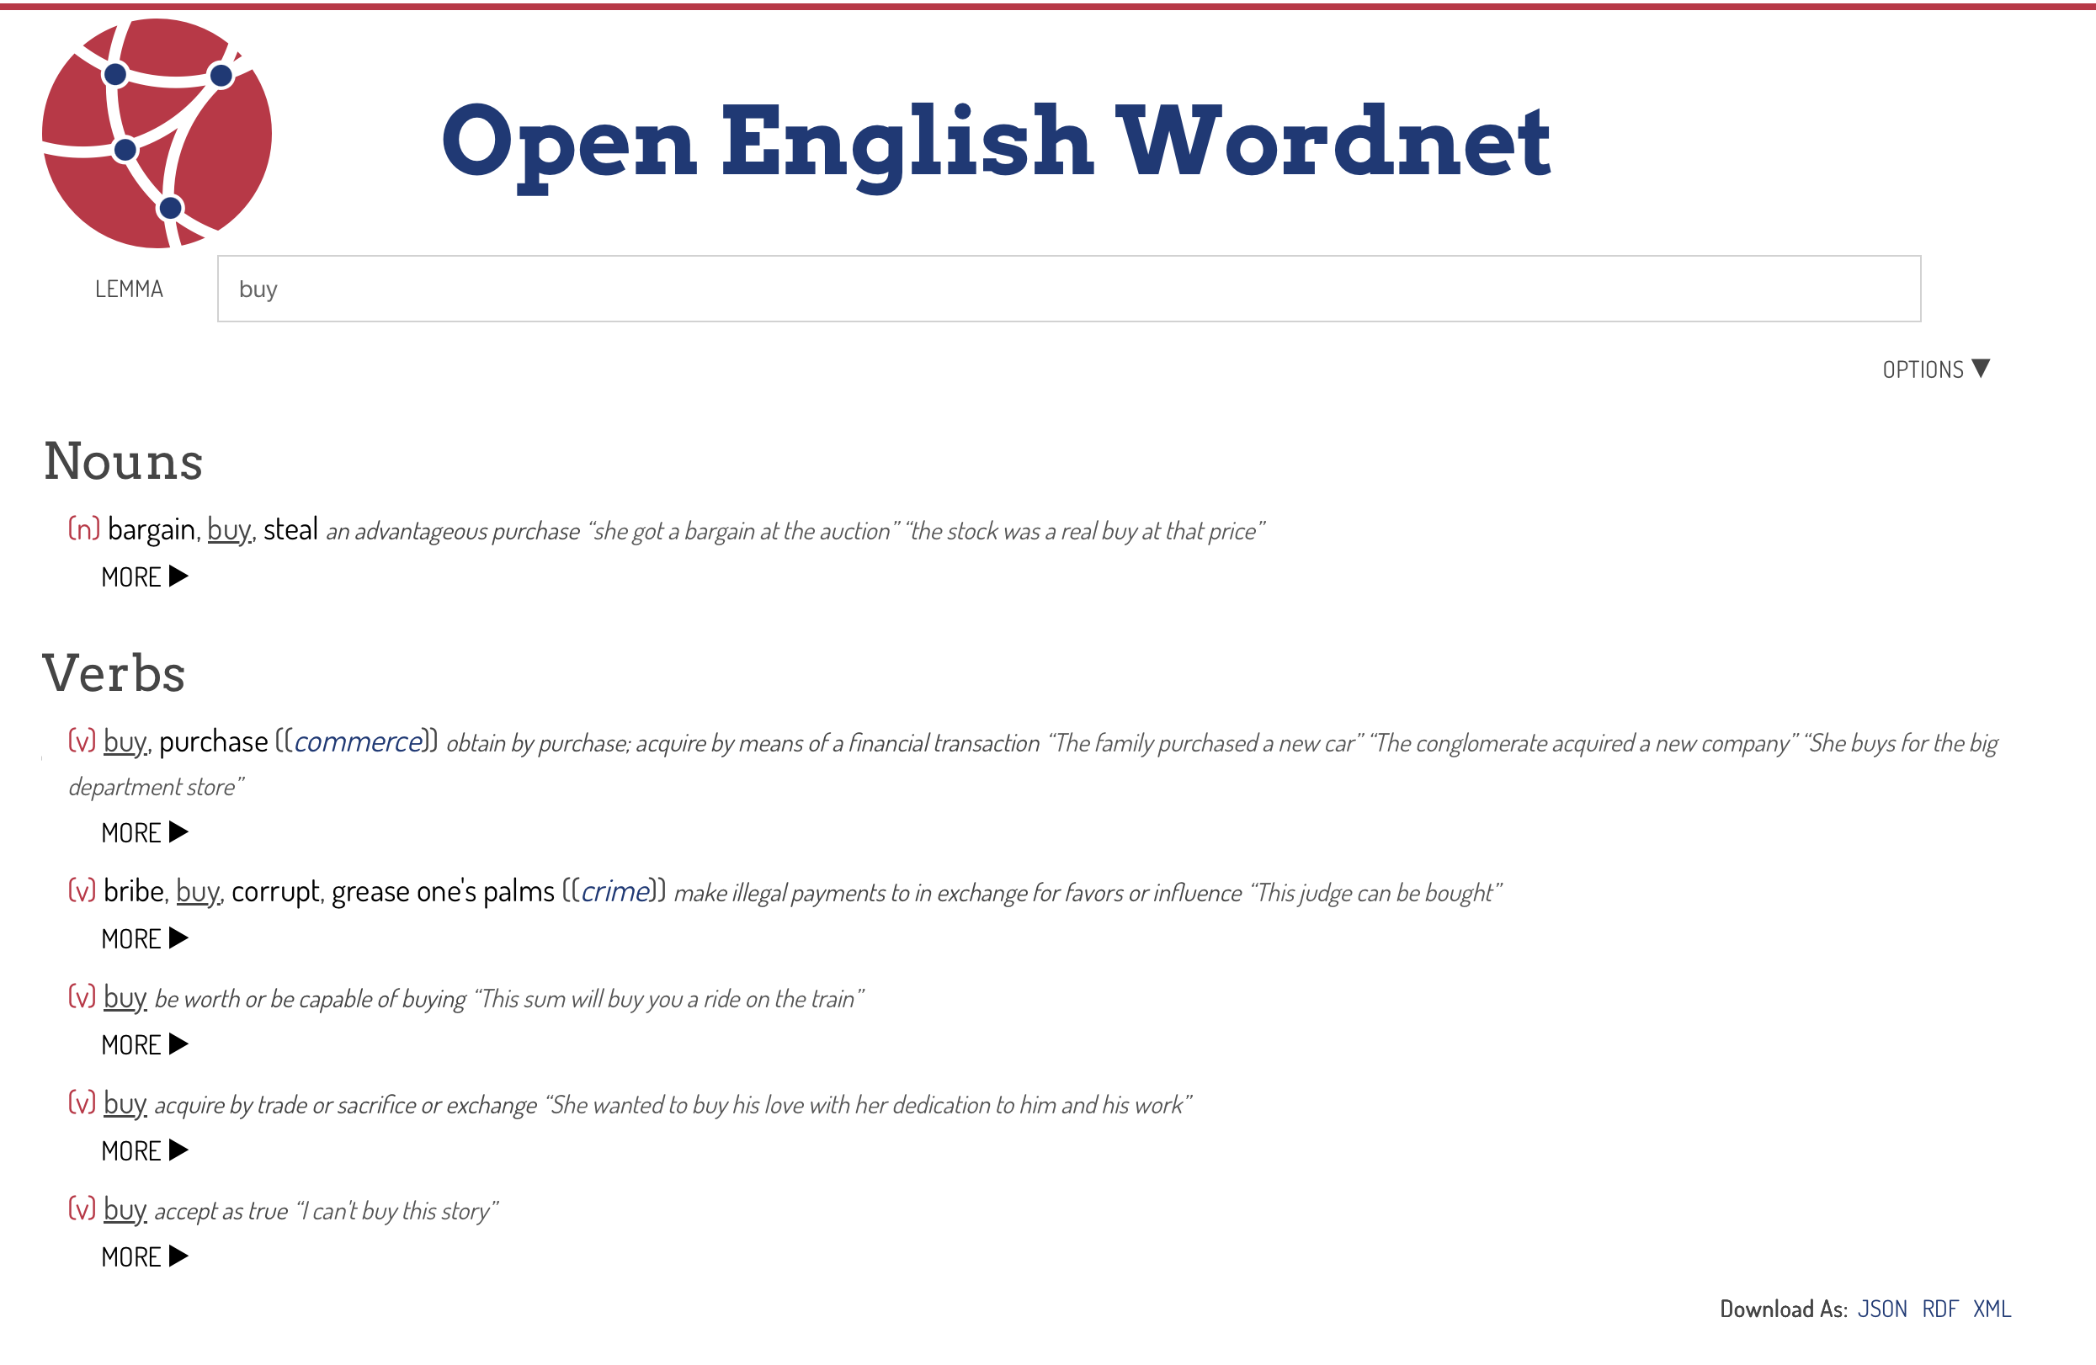
https://en-word.net
https://github.com/globalwordnet/english-wordnet/blob/main/README.md

Slide 6
Princeton WordNet
WordNet® is a large lexical database of English.
Nouns, verbs, adjectives and adverbs are grouped into sets of cognitive synonyms (synsets), each expressing a distinct concept.
Synsets are interlinked by means of conceptual-semantic and lexical relations.
The resulting network of meaningfully related words and concepts can be navigated with the browser. WordNet is also freely and publicly available for download.
WordNet's structure makes it a useful tool for computational linguistics and natural language processing.

Slide 7
Princeton WordNet
WordNet superficially resembles a thesaurus, in that it groups words together based on their meanings.
However, there are some important distinctions.
First, WordNet interlinks not just word forms—strings of letters—but specific senses of words.
As a result, words that are found in close proximity to one another in the network are semantically disambiguated.
Second, WordNet labels the semantic relations among words, whereas the groupings of words in a thesaurus does not follow any explicit pattern other than meaning similarity.

Slide 8
Princeton WordNet
The main relation among words in WordNet is synonymy (synset):
shut and close
car and automobile
nltk:
>>> wn.synsets('shut')
[Synset('close.v.01'), Synset('close.v.02'), Synset('exclude.v.02'), Synset('shut.a.01'), Synset('closed.a.04')]
>>> wn.synsets('shut')[0].lemmas()
[Lemma('close.v.01.close'), Lemma('close.v.01.shut')]
>>> wn.synsets('shut')[1].lemmas()
[Lemma('close.v.02.close'), Lemma('close.v.02.shut')]
>>> wn.synsets('shut')[0].lemma_names()
['close', 'shut']
Synset: <word>.<pos>.<number>
Lemma: <word>.<pos>.<number>.<lemma>

Slide 9
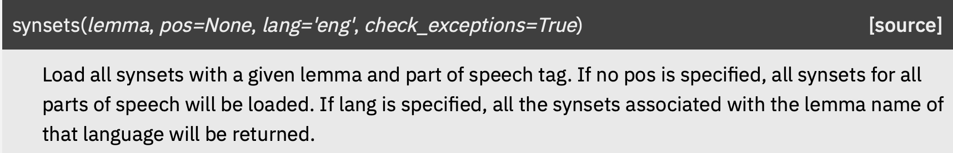

Princeton WordNet
pos (str) – The Part Of Speech tag.
“n” for nouns,
“v” for verbs,
“a” for adjectives,
“r” for adverbs and
“s” for satellite adjectives.
>>> wn.synset('shut.v.01')
Synset('close.v.01')
>>> wn.synset('shut.v')
ValueError: not enough values to unpack (expected 3, got 2)
>>> wn.synset('shut')
ValueError: not enough values to unpack (expected 3, got 1)

Slide 10
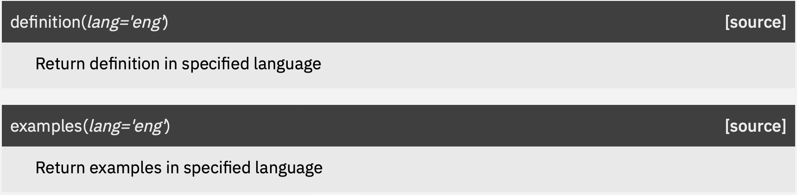
Princeton WordNet
>>> wn.synset('close.v.01').definition()
'move so that an opening or passage is obstructed; make shut'
>>> wn.synset('close.v.02').definition()
'become closed'
>>> wn.synset('close.v.01').examples()
['Close the door', 'shut the window']
>>> wn.synset('close.v.02').examples()
['The windows closed with a loud bang']
Also ok with:
'shut.v.01'
'shut.v.02'
transitive
intransitive

Slide 11
Princeton WordNet
The main relation among words in WordNet is synonymy (synset):
shut and close
Overlap:
>>> wn.synsets('shut')
[Synset('close.v.01'), Synset('close.v.02'), Synset('exclude.v.02'), Synset('shut.a.01'), Synset('closed.a.04')]
>>> wn.synsets('close')
[Synset('stopping_point.n.01'), Synset('conclusion.n.08'), Synset('finale.n.03'), Synset('close.v.01'), Synset('close.v.02'), Synset('close_up.v.01'), Synset('close.v.04'), Synset('conclude.v.04'), Synset('close.v.06'), Synset('close.v.07'), Synset('close.v.08'), Synset('close.v.09'), Synset('close.v.10'), Synset('close.v.11'), Synset('close.v.12'), Synset('close.v.13'), Synset('close.v.14'), Synset('close.v.15'), Synset('close_up.v.03'), Synset('close.v.17'), Synset('close.a.01'), Synset('close.a.02'), Synset('near.a.01'), Synset('close.s.04'), Synset('close.s.05'), Synset('close.s.06'), Synset('close.s.07'), Synset('airless.s.01'), Synset('close.s.09'), Synset('close.s.10'), Synset('close.s.11'), Synset('close.s.12'), Synset('close.s.13'), Synset('cheeseparing.s.01'), Synset('close.s.15'), Synset('near.r.01'), Synset('close.r.02')]
2 out of 5 senses
2 out of 37 senses

Slide 12
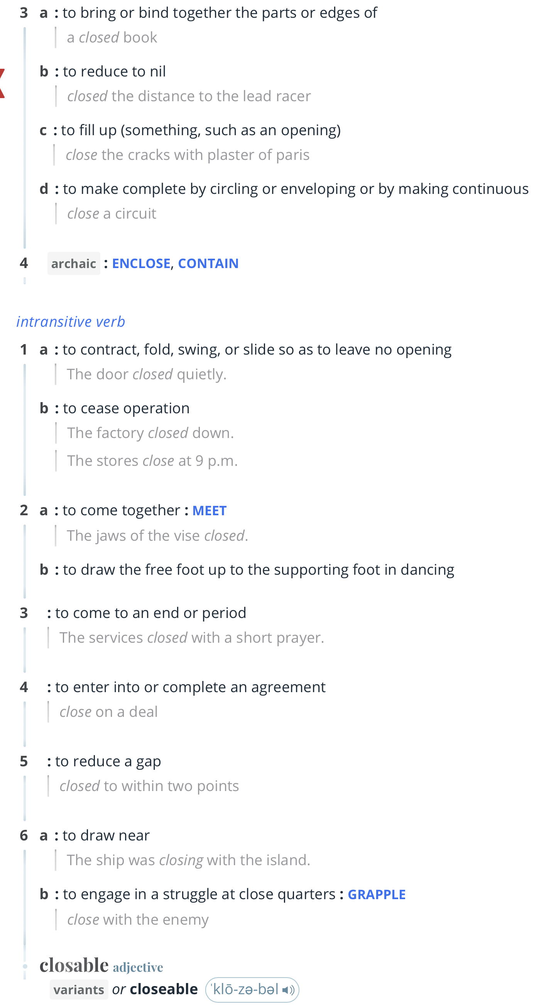
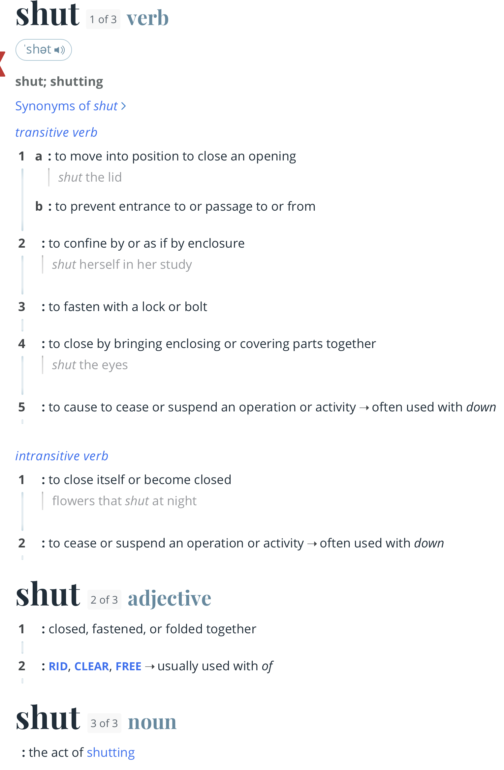
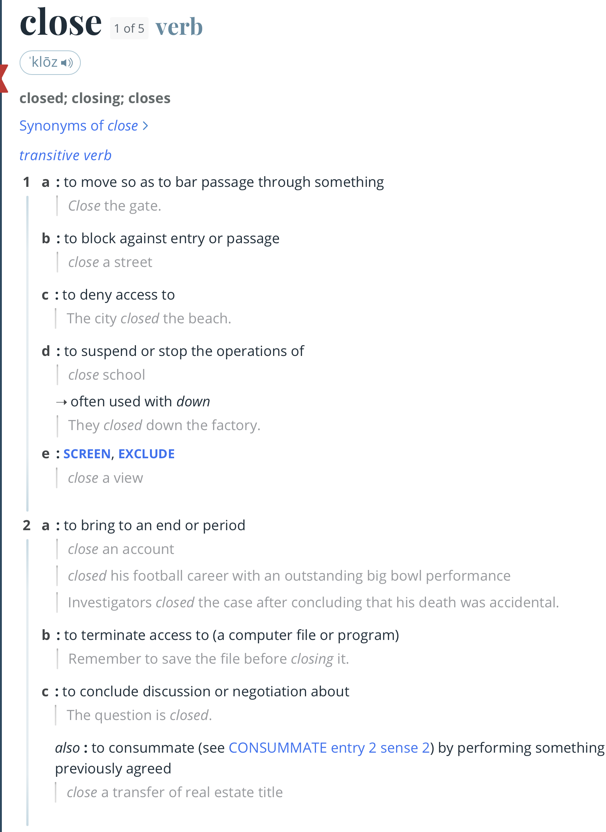
Merriam Webster
Q: How many senses?
wn.synset('close.v.01').definition()
'move so that an opening or passage is obstructed; make shut'
wn.synset('close.v.02').definition()
'become closed'

Slide 13
Princeton WordNet
The most frequently encoded relation among synsets is the super-subordinate relation (also called hyperonymy, hyponymy or ISA relation).
links {furniture, piece_of_furniture} to specific ones like {bed} and {bunkbed}.
WordNet distinguishes among Types (common nouns) and Instances (specific persons, countries and geographic entities).
Thus, armchair is a type of chair, Barack Obama is an instance of a president.
Instances are always leaf (terminal) nodes in their hierarchies.

Slide 14
Princeton WordNet
Synsets have the following methods for retrieving related Synsets.
hypernyms, instance_hypernyms
hyponyms, instance_hyponyms
>>> wn.synsets('entity')
[Synset('entity.n.01')]
>>> wn.synset('entity.n.01').hyponyms()
[Synset('abstraction.n.06'), Synset('physical_entity.n.01'), Synset('thing.n.08')]
>>> wn.synset('entity.n.01').hypernyms()
[]
>>> wn.synset('entity.n.01').instance_hyponyms()
[]
>>> wn.synsets('Tucson')
[Synset('tucson.n.01')]
>>> wn.synset('tucson.n.01').instance_hypernyms()
[Synset('city.n.01')]
>>> wn.synset('tucson.n.01').hypernyms()
[]

Slide 15
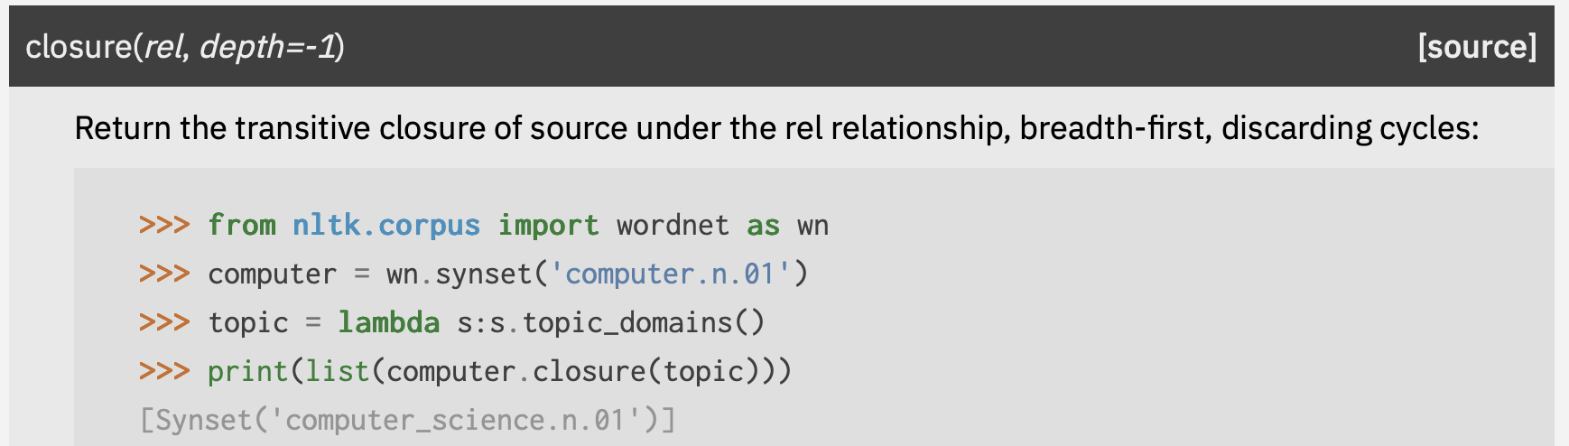
Princeton WordNet
>>> list(wn.synset('entity.n.01').closure(lambda x:x.hyponyms(),depth=2))
[Synset('abstraction.n.06'), Synset('physical_entity.n.01'), Synset('thing.n.08'), Synset('relation.n.01'), Synset('measure.n.02'), Synset('communication.n.02'), Synset('set.n.02'), Synset('attribute.n.02'), Synset('psychological_feature.n.01'), Synset('otherworld.n.01'), Synset('group.n.01'), Synset('thing.n.12'), Synset('process.n.06'), Synset('causal_agent.n.01'), Synset('substance.n.04'), Synset('matter.n.03'), Synset('object.n.01'), Synset('change.n.06'), Synset('stinker.n.02'), Synset('pacifier.n.02'), Synset('whacker.n.01'), Synset('security_blanket.n.01'), Synset('freshener.n.01'), Synset('jimdandy.n.02'), Synset('horror.n.02')]

Slide 16
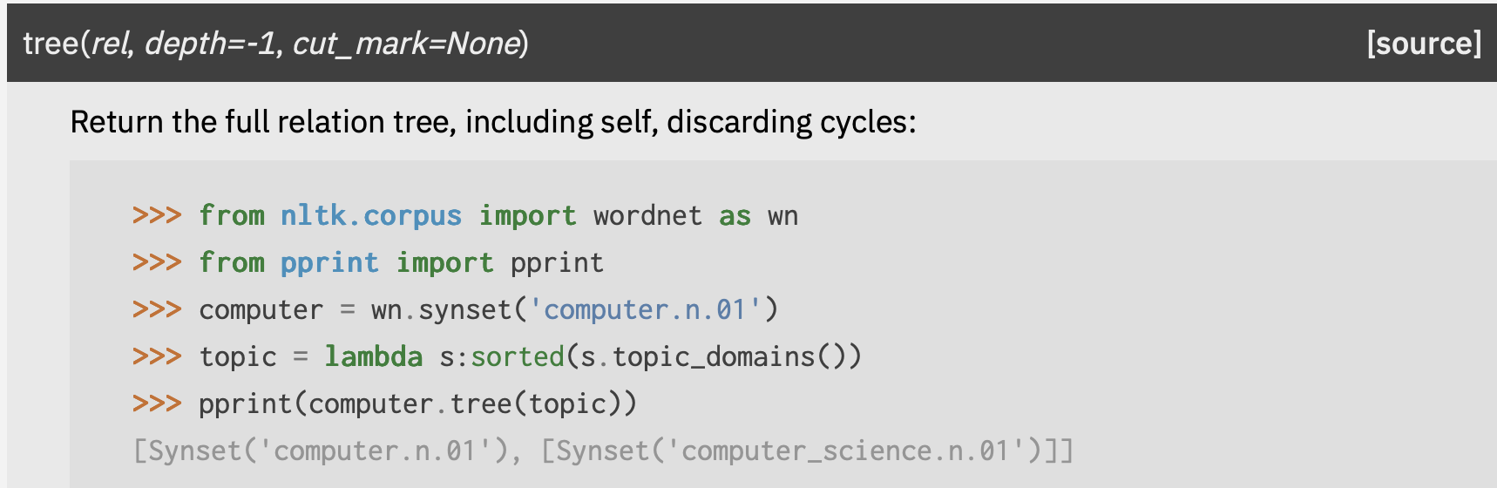
Princeton WordNet
>>> list(wn.synset('entity.n.01').tree(lambda x:x.hyponyms(),depth=2))
[Synset('entity.n.01'), [Synset('abstraction.n.06'), [Synset('relation.n.01')], [Synset('measure.n.02')], [Synset('communication.n.02')], [Synset('set.n.02')], [Synset('attribute.n.02')], [Synset('psychological_feature.n.01')], [Synset('otherworld.n.01')], [Synset('group.n.01')]], [Synset('physical_entity.n.01'), [Synset('thing.n.12')], [Synset('process.n.06')], [Synset('causal_agent.n.01')], [Synset('substance.n.04')], [Synset('matter.n.03')], [Synset('object.n.01')]], [Synset('thing.n.08'), [Synset('change.n.06')], [Synset('stinker.n.02')], [Synset('pacifier.n.02')], [Synset('whacker.n.01')], [Synset('security_blanket.n.01')], [Synset('freshener.n.01')], [Synset('jimdandy.n.02')], [Synset('horror.n.02')]]]

Slide 17
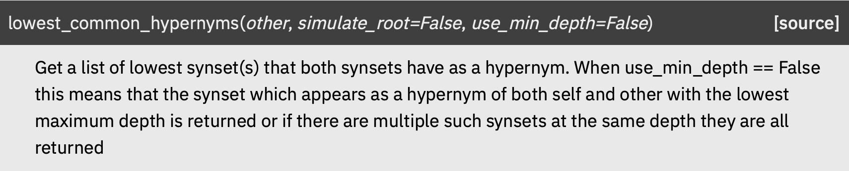
Princeton WordNet
>>> wn.synsets('furniture')
[Synset('furniture.n.01')]
>>> wn.synsets('bed','n')
[Synset('bed.n.01'), Synset('bed.n.02'), Synset('bed.n.03'), Synset('bed.n.04'), Synset('seam.n.03'), Synset('layer.n.01'), Synset('bed.n.07'), Synset('bed.n.08')]
>>> wn.synsets('furniture')[0].lowest_common_hypernyms(wn.synset('bed.n.01'))
[Synset('furniture.n.01')]
>>> wn.synsets('furniture')[0].lowest_common_hypernyms(wn.synset('bed.n.02'))
[Synset('object.n.01')]

Slide 18
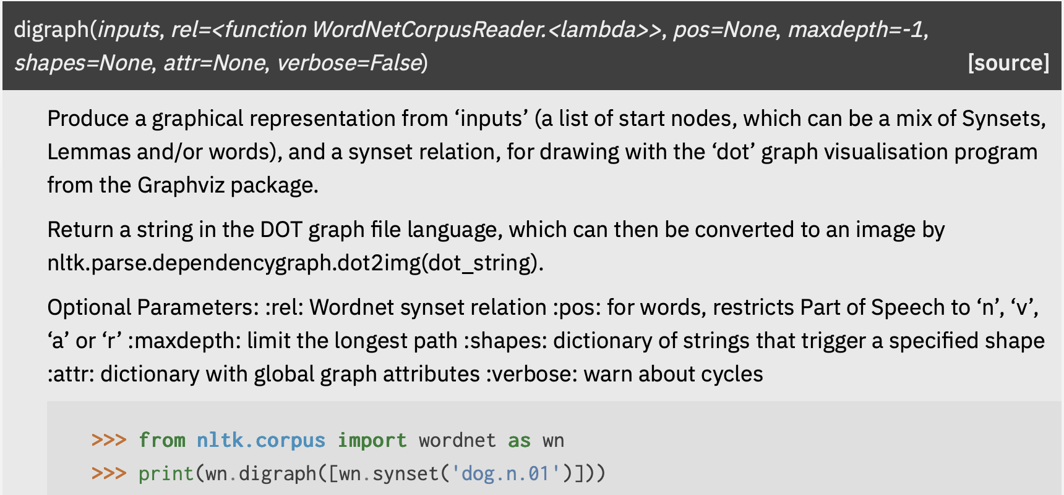
Princeton WordNet
>>> print(wn.digraph([wn.synset('entity.n.01')],rel=lambda x:x.hyponyms(),maxdepth=2))
digraph G {
"Synset('abstraction.n.06')" -> "Synset('attribute.n.02')";
"Synset('abstraction.n.06')" -> "Synset('communication.n.02')";
"Synset('abstraction.n.06')" -> "Synset('group.n.01')";
"Synset('abstraction.n.06')" -> "Synset('measure.n.02')";
"Synset('abstraction.n.06')" -> "Synset('otherworld.n.01')";
"Synset('abstraction.n.06')" -> "Synset('psychological_feature.n.01')";
"Synset('abstraction.n.06')" -> "Synset('relation.n.01')";
"Synset('abstraction.n.06')" -> "Synset('set.n.02')";
"Synset('entity.n.01')" -> "Synset('abstraction.n.06')";
"Synset('entity.n.01')" -> "Synset('physical_entity.n.01')";
"Synset('entity.n.01')" -> "Synset('thing.n.08')";
"Synset('physical_entity.n.01')" -> "Synset('causal_agent.n.01')";
"Synset('physical_entity.n.01')" -> "Synset('matter.n.03')";
"Synset('physical_entity.n.01')" -> "Synset('object.n.01')";
"Synset('physical_entity.n.01')" -> "Synset('process.n.06')";
"Synset('physical_entity.n.01')" -> "Synset('substance.n.04')";
"Synset('physical_entity.n.01')" -> "Synset('thing.n.12')";
"Synset('thing.n.08')" -> "Synset('change.n.06')";
"Synset('thing.n.08')" -> "Synset('freshener.n.01')";
"Synset('thing.n.08')" -> "Synset('horror.n.02')";
"Synset('thing.n.08')" -> "Synset('jimdandy.n.02')";
"Synset('thing.n.08')" -> "Synset('pacifier.n.02')";
"Synset('thing.n.08')" -> "Synset('security_blanket.n.01')";
"Synset('thing.n.08')" -> "Synset('stinker.n.02')";
"Synset('thing.n.08')" -> "Synset('whacker.n.01')";}

Slide 19
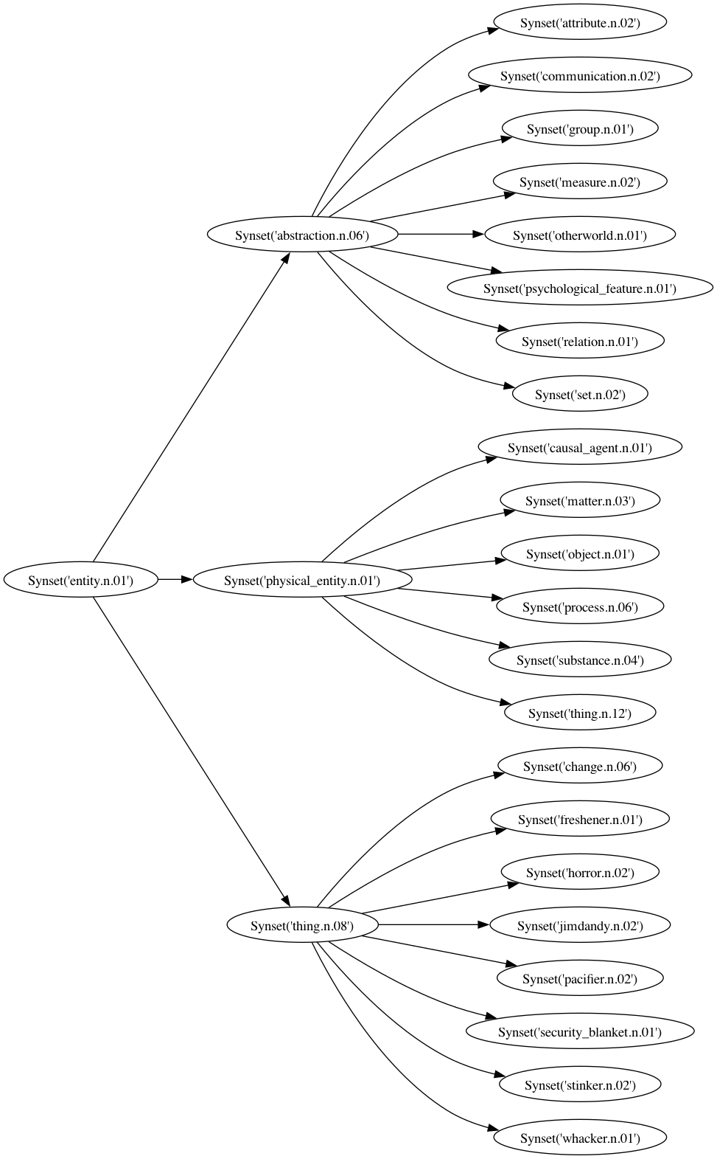
Princeton WordNet
dot -Tpng digraph.dot > digraph.png
digraph G {
rankdir="LR";
"Synset('abstraction.n.06')" -> "Synset('attribute.n.02')";
"Synset('abstraction.n.06')" -> "Synset('communication.n.02')";
"Synset('abstraction.n.06')" -> "Synset('group.n.01')";
"Synset('abstraction.n.06')" -> "Synset('measure.n.02')";
"Synset('abstraction.n.06')" -> "Synset('otherworld.n.01')";
"Synset('abstraction.n.06')" -> "Synset('psychological_feature.n.01')";
"Synset('abstraction.n.06')" -> "Synset('relation.n.01')";
"Synset('abstraction.n.06')" -> "Synset('set.n.02')";
"Synset('entity.n.01')" -> "Synset('abstraction.n.06')";
"Synset('entity.n.01')" -> "Synset('physical_entity.n.01')";
"Synset('entity.n.01')" -> "Synset('thing.n.08')";
"Synset('physical_entity.n.01')" -> "Synset('causal_agent.n.01')";
"Synset('physical_entity.n.01')" -> "Synset('matter.n.03')";
"Synset('physical_entity.n.01')" -> "Synset('object.n.01')";
"Synset('physical_entity.n.01')" -> "Synset('process.n.06')";
"Synset('physical_entity.n.01')" -> "Synset('substance.n.04')";
"Synset('physical_entity.n.01')" -> "Synset('thing.n.12')";
"Synset('thing.n.08')" -> "Synset('change.n.06')";
"Synset('thing.n.08')" -> "Synset('freshener.n.01')";
"Synset('thing.n.08')" -> "Synset('horror.n.02')";
"Synset('thing.n.08')" -> "Synset('jimdandy.n.02')";
"Synset('thing.n.08')" -> "Synset('pacifier.n.02')";
"Synset('thing.n.08')" -> "Synset('security_blanket.n.01')";
"Synset('thing.n.08')" -> "Synset('stinker.n.02')";
"Synset('thing.n.08')" -> "Synset('whacker.n.01')";
}

Slide 20
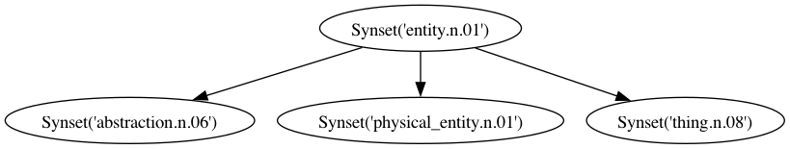
Princeton WordNet
All noun hierarchies ultimately go up the root node {entity}.
Exercise 1: find all the lowest common hypernyms between senses of furniture and bed
Exercise 2: find all the lowest common hypernyms between senses of furniture and bunkbed

Slide 21
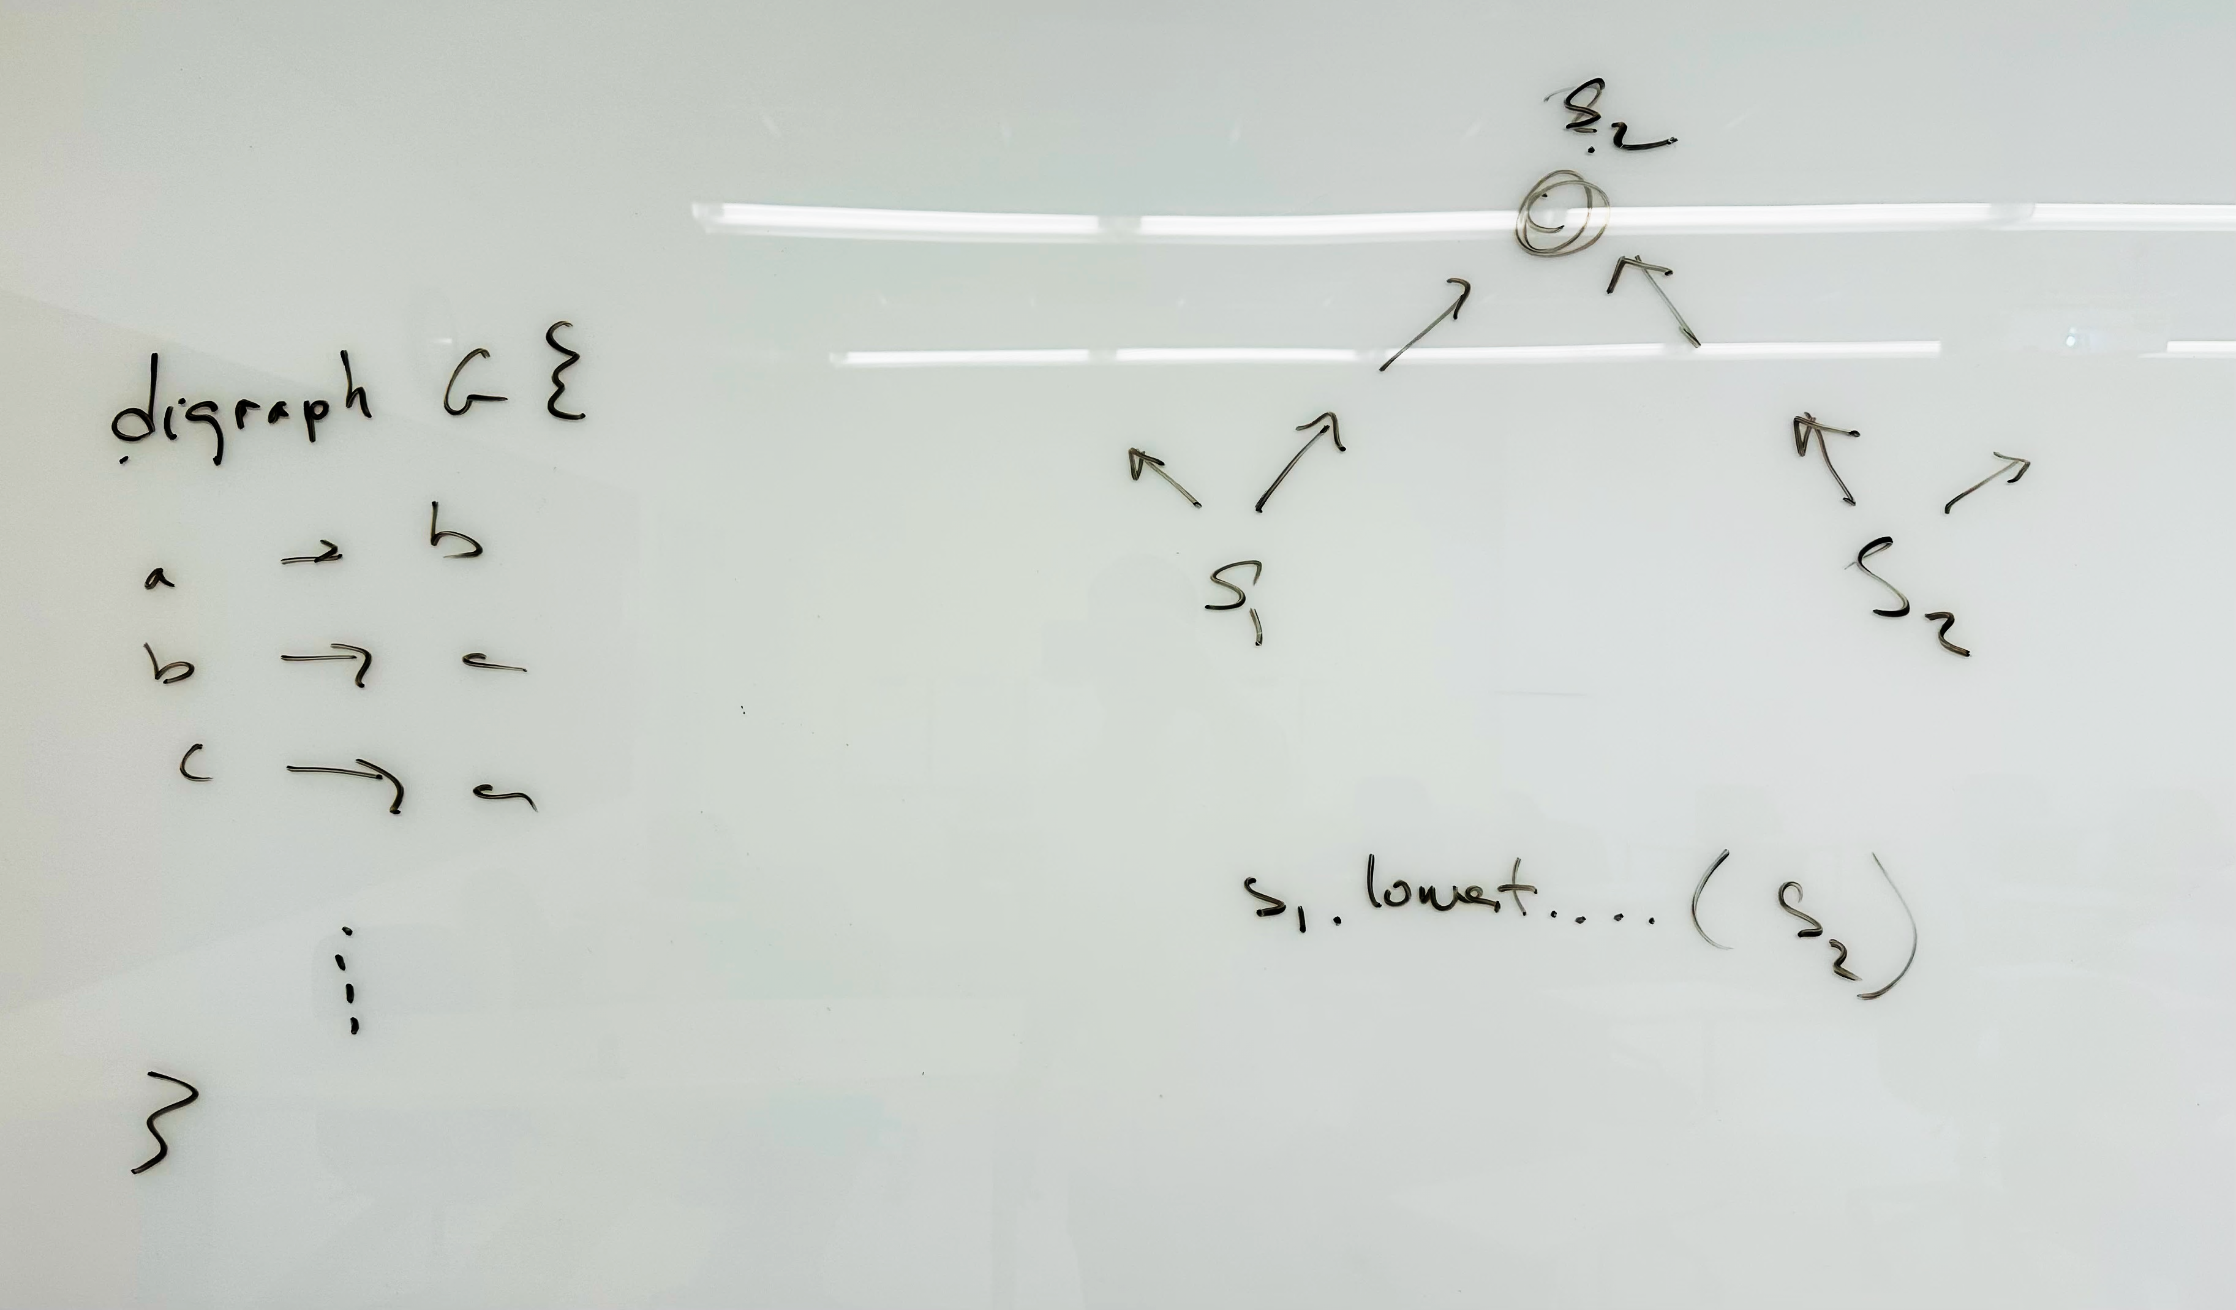
Whiteboard

