Slide 1
LING/C SC 581:
Advanced Computational Linguistics
Lecture 15
Prof. Sandiway Fong

Slide 2
Today's Topics
Install Stanza on your laptop (Homework 8: Part 1)
  described last time
  how to use dependency and constituency parsing
Crash Blossoms (Homework 8: Part 2)

Slide 3
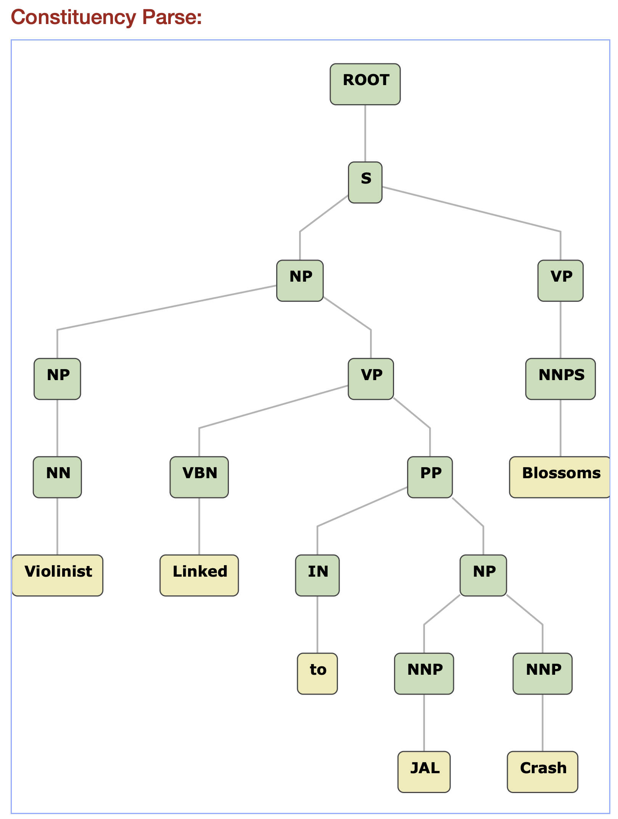
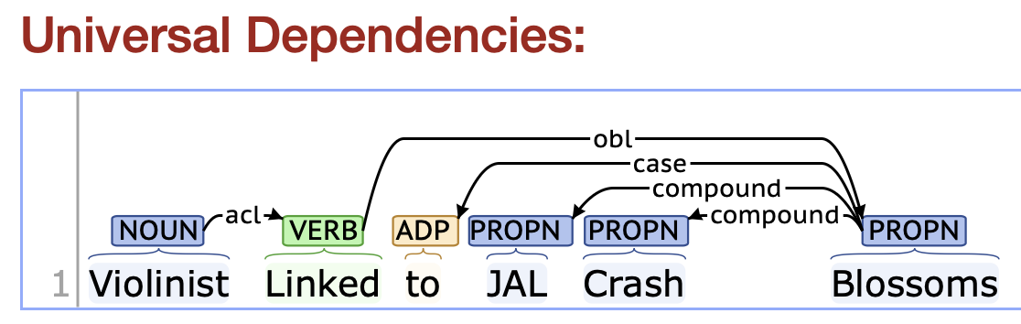
Violinist Linked to JAL Crash Blossoms
Stanza: two different pipelines, two different "parses" of the same data!
>>> nlp = stanza.Pipeline('en')
>>> nlp = stanza.Pipeline(lang='en', processors='tokenize,pos,constituency')
doc = nlp("Violinist Linked to JAL Crash Blossoms")
Blossoms = pl. noun or 3rd pers. sg. present verb

Slide 4
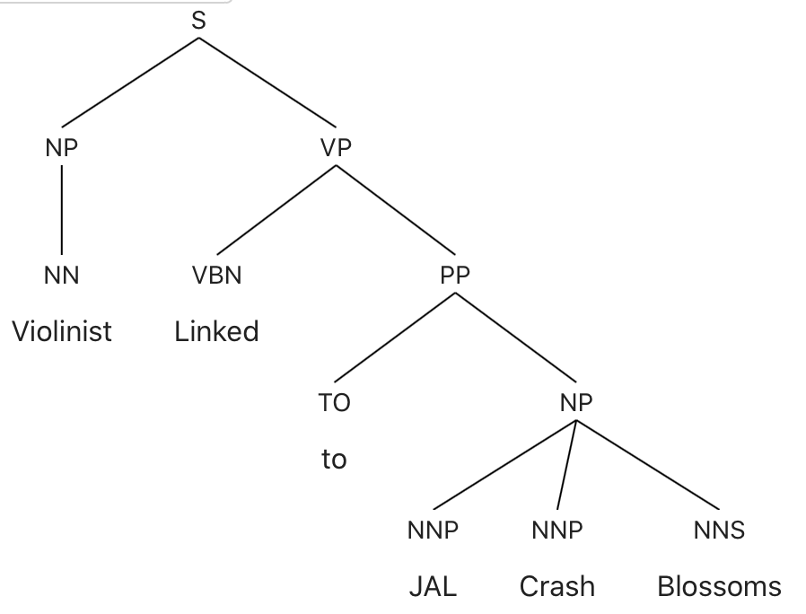
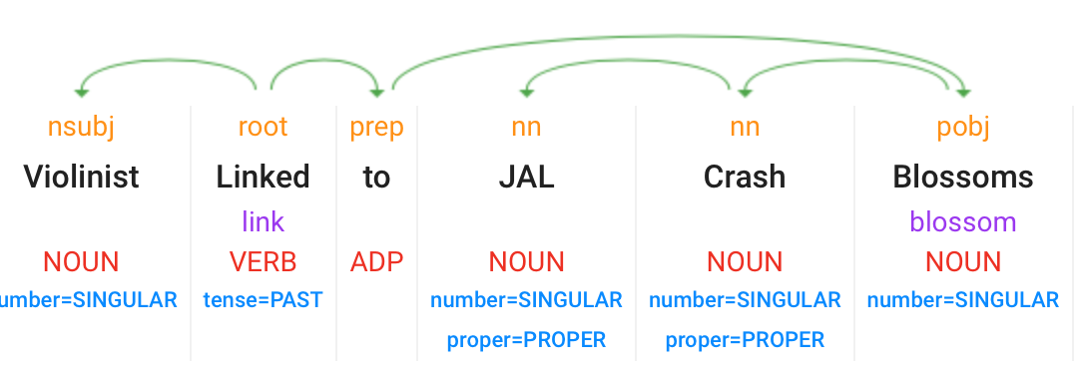
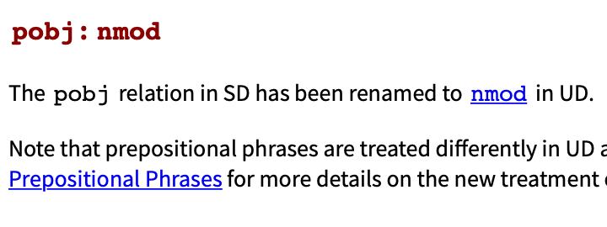
Violinist Linked to JAL Crash Blossoms
Google (no longer available)
Berkeley Neural Parser
https://parser.kitaev.io

Slide 5
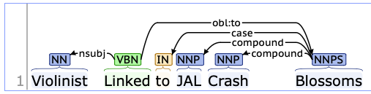
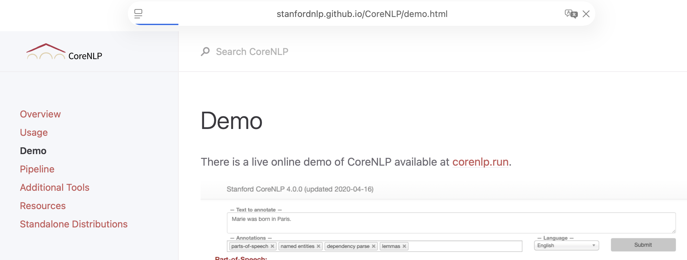
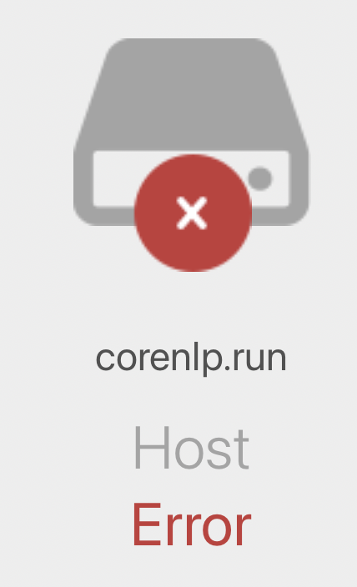
CoreNLP
Violinist Linked to JAL Crash Blossoms
CoreNLP:
  https://corenlp.run
sometimes up, sometimes down

Slide 6
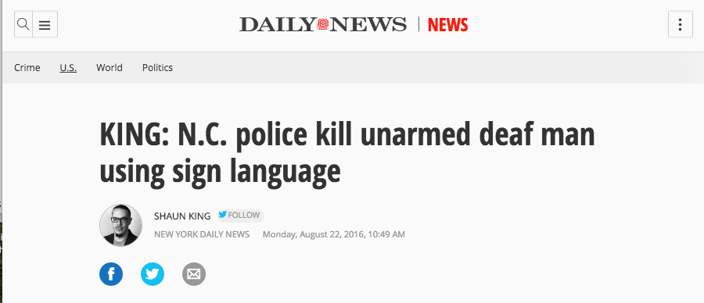
Newspapers could check their headlines?

Slide 7
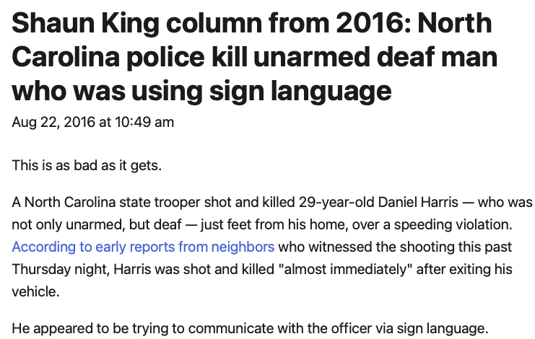
Was fixed!
I went to the Daily News website:

Slide 8
Class Exercise: dependency pipeline
N.C. police kill unarmed deaf man using sign language
~$ python3
>>> import stanza
>>> nlp = stanza.Pipeline('en')
>>> doc = nlp('N.C. police kill unarmed deaf man using sign language')
>>> for word in doc.sentences[0].words:
... print(f"{word.id}: {word.text}/{word.pos} - {word.deprel} -> {word.head}")
...
1: N.C./PROPN - compound -> 2
2: police/NOUN - nsubj -> 3
3: kill/VERB - root -> 0
4: unarmed/ADJ - amod -> 6
5: deaf/ADJ - amod -> 6
6: man/NOUN - obj -> 3
7: using/VERB - acl -> 6
8: sign/NOUN - compound -> 9
9: language/NOUN - obj -> 7
key relation

Slide 9
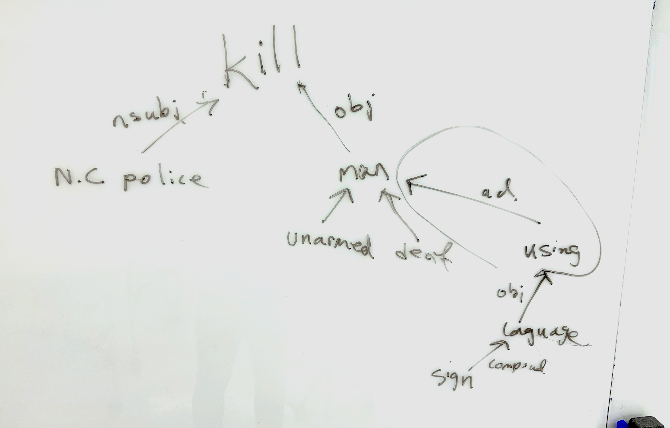
Class Exercise: dependency pipeline

Slide 10
Class Exercise: constituency pipeline
N.C. police kill unarmed deaf man using sign language
>>> nlp = stanza.Pipeline(lang='en', processors='tokenize,pos,constituency')
>>> doc = nlp('N.C. police kill unarmed deaf man using sign language')
>>> for sentence in doc.sentences:
... print(sentence.constituency)
...
(ROOT (S (NP (NNP N.C.) (NNS police)) (VP (VBP kill) (NP (NP (JJ unarmed) (JJ deaf) (NN man)) (VP (VBG using) (NP (NN sign) (NN language)))))))

Slide 11
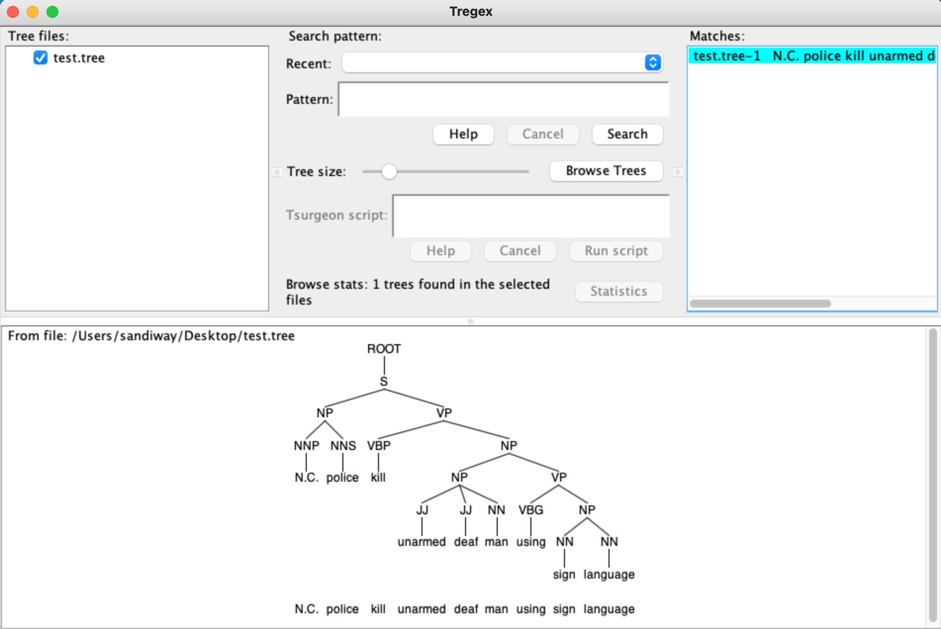
Class Exercise: constituency pipeline
key modification

Slide 12

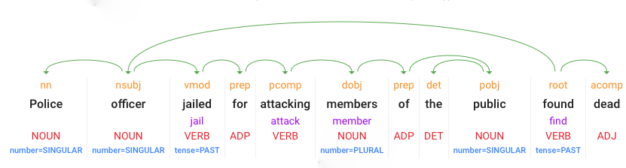
Crash Blossom Archive
vmod: reduced non-finite verbal modifier
  jailed modifies police officer
pcomp: prepositional complement,
for clausal complement
acomp: adjectival complement
https://languagelog.ldc.upenn.edu/nll/?cat=118
https://www.theguardian.com/uk-news/2021/dec/29/pc-jailed-for-attacking-members-of-the-public-found-dead-at-home

Slide 13

Crash Blossom Archive
CoreNLP is your one stop shop for natural language processing in Java!
CoreNLP currently supports 8 languages: Arabic, Chinese, English, French, German, Hungarian, Italian, and Spanish.
https://languagelog.ldc.upenn.edu/nll/?cat=118
Stanford CoreNLP: https://corenlp.run
root
VBN: past participle POS tag

Slide 14
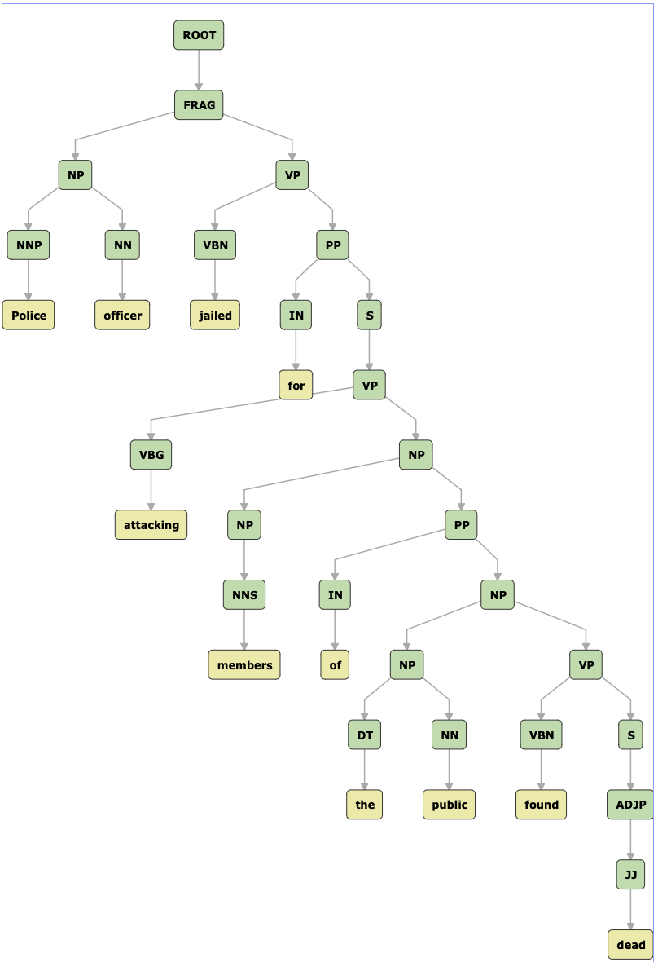
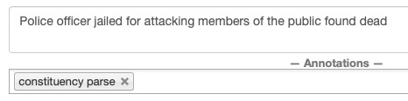
Crash Blossom Archive
FRAG: fragment
https://languagelog.ldc.upenn.edu/nll/?cat=118
Stanford CoreNLP: https://corenlp.run
Who is found dead?

Slide 15
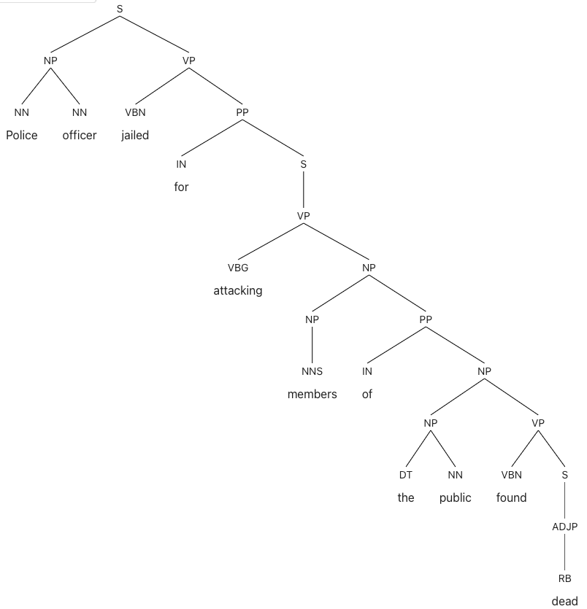
Crash Blossom Archive
S not FRAG
https://languagelog.ldc.upenn.edu/nll/?cat=118
Berkeley Neural Parser: https://parser.kitaev.io
see the VP attachment
Who is found dead?

Slide 16
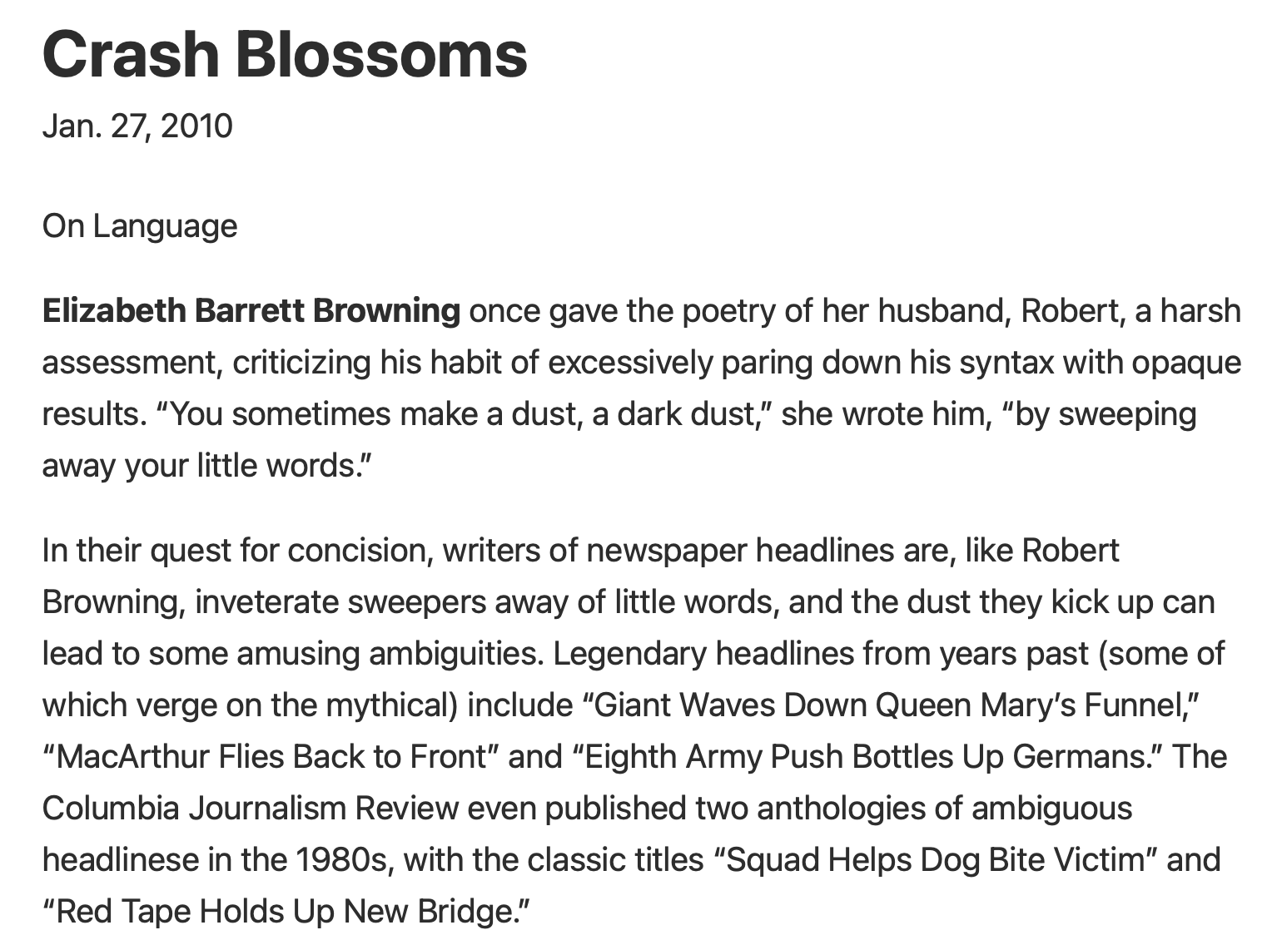
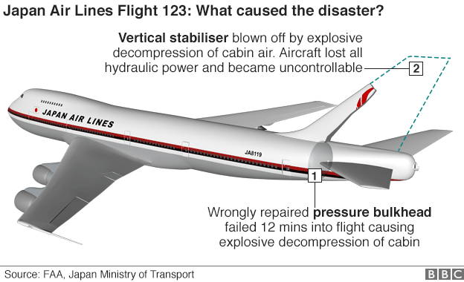
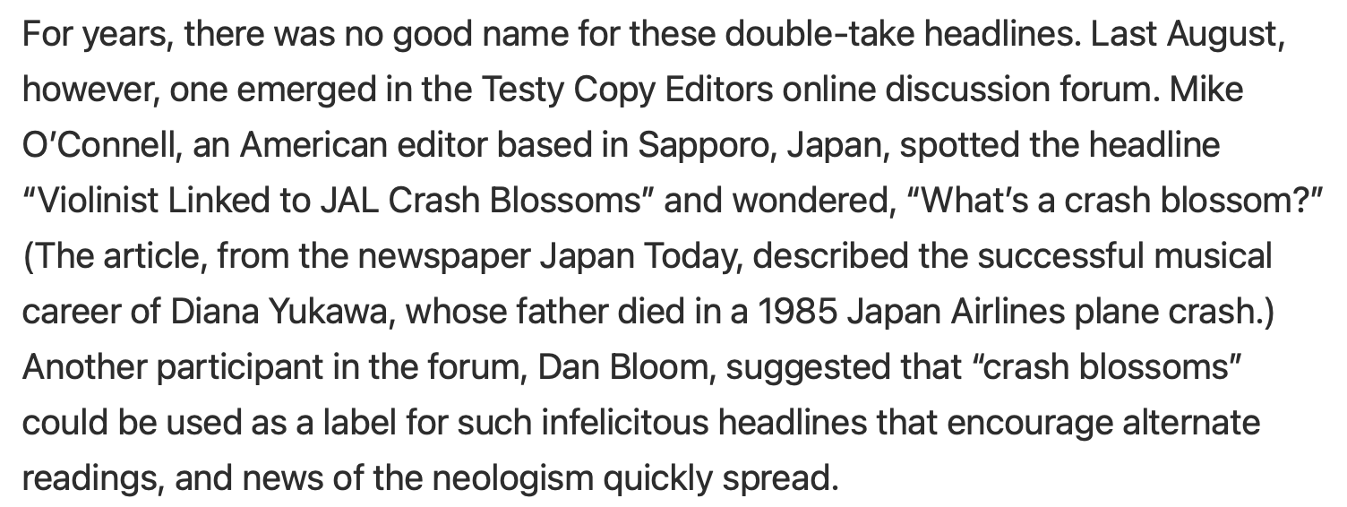
NYTimes Article
https://www.nytimes.com/2010/01/31/magazine/31FOB-onlanguage-t.html

Slide 17
Homework 8
Step 1: Read the New York Times article on Crash Blossoms (CB)
Step 2: Install Stanza into nltk on your machine
Step 3: Find two headlines that you consider to be CBs
  either from the internet
  or look at the Crash Blossom Archive
    https://languagelog.ldc.upenn.edu/nll/?cat=118
  (Don't use one I've already highlighted in class.)
  Explain why they are a CB,
    e.g. what is the misread, why they may be misinterpreted.

Slide 18
Homework 8
Step 4: Now run the headlines you chose on all of the following parsers:
  CoreNLP https://corenlp.run (if it's running)
  Stanza, on your computer, dependency and constituency, and
  Berkeley Neural Parser https://parser.kitaev.io
  Explain each parse, i.e. whether it got
    (A) the intended reading,
    (B) your CB reading (funny), or
    (C) some other reading (incorrect).

Slide 19
Homework 8
Submit to sandiway@arizona.edu
SUBJECT: 581 Homework 8 YOUR NAME
One PDF file (for grading)
  include your screenshots in your answer
  put a web link to each headline (if you found it online)
Usual Deadline:
  Saturday March 21st
  we will review the homework on Monday March 23rd

