Slide 1
LING/C SC 581: Advanced Computational Linguistics
Lecture 14
Prof. Sandiway Fong

Slide 2
Today's Topics
Homework 7 Review
Human judgements
Humans vs. ChatGPT
Install Stanza on your laptop (Homework 8: Part 1)
Crash Blossoms

Slide 3
Homework 7 Review
Contrast 1 vs 2 vs 3:
John knew an untrue story about him.
John listened to an untrue story about him.
John overheard an untrue story about him.
Humans vs. ChatGPT
Asking ChatGPT the right question is key:
Who is him?
Who does him refer to?
Who is the story about?
Responses may vary. Can we conclude anything?

Slide 4
Reflexives and Pronouns
What is the "algorithm" the human brain uses?
Examples from Reuland (2010; 93)
Max knows which pictures of himself Lucie likes
Max knows which pictures of herself Lucie likes
What do you think of these?
Max knows which pictures of him/ him Lucie likes
Max knows which pictures of ??her/ her Lucie likes
Or these?
Max knows *him/ him
Max knows himself
Minimal Search (MS)
upwards
him
her
= someone else

Slide 5
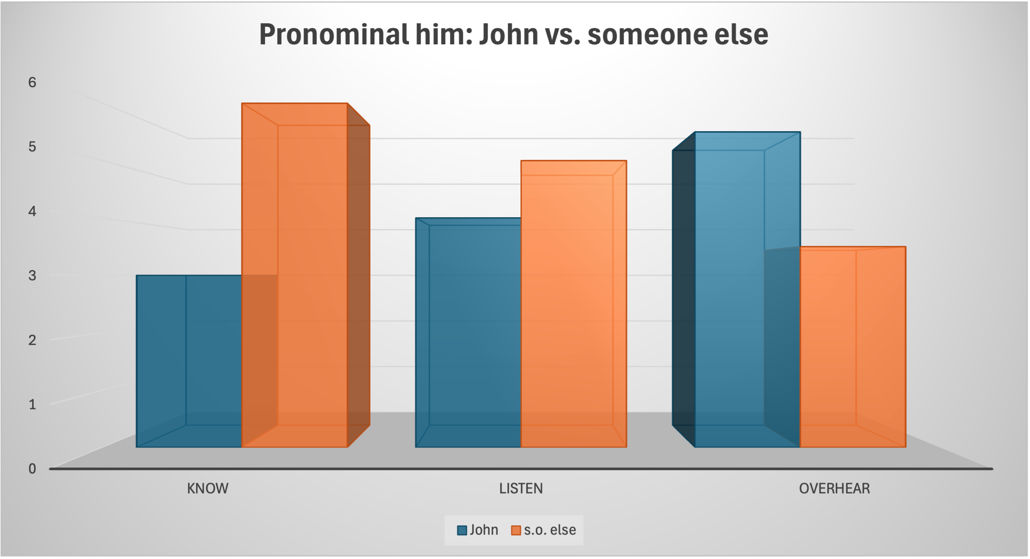
Homework 7 Review

Slide 6
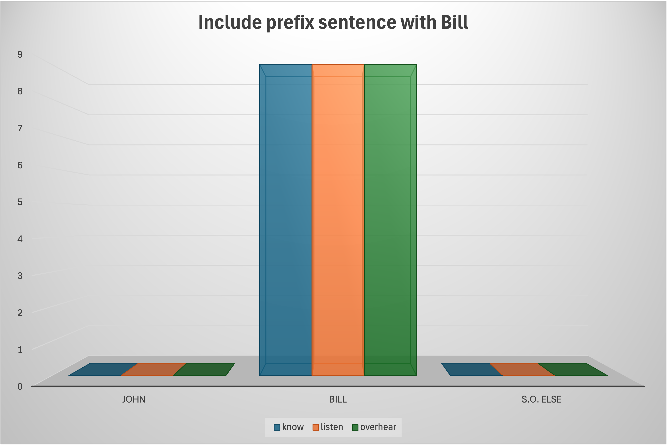
Homework 7 Review

Slide 7
Homework 7 Review: summary
Query | ChatGPT 5.3 | ChatGPT 3.5
know + story about | John | John
Bill + … | Bill | Bill
know + him | John | someone else
Bill + … | Bill
listen + story about | John
Bill + … | Bill
listen + him | John
Bill + … | Bill
overhear + story about | John | John
Bill + … | Bill | Bill
overhear + him | John
Bill + … | Bill

Slide 8
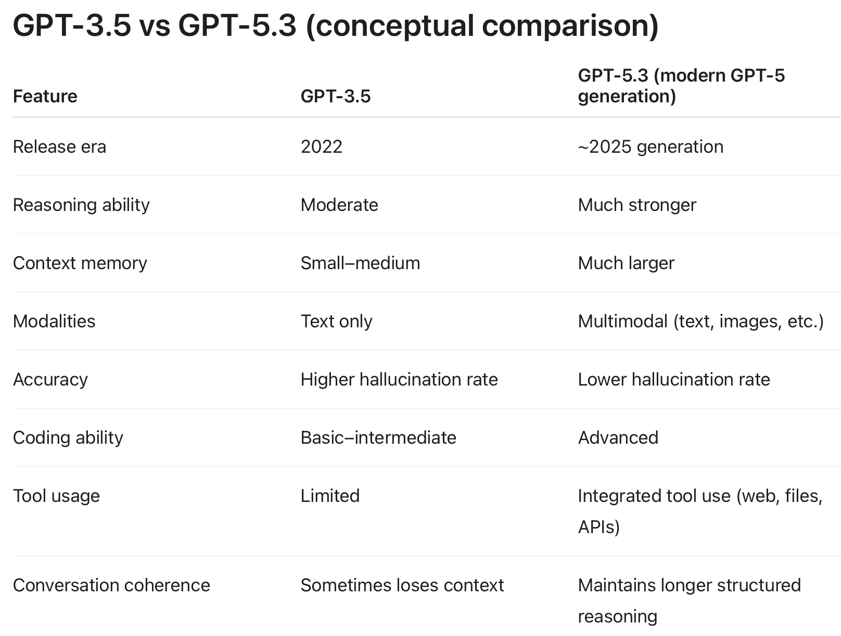
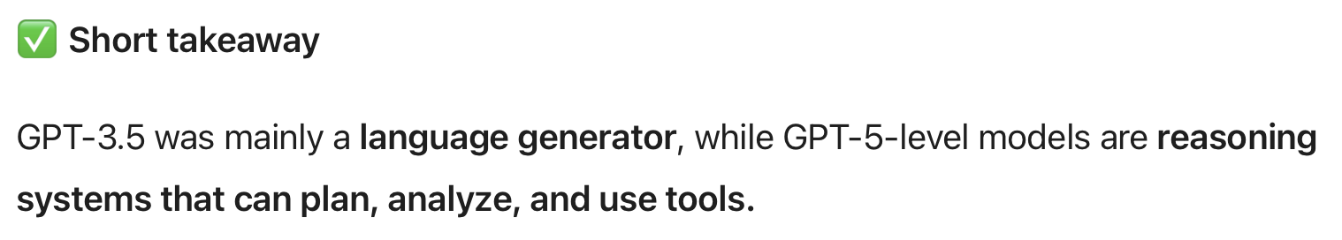
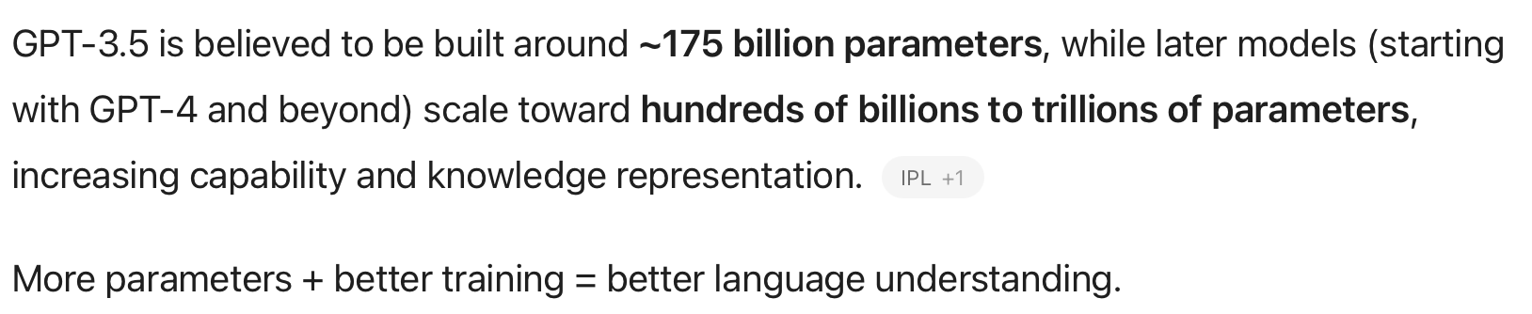
Homework 7 Review: GPT-5.3 vs 3.5

Slide 9
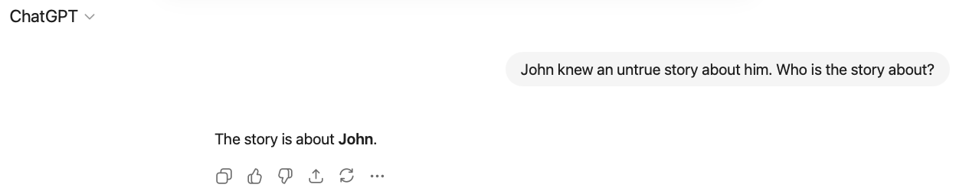
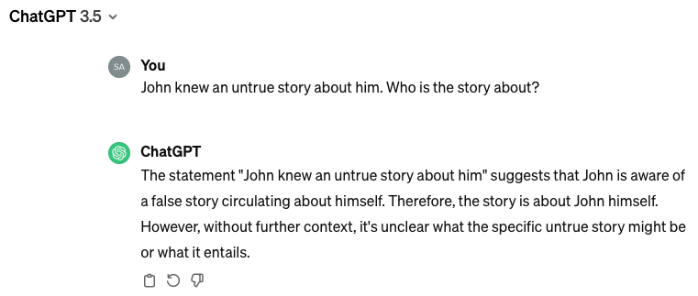
Homework 7 Review: know + story about

Slide 10
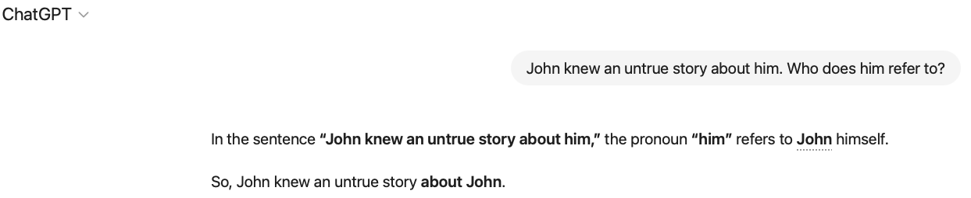
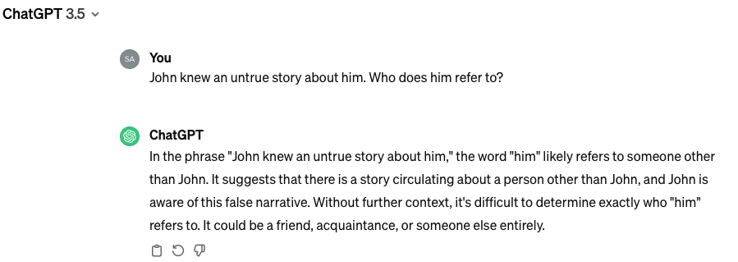
Homework 7 Review: know + him

Slide 11
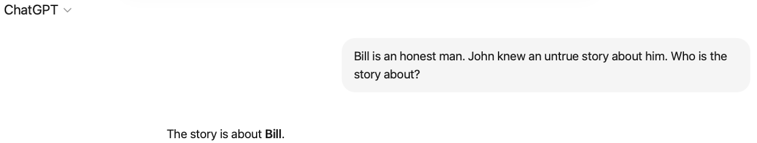
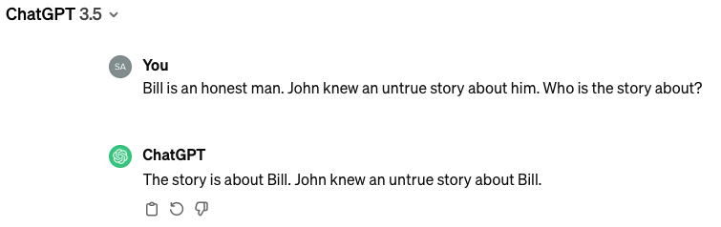
Homework 7 Review: Bill + know + story about

Slide 12
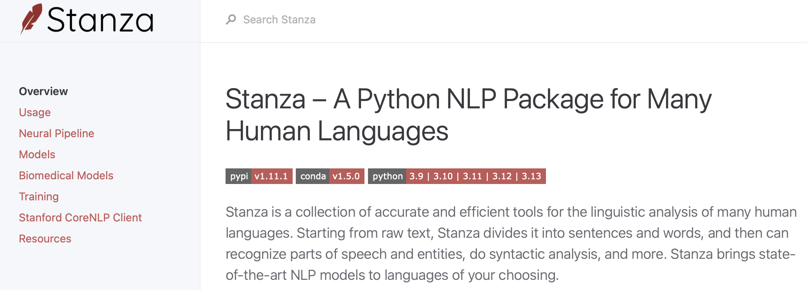
Stanza
https://stanfordnlp.github.io/stanza/

Slide 13
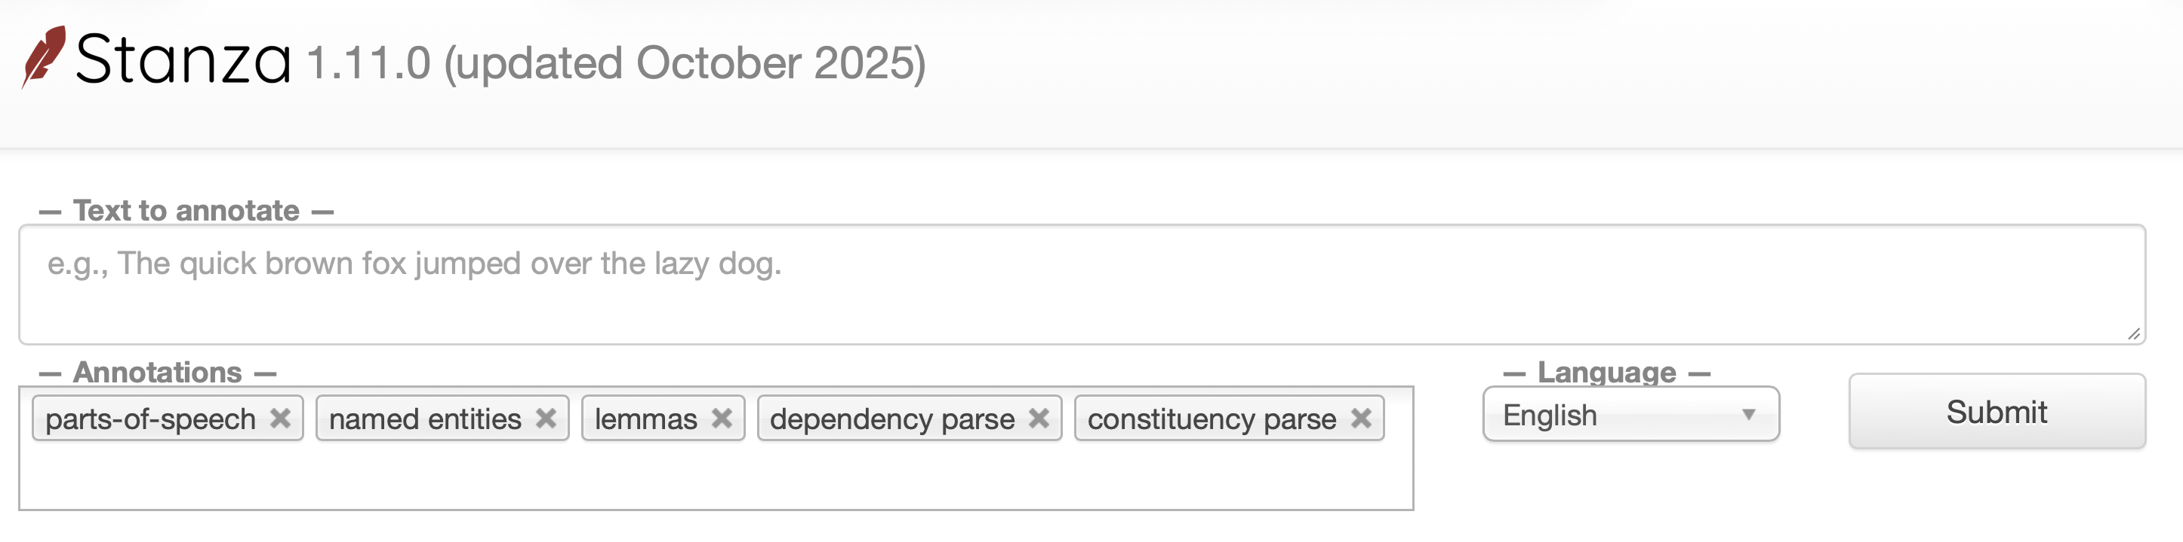
Stanza
https://stanza.stanford.edu
online and off-line (Python package support)

Slide 14
Stanza (1.11.1 most recent)
$ pip3 install stanza
Collecting stanza
Downloading stanza-1.11.1-py3-none-any.whl.metadata (14 kB)
Collecting emoji (from stanza)
Downloading emoji-2.15.0-py3-none-any.whl.metadata (5.7 kB)
…
Downloading stanza-1.11.1-py3-none-any.whl (1.7 MB)
━━━━━━━━━━━━━━━━━━━━━━━━━━━━━━━━━━━━━━━━ 1.7/1.7 MB 4.9 MB/s 0:00:00
Downloading udtools-0.2.7-py3-none-any.whl (773 kB)
━━━━━━━━━━━━━━━━━━━━━━━━━━━━━━━━━━━━━━━━ 773.7/773.7 kB 7.1 MB/s 0:00:00
Downloading udapi-0.5.1-py3-none-any.whl (337 kB)
Downloading emoji-2.15.0-py3-none-any.whl (608 kB)
━━━━━━━━━━━━━━━━━━━━━━━━━━━━━━━━━━━━━━━━ 608.4/608.4 kB 5.4 MB/s 0:00:00
Installing collected packages: udapi, emoji, udtools, stanza
Successfully installed emoji-2.15.0 stanza-1.11.1 udapi-0.5.1 udtools-0.2.7

Slide 15
Stanza (last year)
$ pip3 install stanza
Collecting stanza
Downloading stanza-1.5.0-py3-none-any.whl (802 kB)
|████████████████████████████████| 802 kB 2.6 MB/s
…
Successfully built emoji
Installing collected packages: torch, protobuf, emoji, stanza
Successfully installed emoji-2.2.0 protobuf-4.22.1 stanza-1.5.0 torch-2.0.0

Slide 16
Stanza: download model
https://stanfordnlp.github.io/stanza/#getting-started
Run:
$ python3
Python 3.13.1 (v3.13.1:06714517797, Dec 3 2024, 14:00:22) [Clang 15.0.0 (clang-1500.3.9.4)] on darwin
Type "help", "copyright", "credits" or "license" for more information.
>>> import stanza
>>> stanza.download('en')
Downloading https://raw.githubusercontent.com/stanfordnlp/stanza-resources/main/resources_1.11.0.json: 439kB [00:00, 22.8MB/s]
2026-03-15 18:20:44 INFO: Downloaded file to /Users/sandiway/Library/Caches/stanza/1.11.0/resources/resources.json
2026-03-15 18:20:44 INFO: Downloading default packages for language: en (English) ...
Downloading https://huggingface.co/stanfordnlp/stanza-en/resolve/v1.11.0/models/
2026-03-15 18:21:51 INFO: Downloaded file to /Users/sandiway/Library/Caches/stanza/1.11.0/resources/en/default.zip
2026-03-15 18:21:52 INFO: Finished downloading models and saved to /Users/sandiway/Library/Caches/stanza/1.11.0/resources
[['zip', 'default.zip']]
>>>

Slide 17
Stanza: initialize English pipeline
>>> nlp = stanza.Pipeline('en')
2026-03-15 18:24:36 INFO: Checking for updates to resources.json in case models have been updated. Note: this behavior can be turned off with download_method=None or download_method=DownloadMethod.REUSE_RESOURCES
Downloading https://raw.githubusercontent.com/stanfordnlp/stanza-resources/main/resources_1.11.0.json: 439kB [00:00, 10.8MB/s]
2026-03-15 18:24:37 INFO: Downloaded file to /Users/sandiway/Library/Caches/stanza/1.11.0/resources/resources.json
2026-03-15 18:24:38 INFO: Loading these models for language: en (English):
============================================
| Processor | Package |
--------------------------------------------
| tokenize | combined |
| mwt | combined |
| pos | combined_charlm |
| lemma | combined_nocharlm |
| constituency | ptb3-revised_charlm |
| depparse | combined_charlm |
| sentiment | sstplus_charlm |
| ner | ontonotes-ww-multi_charlm |
============================================
2026-03-15 18:24:38 INFO: Using device: cpu
2026-03-15 18:24:38 INFO: Loading: tokenize
2026-03-15 18:24:39 INFO: Loading: mwt
2026-03-15 18:24:39 INFO: Loading: pos
2026-03-15 18:24:40 INFO: Loading: lemma
2026-03-15 18:24:40 INFO: Loading: constituency
2026-03-15 18:24:41 INFO: Loading: depparse
2026-03-15 18:24:41 INFO: Loading: sentiment
2026-03-15 18:24:41 INFO: Loading: ner
2026-03-15 18:24:43 INFO: Done loading processors!
>>>

Slide 18

Crash Blossoms
Headlinese:
headlines are compressed (due to a lack of space)
Leaving out words, e.g. copulas etc., may lead to unfortunate structural ambiguities
https://www.nytimes.com/2010/01/31/magazine/31FOB-onlanguage-t.html
Legendary headlines […] include “Giant Waves Down Queen Mary’s Funnel,” “MacArthur Flies Back to Front” and “Eighth Army Push Bottles Up Germans.”
The Columbia Journalism Review published two anthologies with the classic titles “Squad Helps Dog Bite Victim” and “Red Tape Holds Up New Bridge.”
a tabloid

Slide 19
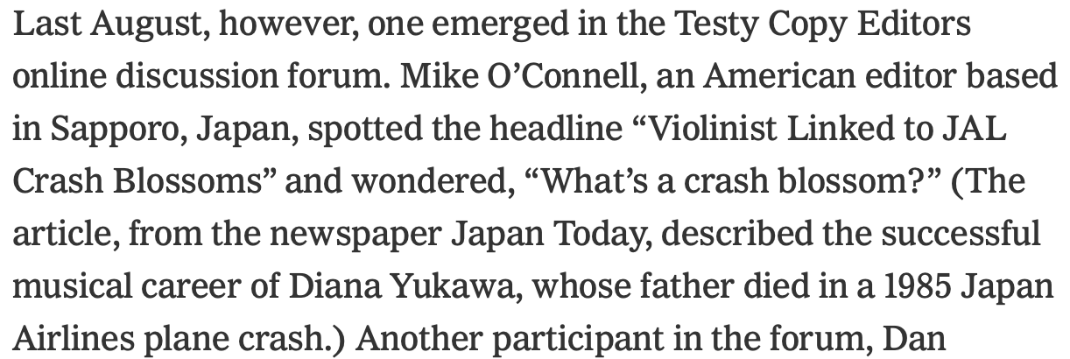
Crash Blossoms

Slide 20
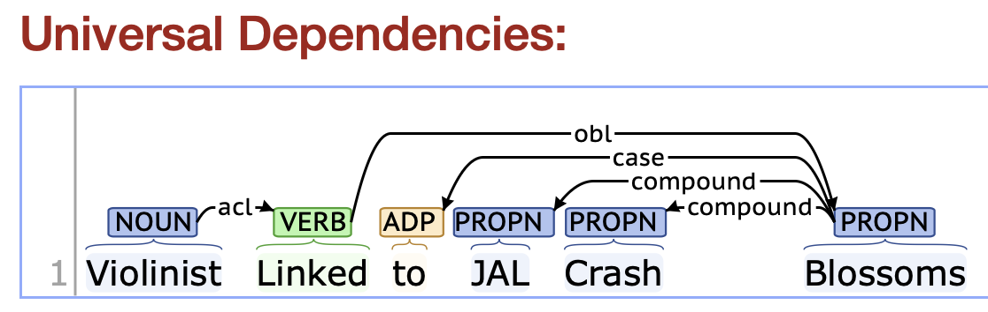
Violinist Linked to JAL Crash Blossoms
>>> doc = nlp("Violinist Linked to JAL Crash Blossoms")
>>> words = doc.sentences[0].words
>>> for word in words:
... print(f"{word.id}: {word.text} - {word.deprel} -> {word.head}")
...
1: Violinist - root -> 0
2: Linked - acl -> 1
3: to - case -> 6
4: JAL - compound -> 6
5: Crash - compound -> 6
6: Blossoms - obl -> 2
>>>
acl: clausal modifier of noun

Slide 21
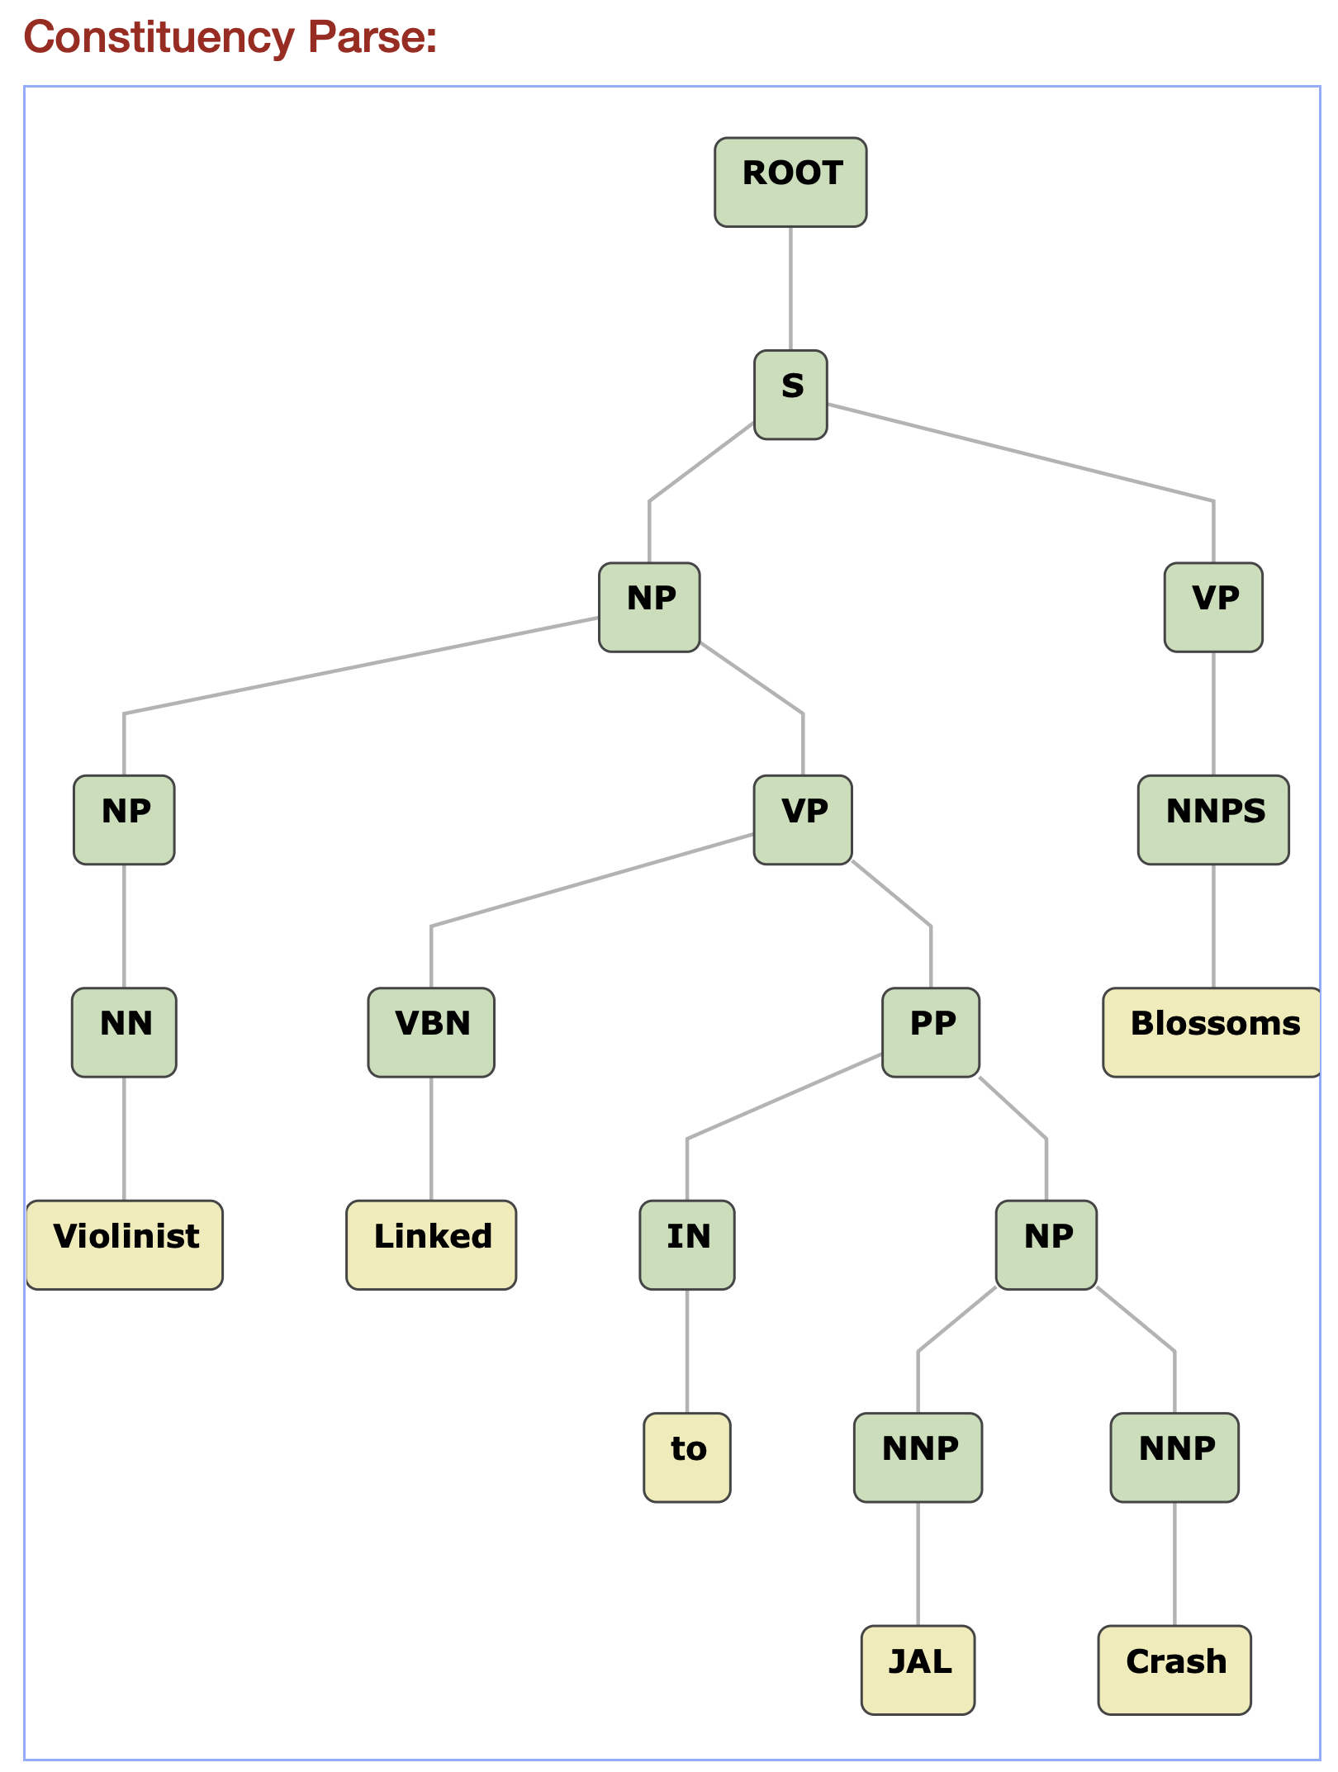
Violinist Linked to JAL Crash Blossoms
WOW!

Slide 22
Violinist Linked to JAL Crash Blossoms
>>> doc = nlp("Violinist Linked to JAL Crash Blossoms")
>>> print(doc)
[
[
{
"id": 1,
"text": "Violinist",
"lemma": "violinist",
"upos": "NOUN",
"xpos": "NN",
"feats": "Number=Sing",
"head": 0,
"deprel": "root",
"start_char": 0,
"end_char": 9,
"ner": "O",
"multi_ner": [
"O"
]
},
{
"id": 2,
"text": "Linked",
"lemma": "link",
"upos": "VERB",
"xpos": "VBN",
"feats": "Tense=Past|VerbForm=Part|Voice=Pass",
"head": 1,
"deprel": "acl",
"start_char": 10,
"end_char": 16,
"ner": "O",
"multi_ner": [
"O"
]
},
{
"id": 3,
"text": "to",
"lemma": "to",
"upos": "ADP",
"xpos": "IN",
"head": 6,
"deprel": "case",
"start_char": 17,
"end_char": 19,
"ner": "O",
"multi_ner": [
"O"
]
},
{
"id": 4,
"text": "JAL",
"lemma": "JAL",
"upos": "PROPN",
"xpos": "NNP",
"feats": "Number=Sing",
"head": 6,
"deprel": "compound",
"start_char": 20,
"end_char": 23,
"ner": "O",
"multi_ner": [
"O"
]
},
{
"id": 5,
"text": "Crash",
"lemma": "Crash",
"upos": "PROPN",
"xpos": "NNP",
"feats": "Number=Sing",
"head": 6,
"deprel": "compound",
"start_char": 24,
"end_char": 29,
"ner": "O",
"multi_ner": [
"O"
]
},
{
"id": 6,
"text": "Blossoms",
"lemma": "Blossom",
"upos": "PROPN",
"xpos": "NNPS",
"feats": "Number=Plur",
"head": 2,
"deprel": "obl",
"start_char": 30,
"end_char": 38,
"ner": "O",
"multi_ner": [
"O"
],
"misc": "SpaceAfter=No"
}
]
]

Slide 23
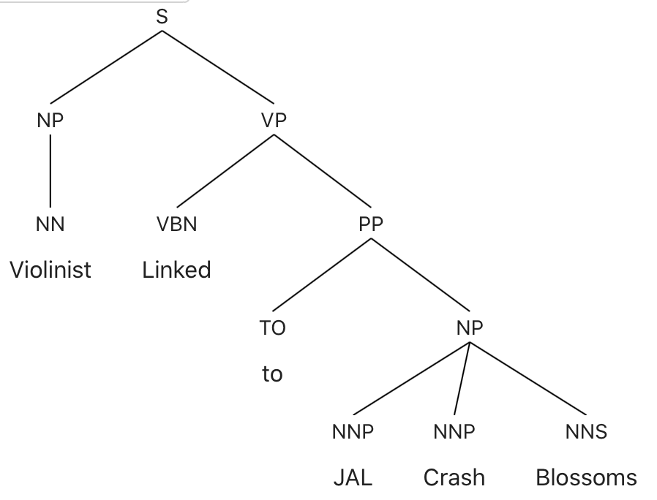
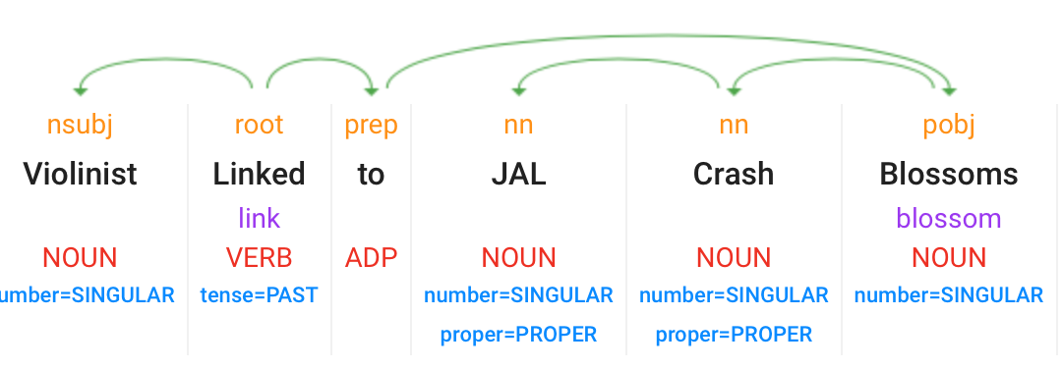
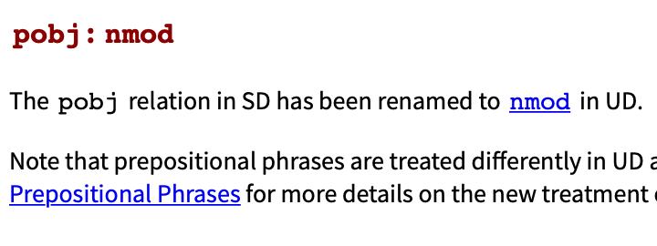
Violinist Linked to JAL Crash Blossoms
https://parser.kitaev.io

Slide 24
Stanza: Constituency Parse
>>> nlp = stanza.Pipeline(lang='en', processors='tokenize,pos,constituency')
2026-03-15 18:59:41 INFO: Checking for updates to resources.json in case models have been updated. Note: this behavior can be turned off with download_method=None or download_method=DownloadMethod.REUSE_RESOURCES
Downloading https://raw.githubusercontent.com/stanfordnlp/stanza-resources/main/resources_1.11.0.json: 439kB [00:00, 11.0MB/s]
2026-03-15 18:59:41 INFO: Downloaded file to /Users/sandiway/Library/Caches/stanza/1.11.0/resources/resources.json
2026-03-15 18:59:41 WARNING: Language en package default expects mwt, which has been added
2026-03-15 18:59:42 INFO: Loading these models for language: en (English):
======================================
| Processor | Package |
--------------------------------------
| tokenize | combined |
| mwt | combined |
| pos | combined_charlm |
| constituency | ptb3-revised_charlm |
======================================
2026-03-15 18:59:42 INFO: Using device: cpu
2026-03-15 18:59:42 INFO: Loading: tokenize
2026-03-15 18:59:42 INFO: Loading: mwt
2026-03-15 18:59:42 INFO: Loading: pos
2026-03-15 18:59:43 INFO: Loading: constituency
2026-03-15 18:59:44 INFO: Done loading processors!

Slide 25
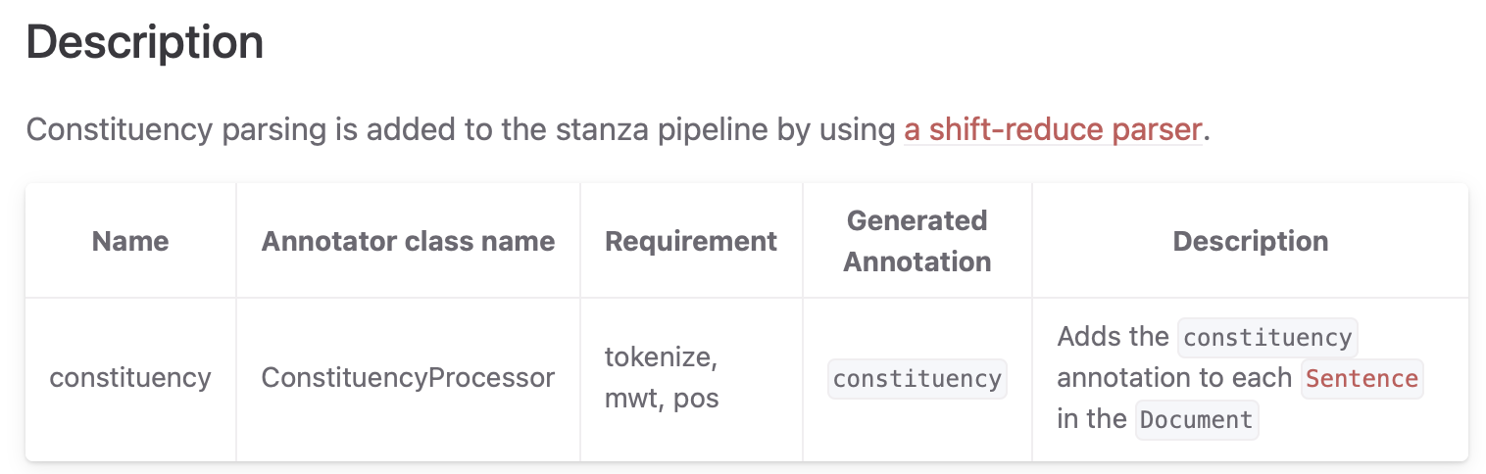
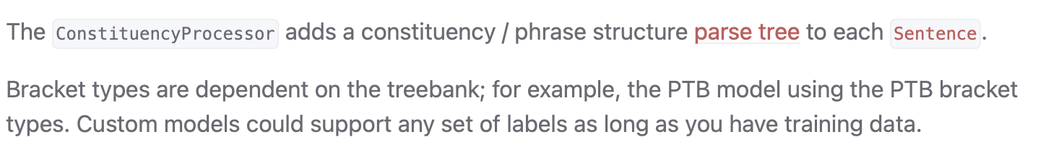
Stanza: Constituency Parse

Slide 26
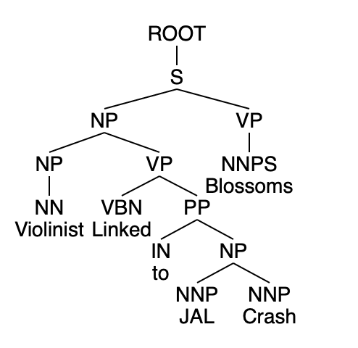
Stanza: Constituency Parse
>>> doc = nlp("Violinist Linked to JAL Crash Blossoms")
>>> for sentence in doc.sentences:
... print(sentence.constituency)
...
(ROOT (S (NP (NP (NN Violinist)) (VP (VBN Linked) (PP (IN to) (NP (NNP JAL) (NNP Crash))))) (VP (NNPS Blossoms))))
>>>

Slide 27
Stanza: Constituency Parse
Labels / children
>>> tree = doc.sentences[0].constituency
>>> tree.label
'ROOT'
>>> tree.children
((S (NP (NP (NN Violinist)) (VP (VBN Linked) (PP (IN to) (NP (NNP JAL) (NNP Crash))))) (VP (NNPS Blossoms))),)
>>> tree.children[0]
(S (NP (NP (NN Violinist)) (VP (VBN Linked) (PP (IN to) (NP (NNP JAL) (NNP Crash))))) (VP (NNPS Blossoms)))
>>> tree.children[0].label
'S'
>>> len(tree.children[0].children)
2

Slide 28
Headlinese
Violinist Linked to JAL Crash Blossoms
Violinist Who Was Linked to JAL Crash Blossoms
A Violinist Who Was Linked to JAL Crash Blossoms
A Violinist Who Was Linked to the JAL Crash Blossoms
A Violinist Who Was Linked to the JAL Crash blossoms
A violinist who was linked to the JAL Crash blossoms
A violinist who was linked to the JAL Crash is now blossoming
This one!

Slide 29
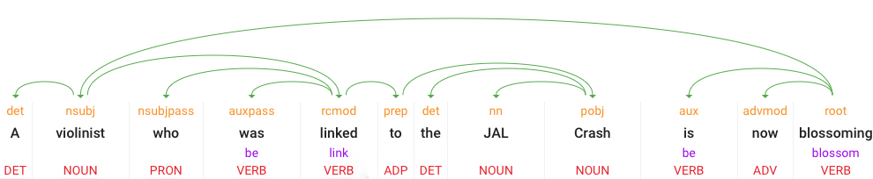

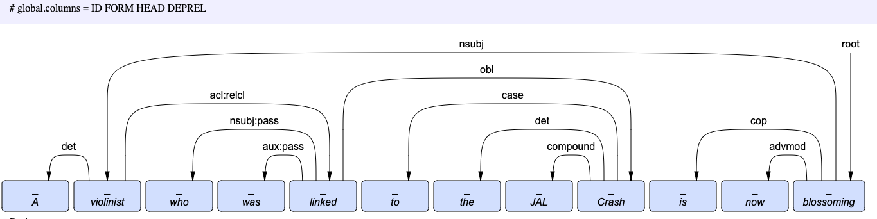
A violinist who was linked to the JAL Crash is now blossoming

Slide 30
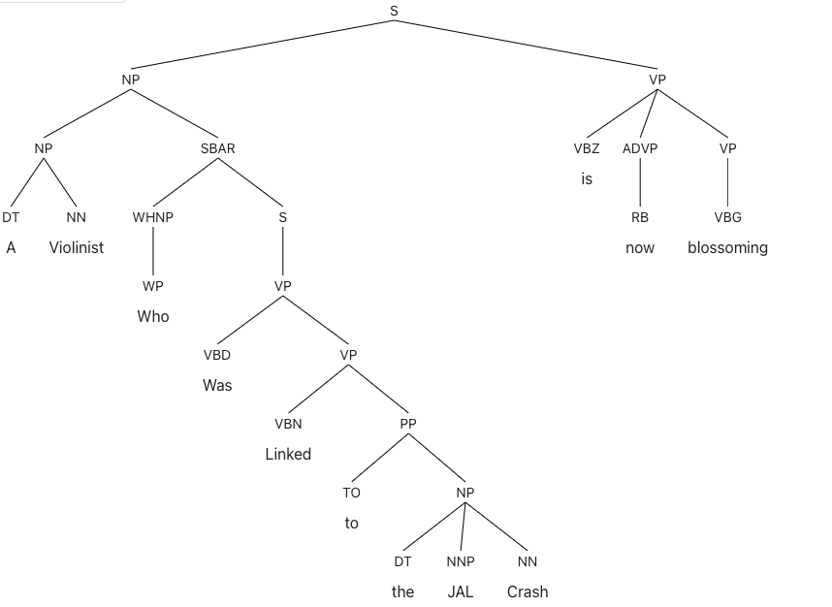
A violinist who was linked to the JAL Crash is now blossoming

Slide 31
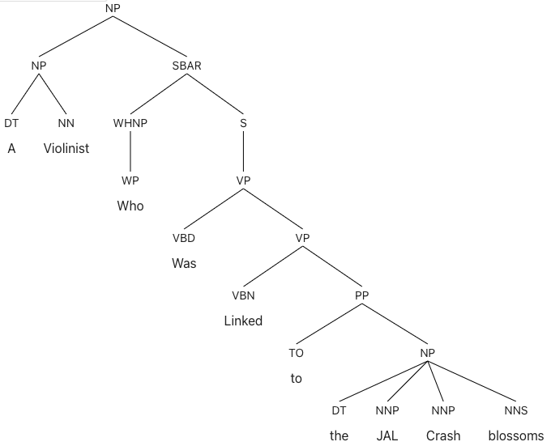
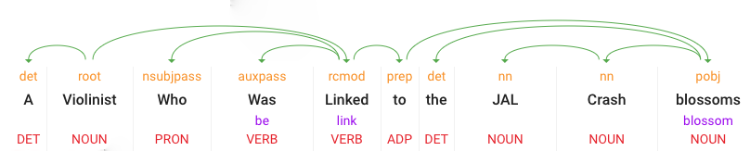

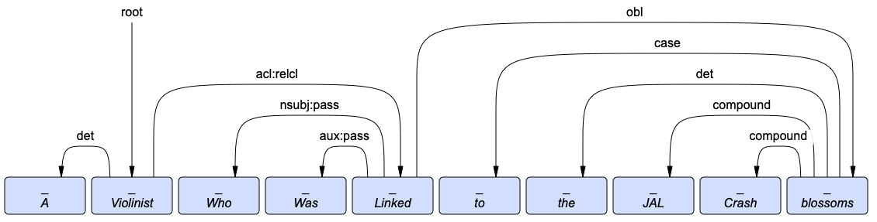
A Violinist Who Was Linked to the JAL Crash blossoms

Slide 32
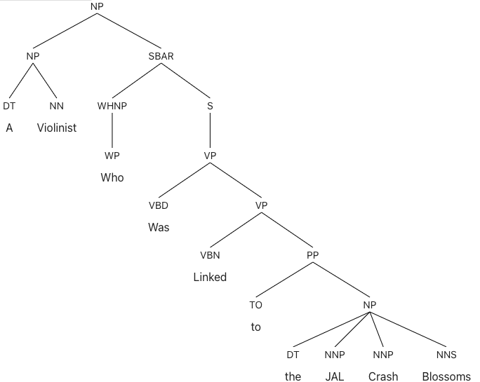
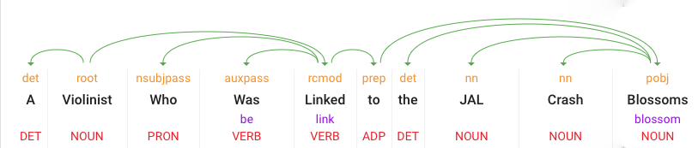


A Violinist Who Was Linked to the JAL Crash Blossoms

Slide 33
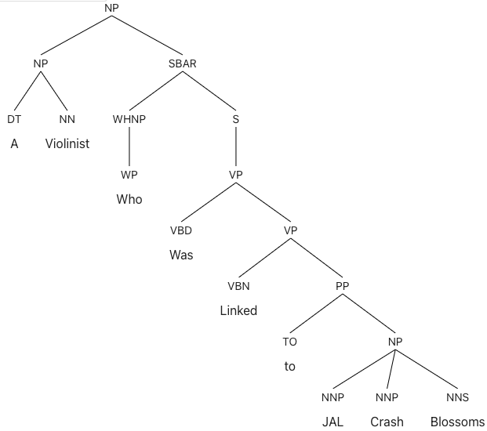
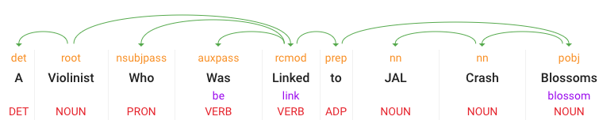

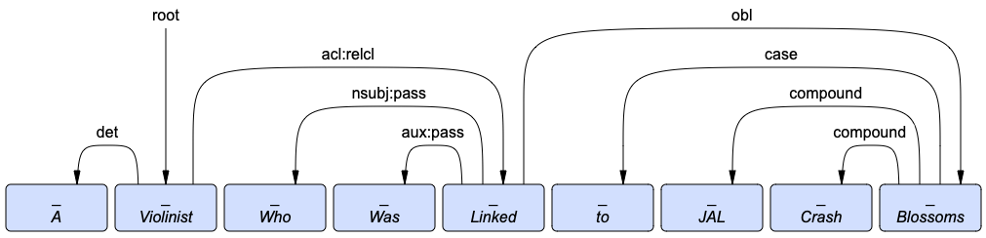
A Violinist Who Was Linked to JAL Crash Blossoms

Slide 34
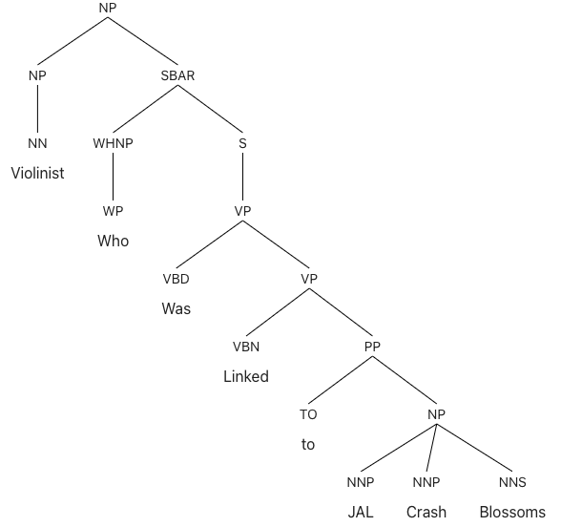
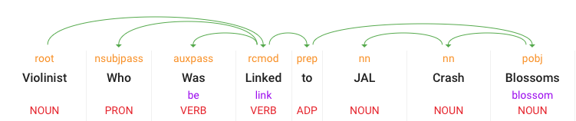

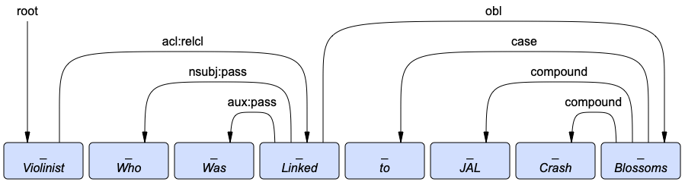
Violinist Who Was Linked to JAL Crash Blossoms

Slide 35
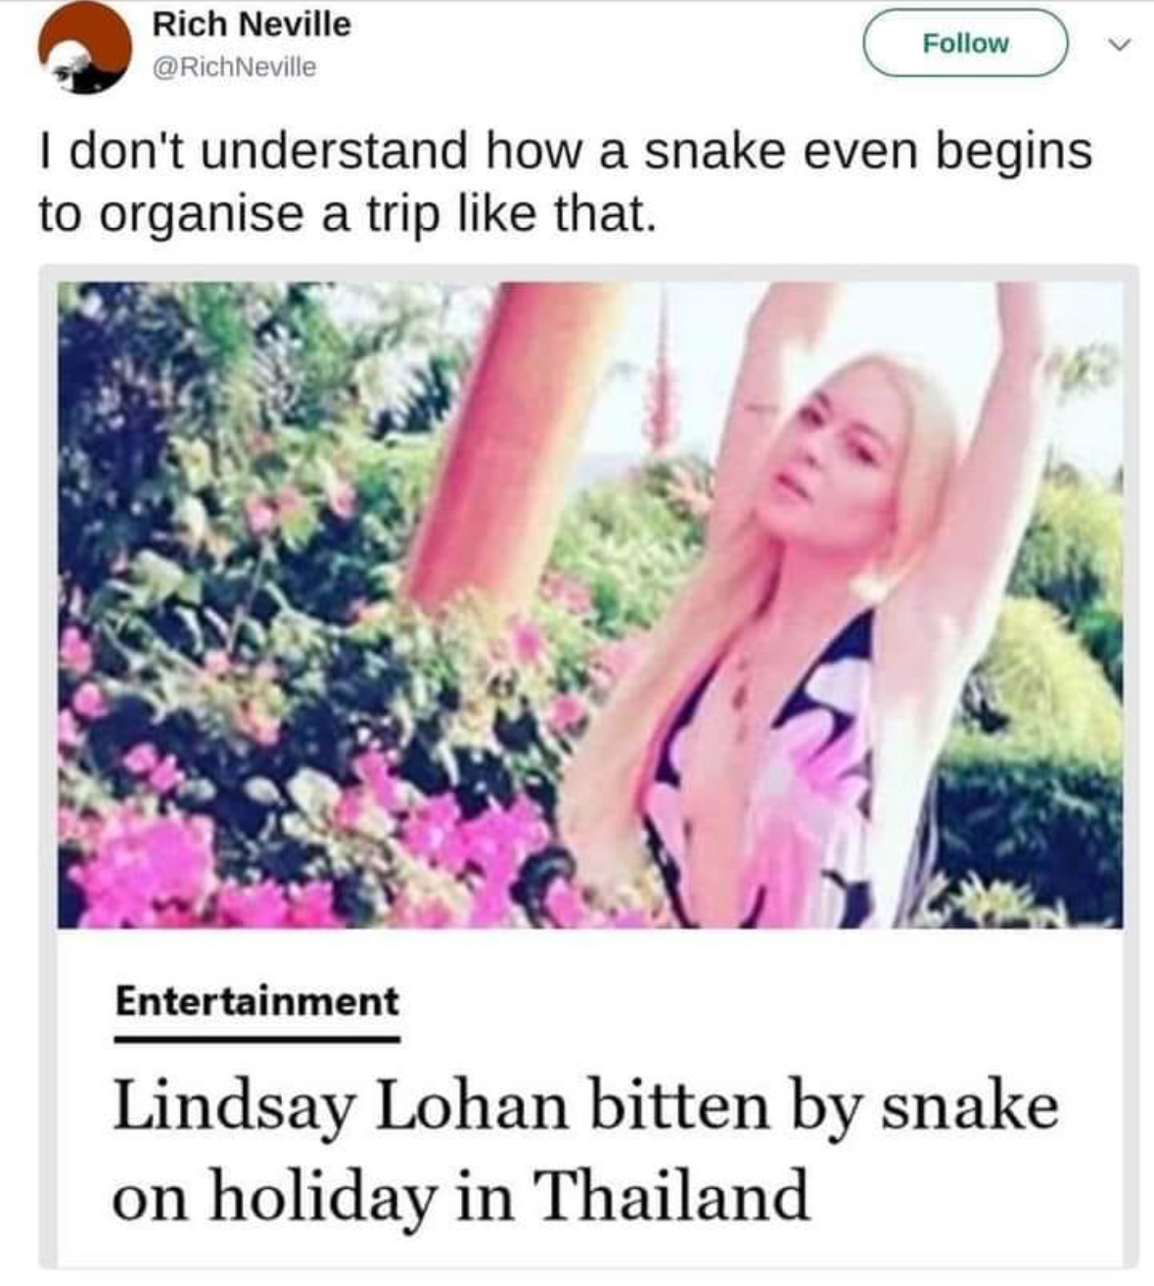

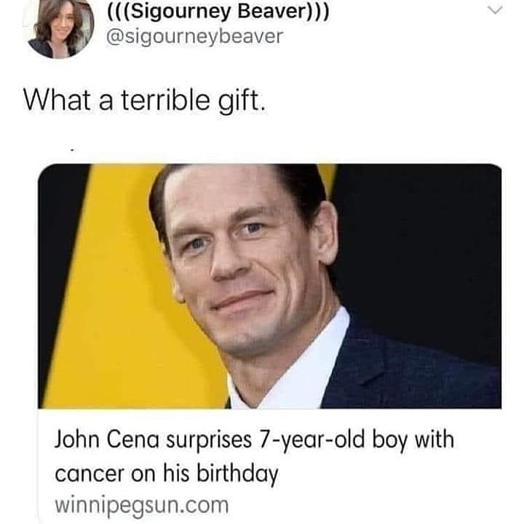
Are these Crash Blossoms?
Perhaps not. Funny, yes, but are they the most likely parse/reading?

