Slide 1
LING/C SC 581:
Advanced Computational Linguistics
Lecture 12
Prof. Sandiway Fong

Slide 2
Today's Topics
CKY Parsing algorithm
  Dynamic Programming
  Chomsky Normal Form (CNF)

Slide 3
Context-Free Grammar Parsing
Algorithm:
  use Prolog's top-down, left-to-right depth-first search
  avoid left recursion problems: our grammar transformation
There are lots of algorithms for parsing context-free rules
  In this course, we'll examine two
  Today: CKY – because of the 2D table (it's used for tabular parsing)
  the 2D table is computationally efficient (memorization of partial results)
    particularly useful when there is structural ambiguity
    e.g. … with a telescope

Slide 4
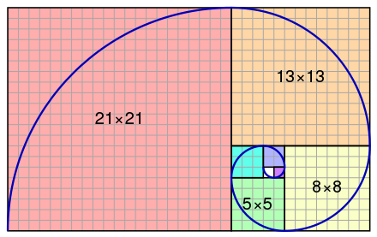
Memorization aka Dynamic Programming
A general computational trick (also used in math)
Example:
  0,1,1,2,3,5,8,13,21,34,55,89,…
  Fibonacci sequence
    f(0)=0,
    f(1)=1,
    f(n)=f(n-1)+f(n-2) for n>1
Example:
  f(5) = f(4) + f(3)
  = f(3) + f(2) + f(3)
  = 2 + 1 + 2
Fibonacci Spiral: adapted from wikipedia
3x3
2x2
1x1

Slide 5
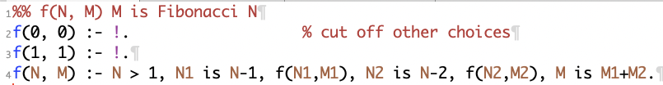
Memorization aka Dynamic Programming
Not a standard feature of Prolog
  Program: fibonacci.prolog implements
  Fibonacci sequence
    f(0)=0,
    f(1)=1,
    f(n)=f(n-1)+f(n-2) for n>1
  no {…} needed here, it's not a grammar, i.e. doesn't use -->

Slide 6
Memorization aka Dynamic Programming
Correct but inefficient:
$ swipl -l fibonacci.prolog
?- f(0,N).
N = 0.
?- f(1,N).
N = 1.
?- f(5,N).
N = 5.
?- f(6,N).
N = 8.
?- f(7,N).
N = 13.
?- f(8,N).
N = 21.

Slide 7
Memorization aka Dynamic Programming
?- spy(f).
% Spy point on f/2
true.
[debug] ?- f(5, N).
Call: (10) f(5, _34086) ? leap
Call: (11) f(4, _35386) ? leap
Call: (12) f(3, _36288) ? leap
Call: (13) f(2, _37190) ? leap
Call: (14) f(1, _38092) ? leap
Exit: (14) f(1, 1) ? leap
Call: (14) f(0, _39886) ? leap
Exit: (14) f(0, 0) ? leap
Exit: (13) f(2, 1) ? leap
Call: (13) f(1, _42578) ? leap
Exit: (13) f(1, 1) ? leap
Exit: (12) f(3, 2) ? leap
Call: (12) f(2, _45270) ? leap
Call: (13) f(1, _46172) ? leap
Exit: (13) f(1, 1) ? leap
Call: (13) f(0, _47966) ? leap
Exit: (13) f(0, 0) ? leap
Exit: (12) f(2, 1) ? leap
Exit: (11) f(4, 3) ? leap
Call: (11) f(3, _51556) ? leap
Call: (12) f(2, _52458) ? leap
Call: (13) f(1, _53360) ? leap
Exit: (13) f(1, 1) ? leap
Call: (13) f(0, _55154) ? leap
Exit: (13) f(0, 0) ? leap
Exit: (12) f(2, 1) ? leap
Call: (12) f(1, _57846) ? leap
Exit: (12) f(1, 1) ? leap
Exit: (11) f(3, 2) ? leap
Exit: (10) f(5, 5) ? leap
N = 5 ;
Fail: (12) f(1, _57846) ? leap
Fail: (13) f(0, _55154) ? leap
Fail: (13) f(1, _53360) ? leap
Fail: (12) f(2, _52458) ? leap
Fail: (11) f(3, _51556) ? leap
Fail: (13) f(0, _47966) ? leap
Fail: (13) f(1, _46172) ? leap
Fail: (12) f(2, _45270) ? leap
Fail: (13) f(1, _42578) ? leap
Fail: (14) f(0, _39886) ? leap
Fail: (14) f(1, _38092) ? leap
Fail: (13) f(2, _37190) ? leap
Fail: (12) f(3, _36288) ? leap
Fail: (11) f(4, _35386) ? leap
Fail: (10) f(5, _34086) ? leap
false.
type l for leap
Computes f(2) = 1 three times!

Slide 8
Memorization aka Dynamic Programming
Using time/1 to measure inferences:
?- time(f(10,N)).
% 352 inferences, 0.000 CPU in 0.000 seconds (83% CPU, 5587302 Lips)
N = 55.
?- time(f(20,N)).
% 43,779 inferences, 0.008 CPU in 0.010 seconds (81% CPU, 5229216 Lips)
N = 6765.
?- time(f(30,N)).
% 5,385,071 inferences, 0.389 CPU in 0.466 seconds (84% CPU, 13836505 Lips)
N = 832040.
?- time(f(40,N)).
% 662,320,559 inferences, 45.644 CPU in 54.645 seconds (84% CPU, 14510661 Lips)
N = 102334155.

Slide 9
Memorization aka Dynamic Programming
How can we improve its efficiency?
  Computes f(2) = 1 three times!
Memorize result in a table first time it's computed
  and use the answer when asked again
Class Exercise:
  let's compute using a table!

Slide 10
Memorization aka Dynamic Programming
Naïve algorithm
Using a table
?- time(f(10,N)).
% 352 inferences, 0.000 CPU in 0.000 seconds (83% CPU, 5587302 Lips)
N = 55.
?- time(f(20,N)).
% 43,779 inferences, 0.008 CPU in 0.010 seconds (81% CPU, 5229216 Lips)
N = 6765.
?- time(f(30,N)).
% 5,385,071 inferences, 0.389 CPU in 0.466 seconds (84% CPU, 13836505 Lips)
N = 832040.
?- time(f(40,N)).
% 662,320,559 inferences, 45.644 CPU in 54.645 seconds (84% CPU, 14510661 Lips)
N = 102334155.
?- time(f(10,N)).
% 108 inferences, 0.000 CPU in 0.000 seconds (88% CPU, 3085714 Lips)
N = 55.
?- ^D
?- time(f(20,N)).
% 228 inferences, 0.000 CPU in 0.000 seconds (87% CPU, 3864407 Lips)
N = 6765.
?- ^D
?- time(f(30,N)).
% 348 inferences, 0.000 CPU in 0.000 seconds (85% CPU, 4350000 Lips)
N = 832040.
?- ^D
?- time(f(40,N)).
% 468 inferences, 0.000 CPU in 0.000 seconds (88% CPU, 4500000 Lips)
N = 102334155.

Slide 11
CKY Algorithm
CKY = Cocke-Kasami-Younger, sometimes CYK
A tabular method (dynamic programming) for parsing Context-Free Grammars (CFG) (JM textbook, 13.4)
Works with CFGs expressed in Chomsky Normal Form (CNF) format (JM textbook, 12.5):
  x --> y, z.
  x --> [w].
  s --> []. (s start symbol) (optional rule, not for non-start symbols)
  Note 1:
    all CFGs can be expressed in this format, although it destroys linguistic structure (which can be rebuilt).
  Note 2:
    cf. regular grammars: rule 1 vs. x --> [w], y. or x --> y, [w].
  Note 3:
    other normal forms are also possible:
    e.g. Greibach Normal Form (GNF): x --> [a], y..z
    non-left recursive!

Slide 12
Chomsky Normal Form (CNF)
Conversion steps:
  new start symbol s₀ --> s.
  (s original start symbol) to cope with possible empty derivation.
  s₀ is the only nonterminal allowed to have form s₀ --> s
  Make new nonterminal for terminals on the RHS:
  x --> … [w] ... (|RHS| > 1)
  becomes x --> ... x_{w} ... and x_{w} --> [w]. (x_{w} a new nonterminal)
  Binarize the RHS:
  x --> y₁, ...,y_{n-1},y_{n}. (|RHS| > 2)
  becomes a cascading sequence of binary rules:
  x --> y₁,x₁. x₁ --> y₂,x₂. ... x_{n-1} --> y_{n-1},y_{n}.
  Delete epsilon rules:
  for each instance of x --> []. and y --> ... x ...
  add a copy of y-rule without x, i.e. y --> ... ... then delete x --> [].
  Remove singleton rules:
  remove x --> y.(exception: x cannot be s₀) Replace x by y in other rules.

Slide 13
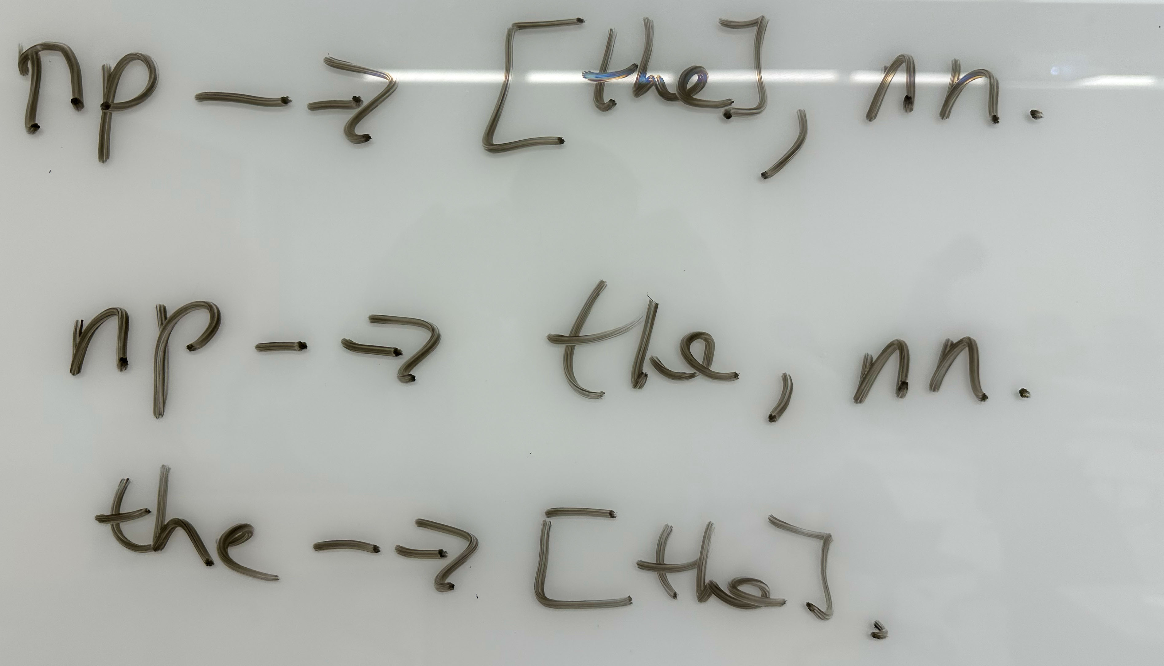
Chomsky Normal Form (CNF)
Replace terminals on the RHS, e.g. [the].

Slide 14
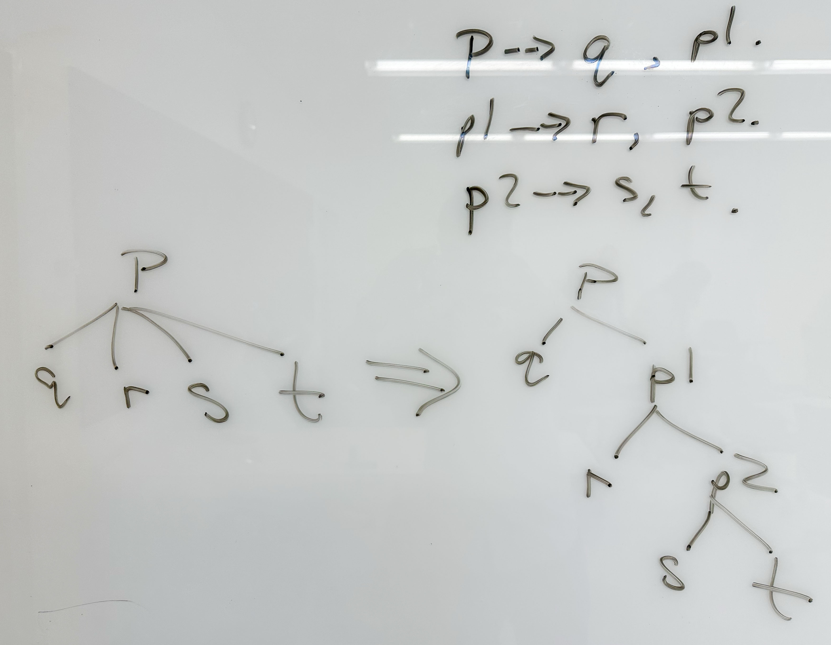
Chomsky Normal Form (CNF)
Binarization of n-ary rules (n > 2), e.g.
p --> q,r,s,t.

Slide 15
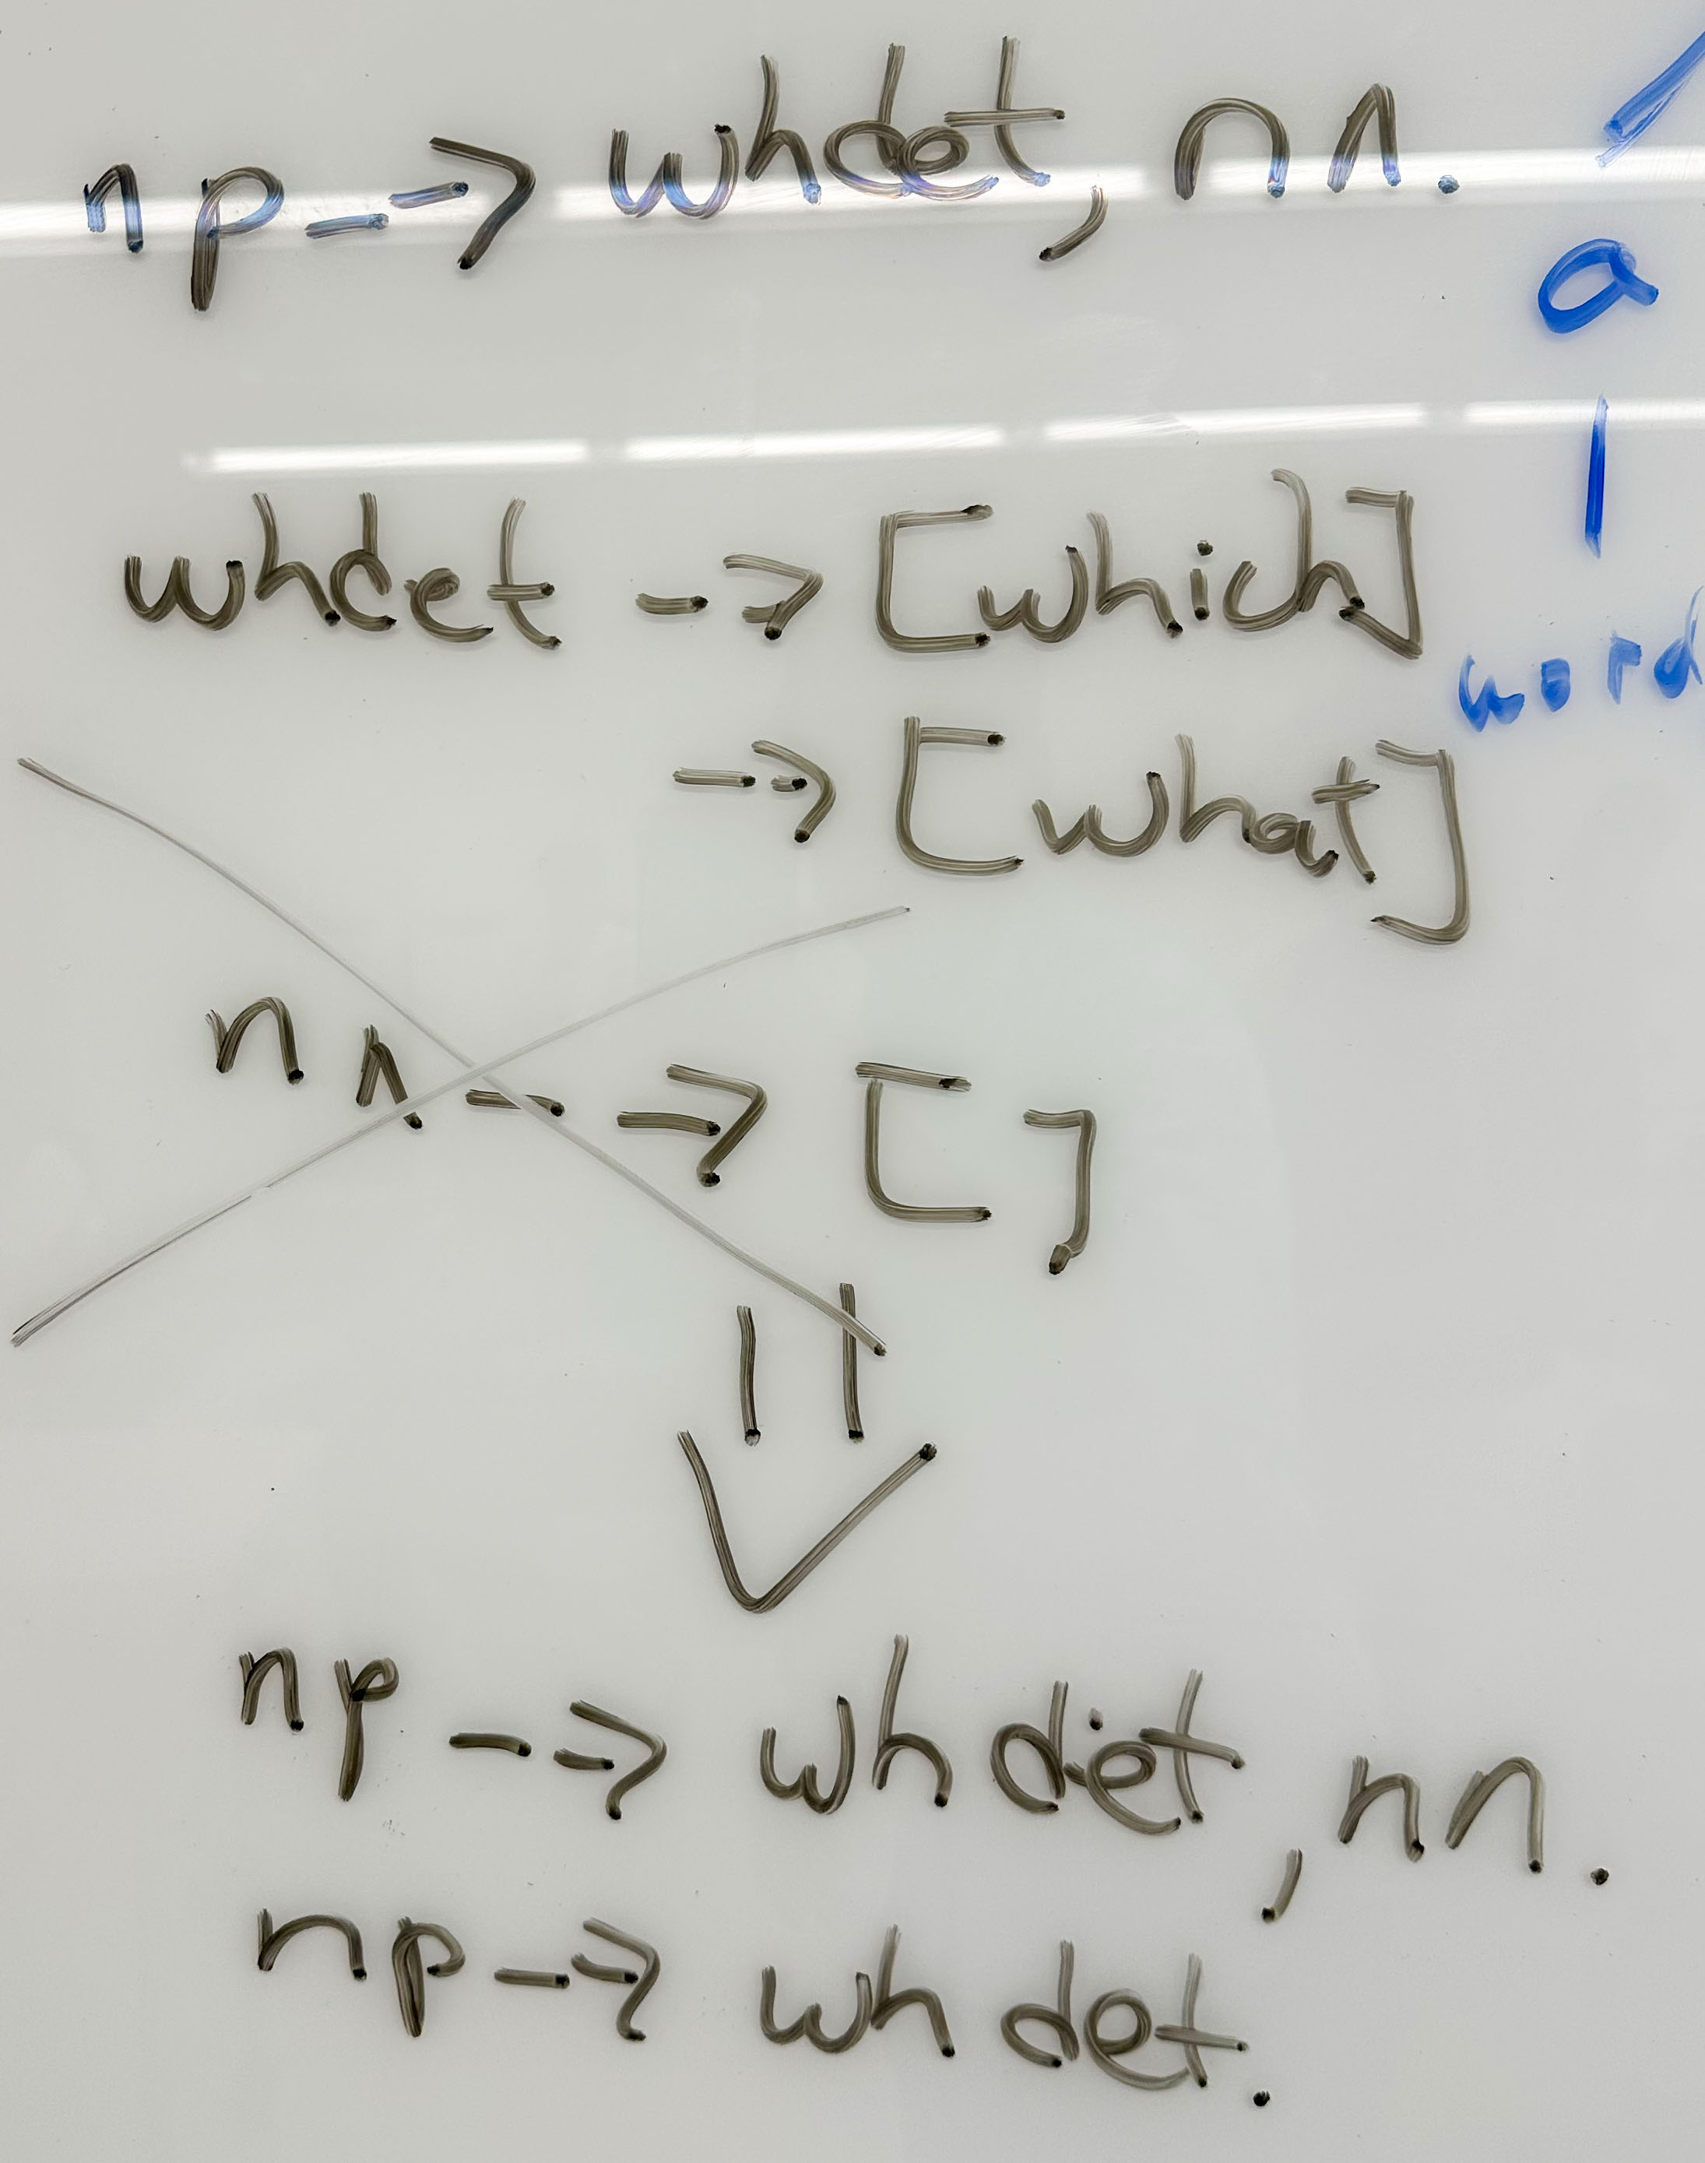
Chomsky Normal Form (CNF)
Delete epsilon rules, e.g. what/which man vs. what/which

Slide 16
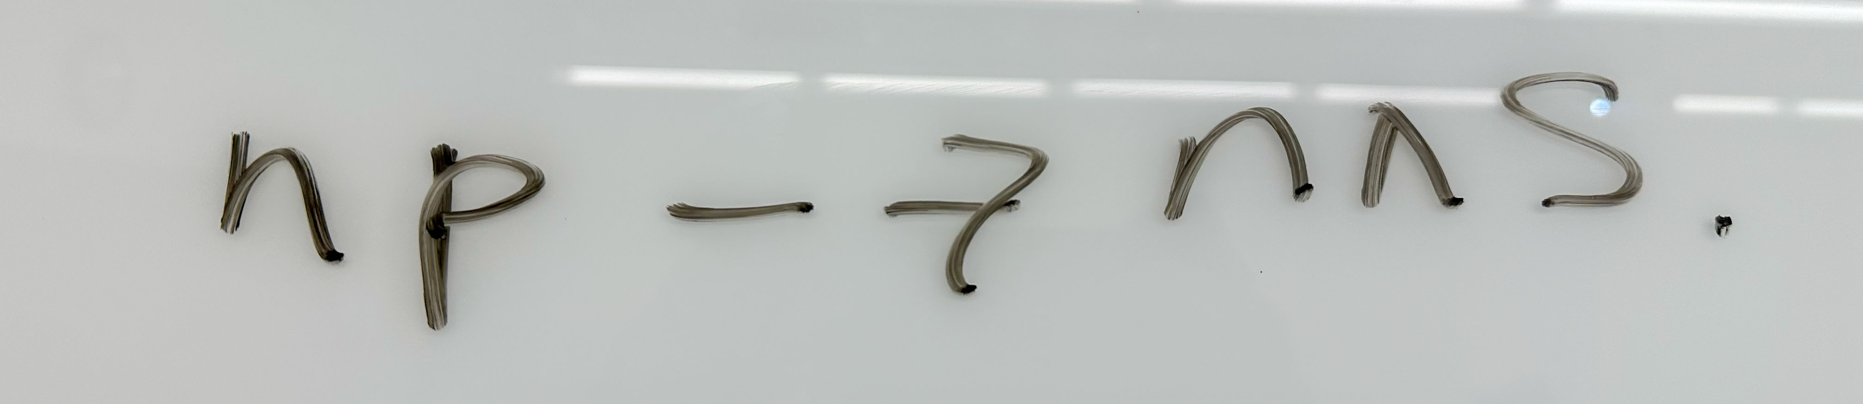
Chomsky Normal Form (CNF)
Singleton rules:
  e.g. cats are nice

Slide 17
Chomsky Normal Form (CNF)
Example:
  s --> [].
  s --> a.
  a --> a, b, b, a.
  a --> [a].
  b --> [b], c, [b].
  c --> [c].
[]
[a]
[a, b, c, b, b, c, b, a]
[a, b, c, b, b, c, b, a, b, c, b, b, c, b, a]
[a, b, c, b, b, c, b, a, b, c, b, b, c, b, a, b, c, b, b, c, b, a]
…
Let's convert this grammar to CNF

Slide 18
Chomsky Normal Form (CNF)
Example:
  s --> [].
  s --> a.
  a --> a, b, b, a.
  a --> [a].
  b --> [b], c, [b].
  c --> [c].
s0 --> s.
s --> [].
s --> a.
a --> a, bba.
bba --> b, ba.
ba --> b, a.
a --> [a].
b --> b2, cb.
b2 --> [b].
cb --> c, b2.
c --> [c].
s0 --> [].
s0 --> a.
a --> [a].
a --> a, bba.
bba --> b, ba.
ba --> b, a.
b --> b2, cb.
b2 --> [b].
cb --> c, b2.
c --> [c].
Grammars behave the same!

Slide 19
CKY Algorithm
Grammar transformed into:
  x --> y, z.
  x --> [w].
Given a sentence w₁,..,w_{n}, represent the possible parsings of this string by a table, where each cell may hold a nonterminal covering a substring.
Example: ⁰ w₁ ¹ w₂ ² w₃ ³ (⁰..³ are position markers)
w₁ | w₂ | w₃
[0,1] | [0,2] | [0,3]
 | [1,2] | [1,3]
 |  | [2,3]

Slide 20
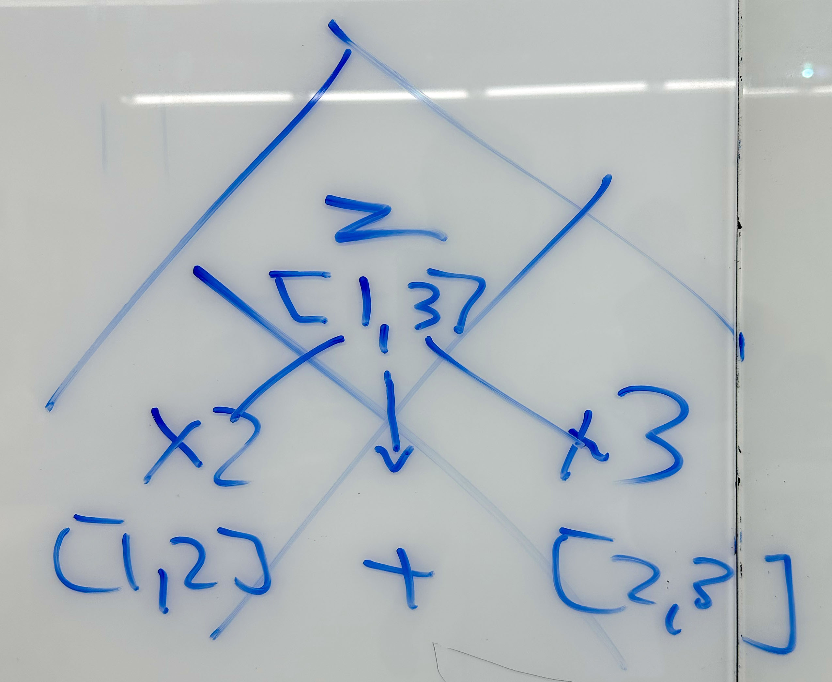
CKY Algorithm
  Chomsky Normal Form (CNF)
    binary branching
  2D table
w₁ | w₂ | w₃
[0,1] x1 | [0,2] y | [0,3] s
 | [1,2] x2 | [1,3] z
 |  | [2,3] x3
s --> y, x3.
s --> x1, z.
s --> y, z.
y --> x1, x2.
z --> x2, x3.
x1 --> [w1].
x2 --> [w2].
x3 --> [w3].

Slide 21
CKY Algorithm
Bottom-up:
w₁ | w₂ | w₃
[0,1] | [0,2] | [0,3]
 | [1,2] | [1,3]
 |  | [2,3]
x1 --> [w1].
x2 --> [w2].
x3 --> [w3].
w₁ | w₂ | w₃
[0,1] x1 | [0,2] | [0,3]
 | [1,2] x2 | [1,3]
 |  | [2,3] x3

Slide 22
CKY Algorithm
Bottom-up: ⁰ w₁ ¹ w₂ ² w₃ ³
w₁ | w₂ | w₃
[0,1] x1 | [0,2] | [0,3]
 | [1,2] x2 | [1,3]
 |  | [2,3] x3
y --> x1, x2.
z --> x2, x3.
w₁ | w₂ | w₃
[0,1] x1 | [0,2] y | [0,3]
 | [1,2] x2 | [1,3] z
 |  | [2,3] x3

Slide 23
CKY Algorithm
Bottom-up:
w₁ | w₂ | w₃
[0,1] x1 | [0,2] y | [0,3]
 | [1,2] x2 | [1,3] z
 |  | [2,3] x3
w₁ | w₂ | w₃
[0,1] x1 | [0,2] y | [0,3]
 | [1,2] x2 | [1,3] z
 |  | [2,3] x3
s --> y, z.
s is not derivable because
[0,2]y overlaps with [1,3]z

Slide 24
CKY Algorithm
Bottom-up:
w₁ | w₂ | w₃
[0,1] x1 | [0,2] y | [0,3]
 | [1,2] x2 | [1,3] z
 |  | [2,3] x3
w₁ | w₂ | w₃
[0,1] x1 | [0,2] y | [0,3] s
 | [1,2] x2 | [1,3] z
 |  | [2,3] x3
s --> x1, z.
[0,3]s is derivable because
[0,1]x1 concats with [1,3]z

Slide 25
CKY Algorithm
Bottom-up:
w₁ | w₂ | w₃
[0,1] x1 | [0,2] y | [0,3]
 | [1,2] x2 | [1,3] z
 |  | [2,3] x3
w₁ | w₂ | w₃
[0,1] x1 | [0,2] y | [0,3] s
 | [1,2] x2 | [1,3] z
 |  | [2,3] x3
s --> y, x3.
[0,3]s is derivable because
[0,2]y concats with [2,3]x3

Slide 26
CKY Algorithm
Backpointers indicate parse:
w₁ | w₂ | w₃
[0,1] x1 | [0,2] y | [0,3] s s
 | [1,2] x2 | [1,3] z
 |  | [2,3] x3

Slide 27
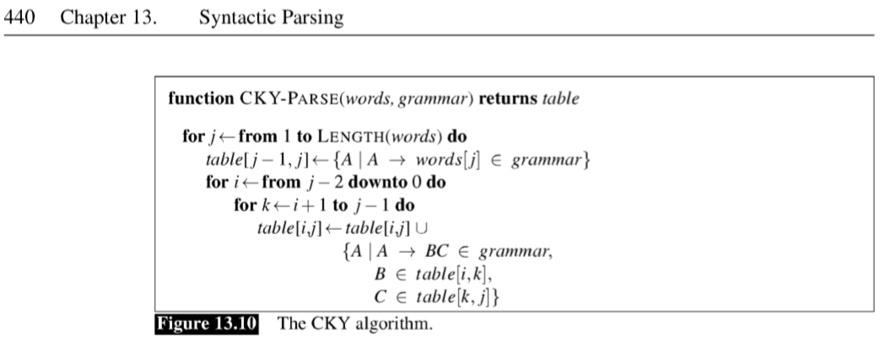
CKY Algorithm

Slide 28
CKY Algorithm and Prolog Grammar Rules
CNF:
  we can make conversion transparent
  because we can decide what to produce as a parse tree using an extra argument, cf. left recursive parse transformation
Table representation:
  (if using Prolog) must be careful about variable bindings:
  solution: make fresh copies of variables
Agreement (feature propagation):
  must save all arguments into table
  and relink up properly, e.g.
  np(np(DT,NN)) --> dt(DT,Num), nn(NN,Num).

Slide 29
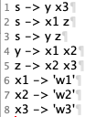
nltk book: chapter 8
Link:
  https://www.nltk.org/book/ch08.html
Steps:
$ python
Python 3.9.12 (main, Jun 1 2022, 06:34:44)
>>> import nltk
>>> cnf = open('cnf.txt').read()
>>> cnf
"s -> y x3\ns -> x1 z\ns -> y z\ny -> x1 x2\nz -> x2 x3\nx1 -> 'w1'\nx2 -> 'w2'\nx3 -> 'w3'\n"
>>> cfg = nltk.CFG.fromstring(cnf)
>>> cfg
<Grammar with 8 productions>
>>> p = nltk.ChartParser(cfg)
cnf.txt on website
cnf is a string,
cfg is a grammar

Slide 30
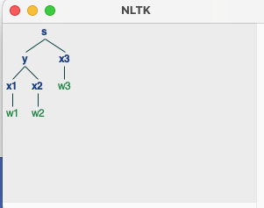
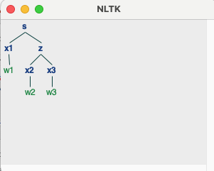
nltk book: chapter 8
To parse, supply a pre-tokenized sentence (a list):
>>> for tree in p.parse(['w1','w2','w3']):
... tree.draw()
...
>>>
<TAB> to indent, and need a blank line as well

Slide 31
nltk book: chapter 8
To perform parsing, call:
  p.parse(list) p is a parser
But, first define p, the parser you want to use.
Different parsing strategies available, e.g.:
  p = nltk.ChartParser(cfg)
  p = nltk.ShiftReduceParser(cfg) doesn't do backtracking
  p = nltk.RecursiveDescentParser(cfg) doesn't do left recursion

Slide 32
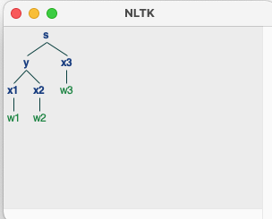
nltk book: chapter 8
Same sentence, different parser:
>>> p = nltk.RecursiveDescentParser(cfg)
>>> for tree in p.parse(['w1','w2','w3']):
... tree.draw()
...
>>>

Slide 33
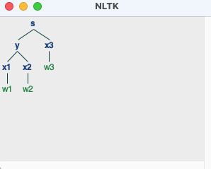
nltk book: chapter 8
Same sentence, different parser:
>>> p = nltk.ShiftReduceParser(cfg)
>>> for tree in p.parse(['w1','w2','w3']):
... tree.draw()
...
>>>

Slide 34
nltk book: chapter 8
Notes on grammar format:
  plain text file
  1st line defines the start-symbol (S)
  -> is the rewrite symbol (cf. Prolog -->)
  space between symbols (cf. Prolog ,)
  lexical items are quoted, e.g. 'I' (cf. Prolog [word])
  you cannot combine grammatical categories with lexical items
    PP -> 'of' NP (disallowed, cf. pp --> [of], np.)
  you are not permitted multi-word lexical items
    not ok: NP -> 'New York'
    ok: NP -> 'New_York' (cf. Prolog [new,york])

