Slide 1
LING/C SC 581: Advanced Computational Linguistics
Lecture 11
Prof. Sandiway Fong

Slide 2
Today's Topics
Homework 6 Review
A note on Stacking PPs
Anaphora

Slide 3
Homework 6 Review
Question 1:
apply the transformation to the left recursion starting with nl3.prolog:
np(np(NP,PP)) --> np(NP), pp(PP).
vp(vp(VP,PP)) --> vp(VP), pp(PP).
There are two (independent) transformations here!
w, the fresh nonterminal (with 2 arguments) cannot be shared between the NP and VP recursions. Why?
x(X) --> [z], w(X,x(z)).
x(x(z)) --> [z].
w(W,X) --> [y], w(W,x(X,y)).
w(x(X,y),X) --> [y].

Slide 4
Homework 6 Review
Question 2:
Jeffrey Epstein, a money manager, (source: NYTimes)
add the comma-separated kind of appositives to your grammar.
w(W,X) --> [','], np(NP), [','], w(W,np(X,',',NP,',')).
Question 3:
context-freeness of the 2nd comma.
Question 4:
can your grammar handle both of these?
the boy , a student , saw the man with the telescope
the boy , a student , saw the man , the astronomer , with the telescope

Slide 5
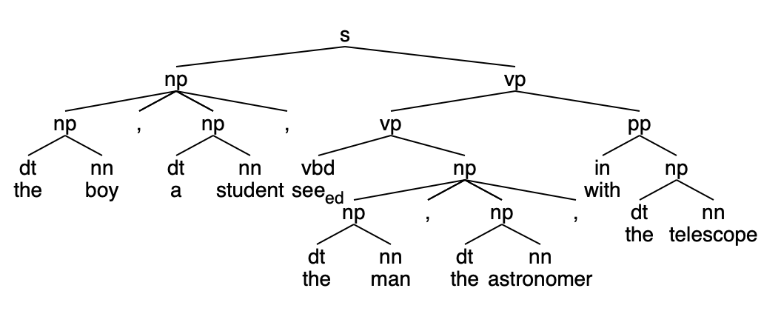
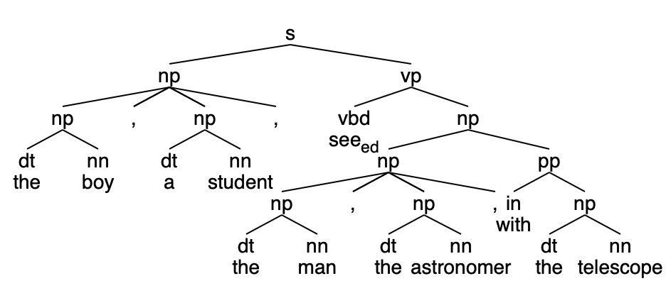
Homework 6 Review
VP adjunction for PP
NP adjunction for PP

Slide 6
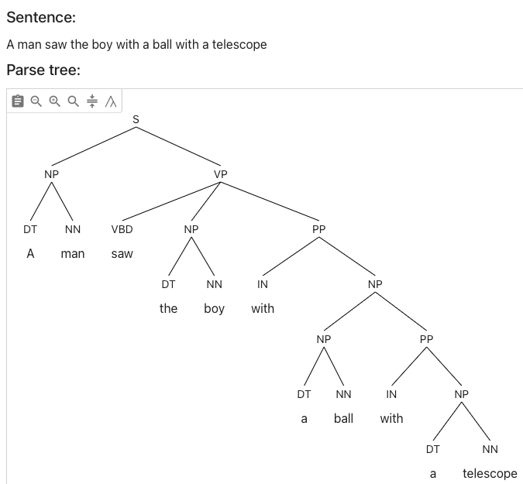
Note on PP Stacking
https://parser.kitaev.io
What's the problem with this parse?

Slide 7
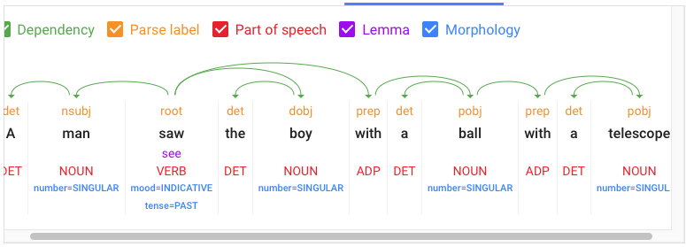
Note on PP Stacking
https://cloud.google.com/natural-language

Slide 8
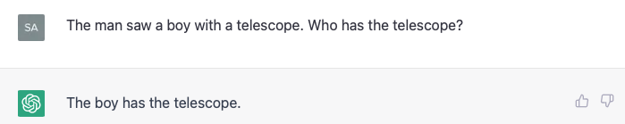
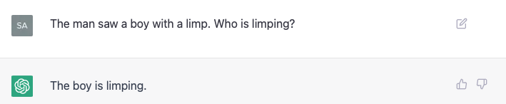
Note on PP Stacking

Slide 9
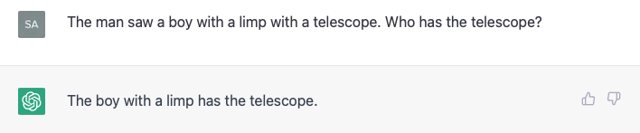
Note on PP Stacking
Stacking:

Slide 10
ChatGPT and Anaphora Resolution
Let's introduce anaphor resolution:
part of our innate language ability: something that we have strong judgements about when faced with a choice
Does ChatGPT mimic human choice?
Is ChatGPT getting more human-like?
early 2023 (v3) vs.
early 2026 (v5.3)
much bigger model, also backed up by web search

Slide 11
ChatGPT and Anaphora Resolution
Two examples from (Reuland 2011) ¹
Alice looked at the Queen. She was angry. (pg4)
¹Reuland, E., Anaphora and Language Design (2011), MIT Press.

Slide 12
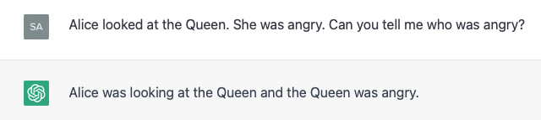
ChatGPT and Anaphora Resolution
Alice looked at the Queen. She was angry. (pg4)

Slide 13
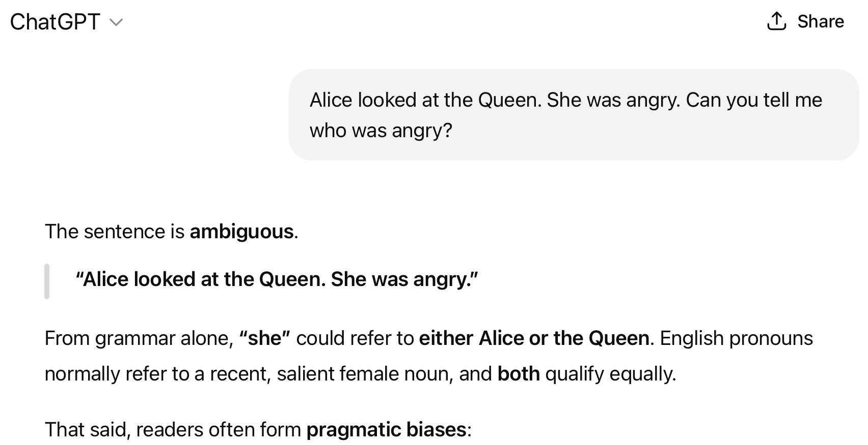
ChatGPT 5.3 and Anaphora Resolution

Slide 14
ChatGPT and Anaphora Resolution
Two examples from (Reuland 2011) ¹
Alice looked at the Queen. She was angry. (pg4)
The white rabbit jumped from behind the bushes. (pg26)
The animal looked around and then he ran away to avoid the angry queen.
Who ran away?
¹Reuland, E., Anaphora and Language Design (2011), MIT Press.

Slide 15
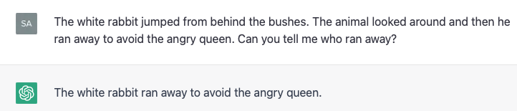
ChatGPT and Anaphora Resolution
The white rabbit jumped from behind the bushes. (Reuland 2011: 26)
The animal looked around and then he ran away to avoid the angry queen.

Slide 16
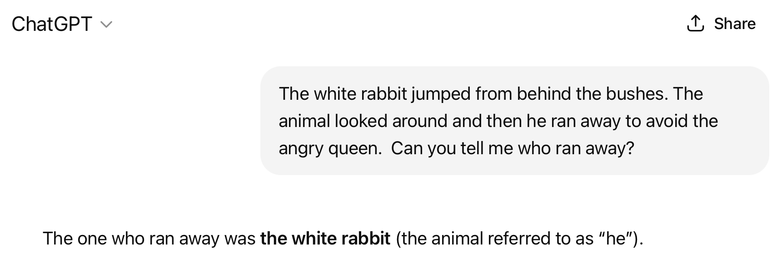
ChatGPT 5.3 and Anaphora Resolution

Slide 17
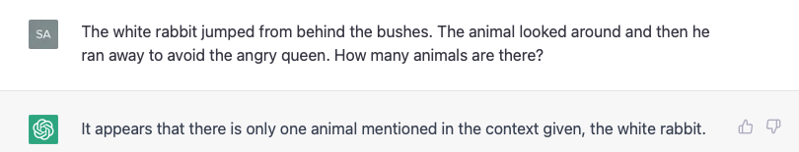
ChatGPT and Anaphora Resolution
The white rabbit jumped from behind the bushes. (Reuland 2011: 26)
The animal looked around and then he ran away to avoid the angry queen.
the expressions the white rabbit, the animal. and he easily receive the same value. For he, for instance, a reading where it gets the same value as the animal/the white rabbit is highly preferred.

Slide 18
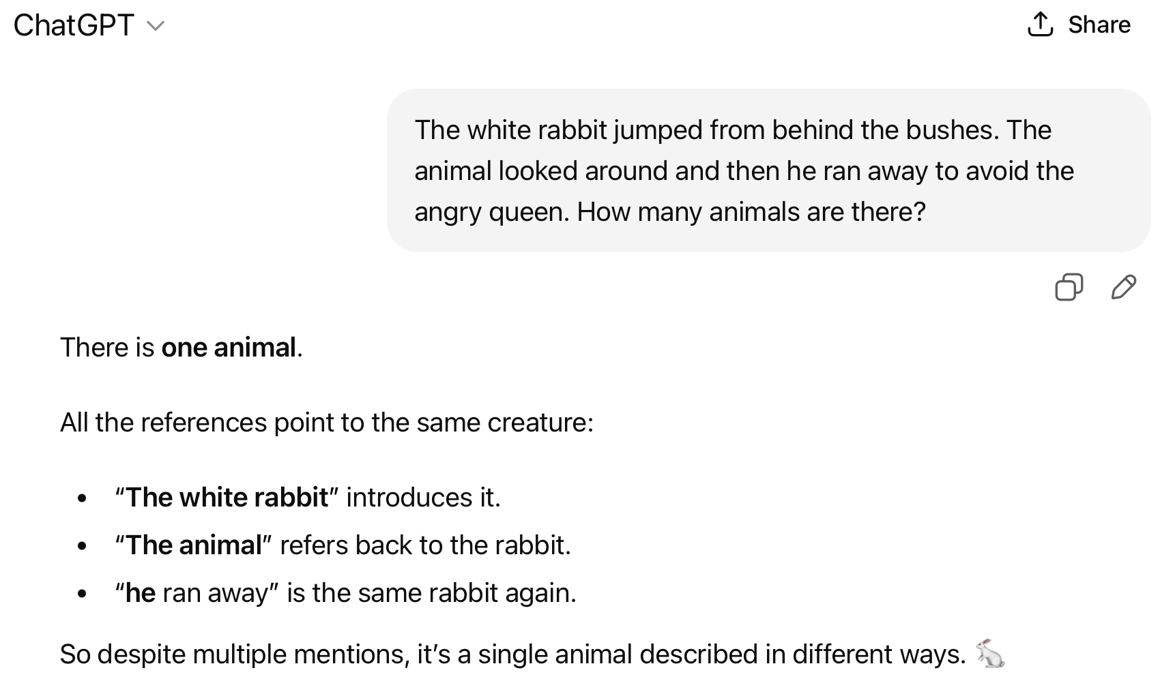
ChatGPT 5.3 and Anaphora Resolution

Slide 19
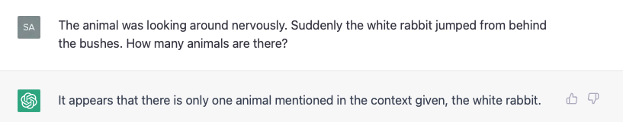
ChatGPT and Anaphora Resolution
Let's modify the 2nd example a bit:
The animal was looking around nervously. Suddenly the white rabbit jumped from behind the bushes.
and ask:
Here the rabbit is preferred to have a value different from the animal.

Slide 20
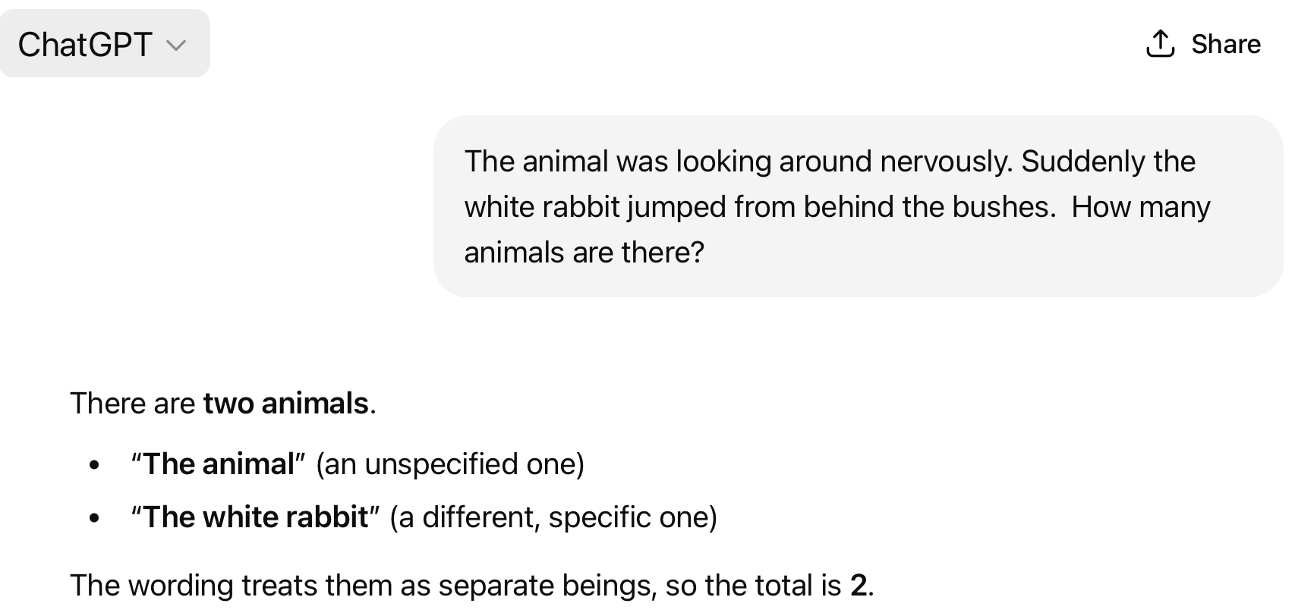
ChatGPT 5.3 and Anaphora Resolution

Slide 21
ChatGPT and Control Verbs
Choice:
X promised Y [PRO to do something]
X ordered Y [PRO to do something]
PRO is the subject of the non-finite clause (to do something)
what grammatical knowledge about the difference in verb meanings do we have?
Turns out it depends on properties of the higher verb:
promise is a subject control verb (PRO = X)
order is an object control verb (PRO = Y)

Slide 22
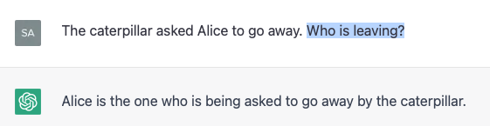
ChatGPT and Control Verbs
Example (object control verb):
The caterpillar asked Alice [PRO to go away]. (Reuland 2011: 45)

Slide 23
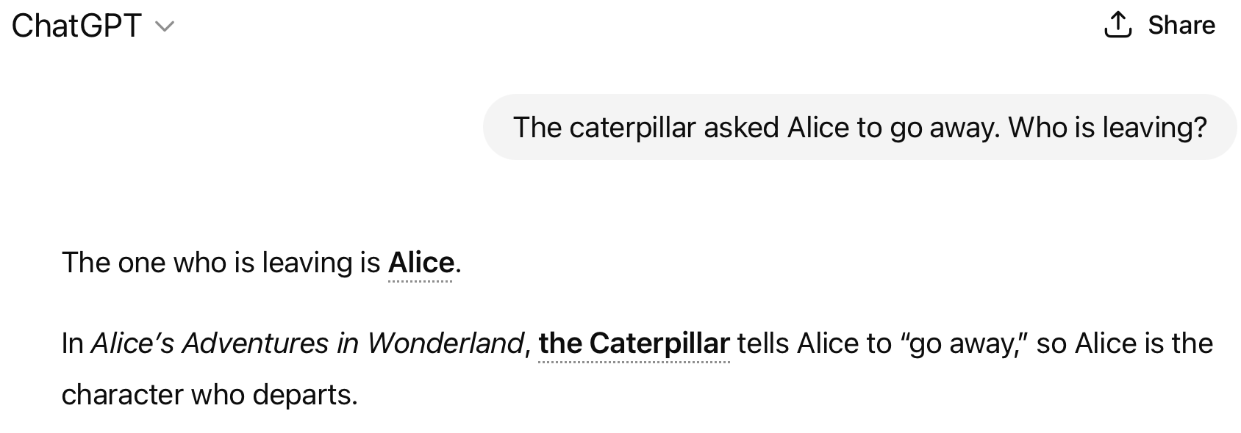
ChatGPT 5.3 and Control Verbs

Slide 24
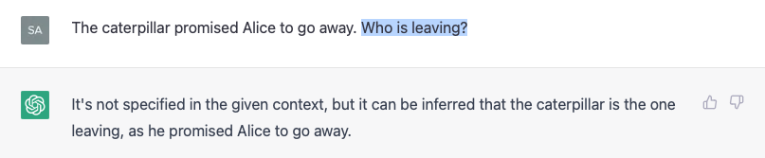
ChatGPT and Control Verbs
Example (subject control verb):
The caterpillar promised Alice [PRO to go away].

Slide 25
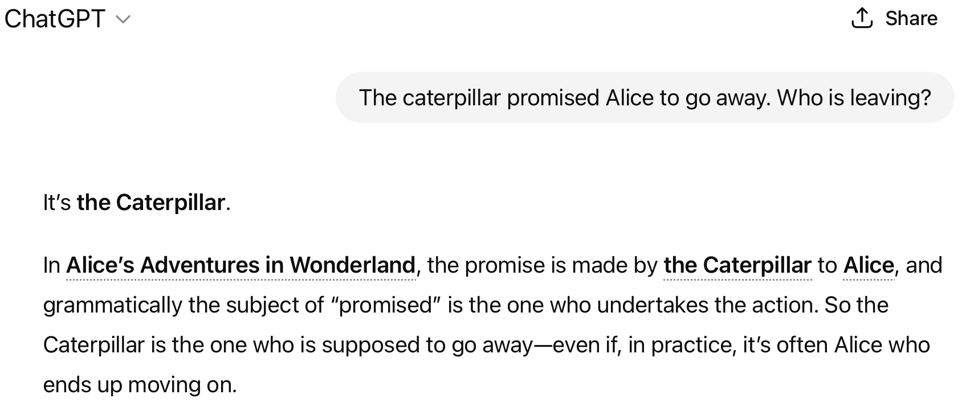
ChatGPT 5.3 and Control Verbs

Slide 26
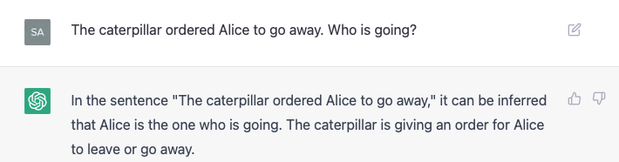
ChatGPT and Control Verbs
Example (object control verb):
The caterpillar ordered Alice [PRO to go away].

Slide 27
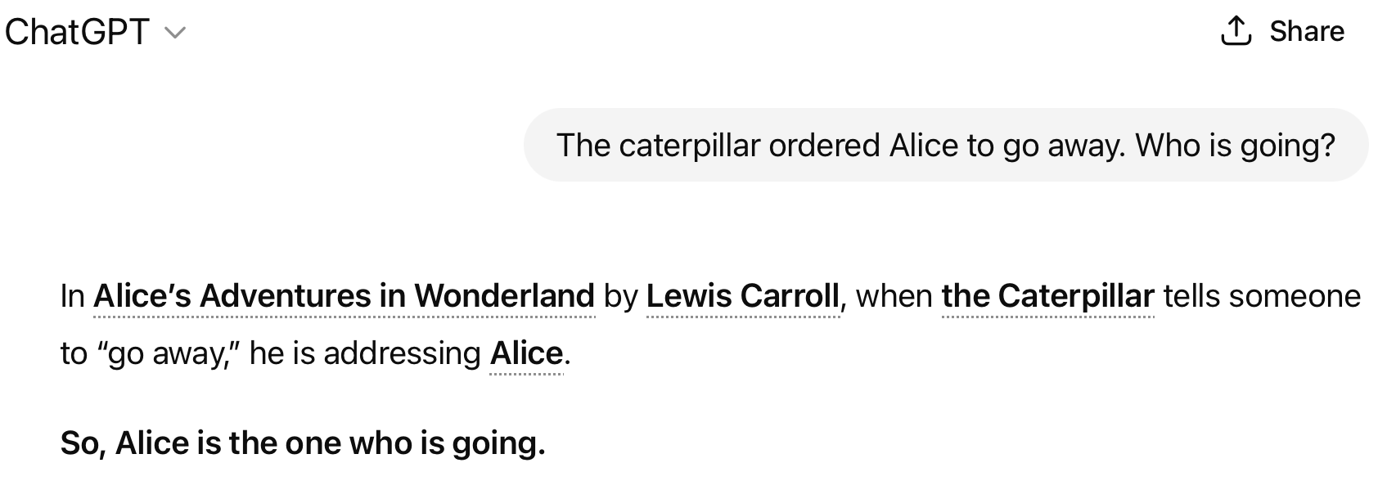
ChatGPT 5.3 and Control Verbs

Slide 28
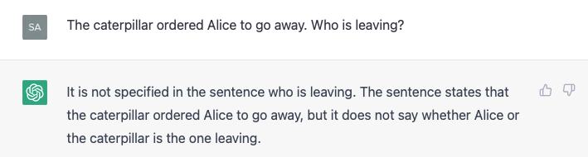
ChatGPT and Control Verbs
Example (object control verb):
The caterpillar ordered Alice [PRO to go away].
Doesn't work in this case!
Asking the right question is key

Slide 29
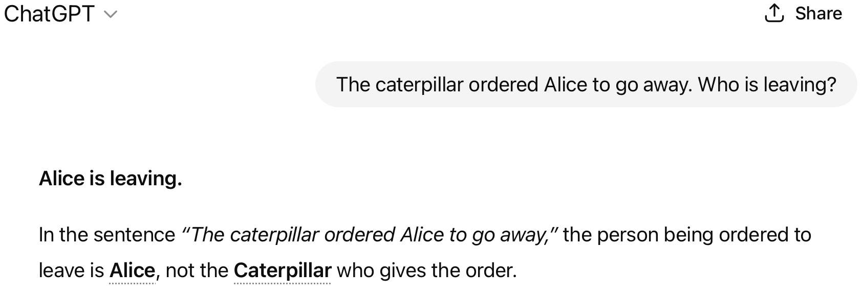
ChatGPT 5.3 and Control Verbs

Slide 30
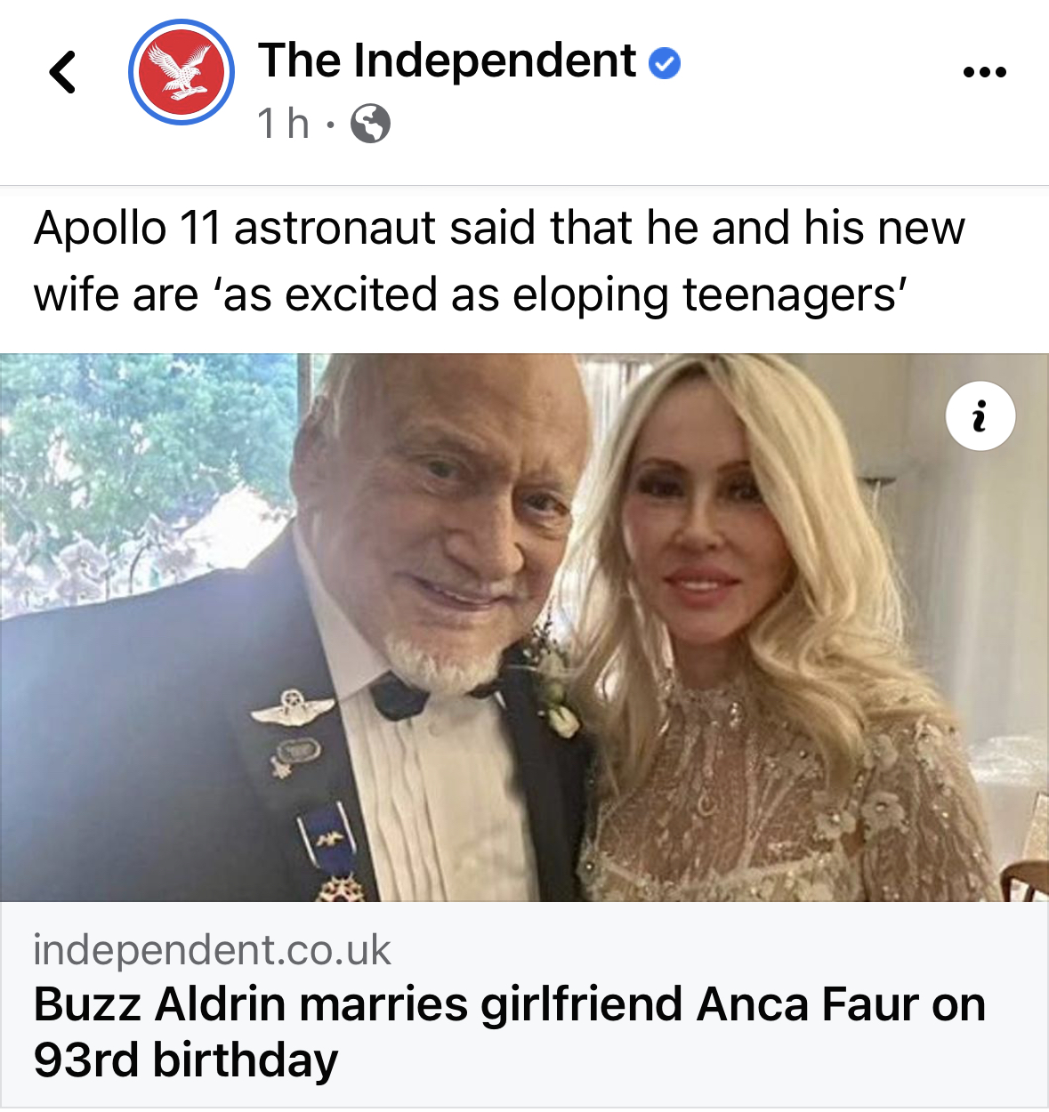
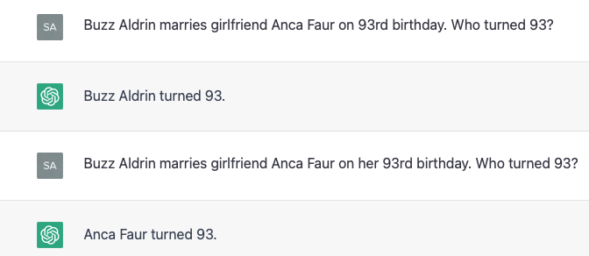

ChatGPT and Anaphora Resolution

Slide 31
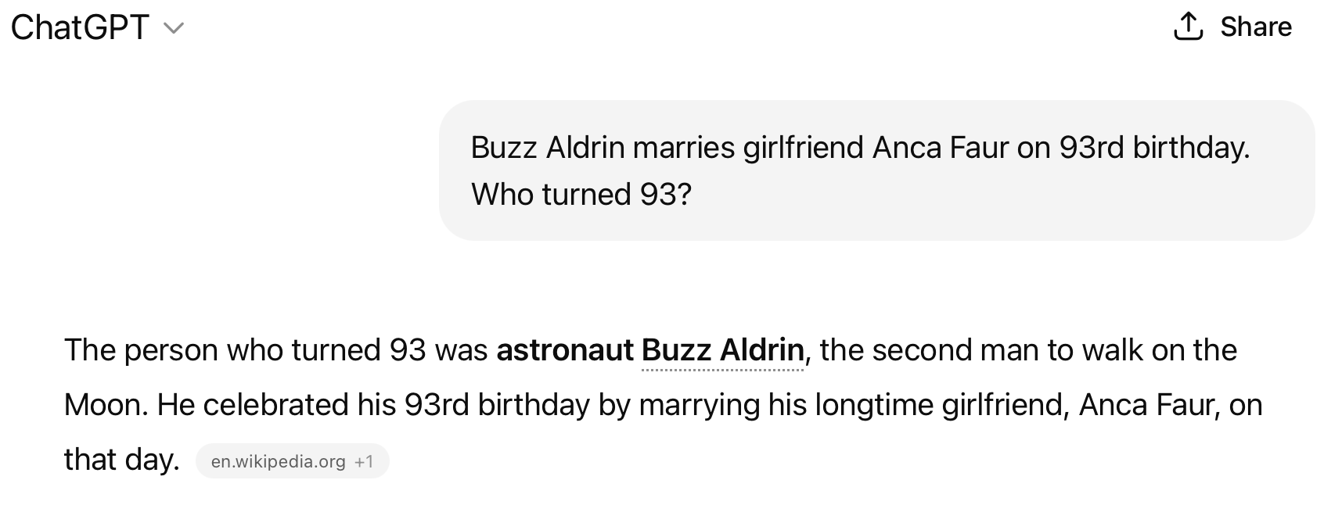
ChatGPT 5.3 and Control Verbs

Slide 32
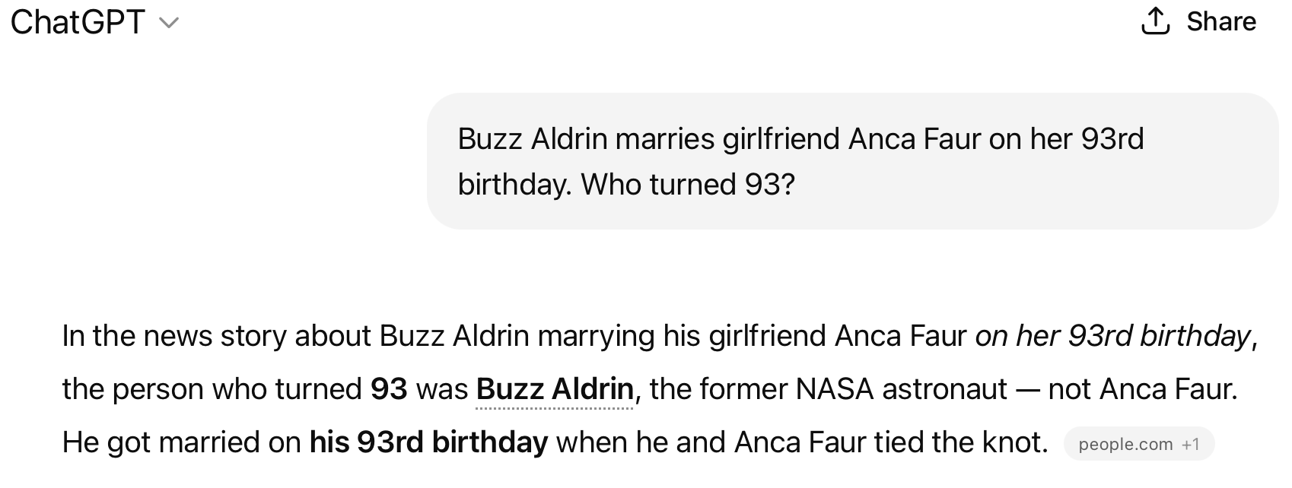
ChatGPT 5.3 and Control Verbs

Slide 33
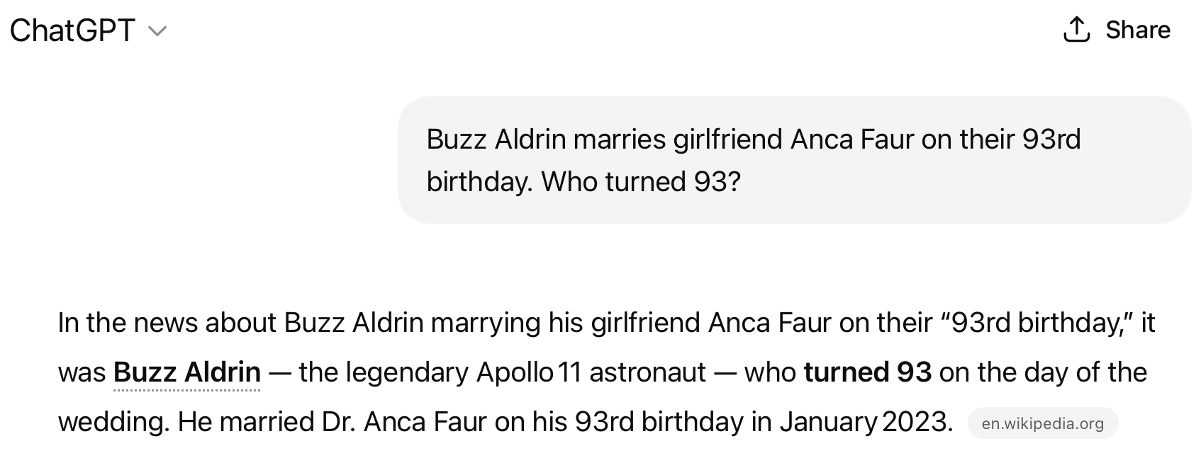
ChatGPT 5.3 and Control Verbs

Slide 34
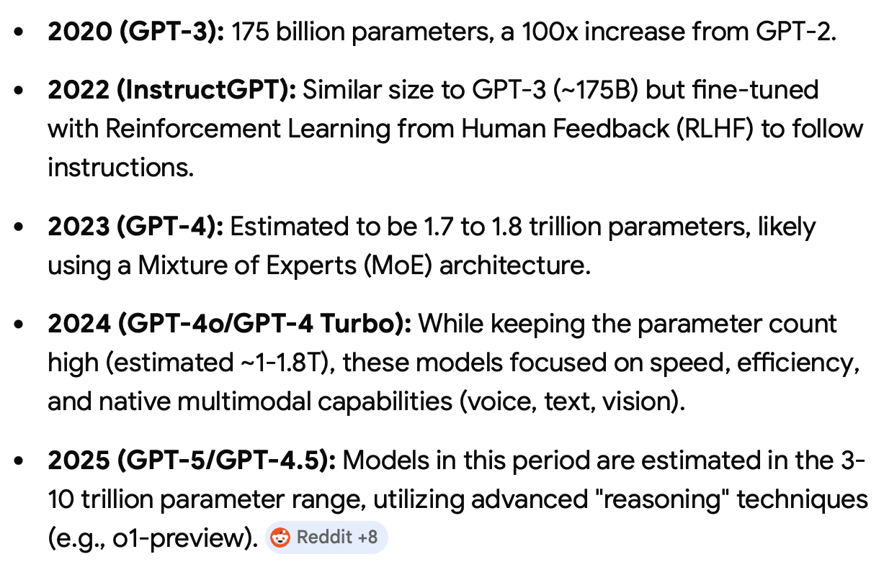
ChatGPT model size

