Slide 1
LING/C SC 581:
Advanced Computational Linguistics
Lecture 10
Prof. Sandiway Fong

Slide 2
Today's Topic
Leaving the topic of context-sensitive languages
Turn to writing our own CFGs for natural language:
  A note on SWISH (SWI-Prolog for Sharing)
  agreement in natural language
  the problem with Prolog & left recursion
  a grammar transformation:
    left recursive to right recursive BUT structure preserving
Homework 6 (note deadline change)

Slide 3
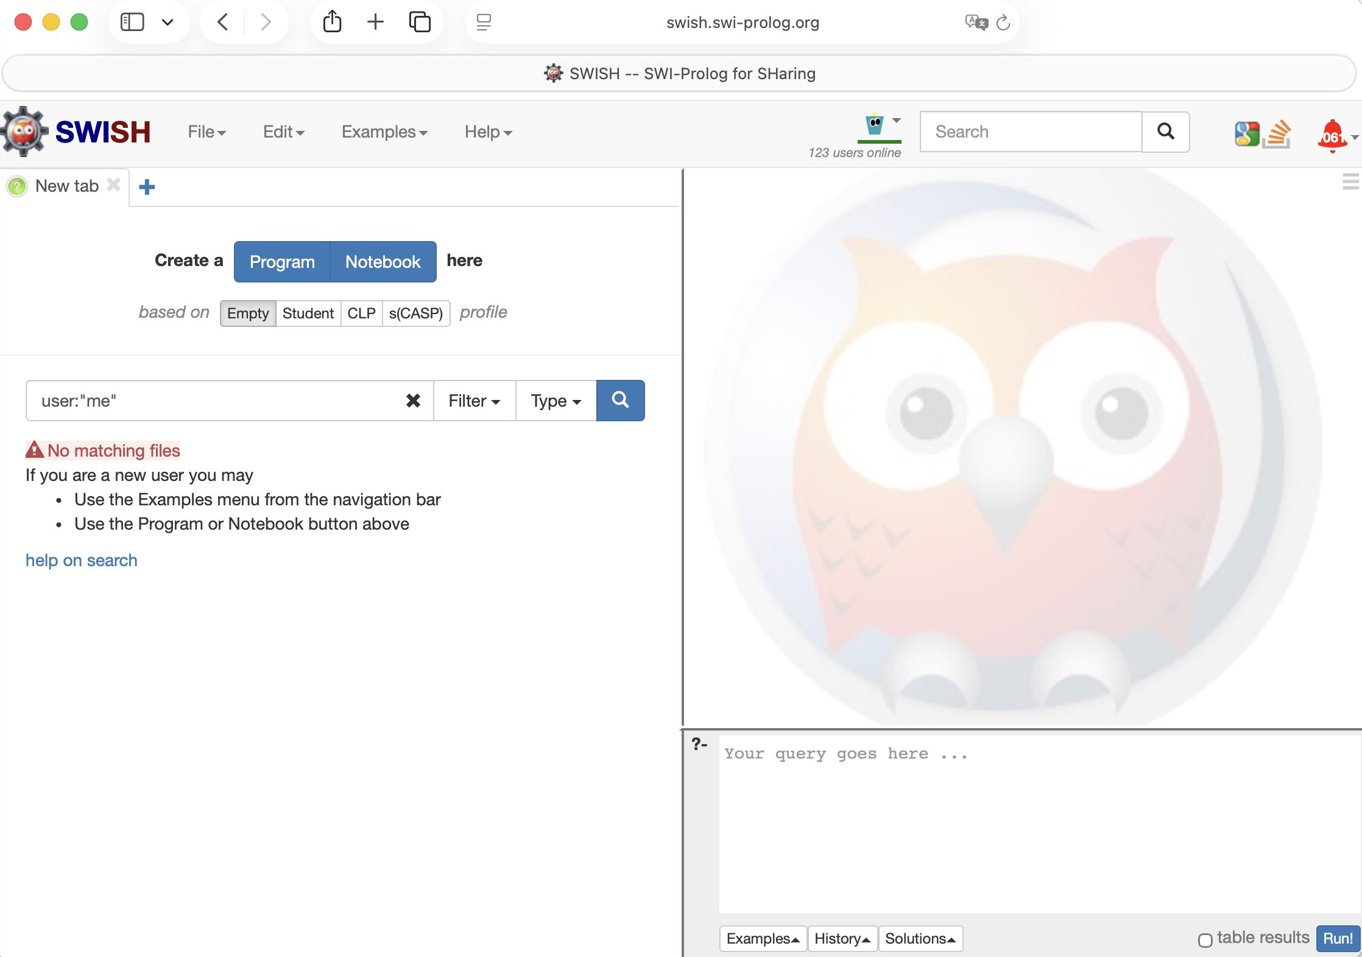
SWISH = SWI Prolog for SHaring

Slide 4
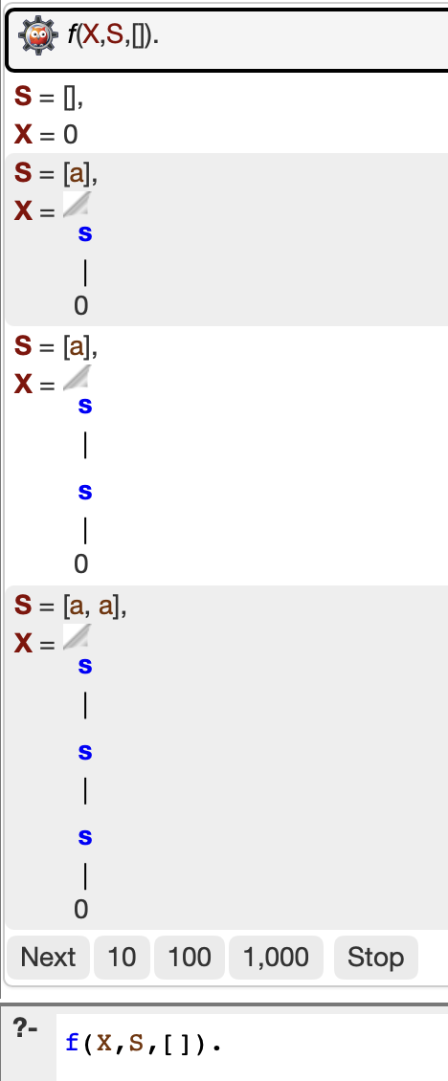
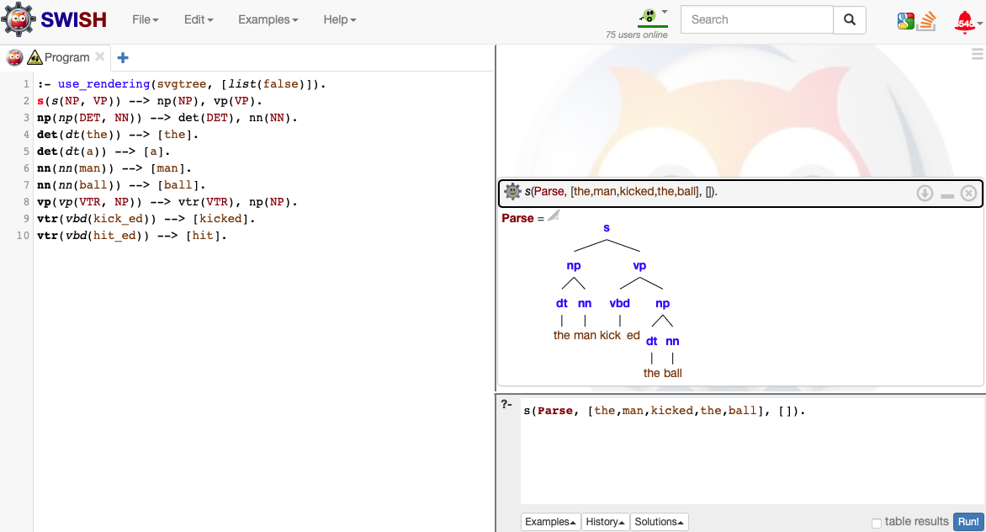
SWISH
https://swish.swi-prolog.org
:- use_rendering(svgtree, [list(false)]).

Slide 5
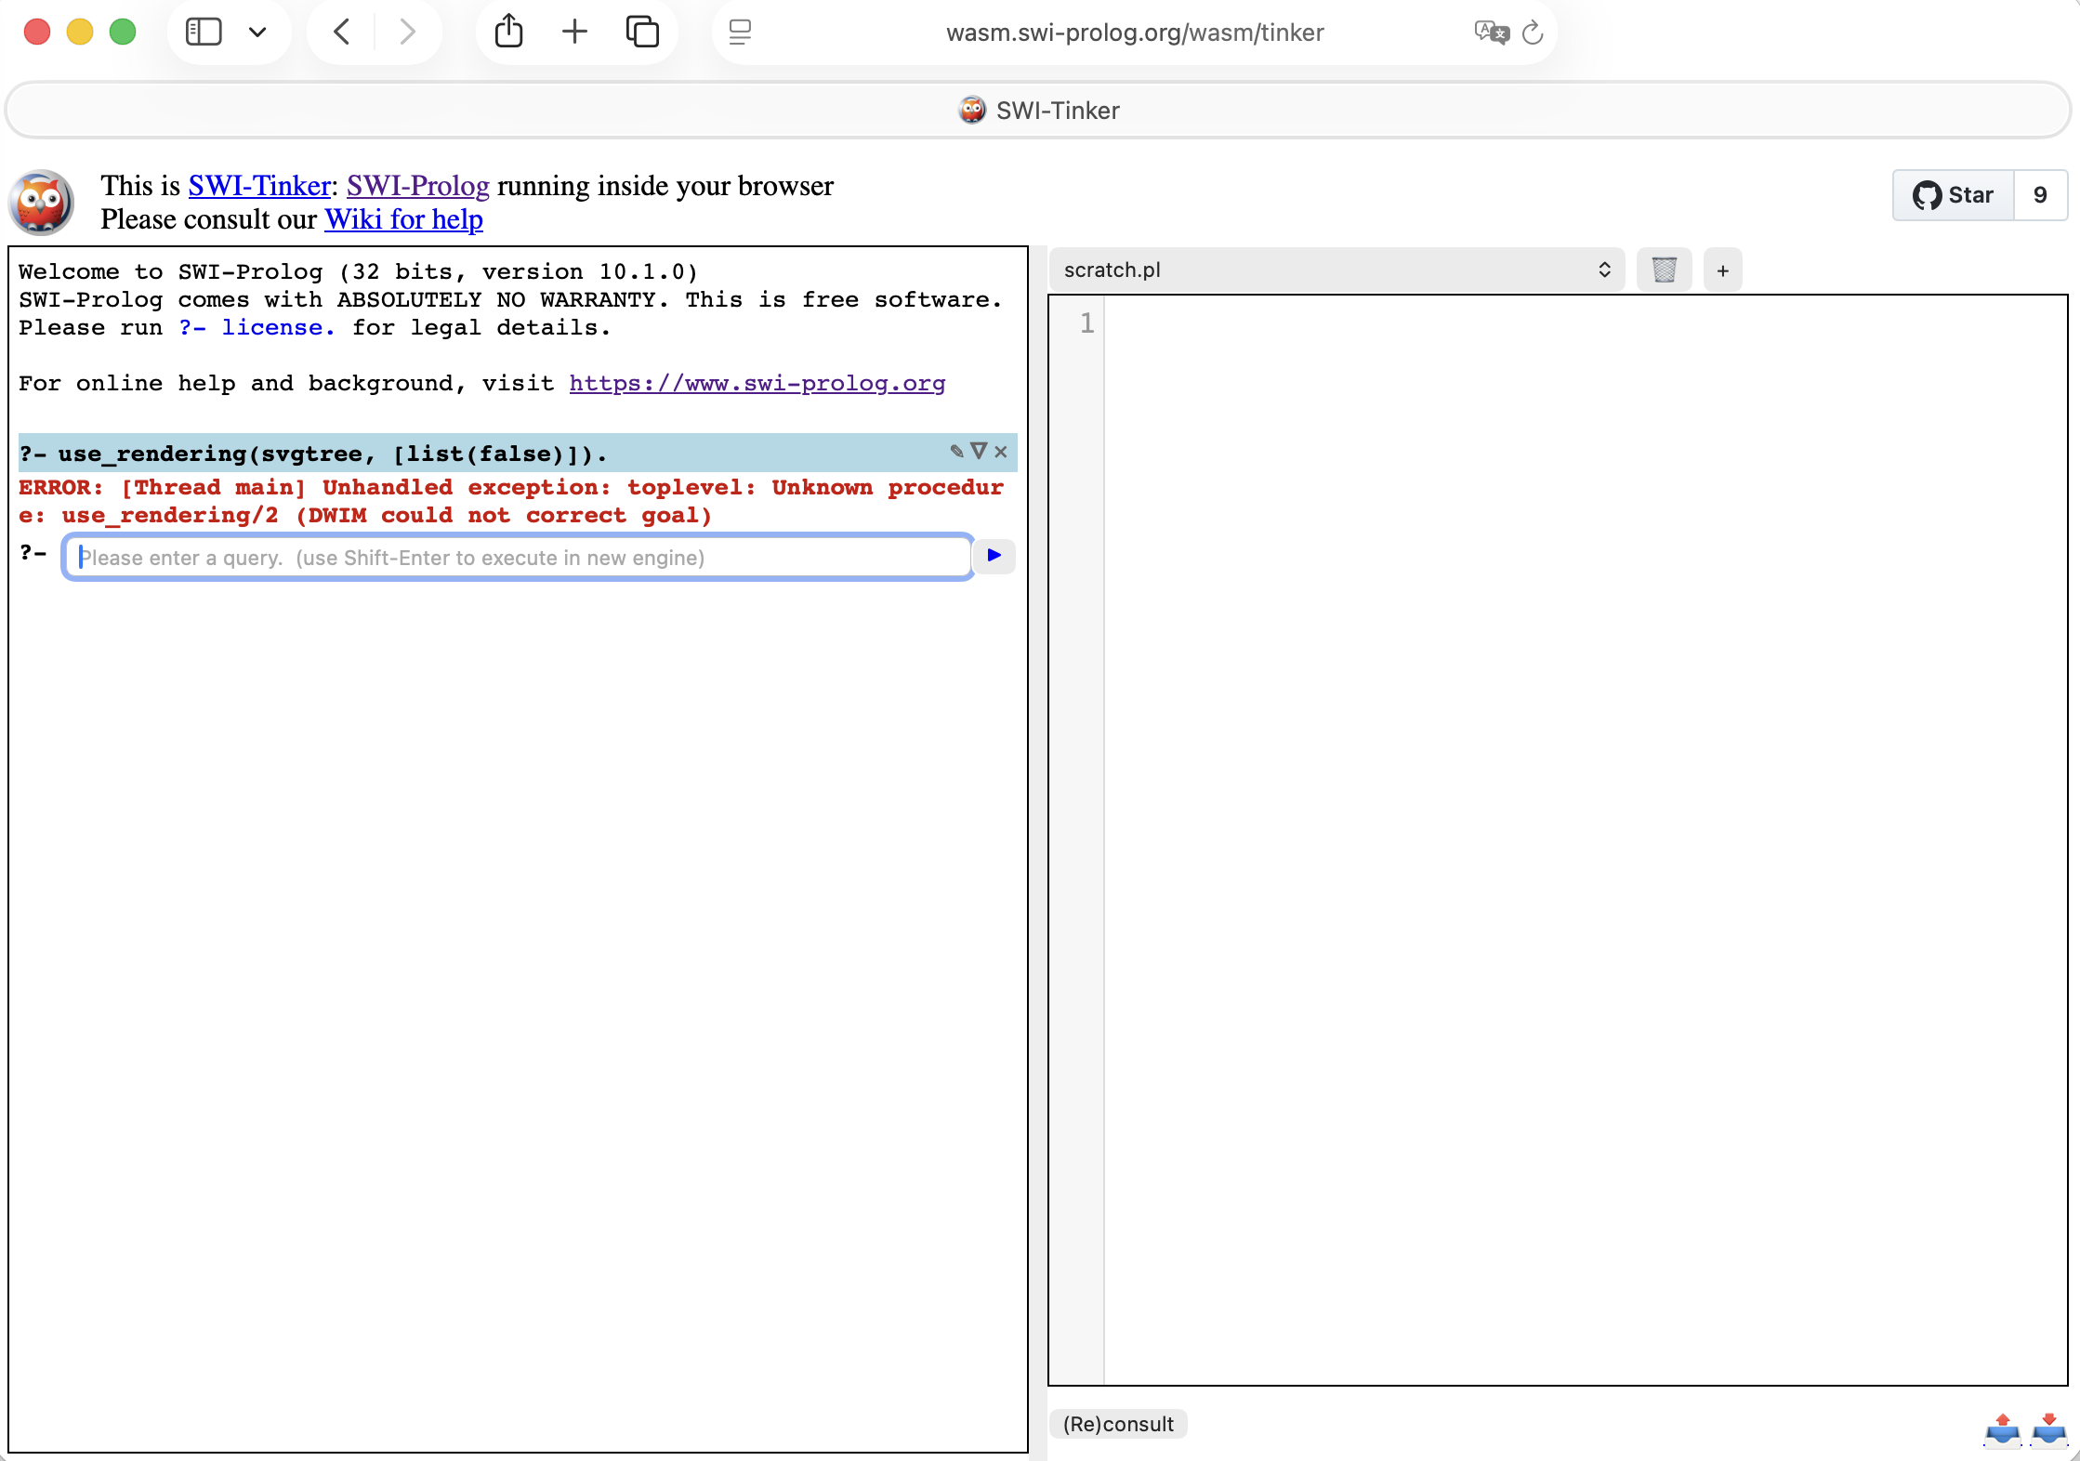
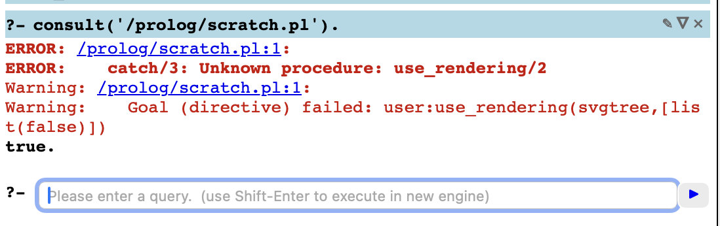
SWI-Tinker (inside your browser)

Slide 6
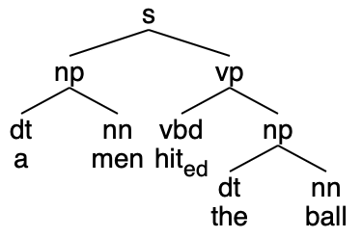
Extra Arguments: Agreement
Idea:
  We can also use an extra argument to impose constraints between constituents within a DCG rule
Example:
  English number agreement between DT and NN
  Data:
    the man the men
    a man *a men
  Lexical Features (Number):
    man value singular (sg)
    men value plural (pl)
    the value singular or plural (sg/pl)
    a value singular (sg)
*
* means ungrammatical

Slide 7
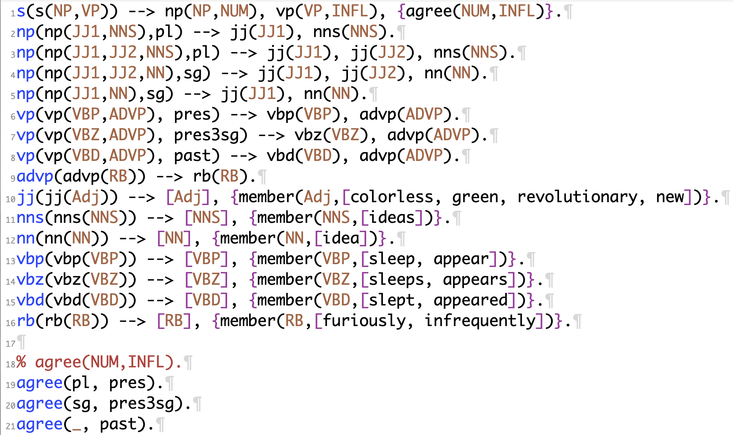
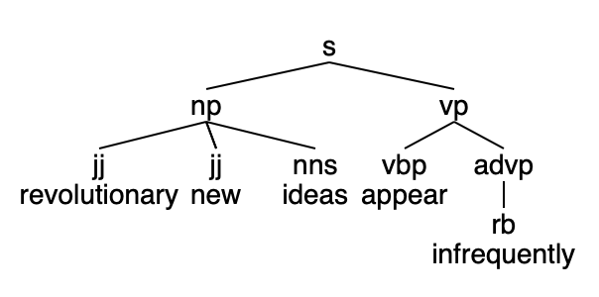
Recall a Class Exercise: agree/2
?- s(P,[revolutionary,new,ideas,appear,infrequently],[]).
P = s(np(jj(revolutionary), jj(new), nns(ideas)), vp(vbp(appear), advp(rb(infrequently)))) ;
false.

Slide 8
Determiner-Noun Agreement
Example (nl3.prolog):
np(np(DET, NN)) --> det(DET, NUM), nn(NN, NUM).
det(dt(the), sg) --> [the].
det(dt(the), pl) --> [the].
det(dt(a), sg) --> [a].
nn(nn(man), sg) --> [man].
nn(nn(men), pl) --> [men].
nn(nn(ball), sg) --> [ball].
vp(vp(VTR, NP)) --> vtr(VTR), np(NP).
vtr(vbd(kick_ed)) --> [kicked].
vtr(vbd(hit_ed)) --> [hit].

Slide 9
Extra Argument: Agreement
Note:
extra argument NUM for agreement here is basically “syntactic sugar” and lends no more expressive power to the grammar rule system:
i.e. we can enforce agreement without the use of the extra argument at the cost of writing more rules
Instead of
  np(np(DET, NN)) --> det(DET, NUM), nn(NN, NUM).
could have encoded NUM into the nonterminal name:
np(np(DET, NN)) --> det_sg(DET), nn_sg(NN).
np(np(DET, NN)) --> det_pl(DET), nn_pl(NN).
det_sg(dt(the)) --> [the].
det_pl(dt(the)) --> [the].
det_sg(dt(a)) --> [a].
nn_sg(nn(man)) --> [man].
nn_pl(nn(men)) --> [men].
nn_sg(nn(ball)) --> [ball].
nl4.prolog

Slide 10
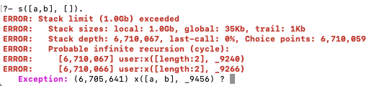
Left recursion and Prolog DCGs
Left recursive grammars:
  given Prolog’s simple left-to-right depth-first computation rule, left recursive rules are a no-no …
s
x
x
6.7 million calls later
Example (left.prolog):
  s --> x, y.
  x --> x, [a].
  x --> [a].
  y --> [b].
rule for nonterminal x
immediately calls x again!
x
x
...

Slide 11
Left recursion and Prolog DCGs
Aside: what is the language of this grammar?
left.prolog:
  s --> x, y.
  x --> x, [a].
  x --> [a].
  y --> [b].

Slide 12

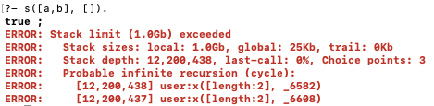
Rule ordering
Example (left.prolog):
  s --> x, y.
  x --> x, [a].
  x --> [a].
  y --> [b].
An idea (swap rules 2 and 3):
  s --> x, y.
  x --> [a].
  x --> x, [a].
  y --> [b].
(left2.prolog)
; eventually calls for stacking rule 3.
12 million deep

Slide 13
Big picture question
Is this just a theoretical problem: i.e. not a problem for natural language grammars?
Unfortunately, it is a problem …
  John saw the boy with a telescope
  is structurally ambiguous wrt. attachment of the PP with a telescope
  (PP = prepositional phrase)

Slide 14
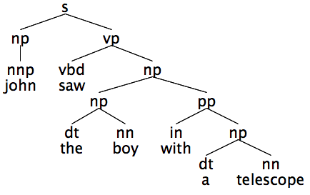
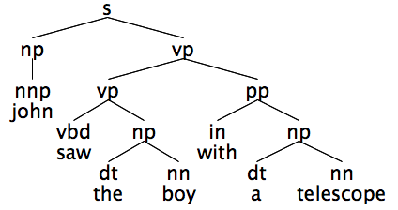
Preposition Phrase (PP) Attachment
The preferred syntactic analysis is a left recursive parse
Example:
  John saw the boy with a telescope
Rules are:
vp --> vp, pp.
np --> np, pp.
with_{instrument}
with_{possessive}

Slide 15
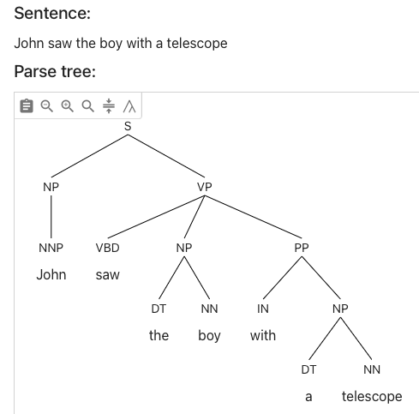
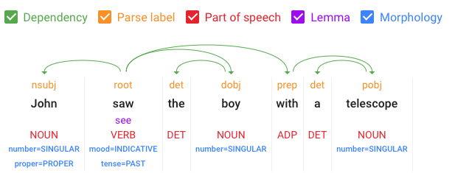
Preposition Phrase (PP) Attachment
https://parser.kitaev.io
https://cloud.google.com/natural-language
Incorrect rule used:
vp --> vbd, np, pp.
dependency parse (essentially same problem):
root is saw
root --> prep
root --> dobj.

Slide 16
Class Exercise
Let's add PP-attachment rules mentioned earlier to nl3.prolog
  vp --> vp, pp.
  np --> np, pp.
Need to add:
  verb (VBD): saw – past tense (-ed)
  preposition (IN): with
  singular nouns (NN): telescope, boy, limp
  proper noun (NNP): john ('John'), mary ('Mary')
    recall: initial caps = Prolog variable

Slide 17
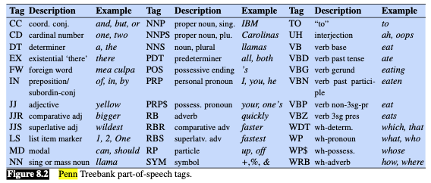
Penn Part-of-Speech (POS)Tagset
Jurafsky & Martin ed3. draft

Slide 18
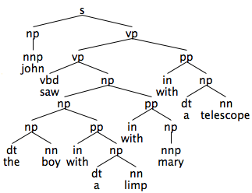
Preposition Phrase (PP) Attachment
The preferred syntactic analysis is a left recursive parse
  notice PPs can be can “stacked”, as in:
  John saw the boy with a limp with Mary with a telescope
  with-ambiguity:
    with_{possessive} ,
    with_{accompaniment},
    with_{instrument}

Slide 19
Preposition Phrase Attachment
Linguistically:
  PP (recursively) adjoins to NP or VP
  np(np(NP,PP)) --> np(NP), pp(PP).
  vp(vp(VP,PP)) --> vp(VP), pp(PP).
Left recursion gives Prolog problems
Derivation (top-down, left-to-right):
  vp
  vp pp
  vp pp pp
  vp pp pp pp
  vp pp pp pp pp infinite loop…
Note:
only the parse tree argument shown here
other extra arguments are possible

Slide 20
Transformation
Apply the general left to right recursive transformation:
to the NP rules:
  np(np(DT,NN)) --> dt(DT,Number), nn(NN,Number).
  np(np(NP,PP)) --> np(NP), pp(PP).
Note:
w is a fresh
nonterminal
that takes 2
arguments
x(X) --> [z], w(X,x(z)).
x(x(z)) --> [z].
w(W,X) --> [y], w(W,x(X,y)).
w(x(X,y),X) --> [y].
x(x(X,y)) --> x(X), [y].
x(x(z)) --> [z].
[z]
[y]
x is the recursive nonterminal
x
x

Slide 21
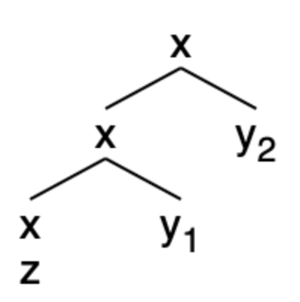
Transformation
Consider input strings: Parse: Transformed rules:
  [z] x(z) 2
  [z, y] x(x(z),y) 1 + 4
  [z, y₁, y₂] x(x(x(z),y₁),y₂) 1 + 3 + 4
x(x(X,y)) --> x(X), [y].
x(x(z)) --> [z].
x(X) --> [z], w(X,x(z)).
x(x(z)) --> [z].
w(W,X) --> [y], w(W,x(X,y)).
w(x(X,y),X) --> [y].
Steps for example 3:
[z, ●y₁, y₂] rule 1: call nonterminal w(X,x(z))
[z, y₁, ●y₂] rule 3: call nonterminal w(X,x(x(z),y₁))
[z, y₁, y₂●] rule 4: answer X = x(x(x(z),y₁),y₂)
the left recursive structure
formed by a right recursive
parse of [z, y₁, y₂]

Slide 22
Homework 6
Question 1: apply the transformation to the left recursion starting with nl3.prolog:
  np(np(NP,PP)) --> np(NP), pp(PP).
  vp(vp(VP,PP)) --> vp(VP), pp(PP).
Show your grammar working properly on example sentences:
  the boy saw the man with the telescope
  the boy with the telescope saw the man
  the boy kicked the man with the telescope
  the boy with the telescope kicked the man
  the boy with the telescope kicked the man with the limp
Show all possible parses (;) until false in each case

Slide 23
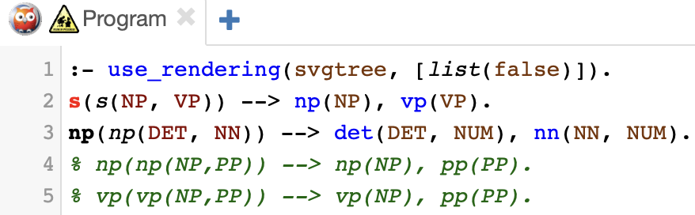
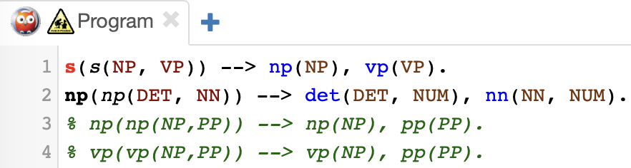
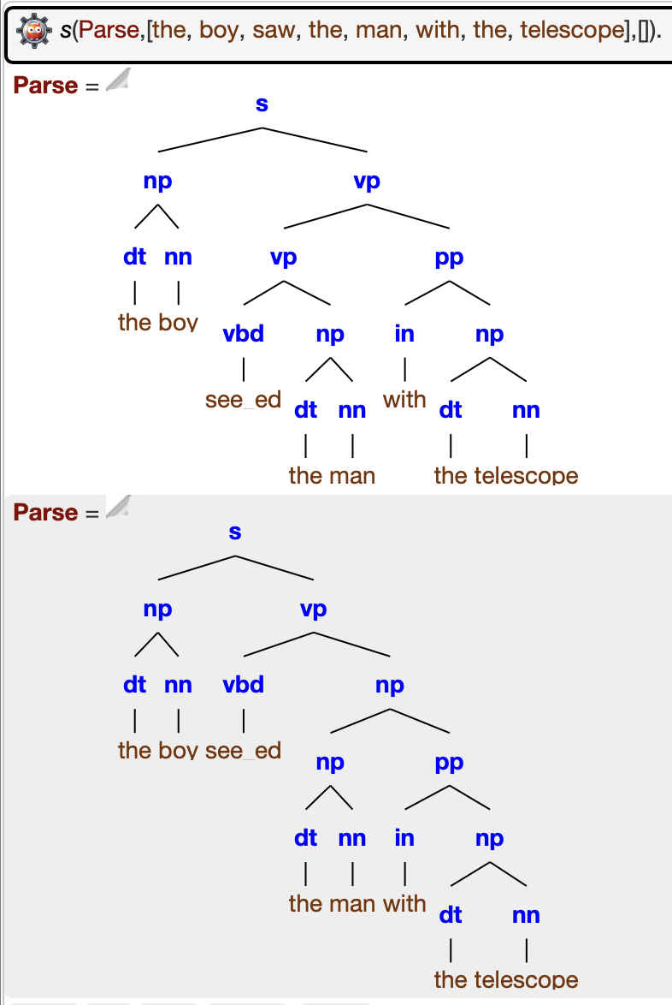
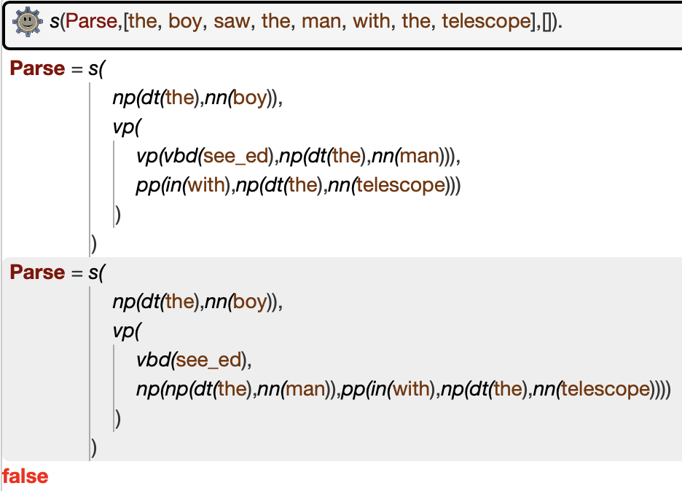
Homework 6
No more parses!

Slide 24
Homework 6
Hint #1:
  consider the case when there are multiple base rules for x
x(x(X,y)) --> x(X), [y].
x(x(z)) --> [z].
x(x(w)) --> [w].
Hint #2:
  w must be a fresh nonterminal, i.e. cannot be shared between the NP and VP recursions. Why?

Slide 25
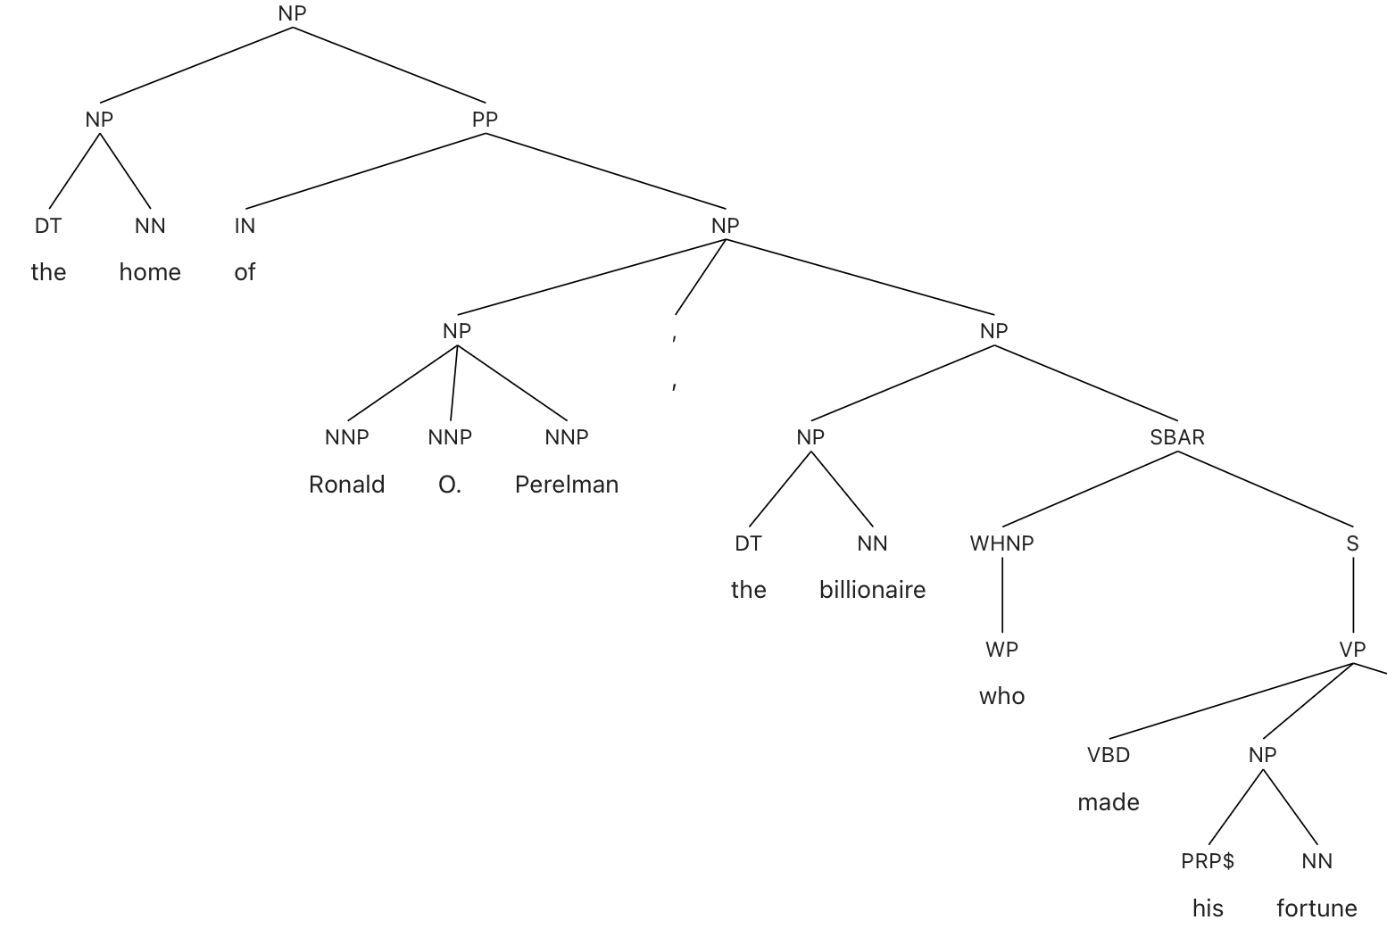
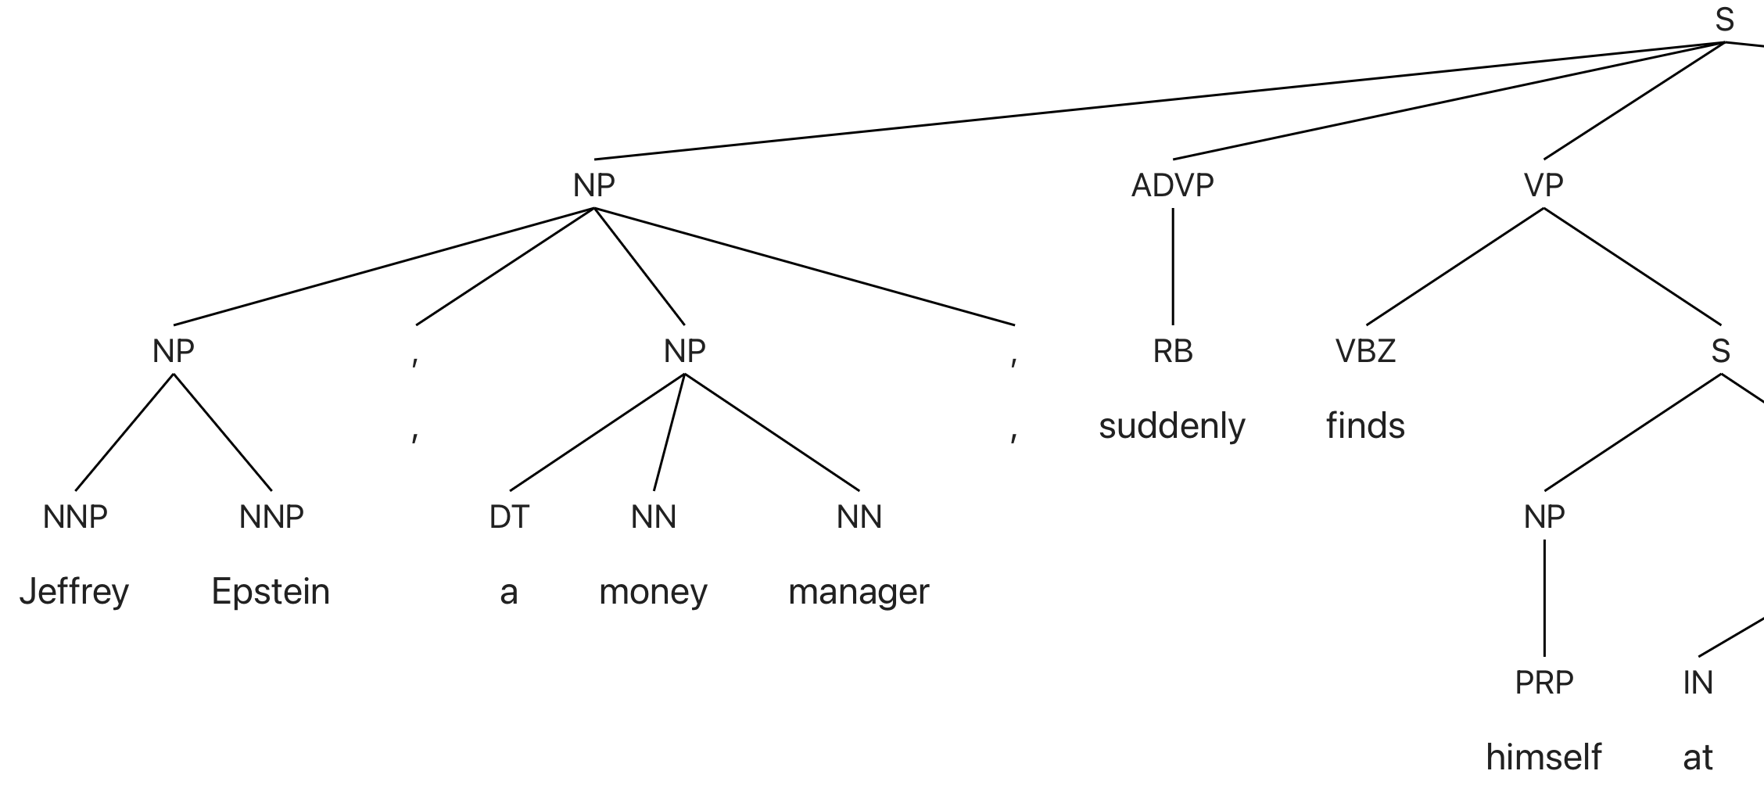
Homework 6
Question 2: with appositives, we also get a left recursive analysis.
Non-restrictive (set off by commas):
  NP, NP, Jeffrey Epstein, a money manager, (source: NYTimes)
  Ronald O. Perelman, the billionaire
Berkeley Neural Parser:
parser.kitaev.io

Slide 26
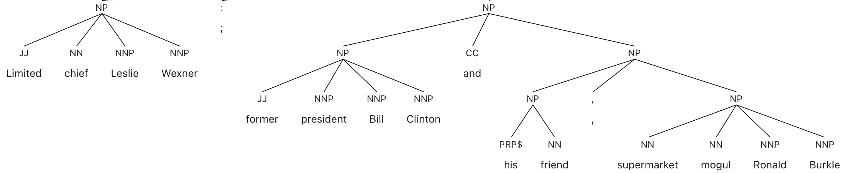
Homework 6
Aside: there's another kind of apposition, but not left recursive (according to the Berkeley Neural Parser):

Slide 27
Homework 6
Question 2: add the comma-separated kind of appositives to your grammar.
  Part 1: give the left recursive rule.
  Part 2: apply the transformation (to eliminate left recursion).
Show how you can parse:
  the boy , a student , saw the man
  the boy , a student , saw the man , the astronomer ,
Note:
  comma needs to be quoted in the input list or grammar rule: [',']
  s(Parse,[the, boy, ',', a, student, ',', saw, the, man],[]).

Slide 28
Homework 6
Question 3: no need to implement this, i.e. don't worry about it, but how can you eliminate the superfluous last comma in Question 2?
  *the boy , a student , saw the man , the astronomer ,
  the boy , a student , saw the man , the astronomer
Hint: is it context-free?

Slide 29
Homework 6
Question 4: can your grammar handle both of these?
  the boy , a student , saw the man with the telescope
  the boy , a student , saw the man , the astronomer , with the telescope
If not, explain why, then modify your grammar.
If yes, explain why it can.

Slide 30
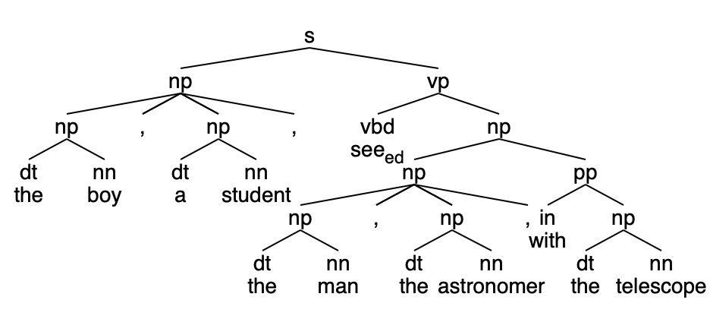
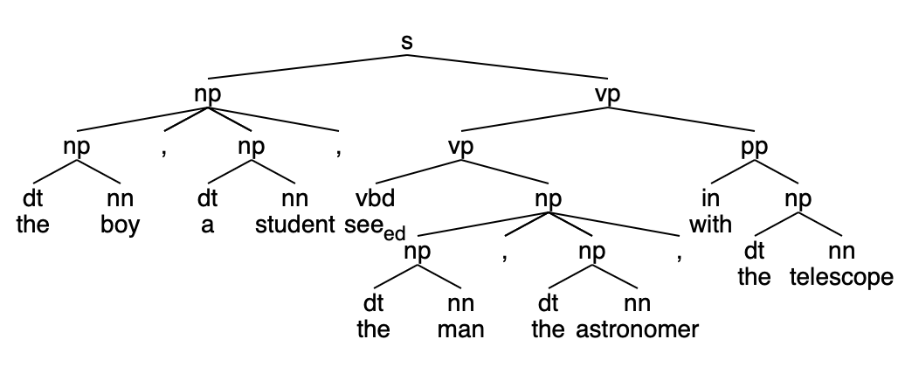
Homework 6
Example parses

Slide 31
Homework 6
Submit to sandiway@arizona.edu
SUBJECT: 581 Homework 6 YOUR NAME
One PDF file (for grading)
  include your grammar code and SWI-Prolog screenshots in your answer
Attach (if I need to run your code):
  source code for your grammar
Deadline:
  midnight Monday: no lecture next Monday (I'm away)
  we will review the homework next Wednesday

