Slide 1
LING/C SC 581:
Advanced Computational Linguistics
Lecture 1
Prof. Sandiway Fong

Slide 2
Course Details
Course Website:
  sandiway.arizona.edu > Classes (Tab) > 581 (Spring 2026 link)
Lectures:
  slides / Panopto (not guaranteed!)
  come to class!
Syllabus:
  see course website
  similar to 438/538
  but homeworks only

Slide 3
Homework 1
Answer syntax review questions: Q1, Q2, Q3
  Due date: Saturday midnight
  Email to: sandiway@arizona.edu
  Title: 581 HW1: YOUR NAME
Copy the full Penn Treebank (PTB) corpus
  instructions given out in Panopto and in class (not on class slides!)
install tregex (see windows/Ubuntu/macoS notes)
  https://nlp.stanford.edu/software/tregex.shtml
  we'll be using the software called tregex to search the PTB
  it's written in Java and requires a Java runtime environment

Slide 4
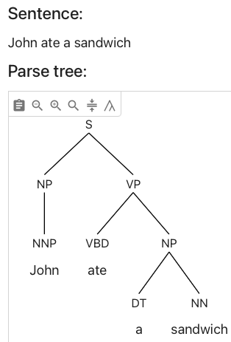
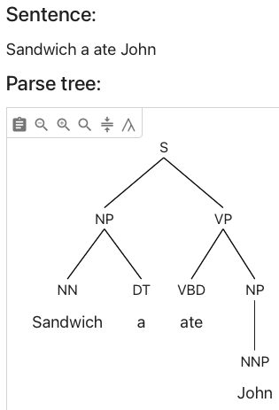
581 assumes 438/538
HW 1: Q1: what rule of English syntax is violated?
Knowledge assumed:
  Syntax: ability to understand a parse
    parser.kitaev.io
    phase structure tree
    see Penn tagsets (this lecture)
    dependency-based diagram
    point out what's wrong!
    argue coherently for one parse over another!
John ate a sandwich
*Sandwich a ate John
(pg.113, Chomsky, 1956)

Slide 5
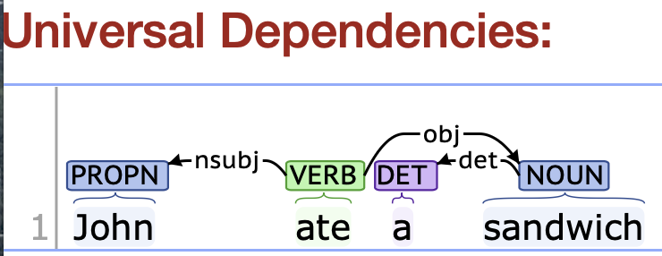
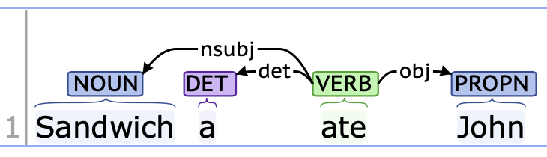
581 assumes 438/538
Universal Dependencies:
  https://universaldependencies.org
Dependency parse:
  (stanza.run)
  https://stanza.stanford.edu
John ate a sandwich
*Sandwich a ate John
(pg.113, Chomsky, 1956)
HW 1: Q2: what's wrong here? Also compare with Q1.

Slide 6
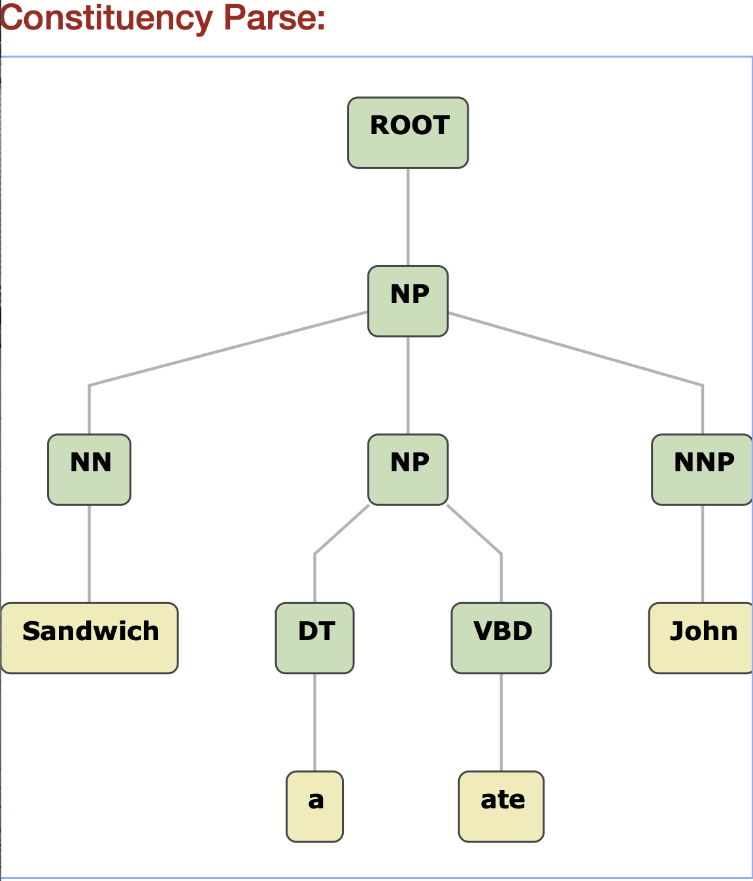
Dependency -> Constituent Tree Conversion
Suppose a "phrase" = group of more than one word
HW 1: Q3: What's wrong with the phrase labels built by the conversion?

Slide 7

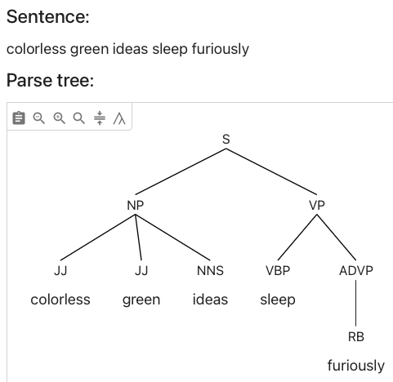
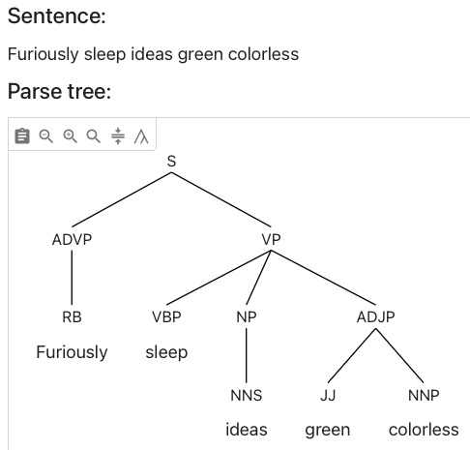
parser.kitaev.io
Colorless green ideas sleep furiously / *Furiously sleep ideas green colorless
(pg.116, Chomsky, 1956)
Statistical systems can accept nearly anything, including unnatural languages.
Is that a feature or a bug?

Slide 8
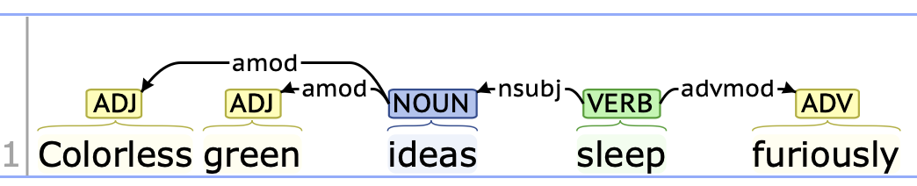
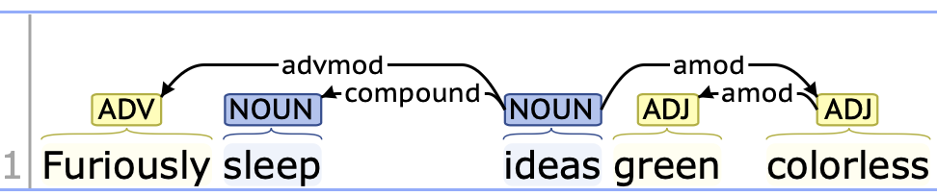
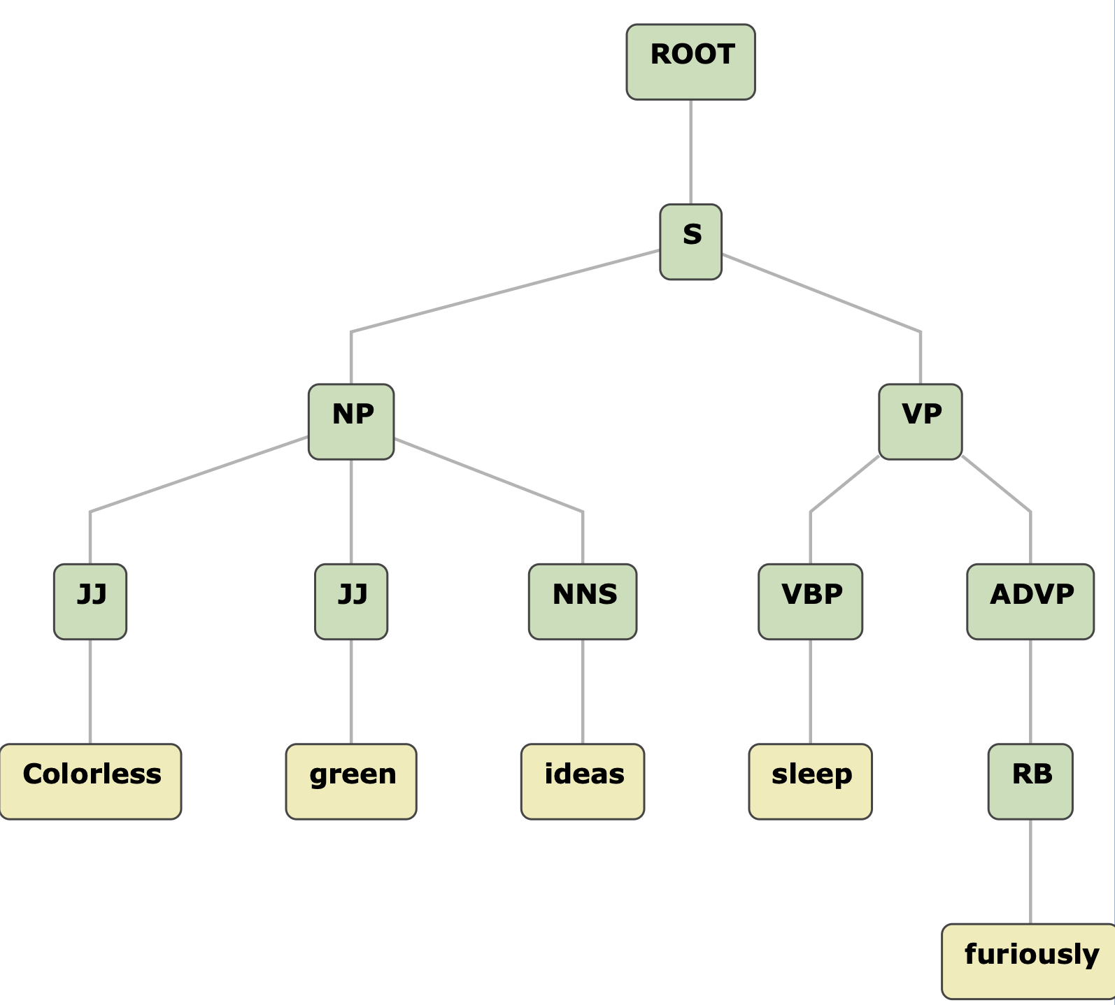
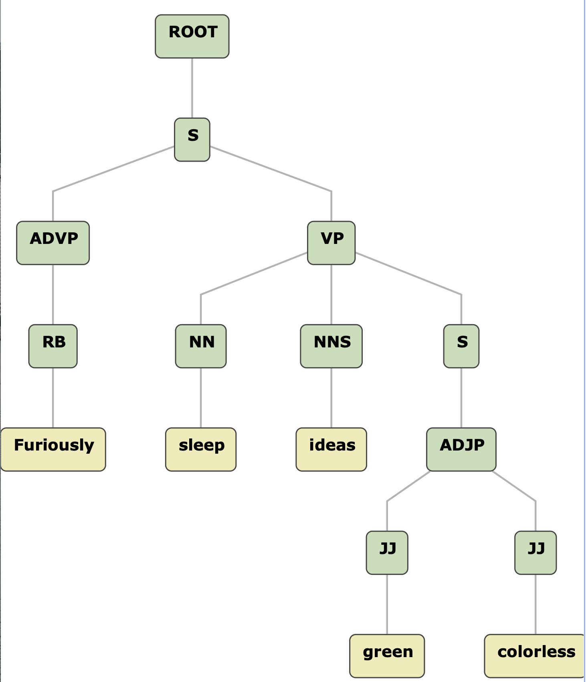
Stanza.run

Slide 9
581 assumes 438/538
Write a phrase structure grammar
  we will use Prolog (DCG rules)
Examples:
  np(np(a,N)) --> [a], nn(N).
  s(s(NP,VP)) --> np(NP), vp(VP).
Query (adds two lists):
  ?- np(X,[a, man], []).
  [a, man] is the list of words passed to np rule.
  [] is the list of words remaining after the np rule (succeeds).
  for what values of X is query true?
Format:
LHS --> RHS.
LHS: a term
  term functor: nonterminal (xp)
  + term arguments
  xp(xp(…), Parameters)
RHS: ,-separated terminals/terms
  terminal: [a]
Note on Prolog case-sensitivity:
  uppercase: variable
Note on Prolog syntax:
  a period ends every statement/query

Slide 10
581 assumes 438/538
Assume you have nltk (nltk.org) and Python working

Slide 11
nltk treebank
nltk: corpus treebank
  a 100,000 word subset of the PTB (not the full thing!)
>>> import nltk
>>> from nltk.corpus import treebank
>>> t = treebank.parsed_sents()
>>> t[0]
Tree('S', [Tree('NP-SBJ', [Tree('NP', [Tree('NNP', ['Pierre']), Tree('NNP', ['Vinken'])]), Tree(',', [',']), Tree('ADJP', [Tree('NP', [Tree('CD', ['61']), Tree('NNS', ['years'])]), Tree('JJ', ['old'])]), Tree(',', [','])]), Tree('VP', [Tree('MD', ['will']), Tree('VP', [Tree('VB', ['join']), Tree('NP', [Tree('DT', ['the']), Tree('NN', ['board'])]), Tree('PP-CLR', [Tree('IN', ['as']), Tree('NP', [Tree('DT', ['a']), Tree('JJ', ['nonexecutive']), Tree('NN', ['director'])])]), Tree('NP-TMP', [Tree('NNP', ['Nov.']), Tree('CD', ['29'])])])]), Tree('.', ['.'])])
>>> t[0].draw()
>>> len(t)
3914

Slide 12
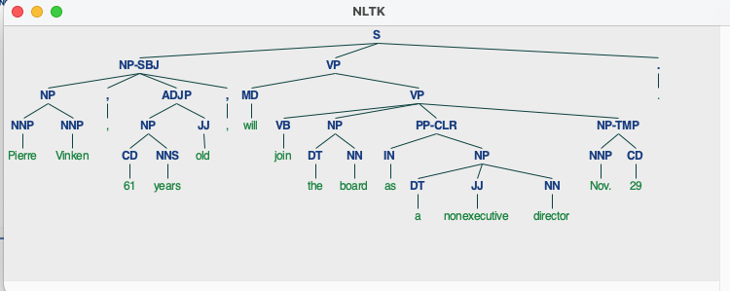
nltk treebank
Tree('S', [Tree('NP-SBJ', [Tree('NP', [Tree('NNP', ['Pierre']), Tree('NNP', ['Vinken'])]), Tree(',', [',']), Tree('ADJP', [Tree('NP', [Tree('CD', ['61']), Tree('NNS', ['years'])]), Tree('JJ', ['old'])]), Tree(',', [','])]), Tree('VP', [Tree('MD', ['will']), Tree('VP', [Tree('VB', ['join']), Tree('NP', [Tree('DT', ['the']), Tree('NN', ['board'])]), Tree('PP-CLR', [Tree('IN', ['as']), Tree('NP', [Tree('DT', ['a']), Tree('JJ', ['nonexecutive']), Tree('NN', ['director'])])]), Tree('NP-TMP', [Tree('NNP', ['Nov.']), Tree('CD', ['29'])])])]), Tree('.', ['.'])])

Slide 13
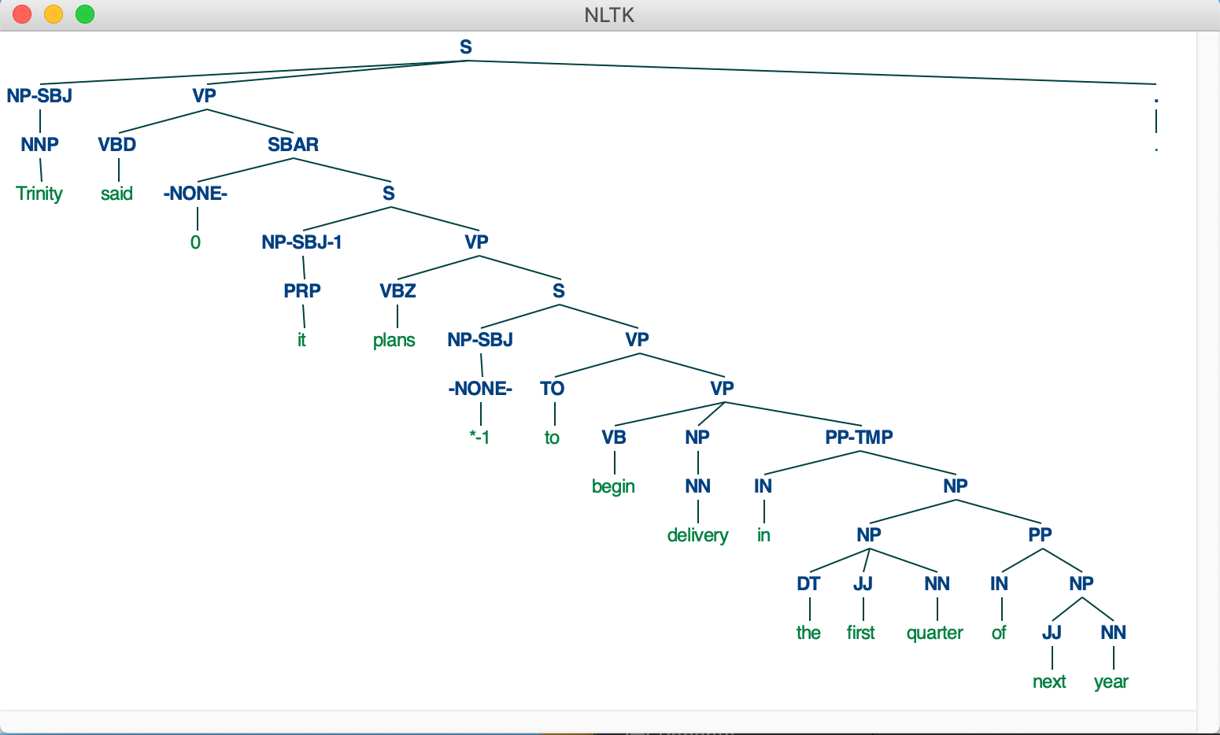
nltk treebank
>>> t[-1].draw()
The sample of the well-known Penn Treebank (PTB) Wall Street Journal (WSJ) corpus includes:
  3,914 parsed sentences
  49,000+ parsed sentences in the full corpus

Slide 14
nltk treebank
Words:
>>> w = treebank.words()
>>> len(w)
100676
>>> w
['Pierre', 'Vinken', ',', '61', 'years', 'old', ',', ...]
>>> tw = treebank.tagged_words()
>>> tw
[('Pierre', 'NNP'), ('Vinken', 'NNP'), (',', ','), ...]
>>> tw[:10]
[('Pierre', 'NNP'), ('Vinken', 'NNP'), (',', ','), ('61', 'CD'), ('years', 'NNS'), ('old', 'JJ'), (',', ','), ('will', 'MD'), ('join', 'VB'), ('the', 'DT')]

Slide 15
nltk: Corpus Readers
http://www.nltk.org/howto/corpus.html#parsed-corpora
  The NLTK data package includes a 10% sample of the Penn Treebank (in treebank), as well as the Sinica Treebank (in sinica_treebank).
Reading the Penn Treebank (Wall Street Journal sample):
>>> from nltk.corpus import treebank
treebank.fileids()
treebank.words(fileid))
treebank.tagged_words(fileid))
treebank.parsed_sents(fileid)

Slide 16
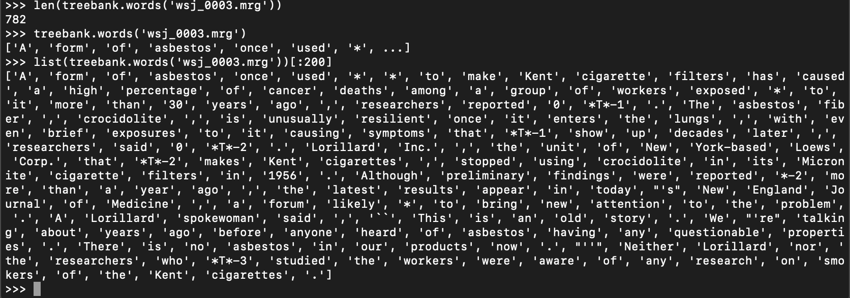
nltk: Corpus Readers
treebank.words(fileid))

Slide 17
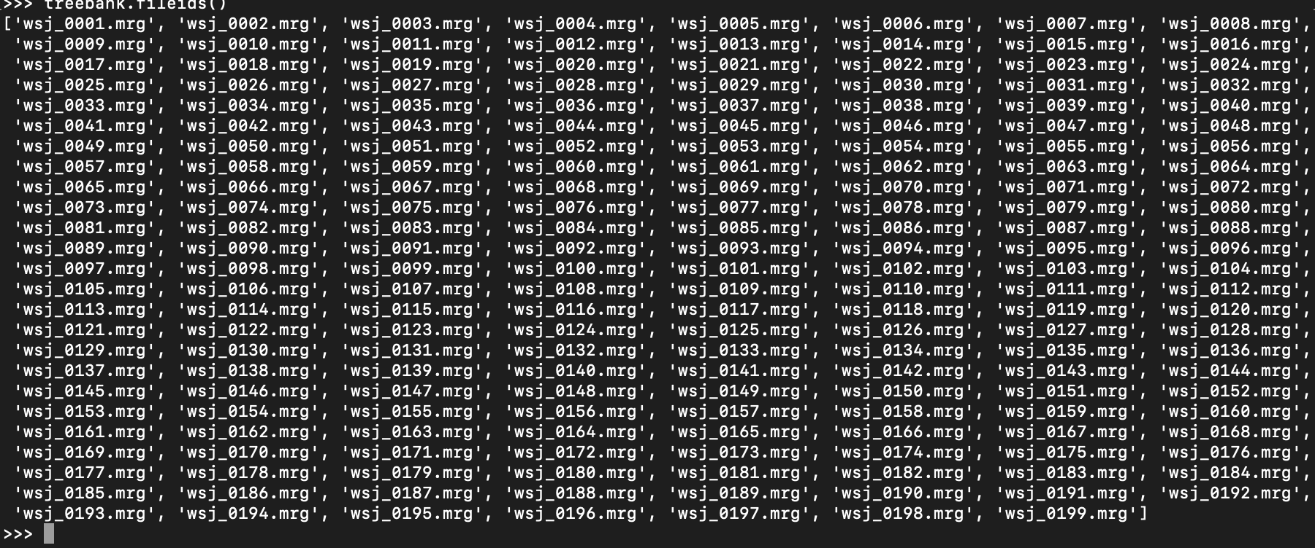
nltk: Corpus Readers
treebank.fileids()
>>> len(treebank.fileids())
199

Slide 18
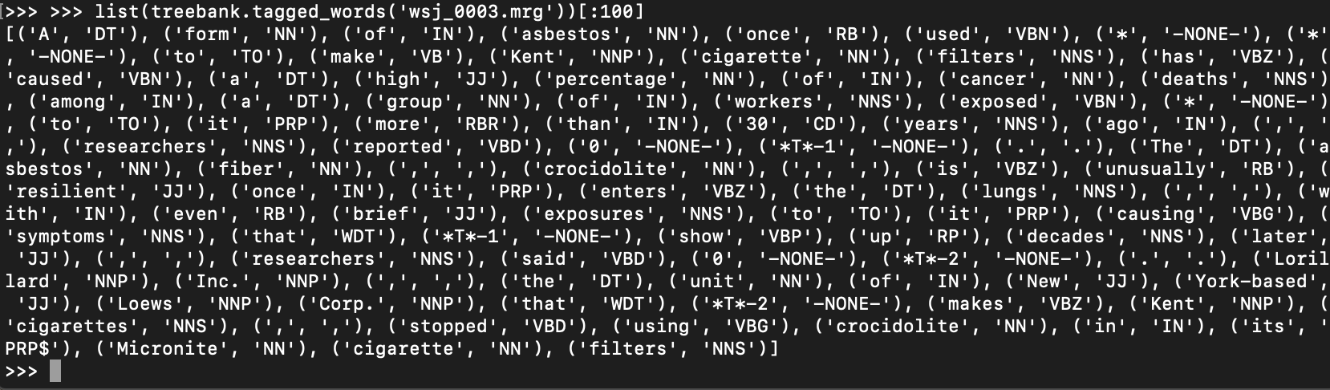
nltk: Corpus Readers
treebank.tagged_words(fileid))

Slide 19
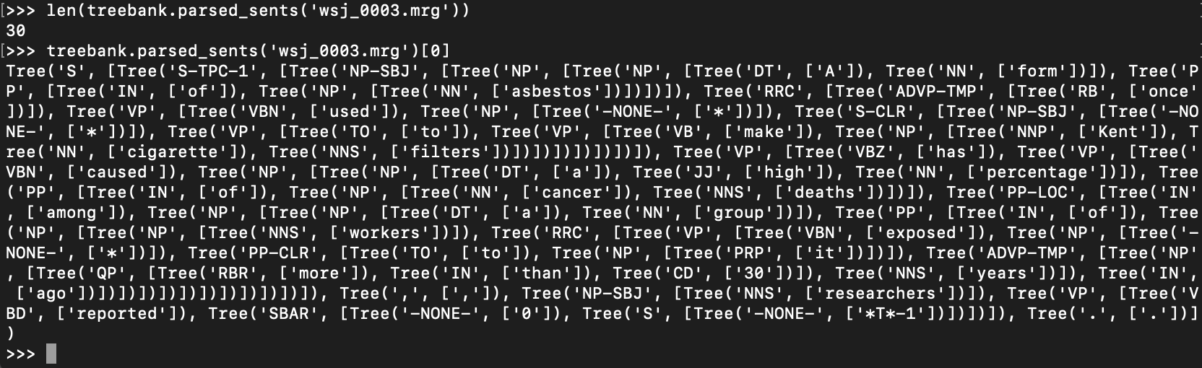
nltk: Corpus Readers
treebank.parsed_sents(fileid)

Slide 20
Penn Treebank
Download instructions in class.
Linguistic Data Consortium (LDC)
  U. of Arizona is a member, we have access
Website:
  https://catalog.ldc.upenn.edu/LDC99T42
This 1999 release contains the following Treebank-2 Material:
One million words of 1989 Wall Street Journal material annotated in Treebank II style.
A small sample of ATIS-3 material annotated in Treebank II style.
A fully tagged version of the Brown Corpus.
and the following new material:
Switchboard tagged, dysfluency-annotated, and parsed text
Brown parsed text
Item Name: | Treebank-3
Author(s): | Mitchell P. Marcus, Beatrice Santorini, Mary Ann Marcinkiewicz, Ann Taylor
LDC Catalog No.: | LDC99T42

Slide 21
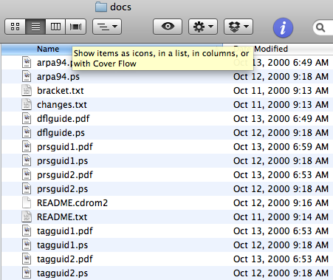
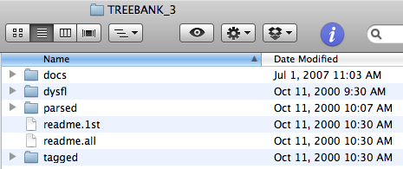
Treebank Guides
Tagging Guide
arpa94 paper
Parse Guide

Slide 22
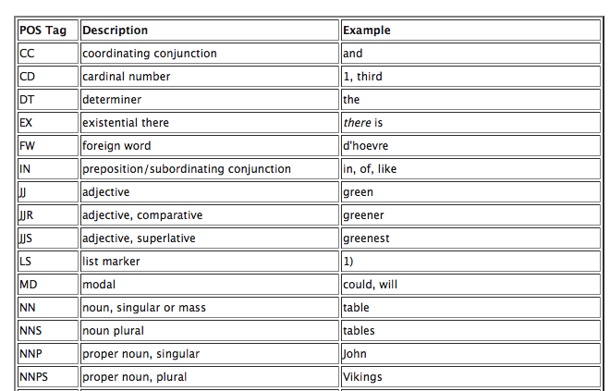
Penn POS Tagset

Slide 23
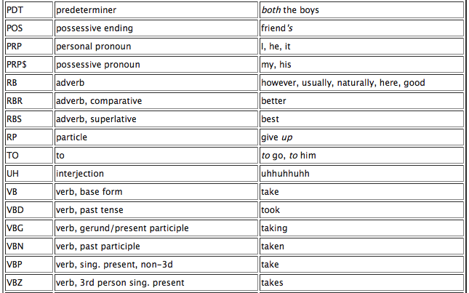
Penn POS Tagset

Slide 24
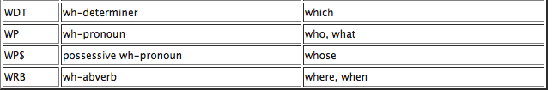
Penn POS Tagset

Slide 25
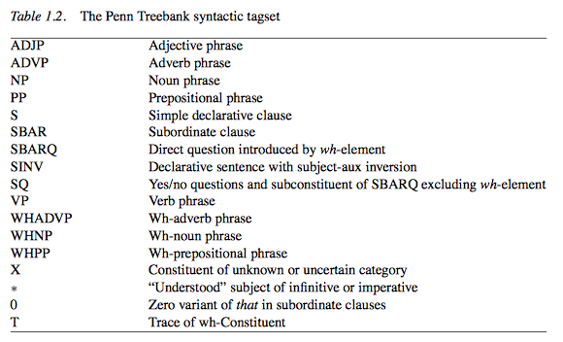
Penn Syntax Tagset
(from The Penn Treebank: An overview, Taylor, Marcus & Santorini)

Slide 26
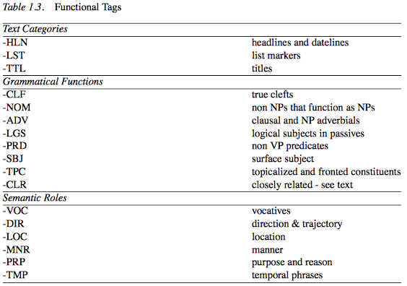
Penn Syntax Tagset
(from The Penn Treebank: An overview, Taylor, Marcus & Santorini)

Slide 27
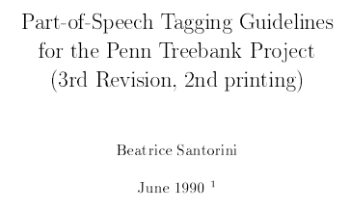
Treebank Guides
Parts-of-speech (POS) Tagging Guide, tagguid1.pdf (34 pages):
tagguid2.pdf: addendum, see POS tag ‘TO’

Slide 28
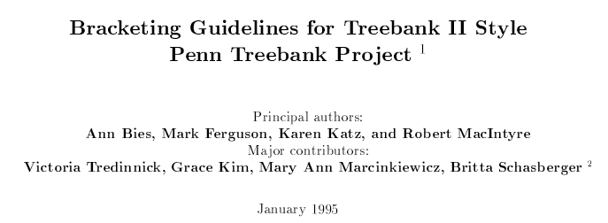
Treebank Guides
Parsing guide 1, prsguid1.pdf (318 pages):
prsguid2.pdf: addendum for the Switchboard corpus

Slide 29
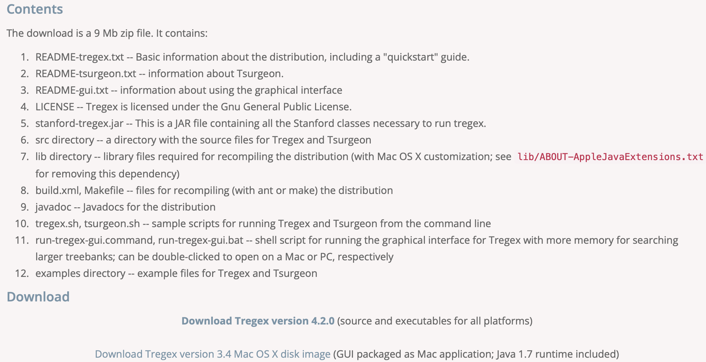
Tregex
URL: https://nlp.stanford.edu/software/tregex.shtml

Slide 30
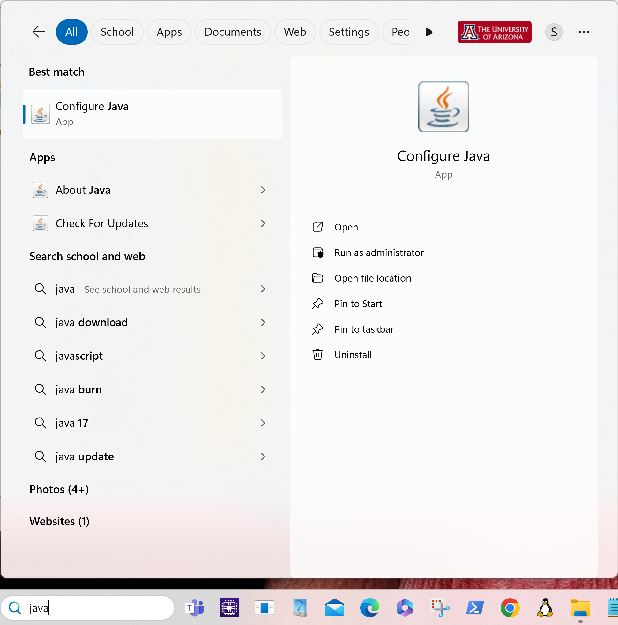
Windows 11: jre 8 update 401
January 2024
Make sure Java's run-time environment is installed

Slide 31
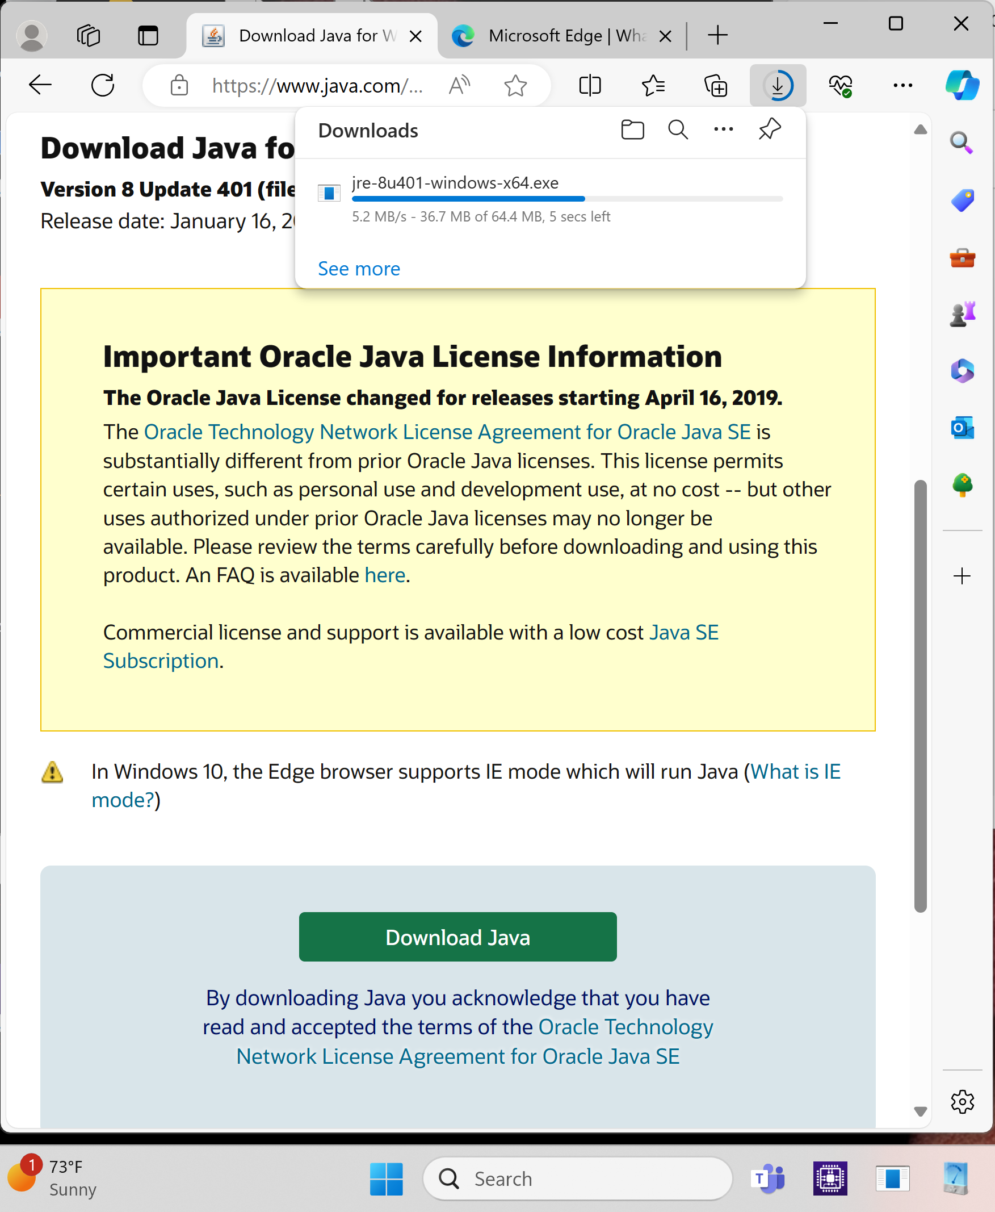
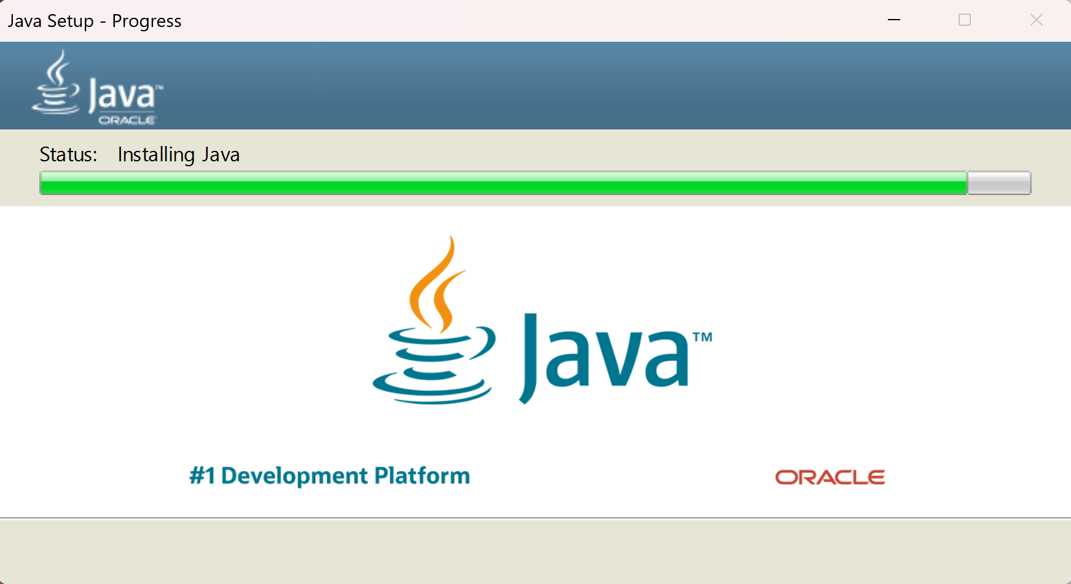
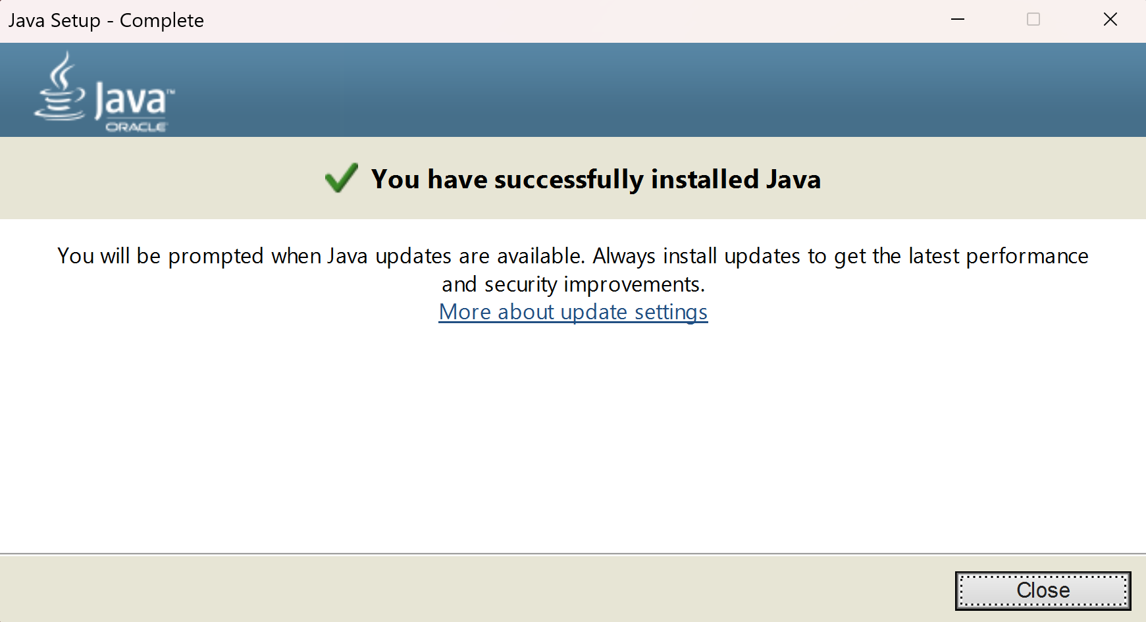
jre-8u401-windows-x86.exe

Slide 32
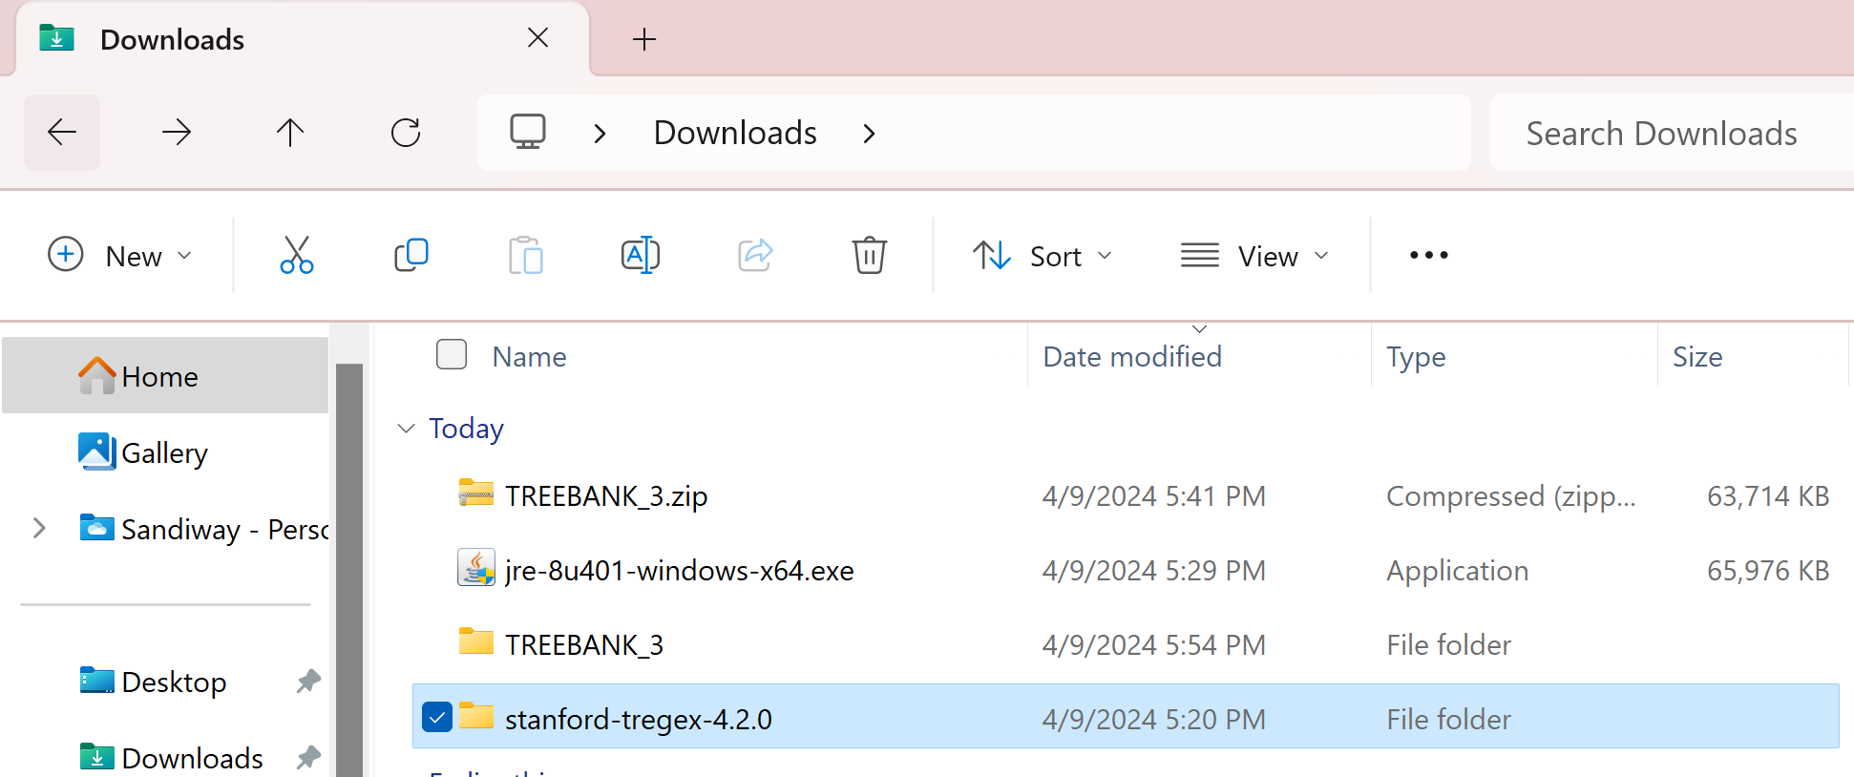
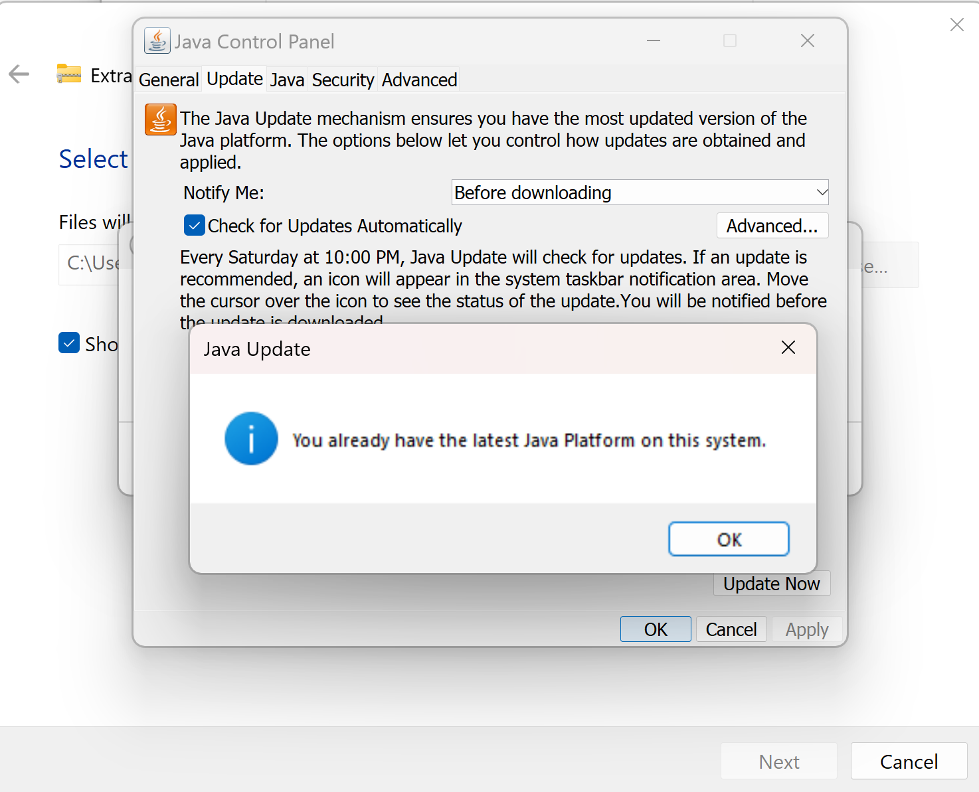
jre updated
PS C:\Users\sandiway\Downloads> powershell -command "Expand-Archive" .\stanford-tregex-4.2.0.zip C:\Users\sandiway\Desktop\

Slide 33
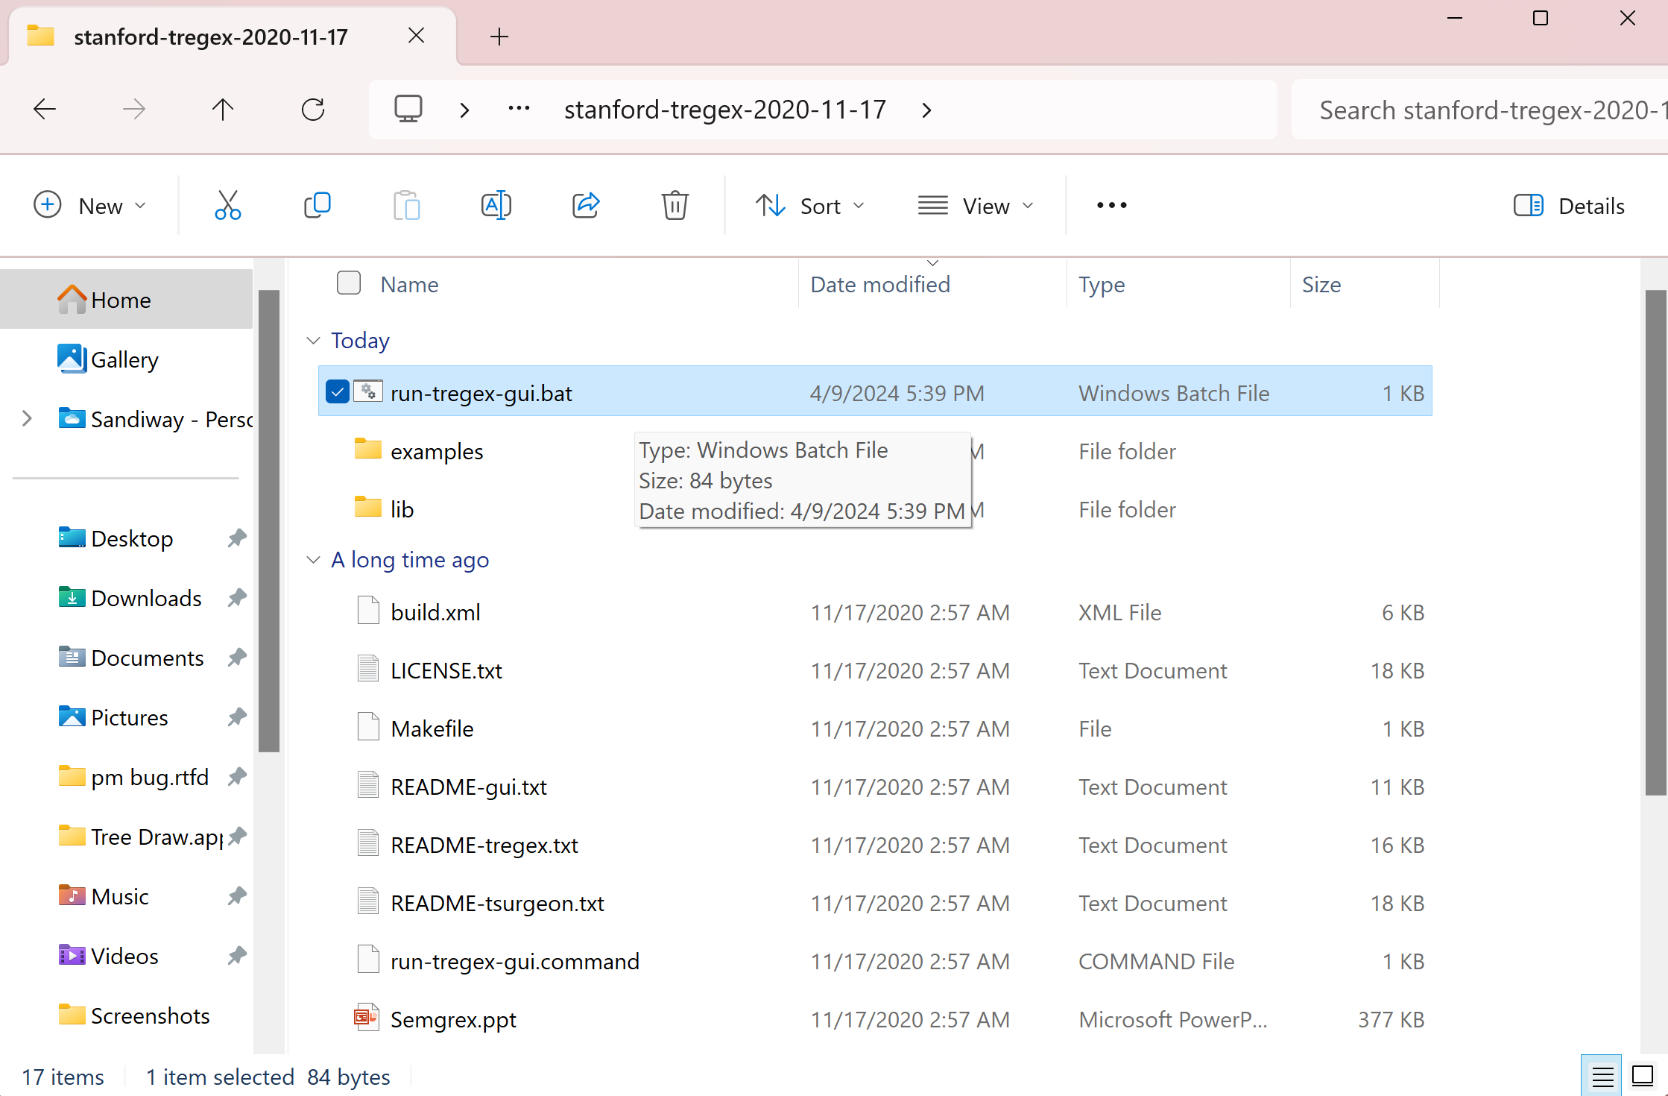
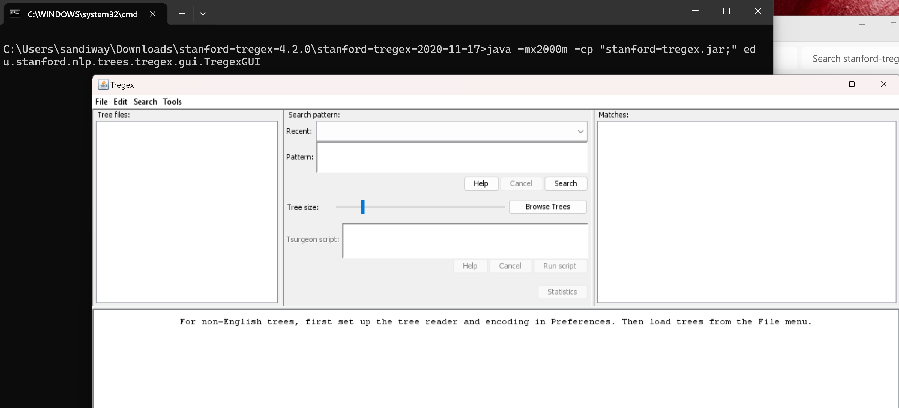
run-tregex-gui.bat
edit .bat file to increase memory: -mx2000

Slide 34
Ubuntu Install
Terminal:
  ~/Downloads$ unzip stanford-tregex-4.2.0.zip
  ~/Downloads$ cd stanford-tregex-2020-11-17/
  ~/Downloads/stanford-tregex-2020-11-17$ ./run-tregex-gui.command
  Gtk-Message: 20:44:58.957: Failed to load module "canberra-gtk-module"
  Apr 09, 2024 8:44:59 PM java.util.prefs.FileSystemPreferences$1 run
  INFO: Created user preferences directory.
Install:
  sudo apt install libcanberra-gtk-module
  The following additional packages will be installed:
  libcanberra-gtk0
  The following NEW packages will be installed:
  libcanberra-gtk-module libcanberra-gtk0

Slide 35
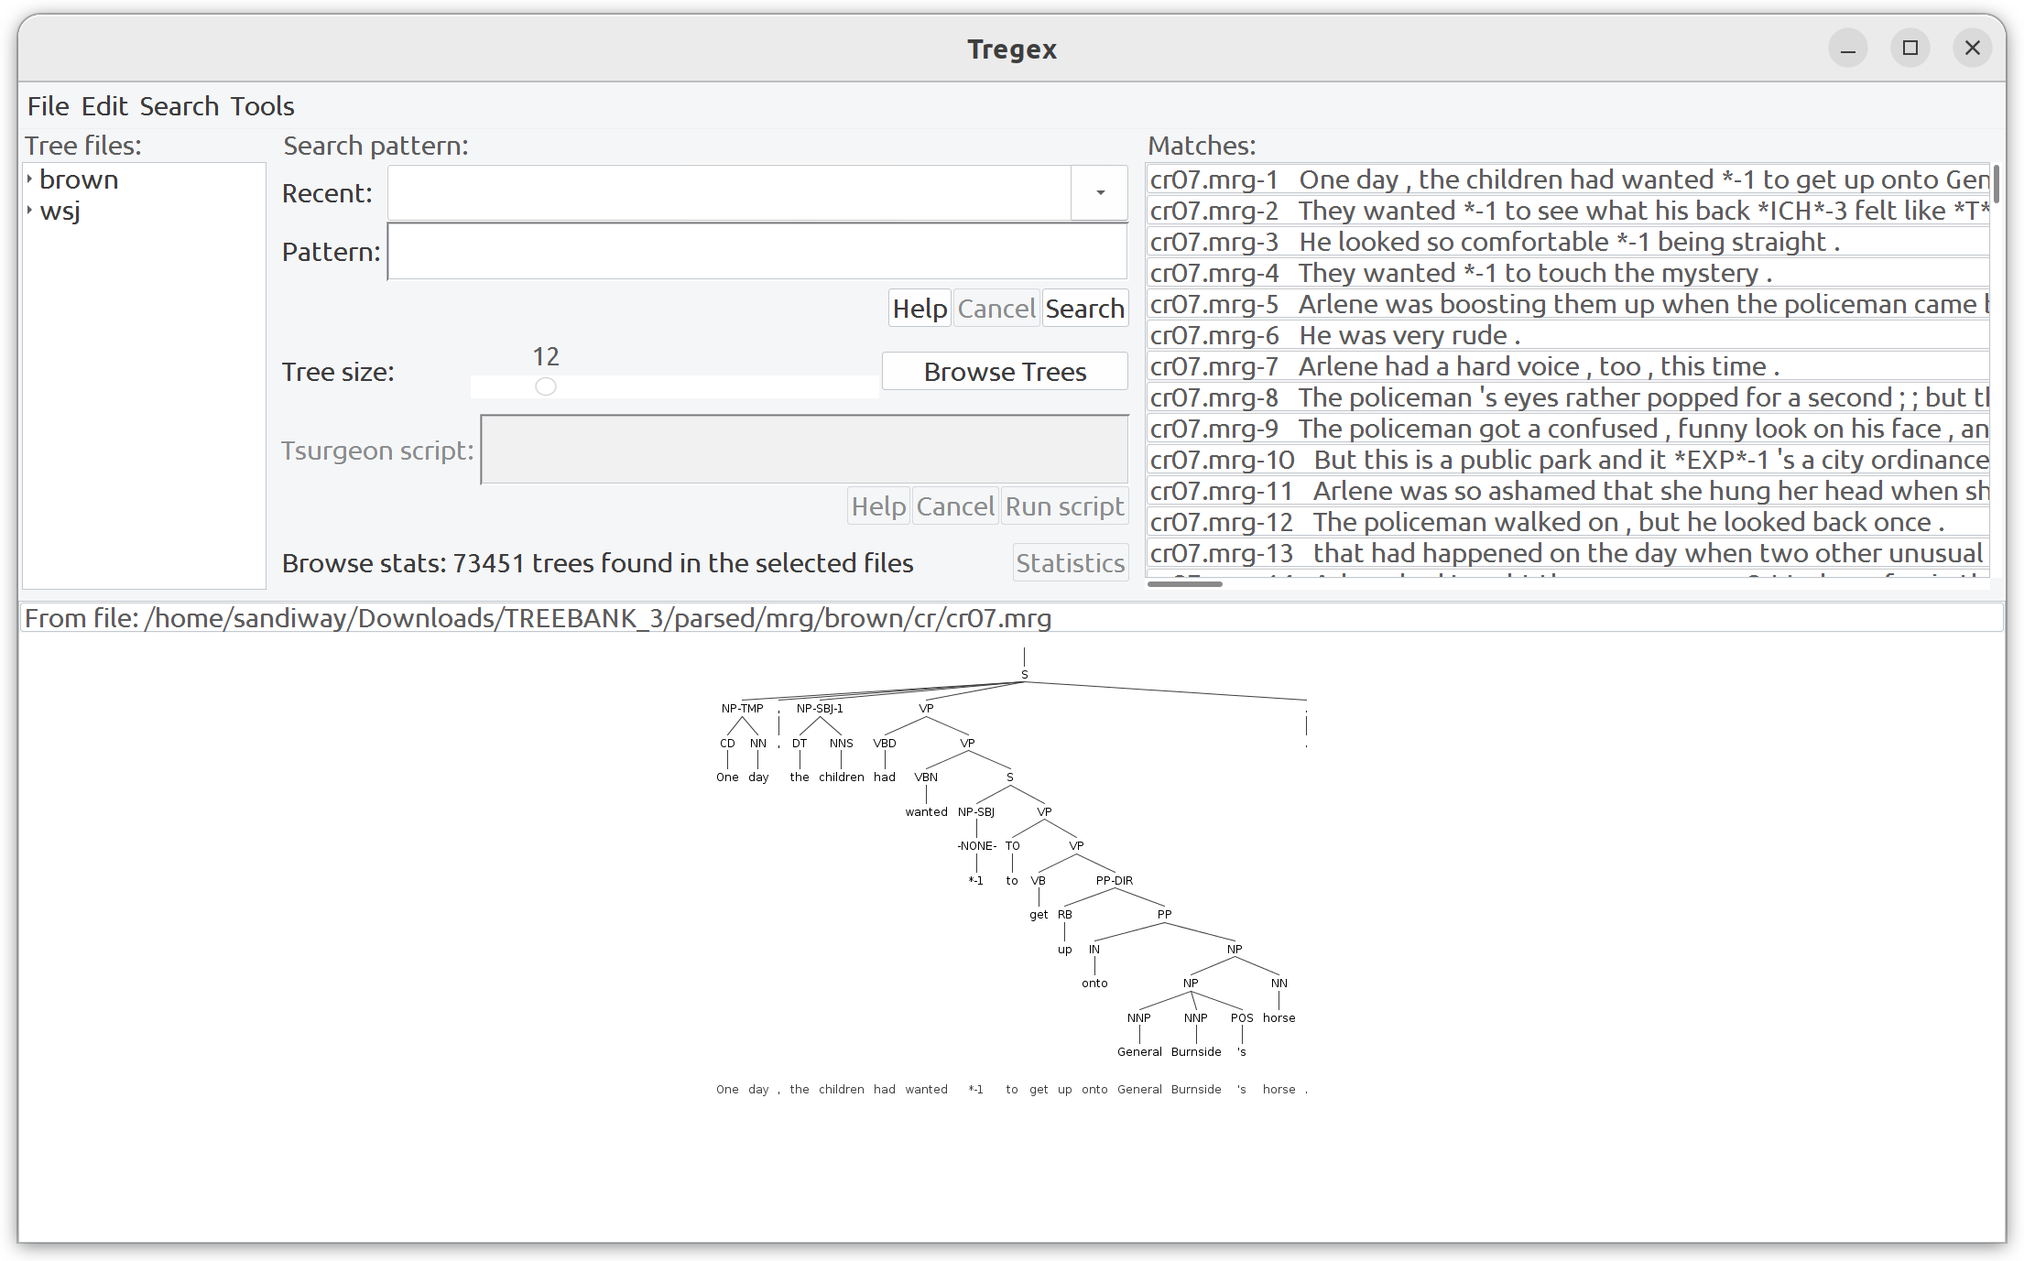
tregex on Ubuntu

Slide 36
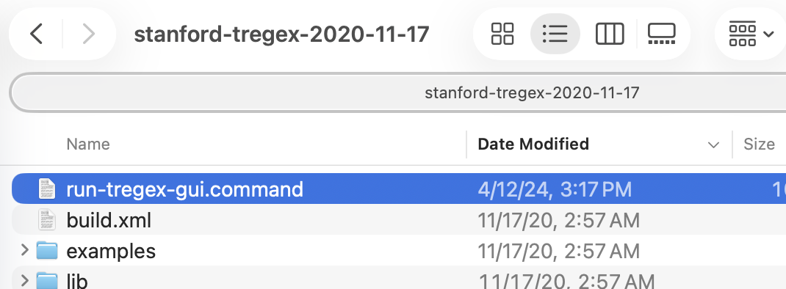
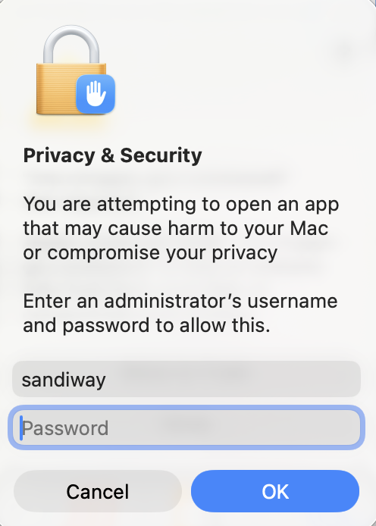
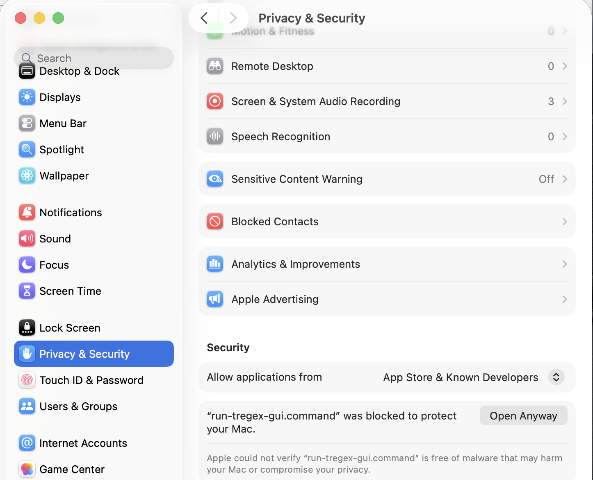
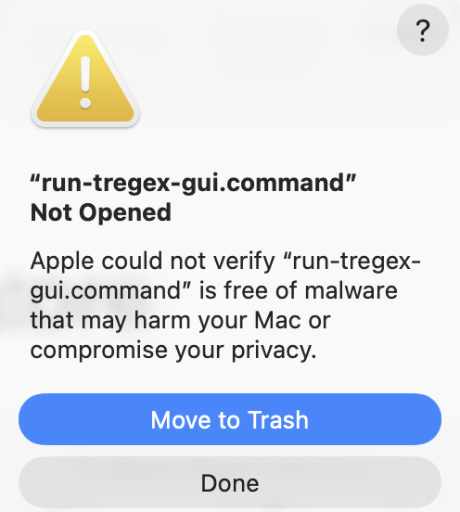
Possible macOS Problem 1

Slide 37
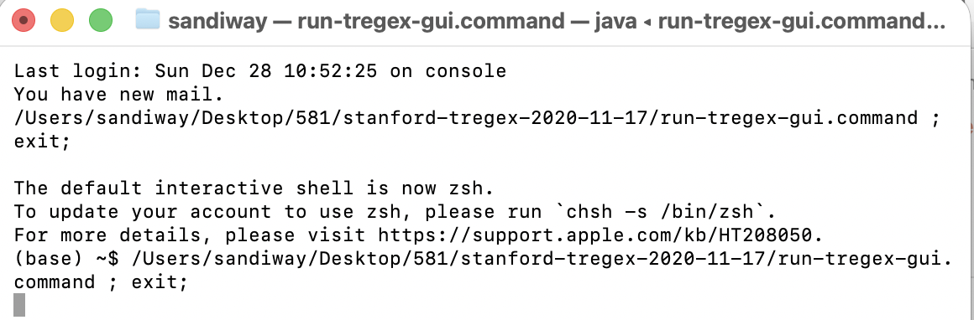
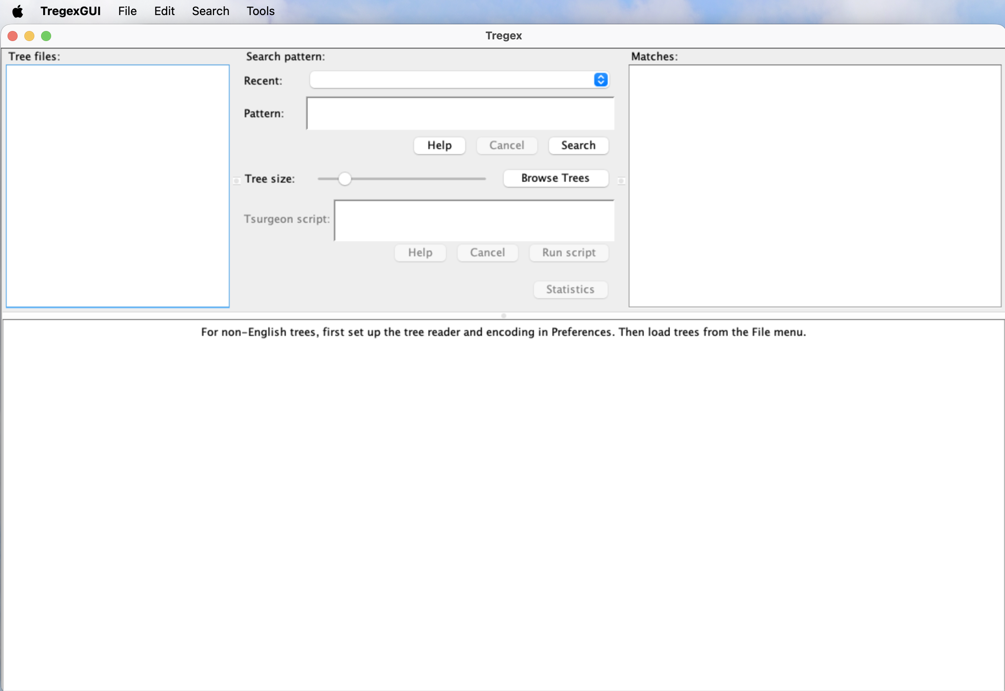
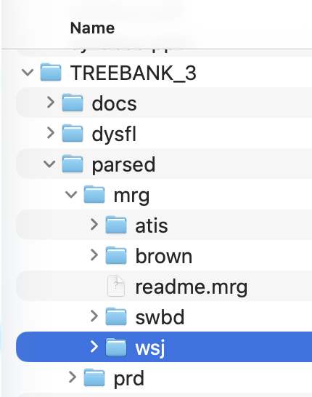
Possible macOS Problem 1

Slide 38
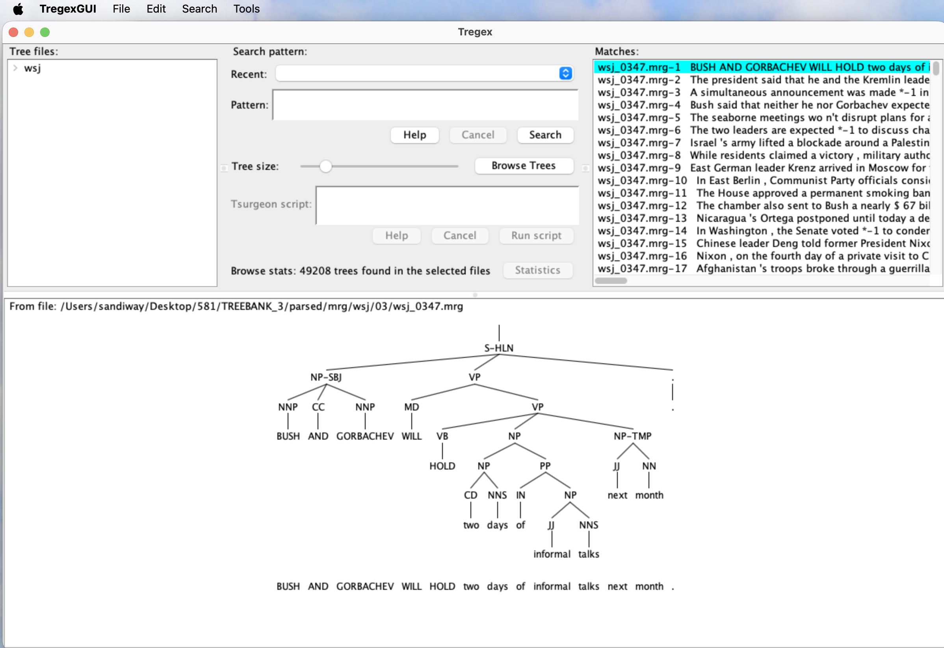
Possible macOS Problem 1

Slide 39
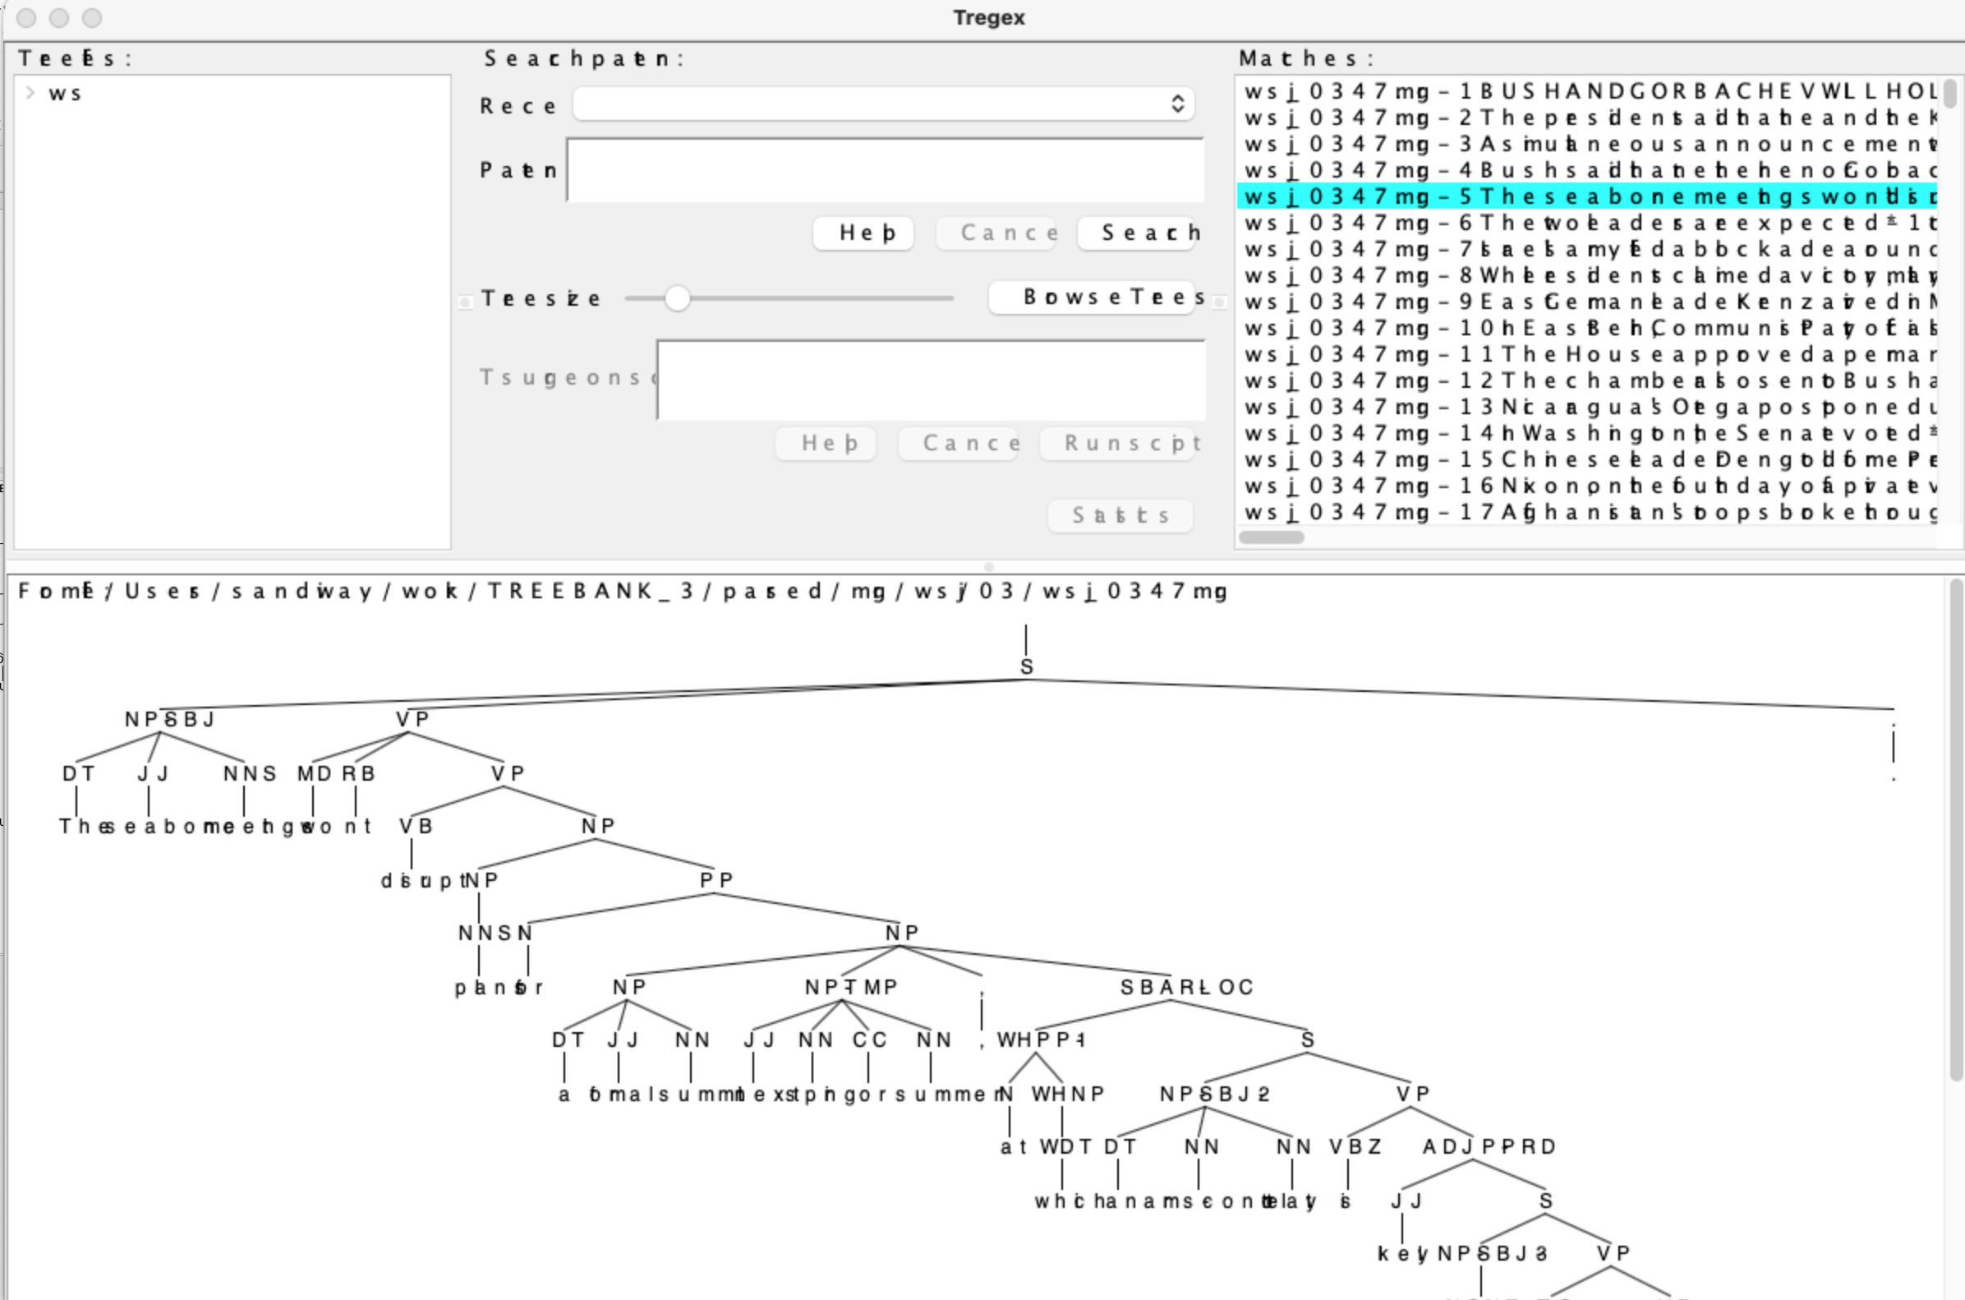
Possible macOS Problem 2
Disk image version, the Java runtime environment seems to pick wrong fonts. Display is hard to read.

Slide 40
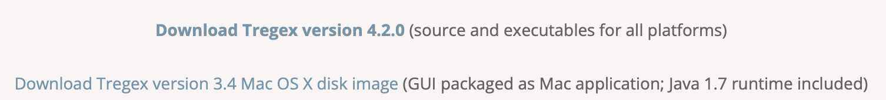
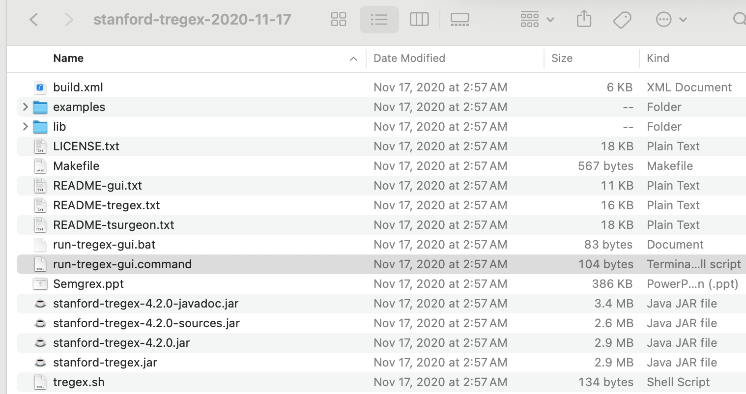
Possible macOS Problem 2
If this happens, download the non disk image link
for macOS, run this command

Slide 41
Possible macOS Problem 2
Terminal
  (base) stanford-tregex-2020-11-17$ ./run-tregex-gui.command
  Warning: the font "Times" is not available, so "Lucida Bright" has been substituted, but may have unexpected appearance or behavor. Re-enable the "Times" font to remove this warning.
  Warning: the font "Times" is not available, so "Lucida Bright" has been substituted, but may have unexpected
Terminal
  can be fixed, but maybe not worth doing …
  (base) stanford-tregex-2020-11-17$ ./run-tregex-gui.command

Slide 42
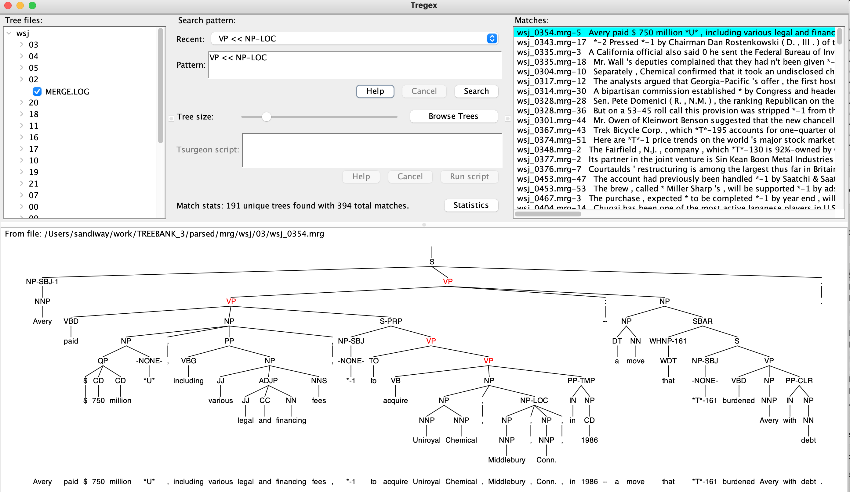
Possible macOS Problem 2
Lucida Bright
is a reasonable
substitute for Times

Slide 43
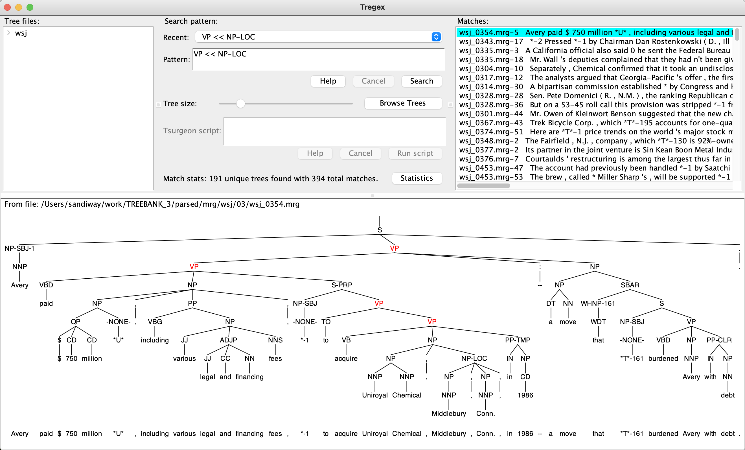
Possible macOS Problem 2
with Times font restored to macOS using instructions here https://stackoverflow.com/questions/68608157/how-can-i-fix-this-warning-the-fonts-times-and-times-are-not-available-fo

