Slide 1
LING/C SC 581: Advanced Computational Linguistics
Lecture 9

Slide 2
Today's Topics
Homework 4 Review
Live programming
Berkeley Neural Parser
ChatGPT
DALL-E 2
FrameNet

Slide 3
Homework 4 Review
Q1: apply the transformation to the left recursion in nl5.prolog:
np(np(NP,PP)) --> np(NP), pp(PP).
vp(vp(VP,PP)) --> vp(VP), pp(PP).
Show your grammar working properly on example sentences:
the boy saw the man with the telescope
the boy with the telescope saw the man
the boy kicked the man with the telescope
the boy with the telescope kicked the man
the boy with the telescope kicked the man with the limp

Slide 4
Homework 4
Hint #1: consider the case when there are multiple base rules for x
x(x(X,y)) --> x(X), [y].
x(x(z)) --> [z].
x(x(w)) --> [w].
Hint #2: w must be a fresh nonterminal, i.e. cannot be shared between the NP and VP recursions. Why?

Slide 5
Homework 4 Review
After live in class programming, we have the following grammar, call it nl5.prolog:
s(s(NP, VP)) --> np(NP), vp(VP).
np(np(DET, NN)) --> det(DET, NUM), nn(NN, NUM).
np(np(NNP)) --> nnp(NNP).
np(np(NP,PP)) --> np(NP), pp(PP).
pp(pp(IN,NP)) --> in(IN), np(NP).
det(dt(the), sg) --> [the].
det(dt(the), pl) --> [the].
det(dt(a), sg) --> [a].
nn(nn(man), sg) --> [man].
nn(nn(boy), sg) --> [boy].
nn(nn(telescope), sg) --> [telescope].
nn(nn(limp), sg) --> [limp].
nn(nn(men), pl) --> [men].
nn(nn(ball), sg) --> [ball].
vp(vp(VTR, NP)) --> vtr(VTR), np(NP).
vp(vp(VP,PP)) --> vp(VP), pp(PP).
vtr(vbd(kick_ed)) --> [kicked].
vtr(vbd(hit_ed)) --> [hit].
vtr(vbd(see_ed)) --> [saw].
in(in(with)) --> [with].
nnp(nnp(john)) --> [john].
nnp(nnp(mary)) --> [mary].

Slide 6
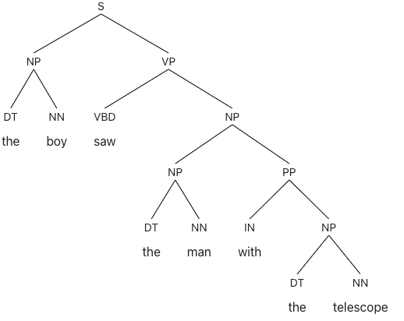
Homework 4 Review
Berkeley Neural Parser (https://parser.kitaev.io):
the boy saw the man with the telescope

Slide 7
Dall-E 2

Slide 8
Homework 4 Review

Slide 9
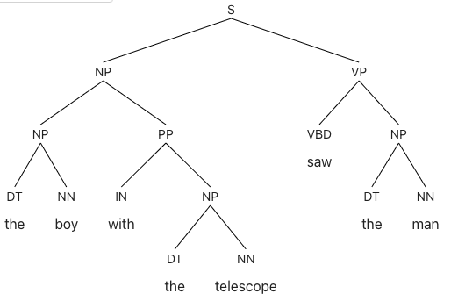
Homework 4 Review
Berkeley Neural Parser (https://parser.kitaev.io):
the boy saw the man with the telescope
the boy with the telescope saw the man

Slide 10
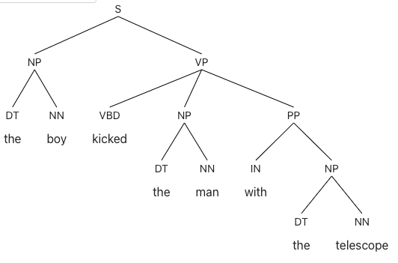
Homework 4 Review
Berkeley Neural Parser (https://parser.kitaev.io):
the boy saw the man with the telescope
the boy with the telescope saw the man
the boy kicked the man with the telescope

Slide 11
Homework 4 Review

Slide 12
Homework 4 Review

Slide 13
Dall-E 2

Slide 14
FrameNet
https://FrameNet.icsi.berkeley.edu

Slide 15
FrameNet
FrameNet is based on a theory of meaning called Frame Semantics (Fillmore 1976, …)
the meanings of most words can best be understood on the basis of a semantic frame, a description of a type of event, relation, or entity and the participants in it.
Example: the concept of cooking:
a person doing the cooking (Cook),
the food that is to be cooked (Food),
something to hold the food while cooking (Container), and
a source of heat (Heating_instrument).

Slide 16
FrameNet
The FrameNet project is building a lexical database of English that is both human- and machine-readable, based on annotating examples of how words are used in actual texts.
From the student's point of view, it is a dictionary of more than 13,000 word senses, most of them with annotated examples that show the meaning and usage.
For the researcher in Natural Language Processing, the more than 200,000 manually annotated sentences linked to more than 1,200 semantic frames provide a unique training dataset for semantic role labeling, used in applications such as information extraction, machine translation, event recognition, sentiment analysis, etc.
For students and teachers of linguistics it serves as a valence dictionary, with uniquely detailed evidence for the combinatorial properties of a core set of the English vocabulary.

Slide 17
FrameNet: Perception_active
Perception_active frame:

Slide 18
FrameNet: Perception_active
Lexical Units:
admire.v, attend.v, eavesdrop.v, eye.v, feel.v, gape.v, gawk.v, gaze.n, gaze.v, glance.n, glance.v, goggle.v, listen.v, look.n, look.v, observation.n, observe.v, palpate.v, peek.n, peek.v, peep.v, peer.v, savour.v, smell.v, sniff.n, sniff.v, spy.v, squint.v, stare.n, stare.v, taste.n, taste.v, view.v, watch.v
No see.v

Slide 19
FrameNet: Perception_experience
Synopsis:
This frame contains perception words whose Perceivers have perceptual experiences that they do not necessarily intend to.
Perception_experience has see, Perception_active has look at.
Lexical Units:
detect.v, experience.n, experience.v, feel.v, hear.v, overhear.v, perceive.v, perception.n, see.v, sense.v, smell.v, taste.v, witness.v

Slide 20
FrameNet: Cause_harm
Synopsis:
Lexical Units:
bash.v, batter.v, bayonet.v, beat up.v, beat.v, belt.v, biff.v, bludgeon.v, boil.v, break.v, bruise.v, buffet.v, burn.v, butt.v, cane.v, chop.v, claw.v, clout.v, club.v, crack.v, crush.v, cudgel.v, cuff.v, cut.v, drug.v, elbow.v, electrocute.v, electrocution.n, flagellate.v, flog.v, fracture.v, gash.v, hammer.v, hit.v, horsewhip.v, hurt.v, impale.v, injure.v, jab.v, kick.v, knee.v, knife.v, knock.v, lash.v, maim.v, maul.v, mutilate.v, pelt.v, poison.v, poisoning.n, pummel.v, punch.v, run through.v, slap.v, slice.v, smack.v, smash.v, spear.v, squash.v, stab.v, sting.v, stone.v, strike.n, strike.v, swipe.v, thwack.v, torture.v, transfix.v, twist.v, welt.v, whip.v, wound.v

Slide 21
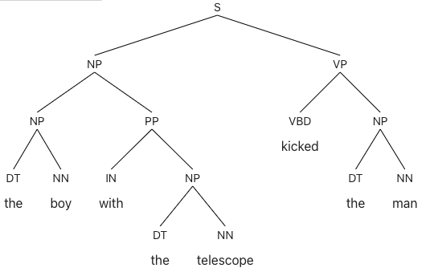
Homework 4 Review
Berkeley Neural Parser (https://parser.kitaev.io):
the boy saw the man with the telescope
the boy with the telescope saw the man
the boy kicked the man with the telescope
the boy with the telescope kicked the man

Slide 22
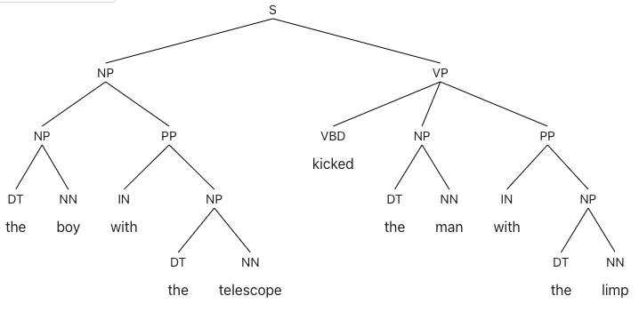
Homework 4 Review
Berkeley Neural Parser (https://parser.kitaev.io):
the boy saw the man with the telescope
the boy with the telescope saw the man
the boy kicked the man with the telescope
the boy with the telescope kicked the man
the boy with the telescope kicked the man with the limp

Slide 23
Dall-E 2

Slide 24
Homework 4 Review

Slide 25
Homework 4 Review
Back to our grammar:
s(s(NP, VP)) --> np(NP), vp(VP).
np(np(DET, NN)) --> det(DET, NUM), nn(NN, NUM).
np(np(NNP)) --> nnp(NNP).
np(np(NP,PP)) --> np(NP), pp(PP).
pp(pp(IN,NP)) --> in(IN), np(NP).
det(dt(the), sg) --> [the].
det(dt(the), pl) --> [the].
det(dt(a), sg) --> [a].
nn(nn(man), sg) --> [man].
nn(nn(boy), sg) --> [boy].
nn(nn(telescope), sg) --> [telescope].
nn(nn(limp), sg) --> [limp].
nn(nn(men), pl) --> [men].
nn(nn(ball), sg) --> [ball].
vp(vp(VTR, NP)) --> vtr(VTR), np(NP).
vp(vp(VP,PP)) --> vp(VP), pp(PP).
vtr(vbd(kick_ed)) --> [kicked].
vtr(vbd(hit_ed)) --> [hit].
vtr(vbd(see_ed)) --> [saw].
in(in(with)) --> [with].
nnp(nnp(john)) --> [john].
nnp(nnp(mary)) --> [mary].

Slide 26
Homework 4 Review
Example:
?- s(Parse, [a, man, saw, the, boy, with, a, telescope], []).
Parse = s(np(dt(a), nn(man)), vp(vbd(see_ed), np(np(dt(the), nn(boy)), pp(in(with), np(dt(a), nn(telescope)))))) ;
ERROR: Stack limit (1.0Gb) exceeded
ERROR: Stack sizes: local: 0.7Gb, global: 0.2Gb, trail: 1Kb
ERROR: Stack depth: 7,189,378, last-call: 0%, Choice points: 11
ERROR: Possible non-terminating recursion:
ERROR: [7,189,376] user:np(<compound np/2>, [length:2], _57529258)
ERROR: [7,189,375] user:np(<compound np/2>, [length:2], _57529292)
Exception: (11) vp(_12994, [saw, the, boy, with, a, telescope], []) ? abort
% Execution Aborted
?-

Slide 27
Homework 4 Review
If you promote the VP rules ahead of the NP rules…
Example:
?- [nl5a].
true.
?- s(Parse, [a, man, saw, the, boy, with, a, telescope], []).
Parse = s(np(dt(a), nn(man)), vp(vbd(see_ed), np(np(dt(the), nn(boy)), pp(in(with), np(dt(a), nn(telescope)))))) ;
ERROR: Stack limit (1.0Gb) exceeded
ERROR: Stack sizes: local: 0.7Gb, global: 0.2Gb, trail: 0Kb
ERROR: Stack depth: 7,189,708, last-call: 0%, Choice points: 10
ERROR: Possible non-terminating recursion:
ERROR: [7,189,707] user:np(<compound np/2>, [length:2], _57525164)
ERROR: [7,189,706] user:np(<compound np/2>, [length:2], _57525198)
Exception: (7,189,707) np(_57525080, [a, telescope], _57525084) ? abort
% Execution Aborted

Slide 28
Homework 4 Review
Parse = s(np(dt(a), nn(man)), vp(vp(vbd(see_ed), np(dt(the), nn(boy))), pp(in(with), np(dt(a), nn(telescope)))))
Parse = s(np(dt(a), nn(man)), vp(vbd(see_ed), np(np(dt(the), nn(boy)), pp(in(with), np(dt(a), nn(telescope))))))
Both parses makes sense in the real world!

Slide 29
Transformation
Consider input strings: Parse: Transformed rules:
[z] x(z) 2
[z, y] x(x(z),y) 1 + 4
[z, y₁, y₂] x(x(x(z),y₁),y₂) 1 + 3 + 4
x(X) --> [z], w(X,x(z)).
x(x(z)) --> [z].
w(W,X) --> [y], w(W,x(X,y)).
w(x(X,y),X) --> [y].
x(x(X,y)) --> x(X), [y].
x(x(z)) --> [z].

Slide 30
x.prolog
x.prolog:
x(x(z)) --> [z].
x(x(X,y)) --> x(X), [y].
Examples:
?- [x].
true.
?- x(Parse, [z], []).
Parse = x(z) ;
ERROR: Stack limit (1.0Gb) exceeded
…
?- x(Parse, [z, y], []).
Parse = x(x(z), y) ;
ERROR: Stack limit (1.0Gb) exceeded
…
?- x(Parse, [z, y, y], []).
Parse = x(x(x(z), y), y) ;
ERROR: Stack limit (1.0Gb) exceeded
…

Slide 31
xt.prolog
xt.prolog:
x(X) --> [z], w(X,x(z)).
x(x(z)) --> [z].
w(W,X) --> [y], w(W,x(X,y)).
w(x(X,y),X) --> [y].
Examples:
?- [xt].
true.
?- x(Parse, [z], []).
Parse = x(z).
?- x(Parse, [z, y], []).
Parse = x(x(z), y) ;
false.
?- x(Parse, [z, y, y], []).
Parse = x(x(x(z), y), y) ;
false.

Slide 32
Transformation
Steps for example 3 (● marks the current spot):
[● z, y₁, y₂]
[z, ●y₁, y₂] rule 1: call nonterminal w(X,x(z))
[z, y₁, ●y₂] rule 3: call nonterminal w(X,x(x(z),y₁))
[z, y₁, y₂●] rule 4: answer X = x(x(x(z),y₁),y₂)
this left recursive structure is formed by a right recursive derivation for [z, y₁, y₂]
x(X) --> [z], w(X,x(z)).
x(x(z)) --> [z].
w(W,X) --> [y], w(W,x(X,y)).
w(x(X,y),X) --> [y].

Slide 33
Uncomfortable with abstract x, y, z ?
npt.prolog:
replace x with np
replace z with noun
replace y with pp
np(NP) --> [noun], w(NP,np(noun)).
np(np(noun)) --> [noun].
w(W,NP) --> [pp], w(W,np(NP,pp)).
w(np(NP,pp),NP) --> [pp].
Examples:
?- [npt].
true.
?- np(Parse, [noun], []).
Parse = np(noun).
?- np(Parse, [noun, pp], []).
Parse = np(np(noun), pp) ;
false.
?- np(Parse, [noun, pp, pp], []).
Parse = np(np(np(noun), pp), pp) ;
false.

Slide 34
Homework 4 Review
Let's do the transformation live on nl5.prolog!

Slide 35
Homework 4 Review
Now, let's run the sentences!
the boy saw the man with the telescope
the boy with the telescope saw the man
the boy kicked the man with the telescope
the boy with the telescope kicked the man
the boy with the telescope kicked the man with the limp

