Slide 1
LING/C SC 581: Advanced Computational Linguistics
Lecture 8

Slide 2
Today's Topics
Homework 4 Aside: stacking PPs
Anaphora
Homework 4 Questions?
note deadline is Wednesday midnight

Slide 3
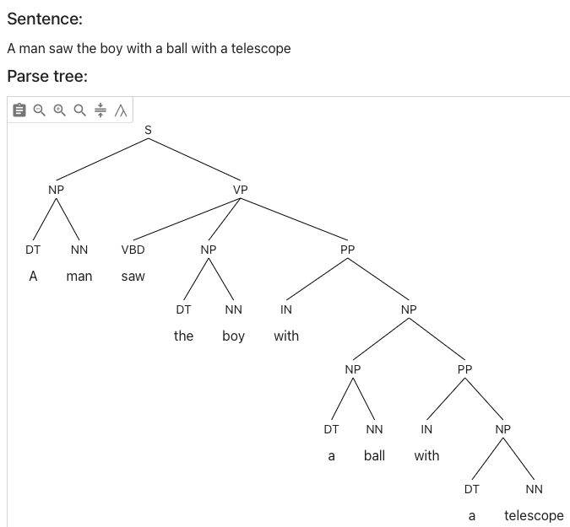
Homework 4 aside
https://parser.kitaev.io
What's the problem with this parse?

Slide 4
Homework 4 aside
https://cloud.google.com/natural-language

Slide 5
Homework 4 aside

Slide 6
Homework 4 aside
Stacking:

Slide 7
ChatGPT and Anaphora Resolution
Two examples from (Reuland 2011) ¹
Alice looked at the Queen. She was angry. (pg4)
¹Reuland, E., Anaphora and Language Design (2011), MIT Press.

Slide 8
ChatGPT and Anaphora Resolution
Alice looked at the Queen. She was angry. (pg4)

Slide 9
ChatGPT and Anaphora Resolution
Two examples from (Reuland 2011) ¹
Alice looked at the Queen. She was angry. (pg4)
The white rabbit jumped from behind the bushes. (pg26)
The animal looked around and then he ran away to avoid the angry queen.
Who ran away?
¹Reuland, E., Anaphora and Language Design (2011), MIT Press.

Slide 10
ChatGPT and Anaphora Resolution
The white rabbit jumped from behind the bushes. (Reuland 2011: 26)
The animal looked around and then he ran away to avoid the angry queen.

Slide 11
ChatGPT and Anaphora Resolution
The white rabbit jumped from behind the bushes. (Reuland 2011: 26)
The animal looked around and then he ran away to avoid the angry queen.
the expressions the white rabbit, the animal. and he easily receive the same value. For he, for instance, a reading where it gets the same value as the animal/the white rabbit is highly preferred.

Slide 12
ChatGPT and Anaphora Resolution
Let's modify the 2nd example a bit:
The animal was looking around nervously. Suddenly the white rabbit jumped from behind the bushes.
and ask:
Here the rabbit is preferred to have a value different from the animal.

Slide 13
ChatGPT and Control Verbs
Choice:
X promised Y [PRO to do something]
X ordered Y [PRO to do something]
PRO is the subject of the non-finite clause (to do something)
what grammatical knowledge about the difference in verb meanings do we have?
promise is a subject control verb (PRO = X)
order is an object control verb (PRO = Y)

Slide 14
ChatGPT and Control Verbs
Example (object control verb):
The caterpillar asked Alice [PRO to go away]. (Reuland 2011: 45)

Slide 15
ChatGPT and Control Verbs
Example (subject control verb):
The caterpillar promised Alice [PRO to go away].

Slide 16
ChatGPT and Control Verbs
Example (object control verb):
The caterpillar ordered Alice [PRO to go away].

Slide 17
ChatGPT and Control Verbs
Example (object control verb):
The caterpillar ordered Alice [PRO to go away].
Doesn't work in this case!
Asking the right question is key

Slide 18
ChatGPT and Anaphora Resolution

Slide 19
Homework 4 Questions?
nl3.prolog was modified live in class:
s(s(NP, VP)) --> np(NP), vp(VP).
np(np(DET, NN)) --> det(DET, NUM), nn(NN, NUM).
det(dt(the), sg) --> [the].
det(dt(the), pl) --> [the].
det(dt(a), sg) --> [a].
nn(nn(man), sg) --> [man].
nn(nn(men), pl) --> [men].
nn(nn(ball), sg) --> [ball].
vp(vp(VTR, NP)) --> vtr(VTR), np(NP).
vtr(vbd(kick_ed)) --> [kicked].
vtr(vbd(hit_ed)) --> [hit].
That modified grammar is the source for the homework.
I called it last lecture nl5.prolog

Slide 20
nl5.prolog (last time)
Live programming
Let's add to nl3.prolog so we can parse:
John saw the boy with a telescope
Need to add:
verb (VBD): saw – past tense (-ed)
preposition (IN): with
singular nouns (NN): telescope, boy, limp
proper noun (NNP): john ('John'), mary – initial caps = variable
Need to add:
PP attachment to NP and VP rules

Slide 21
Homework 4 Questions?

