Slide 1
LING/C SC 581: Advanced Computational Linguistics
Lecture 7

Slide 2
Today's Topic
Leaving the topic of context-sensitive languages
Turn to writing our own CFGs for natural language:
agreement in natural language
the problem with Prolog & left recursion
a grammar transformation:
left recursive to right recursive BUT structure preserving
Homework 4 (note deadline)

Slide 3
nl1.prolog
Example (nl1.prolog):
s --> np, vp.
np --> det, nn.
det --> [the] | [a].
nn --> [man] | [ball].
vp --> vtr, np.
vtr --> [kicked] | [hit].
?- [nl1].
true.
?- s([the,man,kicked,the,ball], []).
true ;
false.
?- s([the,man,kicked,the,ball,into,touch], List).
List = [into, touch] ;
false.

Slide 4
nl1.prolog
Enumerate the language:
?- s(List, []).
List = [the, man, kicked, the, man] ;
List = [the, man, kicked, the, ball] ;
List = [the, man, kicked, a, man] ;
List = [the, man, kicked, a, ball] ;
List = [the, man, hit, the, man] ;
List = [the, man, hit, the, ball] ;
List = [the, man, hit, a, man] ;
List = [the, man, hit, a, ball] ;
List = [the, ball, kicked, the, man] ;
List = [the, ball, kicked, the, ball] ;
List = [the, ball, kicked, a, man] ;
List = [the, ball, kicked, a, ball] ;
List = [the, ball, hit, the, man] ;
List = [the, ball, hit, the, ball] ;
List = [the, ball, hit, a, man] ;
List = [the, ball, hit, a, ball] ;
List = [a, man, kicked, the, man] ;
List = [a, man, kicked, the, ball] ;
List = [a, man, kicked, a, man] ;
List = [a, man, kicked, a, ball] ;
List = [a, man, hit, the, man] ;
List = [a, man, hit, the, ball] ;
List = [a, man, hit, a, man] ;
List = [a, man, hit, a, ball] ;
List = [a, ball, kicked, the, man] ;
List = [a, ball, kicked, the, ball] ;
List = [a, ball, kicked, a, man] ;
List = [a, ball, kicked, a, ball] ;
List = [a, ball, hit, the, man] ;
List = [a, ball, hit, the, ball] ;
List = [a, ball, hit, a, man] ;
List = [a, ball, hit, a, ball].

Slide 5
nl2.prolog
Recovering a parse tree
we use a term data structure for the tree
simple transformation: adding an extra argument to all nonterminals
Example (nl2.prolog):
s(s(NP, VP)) --> np(NP), vp(VP).
np(np(DET, NN)) --> det(DET), nn(NN).
det(dt(the)) --> [the].
det(dt(a)) --> [a].
nn(nn(man)) --> [man].
nn(nn(ball)) --> [ball].
vp(vp(VTR, NP)) --> vtr(VTR), np(NP).
vtr(vbd(kick_ed)) --> [kicked].
vtr(vbd(hit_ed)) --> [hit].
Basic transformation:
x --> y, z.
x(x(Y, Z)) --> y(Y), z(Z).
Note: I can return any term I like

Slide 6
nl2.prolog
Example:
?- [nl2].
true.
?- s(Parse, [the, man, kicked, the, ball], []).
Parse = s(np(dt(the), nn(man)), vp(vbd(kick_ed), np(dt(the), nn(ball)))).

Slide 7
SWISH
https://swish.swi-prolog.org
:- use_rendering(svgtree, [list(false)]).

Slide 8
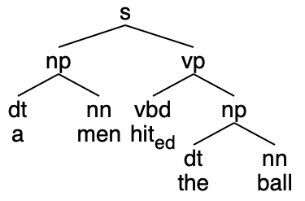
Extra Arguments: Agreement
Idea:
We can also use an extra argument to impose constraints between constituents within a DCG rule
Example:
English number agreement between DT and NN
Data:
the man the men
a man *a men
Lexical Features (Number):
man value singular (sg)
men value plural (pl)
the value singular or plural (sg/pl)
a value singular (sg)
*
* means ungrammatical

Slide 9
Extra Arguments: Agreement
Example (nl3.prolog):
s(s(NP, VP)) --> np(NP), vp(VP).
np(np(DET, NN)) --> det(DET, NUM), nn(NN, NUM).
det(dt(the), sg) --> [the].
det(dt(the), pl) --> [the].
det(dt(a), sg) --> [a].
nn(nn(man), sg) --> [man].
nn(nn(men), pl) --> [men].
nn(nn(ball), sg) --> [ball].
vp(vp(VTR, NP)) --> vtr(VTR), np(NP).
vtr(vbd(kick_ed)) --> [kicked].
vtr(vbd(hit_ed)) --> [hit].

Slide 10
Extra Arguments: Agreement
Note:
Use of the extra argument NUM for agreement here is basically “syntactic sugar” and lends no more expressive power to the grammar rule system
i.e. we can enforce agreement without the use of the extra argument at the cost of writing more rules
Instead of
np(np(DET, NN)) --> det(DET, NUM), nn(NN, NUM).
we could have encoded NUM into the nonterminal name:
np(np(DET, NN)) --> det_sg(DET), nn_sg(NN).
np(np(DET, NN)) --> det_pl(DET), nn_pl(NN).
det_sg(dt(the)) --> [the].
det_pl(dt(the)) --> [the].
det_sg(dt(a)) --> [a].
nn_sg(nn(man)) --> [man].
nn_pl(nn(men)) --> [men].
nn_sg(nn(ball)) --> [ball].
nl4.prolog

Slide 11
Left recursion and Prolog grammars
Left recursive grammars:
given Prolog’s left-to-right depth-first computation rule, left recursive rules are a no-no …
s
x
x
6.7 million calls later
Example (left.prolog):
s --> x, y.
x --> x, [a].
x --> [a].
y --> [b].
rule for nonterminal x
immediately calls x again!
x
x
...

Slide 12
Left recursion and Prolog grammars
Example (left.prolog):
s --> x, y.
x --> x, [a].
x --> [a].
y --> [b].
An idea (swap rules 2 and 3):
s --> x, y.
x --> [a].
x --> x, [a].
y --> [b].
(left2.prolog)
; eventually calls for stacking rule 3.
12 million deep

Slide 13
Big picture question
Is this just a theoretical problem: i.e. not a problem for natural language grammars?
Unfortunately it is a problem …
John saw the boy with a telescope
is structurally ambiguous wrt. attachment of the PP with a telescope
(PP = prepositional phrase)

Slide 14
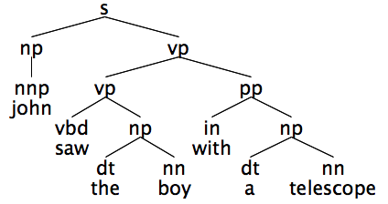
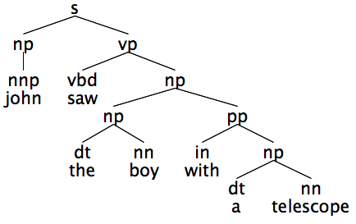
Preposition Phrase (PP) Attachment
The preferred syntactic analysis is a left recursive parse
Example:
John saw the boy with a telescope
Rules are:
vp --> vp, pp.
np --> np, pp.
with_{instrument}
with_{possessive}

Slide 15
Preposition Phrase (PP) Attachment
https://parser.kitaev.io
https://cloud.google.com/natural-language
Incorrect rule used:
vp --> vbd, np, pp.
dependency parse (essentially same problem):
root is saw
root --> prep
root --> dobj.

Slide 16
nl5.prolog
Live programming
Let's add to nl3.prolog so we can parse:
John saw the boy with a telescope
Need to add:
verb (VBD): saw – past tense (-ed)
preposition (IN): with
singular nouns (NN): telescope, boy, limp
proper noun (NNP): john ('John'), mary – initial caps = variable
Need to add:
PP attachment to NP and VP rules

Slide 17
Penn Part-of-Speech (POS)Tagset
Jurafsky & Martin ed3. draft

Slide 18
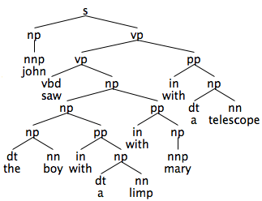
Preposition Phrase (PP) Attachment
The preferred syntactic analysis is a left recursive parse
notice we can “stack” the PPs, as in:
John saw the boy with a limp with Mary with a telescope
with-ambiguity:
with_{possessive} ,
with_{accompaniment},
with_{instrument}

Slide 19
Preposition Phrase Attachment
Linguistically:
PP (recursively) adjoins to NP or VP
np(np(NP,PP)) --> np(NP), pp(PP).
vp(vp(VP,PP)) --> vp(VP), pp(PP).
Left recursion gives Prolog problems
Derivation (top-down, left-to-right):
vp
vp pp
vp pp pp
vp pp pp pp
vp pp pp pp pp infinite loop…
Note:
only the parse tree argument shown here
other extra arguments are possible

Slide 20
Transformation
Apply the general left to right recursive transformation:
to the NP rules:
np(np(DT,NN)) --> dt(DT,Number), nn(NN,Number).
np(np(NP,PP)) --> np(NP), pp(PP).
Note:
w is a fresh
nonterminal
that takes 2
arguments
x(X) --> [z], w(X,x(z)).
x(x(z)) --> [z].
w(W,X) --> [y], w(W,x(X,y)).
w(x(X,y),X) --> [y].
x(x(X,y)) --> x(X), [y].
x(x(z)) --> [z].
[z]
[y]
x is the recursive nonterminal
x
x

Slide 21
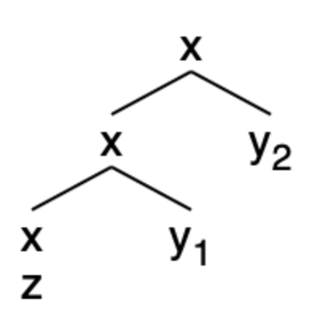
Transformation
Consider input strings: Parse: Transformed rules:
[z] x(z) 2
[z, y] x(x(z),y) 1 + 4
[z, y₁, y₂] x(x(x(z),y₁),y₂) 1 + 3 + 4
x(x(X,y)) --> x(X), [y].
x(x(z)) --> [z].
x(X) --> [z], w(X,x(z)).
x(x(z)) --> [z].
w(W,X) --> [y], w(W,x(X,y)).
w(x(X,y),X) --> [y].
Steps for example 3:
[z, ●y₁, y₂] rule 1: call nonterminal w(X,x(z))
[z, y₁, ●y₂] rule 3: call nonterminal w(X,x(x(z),y₁))
[z, y₁, y₂●] rule 4: answer X = x(x(x(z),y₁),y₂)
the left recursive structure
formed by a right recursive
parse of [z, y₁, y₂]

Slide 22
Homework 4
Q1: apply the transformation to the left recursion in nl5.prolog:
np(np(NP,PP)) --> np(NP), pp(PP).
vp(vp(VP,PP)) --> vp(VP), pp(PP).
Show your grammar working properly on example sentences:
the boy saw the man with the telescope
the boy with the telescope saw the man
the boy kicked the man with the telescope
the boy with the telescope kicked the man
the boy with the telescope kicked the man with the limp
Show all possible parses (;) until false in each case
Q2: suggest a way to limit overgeneration (no need to implement)

Slide 23
Homework 4
Hint #1: consider the case when there are multiple base rules for x
x(x(X,y)) --> x(X), [y].
x(x(z)) --> [z].
x(x(w)) --> [w].
Hint #2: w must be a fresh nonterminal, i.e. cannot be shared between the NP and VP recursions. Why?
You can ask questions about the homework in class Tuesday

Slide 24
Homework 4
Submit to sandiway@arizona.edu
SUBJECT: 581 Homework 4 YOUR NAME
One PDF file (for grading)
include your grammar code and SWI-Prolog screenshots in your answer
Attach (if I need to run your code):
source code for your grammar
Deadline:
midnight Wednesday (assume HW needs more time)
we will review the homework on Thursday

