Slide 1
LING/C SC 581: Advanced Computational Linguistics
Lecture 5

Slide 2
Today's Topics
Three ways to handle the CS language {a^{n}b^{n}c^{n} | n>0}
CFG (context-free grammar) + extra arguments for grammatical constraints
CFG + counting, cf. Perl
CSG (context-sensitive grammar) rules
Homework 3

Slide 3
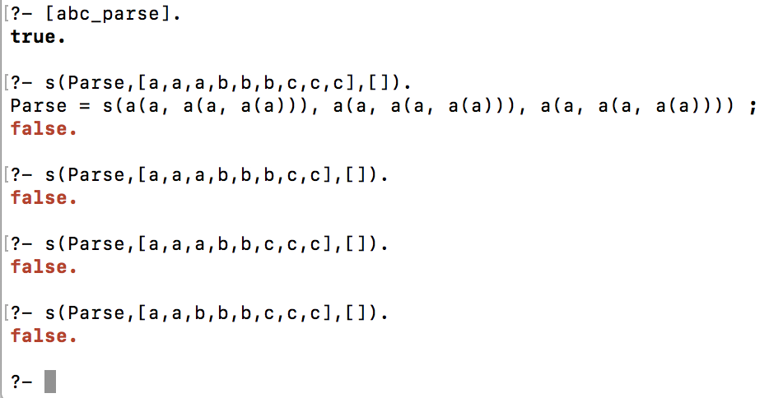
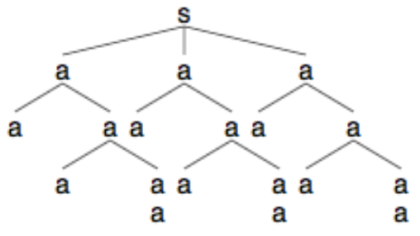
Extra arguments
abc_parse.prolog: a CFG+EA for a^{n}b^{n}c^{n} :
Set membership question

Slide 4
Extra arguments
Consider the following context-free grammar (CFG) + an extra argument for each nonterminal`:
s(s(A,A,A)) --> a(A), b(A), c(A).
a(a(a)) --> [a].
a(a(a,X)) --> [a], a(X).
b(a(a)) --> [b].
b(a(a,X)) --> [b], b(X).
c(a(a)) --> [c].
c(a(a,X)) --> [c], c(X).
Rules 2 & 3
Rules 4 & 5
Rules 6 & 7

Slide 5
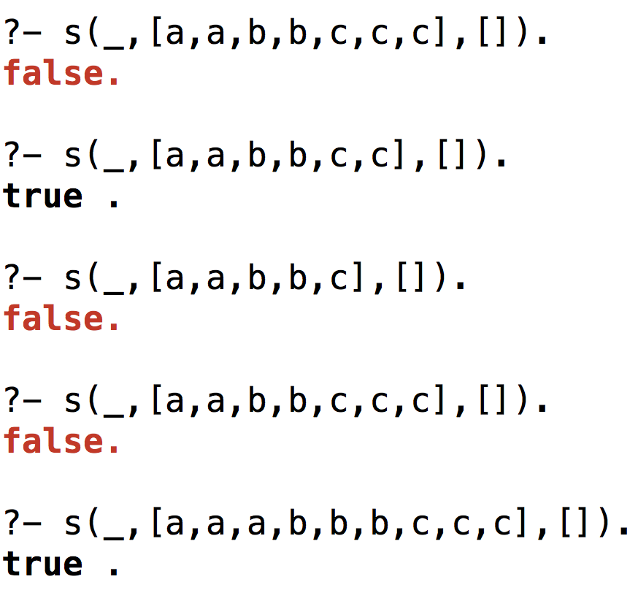
Extra arguments
A CFG+EA for a^{n}b^{n}c^{n} n>0:
Set membership question
Note: underscore (_) means don't report
(the value of the parse term argument)

Slide 6
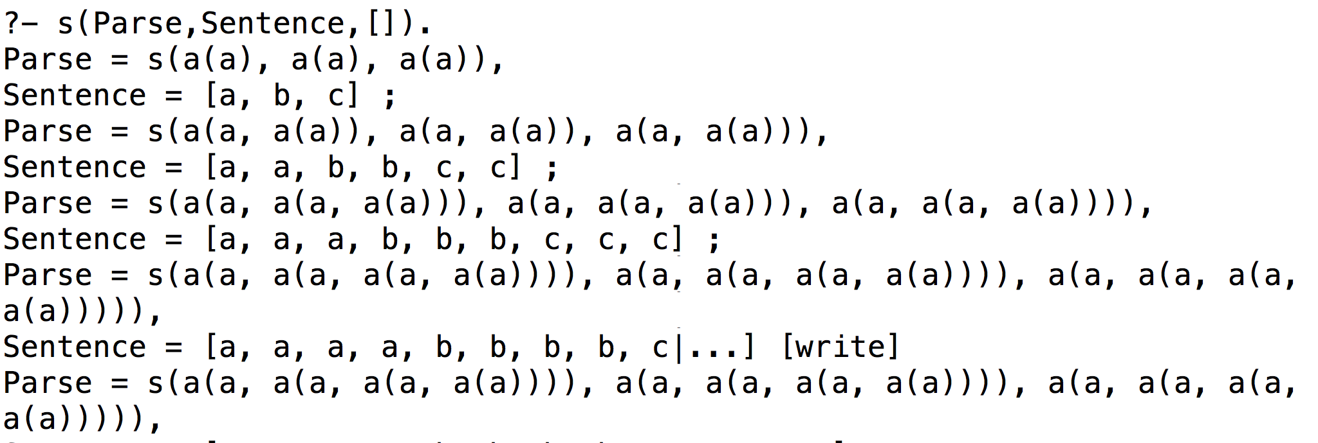
Extra arguments
A CFG+EA grammar for a^{n}b^{n}c^{n} n>0:
Set enumeration

Slide 7
Language {a^{n}b^{n}c^{n} | n>0}
CFG (context-free grammar) + extra arguments for grammatical constraints
CFG + counting, cf. Perl regex with code inserts
CSG (context-sensitive grammar) rules

Slide 8
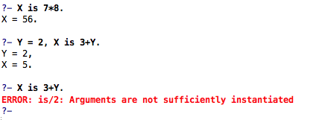
Another grammar for {a^{n}b^{n}c^{n}|n>0}
Use Prolog’s arithmetic predicates directly.
{ … } embeds Prolog code inside grammar rules
These are not nonterminal or terminal symbols.
Used in grammar rules, we must enclose these
statements within curly braces.
Recall (?{… Perl code …})

Slide 9
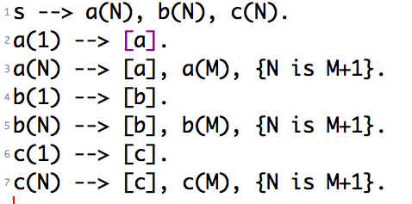
Another Grammar for {a^{n}b^{n}c^{n}|n>0}
Explicit computation of the number of a’s using arithmetic.
{ … } embeds Prolog code inside grammar rules
value for M must be known for N to be computed
Illegal to write:
a(N) --> [a], {N is M+1}, a(M).

Slide 10
Another Grammar for {a^{n}b^{n}c^{n}|n>0}
Parsing the a’s

Slide 11
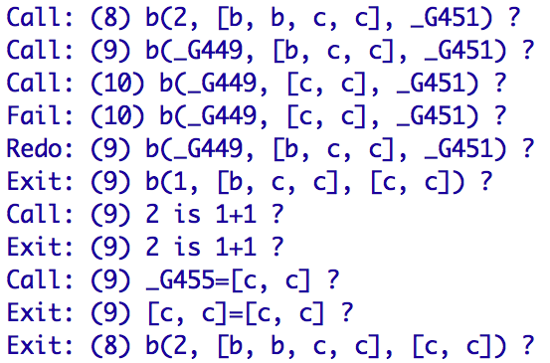
Another Grammar for {a^{n}b^{n}c^{n}|n>0}
Computing the b’s

Slide 12
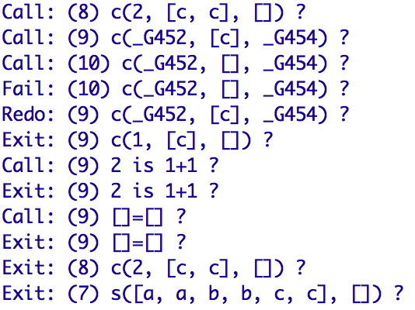
Another Grammar for {a^{n}b^{n}c^{n}|n>0}
Computing the c’s

Slide 13
Another grammar for {a^{n}b^{n}c^{n} | n>0}
Grammar is “correct” – it answers the set membership question, but it's not so efficient…
consider string [a,a,b,b,b,b,b,b,b,c,c]
s --> a(X), b(X), c(X).
a(1) --> [a].
a(N) --> [a], a(M), {N is M+1}.
b(1) --> [b].
b(N) --> [b], b(M), {N is M+1}.
c(1) --> [c].
c(N) --> [c], c(M), {N is M+1}.
counts upwards
could change to
count down from value computed by a(N).

Slide 14
Another grammar for {a^{n}b^{n}c^{n} | n>0}
Comparison:
?- time(s([a,a,b,b,b,b,b,b,b,c,c],[])).
% 38 inferences, 0.000 CPU in 0.000 seconds (69% CPU, 603175 Lips)
false.
?- [abc_count2].
true.
?- time(s([a,a,b,b,b,b,b,b,b,c,c],[])).
% 9 inferences, 0.000 CPU in 0.000 seconds (71% CPU, 145161 Lips)
false.
down counter for b's and c's

Slide 15
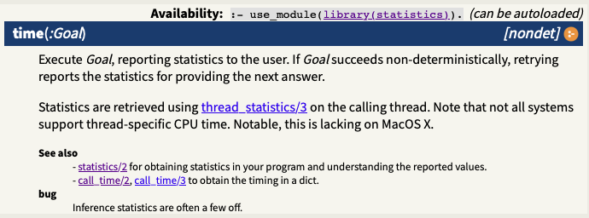
Predicate time/1
arity 1
(takes one argument)
Documentation:
https://www.swi-prolog.org/pldoc/man?predicate=time/1

Slide 16
Language {a^{n}b^{n}c^{n}|n>0}
CFG (context-free grammar) + extra arguments for grammatical constraints
CFG + counting, cf. Perl
CSG (context-sensitive grammar) rules

Slide 17
A context-sensitive grammar for {a^{n}b^{n}c^{n} | n>0}
Non-contracting grammar definition
A CSG (type-1) has rules of the form LHS → RHS
such that both LHS and RHS can be arbitrary strings of terminals and non-terminals, and
|RHS| ≥ |LHS| (without this restriction: type-0)
Notation:
|symbols| = # symbols
exception: permit S → ε, in Prolog s --> []., assuming S doesn't appear on the RHS of any rule

Slide 18
A context-sensitive grammar for {a^{n}b^{n}c^{n}|n>0}
Context-sensitive definition
Consider a context-free rule of the form N → γ
N a single nonterminal
γ a nonempty string of terminals and nonterminals
Then a CSG rule has the form αNβ → αγβ
α, β are strings of terminals and nonterminals (possibly empty)
exception: S → ε (assuming S doesn't appear on the RHS of any rule)

Slide 19
A context-sensitive grammar for {a^{n}b^{n}c^{n} | n>0}
SWI Prolog permits some quirky extensions to the DCG rules:
General format: LHS --> RHS.
LHS must begin with a nonterminal.
Cannot have a CS rule like [a], a --> [a]. still sufficient to encode a lot.
Rest of LHS could be anything…
Examples:
s --> a, b.
a, b --> [c].
a --> [a].
a --> [a], a.
b --> [b].
s --> a, b.
a, b --> [c].
a, [a], b --> [d].
a --> [a].
a --> a, [a].
b --> [b].
s --> a, b.
a --> [a].
b --> [b].
[a], b --> [c].
ERROR: No permission to define dcg_nonterminal `[a]'

Slide 20
A context-sensitive grammar for {a^{n}b^{n}c^{n}|n>0}
This is almost a normal Prolog DCG (abc_cs.prolog):
(but rules 5 & 6 have more than only a single non-terminal on the LHS, ∴ not context-free):
s --> [a,b,c].
s --> [a],a,[b,c].
a --> [a,b], c.
a --> [a],a,[b],c.
c,[b] --> [b], c.
c,[c] --> [c,c].
satisfies noncontracting constraint
Note: rules 5 and 6 are responsible
for shuffling the c's to the end

Slide 21
A context-sensitive grammar for {a^{n}b^{n}c^{n}|n>0}
Case: n = 1
s --> [a,b,c].
s --> [a],a,[b,c].
a --> [a,b], c.
a --> [a],a,[b],c.
c,[b] --> [b], c.
c,[c] --> [c,c].
Rule 1 suffices.

Slide 22
A context-sensitive grammar for {a^{n}b^{n}c^{n}|n>0}
Case: n = 2
s --> [a,b,c].
s --> [a],a,[b,c].
a --> [a,b], c.
a --> [a],a,[b],c.
c,[b] --> [b], c.
c,[c] --> [c,c].
Note: list notation
[a,b,c] is short for [a],[b],[c]
[b,c] is short for [b], [c]
etc.
Sentential forms:
(expanding items in red)
s
[a], a, [b,c] (rule 2)
[a], [a,b], c, [b,c] (rule 3)
[a,a,b], c, [b],[c] (list notation)
[a,a,b], [b], c, [c] (rule 5)
[a,a,b], [b], [c,c] (rule 6)
[a,a,b,b,c,c] (list notation)

Slide 23
A context-sensitive grammar for {a^{n}b^{n}c^{n}|n>0}
Case: n = 3
s --> [a,b,c].
s --> [a],a,[b,c].
a --> [a,b], c.
a --> [a],a,[b],c.
c,[b] --> [b], c.
c,[c] --> [c,c].
Note: list notation
[a,b,c] is short for [a],[b],[c]
[b,c] is short for [b], [c]
etc.
s
[a], a, [b,c] (rule 2)
[a], [a,b], c, [b,c] (rule 3)
[a], [a],a,[b],c, [b,c] (rule 4)
[a,a], [a,b],c, [b], c,[b,c] (rule 3)
[a,a], [a,b],[b],c, c,[b,c] (rule 5)
[a,a,a,b,b],c, [b],c, [c] (rule 5)
[a,a,a,b,b], [b],c, c, [c] (rule 5)
[a,a,a,b,b], [b],c, [c,c] (rule 6)
[a,a,a,b,b], [b],[c,c],[c] (rule 6)
[a,a,a,b,b,b,c,c,c]

Slide 24
A context-sensitive grammar for {a^{n}b^{n}c^{n}|n>0}
?- listing([s,a,c]).
s([a, b, c|A], A).
s([a|A], C) :- a(A, B), B=[b, c|C].
a([a, b|A], B) :- c(A, B).
a([a|A], D) :- a(A, B), B=[b|C], c(C, D).
c(A, C) :- A=[b|B], c(B, D), C=[b|D].
c([c, c|A], [c|A]).
Difference lists
s(List1, List2)
?-s([a,b,c],[])
List1 List2 Difference
[1,2,3] [3] => [1,2]
[1,2,3,4,5] [5] => [1,2,3,4]
[1,2,3,4,5] [4,5] => [1,2,3]
s --> [a,b,c].
s --> [a],a,[b,c].
a --> [a,b], c.
a --> [a],a,[b],c.
c,[b] --> [b], c.
c,[c] --> [c,c].

Slide 25
A context-sensitive grammar for {a^{n}b^{n}c^{n}|n>0}
c,[c] --> [c,c]. c([c, c|A], [c|A]).
Grammar rule says:
nonterminal c gets expanded into terminal c when the nonterminal c is followed by a terminal c
cf. context-free counterpart c --> [c].
Prolog code says:
nonterminal c expands into terminal c
Input: [c,c, …] (green is right context, but not part of
Output: [c, …] nonterminal c expansion)

Slide 26
A context-sensitive grammar for {a^{n}b^{n}c^{n}|n>0}
c,[b] --> [b], c. c(A, C) :- A=[b|B], c(B, D), C=[b|D].
Grammar rule says:
flip order of nonterminal c and terminal b
Prolog code says:
A, B, C and D are lists
Example: Example:
Input: [b,…c…, …] (A) [b,c,c] [b,b,c,c,c]
Call c: […c…, …] (B) [c,c] [b,c,c,c]
Exit c: [ …] (D) [c] [b,c,c]
Output: [b,…] (C) [b,c] [b,b,c,c]
list A with
sub-lists at B and D
↑ | b | ↑ | … c … | ↑ | … rest of string …
A |  | B |  | D

Slide 27
Homework 3
Consider the DCG counting grammar described in class for {a^{n}b^{n}c^{n} | n>0}, i.e. the one with arithmetic rules such as:
a(1) --> [a].
a(N) --> [a], a(M), {N is M+1}.
Question 1:
This grammar counts "up", i.e. the more a's seen, the higher the count.
Suggested in class that a more efficient grammar (measured using time/1) could be built to reject strings not in the grammar by counting down the b's and c's.
Give this grammar.
Show your grammar working and compared to abc_count.prolog for inputs:
[a,a,b,b,b,b,b,b,b,b,c,c] (8 b's)
[a,a,b,b,b,b,b,b,b,b,b,b,b,b,b,b,b,b,c,c] (16 b's)

Slide 28
Homework 3
a grammar rule could contain true/false expressions like {X >= 0}
https://www.swi-prolog.org/pldoc/man?section=arith

Slide 29
Homework 3
a grammar rule could contain true/false expressions like {X is Y + Z}
Note: {X is X + 1} is always false, cf. Python X = X + 1, X += 1
?- X = 1, X is X+1.
false.

Slide 30
Homework 3
Question 2:
Give a counting DCG for {a^{n}b^{2n}c^{n+1} | n>0}
It should accept inputs such as:
abbcc
aabbbbccc
aaabbbbbbcccc
but reject inputs such as:
aabbcc
aabbbccc
aaabbbbbbccc
Show your grammar working

Slide 31
Homework 3
Submit to sandiway@arizona.edu
SUBJECT: 581 Homework 3 YOUR NAME
One PDF file (for grading)
include your grammar code and SWI-Prolog screenshots in your answer
Attachments (if I need to run your code):
source code for the two grammars
Deadline:
midnight Monday
we will review the homework on Tuesday

