Slide 1
LING/C SC 581: Advanced Computational Linguistics
Lecture 4

Slide 2
Today's Topic
Homework 2 Review
We must refamiliarize ourselves with Prolog
Definite Clause Grammars (DCG) quick review
introduced last semester
538 lectures 24–27 (see course website)
Where we are going – context-sensitive grammars (CSG's)

Slide 3
Homework 2 review
Garden path sentence:
humans initially mis-parse the sentence but eventually find the intended reading.
Q1: Explain why this is a garden path sentence:
The old man the boat
Which word causes the garden path?

Slide 4
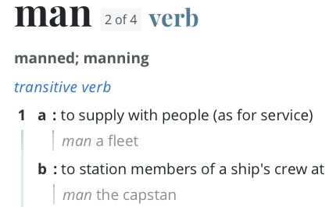
Homework 2 review
Which word causes the garden path?
The old man the boat
Merriam Webster online:
https://www.merriam-webster.com/dictionary/man

Slide 5
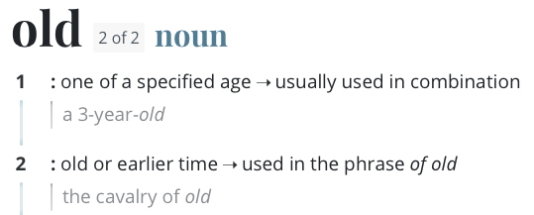
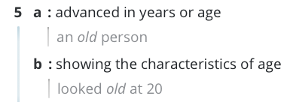
Homework 2 review
Which word causes the garden path?
The old man the boat
Merriam Webster online:
https://www.merriam-webster.com/dictionary/man

Slide 6
Homework 2 review
many explanations exist on the internet!
ChatGPT knows about garden path sentences

Slide 7
Homework 2 review
https://en.wikipedia.org/wiki/Garden-path_sentence
Why do we garden path?
Possible explanation:
frequency of sequence DET ADJ NOUN blocks possibility that NOUN is also a VERB

Slide 8
Homework 2

Slide 9
Convincing ChatGPT it is wrong
Involves Knowledge of Language we take for granted:
verbs vs. nouns
word senses
notion of a grammatical relation
notion of a grammatical function
what are these precisely?
does ChatGPT understand them?

Slide 10
Chomsky LGB (1980)
GFs: subject-of, object-of

Slide 11
Chomsky LGB (1980)
configurationally defined [_{S} NP …], [_{VP} NP …]

Slide 12
Homework 2

Slide 13
Convincing ChatGPT it is wrong
More informally, some of you used terms like:
hidden verb
culprit
etc.

Slide 14
Homework 2

Slide 15
Microsoft CoPilot (uses ChatGPT 4)

Slide 16
SWI Prolog Cheatsheet
At the prompt ?-
halt. ^D
listing. listing(name).
[filename]. loads filename.pl
trace.
notrace.
debug.
nodebug.
spy(name).
pwd.
working_directory(_,Y).
switch directories to Y
Anytime
^C (then a(bort) or h(elp) for other options)
Notation:
\+ negation
, conjunction
; disjunction
:- if
Facts:
predicate(Args).
Rules:
p(Args) :- q(Args) ,.., r(Args).
Data structures:
list: [a,..b]
empty list: []
head/tail: [head|List]
Atom:
name, number
Term:
functor(arguments)
arguments: comma-separated terms/atoms

Slide 17
Derivations
Prolog’s computation rule:
Try first matching (grammar) rule in the database
(but remember other possibilities for backtracking)
Backtrack if matching rule leads to failure (or if asked by the user typing ;)
Auto-management of alternative possibilites:
undo variable bindings (i.e. undo assignments) and try next matching rule
For grammars:
Top-down left-to-right derivations
left-to-right = expand leftmost nonterminal first
Leftmost expansion done recursively = depth-first

Slide 18
Definite Clause Grammars (DCG)
a grammar is code, could be a recognizer program:
no need to write a separate grammar rule interpreter (in this case)
Example query
?- s([a,a,b,b,b],[]). Yes
Note:
Syntax of DCGs:
---> "expands to"
terminal symbol enclosed in square brackets: [terminal]
non-terminal symbol, otherwise
Query uses the start symbol s with two arguments:
(1) sequence (as a list) to be recognized and
(2) the empty list []
Grammar for a⁺b⁺
apbp.prolog:
1. s --> [a],b.
2. b --> [a],b.
3. b --> [b],c.
4. b --> [b].
5. c --> [b],c.
6. c --> [b].

Slide 19
Definite Clause Grammars (DCG)
Infinite Loop:
Doesn't enumerate at all!

Slide 20
Definite Clause Grammars (DCG)
Partial enumerator only! Why?

Slide 21
Definite Clause Grammars (DCG)
type w

Slide 22
Extra Argument: Parse Tree
Recovering a parse tree
when want Prolog to return more than just true/false answers
in case of true, we can compute a syntax tree representation of the parse
by adding an extra argument to nonterminals
Example (sheeptalk.prolog)
DCG (non-regular, context-free):
s --> [b], [a], a, [!].
a --> [a]. (base case)
a --> [a], a. (recursive case)
s
b
a
a
!
a
a
a

Slide 23
Extra Argument: Parse Tree
want Prolog to return more than just true/false answers
$ swipl
Welcome to SWI-Prolog (threaded, 64 bits, version 9.0.4)
?- [sheeptalk].
true.
?- s(String, []).
String = [b, a, a, !] ;
String = [b, a, a, a, !] ;
String = [b, a, a, a, a, !] ;
String = [b, a, a, a, a, a, !] .
?- s([b,a,a,!], []).
true ;
false.
?- s([m,o,o,!], []).
false.

Slide 24
Extra Argument: Parse Tree
s
Prolog term data structure:
hierarchical
allows sequencing of arguments
functor(arg₁,..,arg_{n})
each arg_{i} could be another term or simple atom
Tree:
b
a
a
!
a
a
a
s(b,a,a(a,a(a)),!)

Slide 25
Extra Arguments: Parse Tree
Sheeptalk DCG
s --> [b],[a], a, [!].
a --> [a]. (base case)
a --> [a], a. (right recursive case)
s
b
a
a
!
base case
a --> [a].
a(subtree) --> [a].
a(a(a)) --> [a].
a
a
a
s(b,a,a(a,a(a)),!)
recursive case
a --> [a], a.
a(subtree) --> [a], a(subtree).
a(a(a,A)) --> [a], a(A).
Idea: for each nonterminal, add an argument to store its subtree

Slide 26
Extra Arguments: Parse Tree
Prolog grammar
s --> [b], [a], a, [!].
a --> [a]. (base case)
a --> [a], a. (right recursive case)
s
b
a
a
!
base and recursive cases
a(a(a)) --> [a].
a(a(a,A)) --> [a], a(A).
a
a
a
start symbol case
s --> [b], [a], a, [!].
s(tree) --> [b], [a], a(subtree), [!].
s(s(b,a,A,!) ) --> [b], [a], a(A), [!].
s(b,a,a(a,a(a)),!)

Slide 27
Extra Arguments: Parse Tree
Prolog grammar
sheeptalk.prolog
s --> [b], [a], a, [!].
a --> [a]. (base case)
a --> [a], a. (right recursive case)
Equivalent Prolog grammar computing a parse
sheeptalk2.prolog
s(s(b,a,A,!)) --> [b], [a], a(A), [!].
a(a(a)) --> [a].
a(a(a,A)) --> [a], a(A).

Slide 28
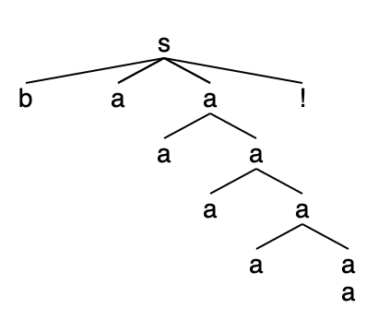
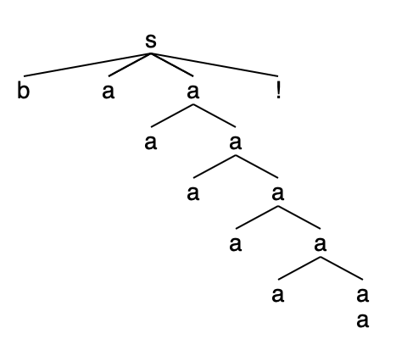
Extra Arguments: Parse Tree
?- [sheeptalk2].
true.
?- s(Parse, String, []).
Parse = s(b, a, a(a), !),
String = [b, a, a, !] ;
Parse = s(b, a, a(a, a(a)), !),
String = [b, a, a, a, !] ;
Parse = s(b, a, a(a, a(a, a(a))), !),
String = [b, a, a, a, a, !] ;
Parse = s(b, a, a(a, a(a, a(a, a(a)))), !),
String = [b, a, a, a, a, a, !] ;
Parse = s(b, a, a(a, a(a, a(a, a(a, a(a))))), !),
String = [b, a, a, a, a, a, a, !] .

Slide 29
Extra Arguments: Parse Tree
?- [sheeptalk2].
true.
?- s(Parse, [b,a,a,!], []).
Parse = s(b, a, a(a), !) ;
false.
?- s(Parse, [m,o,o,!], []).
false.

Slide 30
Extra Arguments
Extra arguments are powerful
they allow us to impose (grammatical) constraints and change the expressive power of the system
if used as read-able memory
Example:
a^{n}b^{n}c^{n} n>0 is not a context-free language (type-2, Chomsky hierarchy)
i.e. you cannot write rules of the form X --> RHS that generate this language
in fact, it's context-sensitive (type-1, Chomsky hierarchy)

