Slide 1
LING/C SC 581: Advanced Computational Linguistics
Lecture 3

Slide 2
Today's Topics
Continuing the Large Language Model lecture, see previous slides.
Homework 2

Slide 3
Homework 2
Garden path sentence:
humans initially mis-parse the sentence but eventually find the intended reading.
Q1: Explain why the sentence
The old man the boat
is a garden path sentence.
Which word causes the garden path?

Slide 4
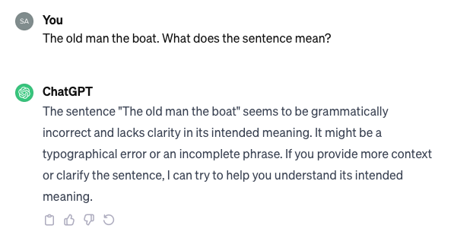
Homework 2
Let's use ChatGPT (openai.com)
Q2: is ChatGPT correct about "grammatically incorrect"? Explain.

Slide 5
Homework 2
Q3: Can you provide ChatGPT with more context or clarify the garden path sentence (without giving it the solution) so it can deduce the intended meaning?
Even if you cannot persuade ChatGPT, make sure you try a number of times/approaches.
Screenshot your interaction with ChatGPT

Slide 6
Homework 2
Submit to sandiway@arizona.edu
SUBJECT: 581 Homework 2 YOUR NAME
One PDF file only
include ChatGPT screenshots in your answer
Deadline:
midnight Monday
we will review the homework on Tuesday

