Slide 1
LING/C SC 581: Advanced Computational Linguistics
Lecture 28

Slide 2
Today's Topic
Example of an experimental project using Python and nltk:
a "pipeline":
get corpus data
split into sentences
tokenize sentences: spaCy vs. nltk
parse sentences (using the Berkeley Neural Parser)
extract verb frames (and compare)

Slide 3
Revisiting the verb break
Big unanswered question:
why does break have so many different senses?
Is the data out there rich?
ptb corpus:
ptb = Brown + Wall Street Journal (1,740,895 words)
73.451 sentences: 244 with break used in a verb frame (VP)
121 different verb frames
Childes database:
non-parsed: we'll parse them using a parser that builds constituents
231 with break used in a verb frame
22 different verb frames
We can compare the ptb to what children hear or produce

Slide 4
ptb database: break verb frame distribution

Slide 5
Childes Database
https://childes.talkbank.org/access/Eng-NA/

Slide 6
Childes Database
Data is unparsed, but we want to find verb frames!
Break:
break&PAST,81,Section10.6 Section40.8.3 Section45.1 Section48.1.1 , car broke ?, what kind of car broke ?, you broke your horn ., see where you broke your horn ?, yes (.) you broke it ., yes (.) you fell down and broke your horn (.) didn't you ?, you put them in your bank (.) remember and it broke your bank ?, he broke his bank and he's showing it to you ., but Adam broke the wagon (.) didn't he ?, oh (.) broke a pencil ., he broke ?, he broke his leg ?, you broke another wheel ., I think you broke it ., I don't know why you broke it ., you fell and broke your head ., maybe it broke (.) Adam ., maybe Robin broke that one ., you broke another one ?, you broke it (.) didn't you ?, you broke that thing off ?, you broke it ., yes (.) you broke it ., because you broke it .

Slide 7
benepar
We can install this into Python (so we call it directly from nltk)
https://github.com/nikitakit/self-attentive-parser

Slide 8
benepar
$ python -m pip install benepar
Collecting benepar
Downloading benepar-0.2.0.tar.gz (33 kB)
Requirement already satisfied: nltk>=3.2 in ./venv/lib/python3.12/site-packages (from benepar) (3.8.1)
Collecting spacy>=2.0.9 (from benepar)
Collecting torch>=1.6.0 (from benepar)
Collecting torch-struct>=0.5 (from benepar)
Collecting tokenizers>=0.9.4 (from benepar)
Collecting transformers>=4.2.2 (from transformers[tokenizers,torch]>=4.2.2->benepar)
Collecting protobuf (from benepar)
Collecting sentencepiece>=0.1.91 (from benepar)
…
Successfully installed MarkupSafe-2.1.5 accelerate-0.29.3 annotated-types-0.6.0 benepar-0.2.0 blis-0.7.11 catalogue-2.0.10 certifi-2024.2.2 charset-normalizer-3.3.2 cloudpathlib-0.16.0 confection-0.1.4 cymem-2.0.8 filelock-3.13.4 fsspec-2024.3.1 huggingface-hub-0.22.2 idna-3.7 jinja2-3.1.3 langcodes-3.4.0 language-data-1.2.0 marisa-trie-1.1.0 mpmath-1.3.0 murmurhash-1.0.10 networkx-3.3 packaging-24.0 preshed-3.0.9 protobuf-5.26.1 psutil-5.9.8 pydantic-2.7.1 pydantic-core-2.18.2 pyyaml-6.0.1 requests-2.31.0 safetensors-0.4.3 sentencepiece-0.2.0 setuptools-69.5.1 smart-open-6.4.0 spacy-3.7.4 spacy-legacy-3.0.12 spacy-loggers-1.0.5 srsly-2.4.8 sympy-1.12 thinc-8.2.3 tokenizers-0.19.1 torch-2.3.0 torch-struct-0.5 transformers-4.40.1 typer-0.9.4 typing-extensions-4.11.0 urllib3-2.2.1 wasabi-1.1.2 weasel-0.3.4

Slide 9
benepar

Slide 10
benepar
$ python3
Python 3.12.3 (main, Apr 9 2024, 08:09:14)
>>> import benepar
>>> benepar.download('benepar_en3')
[nltk_data] Downloading package benepar_en3 to
[nltk_data] /Users/sandiway/nltk_data...
[nltk_data] Unzipping models/benepar_en3.zip
…
>>> parser = benepar.Parser("benepar_en3")
>>> import nltk
>>> nltk.sent_tokenize(" you broke it (.) yeah .")
[' you broke it (.)', 'yeah .']
two sentences

Slide 11
nltk: benepar usage
Grab the 1st sentence out of two:
>>> wt = nltk.pos_tag(nltk.word_tokenize(nltk.sent_tokenize(" you broke it (.) yeah .")[0]))
>>> wt
[('you', 'PRP'), ('broke', 'VBD'), ('it', 'PRP'), ('(', '('), ('.', '.'), (')', ')')]
>>> input = benepar.InputSentence(words=[t[0] for t in wt],tags=[t[1] for t in wt])
>>> parser.parse(input).pretty_print()
TOP
|
S
_____________|______________
| VP | | |
| ____|___ | | |
NP | NP | | |
| | | | | |
PRP VBD PRP ( . )
| | | | | |
you broke it -LRB- . -RRB-

Slide 12
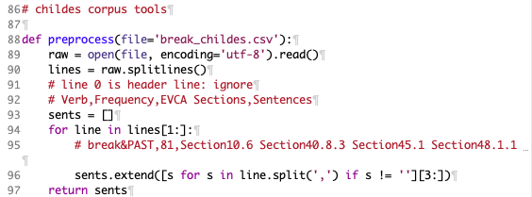
Childes Database
File: break_childes.csv
preprocess(): grab examples from csv file

Slide 13
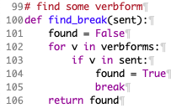
Childes Database
Code:
verbforms = set(['break', 'breaks', 'broke', 'breaking', 'broken'])
verbtags = set(['VB', 'VBP', 'VBZ', 'VBD', 'VBG', 'VBN'])
tokenize()

Slide 14
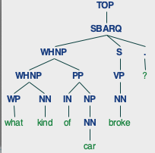
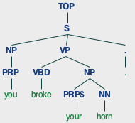
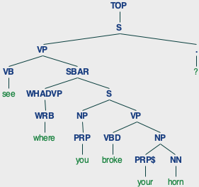
Childes Database
>>> wtl = tokenize(preprocess())
>>> len(wtl)
236
parser = benepar.Parser("benepar_en3")
>>> for wt in wtl[:10]:
... parse(wt).draw()
no subj, no obj under S
broke verb is NN!

Slide 15
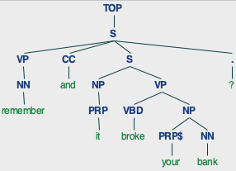
Childes Database

Slide 16
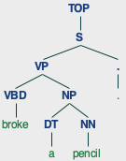
Childes Database

Slide 17
spaCy: benepar usage

Slide 18
spaCy pipeline
Installation via pip: https://spacy.io/usage
benepar

Slide 19
spaCy English language model
>>> import spacy
>>> nlp = spacy.load('en_core_web_md')
Traceback (most recent call last):
…
OSError: [E050] Can't find model 'en_core_web_md'. It doesn't seem to be a Python package or a valid path to a data directory.
$ python3 -m spacy download en_core_web_md
Collecting en-core-web-md==3.7.1
Downloading https://github.com/explosion/spacy-models/releases/download/en_core_web_md-3.7.1/en_core_web_md-3.7.1-py3-none-any.whl (42.8 MB)
━━━━━━━━━━━━━━━━━━━━━━━━━━━━━━━━━━━━━━━━ 42.8/42.8 MB 7.0 MB/s eta 0:00:00
…
Installing collected packages: en-core-web-md
Successfully installed en-core-web-md-3.7.1
✔ Download and installation successful
You can now load the package via spacy.load('en_core_web_md')

Slide 20
spaCy: benepar usage
$ python3
>>> import benepar
>>> import spacy
>>> nlp = spacy.load('en_core_web_md')
>>> nlp.add_pipe("benepar", config={"model": "benepar_en3"})
<benepar.integrations.spacy_plugin.BeneparComponent object at 0x17394bf50>
>>> doc = nlp(" you broke it (.) yeah .")
>>> sent = list(doc.sents)[0]
>>> sent._
<spacy.tokens.underscore.Underscore object at 0x100b22e70>
>>> sent._.parse_string
'(S (NP (NP (PRP )) (NP (PRP you))) (VP (VBD broke) (NP (PRP it))) (-LRB- -LRB-) (. .) (-RRB- -RRB-))'

Slide 21
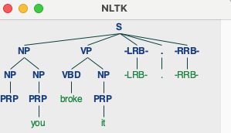
spaCy: benepar usage
>>> import nltk
>>> nltk.Tree.fromstring(sent._.parse_string).pretty_print()
S
_________________|______________
NP VP | | |
___|___ ____|___ | | |
NP NP | NP | | |
| | | | | | |
PRP PRP VBD PRP -LRB- . -RRB-
| | | | | | |
... you broke it -LRB- . -RRB-
>>> nltk.Tree.fromstring(sent._.parse_string).draw()
>>> list(doc.sents)[1]._.parse_string
'(INTJ (UH yeah) (. .))'

Slide 22
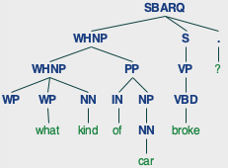
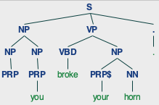
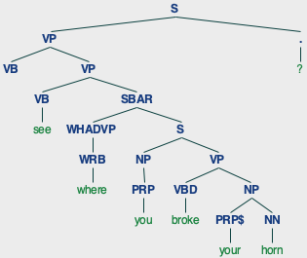
Childes Database
>>> sents = preprocess()
>>> for s in sents:
... Tree.fromstring(sparse(s)).draw()
no subj, no obj under S
but verb is VBD now!
spaCy is better than nltk

Slide 23
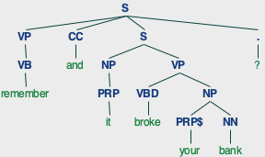
Childes Database

Slide 24
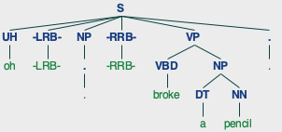
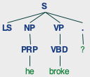
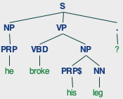
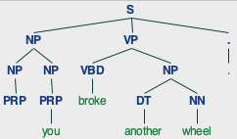
Childes Database

Slide 25
Childes Database: verb frames
[' break through/ADVP SBAR-LOC', ' break NP', ' break with/PP SBAR-PRP', ' break down/PRT into/PP', ' break up/PRT', ' break NP', ' break up/PRT NP', ' break NP', ' break', ' break , SBAR-ADV', ' break out/PRT', ' break (IN into)/PP', ' break up/PRT NP', ' break NP for/PP', ' break NP', ' break out/PRT NP', ' break out/PRT *T*-1/ADVP-TMP', ' break away/ADVP from/PP', ' break S', ' break into/PP', ' break out/PP *T*-3/ADVP', ' break NP on/PP', ' break NP', ' break out/PP', ' break NP', ' break up/PRT into/PP , with/PP', ' VBP CC break NP at/PP-LOC', …, ' break for/PP-TMP SBAR-ADV', ' break off/PRT NP abruptly/ADVP-MNR in/PP-TMP , SBAR-PRP']

Slide 26
Childes Database: frame distribution
>>> frames2 = sparsed_frames(sents)
>>> fd = nltk.FreqDist(frames2)
>>> fd
FreqDist({' break NP': 173, ' break': 31, ' break NP off/PRT': 5, ' break NP NP': 3, ' break SBAR': 2, ' break too/ADVP': 1, ' break NP off/PP': 1, ' break NP down/PRT': 1, ' break NP at/PP': 1, ' break NP on/PP': 1, ...})
>>> fd.N()
231
>>> fd.B()
22
>>> fd.hapaxes()
[' break too/ADVP', ' break NP off/PP', ' break NP down/PRT', ' break NP at/PP', ' break NP on/PP', ' break down/PRT', ' break NP again/ADVP', ' break in/PP', ' break NP up/PRT', ' break NP there/ADVP', ' break NP off/PRT NP', ' break NP apart/ADVP', ' break NP anymore/ADVP', ' break NP now/ADVP', ' break PRP NN -RRB- with/PP', ' break NP NN -RRB- NP', ' break `` . -RRB-']
>>> len(fd.hapaxes())
17

Slide 27
Childes: break verb frame distribution

Slide 28
Childes Database: frame distribution

Slide 29
Matplotlib pie chart
Verb frame distribution:
>>> len(sents)
238
>>> frames2 = sparsed_frames(sents)
>>> fd2 = nltk.FreqDist(frames2)
>>> fd2
FreqDist({' break NP': 173, ' break': 31, ' break NP off/PRT': 5, ' break NP NP': 3, ' break SBAR': 2, ' break too/ADVP': 1, ' break NP off/PP': 1, ' break NP down/PRT': 1, ' break NP at/PP': 1, ' break NP on/PP': 1, ...})
>>> fd2.N()
231

Slide 30
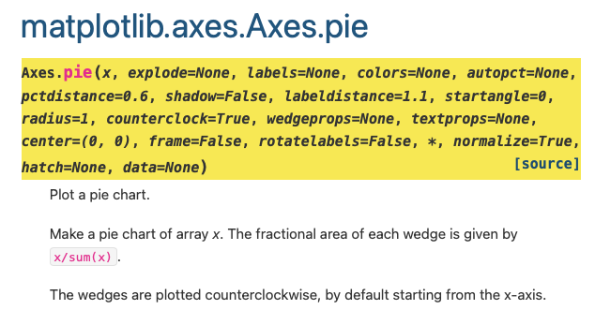
Matplotlib pie chart
1% or greater only
Create abbreviated pie chart:
>>> fd3 = nltk.FreqDist({t[0]:t[1] for t in fd2.most_common() if t[1] > int(fd2.N() / 100)})
>>> fd3['others'] = fd2.N() - fd3.N()
>>> fd3
FreqDist({' break NP': 173, ' break': 31, 'others': 19, ' break NP off/PRT': 5, ' break NP NP': 3})
>>> plt.pie([t[1] for t in fd3.most_common()],labels=[t[0] for t in fd3.most_common()], autopct='%1.0f%%')
>>> plt.show()

Slide 31
Break verb frames
Childes database
ptb

