Slide 1
LING/C SC 581: Advanced Computational Linguistics
Lecture 26

Slide 2
Today's Topics
Optional Homework 11
make-up if you missed or bombed a homework
Or choose,
Optional Homework 12
if you prefer

Slide 3
Last Time: nltk ptb
ptb.parsed_sents() is a list of trees.
Each tree is a Tree object.
Tree printing:
t.pretty_print() ascii graphics
t.pprint() parentheses
t.draw() window
Tree objects are recursively defined. Given a tree t:
t.label() category label of t
e.g. t.label().startswith('VP')
len(t) number of children of t
t[i] ith child of t
which could be a Tree or simply a string
t.subtrees() all possible subtrees in t
t.pos() list of (word, postag) in t

Slide 4
Homework 11 and 12 starting point
$ python
>>> from nltk.corpus import ptb
>>> trees = ptb.parsed_sents()
>>> len(trees)
73451
>>> trees[0].subtrees()
<generator object Tree.subtrees at 0x1434784a0>
>>> len(list(trees[0].subtrees()))
87

Slide 5
Homework 11
Let's define the smallest and largest tree as the ones with the least and most subtrees, respectively.
Question 1:
Find smallest and largest trees in ptb.
What are their sizes?
Display the trees
Question 2:
plot a histogram of tree sizes in ptb
use matplotlib.pyplot.hist (see next slide)
for hist set bins=range(0,450+1,25) (each bin is 25 wide)
use xticks(range(0,450+1,25)) to set the x-axis ticks (every 25)
Which bin has the most trees? About how many?

Slide 6
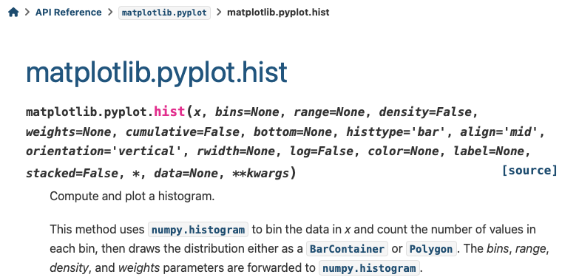
Homework 11
https://matplotlib.org/stable/api/_as_gen/matplotlib.pyplot.hist.html

Slide 7
Homework 11
https://matplotlib.org/stable/api/_as_gen/matplotlib.pyplot.xticks.html

Slide 8
Homework 12
Last time:
verb have frames
e.g. [_{VP} [_{VB.*} break][_{NP} the vase]]
e.g. [_{VP} [_{VB.*} broke] [_{PRT} [_{RB} out]][_{NP} the go codes]]
e.g. [_{VP} [_{VB.*} break][_{NP} it][_{PRT} [_{RB} off]]]
PRT = syntax label (prsguid1.pdf, page 36), RB = adverb (POS label)

Slide 9
Homework 12
Break is not the only verb with many verb frames.
Go is another:
go on endlessly trying to …
go far toward …
went on
going to be confidential …
went over the report …
gone overboard in stressing their significance
going to a chemistry lab

Slide 10
Homework 12
Question 1:
write a Python function to find all VP frames of the form:
[_{VP} [_{VB.*} go|goes|went|going|gone] …]
use ptb from nltk.corpus
how many are there?
Question 2:
modify your function to return the list of labels of the sisters of go in the VP
e.g. ['NP','PP', 'SBAR-TMP'], ['S'] or [] (nothing),
see examples in later slide
How may verb frames does go have?
How many different (kinds of) frames? (Use nltk.FreqDist())
Which is the most common frame?
plot a bar chart for the top 20 frames and their counts (use .plot() from FreqDist)

Slide 11
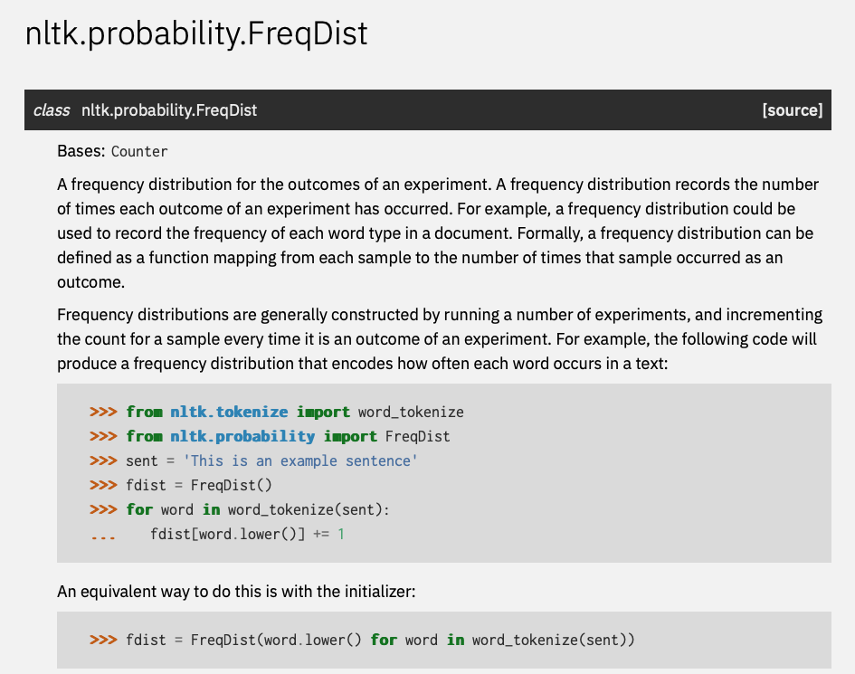
Homework 12
https://www.nltk.org/api/nltk.probability.FreqDist.html

Slide 12
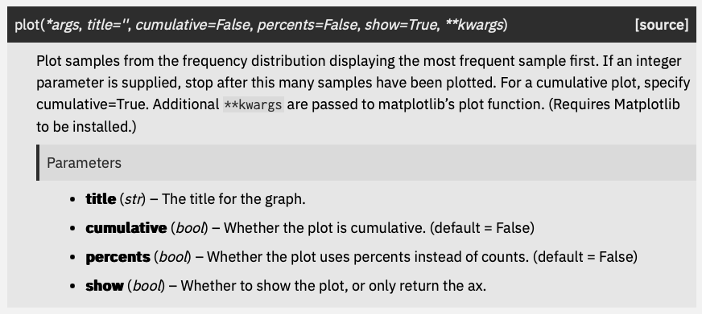
Homework 12
https://www.nltk.org/api/nltk.probability.FreqDist.html

Slide 13
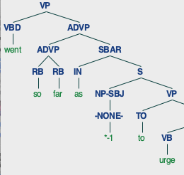
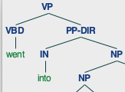
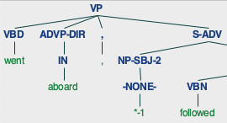
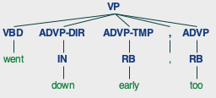
Homework 12

Slide 14
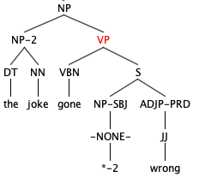
Homework 12

