Slide 1
LING/C SC 581: Advanced Computational Linguistics
Lecture 25

Slide 2
Today's Topics
Homework 10 Review
Statistical Parsers: unimplemented theory
it's in the training data, but they throw it all away
Let's take look at the verb break
Big unanswered question:
why does break have so many different senses?
seems tough to learn them …

Slide 3
Homework 10 Review
PRD (not MRG) shown:
MRG = PRD + POS
@S < (@VP < @VP)
Last @VP < POS tag VBN
Last @VP < POS tag -NONE-
-NONE- < *…-index
@S < NP-SBJ-index

Slide 4
Homework 10 Review
#3
Search patterns:
@S < (@VP < (@VP < VBN < (@NP < /^-NONE-/)))
@S < /^NP-SBJ-(\d+)/#1%i < (@VP < (@VP < VBN < (@NP < /^-NONE-/)))
@S < /^NP-SBJ-(\d+)/#1%i < (@VP < (@VP < VBN < (@NP < (/^-NONE-/ < /^\*.*-(\d+)/#1%i))))
@S < /^NP-SBJ-(\d+)/#1%i < (@VP < (/^VB/ < be|is|am|are|was|were|been|being) < (@VP < VBN < (@NP < (/^-NONE-/ < /^\*.*-(\d+)/#1%i))))

Slide 5
Homework 10 Review
Forms of be:
is|am|are|was|were
be|is|am|are|was|were
be|is|am|are|was|were|been
be|is|am|are|was|were|been|being

Slide 6
Homework 10 Review
85d84
< wsj_0360.mrg-27 While *-1 recognizing that professional environmentalists may feel threatened , I intend *-1 to urge that UV-B be monitored *-2 whenever I can *?* *T*-3 .

Slide 7
Homework 10 Review
235d234
< wsj_0596.mrg-4 Why had Mr. Korotich been called *-1 *T*-2 ?

Slide 8
Homework 10 Review
diff any being
82d81
< cg08.mrg-65 Faulkner culminates the Southern legend perhaps more masterfully than it has ever been *RNR*-1 , or could ever be *RNR*-1 , done *-2 .

Slide 9
Homework 10 Review
283d281
< cg15.mrg-68 The monk Savonarola , * brought *-1 over from the Renaissance and placed *-1 against the background of Munich at the turn of the century , protests against the luxurious works displayed * in the art-shop of M. Bluthenzweig ; ; in particular against a Madonna portrayed * in a voluptuous style and modeled * , according to gossip , upon the painter 's mistress .

Slide 10
Homework 10 Review
371d368
< cn14.mrg-66 If we have *-1 to *?* we 'll take him apart and see what he 's made *-3 of *T*-2 '' ! !

Slide 11
Homework 10 Review
< cn29.mrg-29 … wrestle you for ten minutes -- but then I 'm finished *-2 .

Slide 12
Homework 10 Review
diff any been
40d39
< wsj_0326.mrg-27 Despite the criticism , Philip Morris 's corporate campaign runs little risk of * getting yanked *-1 off the tube .

Slide 13
Homework 10 Review
45d43
< wsj_0309.mrg-18 That sounds like a formula for * ensuring that he gets dragged *-1 into the next HUD tar pit .

Slide 14
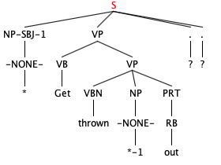
Homework 10 Review
cn11.mrg
cn18.mrg

Slide 15
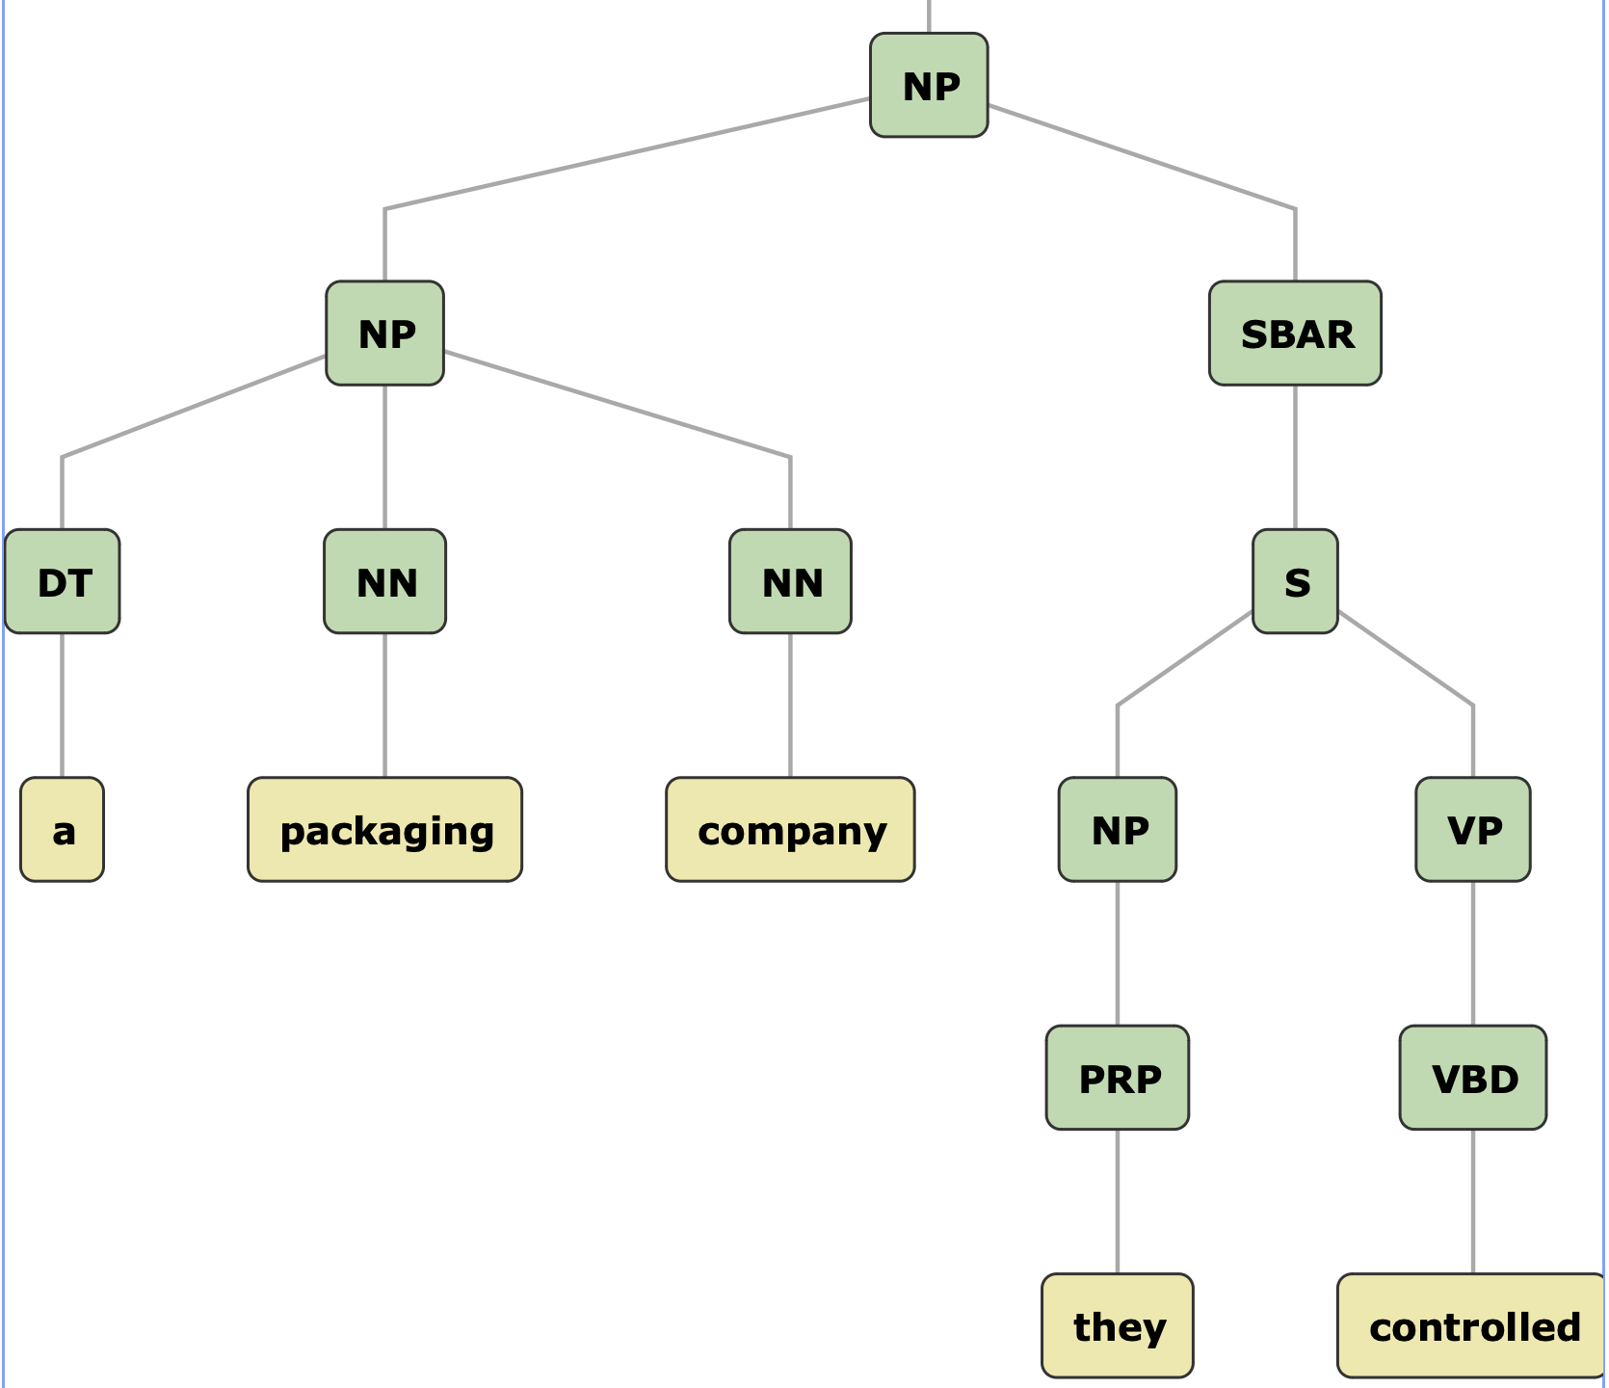
Last Time: theory not implemented
unary branchings, missing empty categories (identifying theta positions)

Slide 16
Senses of break
(Petersen & Potts) https://ling.auf.net/lingbuzz/006859
Change-of-state verb that undergoes the causative alternation:
John broke the window
the window broke
"senses 1–4 all alternate, senses 5–10 are all strictly transitive, … also strictly intransitive uses, as in 11– 12"
*the law broke
careful: need to expand for context:
Central Law Journal, vol. 36, 1893.

Slide 17
Unaccusative
Change-of-state verb that undergoes the causative alternation:
John broke the window
agent causes patient/theme to undergo change of state (broken)
the window broke
window not an agent (usually an external argument)
*the window broke the ball
window undergoes change of state
[_{VP} broke the window] is the underlying structure
the window raises to subject position (in the absence of an external argument)

Slide 18
More senses of break
"Except for 13, 17, and 18, these uses are all intransitive"
Verb particles:
off
out
down
free
even
forth
particle + NP or PP?:
off the engagement
out in hives
into the building
down the problem/proteins
to the right

Slide 19
WordNet: verb senses of break

Slide 20
WordNet: verb senses of break
down a proof
to a whisper
unaccusative: subject is affected
for lunch

Slide 21
WordNet: senses of break out and break down

Slide 22
WordNet: senses of break in and break off

Slide 23
Let's ask ChatGPT
Does the object still exist after being broken?

Slide 24
Let's ask ChatGPT
Does the object still exist after being broken?

Slide 25
Let's ask ChatGPT
Does the object still exist after being broken?

Slide 26
nltk ptb
Recall we installed this a while ago:
>>> from nltk.corpus import ptb
>>> type(ptb)
<class 'nltk.corpus.util.LazyCorpusLoader'>
>>> ptb.fileids()
['BROWN/CF/CF01.MRG','BROWN/CF/CF02.MRG', … ,'WSJ/24/WSJ_2453.MRG','WSJ/24/WSJ_2454.MRG']
>>> len(ptb.fileids())
2504
>>> len(ptb.parsed_sents())
73451
>>> len(ptb.words())
1740895

Slide 27
nltk ptb.parsed_sents()
a list of trees: Tree objects.
Tree printing:
t.pretty_print() ascii graphics
t.pprint() parentheses
t.draw() window
Tree objects are recursively defined. Given a tree t:
t.label() category label of t
len(t) number of children of t
t[i] ith child of t (which could be Tree or string)
t.subtrees() all possible subtrees in t
t.pos() list of (word, postag) in t

Slide 28
Find all break sentences
break.py

Slide 29
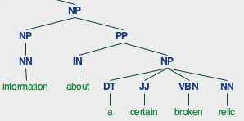
Find all break sentences
Example:
$ python -i break.py
>>> break_trees = [t for t in ptb.parsed_sents() if has_break(t.pos())]
>>> len(break_trees)
244
>>> break_trees[0].draw()
adjectival modification with VBN broken

Slide 30
Find all break sentences
break through/ADVP

Slide 31
Find all break sentences
break NP
break PP[with]

Slide 32
Find all break sentences
break down/PRT PP[into]
RP | Particle

Slide 33
Find all break sentences
break up/PRT
RP | Particle

Slide 34
Find all break sentences
break up/PRT NP
RP | Particle

Slide 35
Find all break sentences
break out of NP

Slide 36
Find all break verb frames
break.py

Slide 37
Find all break verb frames
break.py

Slide 38
Find all break verb frames
Code:
$ python -i break.py
>>> for i,t in enumerate(break_trees):
... for st in t.subtrees():
... found = vp_break(st)
... if found:
... print(i, found)
...

Slide 39
Find all break verb frames
3 break/VB through/ADVP SBAR-LOC
4 broke/VBD NP
5 broken/VBN PP SBAR-PRP
6 broke/VBD down/PRT PP
7 broke/VBD up/PRT
8 breaking/VBG NP
9 break/VB up/PRT NP
10 break/VB NP
11 break/VBP
12 breaking/VBG , SBAR-ADV
13 broke/VBD out/PRT
14 broke/VBD PP
15 broke/VBD up/PRT NP
16 broken/VBN NP PP
17 break/VB NP
18 broke/VBD out/PRT NP
19 broke/VBD out/PRT ADVP-TMP
20 break/VB away/ADVP PP
21 break/VB S
22 breaks/VBZ PP
23 break/VB PP *T*-3/ADVP
26 broke/VBD NP PP
27 break/VB NP
28 breaks/VBZ PP
29 break/VB NP
30 breaks/VBZ up/PRT PP , PP
31 VBP CC break/VBP NP PP-LOC
32 broke/VBD NP
what is this?

Slide 40
Find all break verb frames
>>> break_trees[23].draw()

Slide 41
Find all break verb frames
33 `` breaks/VBZ '' CONJP VBZ SBAR-TMP
34 broken/VBN PP ADVP
35 break/VB down/PRT NP
36 broke/VBD out/PRT PP-LOC ADVP-TMP
38 break/VB ADVP-LOC
39 broke/VBD loose/ADVP
40 broken/VBN NP
41 broke/VBD NP off/PRT
42 breaking/VBG PP
43 broke/VBD PP
44 break/VBP NP
45 breaking/VBG up/PRT NP PP
46 broke/VBD NP ADVP-TMP
47 broke/VBD NP S-ADV
48 broke/VBD PP
50 then/ADVP break/VB off/PRT suddenly/ADVP
51 broke/VBD NP ADVP-TMP
52 break/VB NP PP
53 breaking/VBG NP
54 broke/VBD NP
55 broke/VBD PP , S-ADV
56 break/VB down/PRT
57 broke/VBD out/PRT PP-LOC SBAR-TMP
58 broken/VBN NP
59 break/VB NP
60 broken/VBN NP
61 break/VB PP PP-TMP
62 break/VB NP
64 break/VB PP
65 breaking/VBG NP

