Slide 1
LING/C SC 581: Advanced Computational Linguistics
Lecture 24

Slide 2
Today's Topics
tregex on Windows 11 and Ubuntu
make sure jre is installed
I tested it by updating to jre 8 update 401
Homework 10 questions?
TREEBANK_3 Theory
Example: subject and object relative clauses
Summary of tregex search

Slide 3
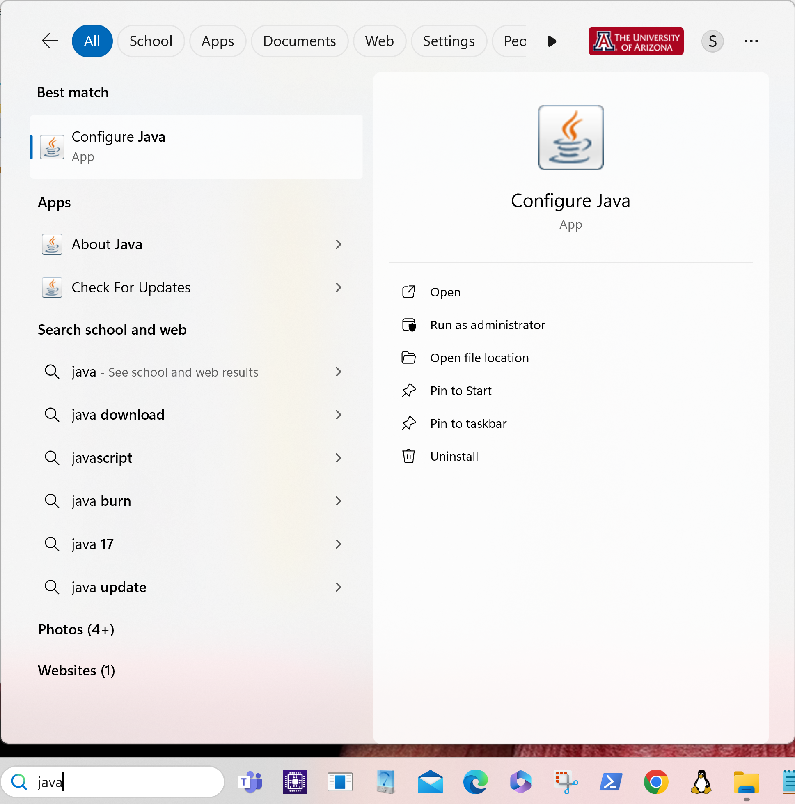
jre 8 update 401 January 2024
Make sure Java's run-time environment is installed

Slide 4
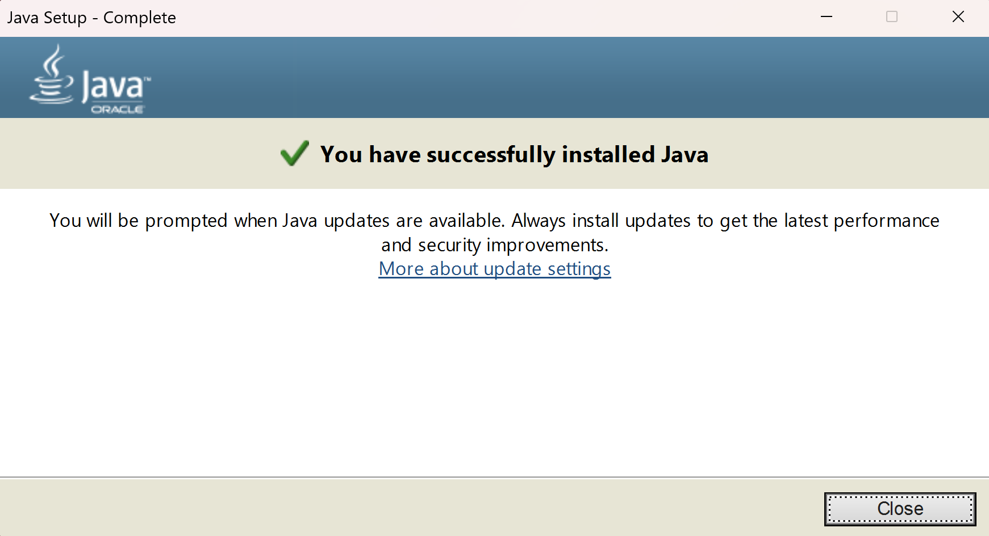
jre-8u401-windows-x86.exe

Slide 5
jre updated
PS C:\Users\sandiway\Downloads> powershell -command "Expand-Archive" .\stanford-tregex-4.2.0.zip C:\Users\sandiway\Desktop\

Slide 6
run-tregex-gui.bat
edit .bat file to increase memory: -mx2000

Slide 7
Load in brown and wsj mrg directories

Slide 8
Example of search

Slide 9
Ubuntu Install
Terminal:
~/Downloads$ unzip stanford-tregex-4.2.0.zip
~/Downloads$ cd stanford-tregex-2020-11-17/
~/Downloads/stanford-tregex-2020-11-17$ ./run-tregex-gui.command
Gtk-Message: 20:44:58.957: Failed to load module "canberra-gtk-module"
Apr 09, 2024 8:44:59 PM java.util.prefs.FileSystemPreferences$1 run
INFO: Created user preferences directory.
Install:
sudo apt install libcanberra-gtk-module
The following additional packages will be installed:
libcanberra-gtk0
The following NEW packages will be installed:
libcanberra-gtk-module libcanberra-gtk0

Slide 10
tregex on Ubuntu

Slide 11
tregex on Ubuntu

Slide 12
Homework 10: English passivization

Slide 13
TREEBANK_3 Theory
Theory includes empty categories:
-NONE- as a POS label is used in many circumstances, e.g.:
the zero complementizer under SBAR (0),
subject of nonfinite clauses (*),
object position in passives (*-index),
relativization of subjects, objects and adjuncts (*T*-index).
Example: the businesses to be acquired

Slide 14
Template: subject relative clause
Example:
the man who left the room at 6pm
leave: (subject, object)
subject = the man

Slide 15
Example: subject relative clause
relative pronoun who/WP (WHNP)
relative pronoun that/WDT (WHNP)

Slide 16
Example: subject relative clause
subject nonfinite relative clause (no relative pronoun, zero WHNP)

Slide 17
Template: object relative clause
Example:
the room the man left at 6pm
leave: (subject, object)
object = the room

Slide 18
Example: object relative clause
subject relatives generally need an overt WH word under SBAR
object finite relative clause without a relative pronoun (zero WHNP)

Slide 19
Example: object relative clause
object finite relative clause with relative pronoun that/WDT (WHNP)
relative pronoun which/WDT (WHNP)

Slide 20
Example: object relative clause

Slide 21
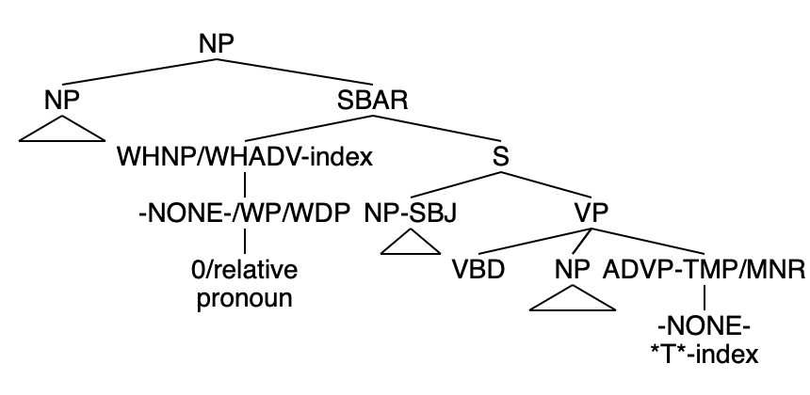
Relative Clause Examples
from adjunct positions (not subject, not object)

Slide 22
Example: adjunct relative clause
adjunct finite relative clause with a relative pronoun when/WRB (WHADVP)

Slide 23
Example: adjunct relative clause
adjunct nonfinite relative clause without a relative pronoun (zero WHADVP)

Slide 24
tregex = regex + structural relations
combines regex with structural relations between tree node labels:
dominance (< or <<),
sisterhood ($+ or $),
precedence (. or ..) etc.
leftmost, nth, only, rightmost child of (<, or <n or <: or <-)
nodes can be matched:
literally (exact match),
@name, or
/…/ regex pattern
groups from regex patterns can be linked via naming,
e.g. #1%index

Slide 25
@SBAR < /^WH.*-([0-9]+)$/#1#index << (__=empty < (/^-NONE-/ < /\*T\*-([0-9]+)$/#1#index)

