Slide 1
LING/C SC 581: Advanced Computational Linguistics
Lecture 23

Slide 2
Today's Topics
tregex: searching, part 3
Homework 10

Slide 3
Last Time
Changed the memory size (-mx) to accommodate larger corpora (brown + wsj) and our searching (without hanging). Inside run-tregex-gui.command we made a change:
java -mx300m
java –mx900m (wasn't big enough)
java -mx2000m (searches don't hang)

Slide 4
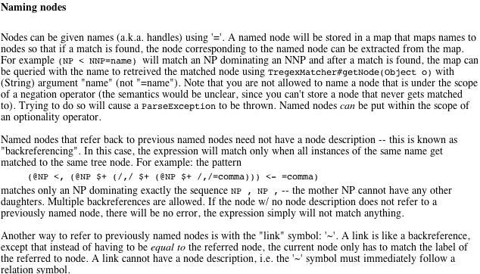
tregex
Key:
x <, y
1st child y
x <- y
last child y
x $+ y
x immediate left sister of y

Slide 5
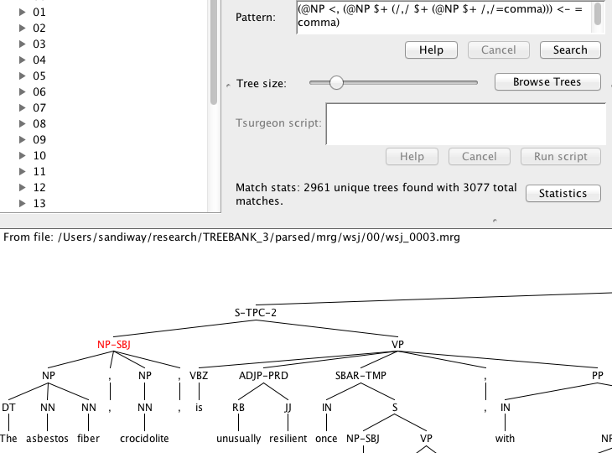
tregex
must be same node
Pattern:
@NP <, (@NP $+ (/,/ $+ (@NP $+ /,/=comma))) <- =comma
Key:
<, first child
$+ immediate left sister
<- last child

Slide 6
tregex

Slide 7
tregex

Slide 8
tregex
Save search sentences to files short and long (form of query). Run diff.
(base) ~$ cd Desktop
(base) Desktop$ diff short long
2d1
< wsj_0353.mrg-2 The Financial Accounting Foundation voted 12-2 that FASB accounting rules supercede GASB rules in regard to utilities , hospitals , and colleges and universities owned * by the government .
11d9
< wsj_0341.mrg-3 Unocal said 0 the venture would enable it to recover more of its refining and marketing investment and prepare for expected growth in exploration , production , chemicals and other areas .
18d15
< wsj_0354.mrg-9 Uniroyal has 2,600 employees and facilities in the U.S. , Canada , Brazil , Italy and Taiwan .

Slide 9
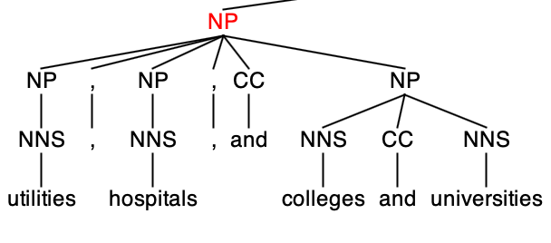
tregex
2d1
< wsj_0353.mrg-2 The Financial Accounting Foundation voted 12-2 that FASB accounting rules supercede GASB rules in regard to utilities , hospitals , and colleges and universities owned * by the government .

Slide 10
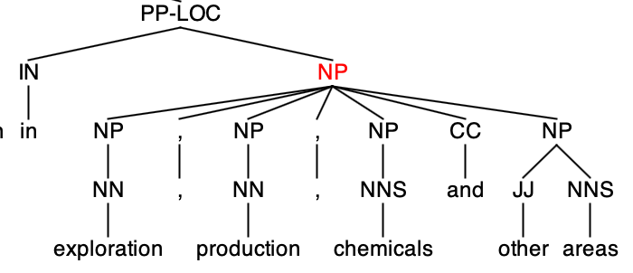
tregex
11d9
< wsj_0341.mrg-3 Unocal said 0 the venture would enable it to recover more of its refining and marketing investment and prepare for expected growth in exploration , production , chemicals and other areas .

Slide 11
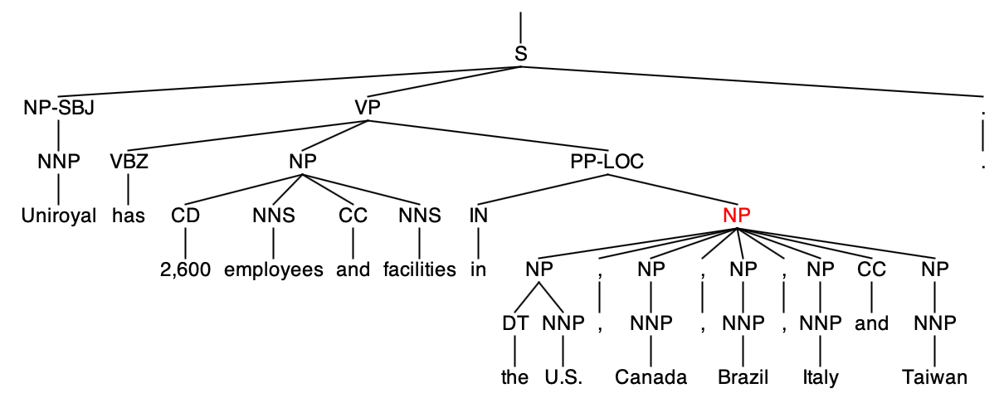
tregex
18d15
< wsj_0354.mrg-9 Uniroyal has 2,600 employees and facilities in the U.S. , Canada , Brazil , Italy and Taiwan .

Slide 12
tregex
Help
Recall regex grouping using parentheses:
e.g. (a+)(b+) defines groups #1 (…) and #2 (…)

Slide 13
tregex

Slide 14
tregex
Different results from:
@SBAR < /^WH.*-([0-9]+)$/#1%index << (@NP < (/^-NONE-/ < /^\*T\*-([0-9]+)$/#1%index))

Slide 15
tregex
Reason for difference
Example:
WHADVP also possible (not just WHNP)

Slide 16
Homework 10
Bracketing Guidelines for Treebank
TREEBANK_3 > docs > prsguid1.pdf

Slide 17
Homework 10
This is the PRD (not MRG) form:
no POS tags, just syntax labels
MRG = PRD + POS
Past participle form of the verb has POS tag:
VBN
Empty categories have POS tag:
-NONE-
Let's write a search for passives!

Slide 18
Homework 10
Build your search pattern a bit at a time and check your results!
Look for basic S (@S)
Immediately dominates a basic VP
VP immediately dominates another VP
This last VP must dominate both VBN and NP –NONE-

Slide 19
Homework 10
Make sure you have brown and wsj loaded for the search.
Max displayed trees: > 1000

Slide 20
Homework 10
Other conditions to add to refine your search:
basic S immediately dominates a subject NP with an index, a number.
NP –NONE- immediately dominates *…-index (same index as in 1)
Note: guide says *T*-index (for trace of passive movement), but example in previous slide has no T, just *-index.
Part 1: after stage 3 above, how many passives do you get? Report your search expression and statistics.
We didn't specify the passive be. What are the forms of be?
Add the restriction in 4. to the search.
Part 2: after stage 5 above, how many passives do you get? Report your search expression and statistics.

Slide 21
Homework 10
Part 3: can you give examples showing why there is a difference in matches between Part 1 and Part 2 (limited to passive be)?
i.e. what other verbs aside from be can be used to form a passive?
Hint: save matched sentences and use diff, then find the tree(s).
show tree or tree fragment screenshots

Slide 22
Homework 10
Usual rules
ONE PDF FILE ONLY!
email: sandiway@arizona.edu
subject: 581 Homework 10 YOUR NAME
due date: next Monday midnight

