Slide 1
LING/C SC 581: Advanced Computational Linguistics
Lecture 22

Slide 2
Today's Topics
I assume everyone has downloaded TREEBANK_3.zip
installing the full PTB into nltk
from nltk.corpus import treebank (3,914 sample)
from nltk.corpus import ptb (full)
tregex: macOS possible problem and solution
tregex: searching

Slide 3
nltk: Corpus Readers
http://www.nltk.org/howto/corpus.html#parsed-corpora
If you have access to a full installation of the Penn Treebank, NLTK can be configured to load it as well.
Download the ptb package, and in the directory nltk_data/corpora/ptb place the BROWN and WSJ directories of the Treebank installation (symbolic links work as well).
Then use the ptb module instead of treebank:
>>> from nltk.corpus import ptb
>>> print(ptb.fileids()) # doctest: +SKIP ['BROWN/CF/CF01.MRG', 'BROWN/CF/CF02.MRG', 'BROWN/CF/CF03.MRG', 'BROWN/CF/CF04.MRG', ...]
>>> print(ptb.words('WSJ/00/WSJ_0003.MRG')) # doctest: +SKIP ['A', 'form', 'of', 'asbestos', 'once', 'used', '*', ...]
>>> print(ptb.tagged_words('WSJ/00/WSJ_0003.MRG')) # doctest: +SKIP [('A', 'DT'), ('form', 'NN'), ('of', 'IN'), ...]

Slide 4
Penn Treebank (PTB) with nltk
TREEBANK_3.zip
Put your wsj directory (from mrg) here ~/nltk_data/corpora/ptb
Filename case problem!

Slide 5
Penn Treebank (PTB) with nltk
COPY
~/nltk_data/corpora/ptb

Slide 6
Penn Treebank (PTB) with nltk
Rename files to uppercase
for f in `find wsj`; do mv -v "$f" "`echo $f | tr '[a-z]' '[A-Z]'`"; done
(found on stackoverflow.com)
seems to work but not clean
directory name needs to be uppercased too!

Slide 7
Penn Treebank (PTB) with nltk
Note: you may run into problems with file permissions when renaming:
Change permissions (recursively):
chmod -R u+w atis

Slide 8
Penn Treebank (PTB) with nltk
Renaming script courtesy of Sandeep Suntwal (from 2018's class):

Slide 9
Penn Treebank (PTB) with nltk
Checking the install:
class BracketParseCorpusReader
seems to be the Brown corpus +
the Wall Street Journal corpus
…

Slide 10
Penn Treebank (PTB) with nltk
WSJ only (news = WSJ):
Defined in ~/nltk_data/corpora/ptb/allcats.txt:

Slide 11
Penn Treebank (PTB) with nltk
Got it working?
>>> import nltk
>>> from nltk.corpus import ptb
>>> parses = ptb.parsed_sents()
>>> len(parses)
73451
>>> wsj = ptb.parsed_sents(categories=['news'])
>>> len(wsj)
49208
>>> len(ptb.words())
1740895
>>> len(ptb.words(categories=['news']))
1253013

Slide 12
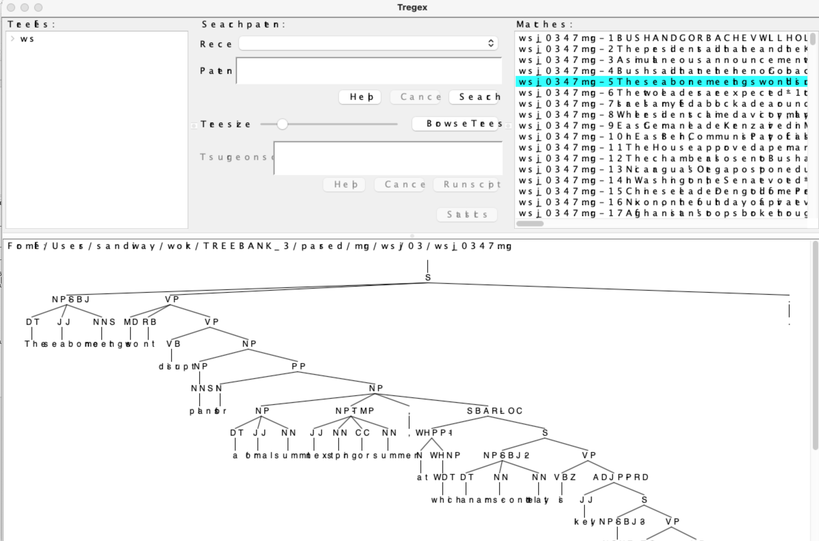
Possible macOS Problem
Disk image version, the Java runtime environment seems to pick wrong fonts. Display is hard to read.

Slide 13
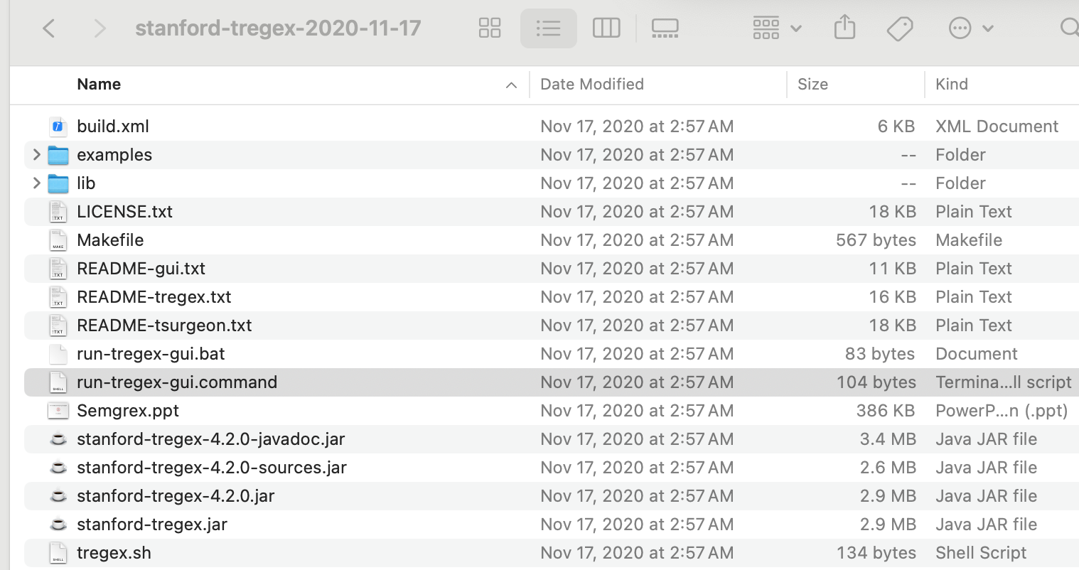
Possible macOS Problem
If this happens, download the non-image link
for macOS, run this command

Slide 14
Possible macOS Problem
Terminal
(base) stanford-tregex-2020-11-17$ ./run-tregex-gui.command
Warning: the font "Times" is not available, so "Lucida Bright" has been substituted, but may have unexpected appearance or behavor. Re-enable the "Times" font to remove this warning.
Warning: the font "Times" is not available, so "Lucida Bright" has been substituted, but may have unexpected
Terminal
can be fixed, but maybe not worth doing …
(base) stanford-tregex-2020-11-17$ ./run-tregex-gui.command

Slide 15
Possible macOS Problem
Lucida Bright
is a reasonable
substitute for Times

Slide 16
Possible macOS Problem
with Times font restored to macOS using instructions here https://stackoverflow.com/questions/68608157/how-can-i-fix-this-warning-the-fonts-times-and-times-are-not-available-fo

Slide 17
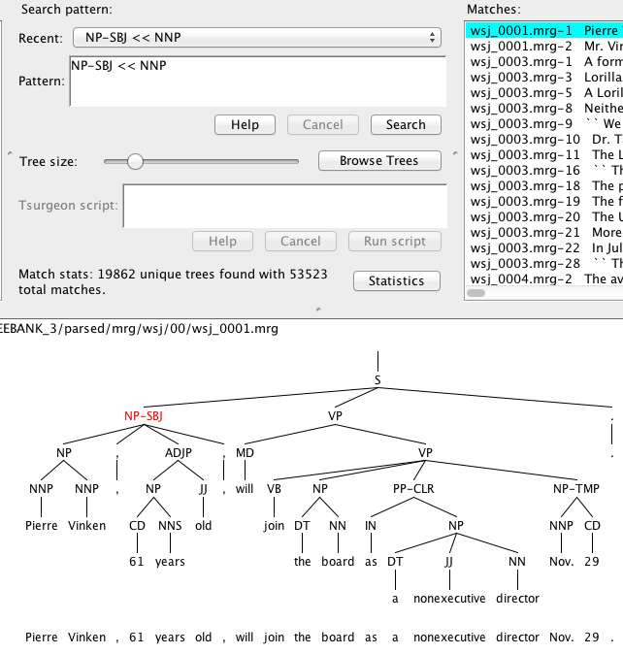
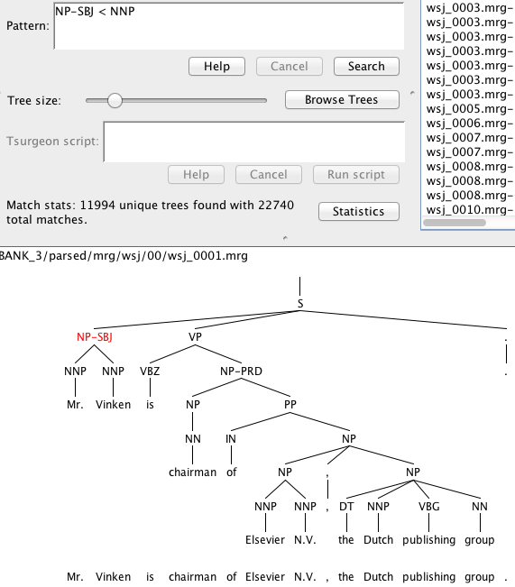
tregex
Search
NP-SBJ << (dominates) vs. < (immediately dominates) NNP

Slide 18
tregex
README-tregex.txt

Slide 19
tregex
Useful:
The (best) introduction to Tregex is the brief powerpoint tutorial for Tregex by Galen Andrew.
https://nlp.stanford.edu/software/tregex/The_Wonderful_World_of_Tregex.ppt

Slide 20
tregex
Adjust Max displayed trees if needed:

Slide 21
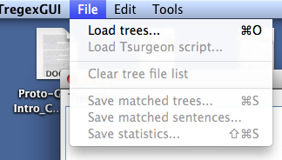
tregex
useful command line tool:
diff <file1> <file2>

Slide 22
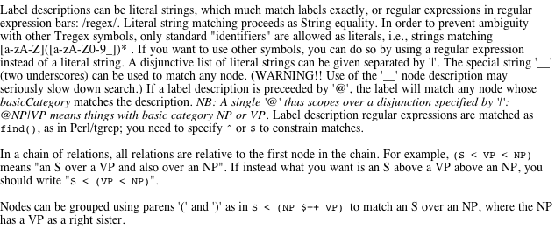
tregex
Help: tregex expression syntax is non-standard wrt bracketing
S < VP
S < NP

Slide 23
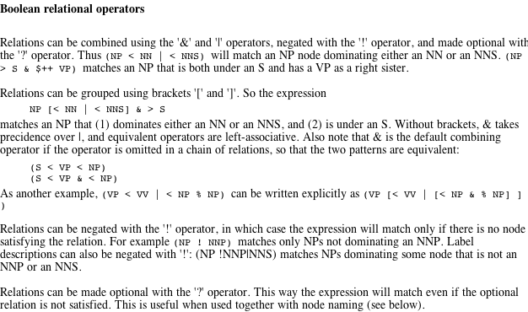
tregex
Help: tregex boolean syntax is also non-standard

Slide 24
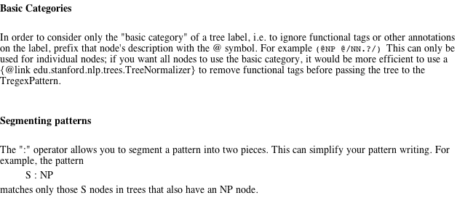
tregex
Help

Slide 25
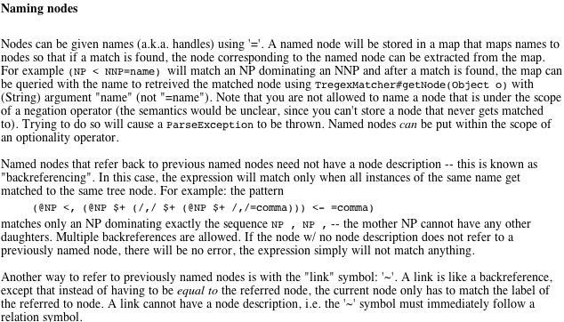
tregex
x <, y, 1st child y; x <- y, last child y;
x $+ y, x immediate left sister of y

Slide 26
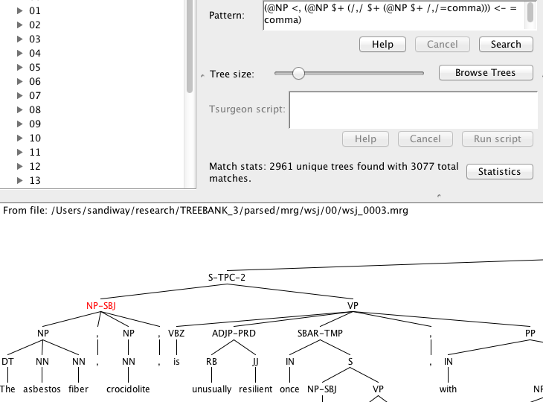
tregex
must be same node
Pattern:
(@NP <, (@NP $+ (/,/ $+ (@NP $+ /,/=comma))) <- =comma)
Key:
<, first child
$+ immediate left sister
<- last child

Slide 27
tregex
Help
Recall regex grouping using parentheses:
e.g. (a+)(b+) defines groups 1 (…) and 2 (…)

Slide 28
tregex

Slide 29
tregex
Different results from:
@SBAR < /^WH.*-([0-9]+)$/#1%index << (@NP < (/^-NONE-/ < /^\*T\*-([0-9]+)$/#1%index))

Slide 30
tregex
Reason for difference
Example:
WHADVP also possible (not just WHNP)

