Slide 1
LING/C SC 581: Advanced Computational Linguistics
Lecture 21

Slide 2
Today's Topic
Copy the full Penn Treebank (PTB)corpus from the course website
instructions given out in Panopto and in class (not on class slides!)
Homework 9: install tregex
we'll be using the software called tregex to search the treebanks
it's written in Java and requires a Java runtime environment

Slide 3
nltk
nltk: corpus treebank
a 100,000 word subset of the PTB (not the full thing!)
>>> import nltk
>>> from nltk.corpus import treebank
>>> t = treebank.parsed_sents()
>>> t[0]
Tree('S', [Tree('NP-SBJ', [Tree('NP', [Tree('NNP', ['Pierre']), Tree('NNP', ['Vinken'])]), Tree(',', [',']), Tree('ADJP', [Tree('NP', [Tree('CD', ['61']), Tree('NNS', ['years'])]), Tree('JJ', ['old'])]), Tree(',', [','])]), Tree('VP', [Tree('MD', ['will']), Tree('VP', [Tree('VB', ['join']), Tree('NP', [Tree('DT', ['the']), Tree('NN', ['board'])]), Tree('PP-CLR', [Tree('IN', ['as']), Tree('NP', [Tree('DT', ['a']), Tree('JJ', ['nonexecutive']), Tree('NN', ['director'])])]), Tree('NP-TMP', [Tree('NNP', ['Nov.']), Tree('CD', ['29'])])])]), Tree('.', ['.'])])
>>> t[0].draw()
>>> len(t)
3914

Slide 4
nltk
Tree('S', [Tree('NP-SBJ', [Tree('NP', [Tree('NNP', ['Pierre']), Tree('NNP', ['Vinken'])]), Tree(',', [',']), Tree('ADJP', [Tree('NP', [Tree('CD', ['61']), Tree('NNS', ['years'])]), Tree('JJ', ['old'])]), Tree(',', [','])]), Tree('VP', [Tree('MD', ['will']), Tree('VP', [Tree('VB', ['join']), Tree('NP', [Tree('DT', ['the']), Tree('NN', ['board'])]), Tree('PP-CLR', [Tree('IN', ['as']), Tree('NP', [Tree('DT', ['a']), Tree('JJ', ['nonexecutive']), Tree('NN', ['director'])])]), Tree('NP-TMP', [Tree('NNP', ['Nov.']), Tree('CD', ['29'])])])]), Tree('.', ['.'])])

Slide 5
nltk
>>> t[-1].draw()
The sample of the well-known Penn Treebank (PTB) Wall Street Journal (WSJ) corpus includes:
3,914 parsed sentences
49,000+ parsed sentences in the full corpus

Slide 6
nltk
Words:
>>> w = treebank.words()
>>> len(w)
100676
>>> w
['Pierre', 'Vinken', ',', '61', 'years', 'old', ',', ...]
>>> tw = treebank.tagged_words()
>>> tw
[('Pierre', 'NNP'), ('Vinken', 'NNP'), (',', ','), ...]
>>> tw[:10]
[('Pierre', 'NNP'), ('Vinken', 'NNP'), (',', ','), ('61', 'CD'), ('years', 'NNS'), ('old', 'JJ'), (',', ','), ('will', 'MD'), ('join', 'VB'), ('the', 'DT')]

Slide 7
nltk: Corpus Readers
http://www.nltk.org/howto/corpus.html#parsed-corpora
The NLTK data package includes a 10% sample of the Penn Treebank (in treebank), as well as the Sinica Treebank (in sinica_treebank).
Reading the Penn Treebank (Wall Street Journal sample):
>>> from nltk.corpus import treebank
treebank.fileids()
treebank.words(fileid))
treebank.tagged_words(fileid))
treebank.parsed_sents(fileid)

Slide 8
nltk: Corpus Readers
treebank.words(fileid))

Slide 9
nltk: Corpus Readers
treebank.fileids()
>>> len(treebank.fileids())
199

Slide 10
nltk: Corpus Readers
treebank.tagged_words(fileid))

Slide 11
nltk: Corpus Readers
treebank.parsed_sents(fileid)

Slide 12
Penn POS Tagset

Slide 13
Penn POS Tagset

Slide 14
Penn POS Tagset

Slide 15
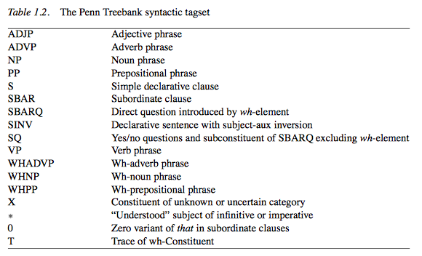
Penn Syntax Tagset
(from The Penn Treebank: An overview, Taylor, Marcus & Santorini)

Slide 16
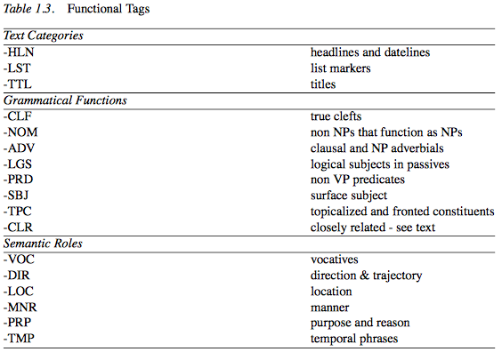
Penn Syntax Tagset
(from The Penn Treebank: An overview, Taylor, Marcus & Santorini)

Slide 17
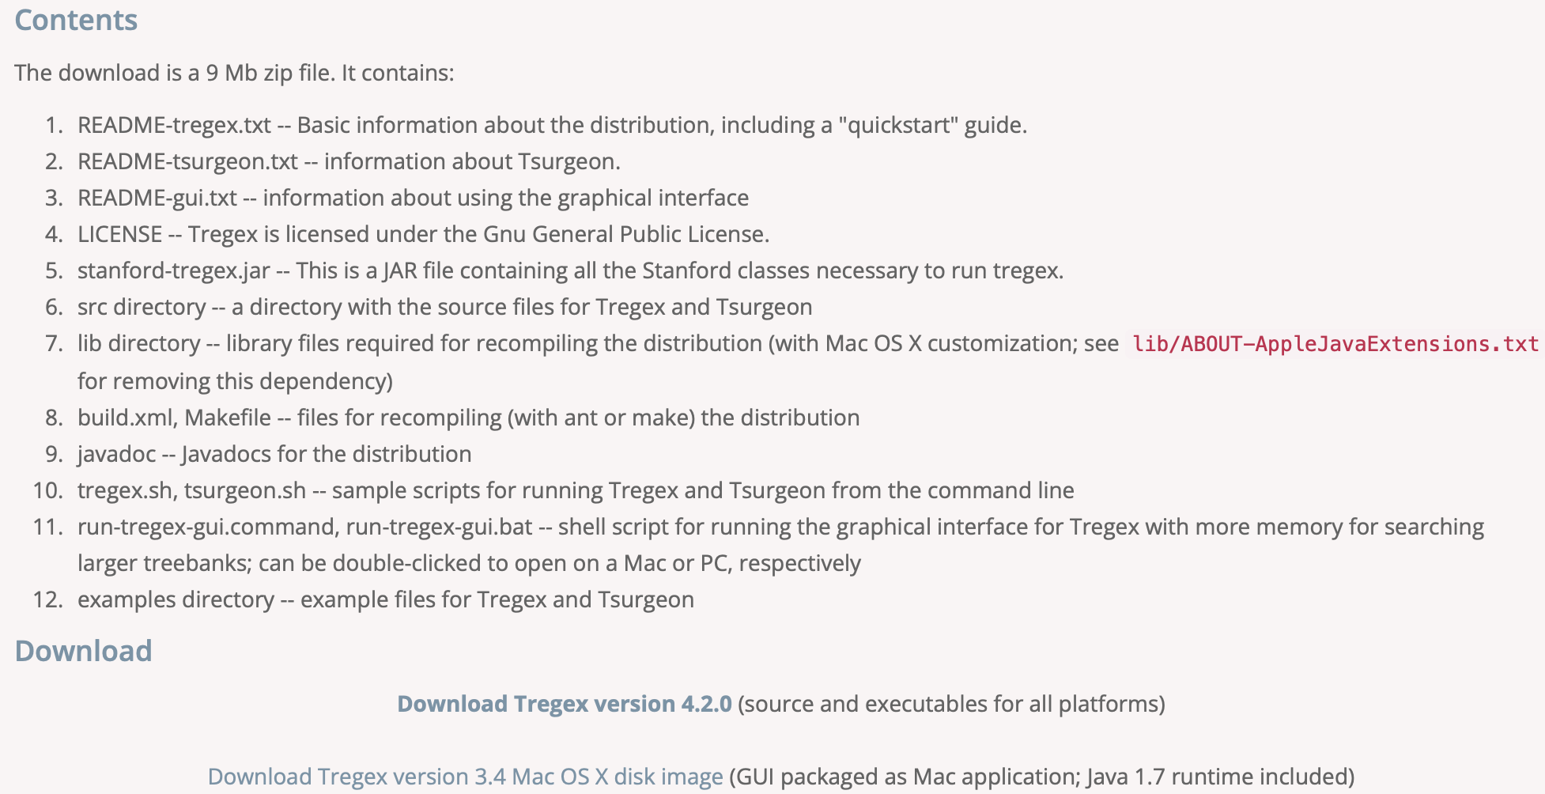
Tregex
URL: https://nlp.stanford.edu/software/tregex.shtml

Slide 18
Treebank Guides
Tagging Guide
arpa94 paper
Parse Guide

Slide 19
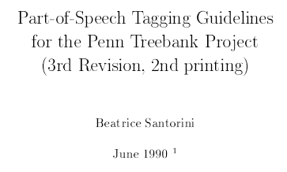
Treebank Guides
Parts-of-speech (POS) Tagging Guide, tagguid1.pdf (34 pages):
tagguid2.pdf: addendum, see POS tag ‘TO’

Slide 20
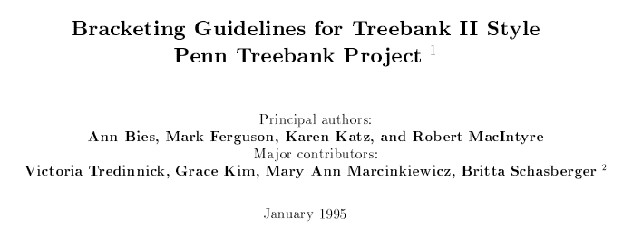
Treebank Guides
Parsing guide 1, prsguid1.pdf (318 pages):
prsguid2.pdf: addendum for the Switchboard corpus

Slide 21
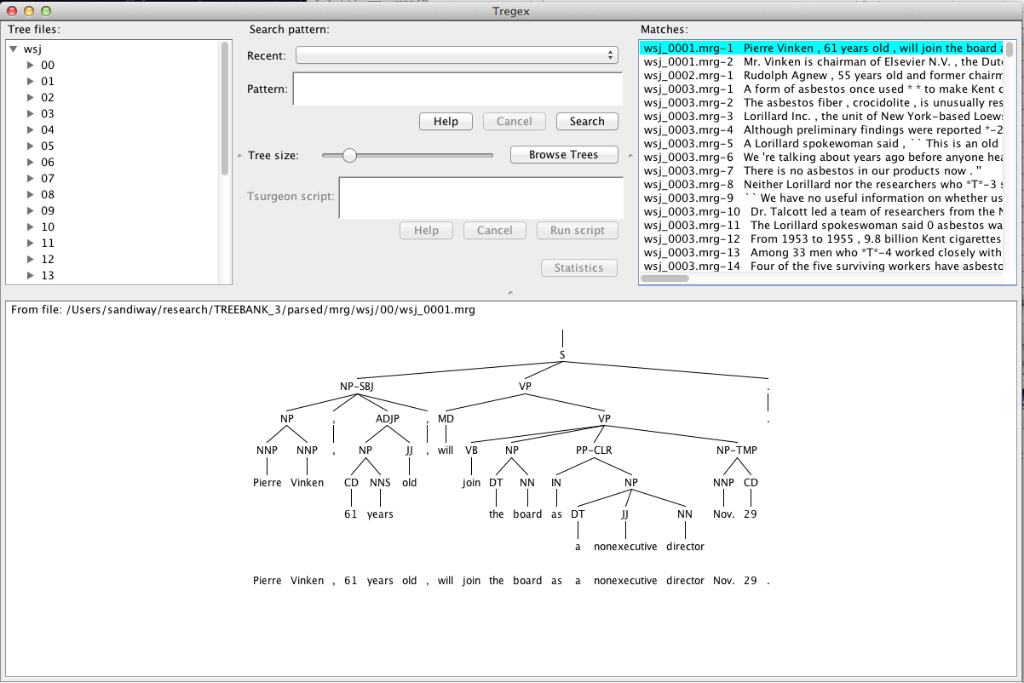
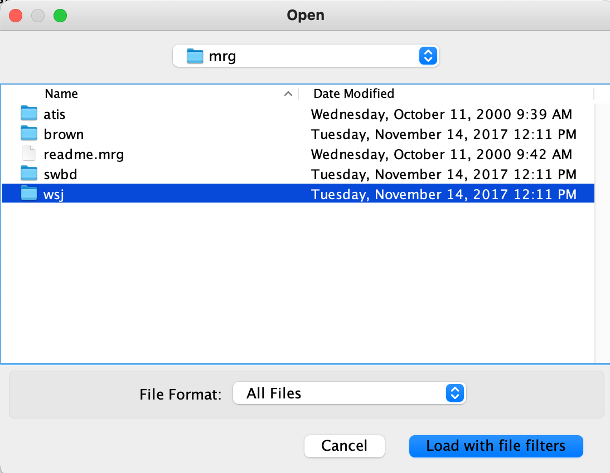
tregex
Shell file:
Select the PTB directory
TREEBANK_3/parsed/mrg/wsj/
you can select more directories
Browse Trees

Slide 22
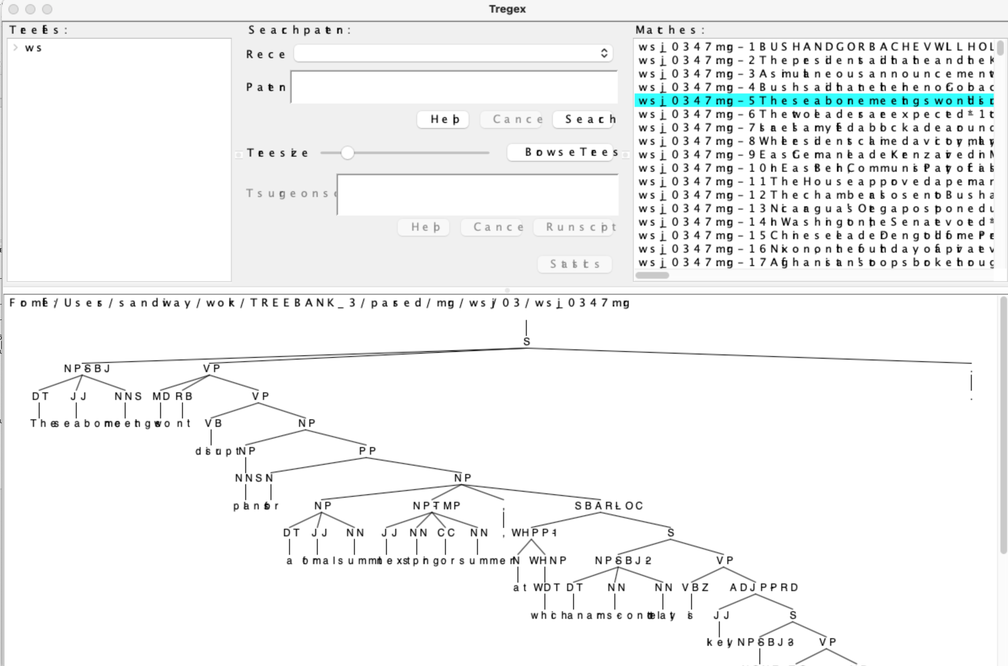
Possible macOS Problem
Disk image version, the Java runtime environment seems to pick wrong fonts. Display is hard to read.

Slide 23
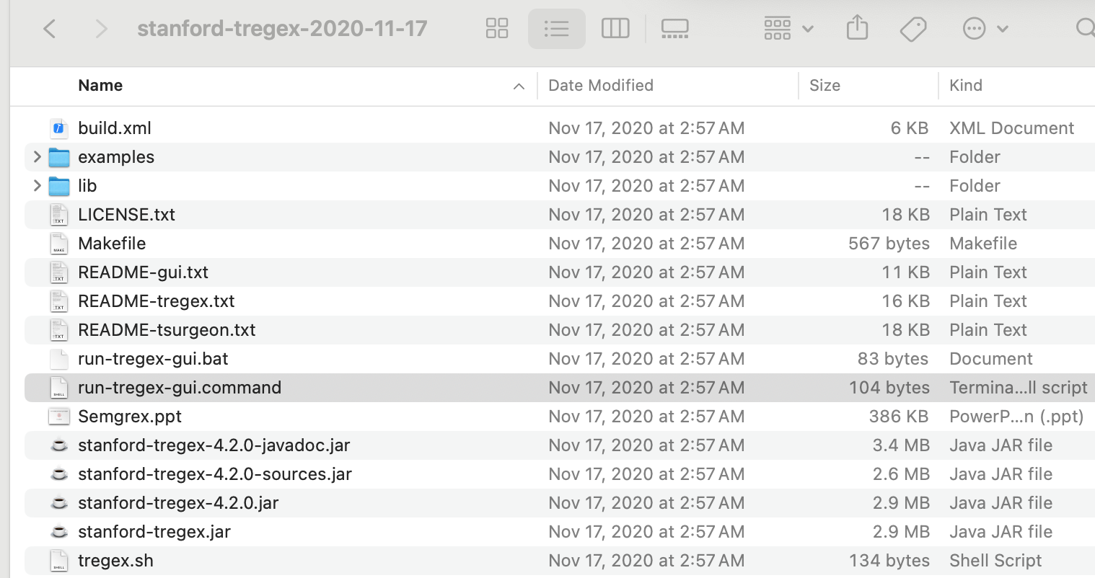
Possible macOS Problem
If this happens, download the non-image link
for macOS, run this command

Slide 24
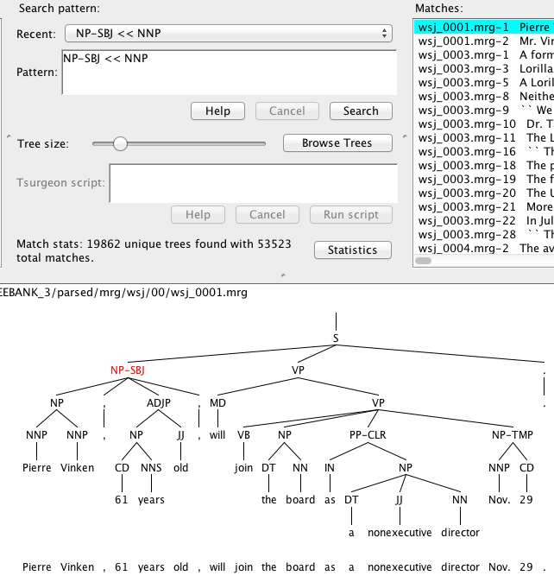
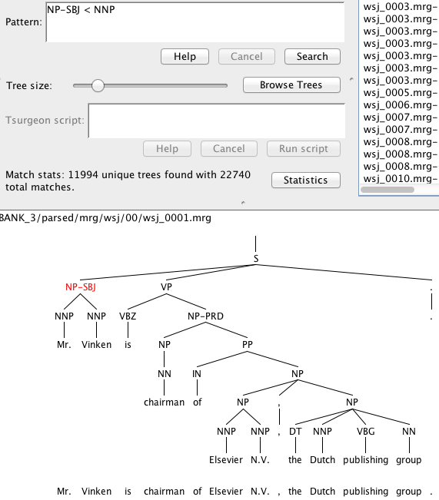
tregex
Search
NP-SBJ << (dominates) vs. < (immediately dominates) NNP

Slide 25
tregex
README-tregex.txt

