Slide 1
LING/C SC 581: Advanced Computational Linguistics
Lecture 20

Slide 2
Today's Topic
Homework 8 not yet graded, no homework today
Live demo of ChatGPT vs. WordNet for Semantic Opposition

Slide 3
Lexical Semantics
Example:
John mended the torn dress
torn dress dress still torn?
John mended the red dress
red dress dress still red?
Idea:
mend is a change-of-state verb
X mend Y, Y changes STATE (X doesn't change)
X CAUSE Y BE-IN STATE(mended)
properties of Y that contradict STATE(mended) are canceled

Slide 4
ChatGPT testing

Slide 5
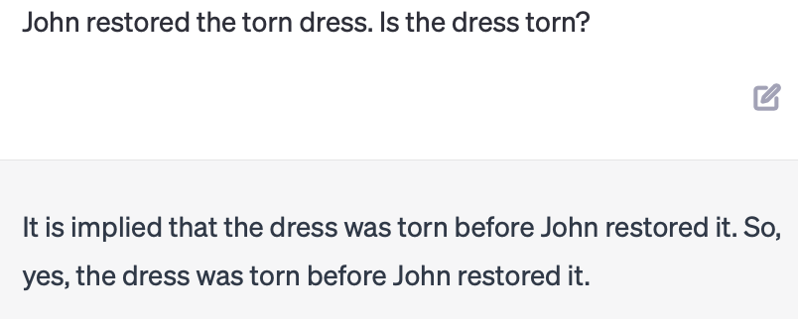
WordNet synsets

Slide 6
More examples
Event-based Models of Change and Persistence in Language (Pustejovsky, 2000).
Adapted examples:
The waiter filled every empty glass
Mary fixed the flat tire
Mary fixed the leaky tire
John comforted the crying child
John rescued the drowning man
The nurse mixed the powdered milk
Which ones work?
Can you think of others?

Slide 7
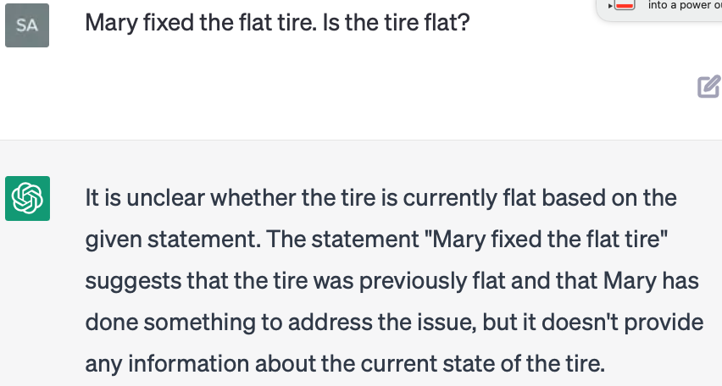
Semantic Opposition and ChatGPT
Other accomplishment verbs:
The waiter filled the empty glass
Mary fixed the flat tire

Slide 8
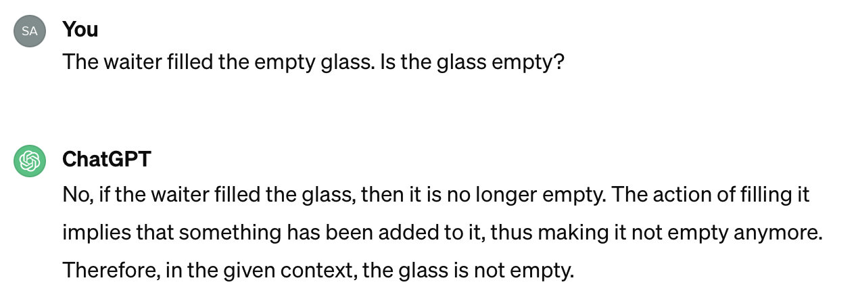
Semantic Opposition and ChatGPT
Other accomplishment verbs:
The waiter filled the empty glass
Mary fixed the flat tire

Slide 9
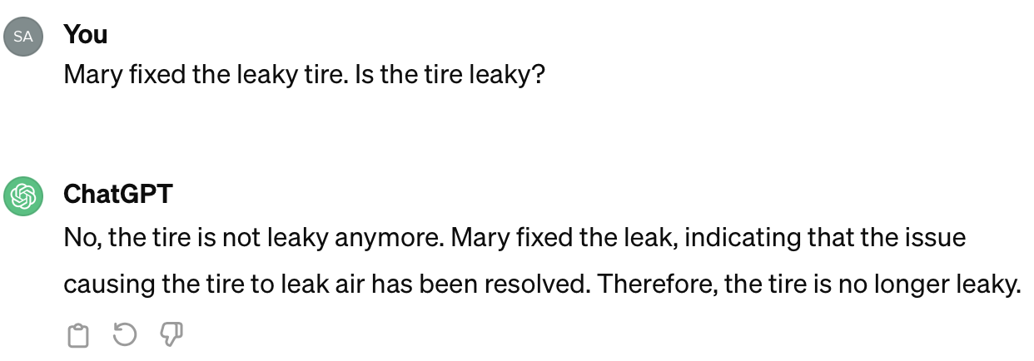
Semantic Opposition and ChatGPT
Other accomplishment verbs:
Mary fixed the leaky tire

Slide 10
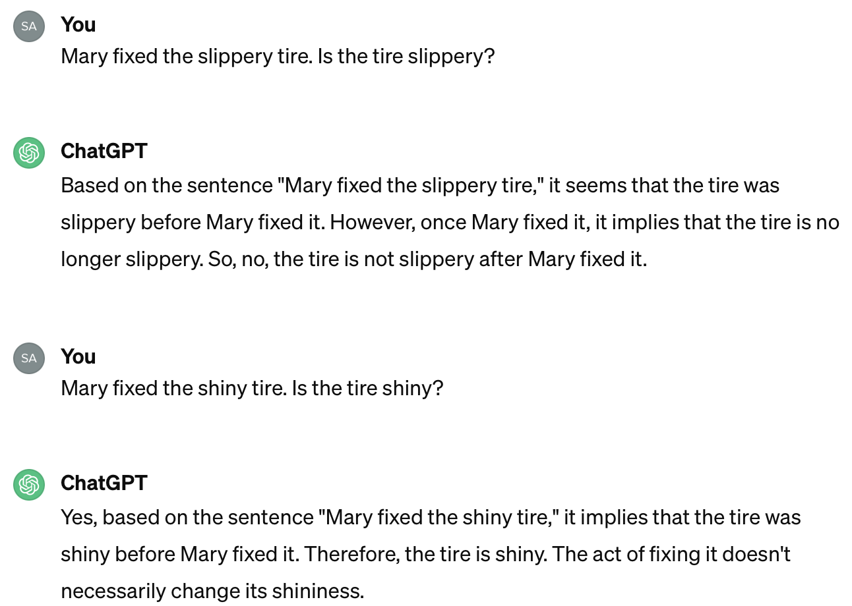
Semantic Opposition and ChatGPT
Other accomplishment verbs:
Mary fixed the shiny/slippery tire

Slide 11
Semantic Opposition and ChatGPT
Activity verbs and resultatives:
John painted the red door blue
John swept the dirty floor
John swept the dirty floor clean

Slide 12
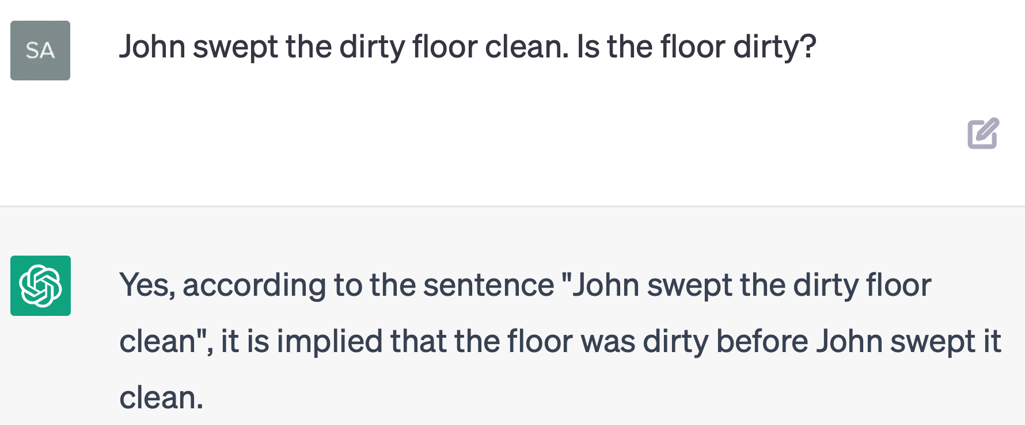
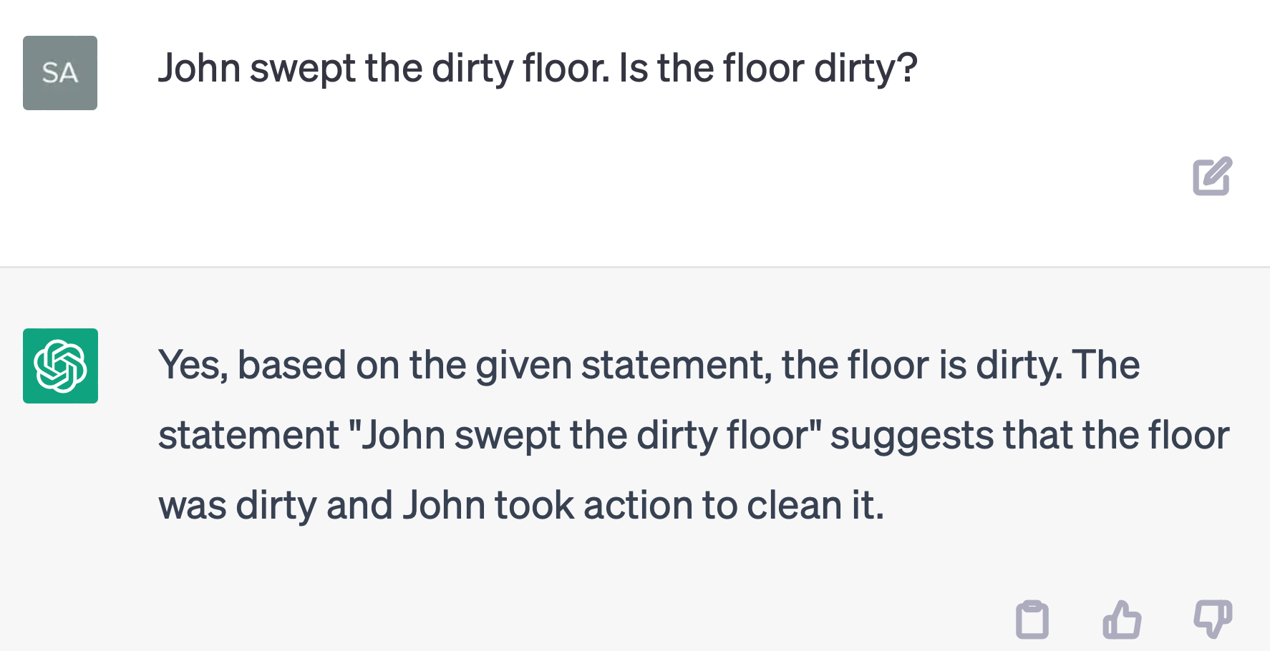
Semantic Opposition and ChatGPT
Activity verbs and resultatives:
John swept the dirty floor
John swept the dirty floor clean

Slide 13
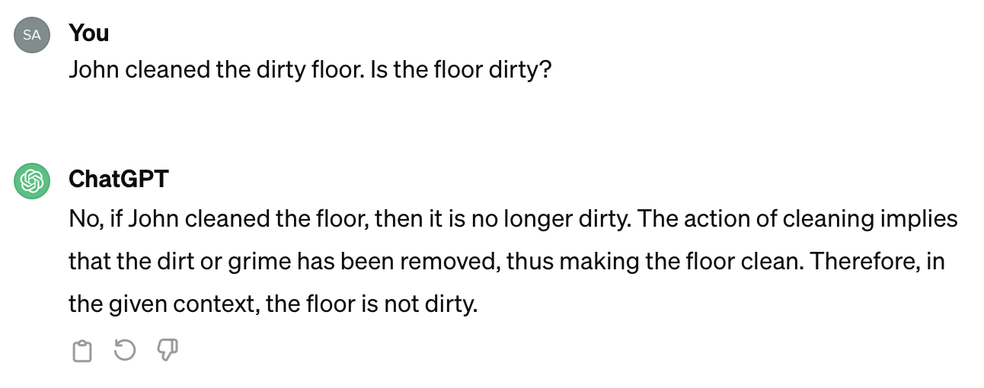
Semantic Opposition and ChatGPT
Other accomplishment verbs:
John cleaned the dirty floor

Slide 14
Searching WordNet
Idea:
if the shortest connection between two word senses involves an antonym relation, Semantic Opposition obtains.
Program
bfs.py word.pos.sense word.pos.sense
BFS (Breadth First Search)
Let's use it to test our hypothesis!

Slide 15
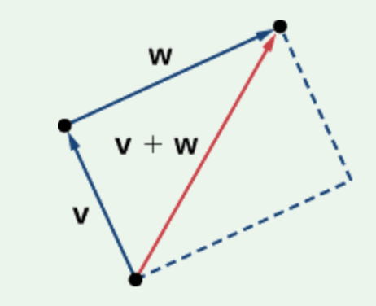
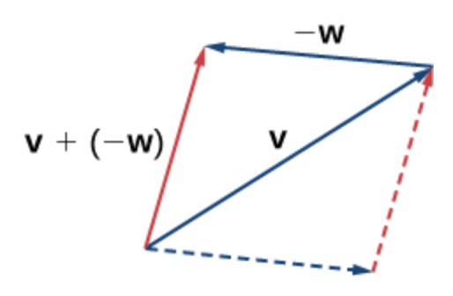
Can the word2vec model be applied?
KeyedVectors setup:
import gensim
from nltk.data import find
word2vec_sample = str(find('models/word2vec_sample/pruned.word2vec.txt'))
model = gensim.models.KeyedVectors.load_word2vec_format(word2vec_sample, binary=False)
Example:
model.most_similar(positive=['woman','king'],negative=['man'], topn=3)
[('queen', 0.7118193507194519), ('monarch', 0.6189674139022827), ('princess', 0.5902430415153503)]
model.most_similar(positive=['man','queen'],negative=['woman'], topn=3)
[('king', 0.6958589553833008), ('kings', 0.5950952768325806), ('queens', 0.583850085735321)]
[wikipedia]

Slide 16
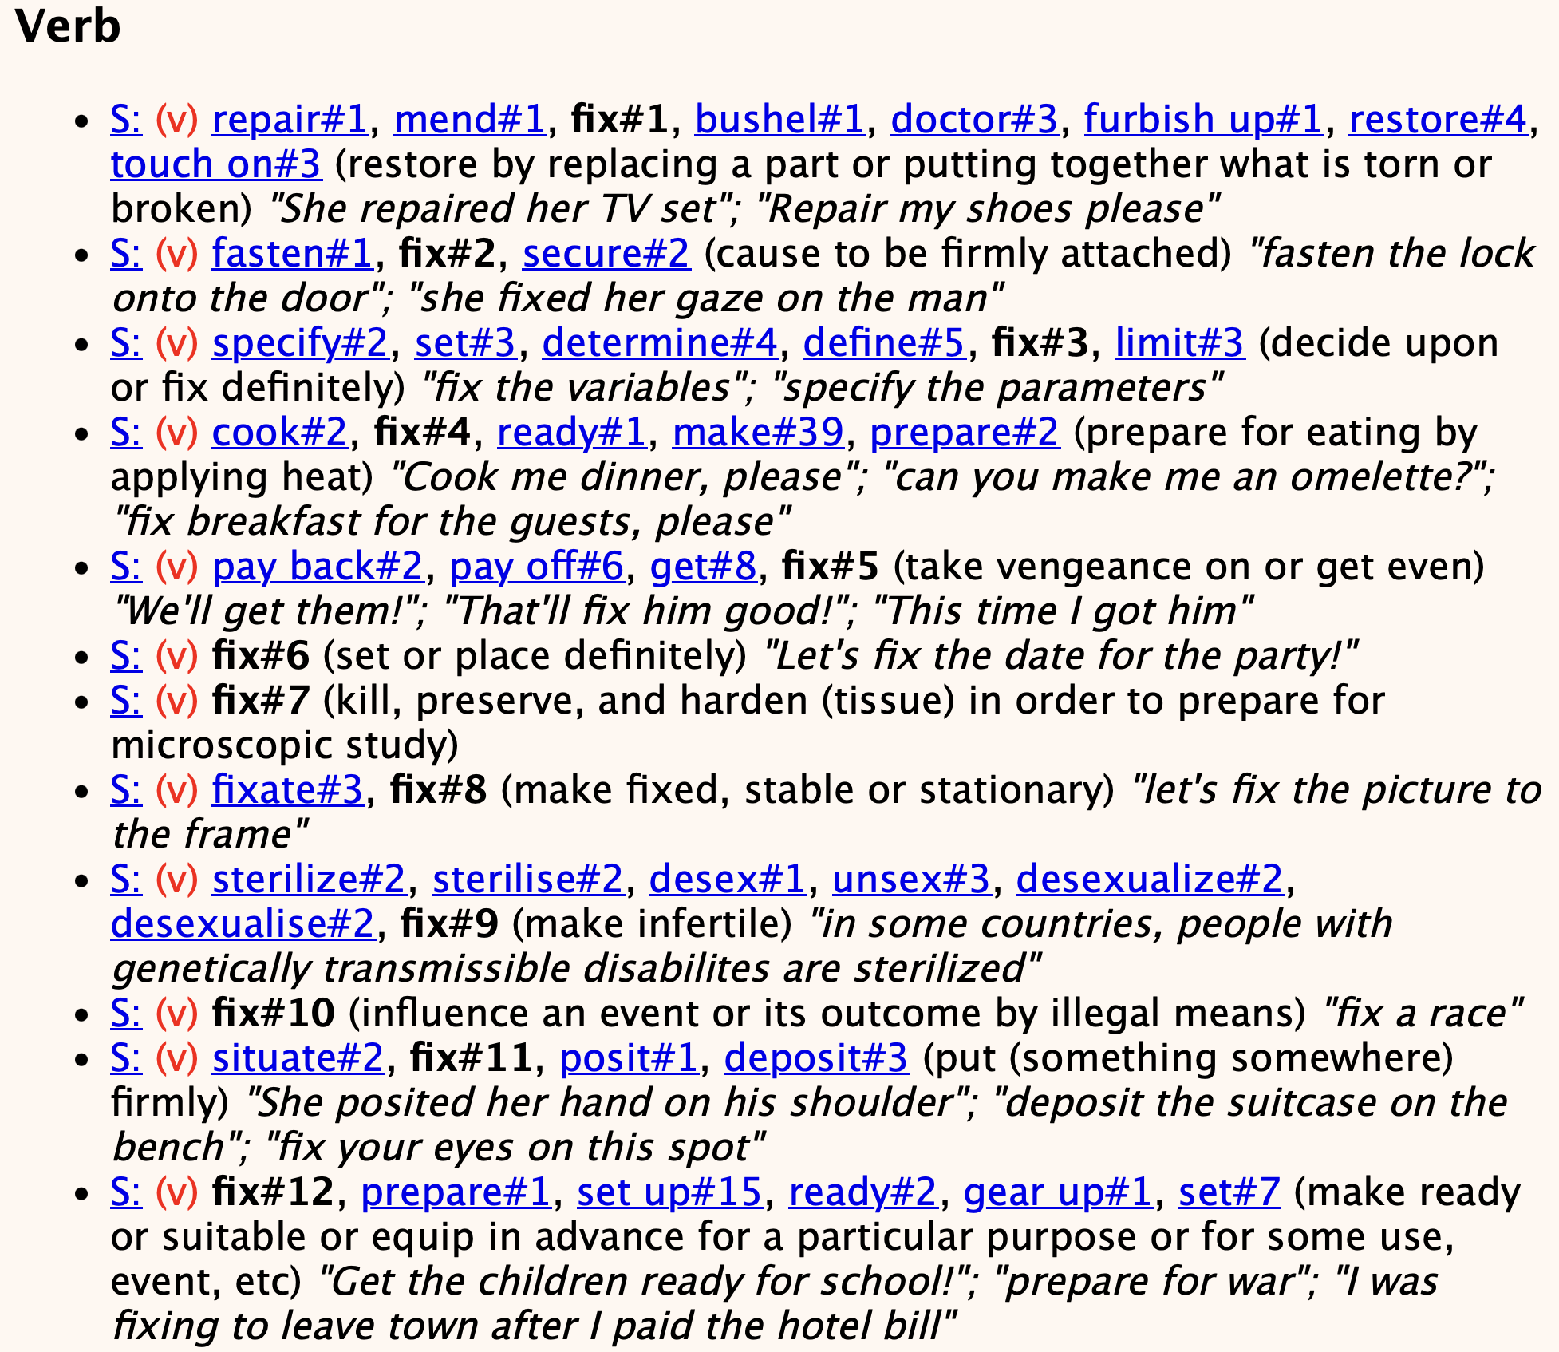
WordNet Browser
Step 1: identifying an appropriate word sense
http://wordnetweb.princeton.edu/perl/webwn

Slide 17
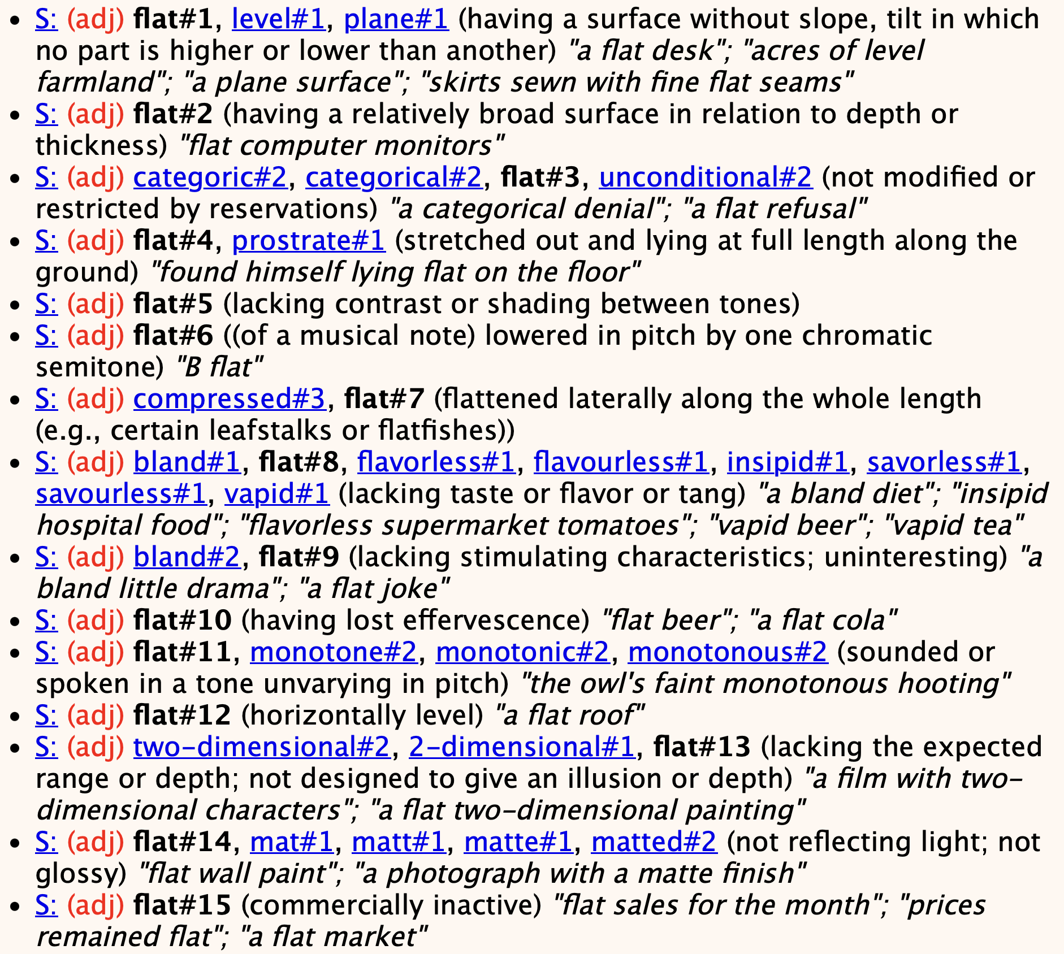
WordNet Browser
Step 1: identifying an appropriate word sense
http://wordnetweb.princeton.edu/perl/webwn

Slide 18
bfs.py parameters
$ python bfs.py -h
usage: bfs.py [-h] [-nd] [-m MAX] start end [others ...]
breadth-first search of nltk WordNet relations with 2D and 3D graphing.
positional arguments:
start word sense pair start
end word sense pair end
others optional additional pairs to search
optional arguments:
-h, --help show this help message and exit
-nd, --nodraw don't draw anything, use with -i flag to drop into the
interpreter.
-m MAX, --max MAX maximum number of nodes to be explored (default: 100000)
Word sense: word.pos.sense, e.g. minibike.n.01 or minibike.n.1; pos = [asrnv]
Run in interactive mode (-i): use lookup(sense1, sense2) then search() to add
to the graph. Plot using draw_graph().

Slide 19
bfs.py parameters

Slide 20
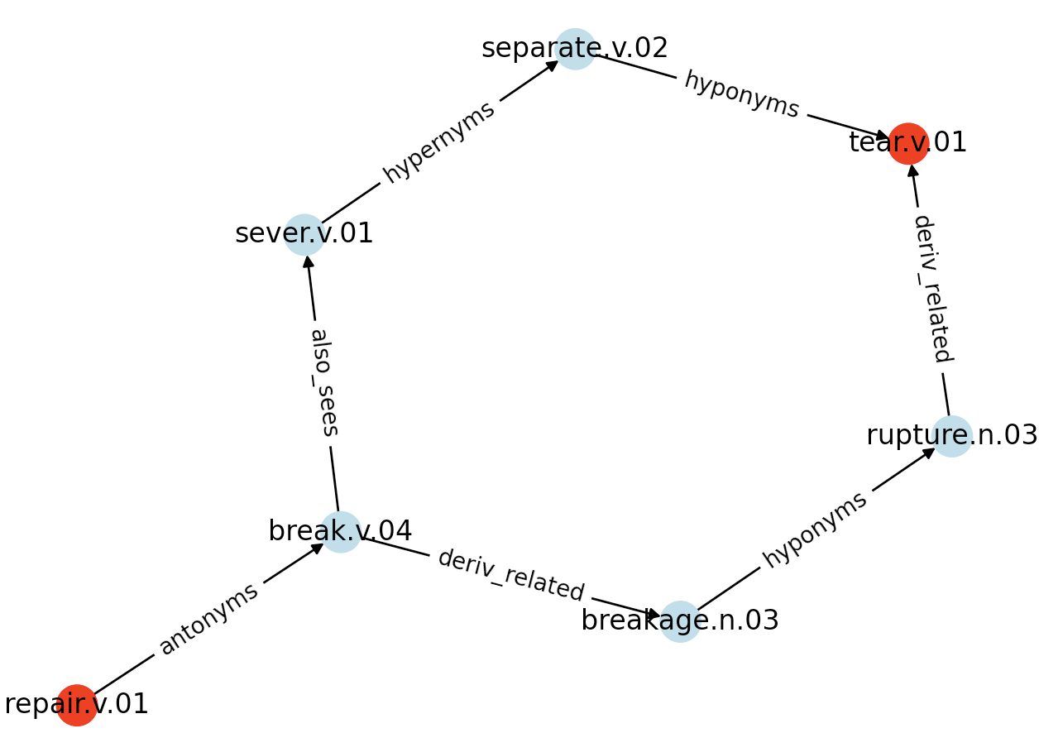
Example
Run:
python bfs.py mend.v.1 tear.v.1
mend.v.1

