Slide 1
LING/C SC 581: Advanced Computational Linguistics
Lecture 19

Slide 2
Today's Topic
Homework 8 Review
Continuing from last time (we didn't get to cover all the slides)
one last mention about word2vec models
Semantic Opposition and WordNet

Slide 3
Homework 8 Review
Using the online Princeton browser or wnb:
Find the connection between recliner (noun, sense 1) and sofa (noun, sense 1).
Show the links (relations).
What is the common hypernym?
python hypernyms.py recliner.n.1 sofa.n.1
Synset('recliner.n.01') Synset('sofa.n.01') have lowest common hypernym Synset('seat.n.03')

Slide 4
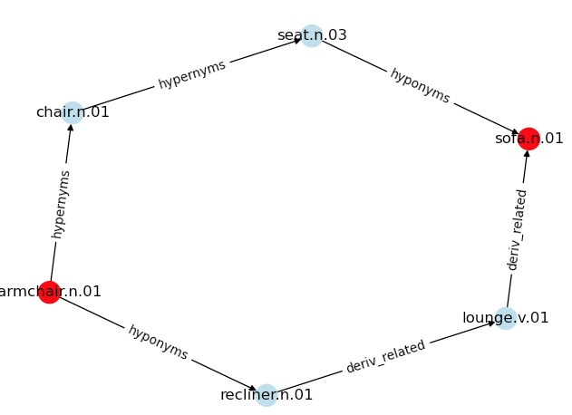
Homework 8 Review
Using the online Princeton browser or wnb:
Find the connection between recliner (noun, sense 1) and sofa (noun, sense 1).
Show the links (relations).
What is the common hypernym?

Slide 5
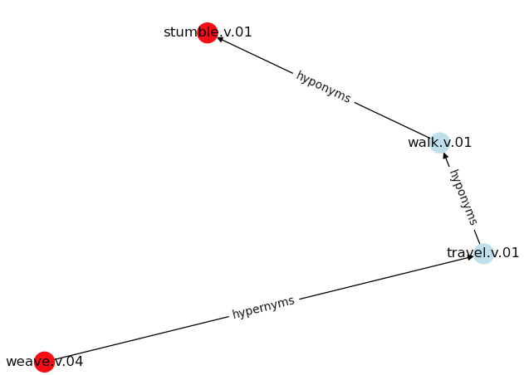
Homework 8 Review
Using the online Princeton browser or wnb:
Find the connection between wander (verb, sense 4) and stumble (verb, sense 1).
Show the links (relations).
What is the common hypernym?
wander.v.4

Slide 6
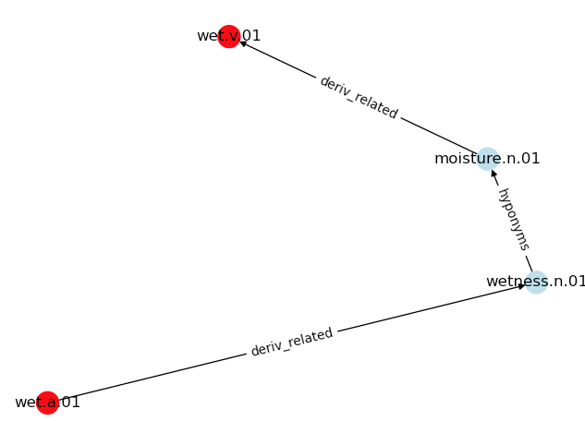
Homework 8 Review
Using the online Princeton browser or wnb:
Find a connection between wet (as a verb) and wet (as an adjective).
Which senses of each word?
Show the links (relations).
What do you think the relationship should be?

Slide 7
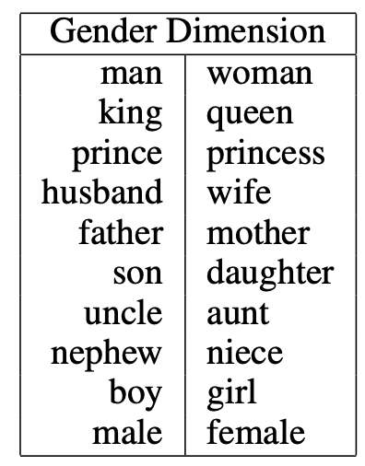
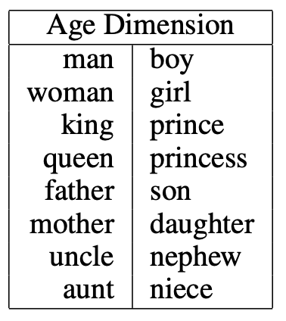
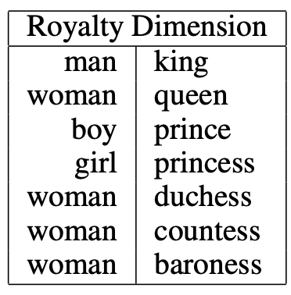
word2vec
Semantic dimensions:
https://www.cs.cmu.edu/~dst/WordEmbeddingDemo/EAAI-2022-Word-Embedding.pdf
given the word “king”, we measure its position along the gender axis by taking the dot product of its embedding vector with a “gender” unit vector.

Slide 8
Using WordNet: Example

Slide 9
Semantic Opposition: mend vs. tear/torn

Slide 10
Semantic Opposition: mend vs. tear/torn

Slide 11
Semantic Opposition and ChatGPT

Slide 12
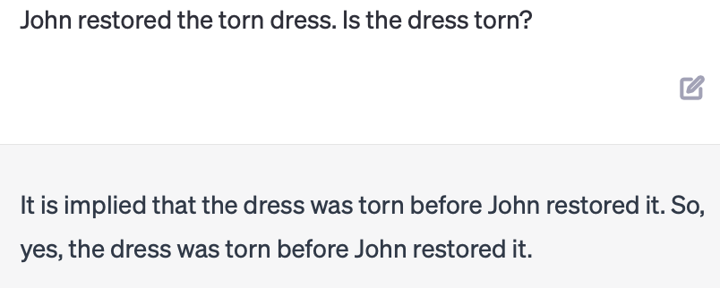
Semantic Opposition and ChatGPT
Synset: {repair, fix, restore, mend, … }
Presupposition only

Slide 13
Semantic Opposition and ChatGPT
Synset: {repair, fix, restore, mend, … }
Presupposition only

Slide 14
Semantic Opposition: clean vs. dirty
resultative

Slide 15
More examples
Event-based Models of Change and Persistence in Language (Pustejovsky, 2000).
Adapted examples:
The waiter filled every empty glass
Mary fixed the flat tire
Mary fixed the leaky tire
John comforted the crying child
John rescued the drowning man
The nurse mixed the powdered milk
Which ones work?
Can you think of others?

Slide 16
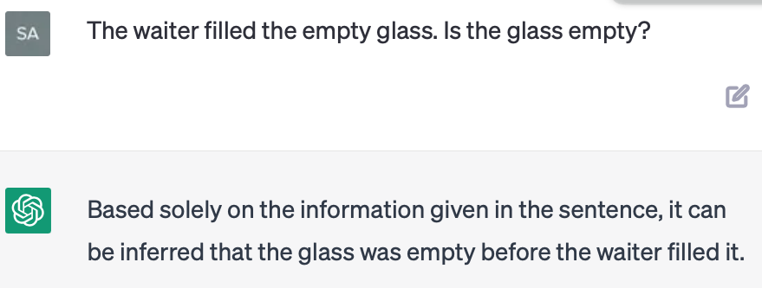
Semantic Opposition
Other accomplishment verbs:
The waiter filled the empty glass
Mary fixed the flat tire
Presupposition only

Slide 17
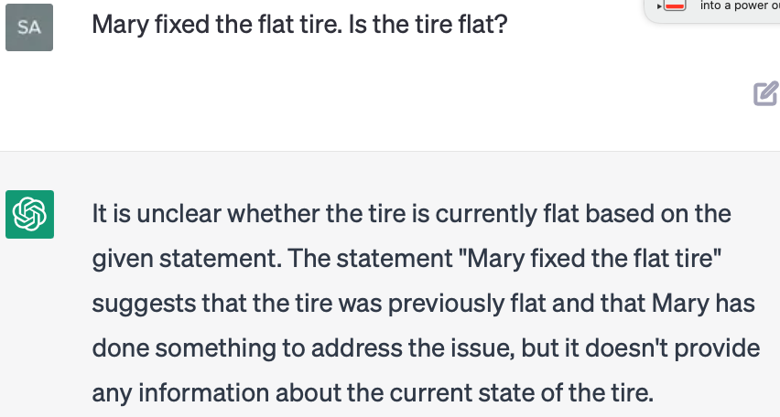
Semantic Opposition and ChatGPT
Other accomplishment verbs:
The waiter filled the empty glass
Mary fixed the flat tire

Slide 18
Semantic Opposition and ChatGPT
Activity verbs and resultatives:
John painted the red door blue
John swept the dirty floor
John swept the dirty floor clean

Slide 19
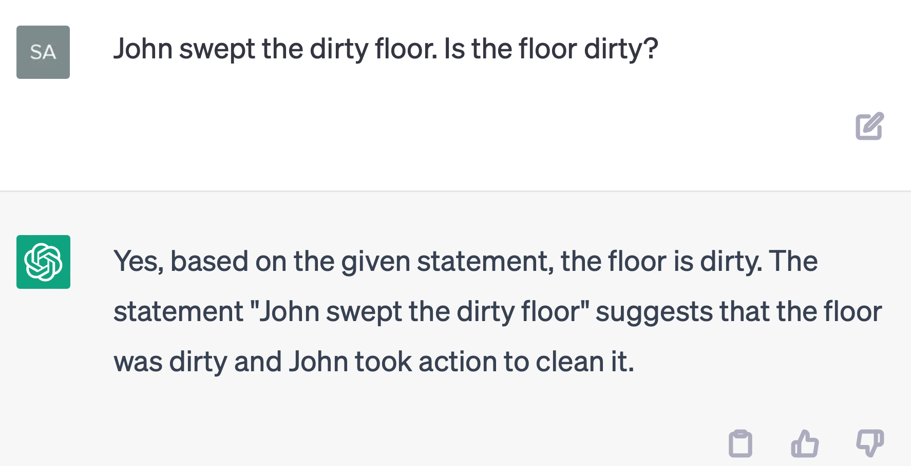
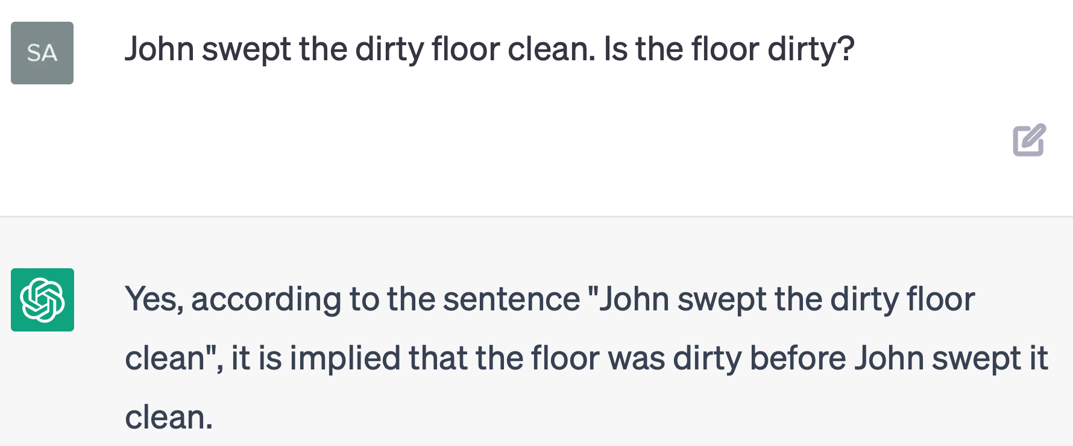
Semantic Opposition and ChatGPT
Activity verbs and resultatives:
John swept the dirty floor
John swept the dirty floor clean

