Slide 1
LING/C SC 581: Advanced Computational Linguistics
Lecture 18

Slide 2
Today's Topic
Last time:
we looked at similarity from two different perspectives:
WordNet (based on hypernymy)
Word Embeddings
Today:
a bit more on vector arithmetic and word embeddings
some of you may be somewhat curious
look at examples of possible uses of WordNet
and a Homework (simple practice with the browser)

Slide 3
Homework 8
Using the online Princeton browser or wnb:
Find the connection between recliner (noun, sense 1) and sofa (noun, sense 1).
Show the links (relations).
What is the common hypernym?
Find the connection between wander (verb, sense 4) and stumble (verb, sense 1).
Show the links (relations).
What is the common hypernym?
Find a connection between wet (as a verb) and wet (as an adjective).
Which senses of each word?
Show the links (relations).
What do you think the relationship should be?

Slide 4
WordNet browsers
Online:
http://wordnetweb.princeton.edu/perl/webwn
Apps:
https://www.sikorskiy.net/info/prj/wnb3/ (I've not tested it.)
wnb code:
macOS: https://sandiway.arizona.edu/ling581-24/working-WordNet-3.0.zip
inside bin subdirectory, suppose you cd to it, type ./wnb after export PATH=./:$PATH (as it calls wishwn).

Slide 5
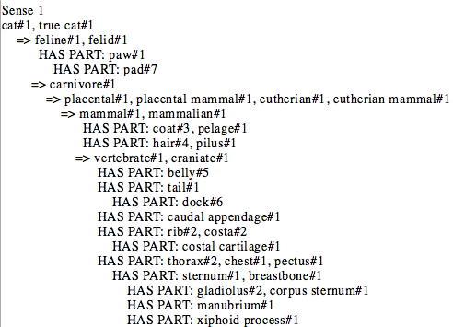
WordNet Relations
Meronyms (has parts, plus inherited):

Slide 6
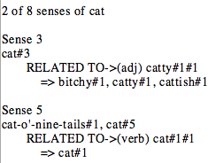
WordNet Relations
Derivationally related to (different part-of-speech):

Slide 7
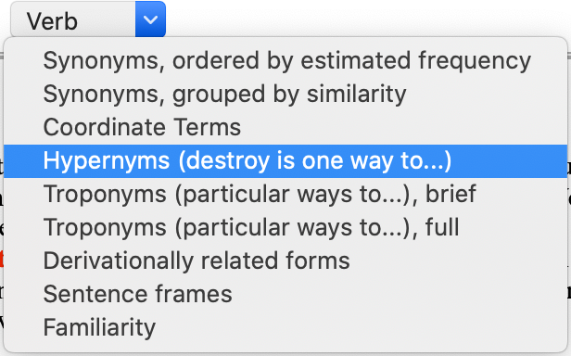
WordNet Relations: verbs
hypernym
troponym
Verbs
destroy (one way to):
destroy#1 => unmake#1, undo#2
destroy#3 => get the better of#1, overcome#1, defeat#1
destroy#4 => kill#1

Slide 8
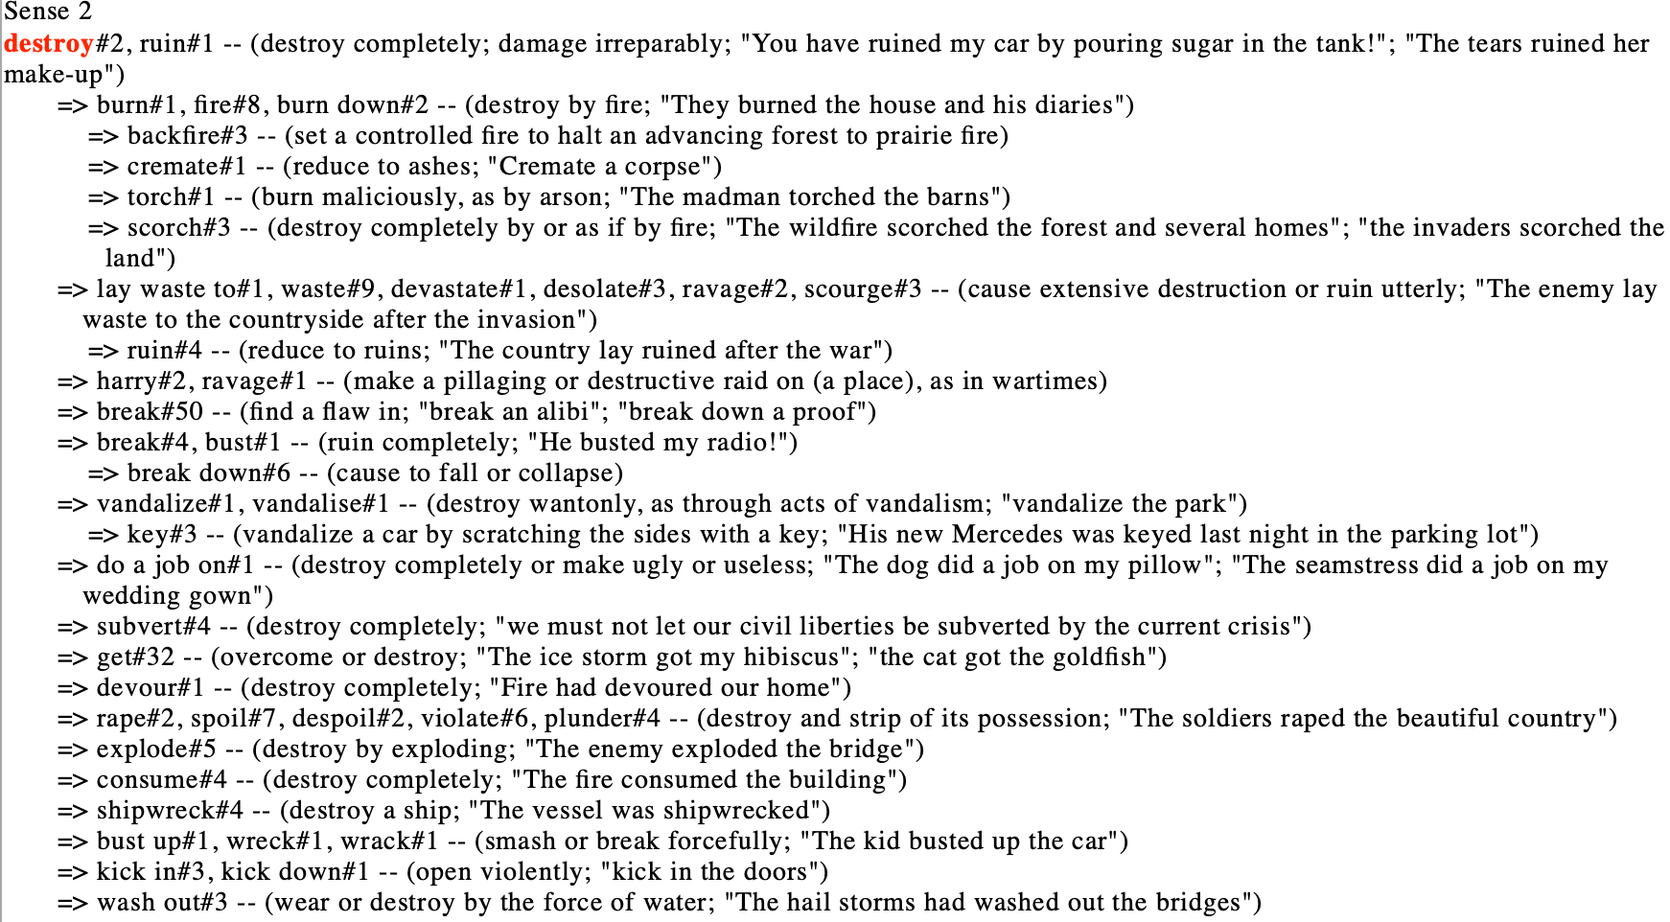
WordNet Relations: verbs
hypernym
troponym
Troponyms (particular ways to destroy#v#2):
e.g. you have ruined my car!

Slide 9
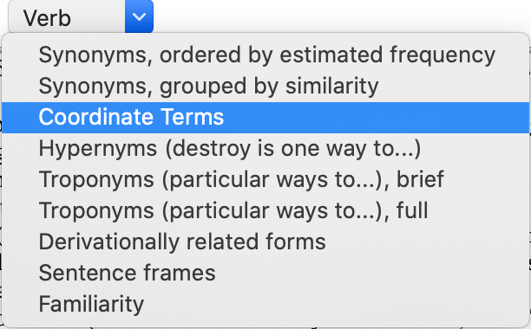
WordNet Relations: verbs
destroy#v#4
destroy#v#4 –up-> kill#v#1 -down-> …

Slide 10
Homework 8
WordNet Browser:
make sure you turn on Sense Numbers
Usual rules.
One PDF file.
Document your answer as needed using screenshots.
Due Monday midnight (we review it next Tuesday)
Email to me sandiway@arizona.edu
Subject: 581 Homework 8 Your Name

Slide 11
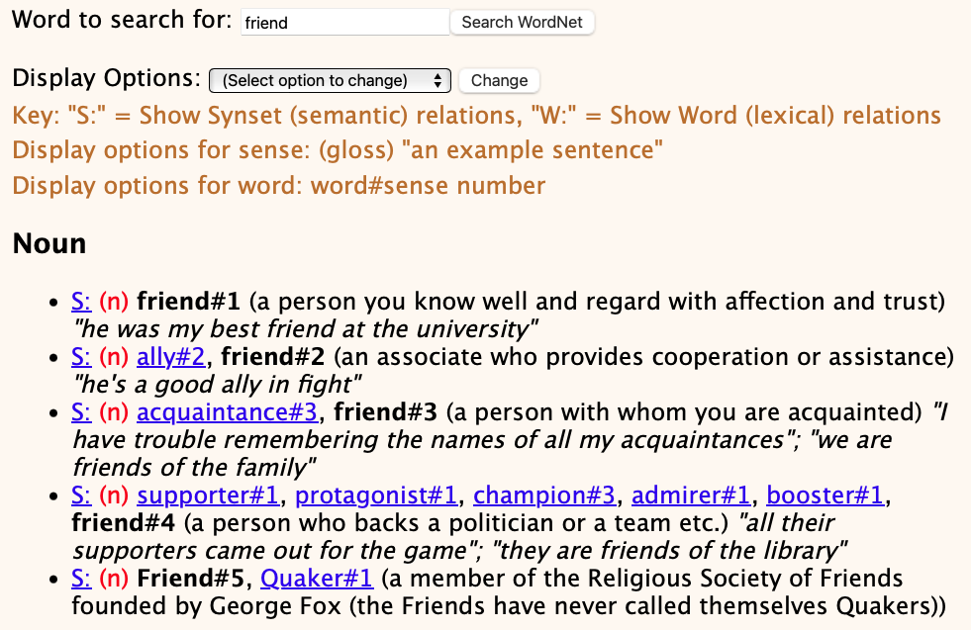
WordNet senses are incomplete
But language is highly productive, and WordNet pre-dates Facebook.

Slide 12
WordNet senses are incomplete
Which word do you think has the most senses?
NPR Pop Culture:
One three-letter word does much of the heavy lifting in the English language. The little word "run" — in its verb form alone — has 645 distinct meanings.
Top three verbs: run, put, set.
https://www.npr.org/2011/05/30/136796448/has-run-run-amok-it-has-645-meanings-so-far

Slide 13
WordNet senses are incomplete

Slide 14
WordNet senses are incomplete
Also, run has 16 senses as a noun.

Slide 15
WordNet senses are incomplete
Plus 1 as a noun

Slide 16
WordNet senses are incomplete
Plus 13 as a noun and 7 senses as an adjective

Slide 17
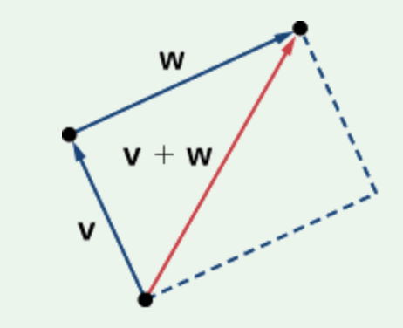
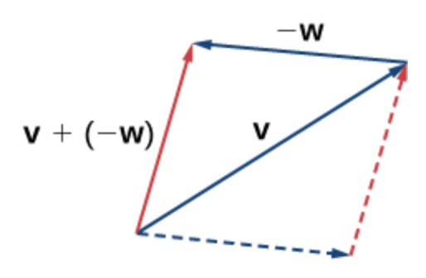
Last Time: word2vec
KeyedVectors setup:
import gensim
from nltk.data import find
word2vec_sample = str(find('models/word2vec_sample/pruned.word2vec.txt'))
model = gensim.models.KeyedVectors.load_word2vec_format(word2vec_sample, binary=False)
Example:
model.most_similar(positive=['woman','king'],negative=['man'], topn=3)
[('queen', 0.7118193507194519), ('monarch', 0.6189674139022827), ('princess', 0.5902430415153503)]
model.most_similar(positive=['man','queen'],negative=['woman'], topn=3)
[('king', 0.6958589553833008), ('kings', 0.5950952768325806), ('queens', 0.583850085735321)]
[wikipedia]

Slide 18
word2vec
Examples:
https://medium.com/plotly/understanding-word-embedding-arithmetic-why-theres-no-single-answer-to-king-man-woman-cd2760e2cb7f
[Y]ou have to include some ‘cheating’. The actual result [is] King - Man + Woman = King. So, the resulting vector would be more similar to King than to Queen. The […] example only works because […] the algorithm will exclude the original vector from the possible results! Second comes Queen, which is what the routine will then pick.
model.most_similar(positive=['woman','king'], topn=3)
[('man', 0.6628608107566833), ('queen', 0.6438565254211426), ('girl', 0.6136073470115662)]
model.most_similar(positive=['programmer','woman'],negative=['man'], topn=3)
[('designer', 0.4621824622154236), ('librarian', 0.45112138986587524), ('copywriter', 0.42773979902267456)]
model.most_similar(positive=['surgeon','woman'],negative=['man'], topn=3)
[('gynecologist', 0.6832519173622131), ('doctor', 0.6073117256164551), ('hysterectomy', 0.5785969495773315)

Slide 19
word2vec
Examples (inflectional morphology):
model.most_similar(positive=['tables','bicycle'],negative=['bicycles'],topn=3)
[('table', 0.5977630019187927), ('Tables', 0.520125687122345), ('napkin', 0.4212760031223297)]
model.most_similar(positive=['table','geese'],negative=['goose'],topn=3)
[('tables', 0.5640795826911926), ('Tables', 0.3900391459465027), ('seated', 0.3859478235244751)]
model.most_similar(positive=['sheep','geese'],negative=['goose'],topn=3)
[('cows', 0.6649561524391174), ('cattle', 0.6110979318618774), ('lambs', 0.609976053237915)]
Let's test a few more?

Slide 20
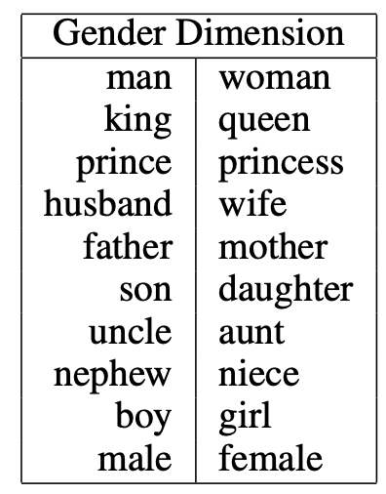
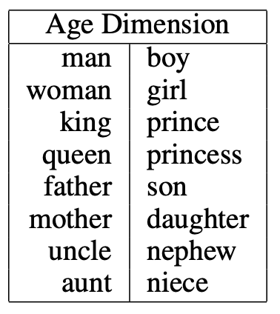
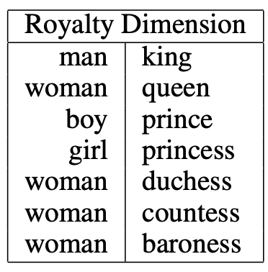
word2vec
Semantic dimensions:
https://www.cs.cmu.edu/~dst/WordEmbeddingDemo/EAAI-2022-Word-Embedding.pdf
given the word “king”, we measure its position along the gender axis by taking the dot product of its embedding vector with a “gender” unit vector.

Slide 21
Using WordNet: Example

Slide 22
Semantic Opposition: mend vs. tear/torn

Slide 23
Semantic Opposition: mend vs. tear/torn

Slide 24
Semantic Opposition and ChatGPT

Slide 25
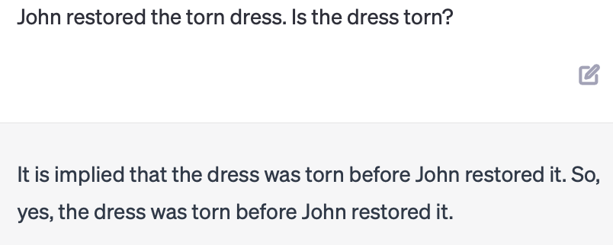
Semantic Opposition and ChatGPT
Synset: {repair, fix, restore, mend, … }
Presupposition only

Slide 26
Semantic Opposition and ChatGPT
Synset: {repair, fix, restore, mend, … }
Presupposition only

Slide 27
Semantic Opposition: clean vs. dirty
resultative

Slide 28
More examples
Event-based Models of Change and Persistence in Language (Pustejovsky, 2000).
Adapted examples:
The waiter filled every empty glass
Mary fixed the flat tire
Mary fixed the leaky tire
John comforted the crying child
John rescued the drowning man
The nurse mixed the powdered milk
Which ones work?
Can you think of others?

Slide 29
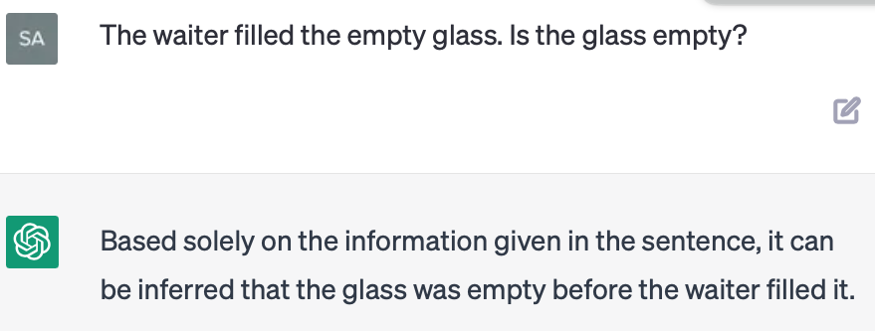
Semantic Opposition
Other accomplishment verbs:
The waiter filled the empty glass
Mary fixed the flat tire
Presupposition only

Slide 30
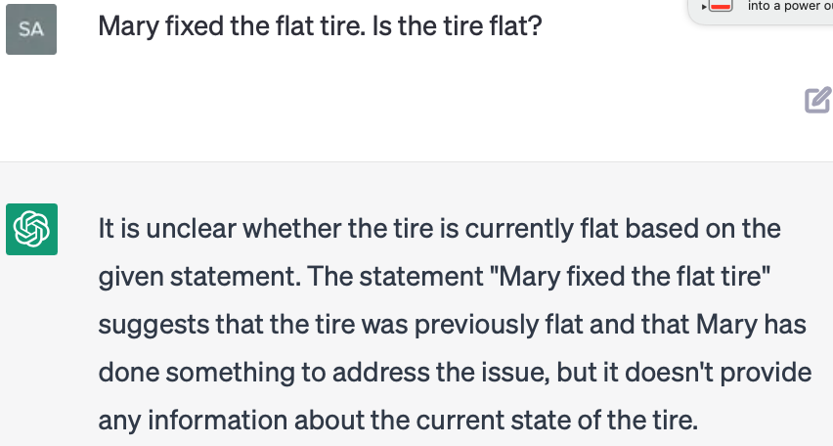
Semantic Opposition and ChatGPT
Other accomplishment verbs:
The waiter filled the empty glass
Mary fixed the flat tire

Slide 31
Semantic Opposition and ChatGPT
Activity verbs and resultatives:
John painted the red door blue
John swept the dirty floor
John swept the dirty floor clean

Slide 32
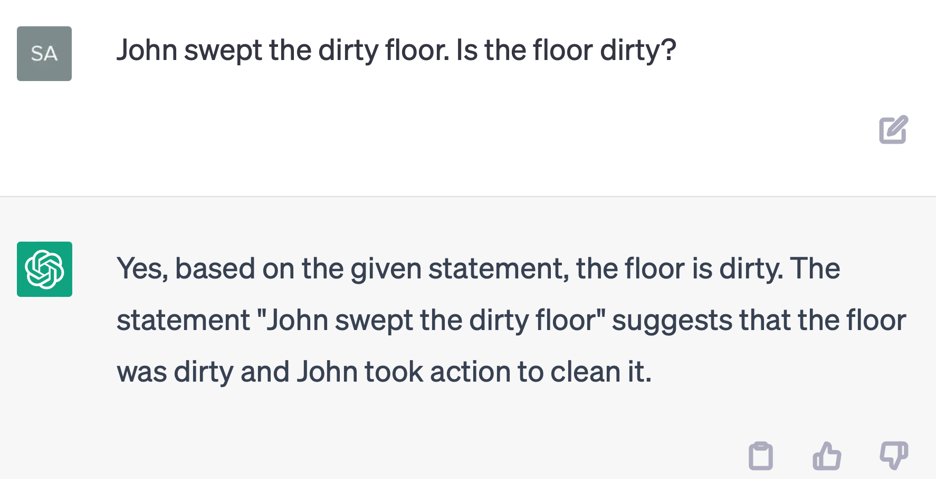
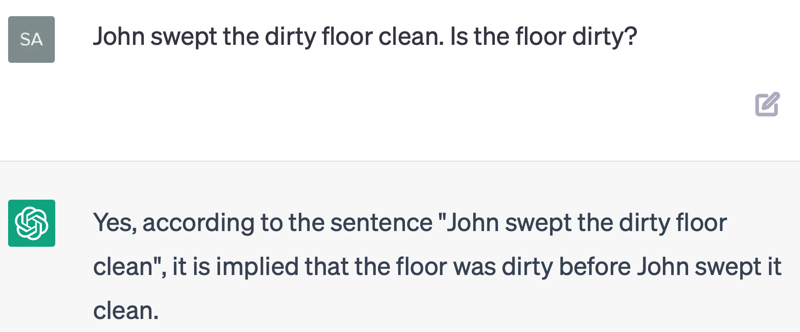
Semantic Opposition and ChatGPT
Activity verbs and resultatives:
John swept the dirty floor
John swept the dirty floor clean

