Slide 1
LING/C SC 581: Advanced Computational Linguistics
Lecture 16

Slide 2
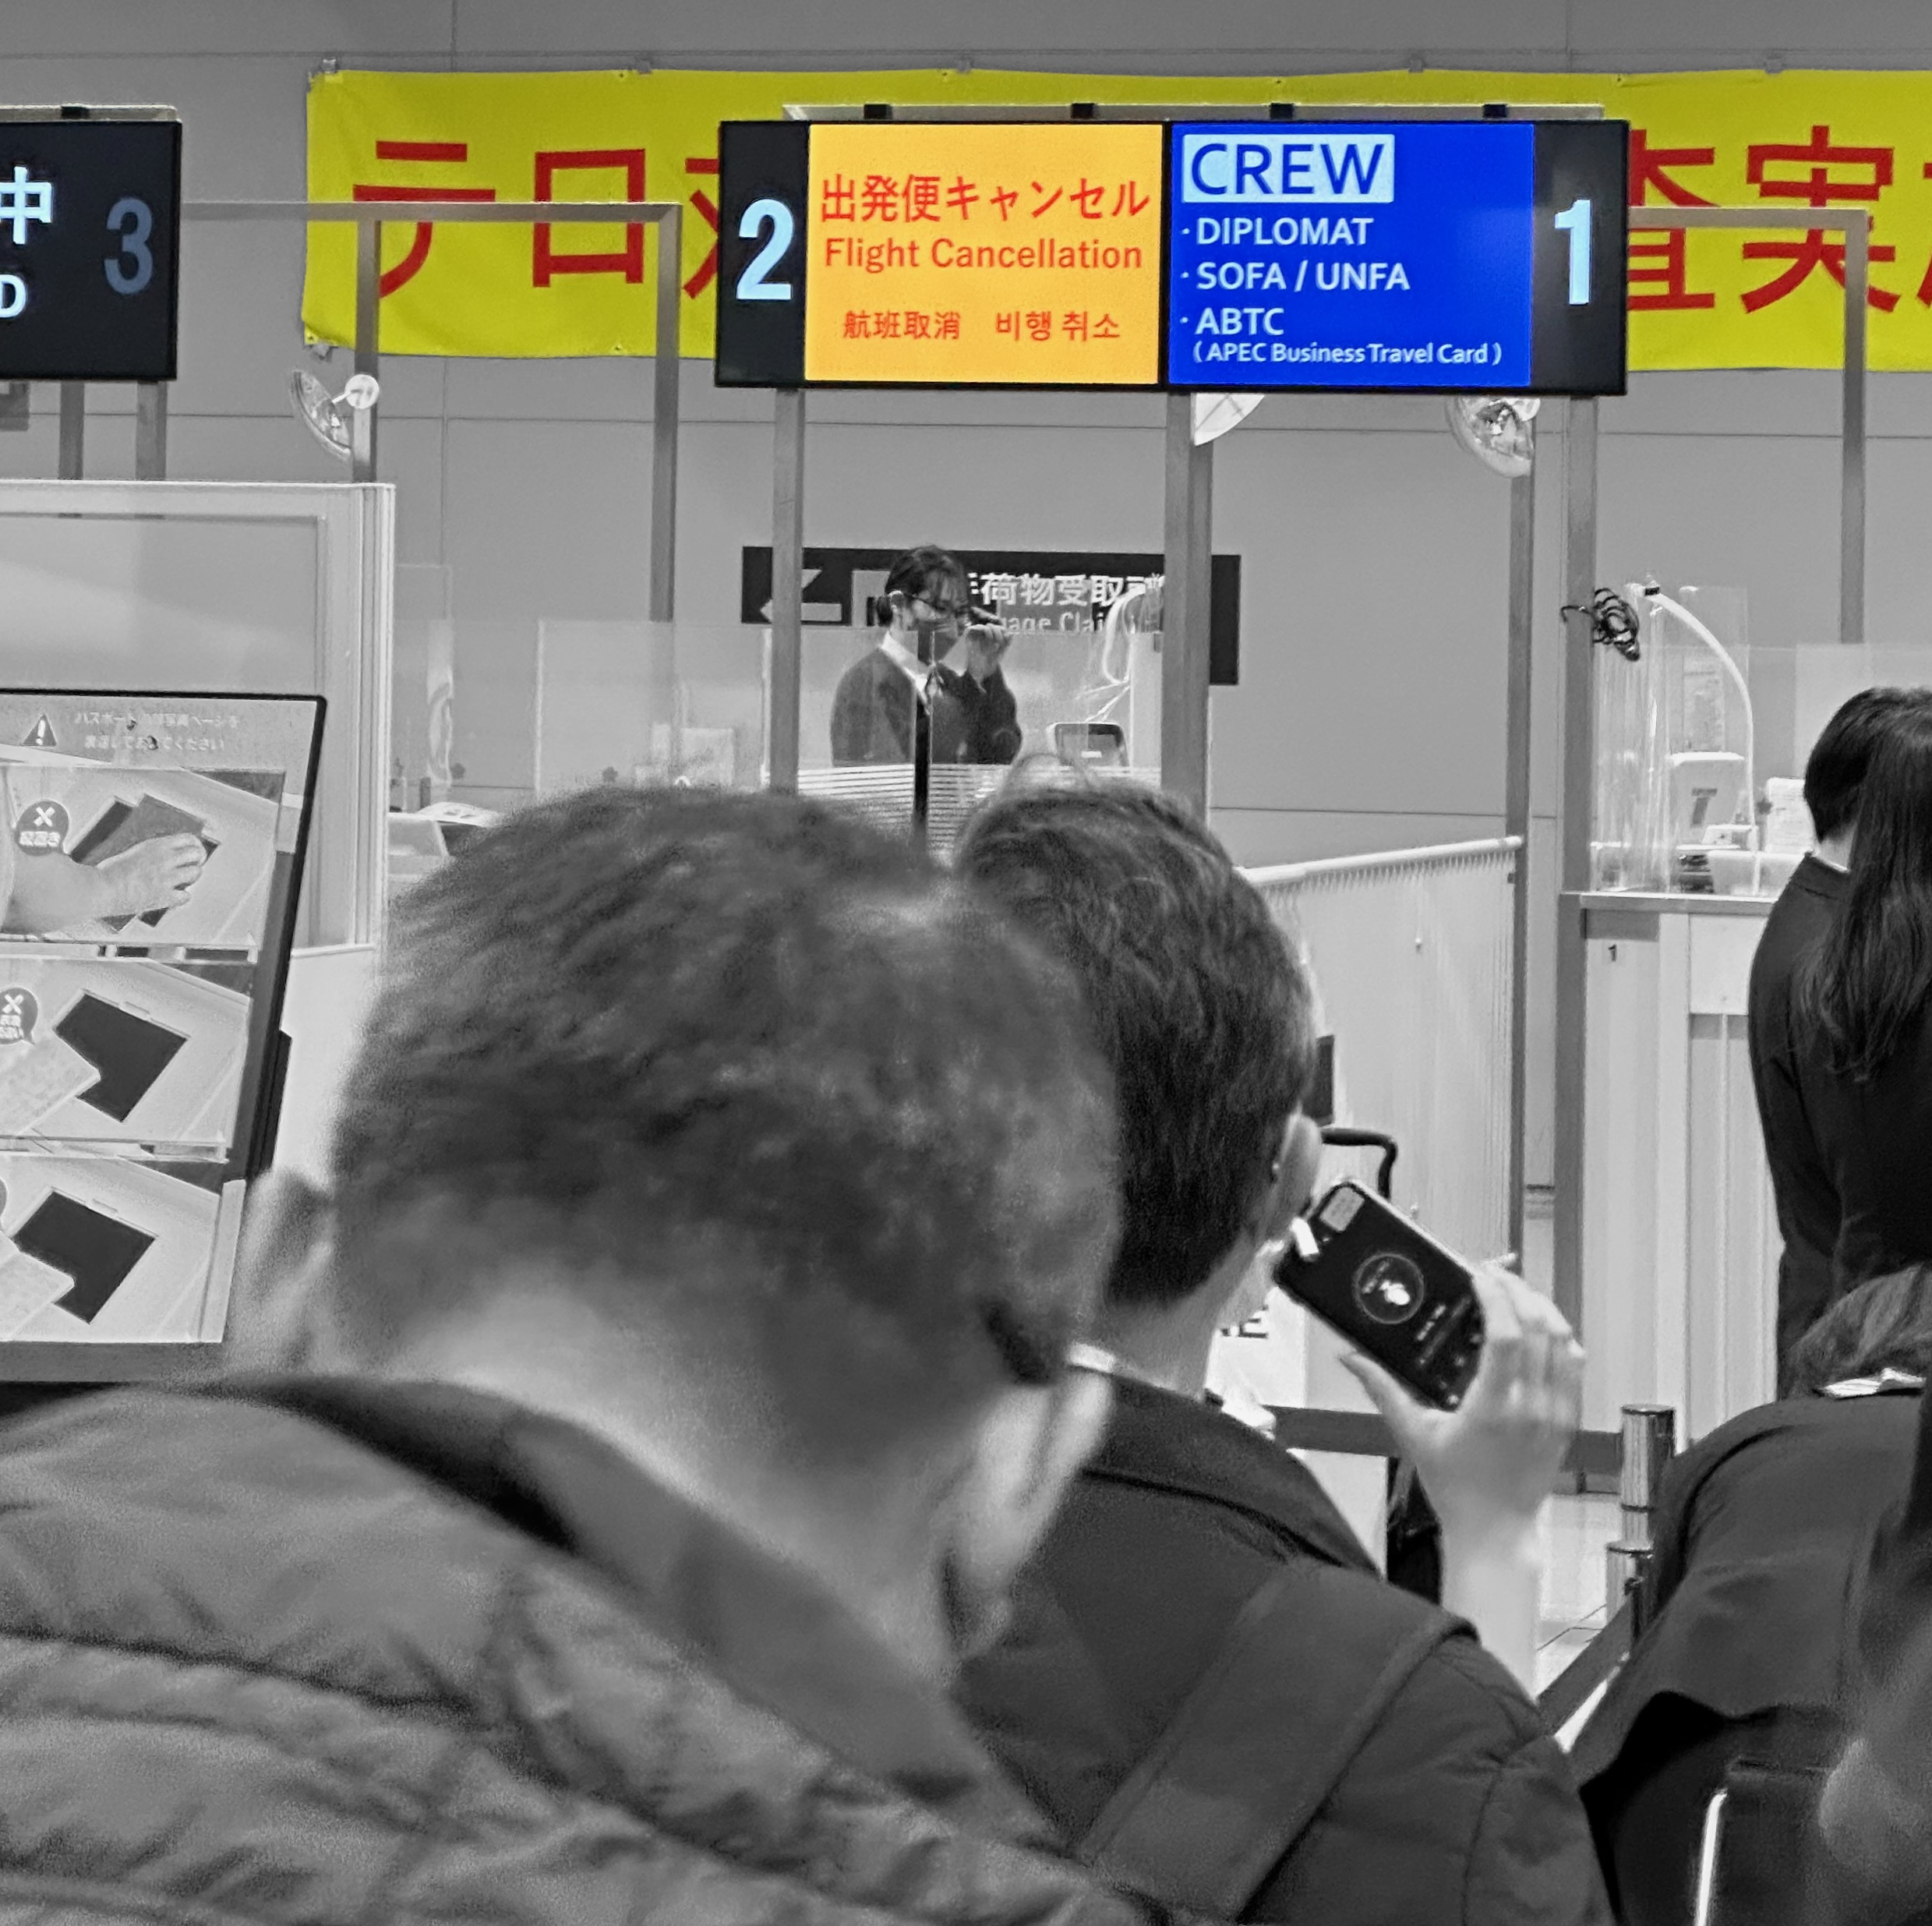
Announcements
There is no lecture 15
Lecture 14 was pre-recorded

Slide 3
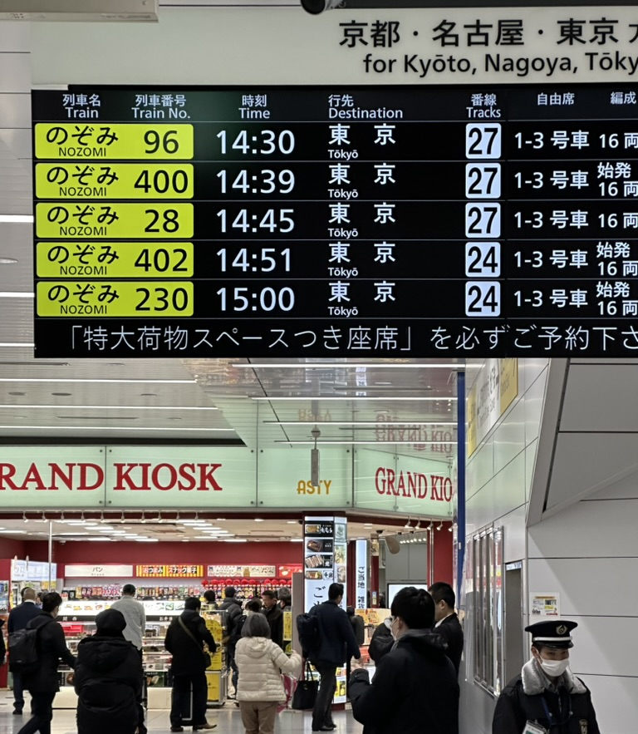

Slide 5
581 is an advanced class
Any interest in my Keio lecture on the latest Chomsky proposals about the theory of language?

Slide 6
https://corenlp.run
appears to be up and running again

Slide 7
Violinist Linked to JAL Crash Blossoms
Crash Blossom Homework:
Not yet graded
Violinist Linked to JAL Crash Blossoms

Slide 8
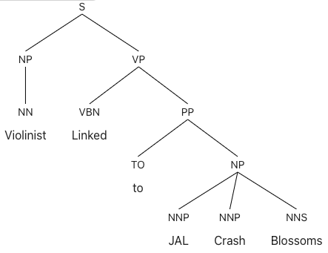
Violinist Linked to JAL Crash Blossoms
https://parser.kitaev.io
Berkeley Neural Parser

Slide 9
Violinist Linked to JAL Crash Blossoms
Stanford Stanza Parser
$ python
Python 3.9.16 | packaged by conda-forge | (main, Feb 1 2023, 21:38:11)
[Clang 14.0.6 ] on darwin
Type "help", "copyright", "credits" or "license" for more information.
>>> import stanza
>>> nlp = stanza.Pipeline('en')
2024-03-14 06:19:20 INFO: Checking for updates to resources.json in case models have been updated. Note: this behavior can be turned off with download_method=None or download_method=DownloadMethod.REUSE_RESOURCES
2024-03-14 06:19:41 INFO: Using device: cpu
2024-03-14 06:19:41 INFO: Loading: tokenize
2024-03-14 06:19:41 INFO: Loading: pos
2024-03-14 06:19:41 INFO: Loading: lemma
2024-03-14 06:19:41 INFO: Loading: constituency
2024-03-14 06:19:41 INFO: Loading: depparse
2024-03-14 06:19:41 INFO: Loading: sentiment
2024-03-14 06:19:41 INFO: Loading: ner
2024-03-14 06:19:42 INFO: Done loading processors!

Slide 10
Stanza updating
Downloading https://raw.githubusercontent.com/stanfordnlp/stanza-resources/main/resources_1.5.0.json: 216kB [00:00, 67.0MB/s]
Downloading https://huggingface.co/stanfordnlp/stanza-en/resolve/v1.5.0/models/d
2024-03-14 06:19:41 INFO: Loading these models for language: en (English):
============================
| Processor | Package |
----------------------------
| tokenize | combined |
| pos | combined |
| lemma | combined |
| constituency | wsj |
| depparse | combined |
| sentiment | sstplus |
| ner | ontonotes |
============================

Slide 11
Violinist Linked to JAL Crash Blossoms
>>> doc = nlp("Violinist Linked to JAL Crash Blossoms")
>>> s = ''
>>> words = doc.sentences[0].words
>>> for i,w in enumerate(words):
... s += '{:<3d}\t{:12s}\t{:<3d}\t{:15s}\n'.format(i+1,w.text,w.head,w.deprel)
...
>>> print(s)
1 Violinist 2 nsubj
2 Linked 0 root
3 to 6 case
4 JAL 6 compound
5 Crash 6 compound
6 Blossoms 2 obl
# global.columns = ID FORM HEAD DEPREL

Slide 12
Violinist Linked to JAL Crash Blossoms
https://urd2.let.rug.nl/~kleiweg/conllu/

Slide 13
Violinist Linked to JAL Crash Blossoms
https://urd2.let.rug.nl/~kleiweg/conllu/

Slide 14
Newspapers could check their headlines?

Slide 15
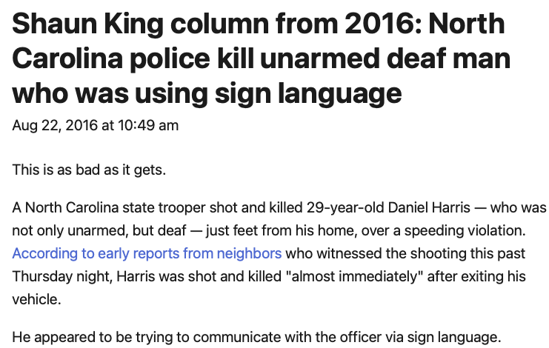
Was fixed!
I went to the Daily News website:

Slide 16
WordNet
Princeton WordNet: a dictionary of English words with semantic relations connecting word senses
also: open Multilingual WordNet

Slide 17
WordNet: online interface
WordNet 3.0
(3.1 the latest version but only online or the database files only)
http://wordnetweb.princeton.edu/perl/webwn
online version of the WordNet browser!

Slide 18
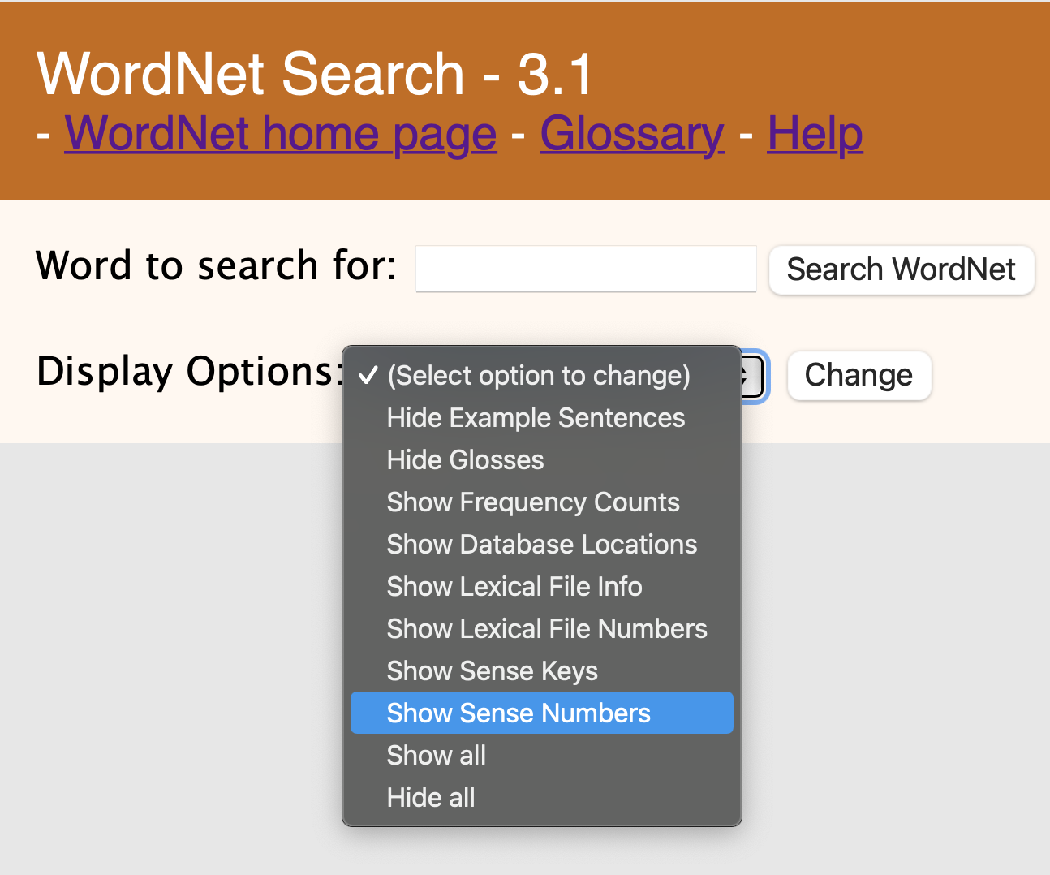
WordNet: online interface
Synonyms:
Benz is credited with the invention of the motorcar.
Benz is credited with the invention of the automobile.
http://wordnetweb.princeton.edu/perl/webwn
turn this on!

Slide 19
WordNet
Relations between word senses grouped into synonym sets (synsets)

Slide 20
WordNet 3.1 Demo

Slide 21
WordNet 3.1 Demo
antonym

Slide 22
NLTK and WordNet
http://www.nltk.org/howto/wordnet.html

Slide 23
nltk WordNet Notation
Details here:
http://www.nltk.org/howto/wordnet.html
A synset is uniquely identified with a 3-part name of the form: word.pos.nn
"head" of the synset is the first listed name: word
pos: one of [asrnv] (adjective/satellite/adverb/noun/verb)
A lemma is uniquely identified with a 4-part name : word.pos.nn.name
the 3-part prefix is the synset

Slide 24
nltk WordNet Notation
Examples:
>>> wn.synsets('dog')
[Synset('dog.n.01'), Synset('frump.n.01'), Synset('dog.n.03'), Synset('cad.n.01'), Synset('frank.n.02'), Synset('pawl.n.01'), Synset('andiron.n.01'), Synset('chase.v.01')]
>>> wn.synsets('animal')
[Synset('animal.n.01'), Synset('animal.s.01')]
>>> wn.synset('motorbike.n.1')
Synset('minibike.n.01')
>>> wn.synset('motorbike.n.1').lemmas()
[Lemma('minibike.n.01.minibike'), Lemma('minibike.n.01.motorbike')]

Slide 25
NLTK and WordNet
Test your nltk:
>>> from nltk.corpus import wordnet as wn
>>> wn.synsets('cat')
[Synset('cat.n.01'),
Synset('guy.n.01'),
Synset('cat.n.03'),
Synset('kat.n.01'),
Synset('cat-o'-nine-tails.n.01'),
Synset('caterpillar.n.02'),
Synset('big_cat.n.01'),
Synset('computerized_tomography.n.01'),
Synset('cat.v.01'),
Synset('vomit.v.01')]
>>> s = wn.synsets('cat')
>>> s[6]
Synset('big_cat.n.01')
>>> s[6].lemma_names()
['big_cat', 'cat']
>>> s[6].lemma_names('fra')
['chat', 'fauve', 'félin']
>>> s[6].lemma_names('spa')
[]
>>> s.lemma_names('jpn')
['大型ネコ科動物']
>>> s[6].hypernyms()
[Synset('feline.n.01')]
>>> s[6].hypernyms()[0].hypernyms()
[Synset('carnivore.n.01')]
>>> s[6].hypernyms()[0].hypernyms()[0].hypernyms()
[Synset('placental.n.01')]
>>> s[6].hypernyms()[0].hypernyms()[0].hypernyms()[0].hypernyms()
[Synset('mammal.n.01')]
Open Multilingual WordNet

Slide 26
NLTK and WordNet
Interlingua is English WordNet senses

Slide 27
nltk book: 2.5.1 Senses and Synonyms
>>> from nltk.corpus import wordnet as wn
>>> wn.synsets('motorcar')
[Synset('car.n.01')]
>>> s = wn.synset('car.n.1')
>>> s
Synset('car.n.01')
>>> s.lemmas()
[Lemma('car.n.01.car'), Lemma('car.n.01.auto'), Lemma('car.n.01.automobile'), Lemma('car.n.01.machine'), Lemma('car.n.01.motorcar')]
>>> s.lemma_names()
['car', 'auto', 'automobile', 'machine', 'motorcar']
>>> s.definition()
'a motor vehicle with four wheels; usually propelled by an internal combustion engine'
>>> s.examples()
['he needs a car to get to work']

