Slide 1
LING/C SC 581: Advanced Computational Linguistics
Lecture 14

Slide 2
Today's Topics
Crash Blossoms
Other Popular Parsers:
CoreNLP, Stanza
Homework 7:
install Stanza into nltk
find Crash Blossoms
run them on parsers

Slide 3
Crash Blossoms
Headlinese:
headlines are compressed (due to a lack of space)
Leaving out words, e.g. copulas etc., may lead to unfortunate structural ambiguities
https://www.nytimes.com/2010/01/31/magazine/31FOB-onlanguage-t.html
Legendary headlines […] include “Giant Waves Down Queen Mary’s Funnel,” “MacArthur Flies Back to Front” and “Eighth Army Push Bottles Up Germans.”
The Columbia Journalism Review published two anthologies with the classic titles “Squad Helps Dog Bite Victim” and “Red Tape Holds Up New Bridge.”
a tabloid

Slide 4
Are these Crash Blossoms?
Perhaps not. Funny, yes, but are they the most likely parse/reading?

Slide 5
Crash Blossoms

Slide 6
Crash Blossom Archive
vmod: reduced non-finite verbal modifier
jailed modifies police officer
pcomp: prepositional complement,
for clausal complement acomp: adjectival complement
https://languagelog.ldc.upenn.edu/nll/?cat=118
https://www.theguardian.com/uk-news/2021/dec/29/pc-jailed-for-attacking-members-of-the-public-found-dead-at-home

Slide 7
Crash Blossom Archive
CoreNLP is your one stop shop for natural language processing in Java!
CoreNLP currently supports 8 languages: Arabic, Chinese, English, French, German, Hungarian, Italian, and Spanish.
https://languagelog.ldc.upenn.edu/nll/?cat=118
Stanford CoreNLP: https://corenlp.run
root
VBN: past participle POS tag

Slide 8
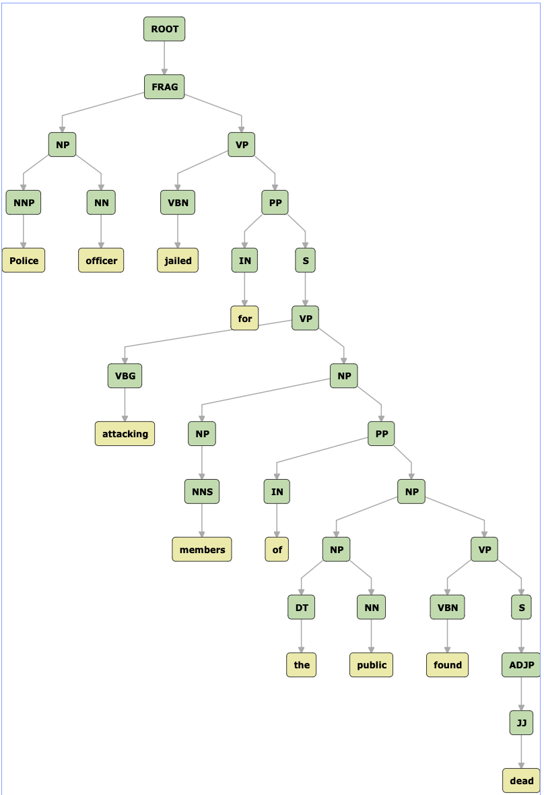
Crash Blossom Archive
FRAG: fragment
https://languagelog.ldc.upenn.edu/nll/?cat=118
Stanford CoreNLP: https://corenlp.run
Who is found dead?

Slide 9
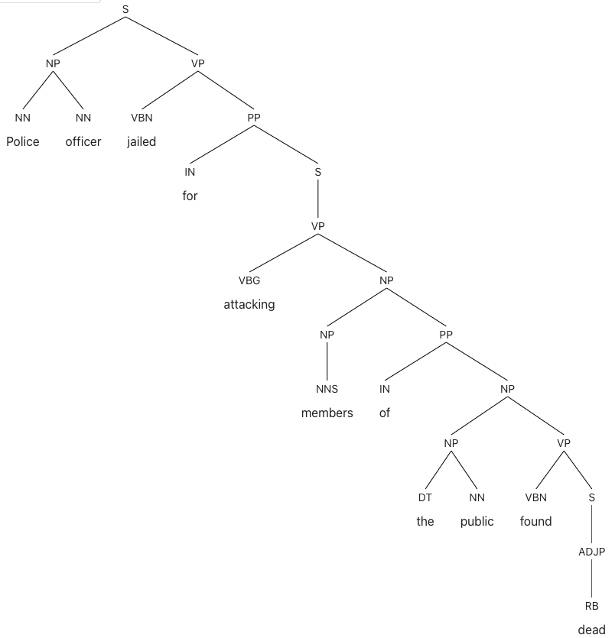
Crash Blossom Archive
S not FRAG
https://languagelog.ldc.upenn.edu/nll/?cat=118
Berkeley Neural Parser: https://parser.kitaev.io
see the VP attachment
Who is found dead?

Slide 10
Stanza
Stanza – A Python NLP Package for Many Human Languages
conda install -c conda-forge stanza
Or
$ pip install stanza
Collecting stanza
Downloading stanza-1.5.0-py3-none-any.whl (802 kB)
|████████████████████████████████| 802 kB 2.6 MB/s
…
Successfully built emoji
Installing collected packages: torch, protobuf, emoji, stanza
Successfully installed emoji-2.2.0 protobuf-4.22.1 stanza-1.5.0 torch-2.0.0
Run:
$ python
Python 3.9.12 (main, Jun 1 2022, 06:34:44)
>>> import stanza
>>> stanza.download('en')
http://stanza.run demo
https://github.com/stanfordnlp/stanza/blob/main/demo/Stanza_Beginners_Guide.ipynb

Slide 11
Stanza
Initialize English neural pipeline:
>>> nlp = stanza.Pipeline('en')
…
2023-03-29 17:50:15 INFO: Loading these models for language: en (English):
============================
| Processor | Package |
----------------------------
| tokenize | combined |
| pos | combined |
| lemma | combined |
| constituency | wsj |
| depparse | combined |
| sentiment | sstplus |
| ner | ontonotes |
============================
2023-03-29 17:50:15 INFO: Using device: cpu
2023-03-29 17:50:15 INFO: Loading: tokenize
2023-03-29 17:50:15 INFO: Loading: pos
2023-03-29 17:50:15 INFO: Loading: lemma
2023-03-29 17:50:15 INFO: Loading: constituency
2023-03-29 17:50:15 INFO: Loading: depparse
2023-03-29 17:50:15 INFO: Loading: sentiment
2023-03-29 17:50:16 INFO: Loading: ner
2023-03-29 17:50:16 INFO: Done loading processors!

Slide 12
Crash Blossom Archive
>>> doc = nlp("Police officer jailed for attacking members of the public found dead")
>>> s = ''
>>> words = doc.sentences[0].words
>>> for i,w in enumerate(words):
... s += '{:<3d}\t{:12s}\t{:6s}\t{:<3d}\t{:15s}\n'.format(i+1,w.text,w.pos,w.head,w.deprel)
...
>>> print(s)
1 Police NOUN 2 compound
2 officer NOUN 3 nsubj
3 jailed VERB 0 root
4 for SCONJ 5 mark
5 attacking VERB 3 advcl
6 members NOUN 5 obj
7 of ADP 9 case
8 the DET 9 det
9 public NOUN 6 nmod
10 found VERB 3 advcl
11 dead ADJ 10 xcomp

Slide 13
Crash Blossom Archive
>>> print(doc)
[
[
{
"id": 1,
"text": "Police",
"lemma": "police",
"upos": "NOUN",
"xpos": "NNS",
"feats": "Number=Plur",
"head": 2,
"deprel": "compound",
"start_char": 0,
"end_char": 6,
"ner": "O",
"multi_ner": [
"O"
]
},
{
"id": 2,
"text": "officer",
"lemma": "officer",
"upos": "NOUN",
"xpos": "NN",
"feats": "Number=Sing",
"head": 3,
"deprel": "nsubj",
"start_char": 7,
"end_char": 14,
"ner": "O",
"multi_ner": [
"O"
]
},
{
"id": 3,
"text": "jailed",
"lemma": "jail",
"upos": "VERB",
"xpos": "VBD",
"feats": "Tense=Past|VerbForm=Part",
"head": 0,
"deprel": "root",
"start_char": 15,
"end_char": 21,
"ner": "O",
"multi_ner": [
"O"
]
},
{
"id": 4,
"text": "for",
"lemma": "for",
"upos": "SCONJ",
"xpos": "IN",
"head": 5,
"deprel": "mark",
"start_char": 22,
"end_char": 25,
"ner": "O",
"multi_ner": [
"O"
]
},
{
"id": 5,
"text": "attacking",
"lemma": "attack",
"upos": "VERB",
"xpos": "VBG",
"feats": "VerbForm=Ger",
"head": 3,
"deprel": "advcl",
"start_char": 26,
"end_char": 35,
"ner": "O",
"multi_ner": [
"O"
]
},
{
"id": 6,
"text": "members",
"lemma": "member",
"upos": "NOUN",
"xpos": "NNS",
"feats": "Number=Plur",
"head": 5,
"deprel": "obj",
"start_char": 36,
"end_char": 43,
"ner": "O",
"multi_ner": [
"O"
]
},
{
"id": 7,
"text": "of",
"lemma": "of",
"upos": "ADP",
"xpos": "IN",
"head": 9,
"deprel": "case",
"start_char": 44,
"end_char": 46,
"ner": "O",
"multi_ner": [
"O"
]
},
{
"id": 8,
"text": "the",
"lemma": "the",
"upos": "DET",
"xpos": "DT",
"feats": "Definite=Def|PronType=Art",
"head": 9,
"deprel": "det",
"start_char": 47,
"end_char": 50,
"ner": "O",
"multi_ner": [
"O"
]
},
{
"id": 9,
"text": "public",
"lemma": "public",
"upos": "NOUN",
"xpos": "NN",
"feats": "Number=Sing",
"head": 6,
"deprel": "nmod",
"start_char": 51,
"end_char": 57,
"ner": "O",
"multi_ner": [
"O"
]
},
{
"id": 10,
"text": "found",
"lemma": "find",
"upos": "VERB",
"xpos": "VBD",
"feats": "Mood=Ind|Person=3|Tense=Past|VerbForm=Fin",
"head": 3,
"deprel": "advcl",
"start_char": 58,
"end_char": 63,
"ner": "O",
"multi_ner": [
"O"
]
},
{
"id": 11,
"text": "dead",
"lemma": "dead",
"upos": "ADJ",
"xpos": "JJ",
"feats": "Degree=Pos",
"head": 10,
"deprel": "xcomp",
"start_char": 64,
"end_char": 68,
"ner": "O",
"multi_ner": [
"O"
]
}
]
]

Slide 14
Graphing: CoNLL-U Plus Format
How to print this? See next slides

Slide 15
Graphing: rolling your own
networkx graph
graphviz_layout

Slide 16
Graphing: CoNLL-U Plus Format
>>> s = ''
>>> for i,w in enumerate(words):
... s += '{:<3d}\t{:12s}\t{:<3d}\t{:15s}\n'.format(i+1,w.text,w.head,w.deprel)
...
>>> print(s)
1 Police 2 compound
2 officer 3 nsubj
3 jailed 0 root
4 for 5 mark
5 attacking 3 advcl
6 members 5 obj
7 of 9 case
8 the 9 det
9 public 6 nmod
10 found 3 advcl
11 dead 10 xcomp

Slide 17
Graphing: CoNLL-U Plus Format
https://urd2.let.rug.nl/~kleiweg/conllu/
# global.columns = ID FORM HEAD DEPREL

Slide 18
Graphing: CoNLL-U Plus Format
https://universaldependencies.org/ext-format.html
While a CoNLL-U file has always precisely ten columns separated by TAB characters, a CoNLL-U Plus file can have any non-zero number of columns.
In addition, the first line must be a sentence-level comment (i.e., starting with a # character) that lists the names of the columns used in this file.
Example:
# global.columns = ID FORM LEMMA UPOS XPOS FEATS HEAD DEPREL DEPS MISC

Slide 19
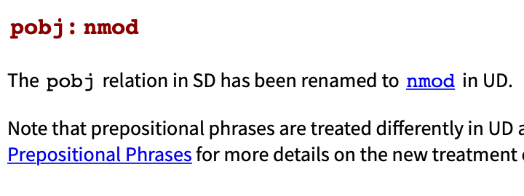
Violinist Linked to JAL Crash Blossoms

Slide 20
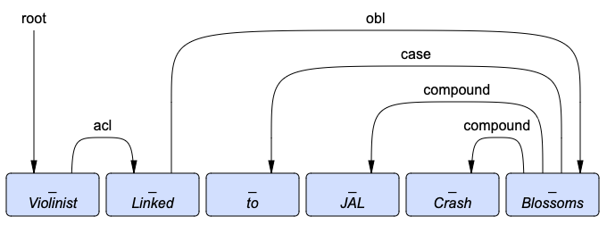
Violinist Linked to JAL Crash Blossoms
>>> doc = nlp("Violinist Linked to JAL Crash Blossoms")
>>> words = doc.sentences[0].words
>>> s = ''
>>> for i,w in enumerate(words):
... s += '{:<3d}\t{:12s}\t{:<3d}\t{:15s}\n'.format(i+1,w.text,w.head,w.deprel)
...
>>> print(s)
1 Violinist 0 root
2 Linked 1 acl
3 to 6 case
4 JAL 6 compound
5 Crash 6 compound
6 Blossoms 2 obl
acl: clausal modifier of noun

Slide 21
Violinist Who Was Linked to JAL Crash Blossoms

Slide 22
A Violinist Who Was Linked to JAL Crash Blossoms

Slide 23
A Violinist Who Was Linked to the JAL Crash Blossoms

Slide 24
A Violinist Who Was Linked to the JAL Crash blossoms

Slide 25
Crash Blossoms
Violinist Linked to JAL Crash Blossoms
Violinist Who Was Linked to JAL Crash Blossoms
A Violinist Who Was Linked to JAL Crash Blossoms
A Violinist Who Was Linked to the JAL Crash Blossoms
A Violinist Who Was Linked to the JAL Crash blossoms
A violinist who was linked to the JAL Crash blossoms
A violinist who was linked to the JAL Crash is now blossoming
This one!

Slide 26
Crash Blossoms

Slide 27
Crash Blossoms

Slide 28
Homework 7
Step 1: Read the New York Times article on Crash Blossoms (CB)
Step 2: Install Stanza into nltk on your machine
Step 3: Find two headlines that you consider to be CBs
either from the internet
or look at the Crash Blossom Archive
https://languagelog.ldc.upenn.edu/nll/?cat=118
Explain why they are a CB,
e.g. what is the misread, why they may be misinterpreted.

Slide 29
Homework 7
Step 4: Now run the headlines you chose on all of the following parsers:
CoreNLP https://corenlp.run
Stanza, on your computer, and
Berkeley Neural Parser https://parser.kitaev.io
Explain each parse, i.e. whether it got the intended reading, your CB reading or some other reading.

Slide 30
Homework 7
Submit to sandiway@arizona.edu
SUBJECT: 581 Homework 7 YOUR NAME
One PDF file (for grading)
include your screenshots in your answer
put a web link to each headline (if you found it online)
Extended Deadline:
Spring Break
midnight Monday March 11th
we will review the homework on Tuesday March 12th

