Slide 1
LING/C SC 581: Advanced Computational Linguistics
Lecture 11

Slide 2
Today's Topics
Homework 4 Review
Let's do the transformation live on nl5.prolog!
Finish the live programming
Homework 5

Slide 3
Homework 4 Review
Now, let's run the sentences!
the boy saw the man with the telescope
the boy with the telescope saw the man
the boy kicked the man with the telescope
the boy with the telescope kicked the man
the boy with the telescope kicked the man with the limp

Slide 4
Homework 4 Review
Sentence 1:
?- s(Parse, [the, boy, saw, the, man, with, the, telescope], []).
Parse = s(np(dt(the), nn(boy)), vp(vbd(see_ed), np(np(dt(the), nn(man)), pp(in(with), np(dt(the), nn(telescope)))))) ;
Parse = s(np(dt(the), nn(boy)), vp(vp(vbd(see_ed), np(dt(the), nn(man))), pp(in(with), np(dt(the), nn(telescope))))) ;
false.
Sentence 2:
?- s(Parse, [the, boy, with, the, telescope, saw, the, man], []).
Parse = s(np(np(dt(the), nn(boy)), pp(in(with), np(dt(the), nn(telescope)))), vp(vbd(see_ed), np(dt(the), nn(man)))) ;
false.

Slide 5
Homework 4 Review
Sentence 3:
?- s(Parse, [the, boy, kicked, the, man, with, the, telescope], []).
Parse = s(np(dt(the), nn(boy)), vp(vbd(kick_ed), np(np(dt(the), nn(man)), pp(in(with), np(dt(the), nn(telescope)))))) ;
Parse = s(np(dt(the), nn(boy)), vp(vp(vbd(kick_ed), np(dt(the), nn(man))), pp(in(with), np(dt(the), nn(telescope))))) ;
false.
Sentence 4:
?- s(Parse, [the, boy, with, the, telescope, kicked, the, man], []).
Parse = s(np(np(dt(the), nn(boy)), pp(in(with), np(dt(the), nn(telescope)))), vp(vbd(kick_ed), np(dt(the), nn(man)))) ;
false.

Slide 6
Homework 4 Review
https://cloud.google.com/natural-language
not the preferred reading either

Slide 7
Homework 4 Review
Sentence 5:
?- s(Parse, [the, boy, with, the, telescope, kicked, the, man, with, the, limp], []).
Parse = s(np(np(dt(the), nn(boy)), pp(in(with), np(dt(the), nn(telescope)))), vp(vbd(kick_ed), np(np(dt(the), nn(man)), pp(in(with), np(dt(the), nn(limp)))))) ;
Parse = s(np(np(dt(the), nn(boy)), pp(in(with), np(dt(the), nn(telescope)))), vp(vp(vbd(kick_ed), np(dt(the), nn(man))), pp(in(with), np(dt(the), nn(limp))))) ;
false.

Slide 8
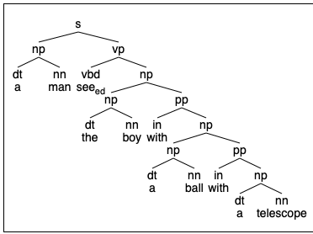
Homework 4 Review
which one will an AI pick?
5 syntactic options
#1
#3
#5
#2
#4

Slide 9
Homework 4 Review

Slide 10
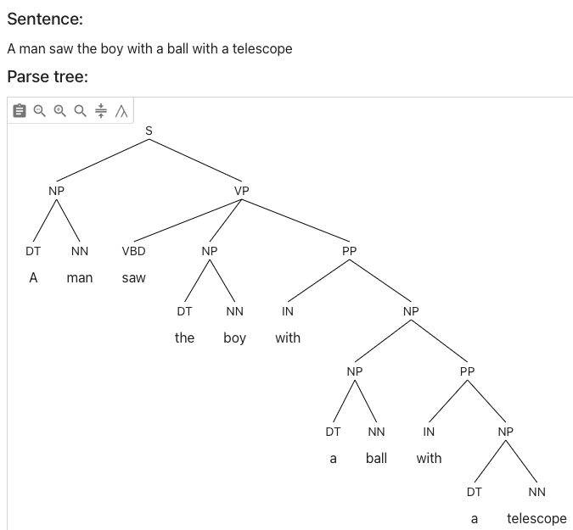
Homework 4 Review
https://parser.kitaev.io
not the preferred reading

Slide 11
Homework 4 Review
https://cloud.google.com/natural-language
not the preferred reading either

Slide 12
Homework 4 Review

Slide 13
Homework 4 Review

Slide 14
Homework 5
Contrast 1 vs 2:
John knew an untrue story about him.
John overheard an untrue story about him.
Q1:
Do you get a difference in the possible antecedents of him? Explain.
You may want to consider some variants:
e.g. when the prior sentence is Bill is an honest man.
e.g. when pronoun him is replaced by the reflexive himself
Q2: ask ChatGPT. Who is the story about?
Evaluate whether ChatGPT gets the same contrast as you.

Slide 15
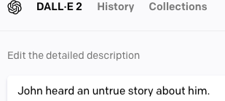

Slide 16
Homework 5
Submit to sandiway@arizona.edu
SUBJECT: 581 Homework 5 YOUR NAME
One PDF file (for grading)
include your ChatGPT screenshots in your answer
Deadline:
midnight Monday
we will review the homework on Tuesday

