Slide 1
LING/C SC 581: Advanced Computational Linguistics
Lecture 1

Slide 2
Today's Topics
Syllabus
Scheduling
Software installation: Homework (if not already installed)
A couple of interesting things …

Slide 3
Administrivia
No lectures scheduled on:
Tues Feb 27th: I'm away in Japan
Thurs Feb 29th: ditto.
Tues March 5th: Spring Break
Thurs March 7th: Spring Break
Pre-recorded lecture for Feb 27th
Homework also given out.
Note:
any other cancellation dates will be announced in due course

Slide 4
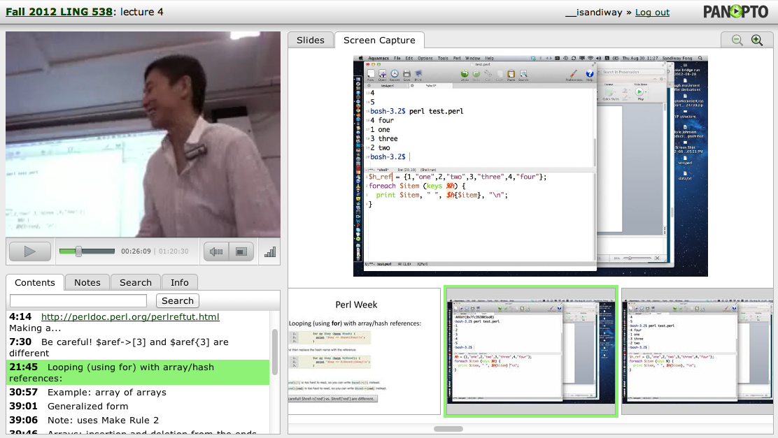
Course
Webpage for lecture slides:
http://sandiway.arizona.edu/#courses
available from just before class time
(afterwards, look again for corrections/updates)
in .pptx (good for animations) and .pdf formats
Meeting information
Tuesday-Thursday 9:30am-10:45am.
Modern Languages, Rm 203
not guaranteed not to crash!

Slide 5
Accessibility and Accommodations
At the University of Arizona, we strive to make learning experiences as accessible as possible.
If you anticipate or experience barriers based on disability or pregnancy, please contact the Disability Resource Center (520-621-3268, https://drc.arizona.edu/) to establish reasonable accommodations.

Slide 6
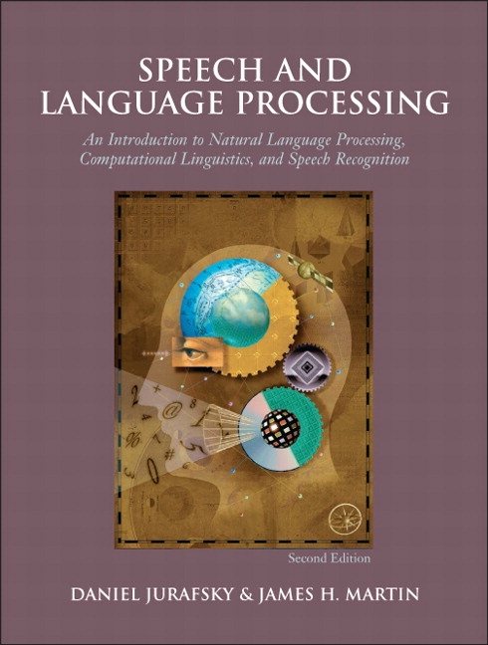
Course Objectives
Follow-on course to LING/C SC/PSYC 538 Computational Linguistics:
pre-requisite: 538
continue with some selected material from the 538 textbook (J&M):
a lot of material was not covered in 438/538
And gain more extensive experience
with new stuff not in textbook
dealing with natural language software packages
Installation, input data formatting
operation
project exercises
useful “real-world” computational experience
abilities gained will be of value to employers
use the v3 PDF draft

Slide 7
Learning Outcomes
Learning outcomes: by the end of the semester, you will have learnt:
to install and deal with natural language software packages (relates to Linguistics HLT program outcome #3)
to properly (re)format input data (relates to Linguistics HLT program outcome #1)
to complete projects, providing useful “real-world” computational experience (relates to Linguistics HLT program outcome #1)
These and other abilities gained will be of value to employers

Slide 8
Computational Requirements
Use your own laptop/desktop
just in case your need adminstrator rights on your machine to get things working right…
Platforms
native Windows 10/11 maybe possible but unsupported,
should install Windows Subsystem for Linux: WSL2
(return to this topic in a couple of slides)
MacOS
(see next slide)

Slide 9
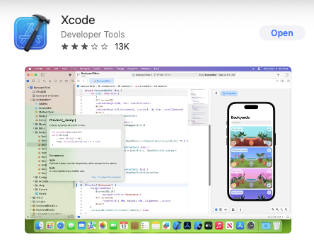
Computational Requirements
Platforms
Much research software assume Linux
macOS
Not quite Linux, some porting issues, especially with C programs.
Macports or Homebrew packages (bit like app-get)
make sure you have Xcode from the Mac App Store (free) installed
then make sure the command line tools component is installed

Slide 10
Computational Requirements
Xcode on macOS:
(base) ~$ xcode-select --version
xcode-select version 2405.
(base) ~$ xcode-select
xcode-select: error: no command option given
Usage: xcode-select [options]
Print or change the path to the active developer directory. This directory
controls which tools are used for the Xcode command line tools (for example,
xcodebuild) as well as the BSD development commands (such as cc and make).
Options:
-h, --help print this help message and exit
-p, --print-path print the path of the active developer directory
-s <path>, --switch <path> set the path for the active developer directory
--install open a dialog for installation of the command line developer tools
-v, --version print the xcode-select version
-r, --reset reset to the default command line tools path
(base) ~$ xcode-select --install
xcode-select: note: Command line tools are already installed. Use "Software Update" in System Settings or the softwareupdate command line interface to install updates

Slide 11
Computational Requirements
Platforms
Windows 10/11 is possible, but you really should run some variant of Linux…
PowerShell can be made to work, but is incompatible with Bash shell scripts
Install WSL2 under Windows 10/11
Why?
gives you a Bash shell (with quoting consistent with the lecture slides)
(simultaneously) use Linux under Windows 10 (not dual-booting)
can access your Windows C: drive via directory /mnt/c

Slide 12
Grading
Satisfactory completion of all homework tasks will result in a grade A.
Tasks typically should be completed before the corresponding class next week.
email me your work (sandiway@arizona.edu).
also be prepared to present your work (if called upon) in class.
Office hours (by appointment – Douglass 311):
quick question? Hang around after the lecture.
longer question? Email me first. We can also meet on Zoom.

Slide 13
Syllabus
Homeworks
you may discuss questions with other students
you can use ChatGPT
however, you must write it up yourself (in your own words, your own code etc.)
cite (web) references, ChatGPT and your classmates (in the case of discussion)
Student Code of Academic Integrity: plagiarism etc.
http://deanofstudents.arizona.edu/codeofacademicintegrity
Revisions to the syllabus
“the information contained in the course syllabus, other than the grade and absence policies, may be subject to change with reasonable advance notice, as deemed appropriate by the instructor.”

Slide 14
Homework
make sure for next time that the following software is already installed!
already required for 538 (last semester)
Python 3
SWI Prolog

Slide 15
Windows Subsystem for Linux 2
I installed Ubuntu under WSL2

Slide 16
Run Linux GUI apps on WSL2
No manual Windows 10 Xserver install and configuring anymore, e.g. the DISPLAY variable!
Link:
https://learn.microsoft.com/en-us/windows/wsl/tutorials/gui-apps
11/28/2022
Prerequisites
used to be Windows 11 only
Windows 10 Build 19044+ or Windows 11

Slide 17
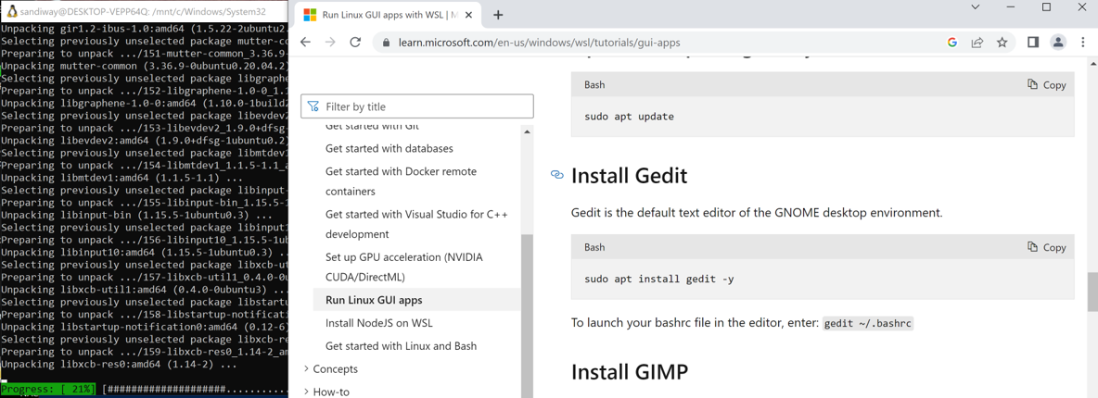
Run Linux GUI apps on WSL2
Installing gedit sets off a storm of downloading (graphics libraries)

Slide 18
Run Linux GUI apps on WSL2
xeyes from x11-apps works: see the eyes pop up on Windows 10!

Slide 19
Python3 and nltk with graphics
Make sure you have Python 3 installed. Also nltk.
https://www.nltk.org
https://www.nltk.org/install.html
Works under macOS, Windows 10/11 and Linux.

Slide 20
Python3 and nltk with graphics
On WSL2:
sudo apt install python3 python3-pip python-is-python3
gets you the non-graphical part.
Both nltk and nltk_data install fine.
pip3 install --user –U nltk
pip3 install --user –U numpy
But:
sudo apt install python3-tk
gets you the graphics so you can plot graphs from nltk

Slide 21
Python3 and nltk with graphics
you can ignore all this! No longer needed.
Inside Python:
>>> import nltk
>>> nltk.download() will now pop up a graphical menu (instead of the command line interface)

Slide 22
nltk treedraw
The Penn Treebank sample from nltk.corpus
here drawing the last syntax tree in the sample

Slide 23
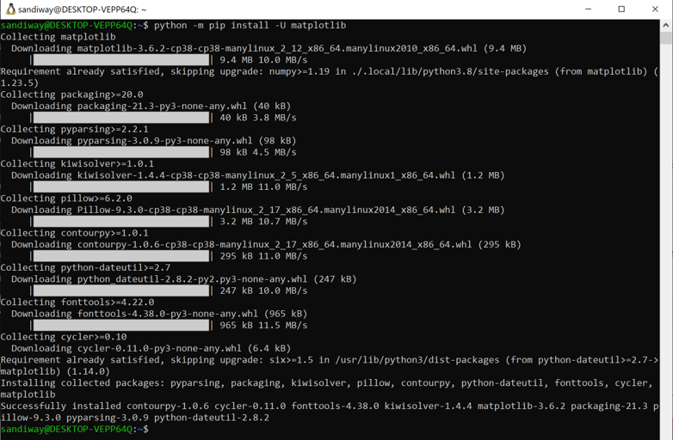
matplotlib
You should install matplotlib:
python –m pip install –U matplotlib

Slide 24
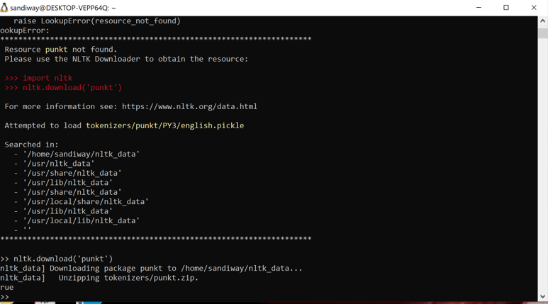
punkt tokenizer
Somehow the punkt tokenizer needed for nltk.sent_tokenize() was not installed by default.

Slide 25
Python3.9 and nltk with graphics
On Ubuntu:
sudo add-apt-repository ppa:deadsnakes/ppa
This PPA contains more recent Python versions packaged for Ubuntu.
sudo apt install python3.9
gets you the non-graphical part.
Test:
python3.9
Python 3.9.15 (main, Oct 12 2022, 19:15:11)
[GCC 7.5.0] on linux
Type "help", "copyright", "credits" or "license" for more information.
>>> ^D

Slide 26
Python3.9 and nltk with graphics
On Ubuntu:
sudo apt install python3.9-tk
gets you the Tk graphics.
Test:
python3.9
Python 3.9.15 (main, Oct 12 2022, 19:15:11)
[GCC 7.5.0] on linux
Type "help", "copyright", "credits" or "license" for more information.
>>> import tkinter
>>> tkinter._test() # small window should show up
>>> ^D

Slide 27
Python3.9 and nltk with graphics
We also need pip3.9 to install nltk:
sudo apt install python3.9-distutils
curl https://bootstrap.pypa.io/get-pip.py -o get-pip.py
% Total % Received % Xferd Average Speed Time Time Time Current
Dload Upload Total Spent Left Speed
100 2509k 100 2509k 0 0 3790k 0 --:--:-- --:--:-- --:--:-- 3784k
sandiway@sandiway-XPS-15-9570:~$ python3.9 get-pip.py --user
Collecting pip
Downloading pip-22.3.1-py3-none-any.whl (2.1 MB)
━━━━━━━━━━━━━━━━━━━━━━━━━━━━━━━━━━━━━━━━ 2.1/2.1 MB 6.1 MB/s eta 0:00:00
Installing collected packages: pip
Successfully installed pip-22.3.1

Slide 28
Python3.9 and nltk with graphics
Both nltk and nltk_data should install fine with pip3.9.
pip3 install --user –U nltk
Use:
Downloading nltk-3.7-py3-none-any.whl (1.5 MB)
━━━━━━━━━━━━━━━━━━━━━━━━━━━━━━━━━━━━━━━━ 1.5/1.5 MB 6.6 MB/s eta 0:00:00
Collecting joblib
Downloading joblib-1.2.0-py3-none-any.whl (297 kB)
━━━━━━━━━━━━━━━━━━━━━━━━━━━━━━━━━━━━━━━ 298.0/298.0 kB 5.9 MB/s eta 0:00:00
Collecting tqdm
Using cached tqdm-4.64.1-py2.py3-none-any.whl (78 kB)
Requirement already satisfied: click in /usr/lib/python3/dist-packages (from nltk) (6.7)
Collecting regex>=2021.8.3
Downloading regex-2022.10.31-cp39-cp39-manylinux_2_17_x86_64.manylinux2014_x86_64.whl (769 kB)
━━━━━━━━━━━━━━━━━━━━━━━━━━━━━━━━━━━━━━━ 770.0/770.0 kB 7.4 MB/s eta 0:00:00
Installing collected packages: tqdm, regex, joblib, nltk
Successfully installed joblib-1.2.0 nltk-3.7 regex-2022.10.31 tqdm-4.64.1

Slide 29
Python3.9 and nltk with graphics
Install numpy with pip3.9:
pip3.9 install --user -U numpy
Collecting numpy
Downloading numpy-1.23.5-cp39-cp39-manylinux_2_17_x86_64.manylinux2014_x86_64.whl (17.1 MB)
━━━━━━━━━━━━━━━━━━━━━━━━━━━━━━━━━━━━━━━━ 17.1/17.1 MB 7.3 MB/s eta 0:00:00
Installing collected packages: numpy
Successfully installed numpy-1.23.5

Slide 30
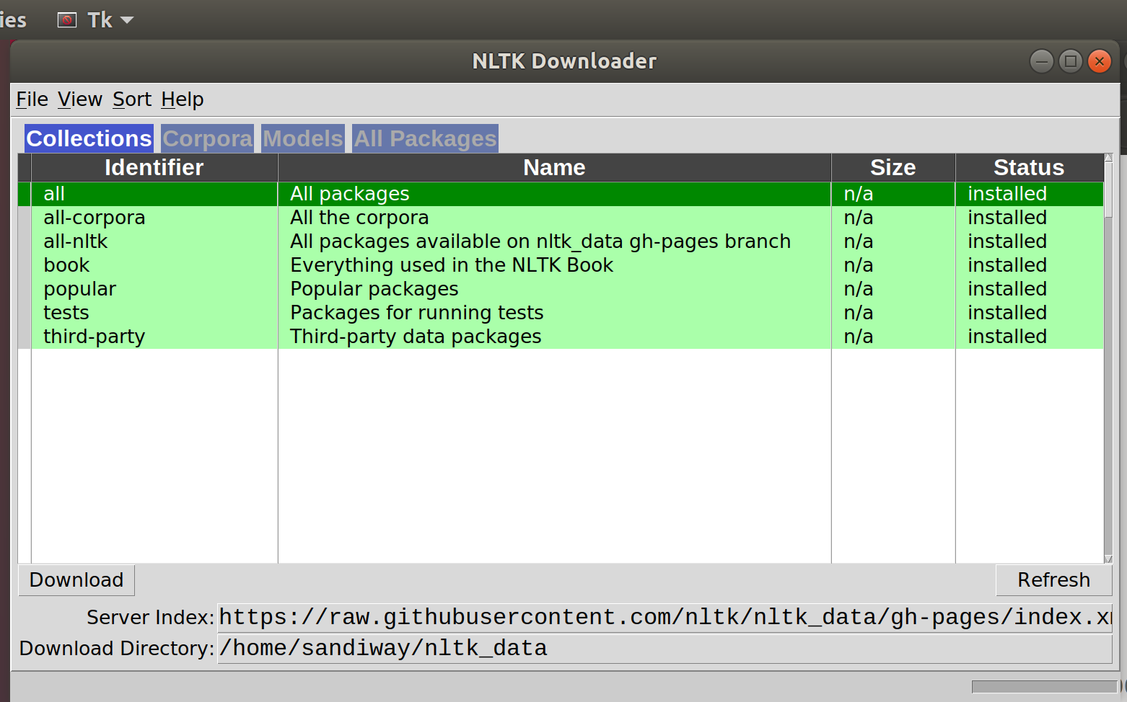
Python3.9 and nltk with graphics
nltk.download() should pop up a window:
python3.9
Python 3.9.15 (main, Oct 12 2022, 19:15:11)
[GCC 7.5.0] on linux
Type "help", "copyright", "credits" or "license" for more information.
>>> import nltk
>>> nltk.download()
showing info https://raw.githubusercontent.com/nltk/nltk_data/gh-pages/index.xml
^CTraceback (most recent call last):
File "<stdin>", line 1, in <module>
File "/home/sandiway/.local/lib/python3.9/site-packages/nltk/downloader.py", line 763, in download
self._interactive_download()
File "/home/sandiway/.local/lib/python3.9/site-packages/nltk/downloader.py", line 1113, in _interactive_download
DownloaderGUI(self).mainloop()
File "/home/sandiway/.local/lib/python3.9/site-packages/nltk/downloader.py", line 1932, in mainloop
self.top.mainloop(*args, **kwargs)
File "/usr/lib/python3.9/tkinter/__init__.py", line 1432, in mainloop
self.tk.mainloop(n)
KeyboardInterrupt

Slide 31
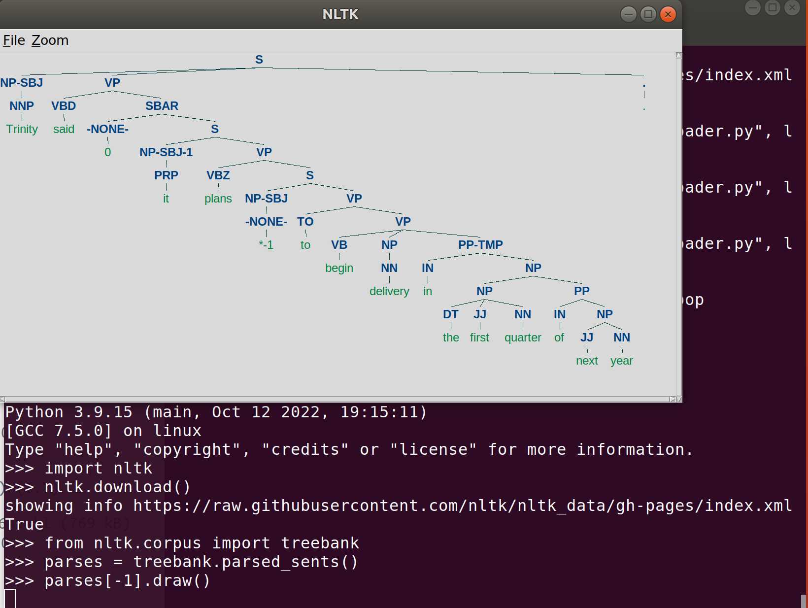
nltk treedraw
treebank parse tree drawing:
python3.9
Python 3.9.15 (main, Oct 12 2022, 19:15:11)
[GCC 7.5.0] on linux
Type "help", "copyright", "credits" or "license" for more information.
>>> import nltk
>>> from nltk.corpus import treebank
>>> parses = treebank.parsed_sents()
>>> parses[-1].draw()

Slide 32
SWI-Prolog
https://www.swi-prolog.org
Used in 538 (pre-requisite class). Make sure it's installed!
https://swish.swi-prolog.org

Slide 33
SWISH

Slide 34
A couple of interesting things

Slide 35
Boston Globe: April 10th 1953
Excerpt:
I think the users will be able to see each other, if they want, as they talk.
"Who knows but what it may actually translate from one language to another?"

Slide 36
Conversation Mode: Apple's Translate App
Translate text, voice, and conversations on iPhone
Introduced in 2020
You can translate text, voice, and conversations between any of the supported languages.
You can download languages to translate entirely on the device
All translations are processed through the neural engine of the device, and as such can be used offline
Tap Conversation.
Tap and speak
(how about on an Apple Watch?)

Slide 37
Conversation Mode: Apple's Translate App
This grew to 17 languages as six new languages were added in 2022, such as Turkish, Indonesian, Polish, Dutch, Thai and Vietnamese.

Slide 38
Conversation Mode: Apple's Translate App
https://github.com/hollance/neural-engine

Slide 39
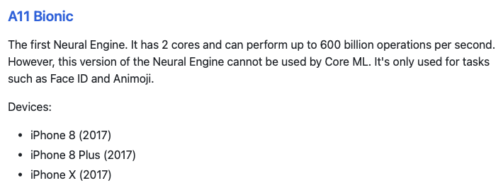
Apple Neural Engine (ANE)

Slide 40
ChatGPT
https://openai.com/blog/chatgpt/

Slide 41
ChatGPT

Slide 42
ChatGPT

Slide 43
ChatGPT

Slide 44
ChatGPT

Slide 45
ChatGPT

Slide 46
ChatGPT

Slide 47
ChatGPT

Slide 48
ChatGPT

Slide 49
U. of Arizona slogan

Slide 50
U. of Arizona slogan

Slide 51
Google Search

