Slide 1
LING/C SC/PSYC 438/538
Lecture 9
Prof. Sandiway Fong

Slide 2
Today's Topics
Homework 6 review
Perl references
Perl module example: Time and Date
Ungraded Homework

Slide 3
Homework 6 Review: Part 1
Well-known English spelling rule: I before E except after C
  Wikipedia:
    many words were spelled with ⟨ie⟩ and ⟨ei⟩ interchangeably (Early Modern English period)
    the rhyme suggests that the correct order is ⟨ie⟩ unless the preceding letter is ⟨c⟩, in which case it may be ⟨ei⟩.
Orthography:
  receive (digraph ie)
  science (I before E after C: exception to the rule, type 1)
    look for CIE using index
  foreign (E before I not after C: exception to the rule type 2)
    look for non-C followed by EI

Slide 4
Homework 6 Review: Part 1: Type 1
6letters.txt:
perl -e 'open $fh, $ARGV[0]; for (split " ",<$fh>) {print "$_\n" if (index($_, "CIE") >= 0)}' 6letters.txt
BOCCIE CIELED CIERGE DECCIE DICIER
FACIES FARCIE GAUCIE ICIEST LACIER
LOCIES OCCIES PACIER RACIER RICIER
SCIENT SPECIE
17
| wc -l
17 / 22971 = 0.074%
17 / 956 = 1.8%

Slide 5
Homework 6 Review: Part 1: Type 1
7letters.txt:
perl -e 'open $fh, $ARGV[0]; for (split " ",<$fh>) {print "$_\n" if (index($_, "CIE") >= 0)}' 7letters.txt
ANCIENT BACCIES BICCIES BOCCIES CEILING CIERGES DANCIER DARCIES DECCIES DICIEST
EPICIER FACIEND FANCIED FANCIER FANCIES FARCIED FARCIES FLEECIE GAUCIER GAWCIER
GLACIER JUICIER LACIEST LECCIES MERCIES MINCIER MOCCIES ORACIES PACIEST PICCIES
PONCIER PRICIER RACIEST RECCIED RECCIES RICIEST SAUCIER SCIENCE SOCIETY SPACIER
SPECIES SPICIER TALCIER ZINCIER
44
44 / 34506 = 0.13%
44 / 2363 = 1.9%

Slide 6
Homework 6 Review: Part 1: Type 2
6letters.txt:
perl -e 'open $fh, $ARGV[0]; for (split " ",<$fh>) {print "$_\n" if ($_ =~ /[^C]EI/)}' 6letters.txt | wc –l
237
7letters.txt:
perl -e 'open $fh, $ARGV[0]; for (split " ",<$fh>) {print "$_\n" if ($_ =~ /[^C]EI/)}' 7letters.txt | wc –l
334
237 / 22971 = 1.0%
237 / 255 = 93%
334 / 34506 = 1.0%
334 / 358 = 93%

Slide 7

Homework 6 review: Part 2
Part A:
  write a Perl program to remove vowels a, e, i, o, u from words typed into the command line. (Don't worry about y.)
Hint: use split from previous lectures
Example:

Slide 8
Homework 6 Review: Part 2
special meaning
Basic Idea:
this is a test
t h i s i s a t e s t
t h s s t s t
ths s tst
Perl:
  @ARGV
  for (@ARGV) {@c = split //; … }
  for $c (@c) { if $c is a vowel, don't print it, else print $c}
perl -e 'for (@ARGV) {@c = split //; print "@c "}; print "\n"' this is a test
t h i s i s a t e s t

Slide 9
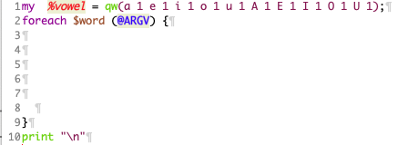
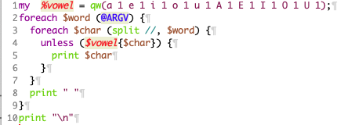
Homework 6 Review: Part 2

Slide 10
Homework 6 Review: Part 2
Examples:
  perl hw6.perl suddenly a White Rabbit with pink eyes ran close by her.
  sddnly Wht Rbbt wth pnk ys rn cls by hr.
  perl hw6.perl quick brown fox
  qck brwn fx
  perl hw6.perl If a sentence is unreadable
  f sntnc s nrdbl

Slide 11
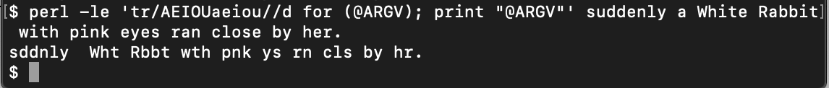
Homework 6 Review: Part 2
transliterate for (@ARGV);
  for-loop on @ARGV with reversed syntax; usually for (@ARGV) {…}
tr/AEIOUaeiou//d
  modifies the words stored in @ARGV
print "@ARGV"
  puts spaces between each word
perl -l
  prints a newline after each print statement

Slide 12
Homework 6 Review: Part 2
Flag in a loop idea:
  Chars: s e n t e n c e
  $not1st: 0 1 1 1 1 1 1 1
  Chars: u n r e a d a b l e
  $not1st: 0 1 1 1 1 1 1 1 1 1

Slide 13
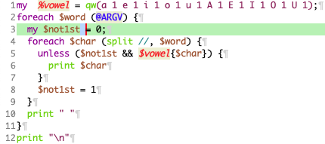
Homework 6 Review: Part 2
flag unset
flag
set

Slide 14
Homework 6 Review: Part 2
Examples:
perl hw6b.perl suddenly a White Rabbit with pink eyes ran close by her.
sddnly a Wht Rbbt wth pnk eys rn cls by hr.
perl hw6b.perl quick brown fox
qck brwn fx
perl hw6b.perl If a sentence is unreadable
If a sntnc is unrdbl

Slide 15
Homework 6 Review: Part 3
$ perl hw6p3.perl ppch1.txt
It is a trth unvrslly acknwldgd, tht a sngl mn in pssssn
of a gd frtn mst b in wnt of a wf.
Hwvr lttl knwn th flngs or vws of sch a mn my b on hs
frst entrng a nghbrhd, ths trth is s wll fxd in th mnds
of th srrndng fmls, tht h is cnsdrd as th rghtfl
prprty of sm on or othr of thr dghtrs.
“My dr Mr. Bnnt,” sd hs ldy t hm on dy, “hv y hrd tht
Nthrfld Prk is lt at lst?”
Mr. Bnnt rpld tht h hd nt.
“Bt it is,” rtrnd sh; “fr Mrs. Lng hs jst bn hr, and sh
tld m all abt it.”
Mr. Bnnt md n answr.
“D nt y wnt t knw wh hs tkn it?” crd hs wf, imptntly.
“_Y_ wnt t tll m, and I hv n objctn t hrng it.”
Ths ws invttn engh.
“Why, my dr, y mst knw, Mrs. Lng sys tht Nthrfld is tkn
by a yng mn of lrg frtn frm th nrth of Englnd; tht h cm
dwn on Mndy in a chs and fr t s th plc, and ws s mch
dlghtd wth it tht h agrd wth Mr. Mrrs immdtly; tht h is
t tk pssssn bfr Mchlms, and sm of hs srvnts ar t b
in th hs by th end of nxt wk.”
“Wht is hs nm?”
“Bngly.”
“s h mrrd or sngl?”
“h, sngl, my dr, t b sr! A sngl mn of lrg frtn; fr or
fv thsnd a yr. Wht a fn thng fr or grls!”
“Hw s? hw cn it affct thm?”
“My dr Mr. Bnnt,” rpld hs wf, “hw cn y b s trsm? Y
mst knw tht I am thnkng of hs mrryng on of thm.”
“s tht hs dsgn in sttlng hr?”
“Dsgn? Nnsns, hw cn y tlk s! Bt it is vry lkly tht h
_my_ fll in lv wth on of thm, and thrfr y mst vst hm as
sn as h cms.”
“ s n occsn fr tht. Y and th grls my g--r y my snd
thm by thmslvs, whch prhps wll b stll bttr; fr as y ar
as hndsm as any of thm, Mr. Bngly mght lk y th bst of th
prty.”
“My dr, y flttr m. I crtnly _hv_ hd my shr of bty, bt
I d nt prtnd t b anythng extrrdnry nw. Whn a wmn hs fv
grwn-p dghtrs, sh oght t gv ovr thnkng of hr own bty.”
“n sch css, a wmn hs nt oftn mch bty t thnk of.”
“Bt, my dr, y mst indd g and s Mr. Bngly whn h cms int
th nghbrhd.”
“t is mr thn I engg fr, I assr y.”
“Bt cnsdr yr dghtrs. Only thnk wht an estblshmnt it wld
b fr on of thm. Sr Wllm and Ldy Lcs ar dtrmnd t g,
mrly on tht accnt; fr in gnrl, y knw, thy vst n nw
cmrs. Indd y mst g, fr it wll b impssbl fr _s_ t vst
hm, if y d nt.”
“Y ar ovr scrpls, srly. I dr sy Mr. Bngly wll b vry
gld t s y; and I wll snd a fw lns by y t assr hm of my
hrty cnsnt t hs mrryng whchvr h chss of th grls--thgh
I mst thrw in a gd wrd fr my lttl Lzzy.”
“ dsr y wll d n sch thng. Lzzy is nt a bt bttr thn th
othrs: and I am sr sh is nt hlf s hndsm as Jn, nr hlf s
gd-hmrd as Lyd. Bt y ar alwys gvng _hr_ th prfrnc.”
“Thy hv nn of thm mch t rcmmnd thm,” rpld h: “thy ar
all slly and ignrnt lk othr grls; bt Lzzy hs smthng mr of
qcknss thn hr sstrs.”
“Mr. Bnnt, hw cn y abs yr own chldrn in sch a wy? Y tk
dlght in vxng m. Y hv n cmpssn on my pr nrvs.”
“Y mstk m, my dr. I hv a hgh rspct fr yr nrvs. Thy
ar my old frnds. I hv hrd y mntn thm wth cnsdrtn
ths twnty yrs at lst.”
“h, y d nt knw wht I sffr.”
“Bt I hp y wll gt ovr it, and lv t s mny yng mn of fr
thsnd a yr cm int th nghbrhd.”
“t wll b n us t us, if twnty sch shld cm, snc y wll nt
vst thm.”
“Dpnd upn it, my dr, tht whn thr ar twnty, I wll vst thm
all.”
Mr. Bnnt ws s odd a mxtr of qck prts, srcstc hmr,
rsrv, and cprc, tht th exprnc of thr-nd-twnty yrs hd
bn insffcnt t mk hs wf undrstnd hs chrctr. _Hr_ mnd
ws lss dffclt t dvlp. Sh ws a wmn of mn undrstndng,
lttl infrmtn, and uncrtn tmpr. Whn sh ws dscntntd, sh
fncd hrslf nrvs. Th bsnss of hr lf ws t gt hr
dghtrs mrrd: its slc ws vstng and nws.

Slide 16
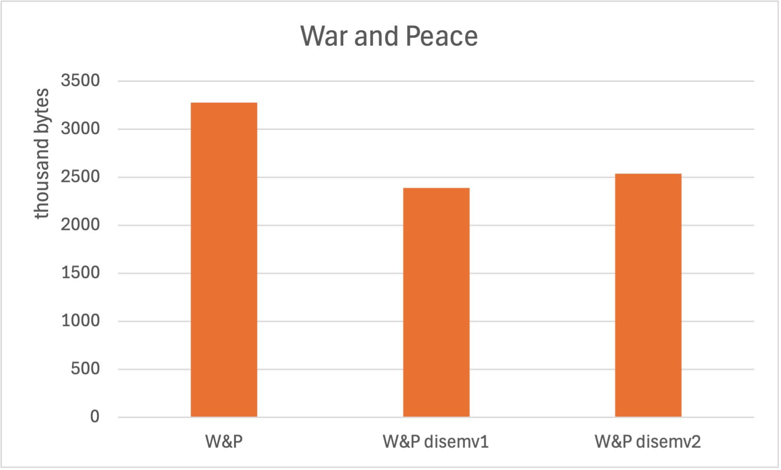
Homework 6 Review: extra
WAR AND PEACE By Leo Tolstoy/Tolstoi (1867)
  using 1922 (L&A Maude) English translation
  $ wc war_and_peace.txt
  65656 563290 3274138 war_and_peace.txt
  $ perl -s disemvowel.perl -del war_and_peace.txt > wr_nd_pc.txt
  $ wc wr_nd_pc.txt
  65656 549620 2386014 wr_nd_pc.txt
  $ perl disemvowel.perl war_and_peace.txt > wr_and_pc.txt
  $ wc wr_and_pc.txt
  65656 563290 2533881 wr_and_pc.txt
73-77%

Slide 17
Python behavior
Different behavior: How do we reconcile these?
python
>>> a = [1]
>>> b = a
>>> b[0] = -1
>>> b
[-1]
>>> a
[-1]
>>> a = 1
>>> b = a
>>> b = -1
>>> b
-1
>>> a
1

Slide 18
Perl: more complex data structures
Arrays and hashes may only contain scalars (Python is way better here)
Question: How to accomplish nesting, i.e. put non-scalars inside?
Answer: use references (called pointers in C), which happen to be scalars
http://perldoc.perl.org/perlreftut.html
(actually a reference is just an unsigned number: a computer address)
We have seen this before! Lecture 8: Part of speech example.
%pos=(likes => ["n","v"], car=>["n"], smiled=>["v"]);

Slide 19
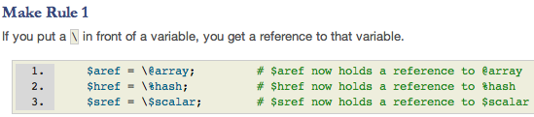
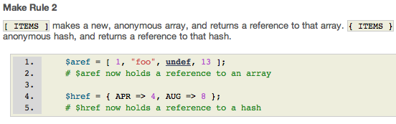
Perl: References
Remember bracketing when initializing:
( ) List – used for both arrays and hashes
[ ] Reference to an array
{ } Reference to a hash
Two ways to make a reference:

Slide 20

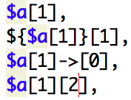

Perl: References
Example: array of arrays
Note: uses Make Rule 2: square brackets
Let’s figure out what the following mean:
de-referencing arrow

Slide 21
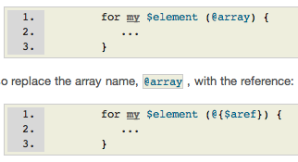

Perl: References
Looping (using for/foreach) with array/hash references:
Careful! $aref->[3] and $aref[3] are different

Slide 22
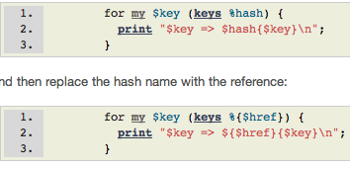
Perl: References
Looping (using for/foreach) with array/hash references:
Careful! $href->{‘red’} and $href{‘red’} are different.

Slide 23
Perl: References
Perl code:
  $a = [1, 2, 3, 4, 5]; print $a+1, "\n";
What happens here?
$ perl -e '$a = [1, 2, 3, 4, 5]; print $a+1, "\n"'
5033213049
$ perl -e '$a = [1, 2, 3, 4, 5]; print $a+1, "\n"'
5628804217
$ perl -e '$a = [1, 2, 3, 4, 5]; print $a+1, "\n"'
5276482681

Slide 24
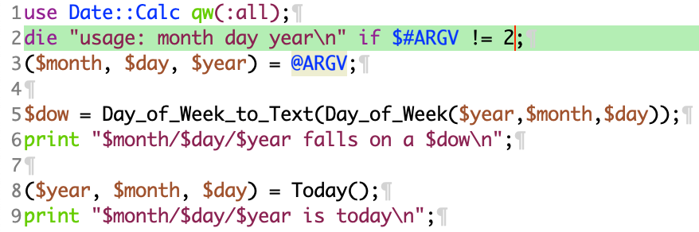
Time and Date Perl Module
Course website:
dow.perl
$ perl dow.perl
usage: month day year
$ perl dow.perl 9 22 2026
9/22/2026 falls on a Tuesday
9/20/2026 is today

Slide 25
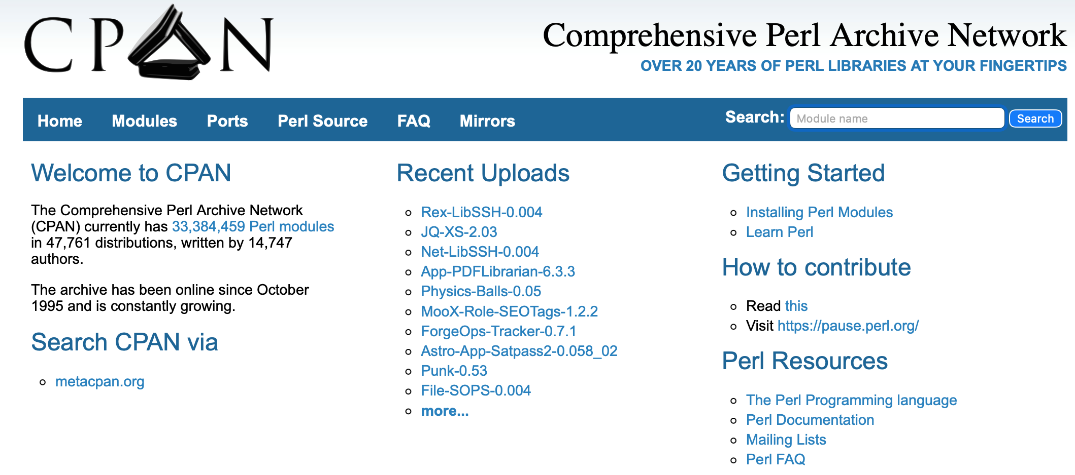
CPAN
https://www.cpan.org

Slide 26
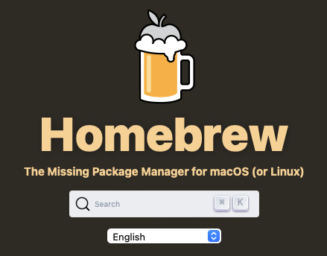
macOS Date/Calc.pm
Homebrew uses the prefix /opt/homebrew on Apple Silicon (Intel /usr/local)
  brew install perl cpanminus
Verify locations (PATH):
  $ which perl
  /opt/homebrew/bin/perl
  $ which cpanm
  /opt/homebrew/bin/cpanm
Verify locations (PATH):
  ~/.bash_profile (bash)
  ~/.zprofile (zsh)
https://brew.sh

Slide 27
Date/Calc.pm
Not installed or can't find it:
  $ perl dow.perl
  Can't locate Date/Calc.pm in @INC (you may need to install the Date::Calc module) (@INC contains: …
  $ cpanm Date::Calc
  --> Working on Date::Calc
  Fetching http://www.cpan.org/authors/id/S/ST/STBEY/Date-Calc-6.4.tar.gz ... OK
  Configuring Date-Calc-6.4 ... OK
  Building and testing Date-Calc-6.4 ... OK
  Successfully installed Date-Calc-6.4
CPAN SSL Certificate Error
export OPENSSL_DIR=$(brew --prefix openssl@3) export SSL_CERT_FILE=$(brew --prefix)/etc/ca-certificates/cert.pem export CURL_CA_BUNDLE=$(brew --prefix)/etc/ca-certificates/cert.pem

Slide 28
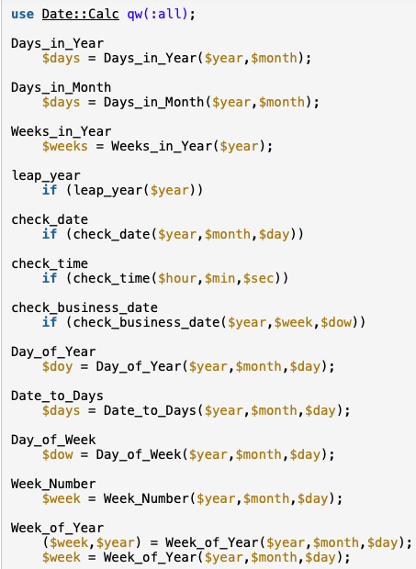
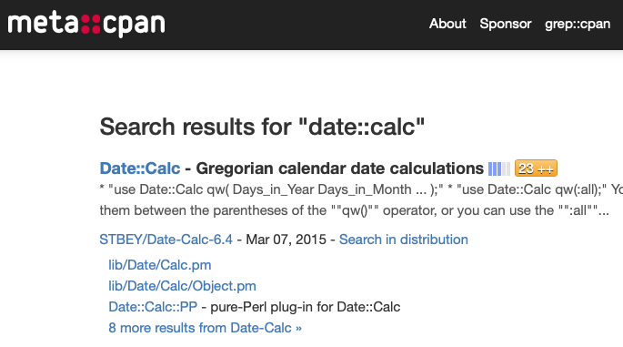
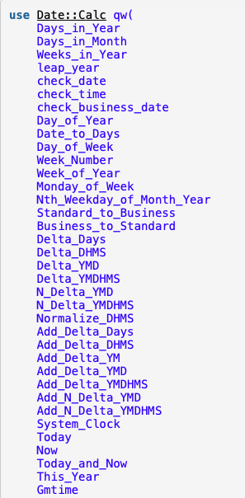
Date::Calc

Slide 29
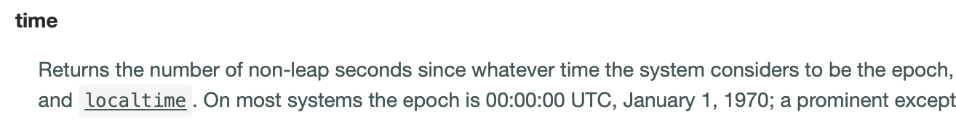
Time and Date
Perl function time:
  perl -le 'print time'
  1695061511
To pause for n seconds, use sleep n
  perl -le '$t1 = time; sleep 10; $t2 = time; print $t2-$t1'
  10

Slide 30
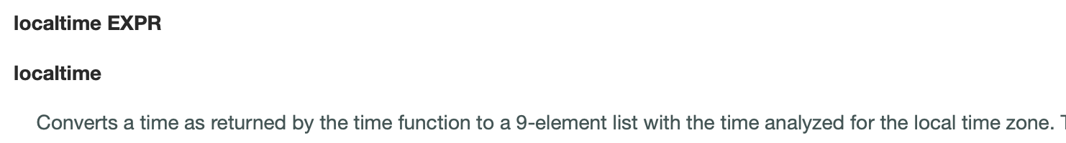
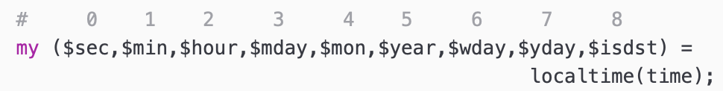
Time and Date
Perl function localtime:
$ perl -le 'print localtime'
23301520812602620
$ perl -le '$now = localtime; print $now'
Sun Sep 20 15:30:54 2026
$ perl -le '@now = localtime; print "@now"'
36 31 15 20 8 126 0 262 0
Note: $mon, $wday (beginning on Sunday)
and $yday indexed from 0
1900

Slide 31
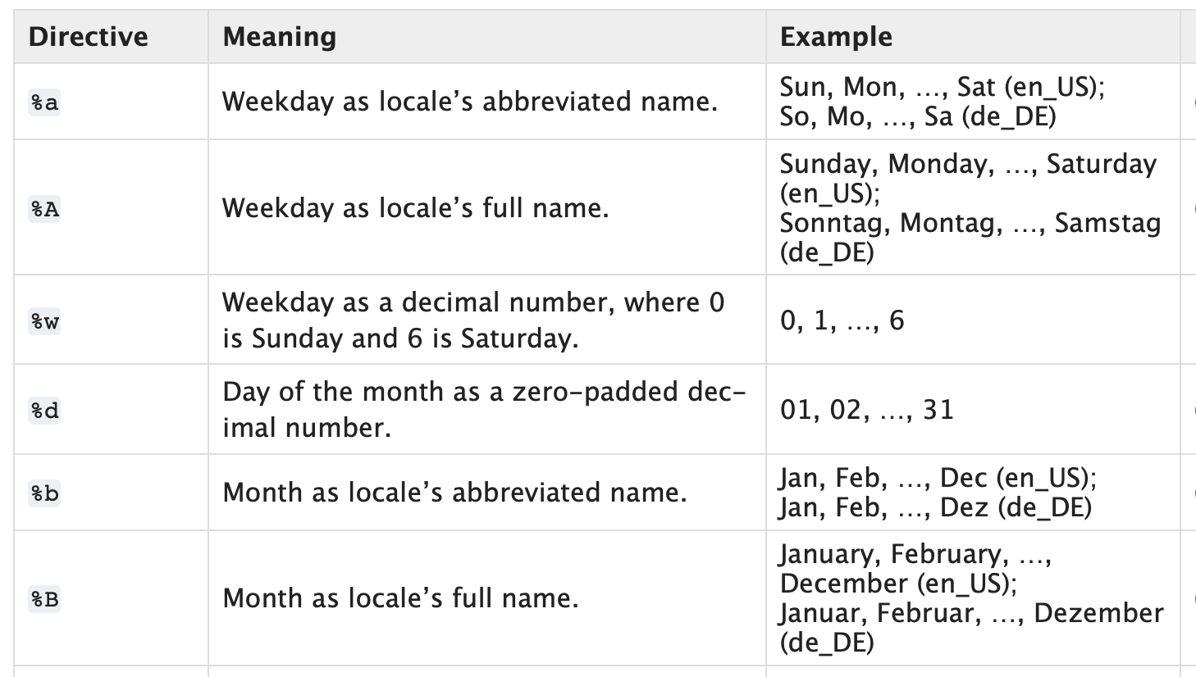
Time and Date
Reference: https://docs.python.org/3/library/datetime.html#strftime-and-strptime-format-codes
$ python3
Python 3.13.1
>>> import datetime
>>> d = datetime.date(2026,9,22)
>>> print(d.strftime("%A"))
Tuesday
>>> print(d.strftime("%B %-d %Y"))
September 22 2026
>>> datetime.datetime.now()
datetime.datetime(2026, 9, 20, 15, 35, 41, 347150)

Slide 32
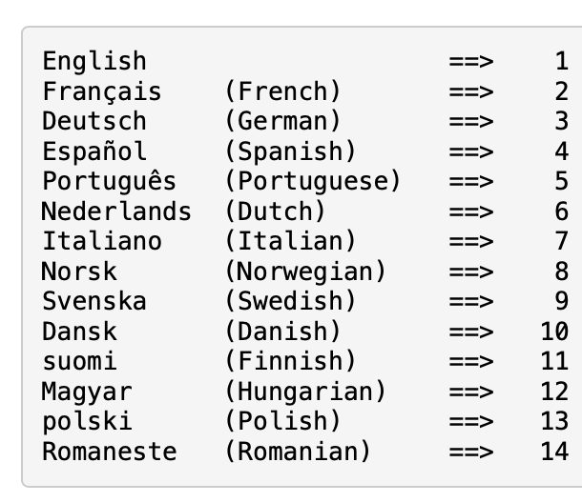
Time and Date
TBH Perl looks a bit scary
perldoc.perl.org/perllocale
perl -e 'use POSIX qw(locale_h); use locale; my $new_locale = setlocale(LC_ALL, "ja_JP.UTF-8"); …'
>>> import locale
>>> loc = locale.setlocale(locale.LC_ALL)
>>> loc
'C/en_US.UTF-8/C/C/C/C'
>>> locale.setlocale(locale.LC_ALL, 'ja_JP.UTF-8')
'ja_JP.UTF-8'
>>> d = datetime.date(2026,9,22)
>>> print(d.strftime("%A"))
火曜日 (kayōbi)
>>> print(d.strftime("%B %-d %Y"))
9月 22 2026
Date::Calc

Slide 33

Ungraded Homework
Install Perl Module Lingua::EN::CMUDict ( CMU Pronouncing dictionary)
  https://metacpan.org/pod/Lingua::EN::CMUDict
Bug in code!
(P UW1 T IH0 N)
write a program cmudict.perl that counts the number of syllables for $ARGV[0]
$ perl cmudict.perl Balkanization
Balkanization: 5
$ perl cmudict.perl Putin
Putin: 1
$ perl cmudict.perl Zelenskyy
Not in cmudict

Slide 34
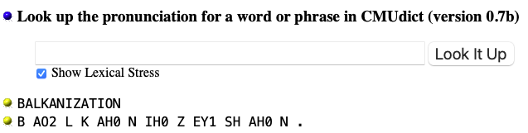
Ungraded Homework
http://www.speech.cs.cmu.edu/cgi-bin/cmudict
Data format: ARPAbet phoneme set
  0 — No stress
  1 — Primary stress
  2 — Secondary stress
  Balkanization: 5 syllables
  B AO2 L - K AH0 - N IH0 - Z EY1 - SH AH0 N

Slide 35
Ungraded Homework
$obj->rhymes(word)
In the case of an array being returned, returns all rhymes to the given word. In a scalar context, returns a single rhyme.
Balkanization rhymes with implication impregnation AVOCATION volition TUITION COARTICULATION pollination AUCTION CONSTELLATION DISTORTION inspection …

