Slide 1
LING/C SC/PSYC 438/538
Lecture 7
Prof. Sandiway Fong

Slide 2
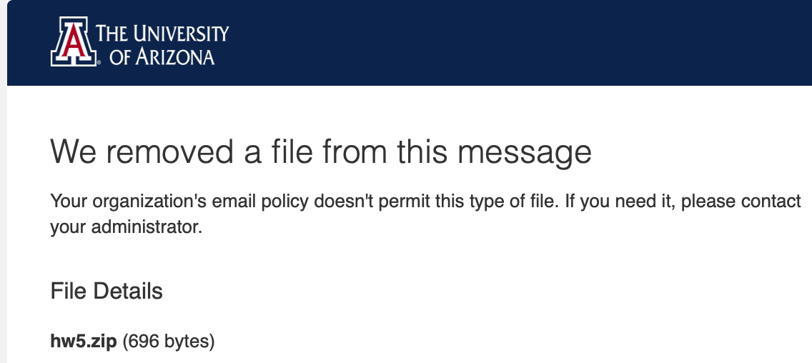
Today's Topics
Homework 5 Review
  best to send a pdf file (.zip doesn't always work)

Slide 3
Today's Topics
Worked file I/O example:
  falconheavylaunch.txt
  I'll be assuming Bash/Zsh (from macOS or Ubuntu)
Sorting

Slide 4
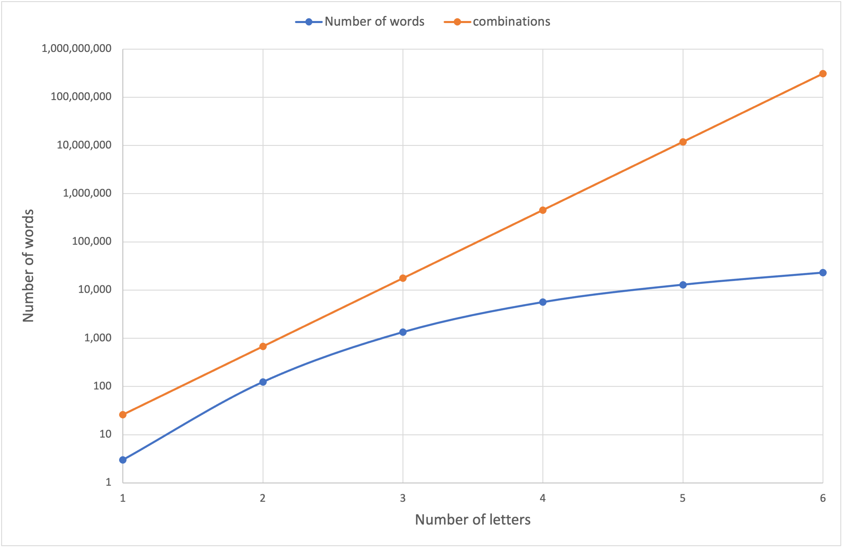
A particular set of Scrabble Words
(# letters ≥ 2)
26⁶
26⁵
log scale
(exponential)
26⁴
gap should continue to widen
26³
26 x 26

Slide 5
Scrabble Words Statistics

Slide 6
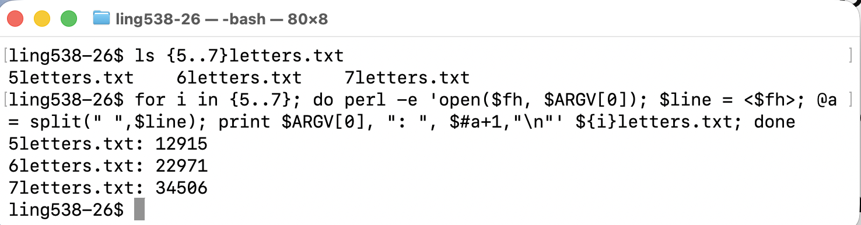
Homework 5 Review
Question 1: print out the number of words.
Bash:

Slide 7
Homework 5 Review
Question 1: print out the number of words.
Example:
  $ perl -e 'open($fh, $ARGV[0]); …' 5letters.txt
  $ for i in {5..7}; do echo ${i}letters.txt; done
  5letters.txt
  6letters.txt
  7letters.txt

Slide 8
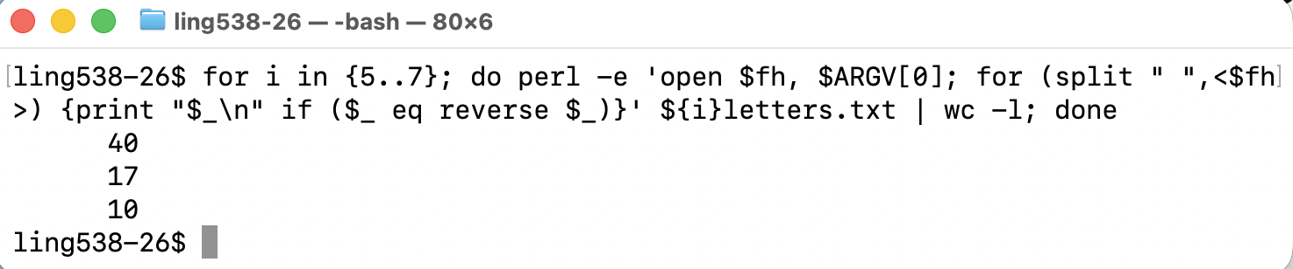
Homework 5 Review
Question 2: which words spell the same forwards as backwards?

Slide 9
Homework 5 Review
Is it true for n = 8,9,10…?
How long before the streak is broken?
Results:
  ALULA ANANA AYAYA CIVIC DEKED DELED DERED DEWED KAIAK KAYAK LAHAL LAVAL LEMEL LEVEL MADAM MALAM MINIM QAJAQ RADAR REFER ROTOR SAGAS SAMAS SEDES SELES SEMES SENES SERES SEXES SHAHS SIMIS SIRIS SOLOS STATS STETS STOTS SULUS SUSUS TENET TOROT
  ARAARA ATAATA DEGGED DENNED HAJJAH HALLAH MALLAM MARRAM PULLUP REDDER SELLES SERRES SESSES SUCCUS TALLAT TERRET TIRRIT
  DEIFIED HADEDAH HALALAH REIFIER REPAPER REVIVER ROTATOR SEITIES SEMEMES SLAHALS

Slide 10
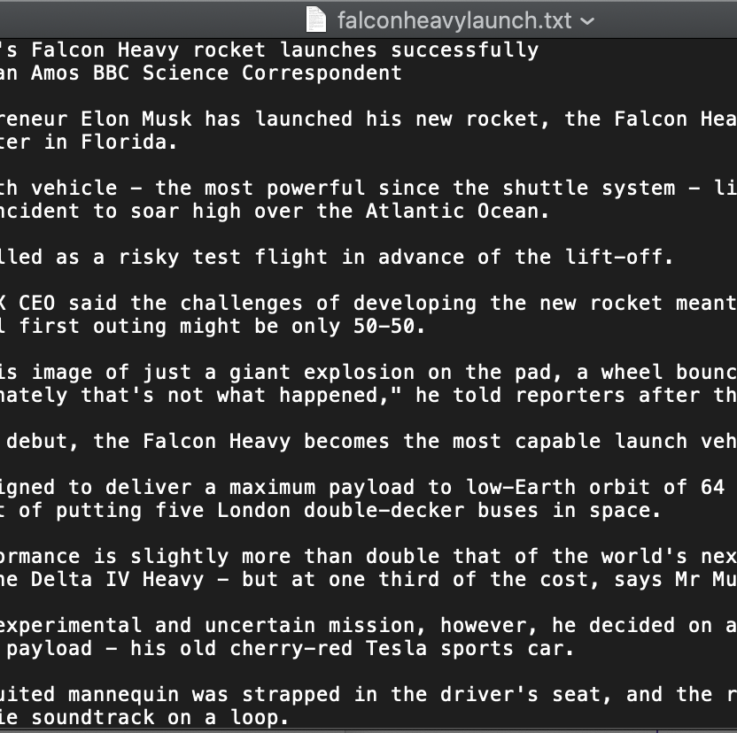
Perl: file I/O
What does this code do?
perl -e 'open $f, "falconheavylaunch.txt"; while (<$f>) {print((split " ")[0],"\n")}'
try it!
perl -e 'open $f, "falconheavylaunch.txt"; while (<$f>) {print((split " ")[0],"\n")}' | wc -l
reports 49 lines
perl -e 'open $f, "falconheavylaunch.txt"; while (<$f>) {@words = split " "; $sum+=@words}; print $sum'
reports 669 words

Slide 11
Perl: file I/O
And another bit more. Looking ahead:
  %freq (is a hash table, or key/value dict – Python)
  $freq{word} will hold the number of times word occurs
  keys %freq will be the list of keys, i.e. words, recorded
  values %freq will be the list of values, i.e. count for each word, recorded
  perl -e 'open $f, "falconheavylaunch.txt"; while (<$f>) {for (split " ") {$freq{$_}++}};'

Slide 12
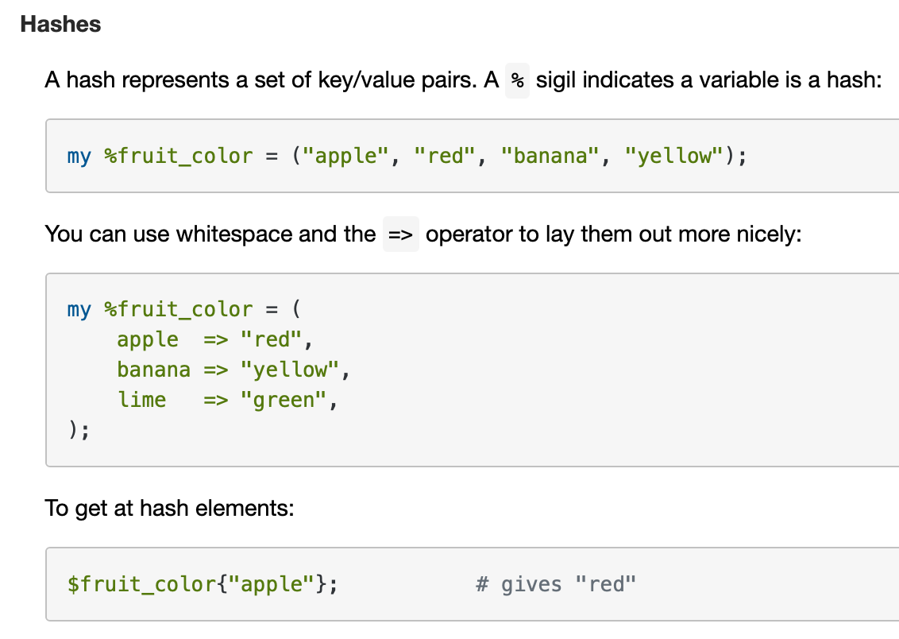
Perl: hash tables
perlintro

Slide 13
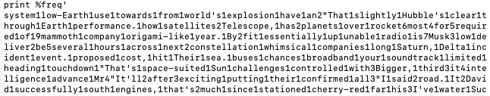
Perl: file I/O
Unfortunately:
  perl -e 'open $f, "falconheavylaunch.txt"; while (<$f>) {for (split " ") {$freq{$_}++}}; print %freq'
pretty-printing for hash tables is non-existent:

Slide 14
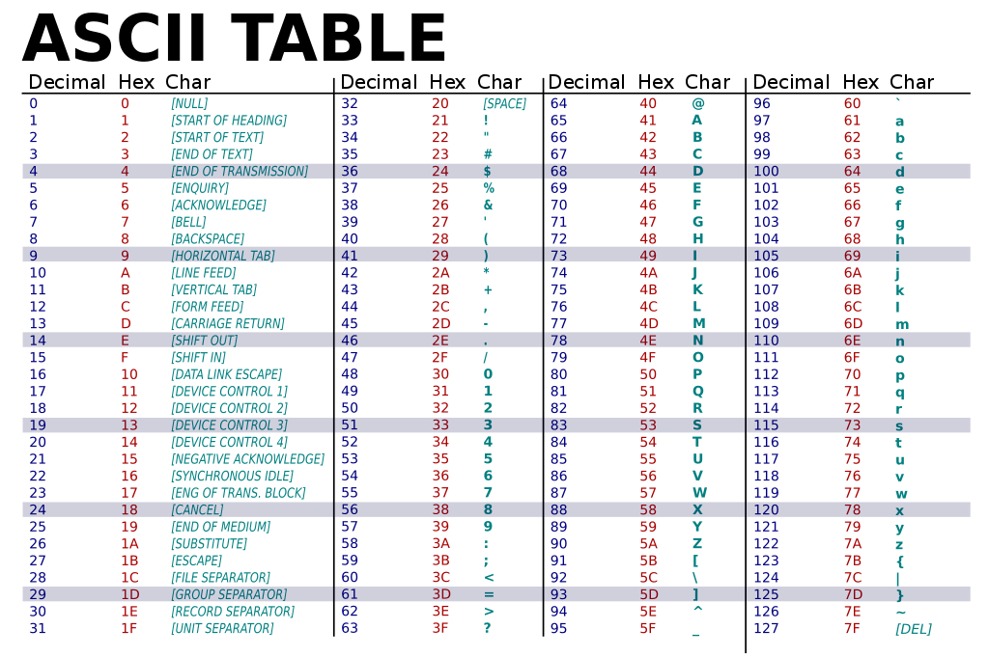
Perl Arrays: sorting
Example:
  perl -e '@a=sort @ARGV; print "@a\n"' 3 2 99 7 13 100
  100 13 2 3 7 99
  perl -e '@a=sort @ARGV; print "@a\n"' mary 77 john vicky Pete
  77 Pete john mary vicky
Standard order:
ascending

Slide 15
Perl: file I/O
Print the word frequency table sorted in descending order:
  sort {$freq{$b} <=> $freq{$a}} keys %freq
  perl -e 'open $f, "falconheavylaunch.txt"; while (<$f>) {for (split " ") {$freq{$_}++}}; for (sort {$freq{$b} <=> $freq{$a}} keys %freq) {printf "%-20s %s\n", $_, $freq{$_}}' | head -10
  the 49
  of 19
  to 18
  a 14
  and 14
  - 11
  on 9
  as 8
  was 8
  is 7
  … …
keys
values

Slide 16
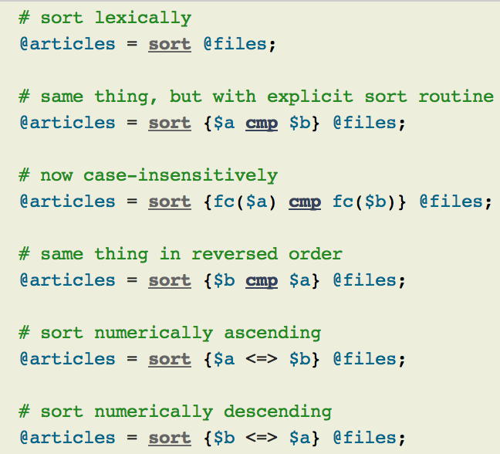
Perl Arrays: sorting
https://perldoc.perl.org/functions/sort
Numeric sort?
Idea: to pass an inline comparison function as parameter…
Note: function fc (fold case)
use feature 'fc';

Slide 17
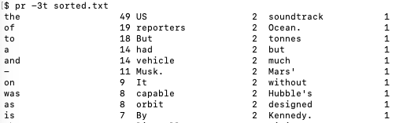
Perl: file I/O
Save the sorted output into a file sorted.txt
  perl -e 'open $f, "falconheavylaunch.txt"; while (<$f>) {for (split " ") {$freq{$_}++}}; for (sort {$freq{$b} <=> $freq{$a}} keys %freq) {printf "%-20s %s\n", $_, $freq{$_}}' > sorted.txt
Then show it in 3 column format
  Terminal command pr -3t sorted.txt

Slide 18
Perl: file I/O
Strictly speaking, we'd like to remove prefix/suffix punctuation,
i.e. avoid accumulating "words" like:
  "It'll 2
  …
  sea. 1
  literally." 1
We haven't covered regex yet:
  for $w (split " ") {$w=~s/(^\W+)|(\W+$)//g; $freq{$w}++}

Slide 19
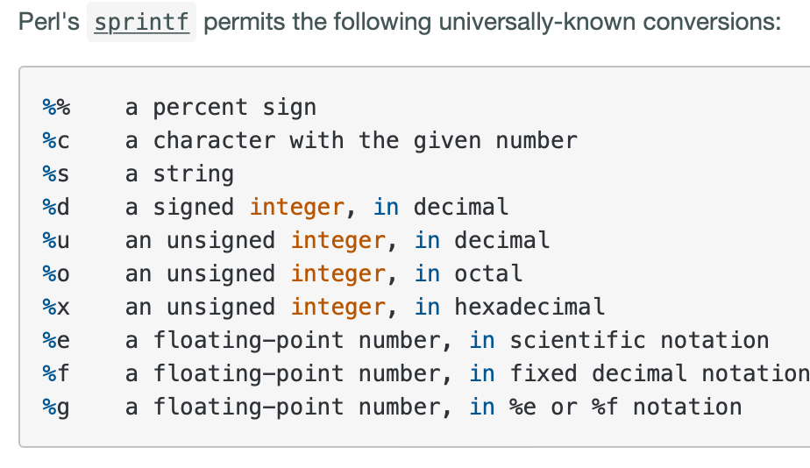
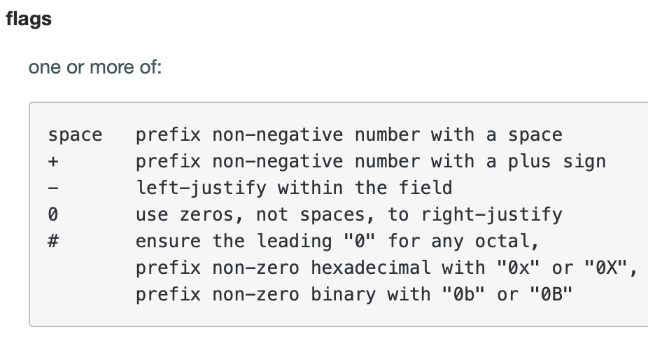
Formatted printing
printf "%-20s %s\n", $_, $freq{$_}
https://perldoc.perl.org/functions/sprintf

Slide 20
Perl: file I/O
Alternative: use shell command sort (instead of Perl sort):
  sort -k 2nr sort by key field #2 numerically (n) in reverse order (r)
  https://man7.org/linux/man-pages/man1/sort.1.html
  perl -e 'open $f, "falconheavylaunch.txt"; while (<$f>) {for (split " ") {$freq{$_}++}}; for (keys %freq) {print $_," ", $freq{$_}, "\n"}' | sort -k 2nr | pr -t5
the 49 reporters 2 With 1 ever 1 military. 1
of 19 rocket, 2 about 1 exciting 1 missed 1
to 18 said 2 across 1 experimental mission, 1
a 14 satellites 2 advance 1 explosion 1 moons. 1
and 14 strapped 2 allied 1 far 1 much 1
- 11 that's 2 around 1 fascinating 1 not 1
on 9 told 2 attempt 1 final 1 occasions, 1
as 8 upper-stage 2 available. 1 fire 1 occurring 1
was 8 vehicle 2 back 1 first 1 old 1
is 7 where 2 batches 1 fit 1 open 1
Falcon 6 "I 1 becomes 1 five 1 or 1
The 6 "That 1 been 1 flight 1 orbit. 1
rocket 6 "That's 1 believes 1 folded 1 origami-like
…

Slide 21
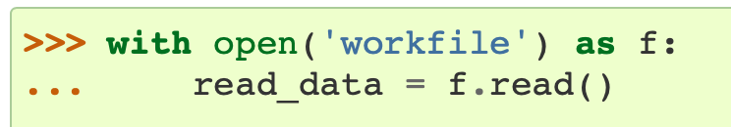
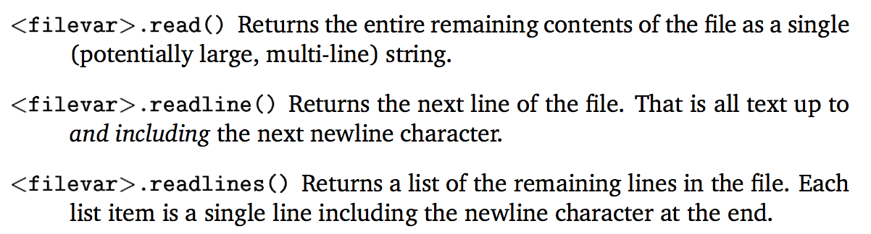
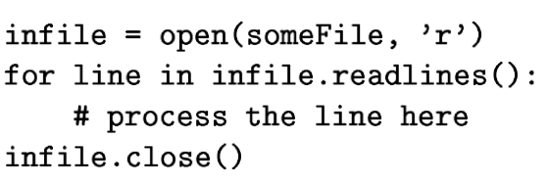
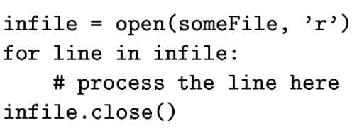
Python: Files
Like all other programming languages, uses a file handle, called file variable: open()
infile = open("file.txt","r") outfile = open("results.txt","w")
same as

Slide 22
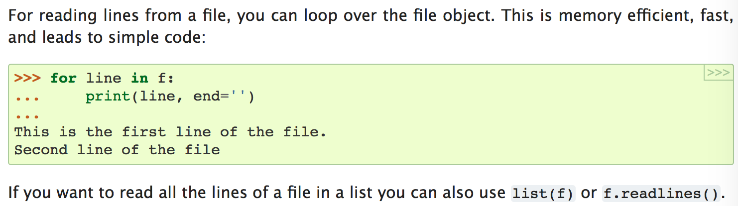
Python: Files
https://docs.python.org/3/tutorial/inputoutput.html#reading-and-writing-files

Slide 23
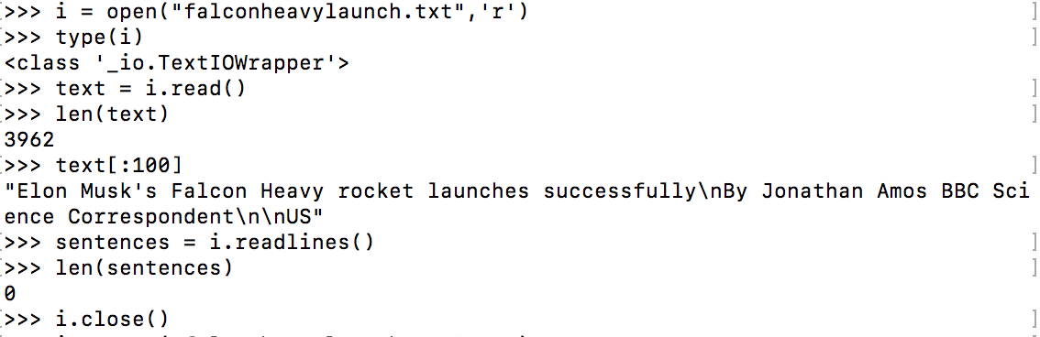
Python: Files

Slide 24
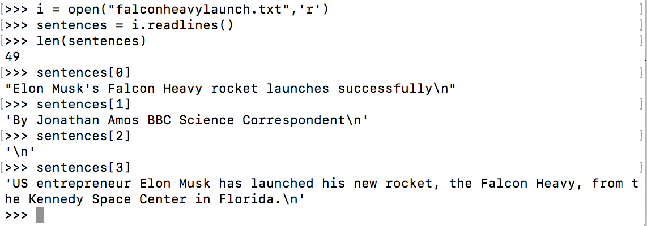
Python: Files

Slide 25
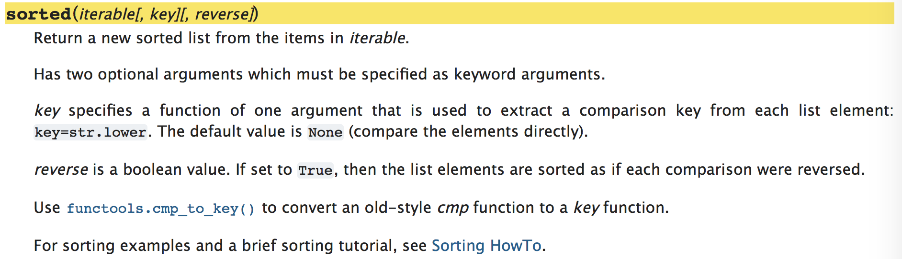
Python: sorting
https://docs.python.org/3/howto/sorting.html

