Slide 1
LING/C SC/PSYC 438/538
Lecture 6
Prof. Sandiway Fong

Slide 2
Today's Topics
perlintro:
  @ARGV array and other array operations
  equality
  coercion
  useful functions on strings: e.g. reverse
  file input/output (I/O)
Homework 5 (due Sunday midnight)
  everything you need is in Lectures 5 & 6

Slide 3
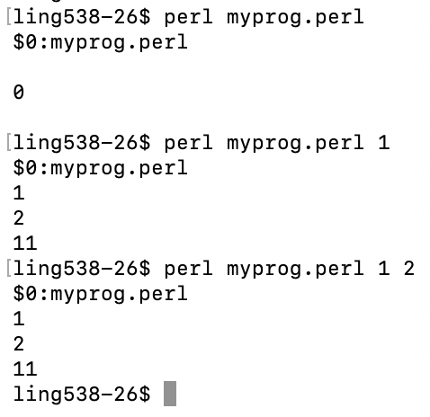
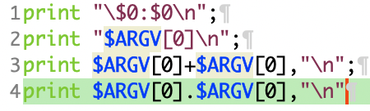
Perl Arrays
Built-in arrays:
  @ARGV (command line arguments;
  coercion possible)
  $ARGV[0] (1st argument)
  $0 (program name)
  @_ (sub(routine) arguments)
Example:
myprog.perl

Slide 4
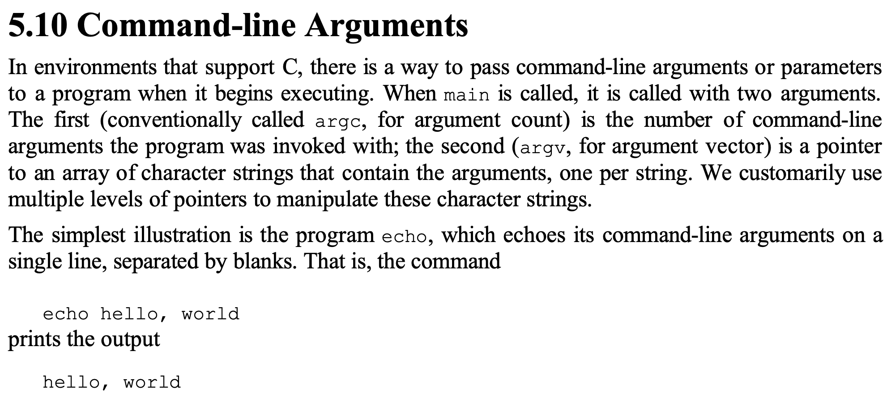
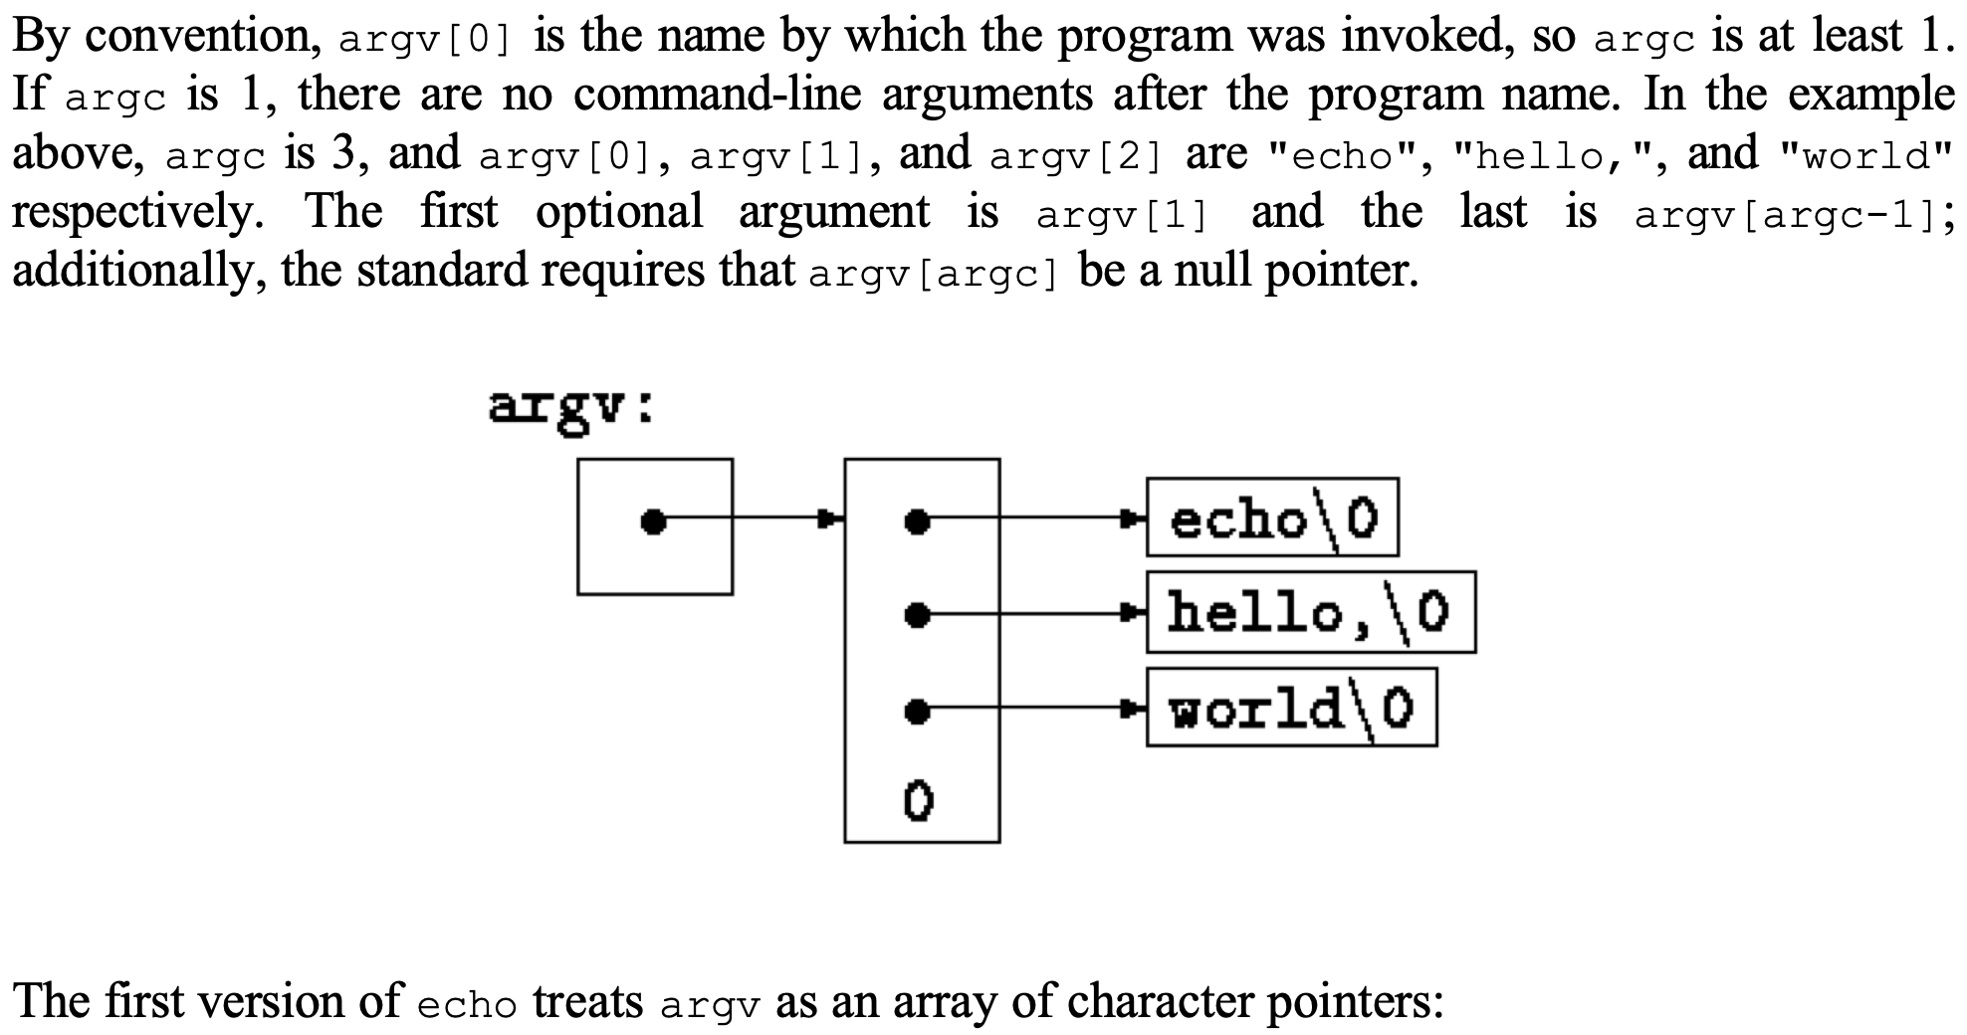
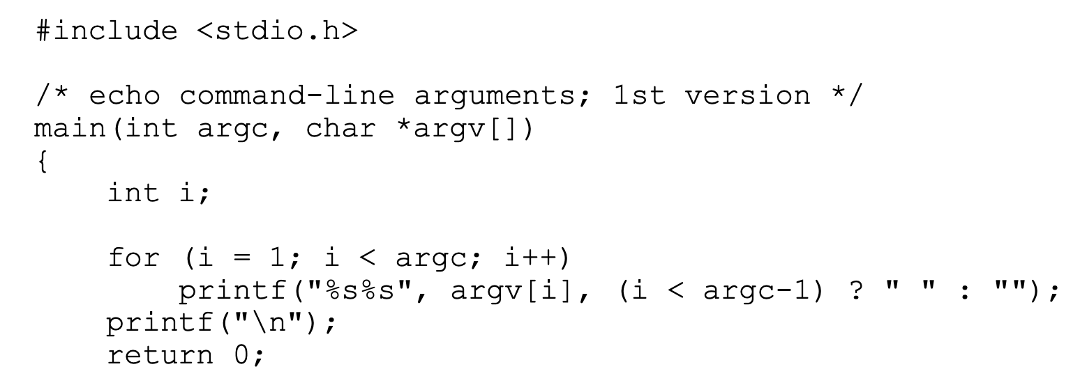
From C (originally)
The C Programming Language, Kernighan & Ritchie (1978; 1988)

Slide 5
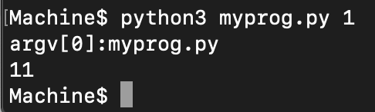
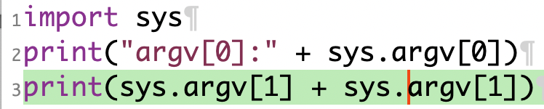
Python argv
Essential details:
  import sys
  sys.argv (list of command arguments as strings)
  sys.argv[0] (Python script name)
  sys.argv[1] (1st argument)
  Example:
myprog.py
use int(sys.argv[1]) to convert string into an integer

Slide 6
Perl Arrays
Built-in functions:
  sort @ARRAY; reverse @ARRAY;
  push @ARRAY, $ELEMENT; pop @ARRAY; (operates at right end of array)
  shift @ARRAY; unshift @ARRAY, $ELEMENT; (left end of array)
  splice @ARRAY, $OFFSET, $LENGTH, $ELEMENT
    $ELEMENT above can be @ARRAY
Python:
  sorted(array) (new array), array.sort() (modify array), array.reverse()
  NO push (use array.append() instead), array.pop()
  No shift/unshift etc… (but can use slicing and concatenation)

Slide 7
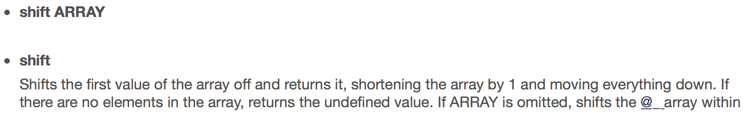
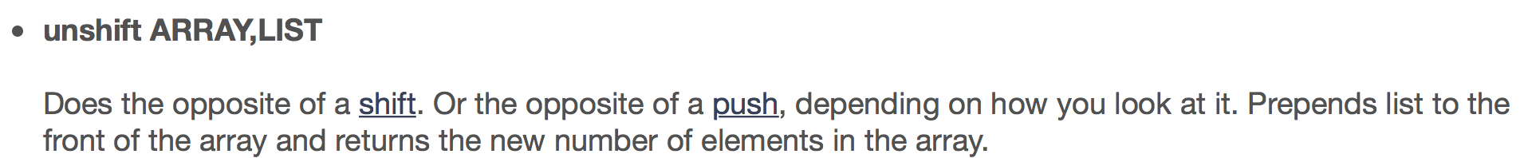
perlintro: Perl Arrays
Similar to pop/push, but operates at the left end of the array
Python doesn't have these defined but can be simulated via slicing and concatenation:
array[1:]
list + array

Slide 8
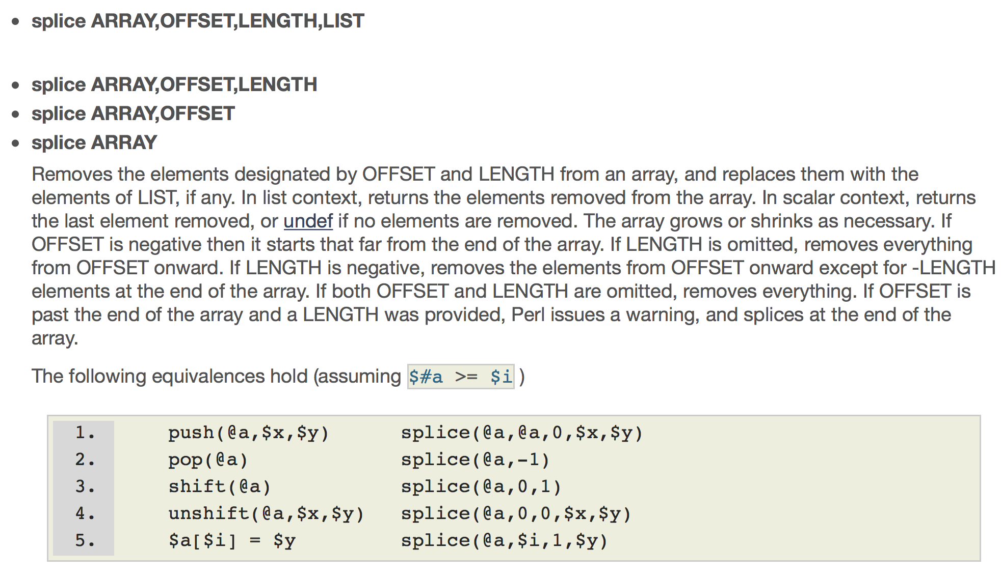
perlintro: Perl Arrays

Slide 9
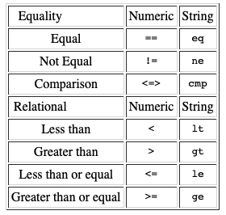
Equality
Conditionals:
  if ( comparison ) { statement }
    else { statement }
    elsif ( comparison ) { statement }
Example:
  if ( @a < 10 ) { print "Small array\n" } else { print "Big array\n" }
  Note: @a here is in a scalar context = size of array
Example:
  unless ( @a > 10 ) { print "@a\n" }
  if size of array a is ≤ 10, it prints the contents of array a
returns 1 for true and "" for false

Slide 10
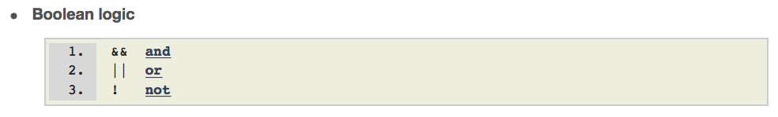
Equality

Slide 11
Perl equality (numeric and string)
returns 1 for true and "" for false
What does eq do?
perl -e '$x = "windy" eq "Windy"; print "$x\n"'
perl -e 'use feature fc; $x = "windy" eq fc("Windy"); print "$x\n"'
1
perl -e '$x = "windy" eq "windy"; print "$x\n"'
1
perl -e '$x = 0.0 eq 1; print "$x\n"'
perl -e '$x = 0.0 eq 0; print "$x\n"'
1
perl -e '$x = 0.0 eq "0"; print "$x\n"'
1
perl -e '$x = 0.0 eq "windy"; print "$x\n"'
implicit coercion

Slide 12
Perl equality (numeric and string)
What does == do?
  perl -e '$x = 0.0 == 1; print "$x\n"'
  perl -e '$x = 0.0 == 0; print "$x\n"'
  1
  perl -e '$x = 0.0 == "0"; print "$x\n"'
  1
  perl -e '$x = 0.0 == "windy"; print "$x\n"'
  1

Slide 13
Perl equality (numeric and string)
Turn on warnings:
  $ perl -e 'use warnings; "windy" == 0'
  Useless use of numeric eq (==) in void context at -e line 1.
  Argument "windy" isn't numeric in numeric eq (==) at -e line 1.
Data type testing:
  use Scalar::Util "looks_like_number";
$ perl -e 'use Scalar::Util "looks_like_number"; print looks_like_number($ARGV[0]), "\n"' 1.23
1
$ perl -e 'use Scalar::Util "looks_like_number"; print looks_like_number($ARGV[0]), "\n"' windy
$

Slide 14
More Implicit Coercion
Example:
  the following program
my @a = qw(one, two, three);
my $string = @a." is my number";
print "$string\n";
  prints
  3 is my number
  Note: . (period) is the string concatenation operator (scalar context)
Note: qw = quoted word, cf.
("one", "two", "three")

Slide 15
Implicit Coercion
$ python3
>>> print("4"*4)
4444
>>>
perl -e 'print "4" * 4, "\n"'
16
perl -e 'print "4" x 4, "\n"' (“x” is the repetition operator)
4444
perl -e '@a = (4) x 4; print "@a\n"' (list context)
4 4 4 4
@a = (4) x 4
(4, 4, 4, 4)

Slide 16
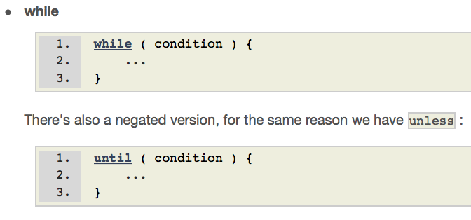
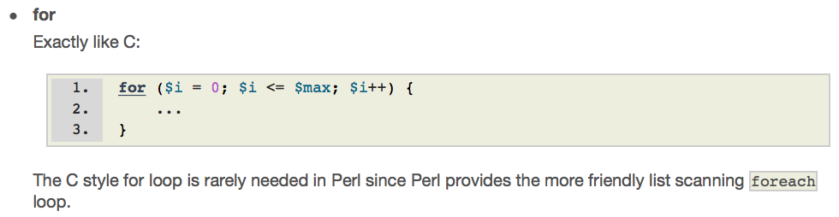
General Looping: while and for
Python: use range(start, end, step) instead. Or Numpy arange()

Slide 17
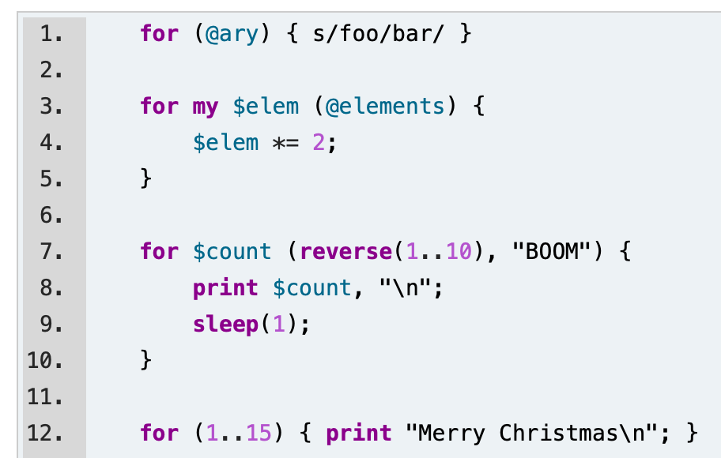
General Looping: foreach
$_ implicit variable

Slide 18
General Looping
perl -e 'for (@ARGV) {print $_ * $_, " "}' 1 2 3 4 5
1 4 9 16 25

Slide 19
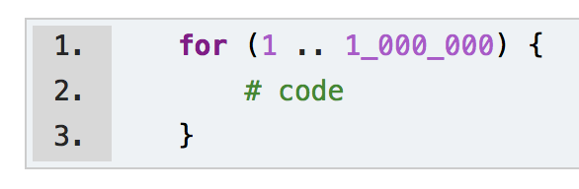
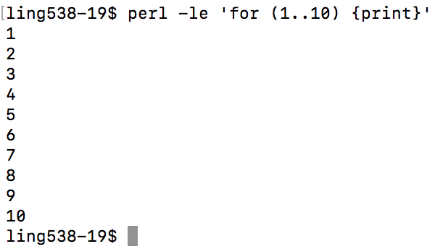
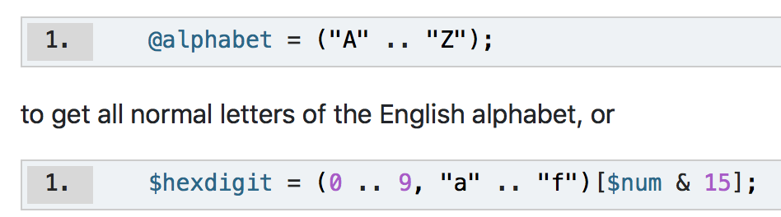

Perl list ranges
Python equivalent:
for i in range(1,1000001):
  # code
iterates setting $_ (the default variable)
from 1, 2, .., 1000000

Slide 20
split
https://perldoc.perl.org/functions/split.html
Compare:
  @a = split " ", "this is a sentence."
  @a = split //, "this is a sentence."
Exercise: what is the size of array @a?

Slide 21
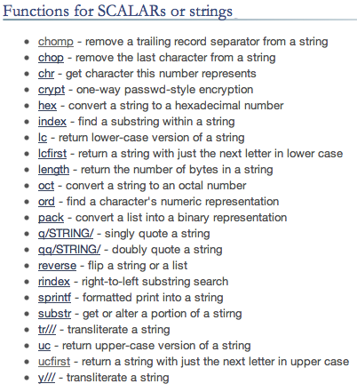

Perl: useful string functions
chomp (useful with file I/O) vs. chop
Note: multiple spaces ok with " " variant

Slide 22
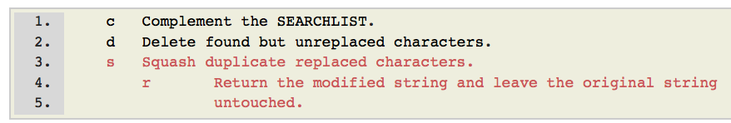
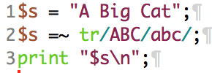

Perl: useful string functions
Transliterate:
destructive operation!
tr/matchingcharacters/replacementcharacters/modifiers
modifiers are optional:

Slide 23

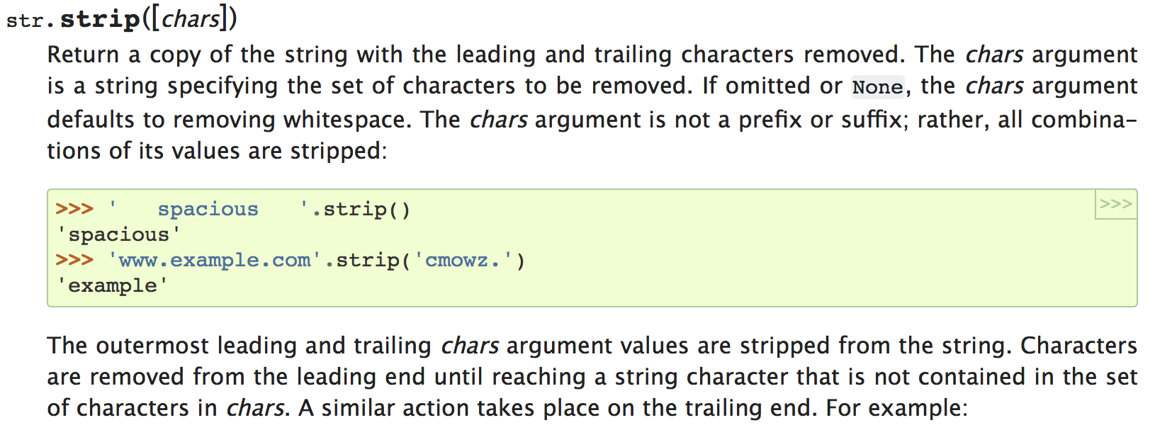
Perl: useful string functions
Perl doesn't have a built-in trim-whitespace-from-both-ends-of-a-string function.
Can be mimicked using regex (more later)
Python:

Slide 24
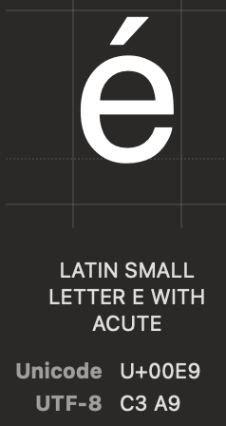
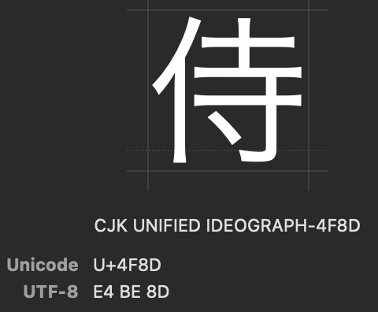
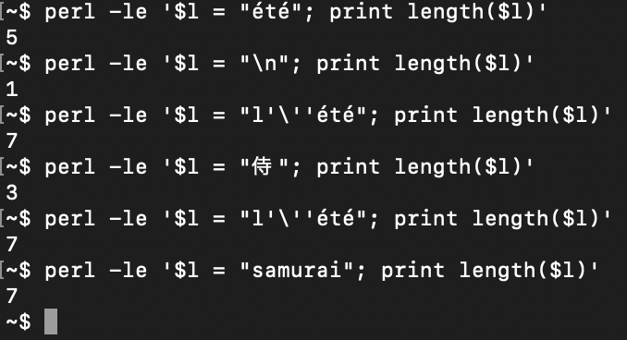
A note on string length
Terminal: newline ("\n") is of length 1 in Perl.

Slide 25
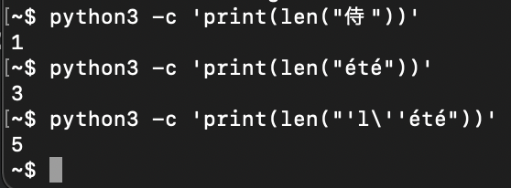
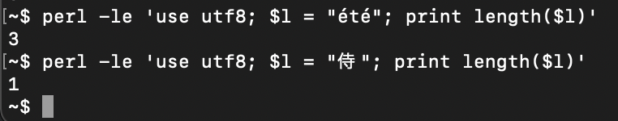
Python: a note on string length

Slide 26
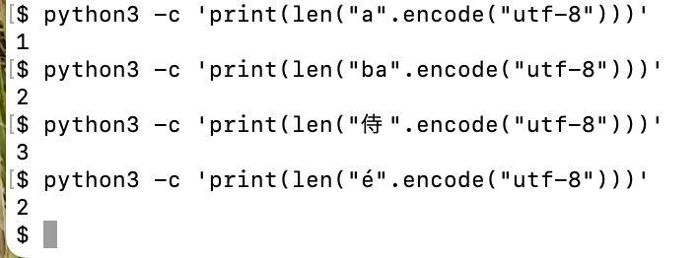
Python: bytes vs. characters
(len) number of characters vs. number of bytes

Slide 27

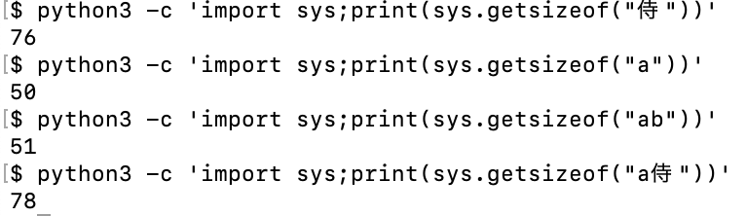
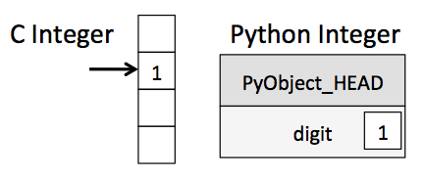
Python: size of object
Python: inefficient in data storage
  overhead

Slide 28
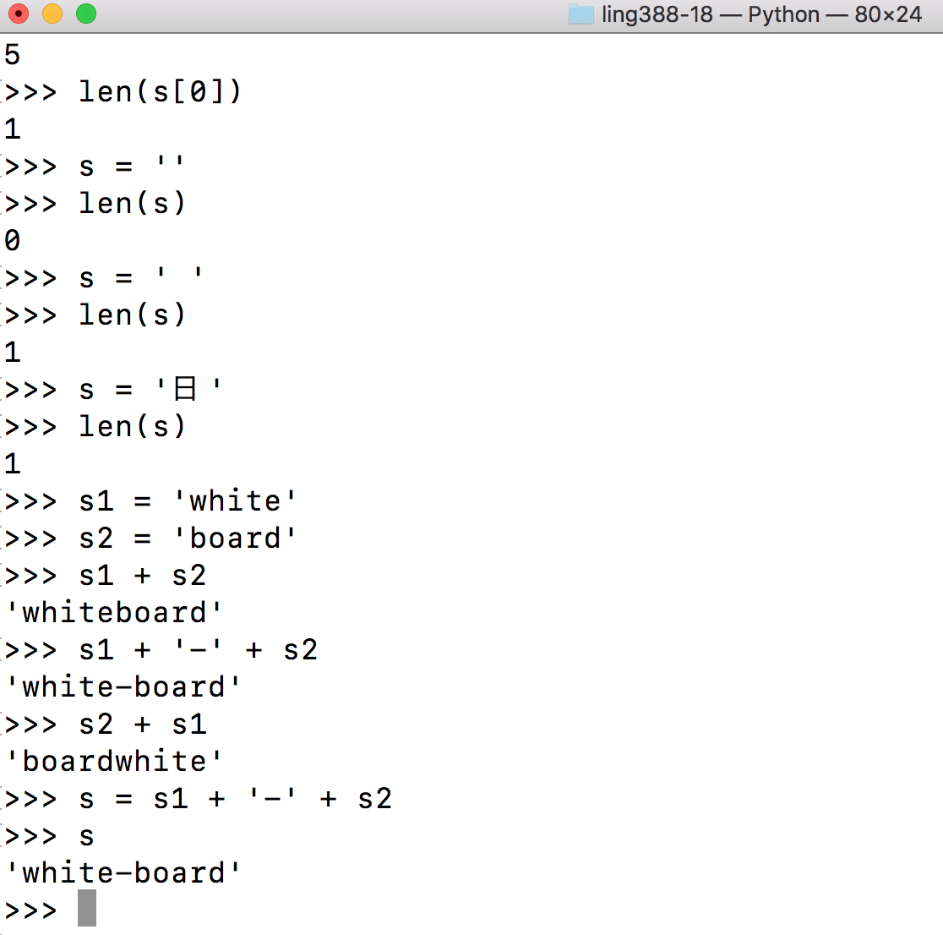
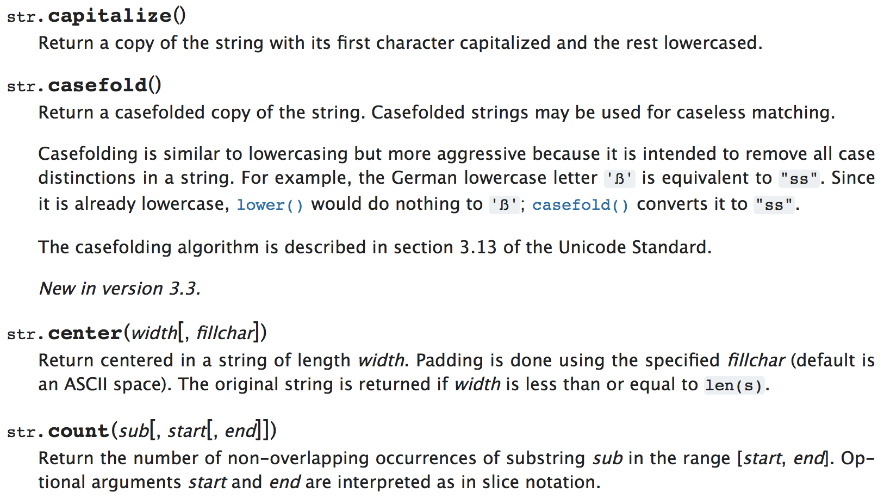
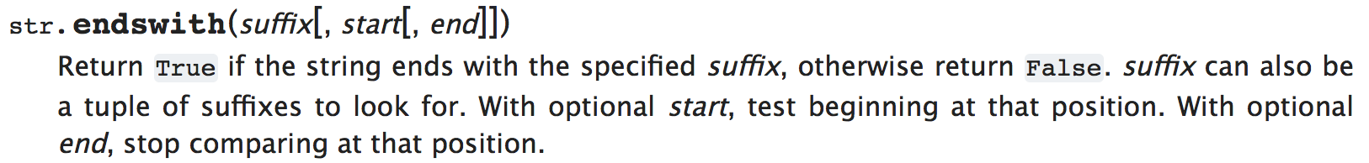
Python: strings
Many methods that work on lists also work on strings

Slide 29
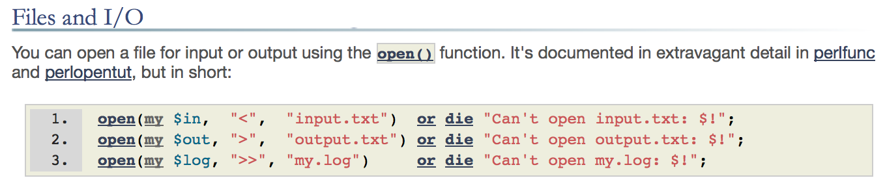
Perl: file I/O
Step 1: call open()
Files: must be opened for reading “<“ or writing “>”
(overwrite or append mode “>>”)
Shell syntax: I/O redirection “<“ “>”
Opening a file creates a file handle (Perl variable)
– not to be confused with filename
Supply the file handle as an argument for read/write

Slide 30
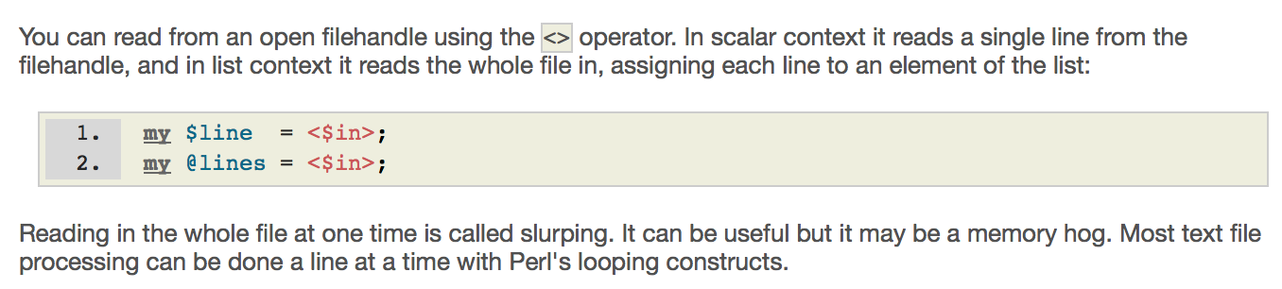
Perl: file I/O
Step 2: use the <> operator:
Note: $in is the file handle instantiated by the open() call, e.g.
open($in, "<", "inputfile.txt");
or
open($in, "inputfile.txt");

Slide 31
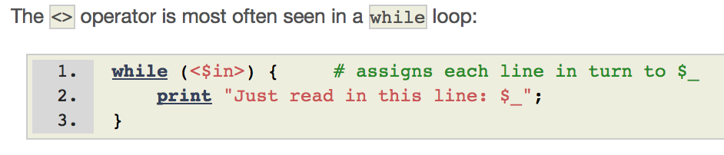
Perl: file I/O
Line by line:
read.perl
open($txtfile, $ARGV[0]) or die "File $ARGV[0] not found!\n";
while ($line = <$txtfile>) {
print "$line";
}
close($txtfile)
Notes:
command $line = <$txtfile> inside the while condition reads in a line from the file referenced by the file handle $txtfile
and places that line into the variable $line (including the newline at the end of the line)
At the end of the file, $line is just an empty string (equivalent to false).
the filename is the first argument to the Perl program (arguments go in @ARGV).

Slide 32
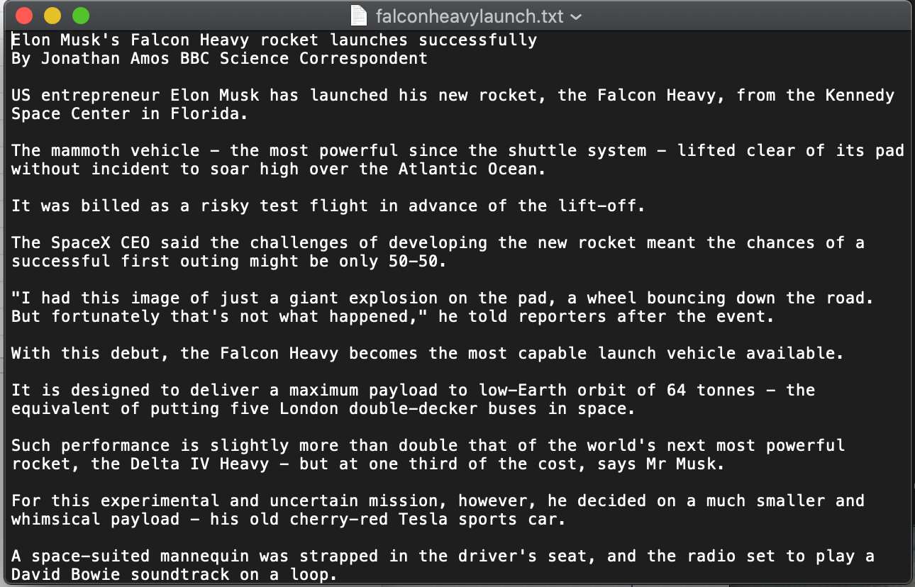
Perl: file I/O

Slide 33
Perl: file I/O
What does this code do?
perl -e 'open $f, "falconheavylaunch.txt"; while (<$f>) {print((split " ")[0],"\n")}'
perl -e 'open $f, "falconheavylaunch.txt"; while (<$f>) {print((split " ")[0],"\n")}' | wc -l
reports 49 lines

Slide 34
Perl: file I/O
A bit more:
  perl -e 'open $f, "falconheavylaunch.txt"; while (<$f>) {@words = split " "; $sum+=@words}; print $sum'
Compare with:
wc falconheavylaunch.txt
49 669 3973 falconheavylaunch.txt

Slide 35
Homework 5
There are 4 files on the course website:
  5letters.txt words with 5 letters etc.
  6letters.txt
  7letters.txt

Slide 36
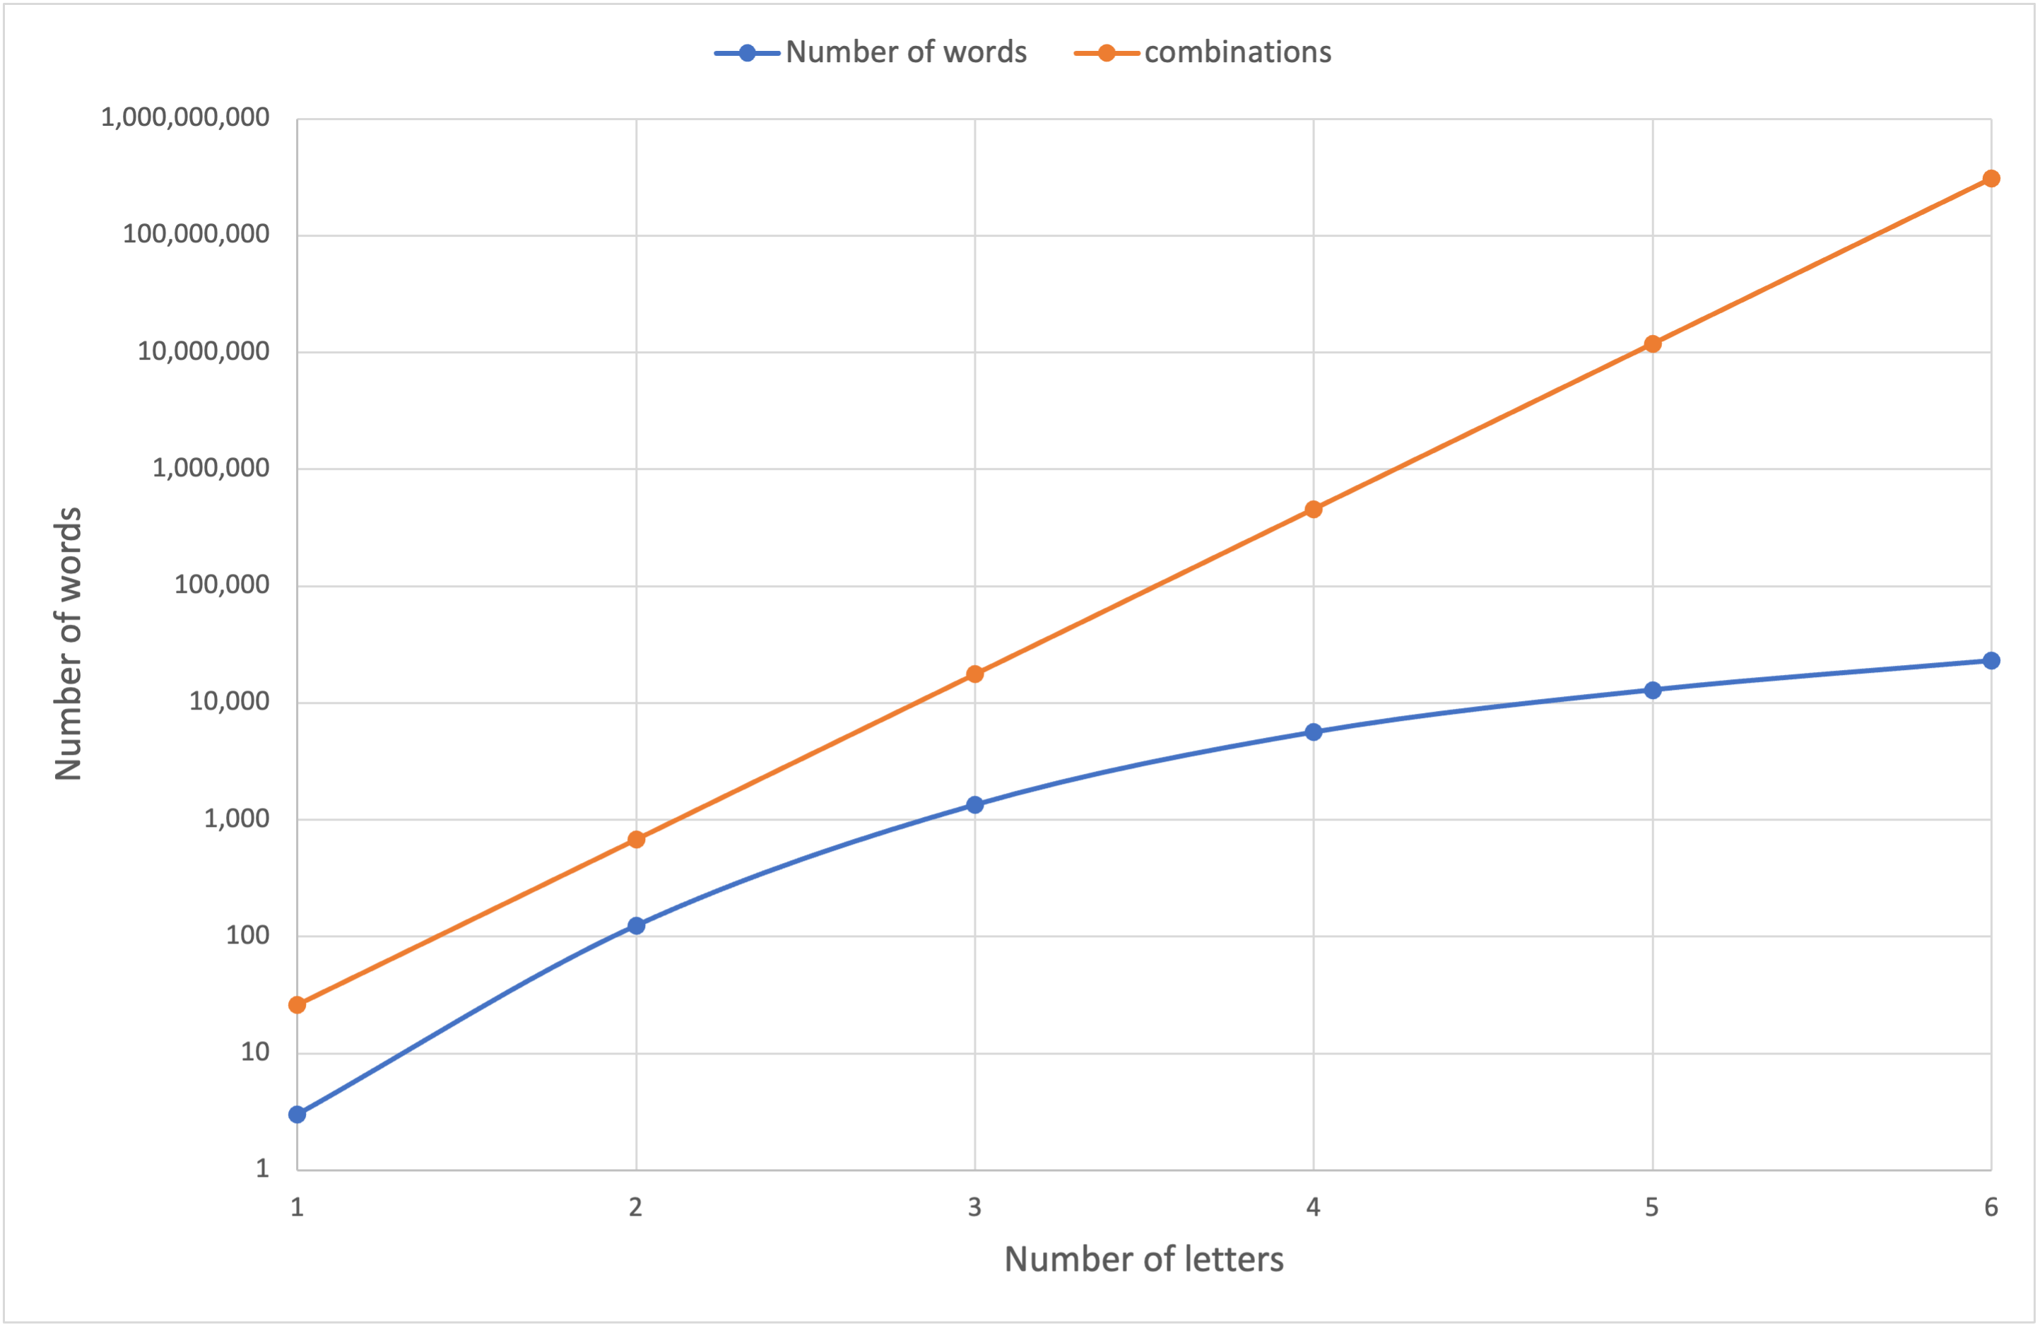
A particular set of Scrabble Words
(# letters ≥ 2)
26⁶
26⁵
26⁴
gap should continue to widen
log scale
(exponential)
26³
26 x 26

Slide 37
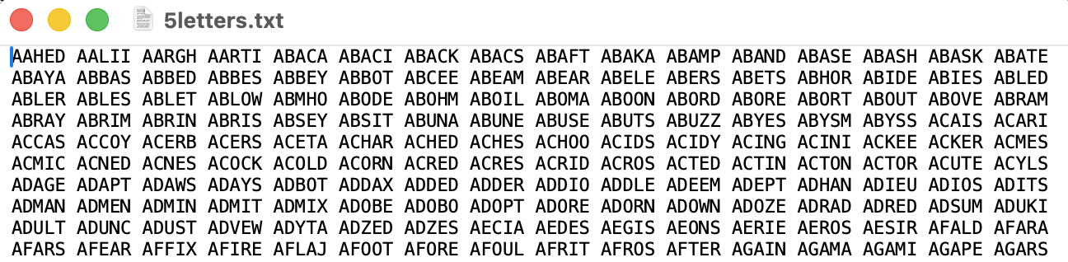
Homework 5
Question 1:
  write a Perl one-liner or a Perl program that reads in one of the nletter.txt files and prints out the number of words.
  Show your program working on each nletter.txt for n = 5, 6 and 7 at the terminal, e.g. screenshot.
  What numbers did you get for n = 5, 6 and 7?

Slide 38
Homework 5
Question 1:
  HINT for new programmers:
    look at the file format (plain text)
    use $ARGV[0] (filename)
    use open and <…> to read the contents
    use split
    Store the words in an array
    Print the size of the array

Slide 39
Homework 5
Question 2:
  Which words in the nletter.txt files spell the same forwards as backwards (palindrome)?
  Examples: YAY, WOW, DEED, NAAN (these are 3 and 4 letter ones)
  write a Perl one-liner or a Perl program that reads in one of the nletter.txt files and prints out the words that satisfy this condition.
  Show your program working on each nletter.txt for n = 5, 6 and 7 at the terminal, e.g. screenshot.
  Report how many words you got for n = 5, 6 and 7?

Slide 40
Homework 5
Question 2:
  HINT for new programmers:
    extend your answer from Question 1
    use foreach to loop over your array (for each word),
    use reverse and eq to test if each word is a palindrome
    print it if it satisfies the condition

Slide 41
Homework 5
Email to sandiway@arizona.edu
Due by Sunday midnight (no late homeworks, please)
  Will be reviewed in class on Tuesday
Email SUBJECT: 438/538 Homework 5: YOUR NAME
Either Plain Text or PDF accepted (no Word .docx files please!)
Submit an actual file, no links to files.

