Slide 1
LING/C SC/PSYC 438/538
Lecture 19
Prof. Sandiway Fong

Slide 2
Today's Topics
Homework 11 Review
Some regular language properties
Turing Machines
  a brief digression – similar to FSA but with a tape (for storage)

Slide 3
Homework 11 Review
Consider the following NDFSA:
Q1: Why is it a NDFSA?
1
x
2
>
2
y
1
2
1
1
1
z
Σ = {1,2}

Slide 4
Homework 11 Review
Consider the following NDFSA:
Q2: What strings of length 3 from Σ* does it accept? How many are there?
Accept 5 (length 3)
112 122 211 212 222
Rejects 3 (length 3)
111 121 221
1
x
2
>
2
y
1
2
1
1
1
z
Σ = {1,2}

Slide 5
Homework 11 Review
Consider the following NDFSA:
Q3: Which strings of length 4 from Σ* does it not accept? How many are there?
Accepts 11 (length 4)
1112 1122 1211 1212 1222
2111 2112 2122 2211 2212 2222
Rejects 5 (length 4)
1111 1121 1221 2121 2221
1
x
2
>
2
y
1
2
1
1
1
z
Σ = {1,2}

Slide 6
Homework 11 Review
1
Q4: Convert our NDFSA into a DFSA
>
{x}
2
1
{y}
2
1
2
x
2
2
>
2
{x,z}
1
{x,y}
y
1
1
2
1
1
1
1
z
How many states does the DFSA have? 5
How many final states? 3
{x,y,z}
Σ = {1,2}
2

Slide 7
Homework 11
538 Q5 (438 Extra Credit):
  Implement your DFSA in Perl or Python (only)
  Then devise a way to calculate how many strings there are in the language (of the DFSA) with string length not exceeding 10
Example:
$ for n in {1..10}; do perl dfsa.perl $(eval echo $(printf '{1,2}%.0s' $(seq $n))); done | wc -l
1525

Slide 8
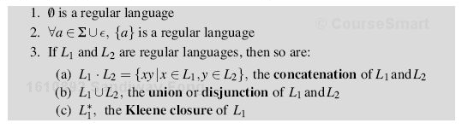
Regular Languages and FSA
Recall languages are sets of strings.
Regular languages:
Correspondence between Regular Languages and regex devices:
  concatenation (juxtaposition)
  union (| also [ ])
  Kleene closure (*) Note: x⁺ = xx*)
Note:
  backreferences are memory devices and thus are too powerful
  e.g. L = {ww} and prime number testing (see earlier lectures)

Slide 9
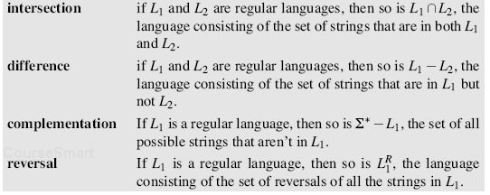
Regular Languages and FSA
Closure properties:
  i.e. do we still have a regular language after applying the operation?
Closure properties not necessarily preserved higher up, e.g. context-free languages

Slide 10
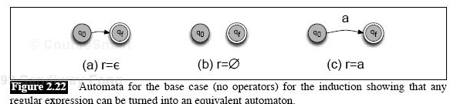
Regular Languages and FSA
Textbook gives one direction only
there are three cases:
  Empty string
  Empty set
  Any character from the alphabet

Slide 11
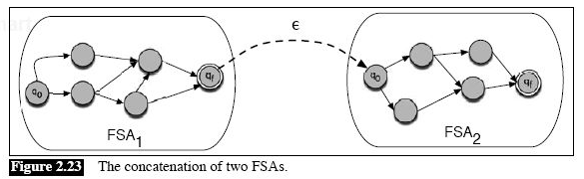
Regular Languages and FSA
Concatenation:
  Link final state of FSA₁ to initial state of FSA₂ using an empty transition
Note: empty transition ε can be deleted using the set of states construction

Slide 12
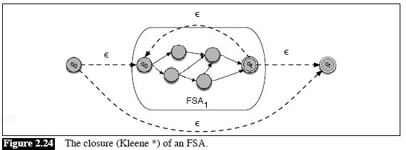
Regular Languages and FSA
Kleene closure:
  repetition operator: zero or more times
  use empty transitions for loopback and bypass

Slide 13
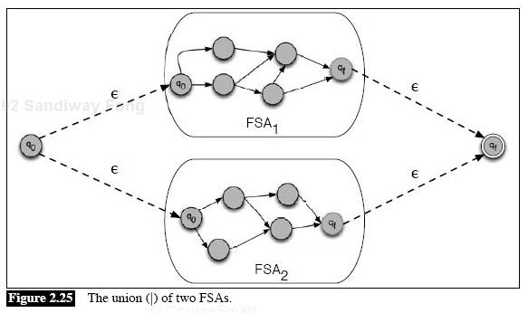
Regular Languages and FSA
Union: aka disjunction
  Non-deterministically run both FSAs at the same time, accept if either one accepts

Slide 14
Regular Languages and FSA
Other closure properties:
Let’s consider building the FSA machinery for each of these guys in turn…

Slide 15
Regular Languages and FSA
Other closure properties:
What would be the final state?

Slide 16
Regular Languages and FSA
Other closure properties:
What would be the final state?

Slide 17
Regular Languages and FSA
Other closure properties:
Example: Σ = {a,b}; Σ* = {a, b}*
we need explicit arcs for each character in Σ
  to a "dead" state (if necessary)
then flip accepting and non-accepting states

Slide 18
Regular Languages and FSA
Other closure properties:
reverse arrows and swap initial/final

Slide 19
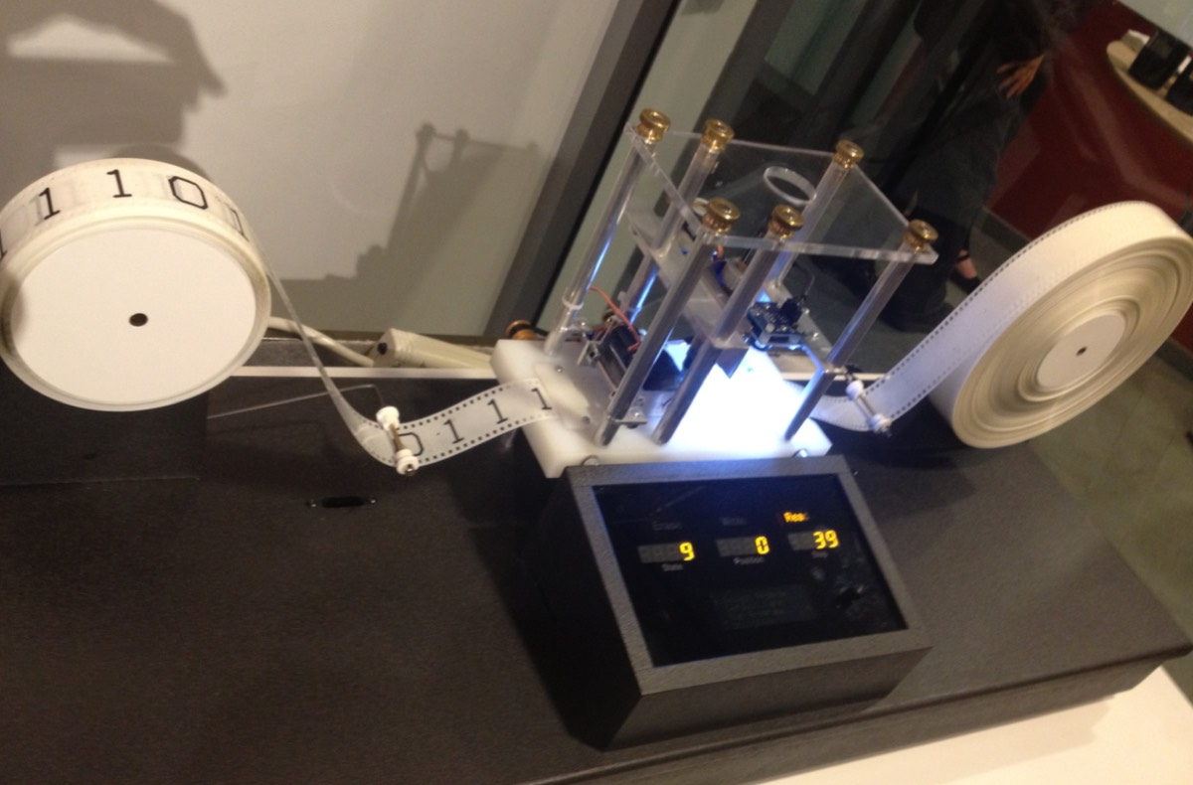
Turing Machine
TM = (Q, Σ, q₀, δ) + tape
Q, Σ finite. ∴ δ finite.
(partial) transition function δ:
  Q x Σ -> Q x Σ x d d = [LRN]
  ⟨q, σ, q', σ', d⟩
Memory:
  one-way infinite tape
  initially: ▷ input …, head at start of input
  ▷ is the end-of-tape symbol (part of Σ)
  how to signal right end? Suppose 0. Σ = {▷, 0} + new symbols (minimum 1)
  initial values of cells beyond the input = 0
  assume cannot fall off the left side
Halt:
  when no matching transition exists
Encodable as a (finite) sequence of numbers:
  ⟨|Q|, Q, |Σ|, Σ, q₀, q, σ, q', σ', d,… ⟩
Configuration:
  ⟨Tape, position, q⟩
  initially: ⟨ ▷·input, 1, q⟩
FSA +
Model of a basic Turing machine, part of the Go Ask Alice exhibit at the Harvard Collection of Historical Scientific Instruments.

Slide 20
Turing Machine
It can be configured as a decider like an ordinary FSA
Or it can be a transducer (i.e. map input into output strings)
Example
Successor function:
  Σ = {▷,1,0}, Q = {q₀, q₁}, q₀ initial state
  recall unary notation (initially, at the leftmost 1): ▷ 1 1 1 0 …
  Idea: find 1st zero, change it to a 1
  ⟨q₀, 1, q₀, 1, R⟩
  ⟨q₀, 0, q₁, 1, R⟩

Slide 21
Turing Machine
+2 (add 2) function:
  Σ = {▷,1,0}, Q = {q₀, q₁ , q₂}, q₀ initial state
  unary notation (initially, at the leftmost 1): ▷ 1 1 1 0 …
  Idea: find 2 zeros, change them to 1's
  ⟨q₀, 1, q₀, 1, R⟩
  ⟨q₀, 0, q₁, 1, R⟩
  ⟨q₁, 0, q₂, 1, R⟩

Slide 22
Turing Machine
Example:
doubler
  ▷ 1 1 1 ▷ (start)
  ▷ 2 1 1 ▷ (change 1 to 2, move R)
  ▷ 2 2 1 ▷ (change 1 to 2, move R)
  ▷ 2 2 2 ▷ (change 1 to 2, move R)
  ▷ 2 2 2 ▷ (move L at ▷)
  ▷ 2 2 1 ▷ (change 2 to 1, move R)
  ▷ 2 2 1 1 ▷ (change ▷ to 1, move L)
  ▷ 2 2 1 1 ▷ (skip L 1's)
  ▷ 2 1 1 1 ▷ (change 2 to 1, move R)
  ▷ 2 1 1 1 ▷ (skip R L's)
  ▷ 2 1 1 1 1 ▷ (change ▷ to 1, move L)
  ▷ 2 1 1 1 1 ▷ (skip L 1's)
  ▷ 1 1 1 1 1 ▷ (change 2 to 1, move R)
  ▷ 1 1 1 1 1 ▷ (skip R L's)
  ▷ 1 1 1 1 1 1 ▷ (change ▷ to 1, move L)
  ▷ 1 1 1 1 1 1 ▷ (skip L 1's)
  halt

Slide 23
Turing Machine
initially: change all 1's to 2's
move L all the way, until you see a 2 or ▷
1,2,R
1,1,L
Machine:
has 4 states: {0, 1, 2, 3}
Σ = {1, 2, ▷}
q₀ = 0
f = 3
deterministic
  transition function
  each arc at states labeled
  sym,sym',Move
  sym ∈ Σ, Move ∈ {L,R}
end? move L
0
▷, ▷,L
1
▷, ▷,R
3
>
2,1,R
change 2 to 1
▷,1,L
2
end? ▷ change to 1
1,1,R
move R all the way
until end
doubles!

