Slide 1
LING/C SC/PSYC 438/538
Lecture 18
Prof. Sandiway Fong

Slide 2
Today's Topics
FSA contd.
  recall non-determinism?
  NDFSA to DFSA conversion
Markov Chains
Homework 11: FSA Homework

Slide 3
Last Time: NDFSA → DFSA
Idea: construct a new machine
  each state of the new machine represents the set of possible states of the original machine when stepping through the input alphabet (Σ)
Notes:
  new machine is equivalent to old one (but has more states)
  new machine is deterministic!
example
>
s
a
{x,y}
[Powerpoint
Animation]
>
s
a
x
b
a
a
a
b
b
{y,z}
{z}
a
y
z
b
b
a
a
a
{y}
b
b
b

Slide 4
Worked EXERCISE
Let's check our understanding:
  apply the set-of-states construction technique to the two machines on the ε-transition slide from the previous lecture (repeated below)
How to check your answer?
  should confirm the machine produced is actually deterministic and accurately simulates its ε-transition counterpart
a
b
a
b
>
1
2
3
>
1
2
3
ε
ε

Slide 5
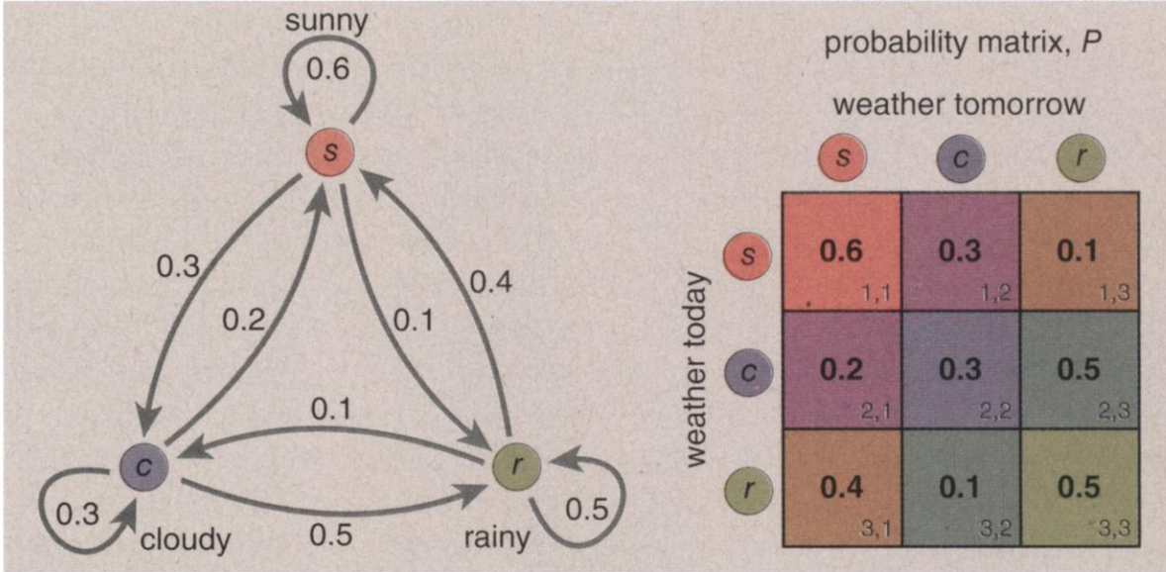
Markov Chain: when events are not independent
Note: exit transition probabilities must sum to 1 (otherwise just weights)
Any state here can be a start state!
(Hayes 2013)

Slide 6
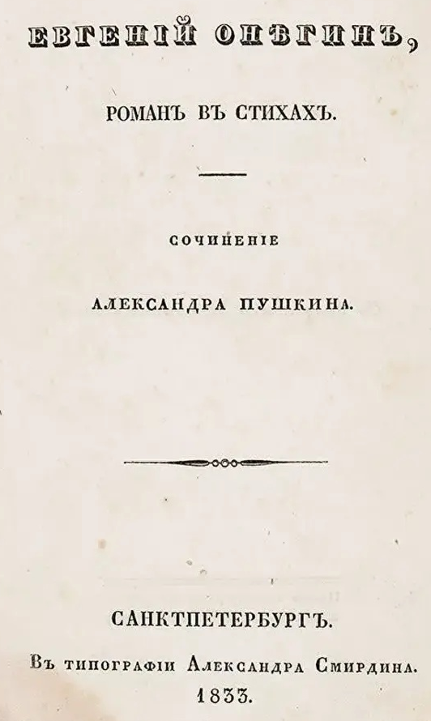
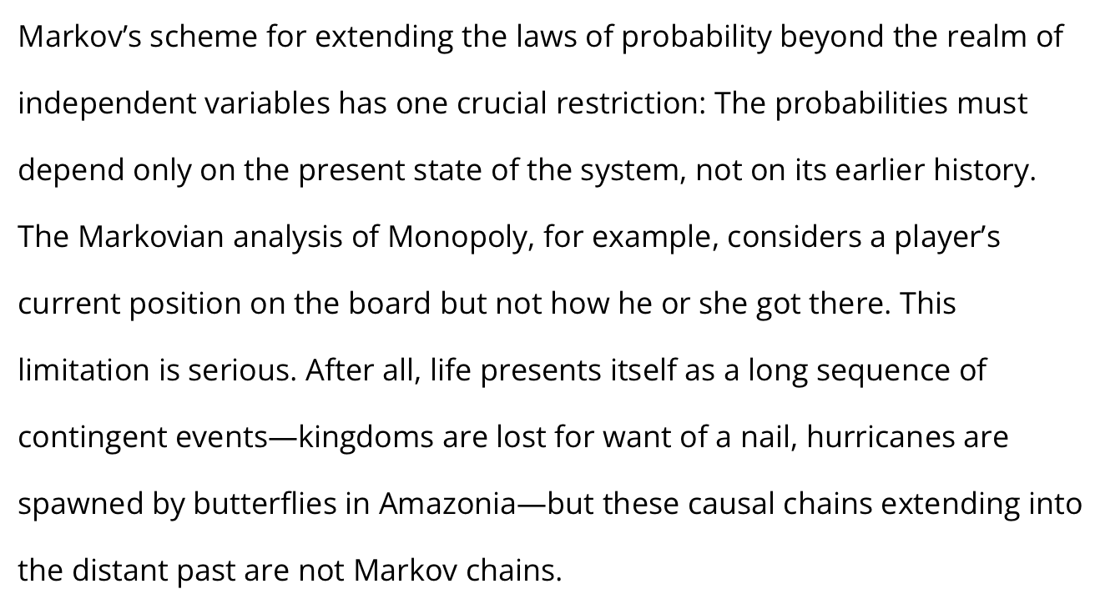
Markovian Assumption
20K letter sequence (Russian):
8638 vowels / 11362 consonants
1104 vowel | vowel (by counting: circling (?))
p₁ vowel | vowel = 0.128
p₀ vowel | consonant = 0.663
computed by:
  8638 – 1104 = 7534 (vowel | consonants);
  7534 / 11362 = 0.663
q₀ consonant | consonant = 0.337
  11362 – 7534 = 3827 (consonant | consonant);
  3827 / 11362 = 0.337
q₁ consonant | vowel = 0.872
  7534 / 8638 = 0.872
Markov, A. A. 1913. An example of statistical investigation of the text Eugene Onegin concerning the connection of samples in chains (in Russian). Bulletin of the Imperial Academy of Sciences of St. Petersburg 7(3):153-162.
Investigation of a Remarkable Case of Dependent Samples” [Markov 1907a]
Hayes (2013)

Slide 7
Eugene Onegin
Russian (33 letters):
twenty consonants: ⟨б⟩, ⟨в⟩, ⟨г⟩, ⟨д⟩, ⟨ж⟩, ⟨з⟩, ⟨к⟩, ⟨л⟩, ⟨м⟩, ⟨н⟩, ⟨п⟩, ⟨р⟩, ⟨с⟩, ⟨т⟩, ⟨ф⟩, ⟨х⟩, ⟨ц⟩, ⟨ч⟩, ⟨ш⟩, ⟨щ⟩
ten vowels: ⟨а⟩, ⟨е⟩, ⟨ё⟩, ⟨и⟩, ⟨о⟩, ⟨у⟩, ⟨ы⟩, ⟨э⟩, ⟨ю⟩, ⟨я⟩
a semivowel / consonant (⟨й⟩
two modifier letters or "signs" ⟨ъ⟩, ⟨ь⟩
20K letters (Eugene Onegin, in Russian, 1st chapter, 16 stanzas of the 2nd chapter)
vowels: 8638; consonants: 11362
p(vowel) = 0.43
p(vowel|vowel) = 0.43² = 0.19 (assuming independence)
p(consonant|consonant) = 0.32 (assuming independence)

Slide 8
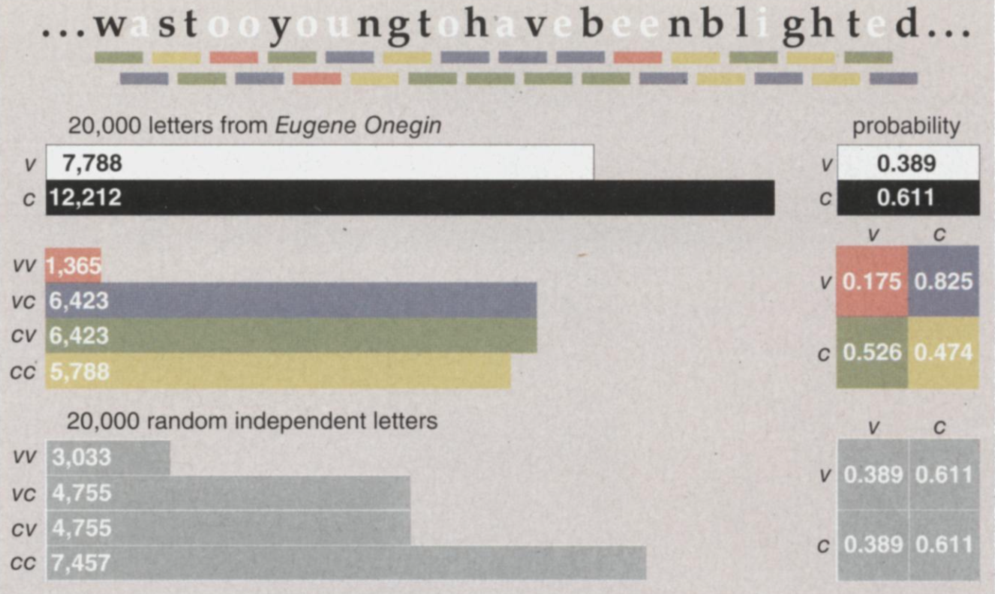
Eugene Onegin
(English translation)
P(x|y) means
probability of event x given event y (has happened)
Table cells represent
P(v|c)
P(v|v)
P(c|v)
P(c|c)

Slide 9
Markovian Assumption in real life?
13th C poet:
  The wise tell us that a nail keeps a shoe, a shoe keeps a horse, a horse keeps a knight, a knight, who can fight, keeps a castle.
Shakespeare:
  A horse! a horse! my kingdom for a horse!
  (Richard III, Act V, Scene IV)
Butterfly Effect:
  Does the flap of a butterfly's wings in Brazil set off a tornado in Texas?
  E.N. Lorenz (Chaos theory mathematician)
  weather: 0.506 vs. 0.506127 resulted in a completely different simulation outcome (1961)

Slide 10
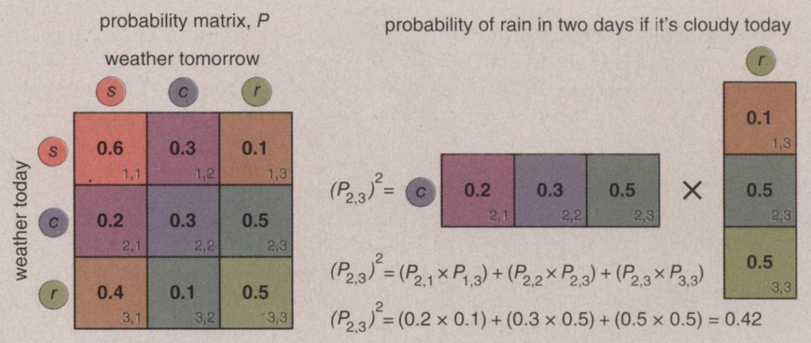
Markov Chain

Slide 11
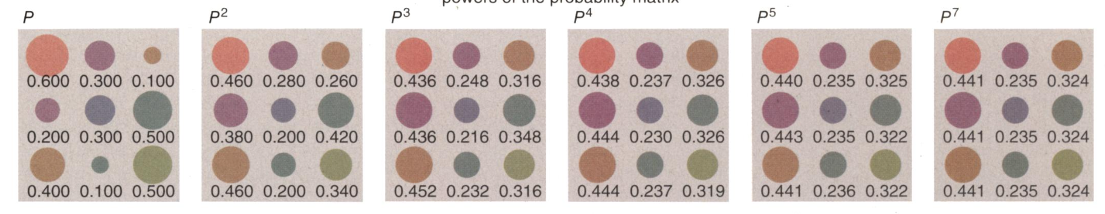
Markov Chain
a week later!

Slide 12
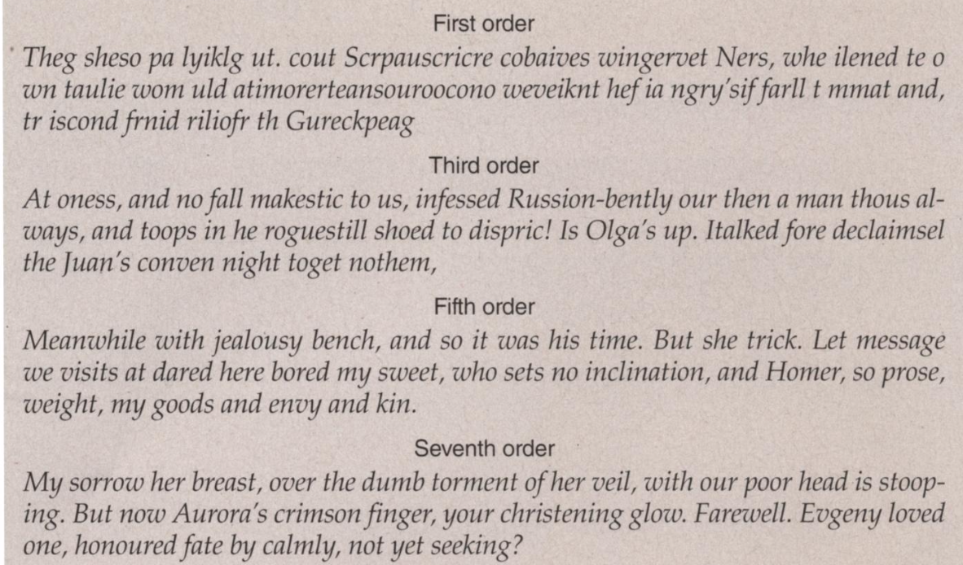
Text Generation by Markov Chain
In a kth-order random-text Markov model the states are
sequences of k characters, and transitions are defined for all characters that can follow each of
these sequences.

Slide 13
Homework 11
Consider the following NDFSA:
Q1: Why is it a NDFSA?
Q2: What strings of length 3 from Σ* does it accept? How many are there?
Q3: Which strings of length 4 from Σ* does it not accept? How many are there?
Q4: Convert our NDFSA into a DFSA. How many states does the DFSA have? How many final states?
  use the construction shown in class
1
x
2
>
2
y
1
2
1
1
1
z
Σ = {1,2}

Slide 14
Homework 11
538 Q5 (438 Extra Credit):
  Implement your DFSA in Perl or Python (only)
  Then devise a way to calculate how many strings there are in the language (of the DFSA) with string length not exceeding 10?
  e.g. 221 (length 3); 121122 (length 6)
  Generally, given Σ={1,2} the number of strings of length n is 2^{n}.
    2¹ = {*1, 2}
    2² = {*11, 12, *21, 22}
  Bash (terminal):
    $ eval echo $(printf '{1,2}%.0s' $(seq 3))
    111 112 121 122 211 212 221 222

Slide 15
Homework 11
Usual rules …
  One PDF file (no links to file)
  Subject: 438/538 Homework 11 YOUR NAME
  Due date: Sunday midnight
You can draw your machine for Q4 by hand (make it legible)
  put in the set of states {…}
For the 538 Q5 question:
  copy/paste your Perl/Python code into your PDF file
  attachments don't work well with UA Mail nuking them

