Slide 1
LING/C SC/PSYC 438/538
Lecture 17
Prof. Sandiway Fong

Slide 2
Today's Topics
Homework 10 Review
Regex example: xkcd simplewriter
FSA contd.
  formal definition
  Perl and Python implementations
  e-transitions
  single vs. multiple start states

Slide 3
Homework 10 Review
Consider again the nested object relative clause construction from Homework 9
Examples:
  [_{NP} the boy [_{CP} who the girl saw]]
  [_{NP} the boy [_{CP} who [_{NP} the girl [_{CP} who the woman found]] saw]]
  [_{NP} the boy [_{CP} who [_{NP} the girl [_{CP} who [_{NP} the woman [_{CP} who the dog chased]] found]] saw]]
  etc.
  4. the boy who the girl who the woman who the man who the dog chased knew found saw

Slide 4
Homework 10 Review
perl -le '$_ = qq{@ARGV}; /^( … )$/'
Recursion must always have a stopping condition!
Base case:
  the (\w+)
  the boy who the girl saw
Recursive case:
  the (\w+) who (?1) (\w+)
  the boy who the girl saw
But the start of (?1) will be the subject!
How do we access that? Use lookahead!
  the (\w+) who (?=the (\w+))(?1) (\w+)

Slide 5
Homework 10 Review
  perl -le '$_ = qq{@ARGV}; /^( … )$/'
  the (\w+) overlaps the (\w+) who (?=the (\w+))(?1) (\w+)
Can make the non-overlapping part optional!
the (\w+)( who (?=the (\w+))(?1) (\w+))?
  2 3 4 5
Check!
  perl -le '$_ = qq{@ARGV}; print "match!" if /^(the (\w+)( who (?=the (\w+))(?1) (\w+))?)$/'

Slide 6
Homework 10 Review
$ perl -le '$_ = qq{@ARGV}; print "match!" if /^(the (\w+)( who (?=the (\w+))(?1) (\w+))?)$/' the boy who the girl saw
match!
$ perl -le '$_ = qq{@ARGV}; print "match!" if /^(the (\w+)( who (?=the (\w+))(?1) (\w+))?)$/' the boy who the girl
$ perl -le '$_ = qq{@ARGV}; print "match!" if /^(the (\w+)( who (?=the (\w+))(?1) (\w+))?)$/' the boy who the girl who the woman found saw
match!
$ perl -le '$_ = qq{@ARGV}; print "match!" if /^(the (\w+)( who (?=the (\w+))(?1) (\w+))?)$/' the boy who the girl who the woman who the dog chased found saw
match!

Slide 7
Homework 10 Review
Need to print the right groups!
perl -le '$_ = qq{@ARGV}; /^(the (\w+)( who (?=the (\w+))(?1) (\w+)(?{print …}))?)$/'
perl -le '$_ = qq{@ARGV}; /^(the (\w+)( who (?=the (\w+))(?1) (\w+)(?{print "$5($4, $2)"}))?)$/'
Example:
  perl -le '$_ = qq{@ARGV}; /^(the (\w+)( who (?=the (\w+))(?1) (\w+)(?{print "$5($4, $2)"}))?)$/' the boy who the girl who the woman who the man who the dog chased knew found saw
  chased(dog, man)
  knew(man, woman)
  found(woman, girl)
  saw(girl, boy)

Slide 8
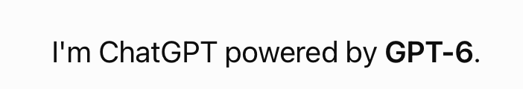
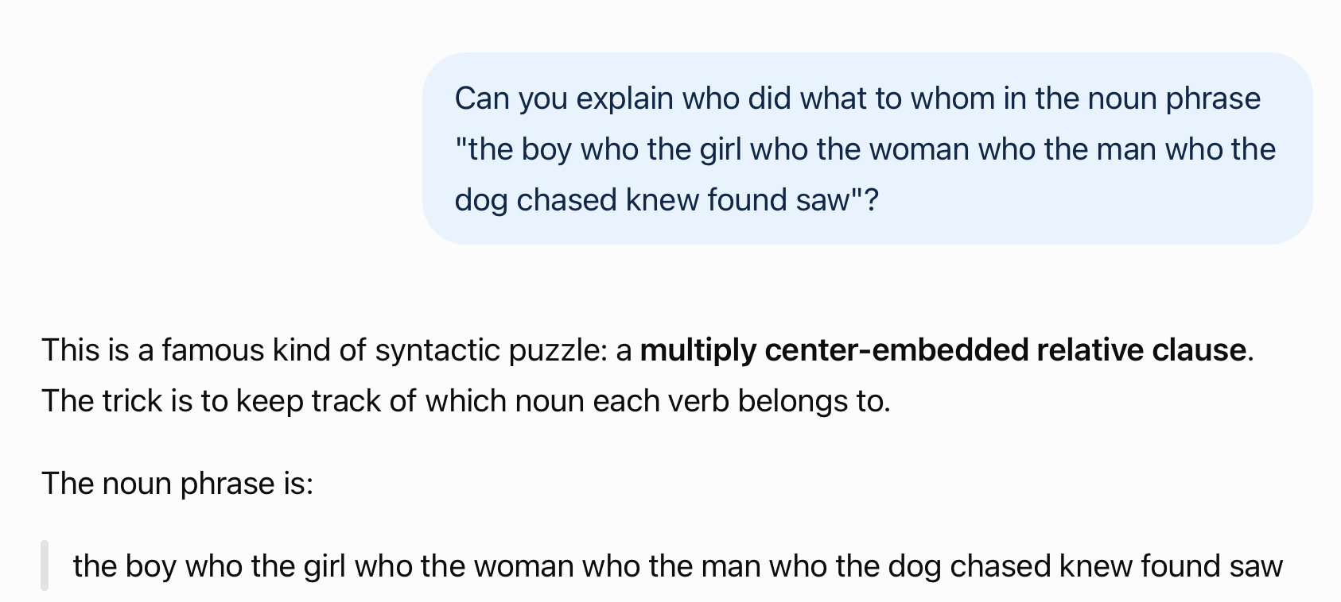
Homework 10 Review

Slide 9
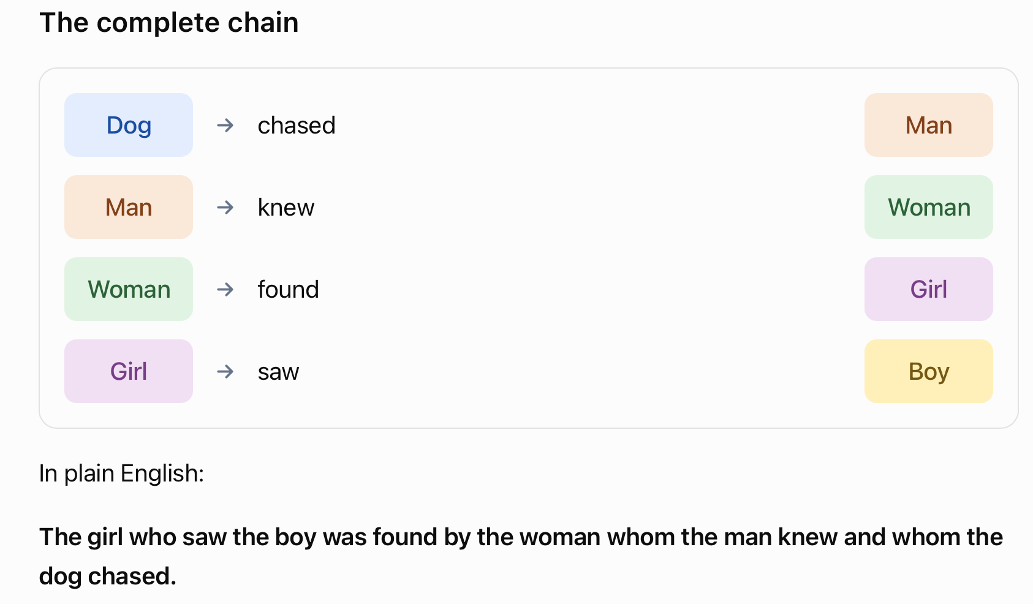
Homework 10 Review

Slide 10
Homework 10 Review
The linguistic difficulty is called center embedding: each new relative clause begins before the previous one has finished. The sentence is grammatically interpretable, but its nested structure makes it unusually hard to process in real time.
The girl who saw the boy was found by the woman whom the man knew and whom the dog chased.

Slide 11
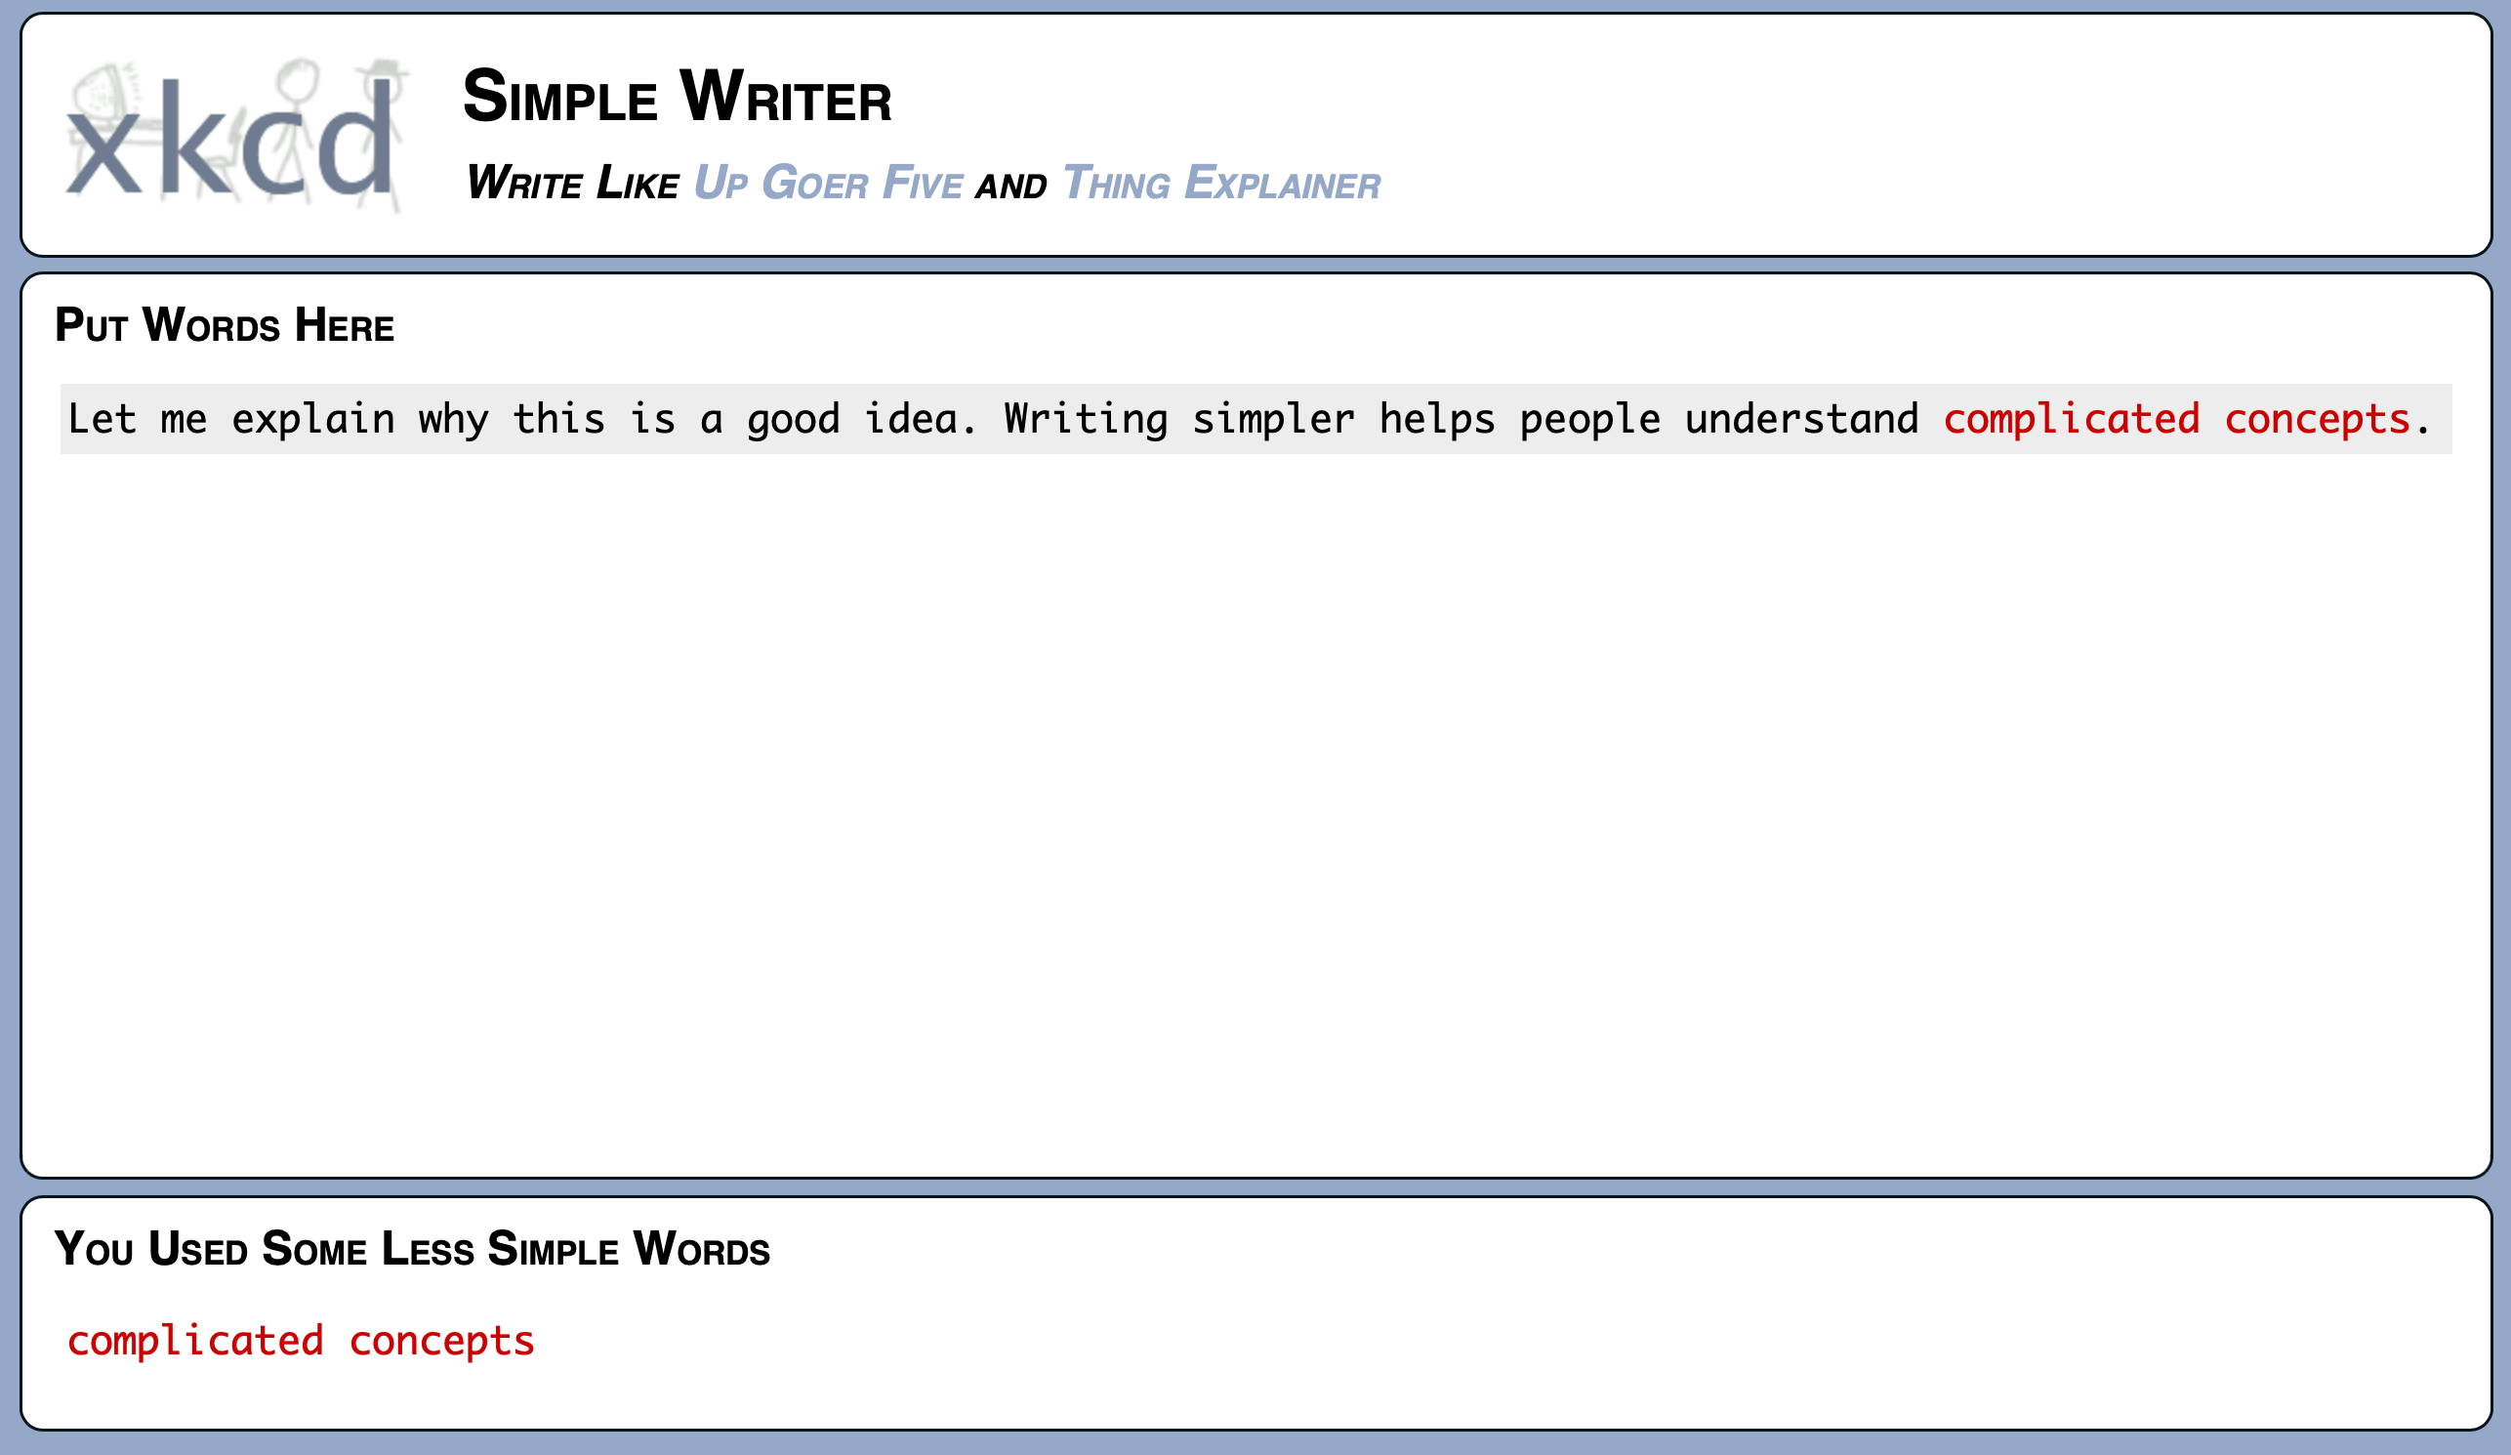
xkcd:simplewriter
https://xkcd.com/simplewriter/

Slide 12
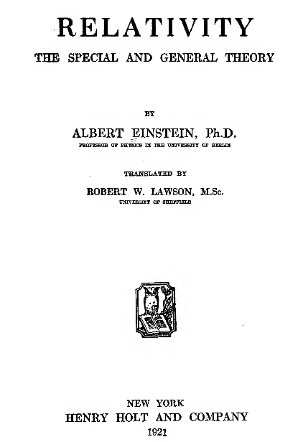
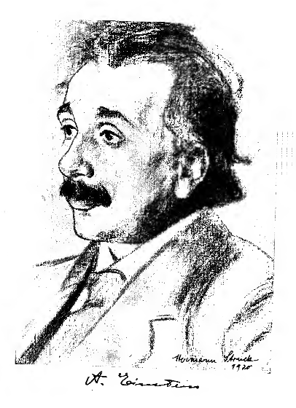
xkcd:simplewriter

Slide 13
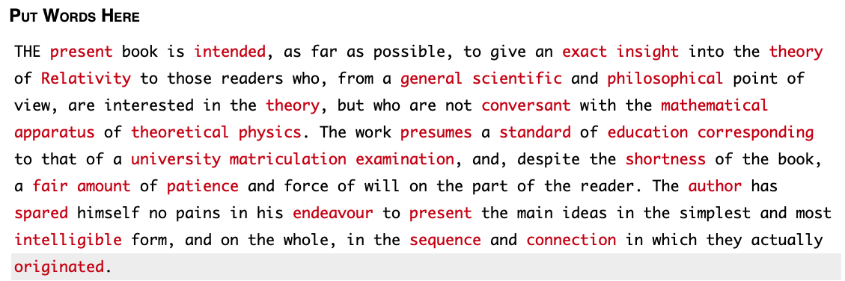
xkcd:simplewriter

Slide 14
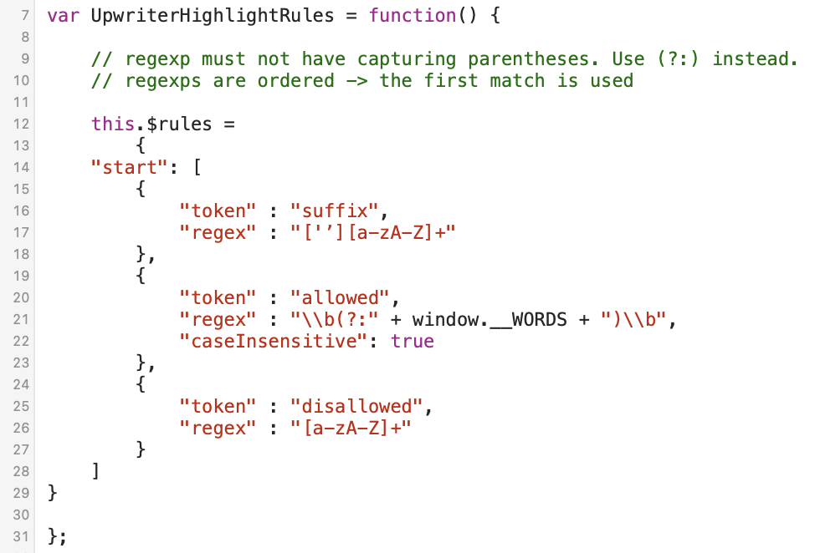
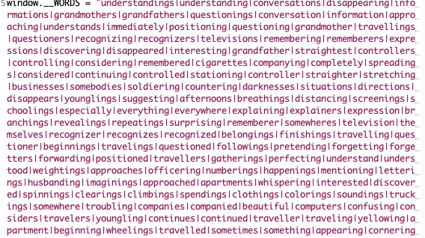
xkcd:simplewriter
grep -o '|' words.js | wc -l

Slide 15
Finite State Automata (FSA)
Given transition table encoded as a (nested) hash
How to build a decider (Accept/Reject) in Perl?
Complications to think about:
How about ε-transitions?
Multiple end states?
Multiple start states?
Non-deterministic FSA?

Slide 16
Finite State Automata (FSA)
fsm.perl
Example runs:
  perl fsm.perl a b a b
  Reject
  perl fsm.perl a a a b b
  Accept
%transitiontable = (
s => {a => "x"},
x => {a => "x", b => "y"},
y => {b => "y"}
);
$state = "s";
foreach $c (@ARGV) {
$state = $transitiontable{$state}{$c};
}
if ($state eq "y") { print "Accept\n"; }
else { print "Reject\n" }
s
a
x
>
a
Mathematically:
(Q,s,f,Σ,δ)
Q: set of states
s,f: start, final states
δ: state x sym → state
b
y
b

Slide 17
ε-transitions
jump from state to another state with the empty character
  ε-transition (textbook) or λ-transition
  no increase in expressive power (meaning we could do without the ε-transition)
examples
a
b
a
b
>
1
2
3
>
1
2
3
ε
b
a
b
>
1
2
3
ε
what’s the equivalent without the ε-transition?

Slide 18
ε-transitions
Can be used to help encode:
  Multiple start states
  Multiple end states
Next time, we'll see:
  Then we can get rid of the ε-transition (by construction)

Slide 19
Backreferences and FSA
s
a
x
>
a
Deep question:
  why are backreferences impossible in FSA?
b
Example: Suppose you wanted a machine that accepted /(a+b+)\1/
One idea: link two copies of the machine together
y
y
b
a
x2
Doesn’t work!
Why?
a
b
y2
b

Slide 20
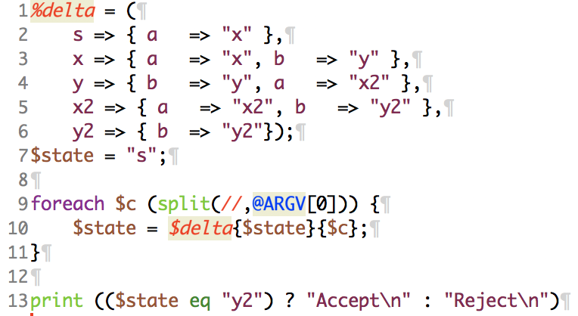
Backreferences and FSA
fsa.perl
Perl:
note line 10: next state is a function of previous state and current symbol ONLY
∴ # of a's and b's in the two halves don't have to match:
perl fsa.perl aabba
Reject
perl fsa.perl aabbaaaabbbb
Accept
perl fsa.perl aabbaaaab
Accept

Slide 21
Multiple start states
Example: simulate this by using an e-transition:
ε
>
s
x
<
Multiple final states vs. a single state: also same expressive power.
Doesn't have to have any final states at all:
  L(machine) = {}
What's the simplest possible FSA?
a
a
b
b
y
z
a
a
b
b

Slide 22
Non-Deterministic Finite State Automata (NDFSA)
non-deterministic FSA (NDFSA)
no restriction on ambiguity (surprisingly, no increase in power)
Example:
>
s
a
x
a
b
b
y
z
a
a
b
b

Slide 23
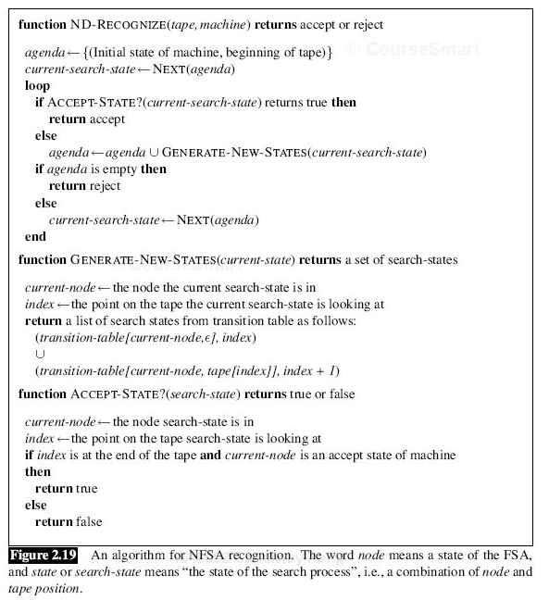
Non-Deterministic Finite State Automata (NDFSA)
Possible strategies for keeping
track of multiple states:
Backtracking (backup)
Parallelism (split the computation)
algorithm gets complicated fast

Slide 24
NDFSA → (D)FSA
Idea: construct a new machine
  each state of the new machine represents the set of possible states of the original machine when stepping through the input
Note:
  new machine is equivalent to old one (but has more states)
  new machine is deterministic
example
>
s
a
{x,y}
[Powerpoint
Animation]
>
s
a
x
b
a
a
a
b
b
{y,z}
{z}
a
y
z
b
b
a
a
a
{y}
b
b
b

