Slide 1
LING/C SC/PSYC 438/538
Lecture 16
Prof. Sandiway Fong

Slide 2
Today's Topics
Homework 10: only one question!
  (but maybe challenging)
Finite State Automata (FSA)

Slide 3
Homework 10
Consider again the nested object relative clause construction from Homework 9
Examples:
  the boy who the girl saw
  the boy who the girl who the woman found saw
  the boy who the girl who the woman who the dog chased found saw
  etc.

Slide 4
Homework 10
Given a recursive Perl regex that computes the predicate argument structure for examples 1–3 (from the previous slide).
Show your code working on each example.
Example output:
  the boy who the girl who the woman who the dog chased found saw
  saw(girl, boy)
  found(woman, girl)
  chased(dog, woman)
Hint: doesn't have to be in this order of output

Slide 5
Homework 10
Hints:
  perl -le '$_ = qq{@ARGV}; /regex/' the boy who the girl saw
recursive means we don't need a loop or the global flag: g
recursive (?n) where n = 0 (whole regex), n = 1 (1st parentheses group) etc.
lookahead: (?=regex)
negative lookahead: (?!regex) may be useful if you want to block regex
Perl code: (?{…}) could be embedded inside a regex to do output
e.g. (?{print "$n(…)"})

Slide 6
Homework 10
Email to me: sandiway@arizona.edu
Subject: 438/538 Homework 10: YOUR NAME
Submit everything in one PDF file
Submit a real file, not a link
Screenshots: make sure text is readable – not too tiny!
Due Sunday midnight:
  to be reviewed in class next Tuesday

Slide 7
Regular Languages
Three formalisms:
  All formally equivalent (no difference in expressive power)
  i.e. if you can encode it using a RE, you can do it using a FSA or regular grammar, and so on …
Regular Languages
Note: Perl regexs are more powerful
than the math characterization:
backreferences \n,
recursive regexs (?n),
insertion of general code(?{…})
FSA
Regular
Expressions
Regular
Grammars
we'll talk about formal equivalence next time…

Slide 8
Regular Languages
A regular language is the set of strings
    (including possibly the empty string)
    (set itself could also be empty)
    (set can be infinite)
    generated by a regex/FSA/Regular Grammar
Note: in formal language theory: a language =_{def} set of strings
(we don't specify how it's generated)

Slide 9
Regular Languages
Example:
  Language: L = { a⁺b⁺ }
  “one or more a’s followed by one or more b’s”
  L is a regular language
      described by a regular expression (we’ll define it formally next time)
  Note:
    infinite set of strings belonging to language L
      e.g. abbb, aaaab, aabb, *abab, *λ
  Notation:
    λ is the empty string (or string with zero length),
    sometimes ε is used instead
    * means string is not in the language

Slide 10
Finite State Automata (FSA)
L = { a⁺b⁺ } can be also be generated by the following FSA
s
a
x
>
a
Conventions (used here):
> Indicates start state
Red circle indicates end (accepting) state
we accept a input string only when we’re in an end state and we’re at the end of the string
b
y
b

Slide 11
Finite State Automata (FSA)
L = { a⁺b⁺ } can be also be generated by the following FSA
s
a
x
>
a
There is a natural correspondence between
components of the FSA and the regex defining L
Note:
L = {a⁺b⁺}
L = {aa*bb*}
b
y
b

Slide 12
Finite State Automata (FSA)
L = { a⁺b⁺ } can be also be generated by the following FSA
s
a
x
>
a
deterministic FSA (DFSA)
no ambiguity about where to go at any given state
i.e. for each input symbol in the alphabet at any
given state, there is a unique “action” to take
b
y
b
non-deterministic FSA (NDFSA)
no restriction on ambiguity (surprisingly, no increase in power)

Slide 13
Finite State Automata (FSA)
more formally
  (Q,s,f,Σ,δ)
  set of states (Q): {s,x,y} must be a finite set
  start state (s): s
  end state(s) (f): y
  alphabet (Σ): {a, b}
  transition function δ:
    signature: character × state → state
    δ(a,s)=x
    δ(a,x)=x
    δ(b,x)=y
    δ(b,y)=y
s
a
x
>
a
b
y
b

Slide 14
Finite State Automata (FSA)
In Perl
  transition function δ:
    δ(a,s)=x
    δ(a,x)=x
    δ(b,x)=y
    δ(b,y)=y
We can simulate our 2D transition table using a hash table
whose elements are themselves also hash tables
(anonymized; note: {..} = hashes)
%transitiontable = (
s => {
a => "x"
},
x => {
a => "x",
b => "y"
},
y => {
b => "y"
}
);
Example:
print "$transitiontable{s}{a}\n";
s
a
x
>
a
Syntactic sugar for
%transitiontable = (
"s", { "a", "x", },
"x", { "a", "x" , "b", "y" },
"y", { "b", "y" },
);
b
y
b

Slide 15
Finite State Automata (FSA)
Given transition table encoded as a (nested) hash
How to build a decider (Accept/Reject) in Perl?
Complications to think about:
How about ε-transitions?
Multiple end states?
Multiple start states?
Non-deterministic FSA?

Slide 16
Finite State Automata (FSA)
%transitiontable = (
s => {a => "x"},
x => {a => "x", b => "y"},
y => {b => "y"}
);
$state = "s";
foreach $c (@ARGV) {
$state = $transitiontable{$state}{$c};
}
if ($state eq "y") { print "Accept\n"; }
else { print "Reject\n" }
Example runs:
  perl fsm.prl a b a b
  Reject
  perl fsm.prl a a a b b
  Accept

Slide 17
Finite State Automata (FSA)
Perl one-liner:
  perl -le '%h=(s=>{a=>"x"},x=>{a=>"x",b=>"y"},y=>{b=>"y"}); $s="s"; for $c (@ARGV) {$s=$h{$s}{$c}}; print "Accept" if $s eq "y"'

Slide 18
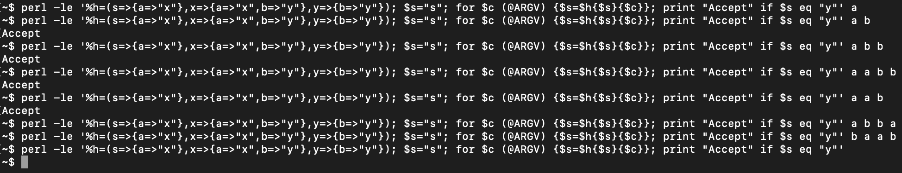
Finite State Automata (FSA)
Perl one-liner examples:
  perl -le '%h=(s=>{a=>"x"},x=>{a=>"x",b=>"y"},y=>{b=>"y"}); $s="s"; for $c (@ARGV) {$s=$h{$s}{$c}}; print "Accept" if $s eq "y"' a
  perl -le '%h=(s=>{a=>"x"},x=>{a=>"x",b=>"y"},y=>{b=>"y"}); $s="s"; for $c (@ARGV) {$s=$h{$s}{$c}}; print "Accept" if $s eq "y"' a b
  Accept

Slide 19
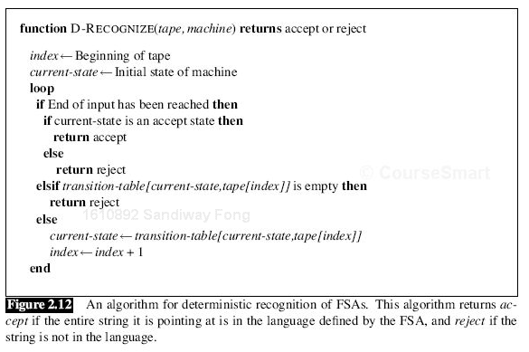
Finite State Automata (FSA)
this is just pseudo-code
not any real programming language
but can be easily translated

Slide 20
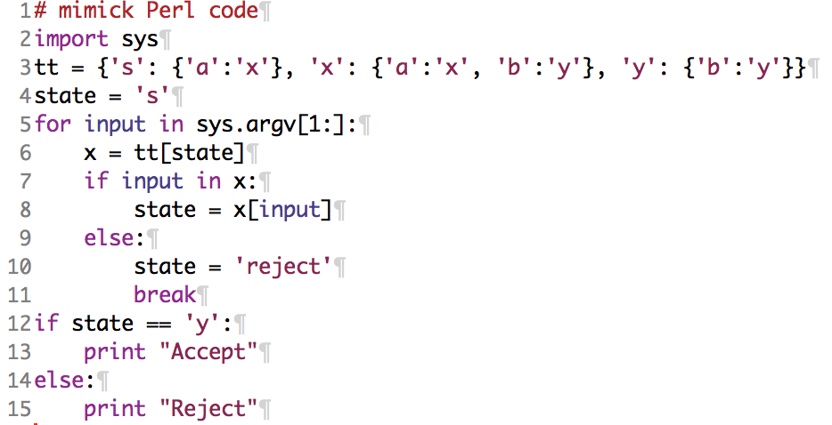
In Python
Python dictionary = Perl hash
  key:value
sys.argv = @ARGV
  (but numbered from 1, not 0)
[1:] slices the command line

Slide 21
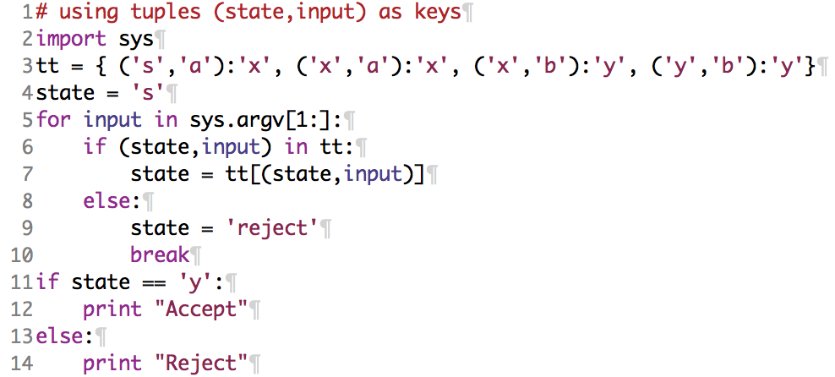
In Python
Python has a data structure called a tuple: (e₁,..,e_{n})
Note: Python lists use [..]
In Python, crucially tuples (but not lists) can also be dictionary keys
Note: Many other ways of encoding FSA in Python,
e.g. using object-oriented programming (classes)
https://wiki.python.org/moin/FiniteStateMachine#FSA_-_Finite_State_Automation_in_Python

Slide 22
Finite State Automata (FSA)
Practical applications
  can be encoded and run efficiently on a computer
  widely used
  encode regular expressions (e.g. Perl regex – without the bells and whistles)
  morphological analyzers
  e.g. want, wanted, unwanted; (suffixation/prefixation)
  car, cars; bike, bikes; box, boxes;
  slow, slower, slowest, slowly, slowness; (proud)
  realize, realization, realizable;
  Markov models
    = FSA + transition probabilities
  and much more …

