Slide 1
LING/C SC/PSYC 438/538
Lecture 15
Prof. Sandiway Fong

Slide 2
Today's Topics
Regex recursion unlocks new pattern-matching powers!
Also today:
  How to show a number is prime using regex (backreferences)!

Slide 3
Last Time
Subject relative clauses:
  the man noticed the girl who noticed the boy who found the person who chased the squirrel
  who-did-what-to-whom: can use a Perl left-to-right expression
  /the (\w+) (who )?(\w+) (?=the (\w+))/g
Object relative clauses:
  the man discovered the girl (who) the boy (who) the man (who) the dog chased found noticed
  who-did-what-to-whom: cannot use a Perl left-to-right expression

Slide 4
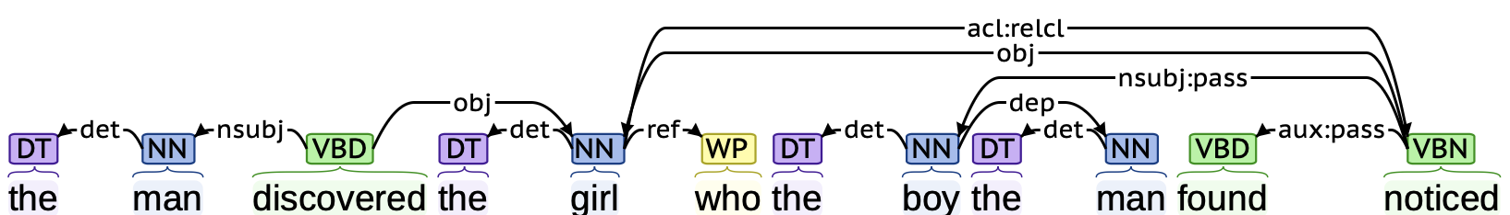
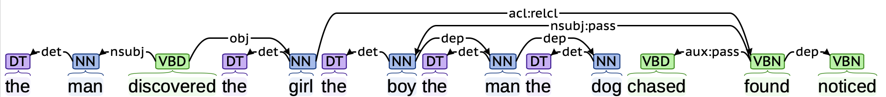
CoreNLP: problematic analyses
Center-embedding (nested) character:
  the man discovered the girl (who) the boy (who) the man (who) the dog chased found noticed
  the man discovered [ the girl [ the boy [ the man_{OBJ} the dog_{NSUBJ} chased_{(dog,man)} ] found_{(man, girl)} ] noticed_{(boy,girl)} ]

Slide 5
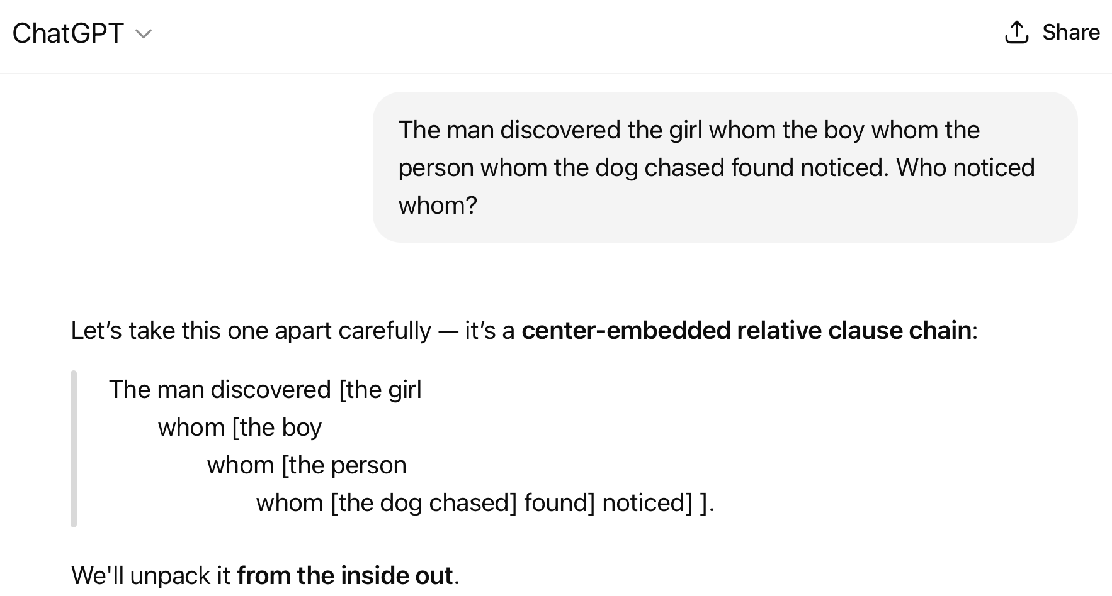
Homework 9 Extras

Slide 6
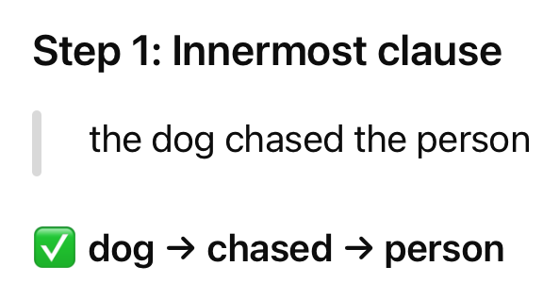
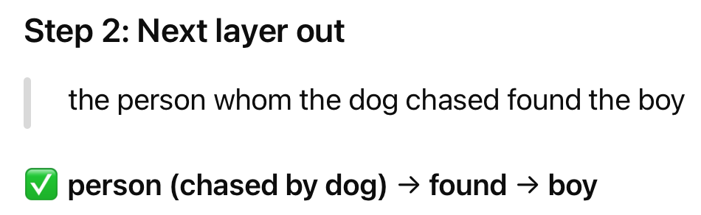
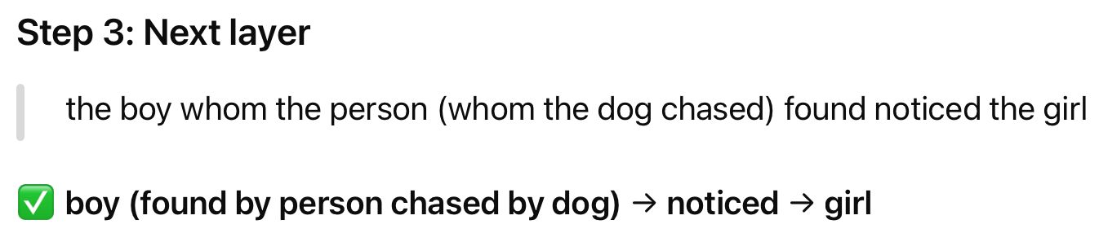
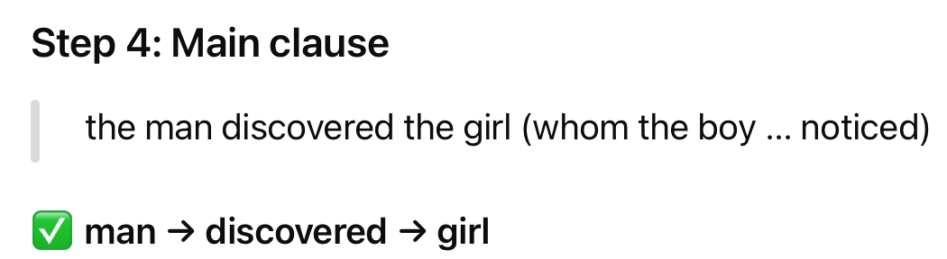
Homework 9 Extras

Slide 7
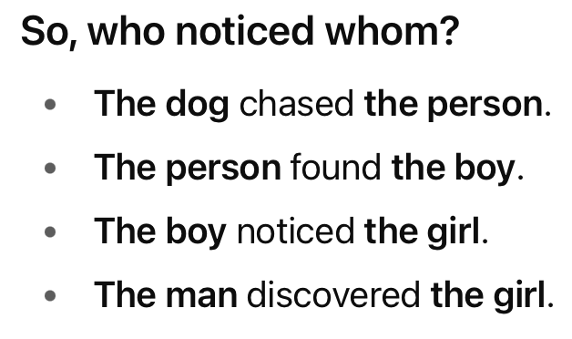
Homework 9 Extras

Slide 8
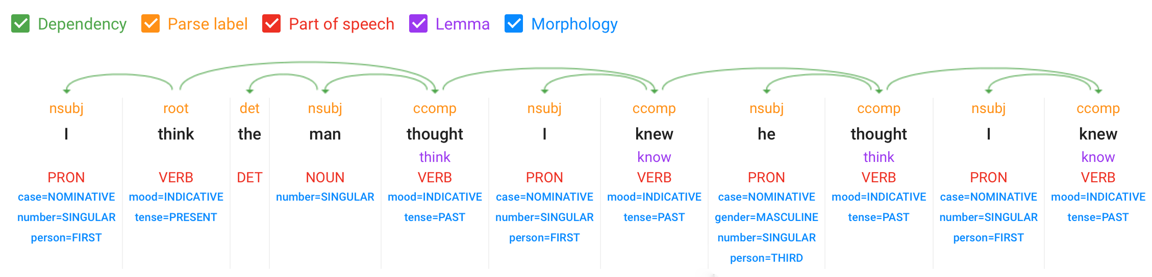
Recursion
The concept of recursion:
  I think the man thought I knew he thought I knew
  [_{S} I think [_{S} the man thought [_{S} I knew [_{S} he thought … ]]]] (S = sentence/clause)
Constituent structure (embedding – potentially indefinitely)
There may be performance limitations on types of embedding
Dependency structure (chaining ccomp relations)

Slide 9
Recursion
The concept of recursion:
  n! = n x (n-1)! for n ∈ ℕ, and 0! = 1 (factorial function)
  can be defined non-recursively equivalently as:
  n! = ∏ ^{n}_{i=1} i (product-based factorial function)

Slide 10
Regex Recursion
Example: palindrome words
  e.g. I, dad, noon, kayak, redder, racecar and redivider
  or phrases (if we ignore white space and punctuation):
  e.g. Was it a car or a cat I saw?
Normally, you can't write a regex for palindromes. Why?
  Fundamentally, it involves embedding, e.g. the use of a stack
  (also required for our object relative clause structures)
Perl regexs can because we can use backreferences recursively.
regex recursion refers to the ability to repeatedly embed regexs using:
  (?Group-Number)

Slide 11
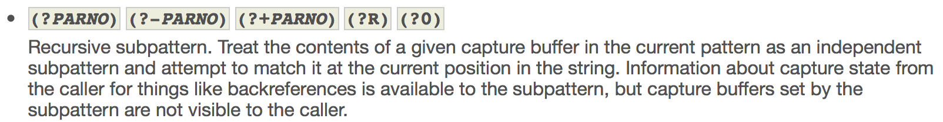
Regex Recursion
(?group-ref)
Program:
perl -e '$word = shift; print $word; print " not" if $word !~ /^(\w?|(\w)(?1)\2)$/; print " a palindrome\n"' kayak
kayak a palindrome
perl -e '$word = shift; print $word; print " not" if $word !~ /^(\w?|(\w)(?1)\2)$/; print " a palindrome\n"' abacus
abacus not a palindrome

Slide 12
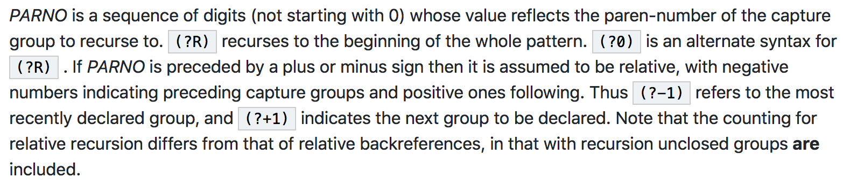
Regex Recursion
/^(\w?|(\w)(?1)\2)$/
1
2

Slide 13
Regex Recursion
Successful match with kayak
/^(\w?|(\w)(?1)\2)$/ ❘kayak
k k k❘ayak
a a ka❘yak
y kay❘ak

Slide 14
Regex Recursion
Failed match with abacus
/^(\w?|(\w)(?1)\2)$/ ❘abacus
a a a❘bacus a
b b ab❘acus ba
a a aba❘cus aba
c c abac❘us caba
…

Slide 15
Regex Recursion
perl -e '$word = shift; print $word; print " not" if $word !~ /^(\w?|(\w)(?1)\2)$/; print " a palindrome\n"' noon
noon a palindrome
perl -e '$word = shift; print $word; print " not" if $word !~ /^(\w?|(\w)(?1)\2)$/; print " a palindrome\n"' I
I a palindrome
perl -e '$word = shift; print $word; print " not" if $word !~ /^(\w?|(\w)(?1)\2)$/; print " a palindrome\n"'
a palindrome

Slide 16
Regex Recursion
Successful match with noon
/^(\w?|(\w)(?1)\2)$/ ❘noon
n n n❘oon
o o no❘on
ε no❘on
ε = empty string

Slide 17
Context-Free Grammar (CFG)
Assume for now, the alphabet is lowercase English letters.
53 (26+26+1) rules for the palindrome grammar:
  P --> λ (empty string)
  P --> t (terminal, for t ∈ [a-z], 26 rules)
  …
  P --> a P a
  …
  P --> z P z (another 26 rules)
Conceptually simpler…

Slide 18
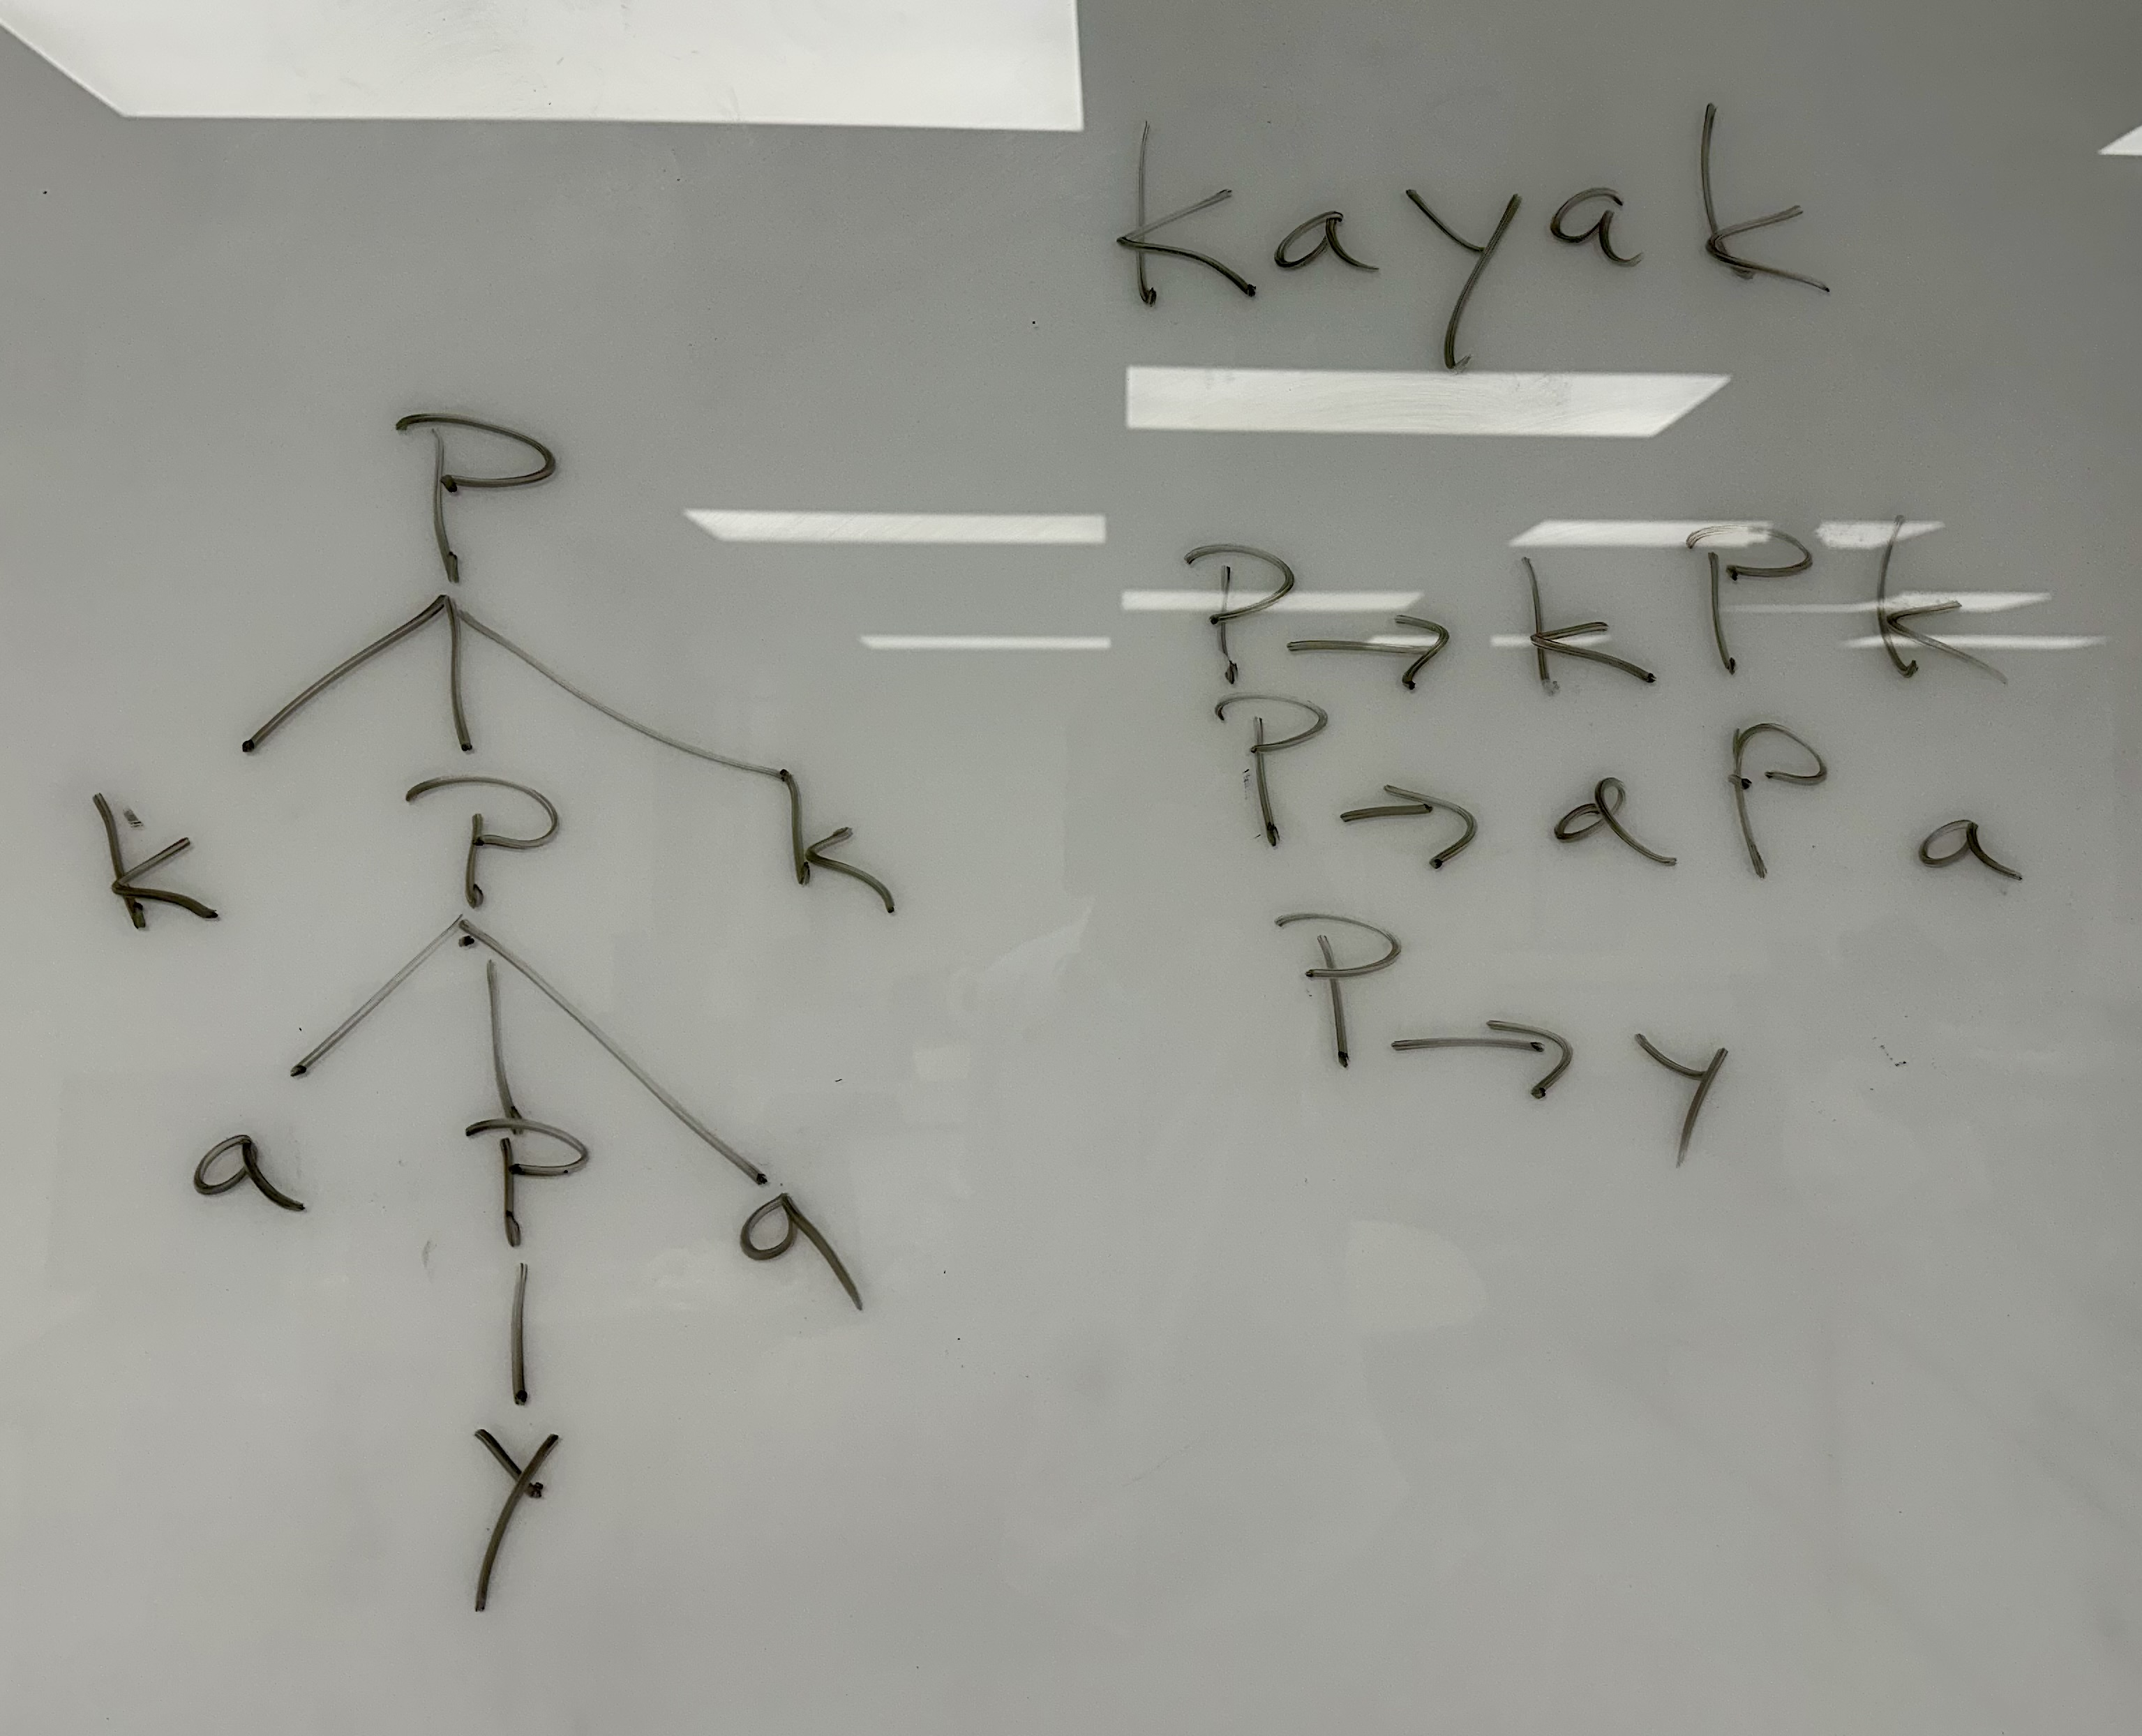
Context-Free Grammar (CFG)

Slide 19
Regex Recursion
Python:
import re
re.match(r'^(\w?|(\w)(?1)\2)$',"releveler")
Let's see what happens…

Slide 20
Regex Recursion
python3
Python 3.7.3 (v3.7.3:ef4ec6ed12, Mar 25 2019, 16:52:21)
[Clang 6.0 (clang-600.0.57)] on darwin
Type "help", "copyright", "credits" or "license" for more information.
>>> import re
>>> re.match(r'^(\w?|(\w)(?1)\2)$',"releveler")
Traceback (most recent call last):
File "<stdin>", line 1, in <module>
File "/Library/Frameworks/Python.framework/Versions/3.7/lib/python3.7/re.py", line 173, in match
return _compile(pattern, flags).match(string)
File "/Library/Frameworks/Python.framework/Versions/3.7/lib/python3.7/re.py", line 286, in _compile
p = sre_compile.compile(pattern, flags)
File "/Library/Frameworks/Python.framework/Versions/3.7/lib/python3.7/sre_compile.py", line 764, in compile
p = sre_parse.parse(p, flags)
File "/Library/Frameworks/Python.framework/Versions/3.7/lib/python3.7/sre_parse.py", line 930, in parse
p = _parse_sub(source, pattern, flags & SRE_FLAG_VERBOSE, 0)
File "/Library/Frameworks/Python.framework/Versions/3.7/lib/python3.7/sre_parse.py", line 426, in _parse_sub
not nested and not items))
File "/Library/Frameworks/Python.framework/Versions/3.7/lib/python3.7/sre_parse.py", line 816, in _parse
p = _parse_sub(source, state, sub_verbose, nested + 1)
File "/Library/Frameworks/Python.framework/Versions/3.7/lib/python3.7/sre_parse.py", line 426, in _parse_sub
not nested and not items))
File "/Library/Frameworks/Python.framework/Versions/3.7/lib/python3.7/sre_parse.py", line 806, in _parse
len(char) + 1)
re.error: unknown extension ?1 at position 11

Slide 21
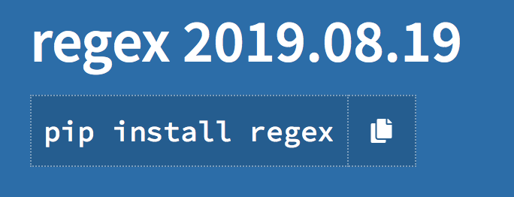
Regex Recursion
Python: alternate regex module handles recursion
https://pypi.org/project/regex/

Slide 22

Prime Number Testing using Perl Regular Expressions
Another example:
  the set of prime numbers is not a regular language (can't do It with FSA/regex)
  L_{prime} = {2, 3, 5, 7, 11, 13, 17, 19, 23,.. }
Turns out, we can use a short Perl regex to determine membership in this set
.. and to factorize numbers
/^(11+?)\1+$/

Slide 23
Prime Number Testing using Perl regex
can be proved mathematically using the Pumping Lemma for regular languages
(later)
L = {1^{n} | n is prime} is not a regular language
Keys to making this work:
  \1 backreference
  unary notation for representing numbers, e.g.
    11111 “five ones” = 5
    111111 “six ones” = 6
  unary notation allows us to factorize numbers by repetitive pattern matching
    (11)(11)(11) “six ones” = 6
    (111)(111) “six ones” = 6
  numbers that can be factorized in this way aren’t prime!
    no way to get nontrivial subcopies of 11111 “five ones” = 5
Then /^(11+?)\1+$/ will match anything that’s greater than 1 that’s not prime

Slide 24
Prime Number Testing using Perl regex
Question: is the non-greedy
operator necessary?
Let’s analyze this Perl regex /^(11+?)\1+$/
  ^ and $ anchor both ends of the strings, forces (11+?)\1+ to cover the entire string
  (11+?) is the non-greedy (shortest) match version of (11+)
  \1+ provides one or more copies of what we previously matched in (11+?)
Examples:
  perl -le '$n = shift; $u = "1" x $n; print "$n prime" if $u !~ /^(11+?)\1+$/' 101
  101 prime
  perl -le '$n = shift; $u = "1" x $n; print "$n prime" if $u !~ /^(11+?)\1+$/' 103
  103 prime
  perl -le '$n = shift; $u = "1" x $n; print "$n prime" if $u !~ /^(11+?)\1+$/' 105

Slide 25
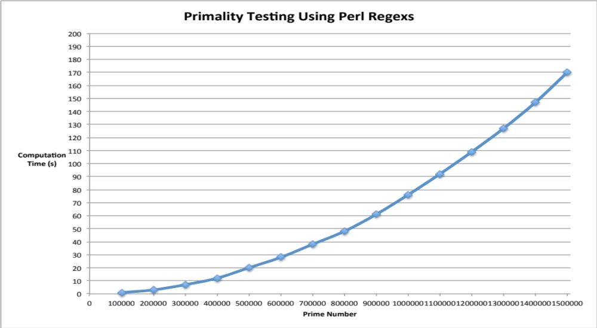
Prime Number Testing using Perl regex
Prime Numbers
100003
200003
300007
400009
500009
600011
700001
800011
900001
1000003
1100009
1200007
1300021
1400017
1500007
testing with prime numbers only
can take a lot of time to compute …

Slide 26
Prime Number Testing using Perl regex
/^(11+?)\1+$/ vs. /^(11+)\1+$/
i.e. non-greedy vs. greedy matching
finds smallest factor vs. largest
  90021 factored using 3, not a prime (0 secs)
  vs.
  90021 factored using 30007, not a prime (0 secs)
Puzzling behavior: same output non-greedy vs. greedy
900021 factored using 300007, not a prime (48 secs vs. 13 secs)

Slide 27
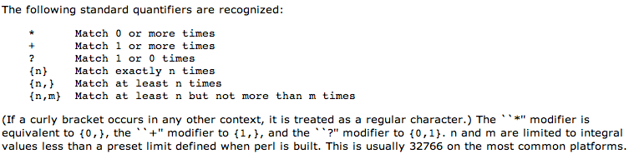
Prime Number Testing using Perl regex
http://www.xav.com/perl/lib/Pod/perlre.html
nearest primes to preset limit
32749 32771
3*32749 32766 3*32771
= 98247 = 98313

Slide 28
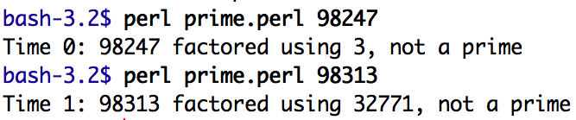
Prime Number Testing using Perl regex
32749 x 3 = 98247
32771 x 3 = 98313
When preset limit is exceeded: Perl’s regex matching fails quietly
Why does it report 32771?

Slide 29
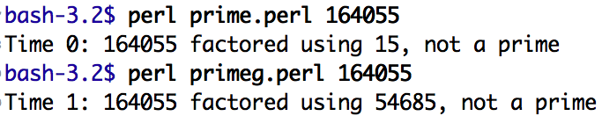
Prime Number Testing using Perl Regular Expressions
Can also get non-greedy to skip several factors
Example: pick non-prime 164055 = 3 x 5 x 10937 (prime factorization)
Non-greedy: missed factors 3 and 5 …
Because
3 * 54685 = 164055
5 * 32811 = 164055
32766 limit
15 * 10937 = 164055
greedy version

Slide 30
Prime Number Testing using Perl Regular Expressions
Results are still right so far though:
  wrt. prime vs. non-prime
But we predict it will report an incorrect result for
  1,073,938,441
  It should claim (incorrectly) that this is prime since 1073938441 = 32771²
  (32766 is the limit for the number of bundles)
https://primes.utm.edu/lists/small/10000.txt

