Slide 1
LING/C SC/PSYC 438/538
Lecture 14
Prof. Sandiway Fong

Slide 2
Today's Topics
Ungraded Homework
Predicate-Argument Structure contd.
  Framenet: verbs and their semantic roles
  Stanford CoreNLP: dependency parses
    (seems no longer in operation) http://nlp.stanford.edu:8080/corenlp/
    For Python-savvy users, can run it locally as:
    pip3 install stanza
    python3
    >>> import stanza
    >>> stanza.install_corenlp()
    https://stanfordnlp.github.io/stanza/client_usage.html

Slide 3
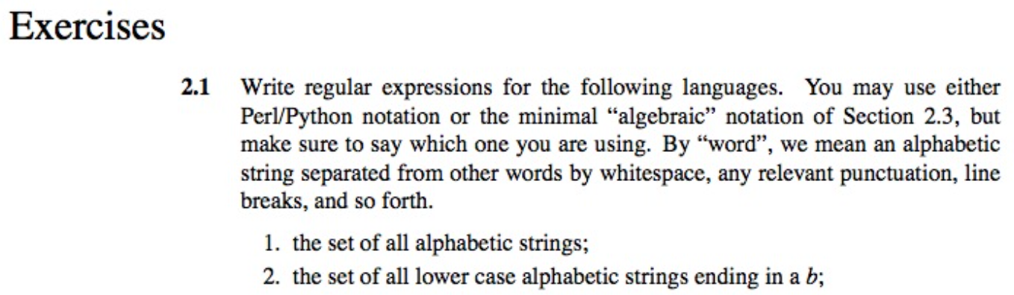
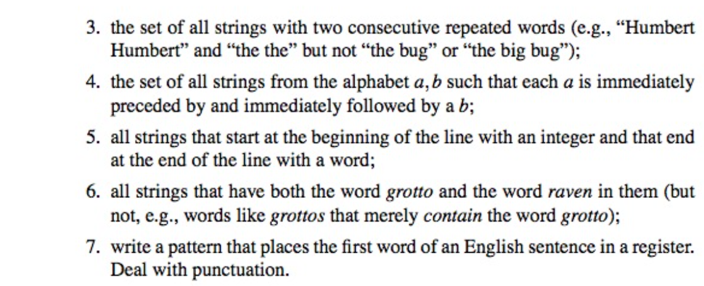
Ungraded regex Homework
(from the textbook)
If you'd like
a bit more
practice
…

Slide 4
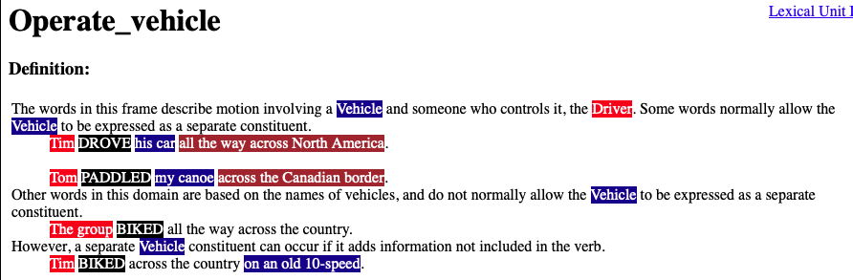
Background: Framenet: drive

Slide 5
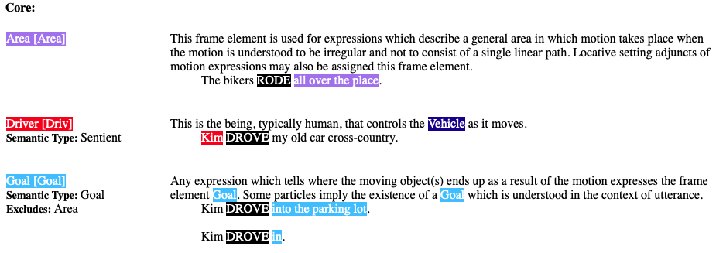
Background: Framenet: drive

Slide 6
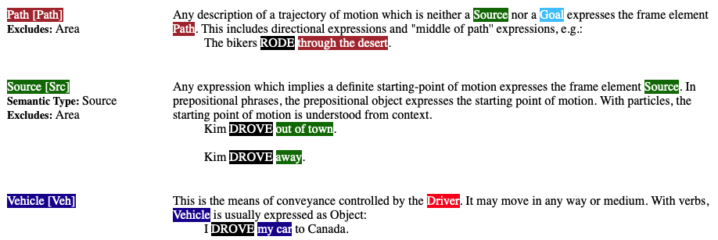
Background: Framenet: drive

Slide 7
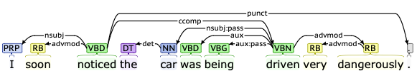
Background: CoreNLP
Examples (from Framenet):
  [_{Cognizer}I] soon NOTICED [_{Phenomenon} the car was being driven very dangerously] .
Verb (VBD) = noticed, Cognizer = nsubj, Phenomenon = ccomp
Verb(VBN) = driven, Vehicle = nsubj:pass
root
VERB(NSUBJ, CCOMP)
noticed(I, driven(…))
VERB(NSUBJ, NSUBJ:PASS)
driven(Driver?, car)

Slide 8
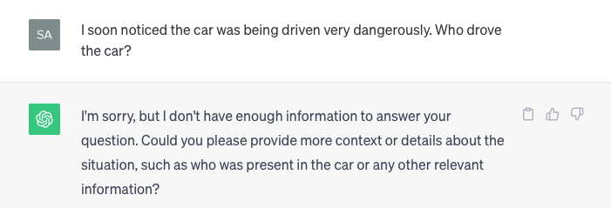
ChatGPT

Slide 9
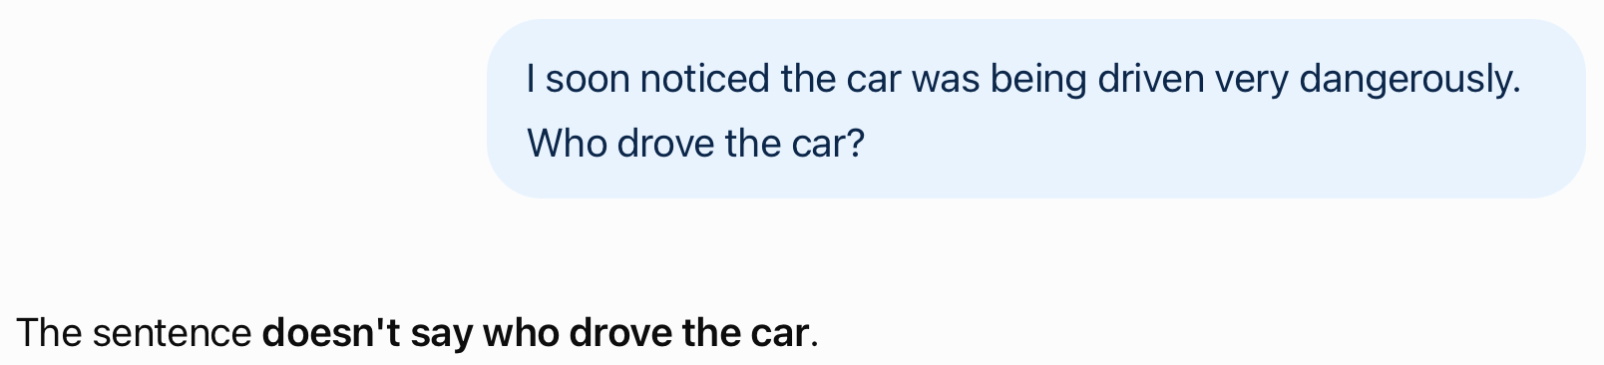
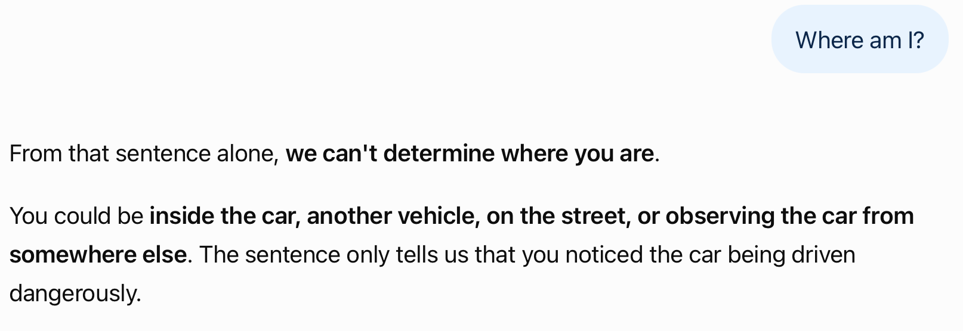
ChatGPT

Slide 10
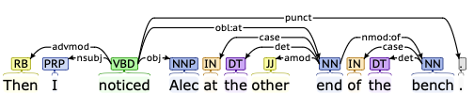
Background: CoreNLP
Examples (from Framenet):
  Then [_{Cognizer}I] NOTICED [_{Phenomenon}Alec] [_{Ground}at the other end of the bench] .
root
VERB(NSUBJ, OBJ)
noticed(I, Alec)
event(e, noticed) &
cognizer(e, I) &
phenomenon(e, Alec) &
ground(e, other end of the bench)

Slide 11
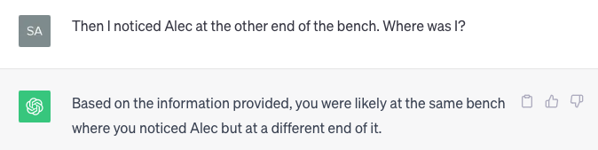
ChatGPT
GPT-5.6 Luna.

Slide 12
Background: Stanford Dependencies
Some definitions you may find useful https://nlp.stanford.edu/software/dependencies_manual.pdf
  ccomp: clausal complement
  A clausal complement of a verb or adjective is a dependent clause
  dobj: direct object
  The direct object of a VP is the noun phrase which is the (accusative) object of the verb.
  iobj: indirect object
  The indirect object of a VP is the noun phrase which is the (dative) object of the verb.
  nsubj: nominal subject
  A nominal subject is a noun phrase which is the syntactic subject of a clause.
  rcmod: relative clause modifier
  A relative clause modifier of an NP is a relative clause modifying the NP. The relation points from the head noun of the NP to the head of the relative clause, normally a verb.
  vmod: reduced non-finite verbal modifier
  A reduced non-finite verbal modifier is a participial or infinitive form of a verb heading a phrase (which may have some arguments, roughly like a VP).

Slide 13
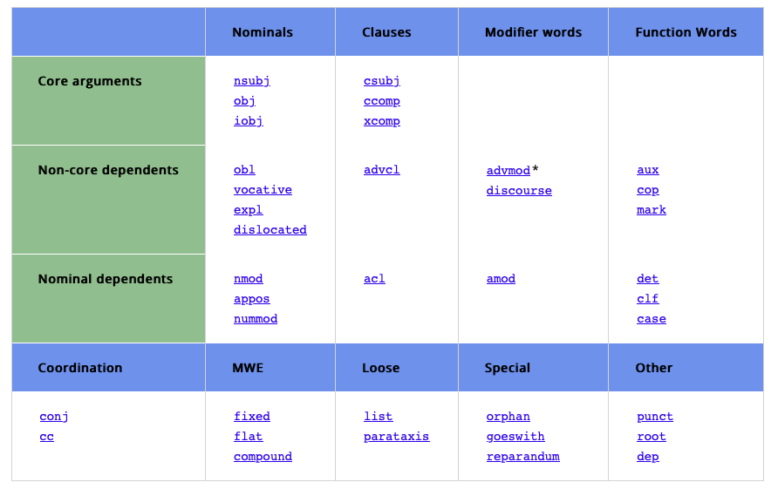
Background: Universal Dependencies
https://universaldependencies.org/u/dep/index.html

Slide 14
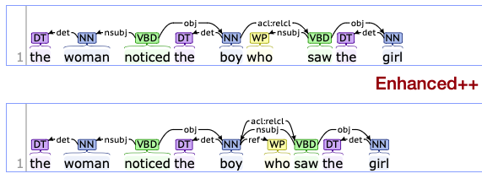
Background: CoreNLP
Root: noticed(woman, boy)
ACL:RELCL points back to NOUN boy
ACL:RELCL/VERB(NSUBJ/PRON, OBJ)
We infer saw(boy, girl)

Slide 15
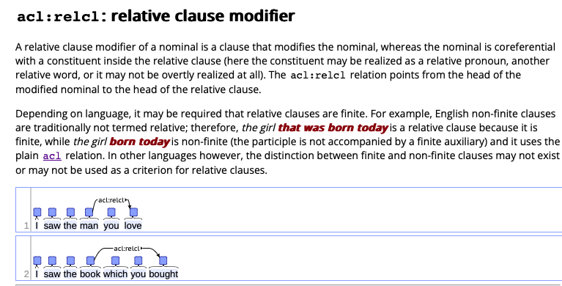
Background: Universal Dependencies
acl = adnominal clause (basically, a sentence that modifies a noun)

Slide 16
Subject relative clauses and Perl
Examples:
  the man noticed the girl
  noticed(man, girl)
  the man noticed the girl who noticed the boy
  noticed(man, girl)
  noticed(girl, boy)
Perl regex patterns:
  /the (\w+) (\w+) the (\w+)/ ➠ print "$2($1, $3)"
  /the (\w+) who (\w+) the (\w+)/ ➠ print "$2($1, $3)"

Slide 17
Subject relative clauses and Perl
Note the regex overlap:
the man noticed the girl who noticed the boy who found the person
the (\w+)(\w+) the (\w+)
the (\w+) who (\w+) the (\w+)
the (\w+) who (\w+) the (\w+)
Recall regex matching goes from left to right (keeping track of a pointer)
We want to iterate this matching using the g (global) flag
One solution: make the overlapping part a lookahead (so the pointer is not advanced):
  i.e. (?=the (\w+))

Slide 18
Subject relative clauses and Perl
Began with two regex patterns:
  /the (\w+) (\w+) the (\w+)/ ➠ print "$2($1, $3)"
  /the (\w+) who (\w+) the (\w+)/ ➠ print "$2($1, $3)"
One regex pattern:
  /the (\w+) (who )?(\w+) the (\w+)/
With lookahead:
  /the (\w+) (who )?(\w+) (?=the (\w+))/
Global match using a while loop:
  while (/the (\w+) (who )?(\w+) (?=the (\w+))/g) {
  print "$3($2, $4)"
  }
You can also use a non- capturing group
(?:regexp)

Slide 19
Subject relative clauses and Perl
Examples:
$ perl -le '$_ = qq/@ARGV/; while (/the (\w+) (who )?(\w+) (?=the (\w+))/g){ print "$3($1, $4)"}' the man noticed the girl
noticed(man, girl)
$ perl -le '$_ = qq/@ARGV/; while (/the (\w+) (who )?(\w+) (?=the (\w+))/g){ print "$3($1, $4)"}' the man noticed the girl who noticed the boy
noticed(man, girl)
noticed(girl, boy)
$ perl -le '$_ = qq/@ARGV/; while (/the (\w+) (who )?(\w+) (?=the (\w+))/g){ print "$3($1, $4)"}' the man noticed the girl who noticed the boy who found the person
noticed(man, girl)
noticed(girl, boy)
found(boy, person)

Slide 20
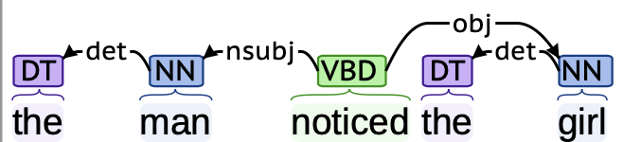
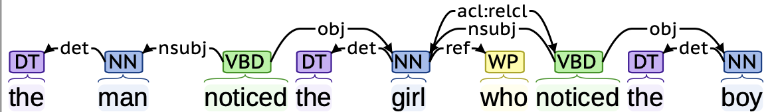
CoreNLP
the man noticed the girl
the man noticed the girl who noticed the boy

Slide 21
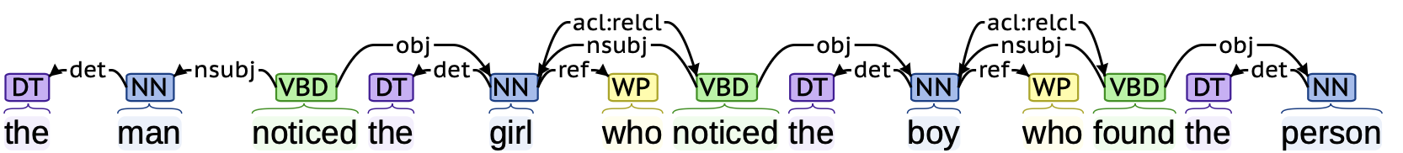
CoreNLP
the man noticed the girl who noticed the boy who found the person
the man noticed the girl who noticed the boy who found the person who chased the squirrel

Slide 22
Object relative clauses and Perl
Examples:
  the man discovered the girl
  discovered(man, girl)
  the man discovered the girl the boy noticed
  discovered(man, girl)
  noticed(boy, girl)
  the man discovered the girl the boy the man found noticed
  discovered(man, girl)
  noticed(boy, girl)
  found(man, boy)
  the man discovered the girl the boy the man the dog chased found noticed
  …
  chased(dog, man)

Slide 23
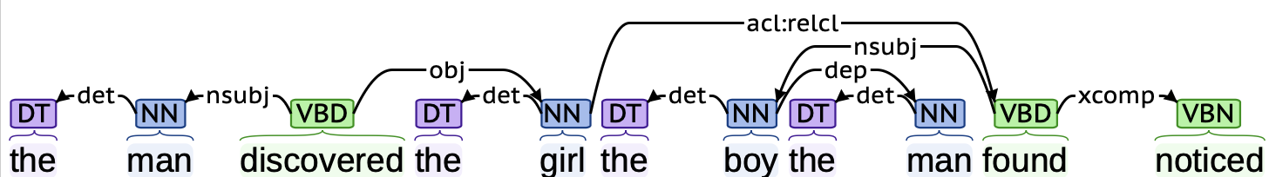
CoreNLP
  the man discovered the girl the boy the man found noticed

Slide 24
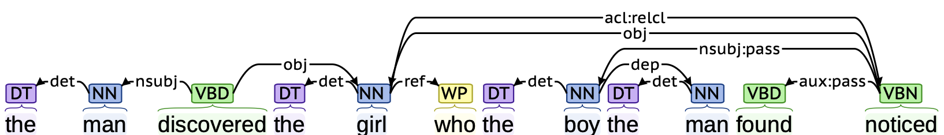
CoreNLP
  (7') the man discovered the girl who the boy the man found noticed
got totally lost here

Slide 25
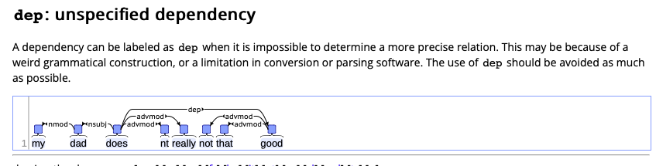
Background: Universal Dependencies
i.e. when we have no clue what's going on!

Slide 26
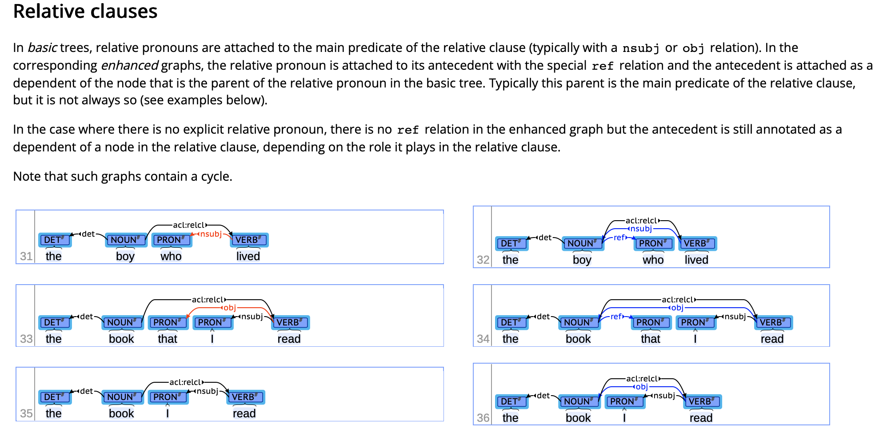
Background: Universal Dependencies: ref

Slide 27
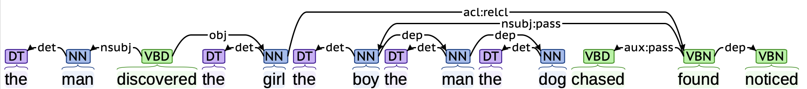
CoreNLP
  the man discovered the girl the boy the man the dog chased found noticed

