Slide 1
LING/C SC/PSYC 438/538
Lecture 13
Prof. Sandiway Fong

Slide 2
Today's Topic
Homework 8 Review
Last Time:
  two ways of inserting Perl code into regex
    s/regex/code/e
    (?{code})
More on powerful features in Perl regex:
  lookahead
  lookbehind
Predicate-Argument Structure
  Framenet
  Stanford CoreNLP

Slide 3
Homework 8 Review
Format (1st line):
  id¹,icij_sar_id²,filer_org_name_id³,filer_org_name⁴,begin_date⁵,end_date⁶,originator_bank_id⁷,originator_bank⁸,originator_bank_country⁹,originator_iso¹⁰,beneficiary_bank_id¹¹,beneficiary_bank¹²,beneficiary_bank_country¹³,beneficiary_iso¹⁴,number_transactions¹⁵,amount_transactions¹⁶
Notes:
  "May 31, 2012","May 31, 2012"
  The Bank of New York Mellon Corp.
  "Citigroup, Inc."

Slide 4
Homework 8 Review
Basic code:
  perl -le 'open $f, $ARGV[0]; while(<$f>){print "…" if /(".+?",|.*?,){4}"(.*?$ARGV[1])",".*?",(".+?",|.*?,){8}(.*?),(.*)/}' download_transactions_map.csv 2000

Slide 5
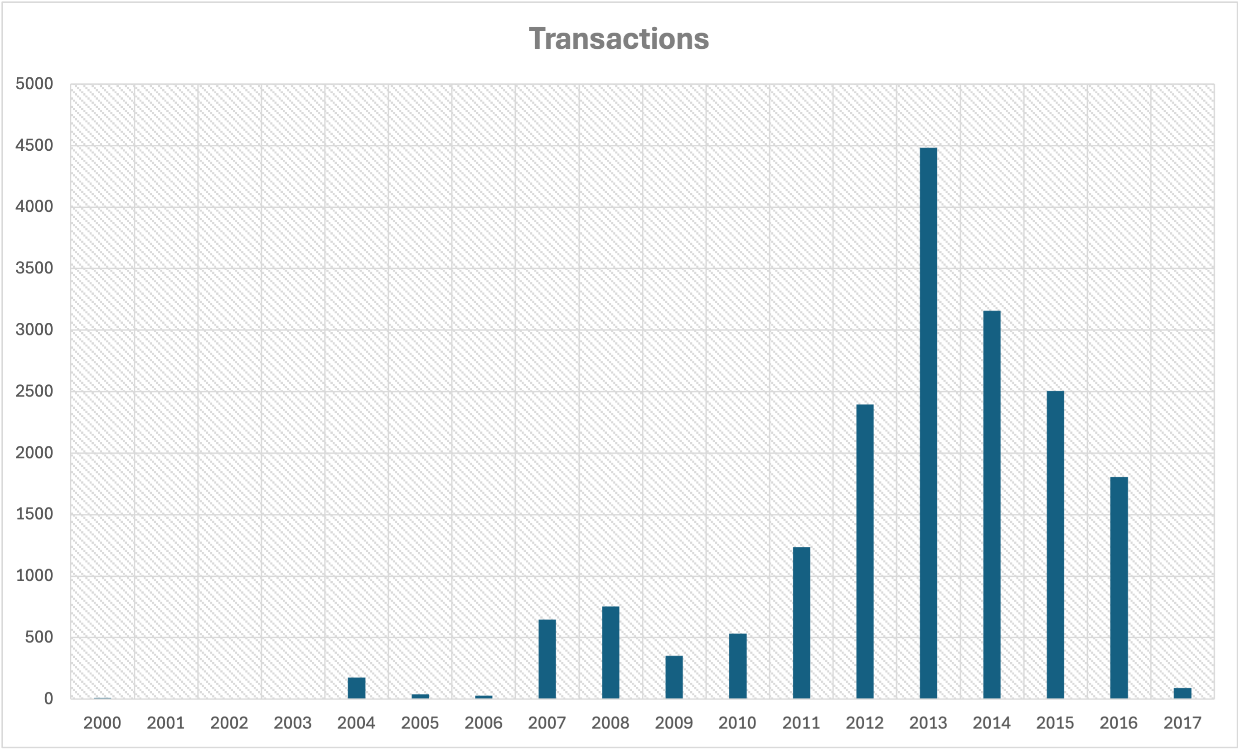
Homework 8 Review
Question 1:
  (A) 2013 2014 2015 2012 2016 2011 2008 2007 2010 2009 2004 2017 2005 2006 2000 2002 2001 2003
  (B) 2003: no transactions
  (C) 2013: 4484 transactions

Slide 6
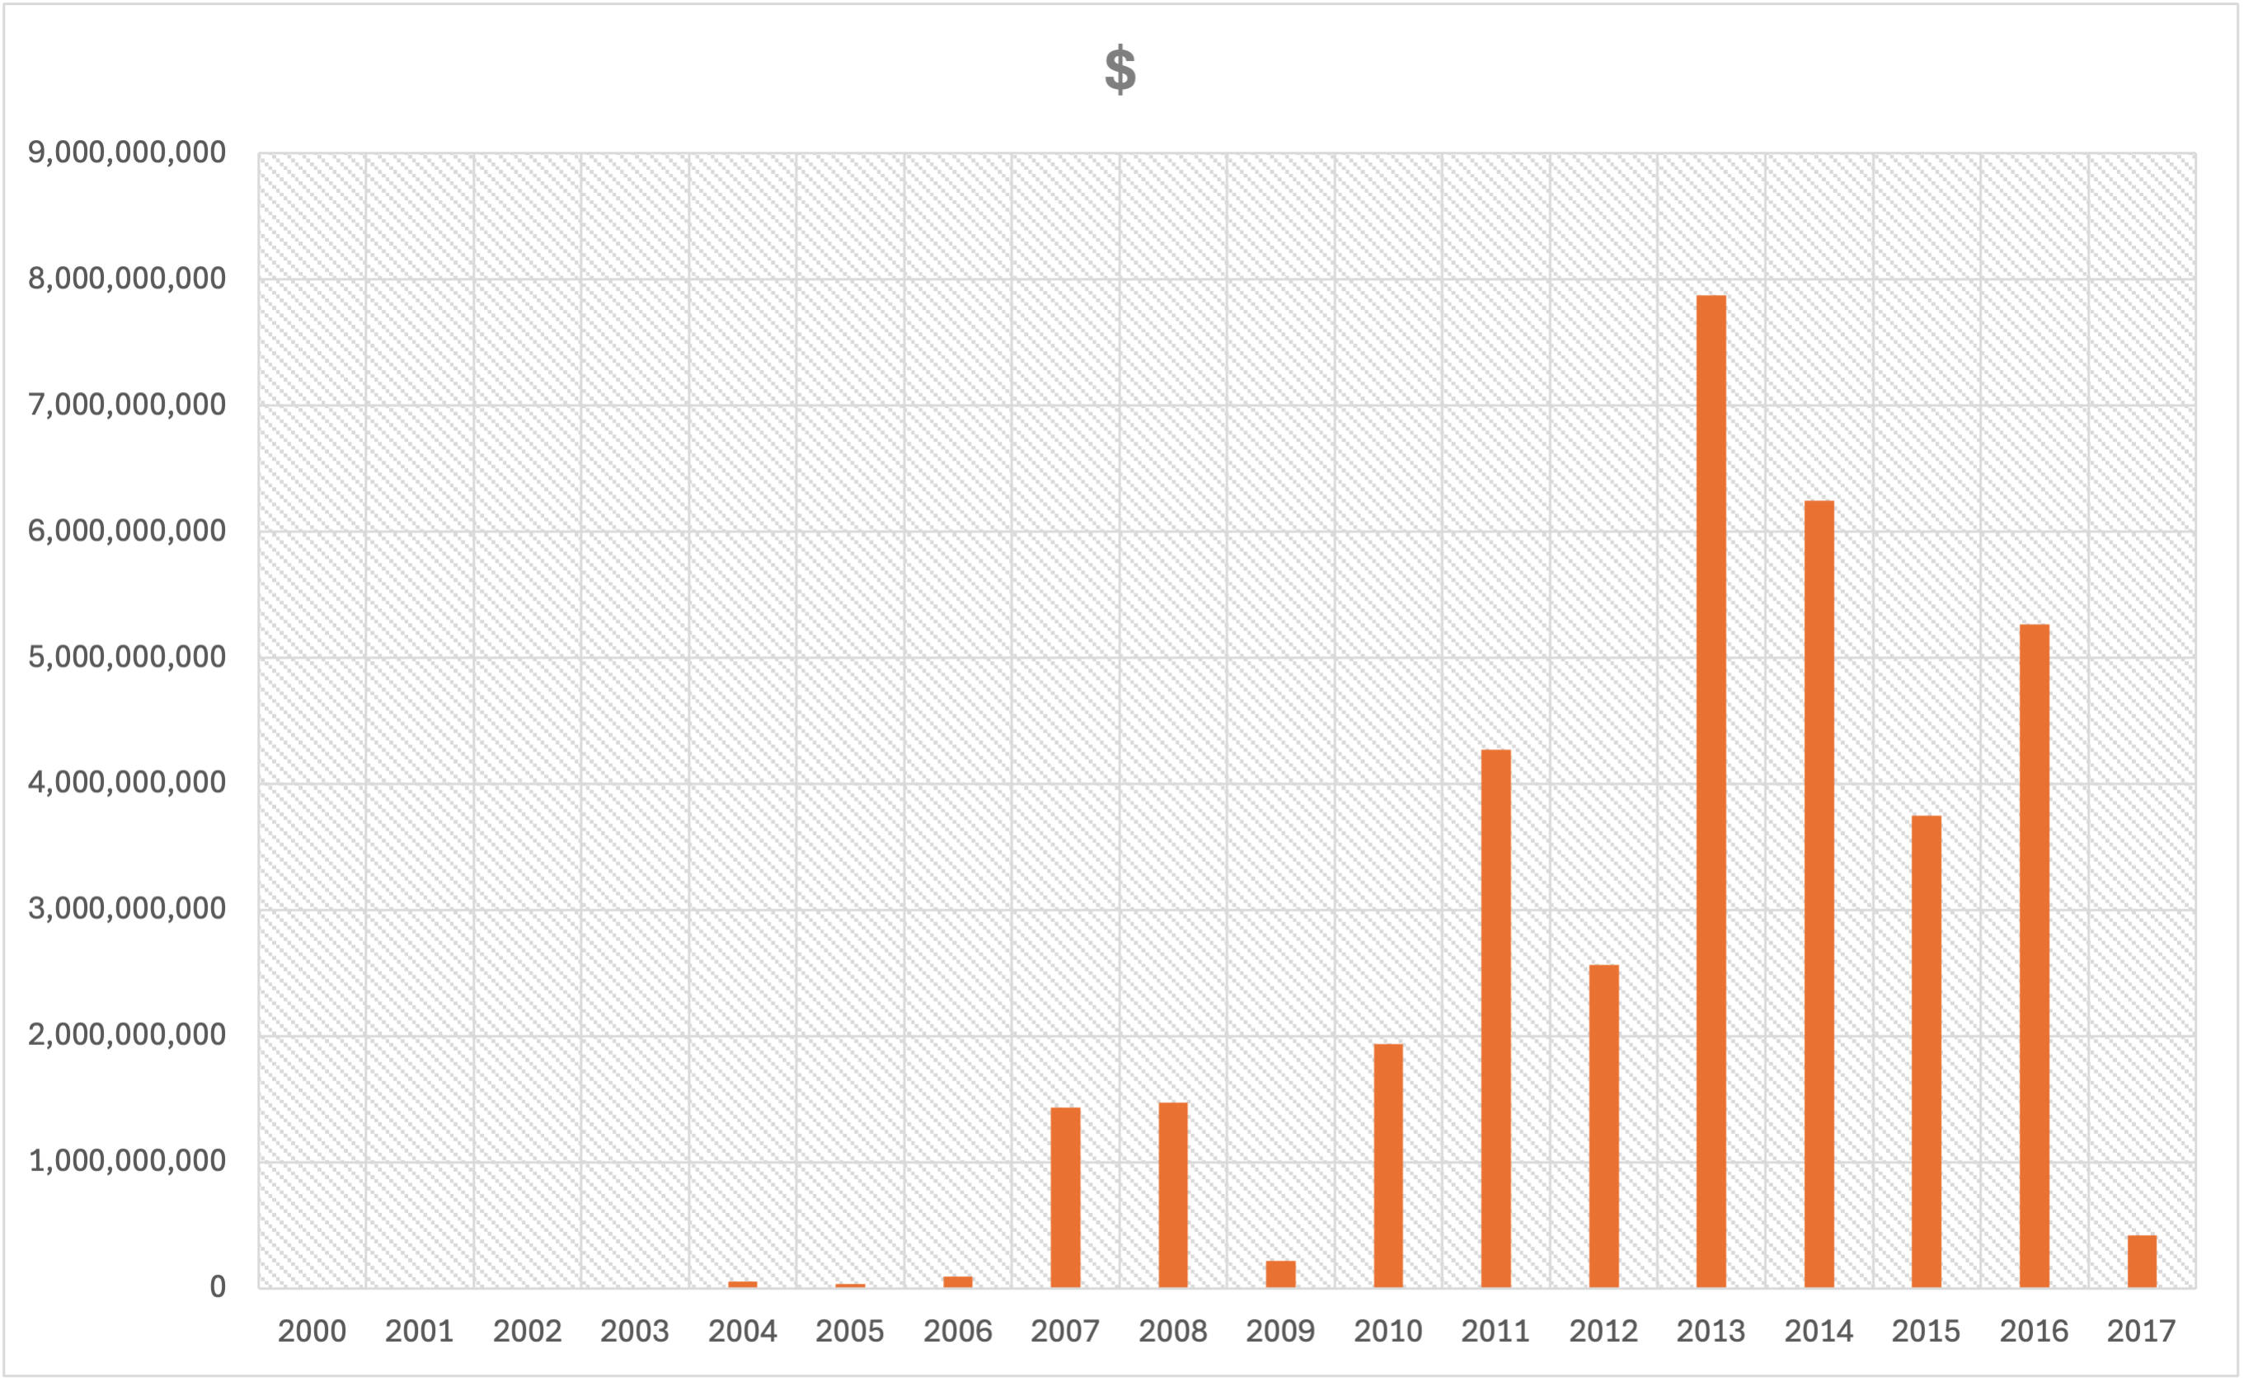
Homework 8 Review
Question 2:
  (A) 2013 2014 2016 2011 2015 2012 2010 2008 2007 2017 2009 2006 2004 2005 2000 2002 2001 2003
  (B) 2013: $7,871,446,356.98

Slide 7
Homework 8 Review
Question 3: originator_bank⁸ by number_transactions¹⁵
  perl -le 'open $f, $ARGV[0]; while(<$f>){if (/(".+?",|.*?,){7}(".+?"|.*?),(".+?",|.*?,){6}(.*?),/) {if ($4) {$c{$2}+=$4} else {$c{$2}++}}}; for(keys %c){print "$c{$_} $_"}' download_transactions_map.csv | sort -rn
478 AS Expobank
401 Western Union Business Solutions
377 Standard Chartered Bank
362 Primorye Bank
296 VP Bank AG
282 CIMB Bank Berhad
278 DBS Bank Ltd
278 Barclays Bank Plc Ho UK
253 Deutsche Bank AG
248 JSC Norvik Banka

Slide 8
Homework 8 Review
Question 3: originator_bank⁸ by amount_transactions¹⁶
  perl -le 'open $f, $ARGV[0]; while(<$f>){if (/(".+?",|.*?,){7}(".+?"|.*?),(".+?",|.*?,){7}(.+)$/) {$c{$2}+=$4}}; for(keys %c){print "$c{$_} $_"}' download_transactions_map.csv | sort -rn
3157943202.12 Amsterdam Trade Bank NV
2666430134.11 AS Expobank
1702860761.18 Deutsche Bank AG
1375421435.08 ING Netherland NV
1366123530.96 Rigensis Bank AS
1207455547.63 Rosbank
1114866517.7 JPMorgan Chase Bank
926899916.66 Gazprombank
856543576.77 Caledonian Bank Ltd
760041526 Societe Generale Private Banking

Slide 9
Homework 8 Review
Question 4: beneficiary_bank¹² by number_transactions¹⁵
  perl -le 'open $f, $ARGV[0]; while(<$f>){if (/(".+?",|.*?,){11}(".+?"|.*?),(".+?",|.*?,){2}(.*?),/) {if ($4) {$c{$2}+=$4} else {$c{$2}++}}}; for(keys %c){print "$c{$_} $_"}' download_transactions_map.csv | sort -rn
742 Credit Suisse AG
480 JSC Norvik Banka
414 Barclays Bank Plc
385 Habib Bank A G Zurich
309 HSBC
294 Standard Chartered Bank
248 United Overseas Bank Ltd
237 Raiffeisen Bank International Ag
237 Deutsche Bank AG
215 United Overseas Bank Limited

Slide 10
Homework 8 Review
Question 4: beneficiary_bank¹² by amount_transactions¹⁶
  perl -le 'open $f, $ARGV[0]; while(<$f>){if (/(".+?",|.*?,){11}(".+?"|.*?),(".+?",|.*?,){3}(.+)$/) {$c{$2}+=$4}}; for(keys %c){print "$c{$_} $_"}' download_transactions_map.csv | sort -rn
3559645309.54 Rosbank
2089081782.75 Credit Suisse AG
1754253899.57 Rigensis Bank AS
1324026206.64 ING Netherland NV
1082748112.02 Deutsche Bank AG -- London Branch
881880017.38 JPMorgan
860707022.51 Societe Generale Bank And Trust Singapore SA
813175350.59 Hong Kong And Shanghai Banking Corp
805642190.61 Bank Soyuz
803999980 Caledonian Bank Ltd

Slide 11
Regex Lookahead and Lookbehind
We've already seen some zero-width regexs:
  ^ (start of string)
  $ (end of string)
  \b (word boundary)
    matches the imaginary position between \w\W or \W\w, or just before beginning of string if ^\w, just after the end of the string if \w$
zero-width because position of match (so far), pos, doesn't change!
  (?=regex) (lookahead from current position)
  (?<=regex) (lookbehind from current position)
  (?!regex) (negative lookahead)
  (?<!regex) (negative lookbehind)

Slide 12
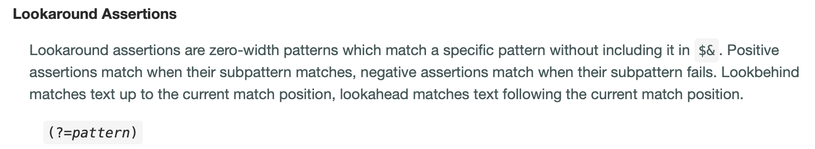
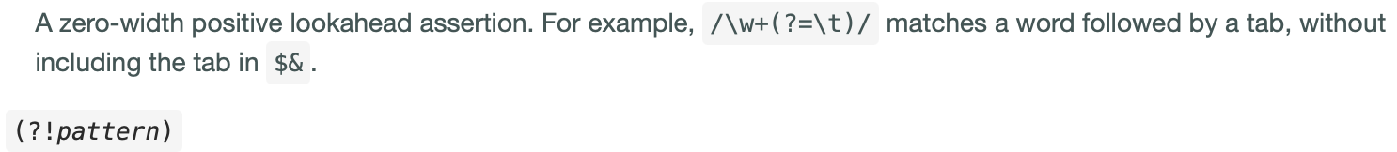
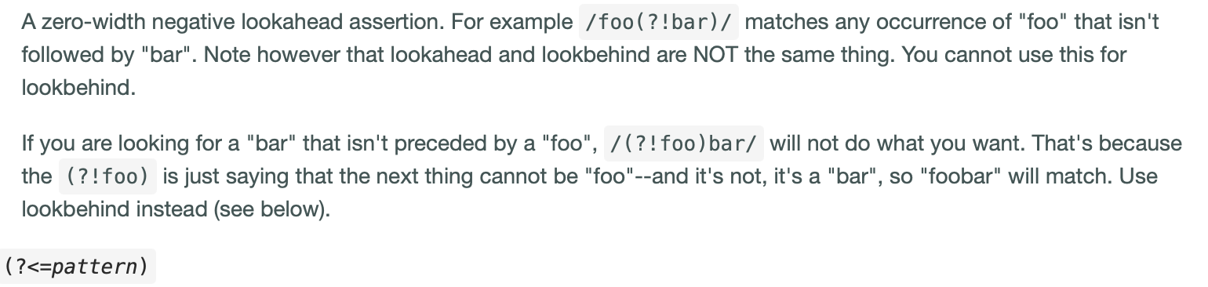


Lookahead (and lookbehind)
lookbehind for pattern
negative lookbehind for pattern

Slide 13
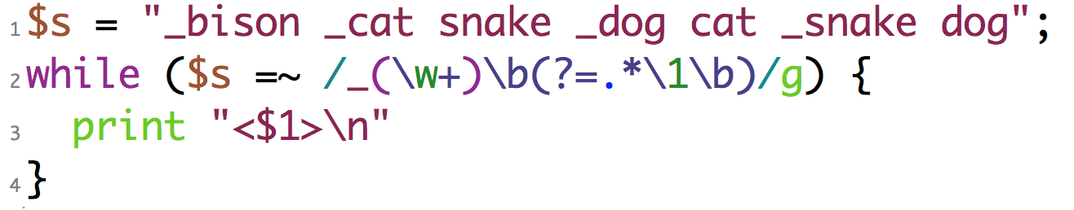
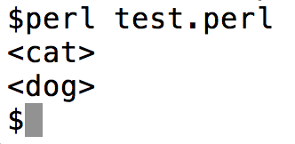
Regex Lookahead and Lookbehind
Example:
looks for a word beginning with _ such that
there is a duplicate ahead (without the _ )
(?= ..) means lookahead

Slide 14
Regex Lookahead and Lookbehind
Some restrictions apply:
lookbehind (in most versions of Perl) cannot be of variable length
From perlretut:
  Lookahead can match arbitrary regexps,
  but lookbehind prior to 5.30 (?<=fixed-regexp)only works for regexps of fixed width, i.e., a fixed number of characters long. Thus (?<=(ab|bc)) is fine, but (?<=(ab)*) prior to 5.30 is not.

Slide 15
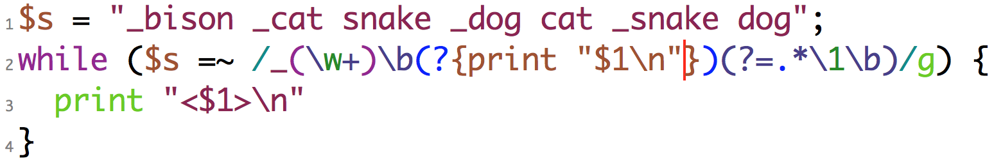
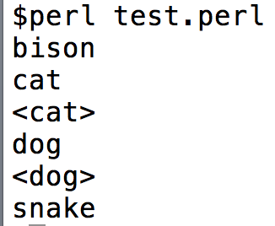
Debugging Perl regex
(?{ Perl code }) can be inserted anywhere in a regex
can assist with debugging
Example:

Slide 16
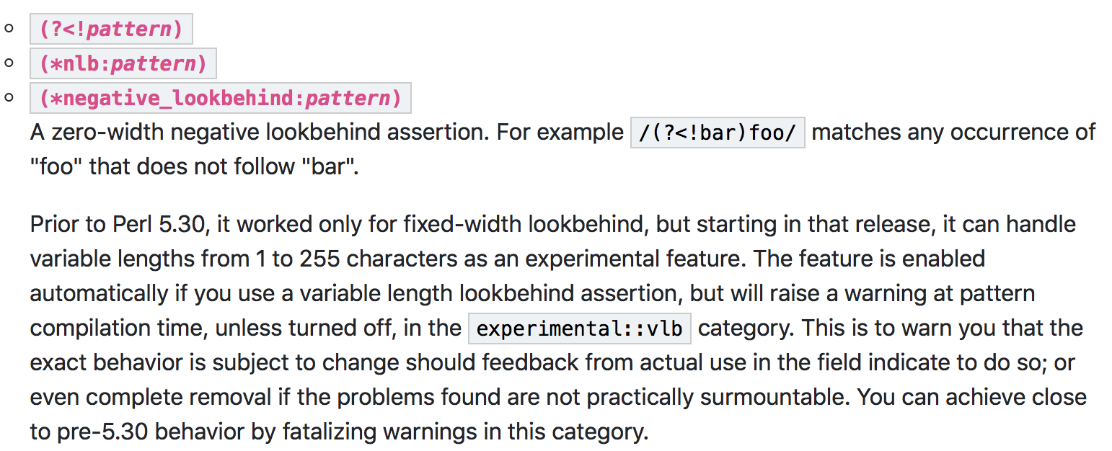
Regex Lookahead and Lookback
/(?<!bar)foo/

Slide 17
Background
Background stuff you should familiar yourself with …
  Predicate-argument structure
  Stanford CoreNLP

Slide 18
Background
Predicate-Argument Structure (typically for verbs)
Example
  John saw/noticed the javelina
  notice(experiencer, theme) or see(experiencer, theme)
  John noticed that Mary saw the javelina
  notice(perceiver, proposition) 1st argument: subject, 2nd argument: direct object
  the cat chased the mouse
  chase(agent, theme) 1st argument: subject, 2nd argument: direct object
  the mouse was chased by the cat (passivization)
  *John was jogged for an hour (*passivization)
  John jogged for an hour (intransitive)
  jog(agent)

Slide 19
Background
Different representations exist in the literature.
Simple:
  John saw/noticed the javelina
  notice(experiencer, theme)
Neo-Davidsonian:
  event(e) & experiencer(e, John) & theme(e, javelina)

Slide 20
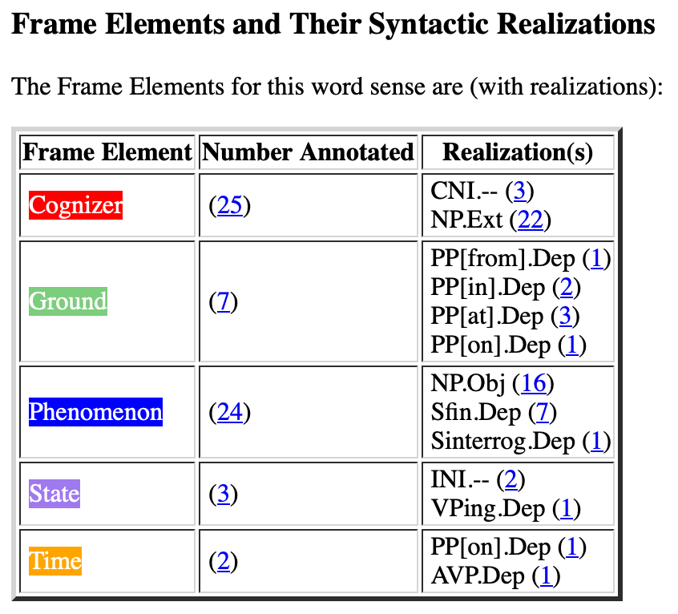
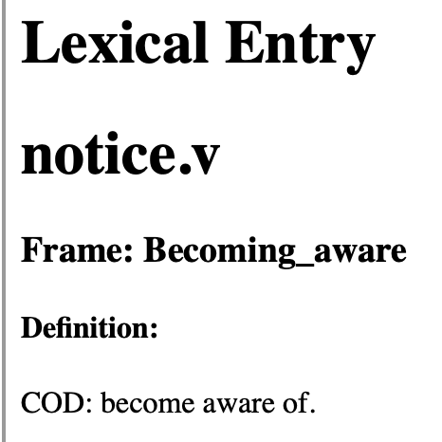
Background
Framenet
  https://framenet.icsi.berkeley.edu/luIndex
  Words in this frame have to do with a Cognizer adding some Phenomenon to their model of the world.
core
core

Slide 21
Background
Framenet Examples:
420-that-sfin
  [_{Cognizer}I] soon NOTICED [_{Phenomenon}that the car was being driven very dangerously] .
  Then off they went but [_{Cognizer}I] had NOTICED [_{Phenomenon}that Mrs Taylor was really crying] .
  [_{Cognizer}You] will NOTICE that there is , [_{Ground}in the wording of that letter] , [_{Phenomenon}something curious] .
430-sfin
  NOTICE [_{Phenomenon}the street names] [_{Ground}in the centre of Bristol] .[_{Cognizer}CNI]
  [_{Cognizer}You] may NOTICE [_{Phenomenon}that food tastes different when you are pregnant] .
  ` I do n't suppose [_{Cognizer}anyone] will even NOTICE [_{Phenomenon}you 're not there] .
  [_{Cognizer}Nobody] even NOTICED [_{Phenomenon}I was in the room !]
480-swh
  On the way [_{Cognizer}he] NOTICED [_{Phenomenon}how quiet the school seemed] .
520-np-vping
  ` Did [_{Cognizer}you] NOTICE [_{Phenomenon}any knives] [_{State}lying about] ? "
570-np-ppabout
  ` I see [_{Cognizer}you] have NOTICED [_{Phenomenon}a certain peculiarity about my appearance .] "
570-np-ppat
  When examining the wound , [_{Cognizer}I] NOTICED [_{Phenomenon}a dark area] [_{Ground}at each end of the cut] .
  [_{Cognizer}Users of the main car park at Park Royal] will have NOTICED [_{Phenomenon}a new fence] [_{Ground}at the back of the site] .
  Then [_{Cognizer}I] NOTICED [_{Phenomenon}Alec] [_{Ground}at the other end of the bench] .

Slide 22
Background
Lexical Units:
chance (across).v, chance (on).v, come (across).v, come (upon).v, descry.v, detect.v, discern.v, discover.v, discovery.n, encounter.v, espy.v, fall (on).v, find (oneself).v, find out.v, find.v, happen (on).v, learn.v, locate.v, note.v, notice.v, observe.v, perceive.v, pick up.v, recognize.v, register.v, spot.v, spy out.v, tell.v
Not present Perception_experience verbs:
detect.v, experience.n, experience.v, feel.v, hear.v, overhear.v, perceive.v, perception.n, see.v, sense.v, smell.v, taste.v, witness.v
Not present Perception_active verbs:
admire.v, attend.v, eavesdrop.v, eye.v, feel.v, gape.v, gawk.v, gaze.n, gaze.v, glance.n, glance.v, goggle.v, listen.v, look.n, look.v, observation.n, observe.v, palpate.v, peek.n, peek.v, peep.v, peer.v, savour.v, smell.v, sniff.n, sniff.v, spy.v, squint.v, stare.n, stare.v, taste.n, taste.v, view.v, watch.v

Slide 23
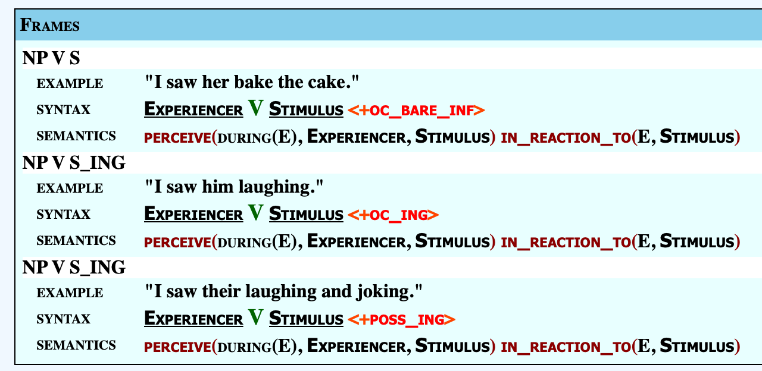
Background
Unified Verb Index
  https://verbs.colorado.edu/verb-index/vn3.3/

Slide 24
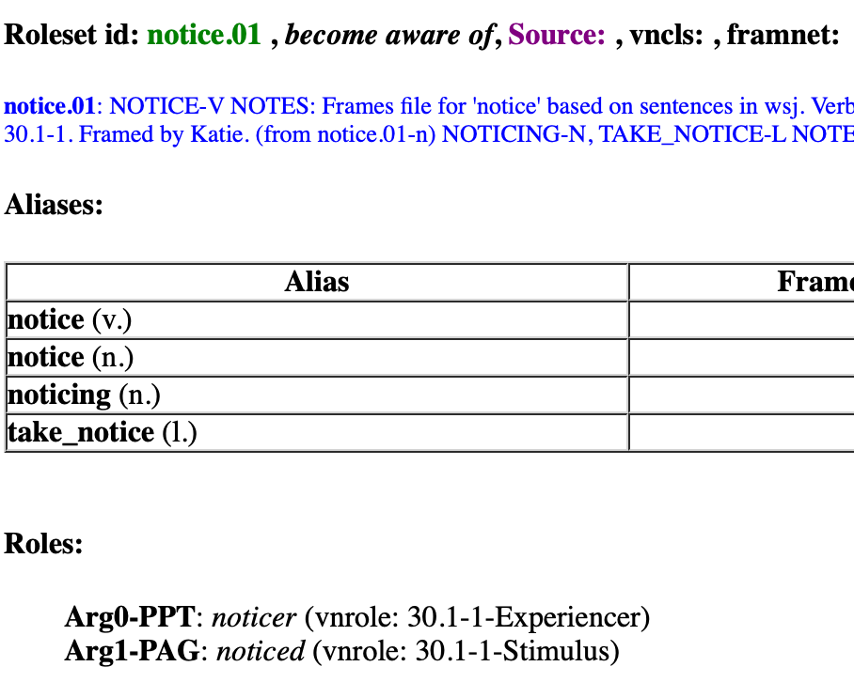
Background: Propbank
Propbank:
  • ARGn-PAG ... proto-agent
  • ARGn-PPT ... proto-patient

Slide 25
Background: Propbank
notice-v; 2 Senses
Sense Number 1: observe, perceive or become aware of something
Examples:
Did you notice what he had in his hand?
I noticed that he avoided mentioning her name.
Mary waved at the man but he didn't seem to notice.
Starting in 1987, scientists noticed large drops in the amount of phytoplankton.
Her musical talent was first noticed by the critics at the age of 12.
Mappings:
VerbNet: see-30.1-1-1
FrameNet: Becoming_aware
PropBank: notice.01
WordNet 3.0 Sense Numbers: 1, 2, 4

Slide 26
Background: Propbank
notice-v; 2 Senses
Sense Number 2: bring to attention; give notice or announce
Examples:
The Solicitor General noticed the court of a change in Justice Department police.
The foundation noticed the Council of the new approach.
Mappings:
VerbNet: NM
FrameNet: NM
PropBank: NM

Slide 27
Background
Predicate-Argument Structure (typically for verbs)
Example
  *the librarian put the book
  the librarian put the book on the table
  put(agent, theme, location)
  Mary gave John the textbook
  *Mary gave John
  give(agent, goal, theme)
  Mary gave the textbook to John

Slide 28
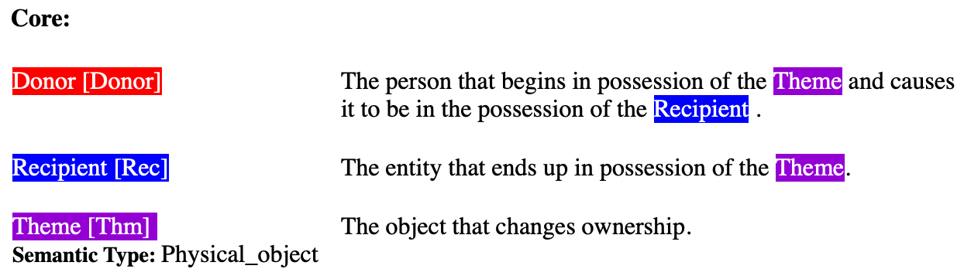
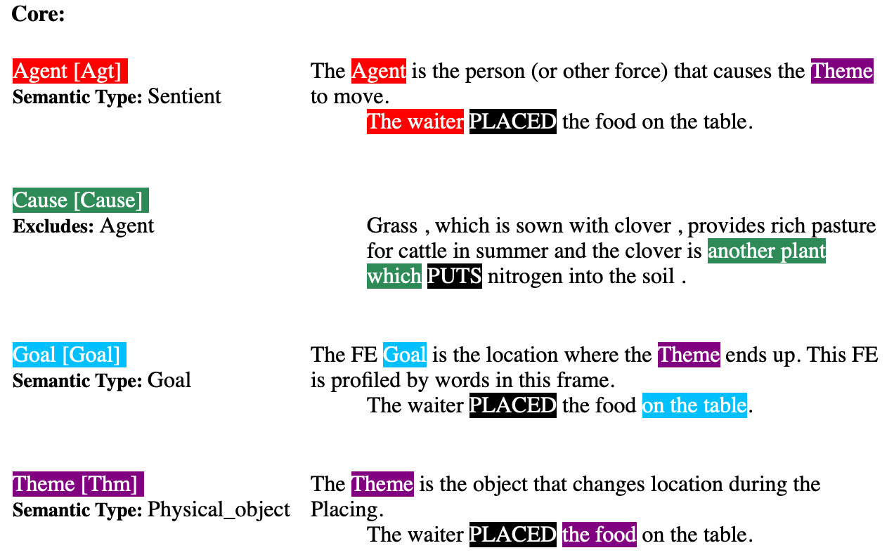
Background: Framenet
give:
put:

