Slide 1
LING/C SC/PSYC 438/538
Lecture 12
Prof. Sandiway Fong

Slide 2
Today's Topics
Homework 8
More on Perl regex:
  Perl code inside a regex!
  Character and word frequency counting
Zipf's Law
  Brown Corpus case study

Slide 3
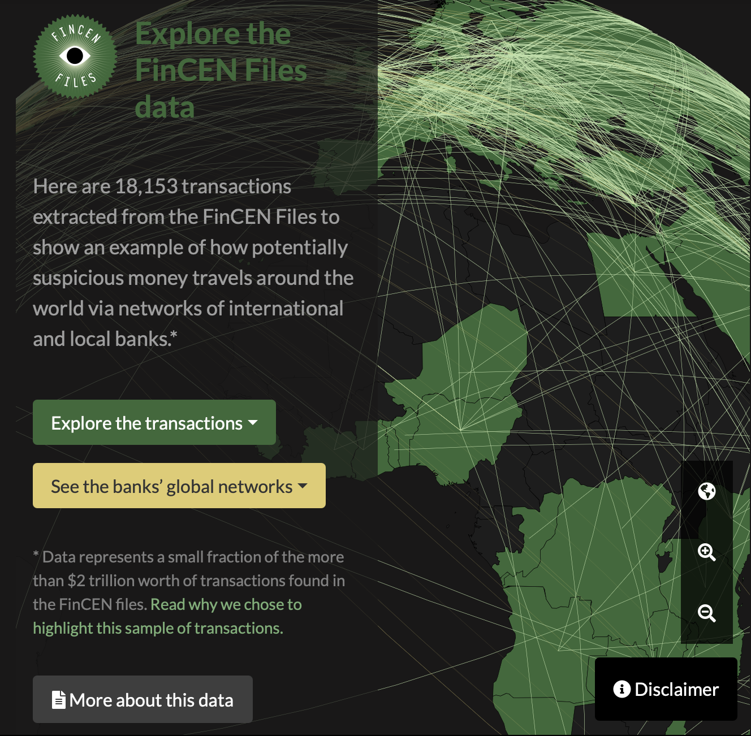
FinCEN Files (www.icij.org)
Money travels around the world
  $35 billion in transactions dated from 2000-2017 that were flagged by financial institutions as suspicious to United States authorities
  The data in this map represents a fraction of the more than $2 trillion worth of transactions found in the FinCEN Files.

Slide 4
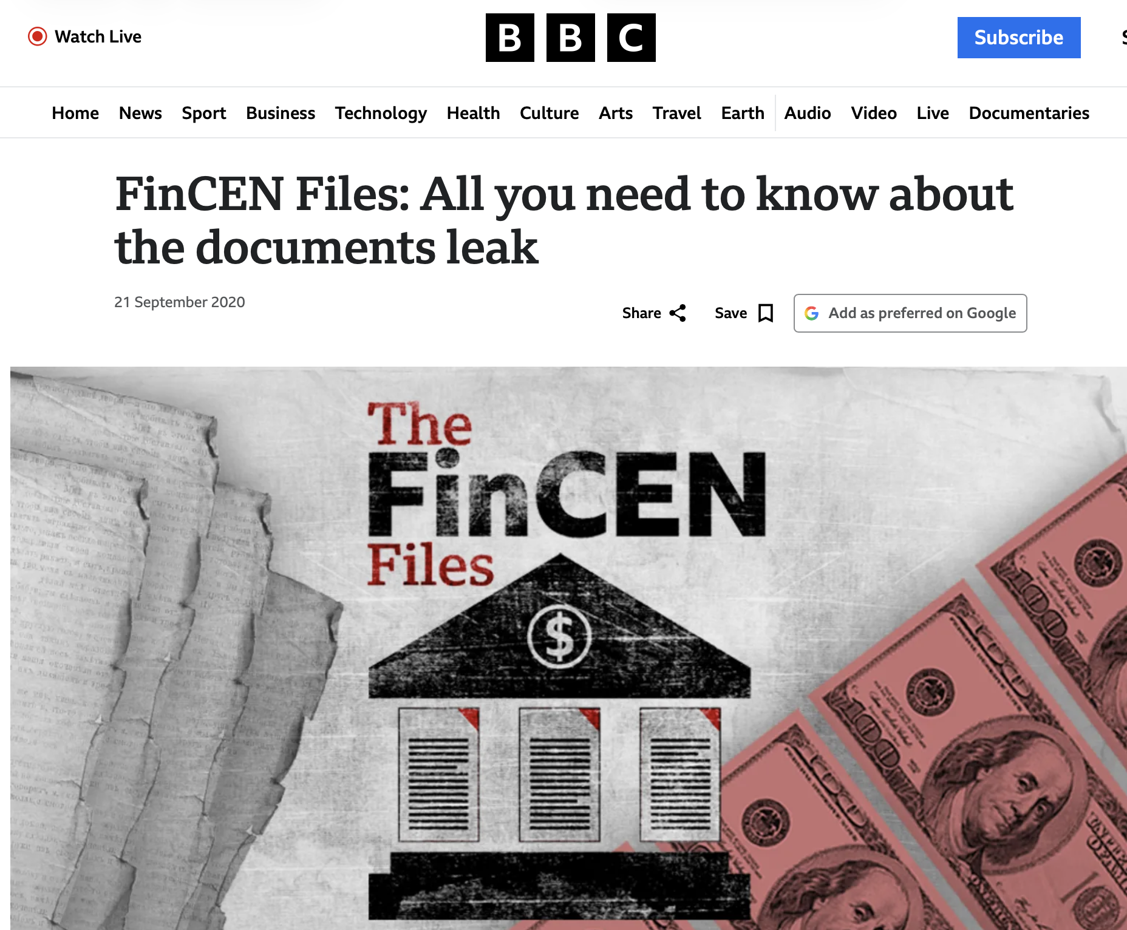
Background
BBC News
  www.bbc.com/news/uk-54226107
  FinCEN is the US Financial Crimes Enforcement Network (US Treasury).
  Concerns about transactions made in US dollars need to be sent to FinCEN, even if they took place outside the US.
  These documents are some of the international banking system's most closely guarded secrets.
  They were leaked to Buzzfeed News and shared with a group that brings together investigative journalists from around the world
icij.org

Slide 5
download_transactions_map.csv
.csv: comma-separated values
Format (1st line):
  id,icij_sar_id,filer_org_name_id,filer_org_name,begin_date,end_date,originator_bank_id,originator_bank,originator_bank_country,originator_iso,beneficiary_bank_id,beneficiary_bank,beneficiary_bank_country,beneficiary_iso,number_transactions,amount_transactions
Examples:
  223254,3297,the-bank-of-new-york-mellon-corp,The Bank of New York Mellon Corp.,"Mar 25, 2015","Sep 25, 2015",cimb-bank-berhad,CIMB Bank Berhad,Singapore,SGP,barclays-bank-plc-london-england-gbr,Barclays Bank Plc,United Kingdom,GBR,68,5.689852347E7
  223255,3297,the-bank-of-new-york-mellon-corp,The Bank of New York Mellon Corp.,"Mar 30, 2015","Sep 25, 2015",cimb-bank-berhad,CIMB Bank Berhad,Singapore,SGP,barclays-bank-plc-london-england-gbr,Barclays Bank Plc,United Kingdom,GBR,118,1.1623836125E8
  223258,2924,the-bank-of-new-york-mellon-corp,The Bank of New York Mellon Corp.,"Jul 5, 2012","Jul 5, 2012",barclays-bank-plc-ho-uk,Barclays Bank Plc Ho UK,United Kingdom,GBR,skandinaviska-enskilda-banken-stockholm-sweden-swe,Skandinaviska Enskilda Banken,Sweden,SWE,,5000
  …
  223261,2924,the-bank-of-new-york-mellon-corp,The Bank of New York Mellon Corp.,"May 29, 2012","May 29, 2012",barclays-bank-plc-ho-uk,Barclays Bank Plc Ho UK,United Kingdom,GBR,skandinaviska-enskilda-banken-stockholm-sweden-swe,Skandinaviska Enskilda Banken,Sweden,SWE,,88.03
  …
  243960,2804,deutsche-bank-ag,Deutsche Bank AG,"Jun 14, 2016","Jun 14, 2016",ing-netherland-nv,ING Netherland NV,Netherlands,NLD,rigenesis-bank-as-latvia-lva,Rigenesis Bank AS,Latvia,LVA,1,33259000

Slide 6
Homework 8
Question 1:
  Using Perl and regex
  (A) Compute how many suspicious transactions in each year were recorded.
  Rank the years, i.e. #1 #2 .. #18 ( #1 = most; 2000-2017)
  Treat ,, as 1
Use begin_date (to locate date) and number_transactions
  Hint: .*? (non-greedy) vs .* (greedy), beware of commas inside a quoted field!
    "May 31, 2012"
    The Bank of New York Mellon Corp.
    "Citigroup, Inc."
  Double/triple check: you read in the right number of records and you identified the output field correctly
  (B) Which year had no transactions?
  (C) Which year had the most transactions? How many?
  Show your code and results

Slide 7
Homework 8
Question 2:
  (A) Compute the total dollar value for each year (2000-2017). Rank the years.
  (B) Which year has the biggest dollar value? What is the value?
  Use amount_transactions
Question 3:
  (Still using Perl)
  What are the "top three" originating banks overall for suspicious money transfers?
  use originator_bank
    "The Bank of Tokyo-Mitsubishi Ufj, Ltd"
  Hint: use a hash table to count
  (A) Define "top three" as # of transactions (number_transactions)
  (B) Then define "top three" as total dollar value (amount_transactions)
  (Show your code and results)

Slide 8
Homework 8
Question 4:
  Do the same for "top three" beneficiary banks (as for Question 3)
  use beneficiary_bank

Slide 9
Homework 8
Email to me: sandiway@arizona.edu
Subject: 438/538 Homework 8: YOUR NAME
Submit everything in one PDF file
Submit a real file, not a link
Screenshots: make sure text is readable – not too tiny!
Due Sunday midnight:
  to be reviewed in class next Tuesday

Slide 10
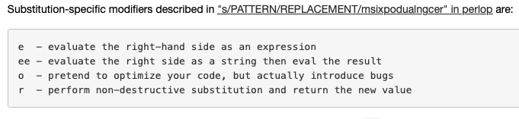
s/regex/replace/e
A /e will cause the replacement portion to be treated as a full-fledged Perl expression and evaluated right then and there. It is, however, syntax checked at compile-time. A second e modifier will cause the replacement portion to be evaled before being run as a Perl expression.

Slide 11
s/regex/replace/e
# Add one to the value of any numbers in the string
s/(\d+)/1 + $1/eg;
One-liner:
perl -le '$_ = qq/@ARGV/; s/(\d+)/1 + $1/eg; print' 123 234
124 235

Slide 12
s/regex/replace/ee
The period is a string concatenation operator (cf. Python +):
perl -le '$_=shift; s/((\d+)(.)(\d+))/$2.$1/;print' '3*4'
3.3*4
perl -le '$_=shift; s/((\d+)(.)(\d+))/$2.$1/e;print' '3*4'
33*4
perl -le '$_=shift; s/((\d+)(.)(\d+))/$2.$1/ee;print' '3*4'
132

Slide 13
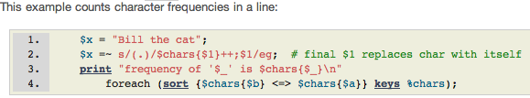
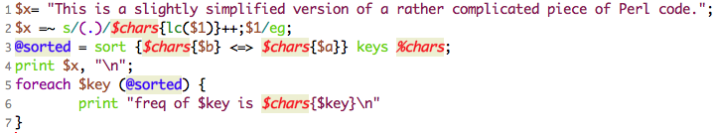
Character Frequency Counting
Sample code is rather interesting (e flag):
s/regex/replace/e
Generally, in regex:
(?{ Perl code })
Slightly modified but easier to read:
note: lowercase

Slide 14
Character Frequency Counting
$ perl -le '$_ = qq/@ARGV/; s/(.)/$c{$1}++/eg; foreach $k (sort {$c{$b} <=> $c{$a}} keys %c) {print "$k:$c{$k} "}' this is a sentence to test this program.
:7
t:6
s:5
e:4
i:3
r:2
h:2
a:2
n:2
o:2
g:1
m:1
.:1
p:1
c:1
Steps:
$_ = qq/@ARGV/ put the command line arguments into a string $_
globally match each character (.) and increment a hash table (%c) count
for each key $k in %c (sorted in descending order by value), print key:value

Slide 15
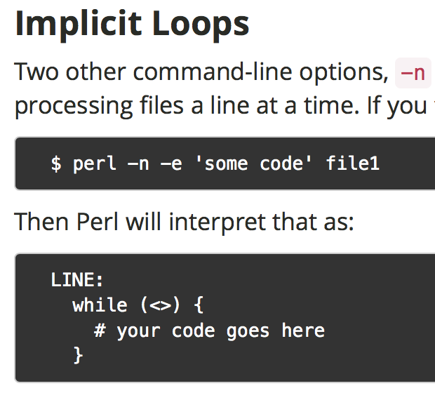
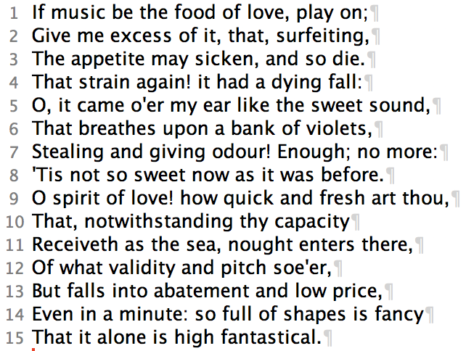
Character Frequency Counting
perl -ne '{s/(.)/$c{lc($1)}++/eg} END {foreach $k (sort {$c{$b} <=> $c{$a}} keys %c) {print "$k:$c{$k} "} print "\n"}' 12thnight.txt
12thnight.txt
Note:
$_ will contain each line of file1
loop code END post-loop code

Slide 16
Character Frequency Counting
12th Night:
perl -ne '{s/(.)/$c{lc($1)}++/eg} END {foreach $k (sort {$c{$b} <=> $c{$a}} keys %c) {print "$k:$c{$k} "} print "\n"}' 12thnight.txt
:99 t:52 e:51 a:45 i:40 o:36 n:33 s:31 h:25 f:16 l:16 r:16 ,:14 d:13 u:12 c:12 g:11 p:9 w:8 m:8 v:8 y:8 b:6 k:4 ':3 .:3 !:3 ::3 ;:2 x:1 q:1

Slide 17
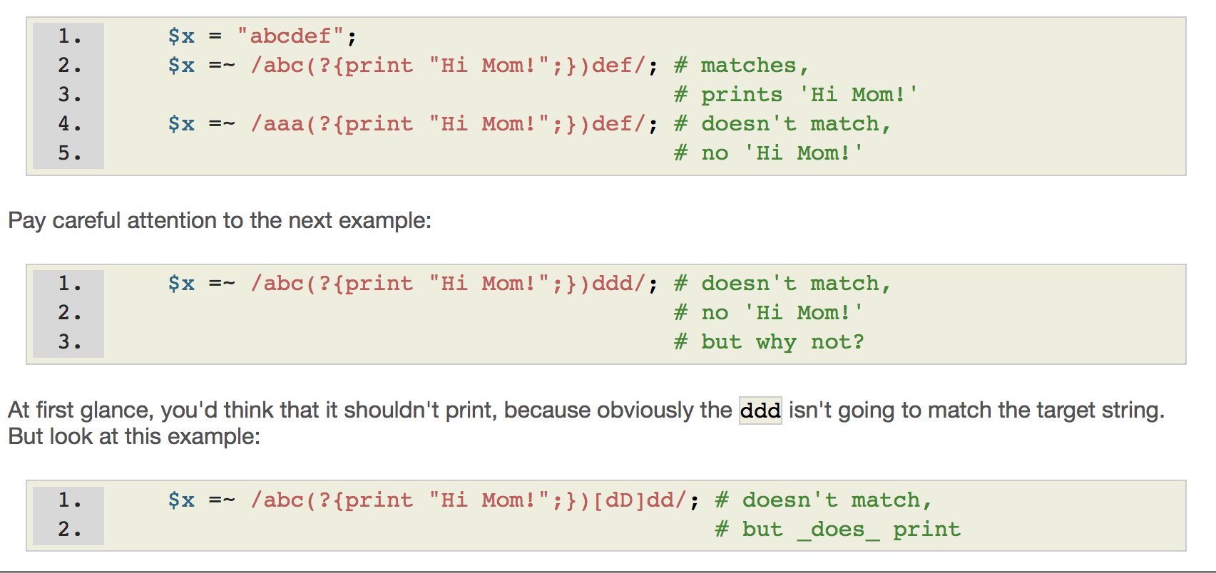
(?{ Perl code })
Perl regex optimization
No Perl regex optimization

Slide 18
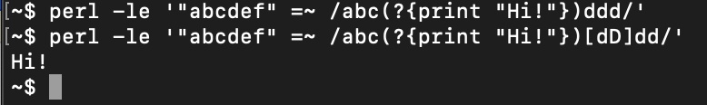
(?{ Perl code })
One-liner:

Slide 19
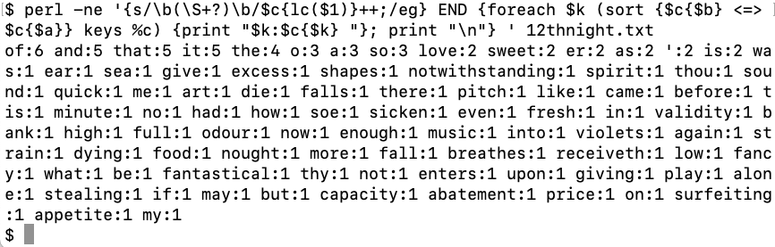
Word Frequency Counting
Words, including punctuation: \b(\S+?)\b

Slide 20
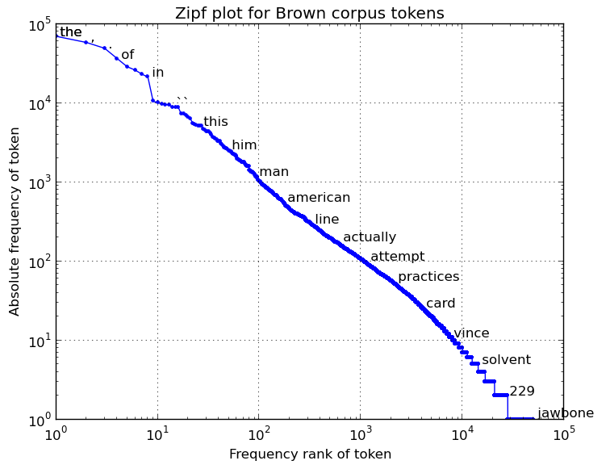
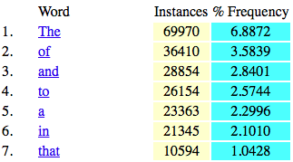
Zipf's Law
Zipf's law states that given some corpus of natural language utterances, the frequency of any word is inversely proportional to its rank in the frequency table.
See:
  http://demonstrations.wolfram.com/ZipfsLawAppliedToWordAndLetterFrequencies/
  Brown Corpus (1,015,945 words): only 135 words are needed to account for half the corpus.
On a Log – Log scale:
almost straight line
http://www.learnholistically.it/esp-clil/wfk2.htm
https://finnaarupnielsen.wordpress.com/2013/10/22/zipf-plot-for-word-counts-in-brown-corpus/

Slide 21
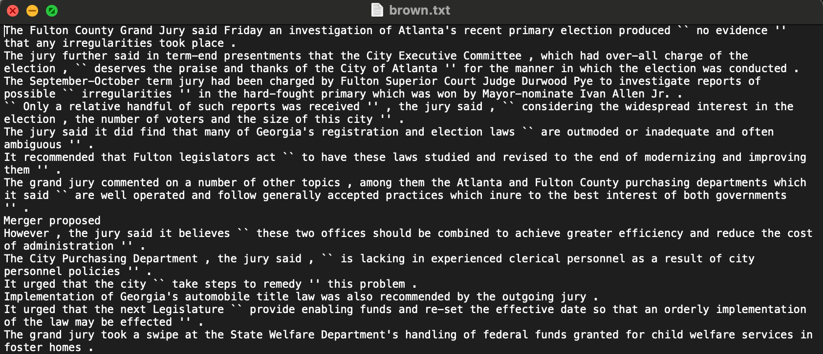
Brown Corpus
https://en.wikipedia.org/wiki/Brown_Corpus
  "It contains 500 samples of English-language text, totaling roughly one million words, compiled from works published in the United States in 1961."

Slide 22
Brown Corpus
brown.txt (lines taken from brown.sents() from nltk.corpus)
perl -ne '{s/\b(\S+?)\b/$c{lc($1)}++;/eg} END {@s = sort {$c{$b} <=> $c{$a}} keys %c; foreach $k (@s[0..99]) { print "$k:$c{$k} " }}' brown.txt
the:70003 of:36473 and:28935 to:26247 a:23502 in:21422 that:10789 is:10109 ':9865 was:9815 he:9801 for:9500 it:9094 -:8355 with:7290 as:7255 his:6999 on:6765 be:6388 s:6250 i:5932 at:5377 by:5346 this:5146 had:5133 not:4620 are:4394 but:4382 from:4371 or:4226 have:3942 they:3763 an:3751 you:3634 which:3561 one:3504 were:3285 all:3099 her:3036 she:2987 we:2844 there:2844 would:2719 their:2670 him:2619 been:2472 has:2437 when:2331 who:2280 will:2251 t:2246 more:2225 no:2219 if:2198 out:2167 so:2033 up:1974 what:1968 said:1961 can:1942 its:1858 about:1817 than:1796 into:1791 them:1790 only:1748 other:1714 time:1695 new:1646 some:1618 could:1602 these:1573 two:1516 may:1402 first:1389 then:1380 do:1375 man:1364 any:1344 like:1343 my:1319 now:1317 over:1307 such:1303 our:1253 .:1209 me:1185 even:1173 most:1162 made:1147 after:1077 also:1069 did:1044 many:1037 before:1016 must:1015 well:1006 af:1005 back:976 through:974

Slide 23
Brown Corpus
Using termgraph:
  pip3 install termgraph (Python)
  termgraph [datafile] (two columns: #1 label, #2 value)
perl -ne '{s/\b(\S+?)\b/$c{lc($1)}++;/eg} END {@s = sort {$c{$b} <=> $c{$a}} keys %c; foreach $k (@s[0..19]) { print "$k $c{$k}\n" }}' brown.txt | termgraph
the : ▇▇▇▇▇▇▇▇▇▇▇▇▇▇▇▇▇▇▇▇▇▇▇▇▇▇▇▇▇▇▇▇▇▇▇▇▇▇▇▇▇▇▇▇▇▇▇▇▇▇ 70.00K
of : ▇▇▇▇▇▇▇▇▇▇▇▇▇▇▇▇▇▇▇▇▇▇▇▇▇▇ 36.47K
and : ▇▇▇▇▇▇▇▇▇▇▇▇▇▇▇▇▇▇▇▇ 28.93K
to : ▇▇▇▇▇▇▇▇▇▇▇▇▇▇▇▇▇▇ 26.25K
a : ▇▇▇▇▇▇▇▇▇▇▇▇▇▇▇▇ 23.50K
in : ▇▇▇▇▇▇▇▇▇▇▇▇▇▇▇ 21.42K
that: ▇▇▇▇▇▇▇ 10.79K
is : ▇▇▇▇▇▇▇ 10.11K
' : ▇▇▇▇▇▇▇ 9.87 K
was : ▇▇▇▇▇▇▇ 9.81 K
he : ▇▇▇▇▇▇▇ 9.80 K
for : ▇▇▇▇▇▇ 9.50 K
it : ▇▇▇▇▇▇ 9.09 K
- : ▇▇▇▇▇ 8.36 K
with: ▇▇▇▇▇ 7.29 K
as : ▇▇▇▇▇ 7.25 K
his : ▇▇▇▇ 7.00 K
on : ▇▇▇▇ 6.76 K
be : ▇▇▇▇ 6.39 K
s : ▇▇▇▇ 6.25 K

Slide 24
Brown Corpus
from the earlier slide:
http://demonstrations.wolfram.com/ZipfsLawAppliedToWordAndLetterFrequencies/
Brown Corpus (1,015,945 words): only 135 words are needed to account for half the corpus.
perl -ne '{s/\b(\S+?)\b/$c{lc($1)}++;$t++;/eg} END {$t /=2; foreach $k (sort {$c{$b}<=>$c{$a}} keys %c) {$n++; $t -= $c{$k}; last if ($t<0) }; print "$n\n"}' brown.txt
122
last means terminate the running of foreach loop early
$t total number of words, halved by $t /= 2
$n to count the number of different words ($n++), stop when $t<0

Slide 25
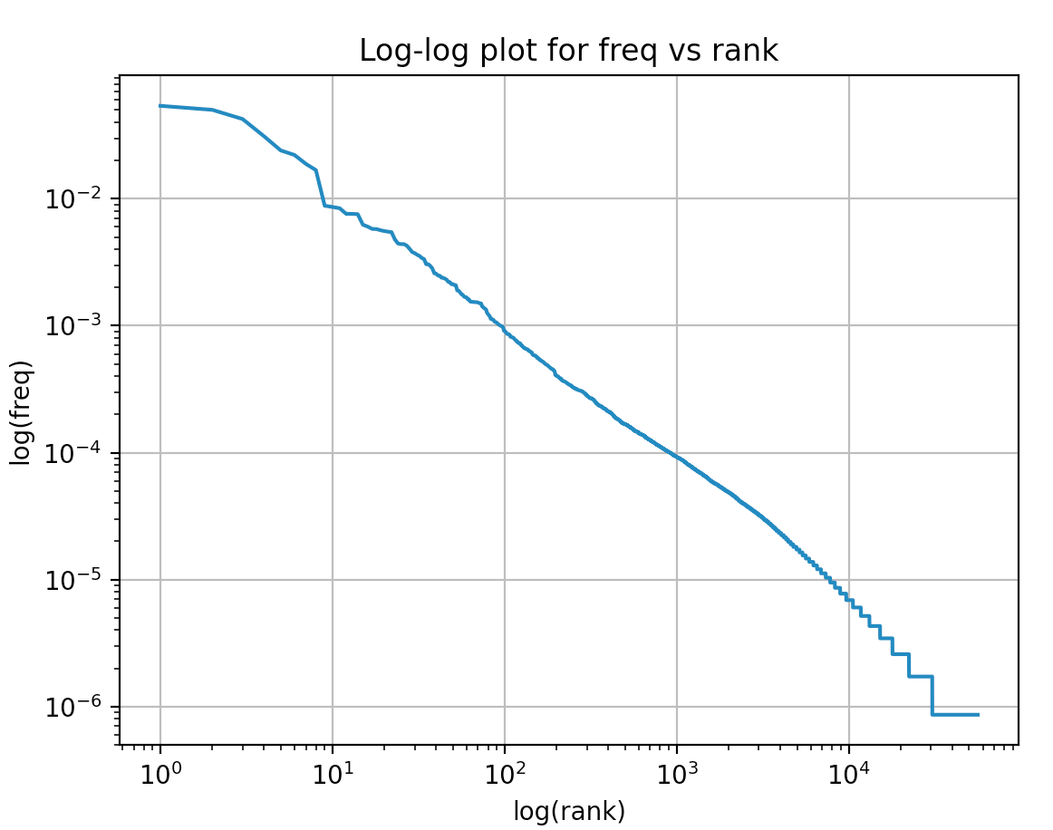
Brown Corpus
In nltk (Natural Language Toolkit):
  python -i zipf.py
  >>> import nltk
  >>> from nltk.corpus import brown
  >>> plot(brown.words())

Slide 26
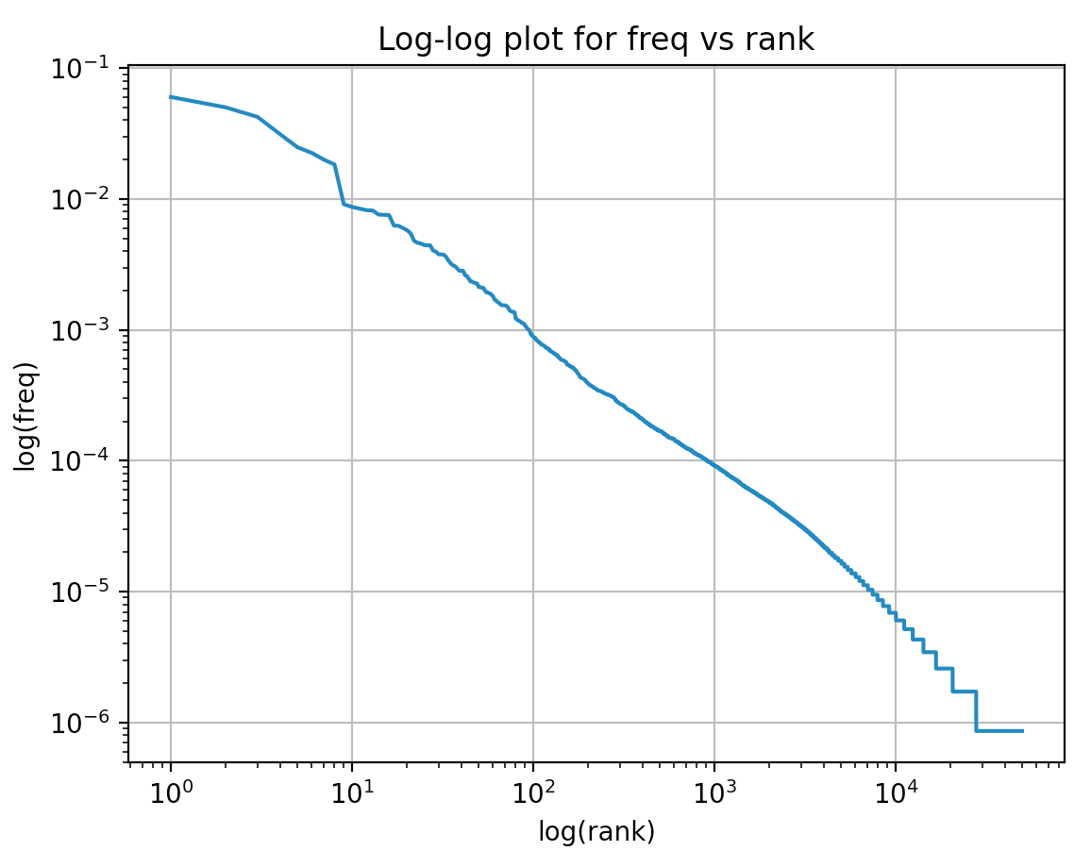
Brown Corpus
plot([w.lower() for w in brown.words()])

