Slide 1
LING/C SC/PSYC 438/538
Lecture 11
Prof. Sandiway Fong

Slide 2
Today's Topics
Some comments on Homework 7
The lines of code that changed everything
Getting deeper into Perl regex
  word boundaries
  capture
  backreferences
  shortest vs. greedy matching
  nondeterminism (backtracking)

Slide 3
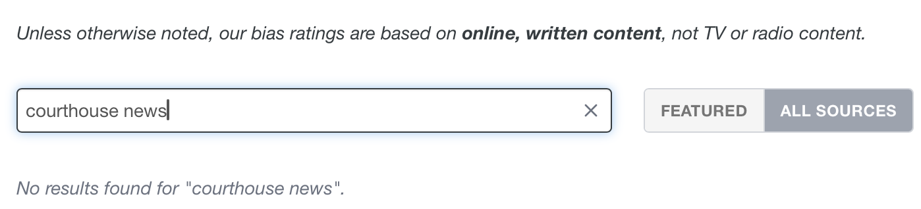
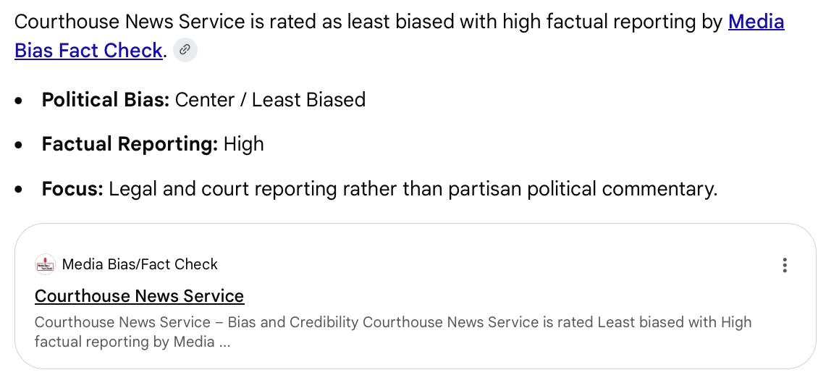
Homework 7 Review

Slide 4


Homework 7 Review
Media bias and headlines
  is it predictable from headline content?
  what makes us pick Left, Center or Right?
  can we expect even coverage? No, blindspots

Slide 5
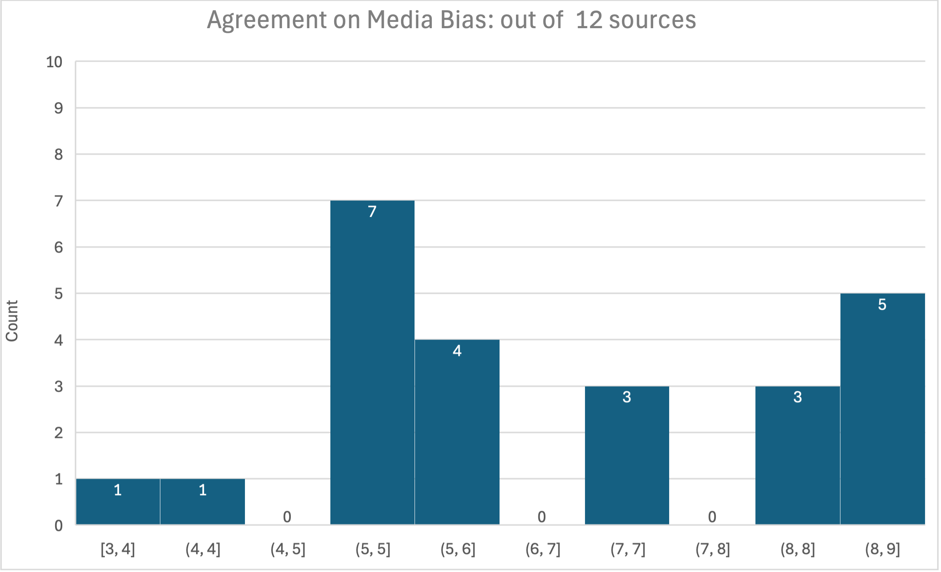
Homework 7 Review
Not so predictable!
Results:
strange binning by Excel btw
We could do some modern statistics, e.g. wrt. inter-annotator agreement

Slide 6
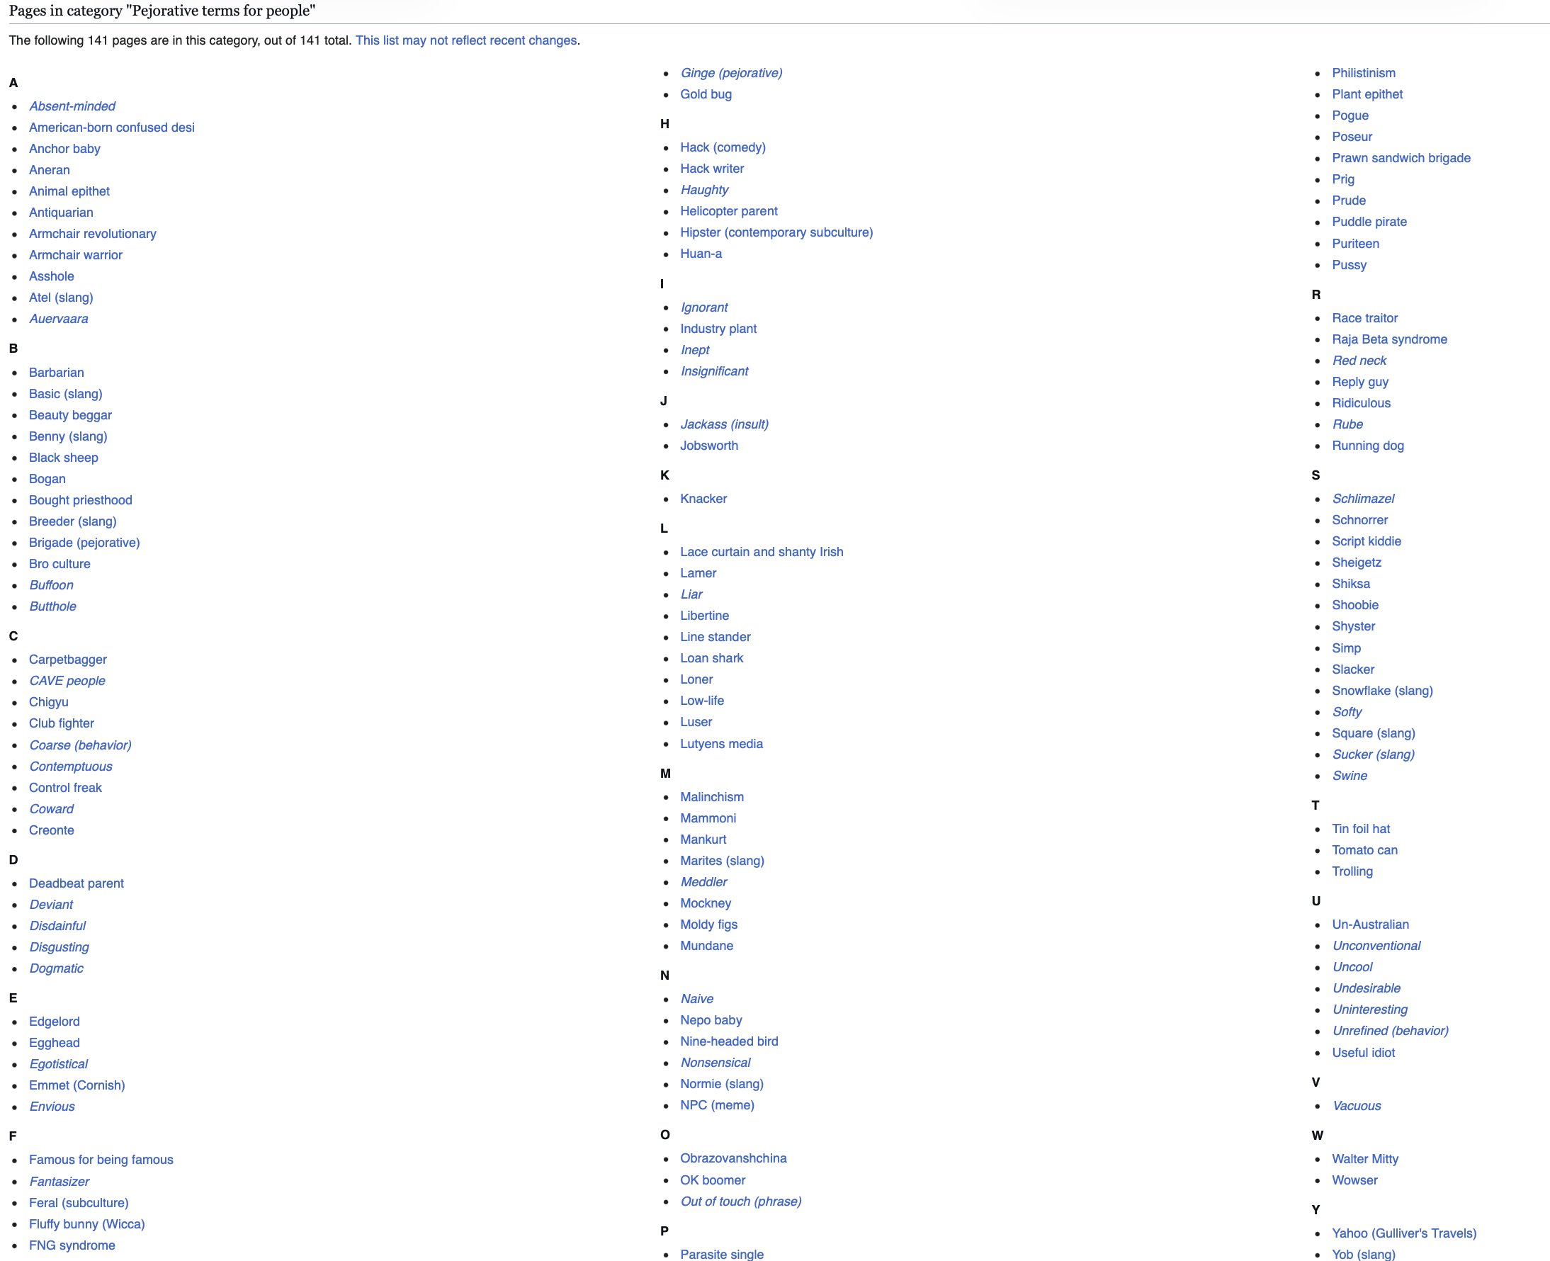
Homework 7 Review
How people are labeled: (political) pejorative terms for people, groups, etc. from Wikipedia

Slide 7
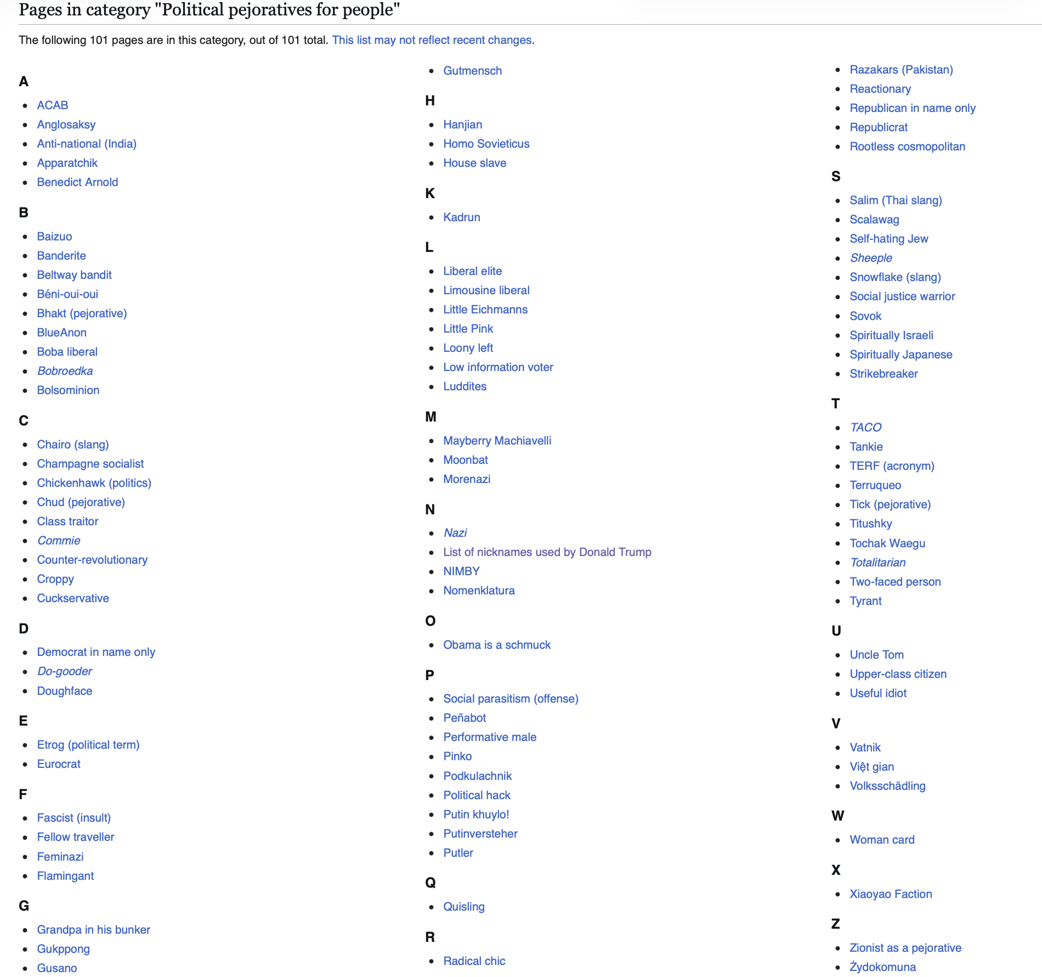
Homework 7 Review
How people are labeled: (political) pejorative terms for people, groups, etc. from Wikipedia

Slide 8
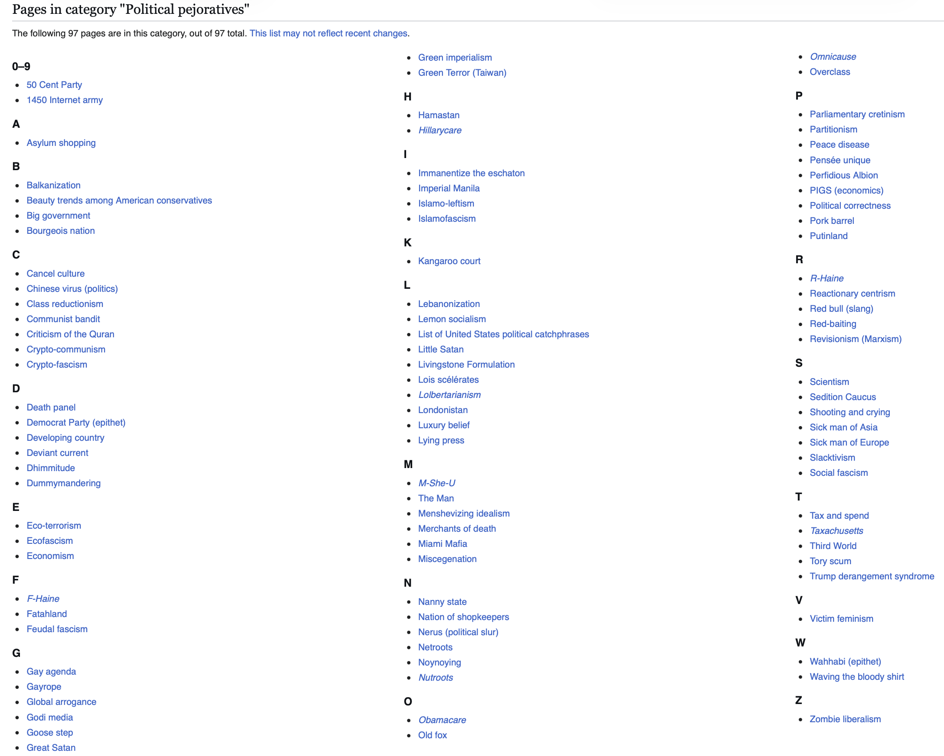
Homework 7 Review
How people are labeled: (political) pejorative terms for people, groups, etc. from Wikipedia

Slide 9
Homework 7 Review
Media bias and headlines
  How about AI?
  Does it do a better job than you?
Tell me if you think this headline feels like it is from a left, center or right wing source? Can you explain why you think so? Just use the words in the headline only for your reasoning.

Slide 10
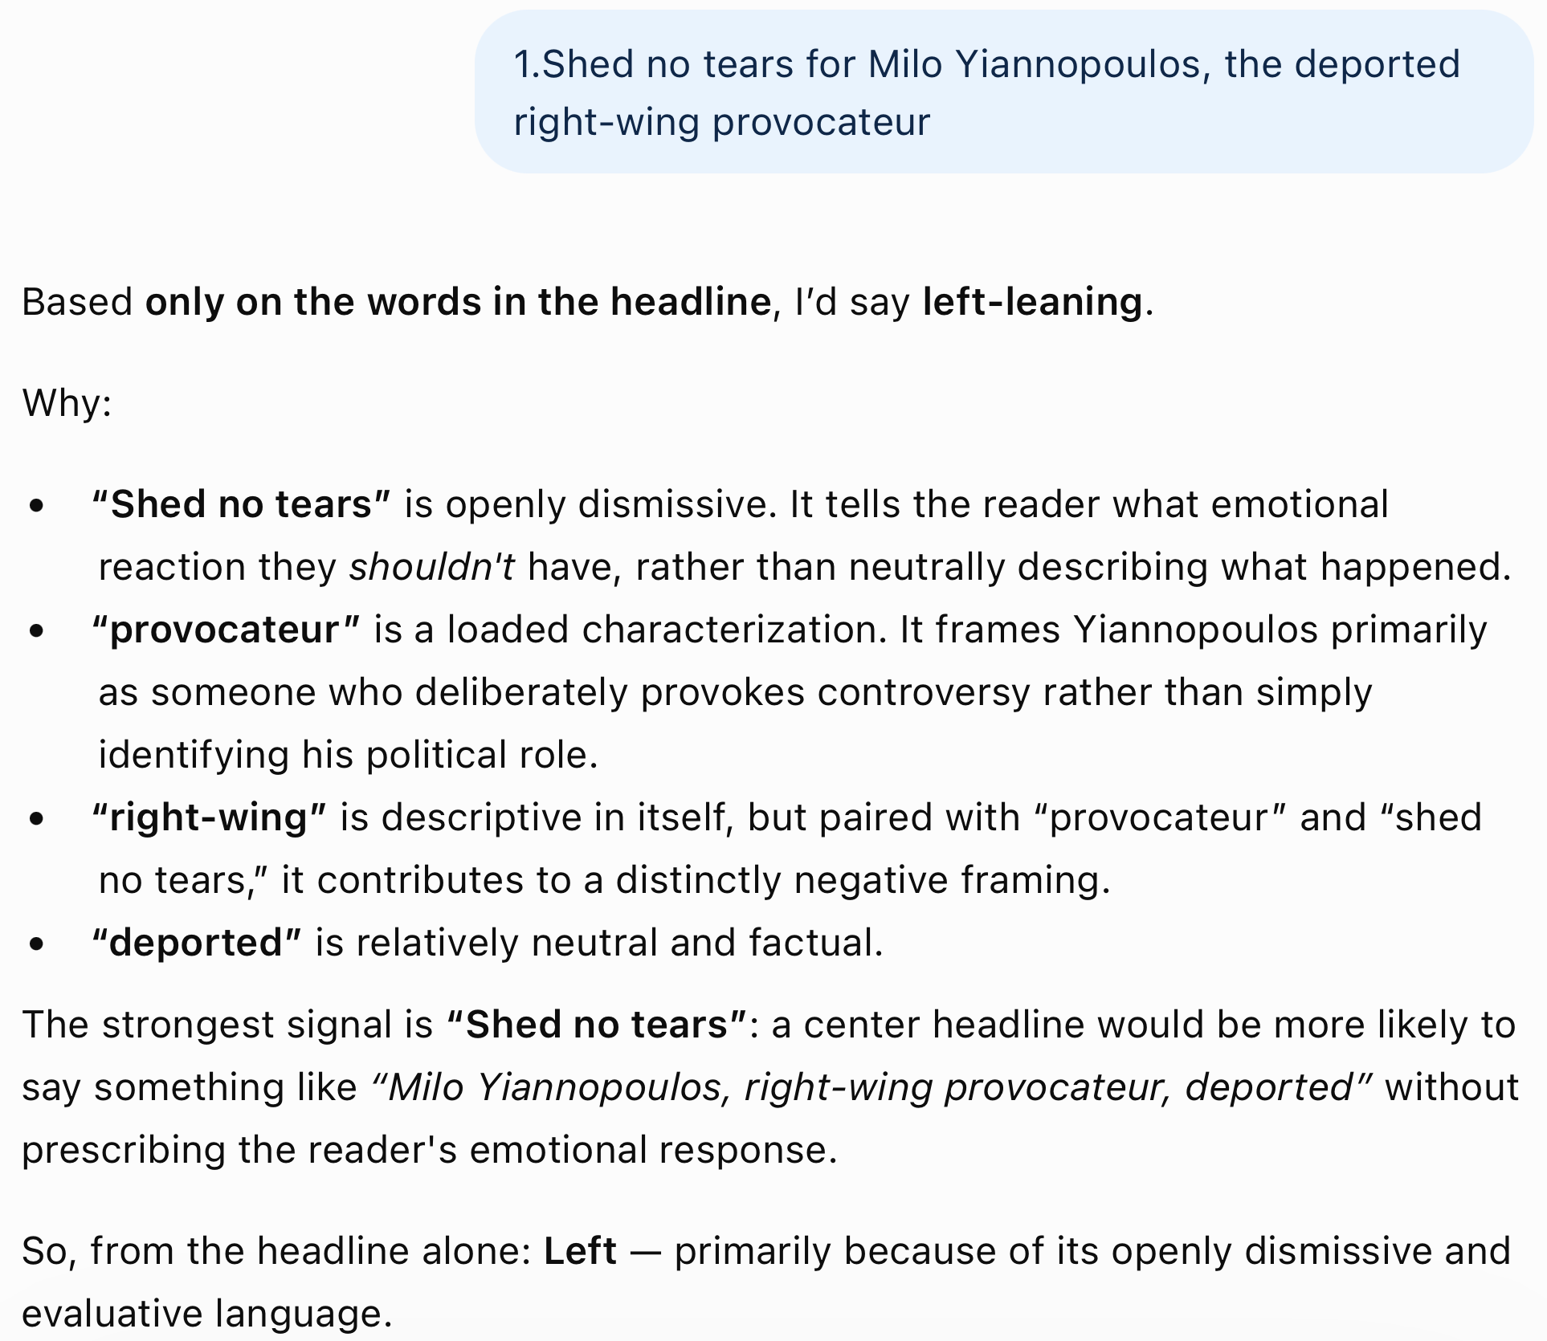
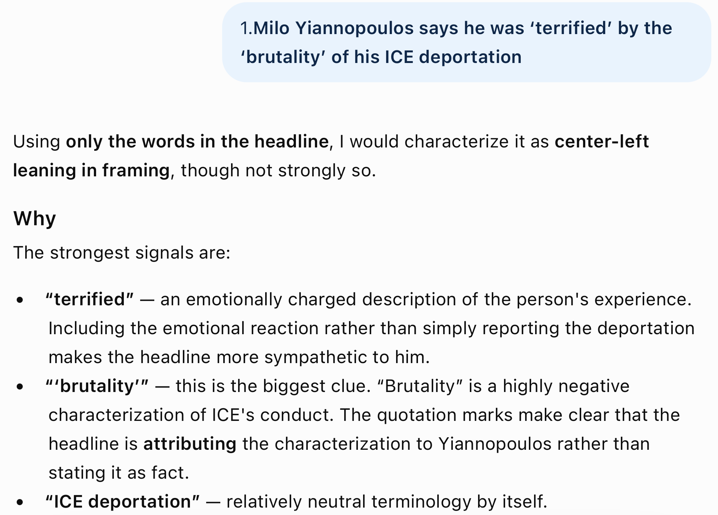
Homework 7 Review
2 for 2

Slide 11
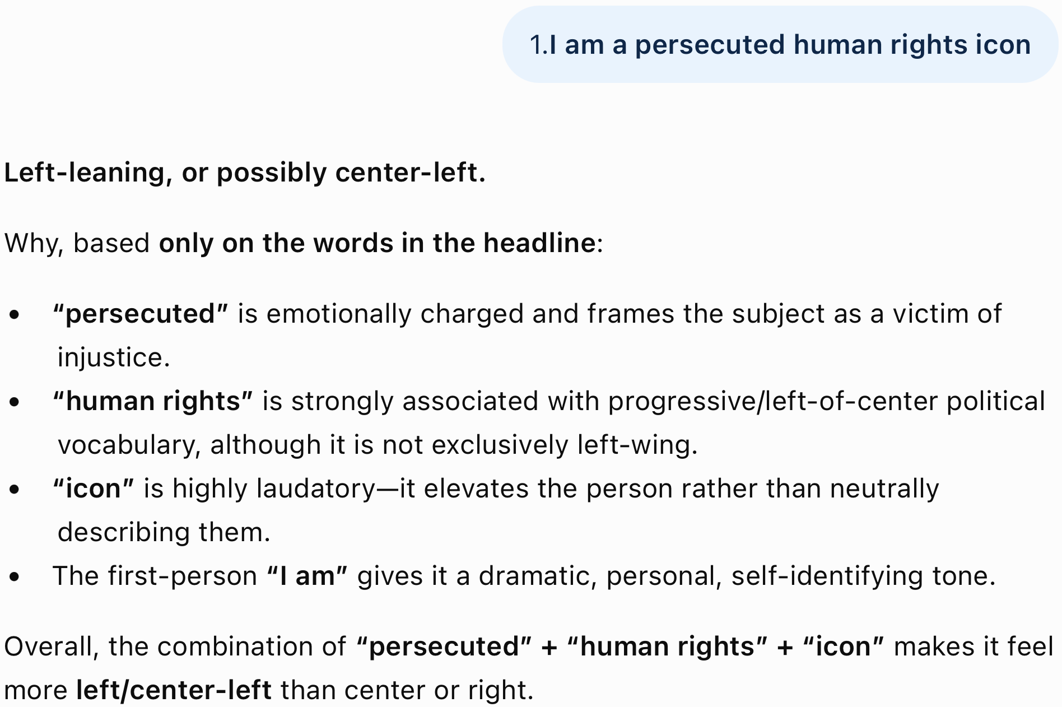
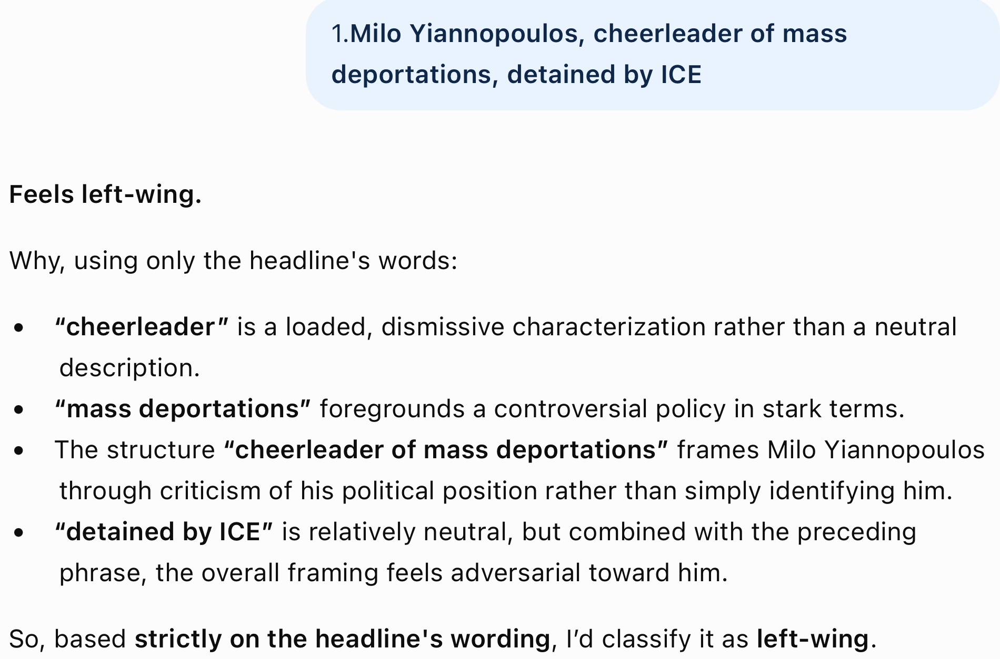
Homework 7 Review
2 for 4

Slide 12
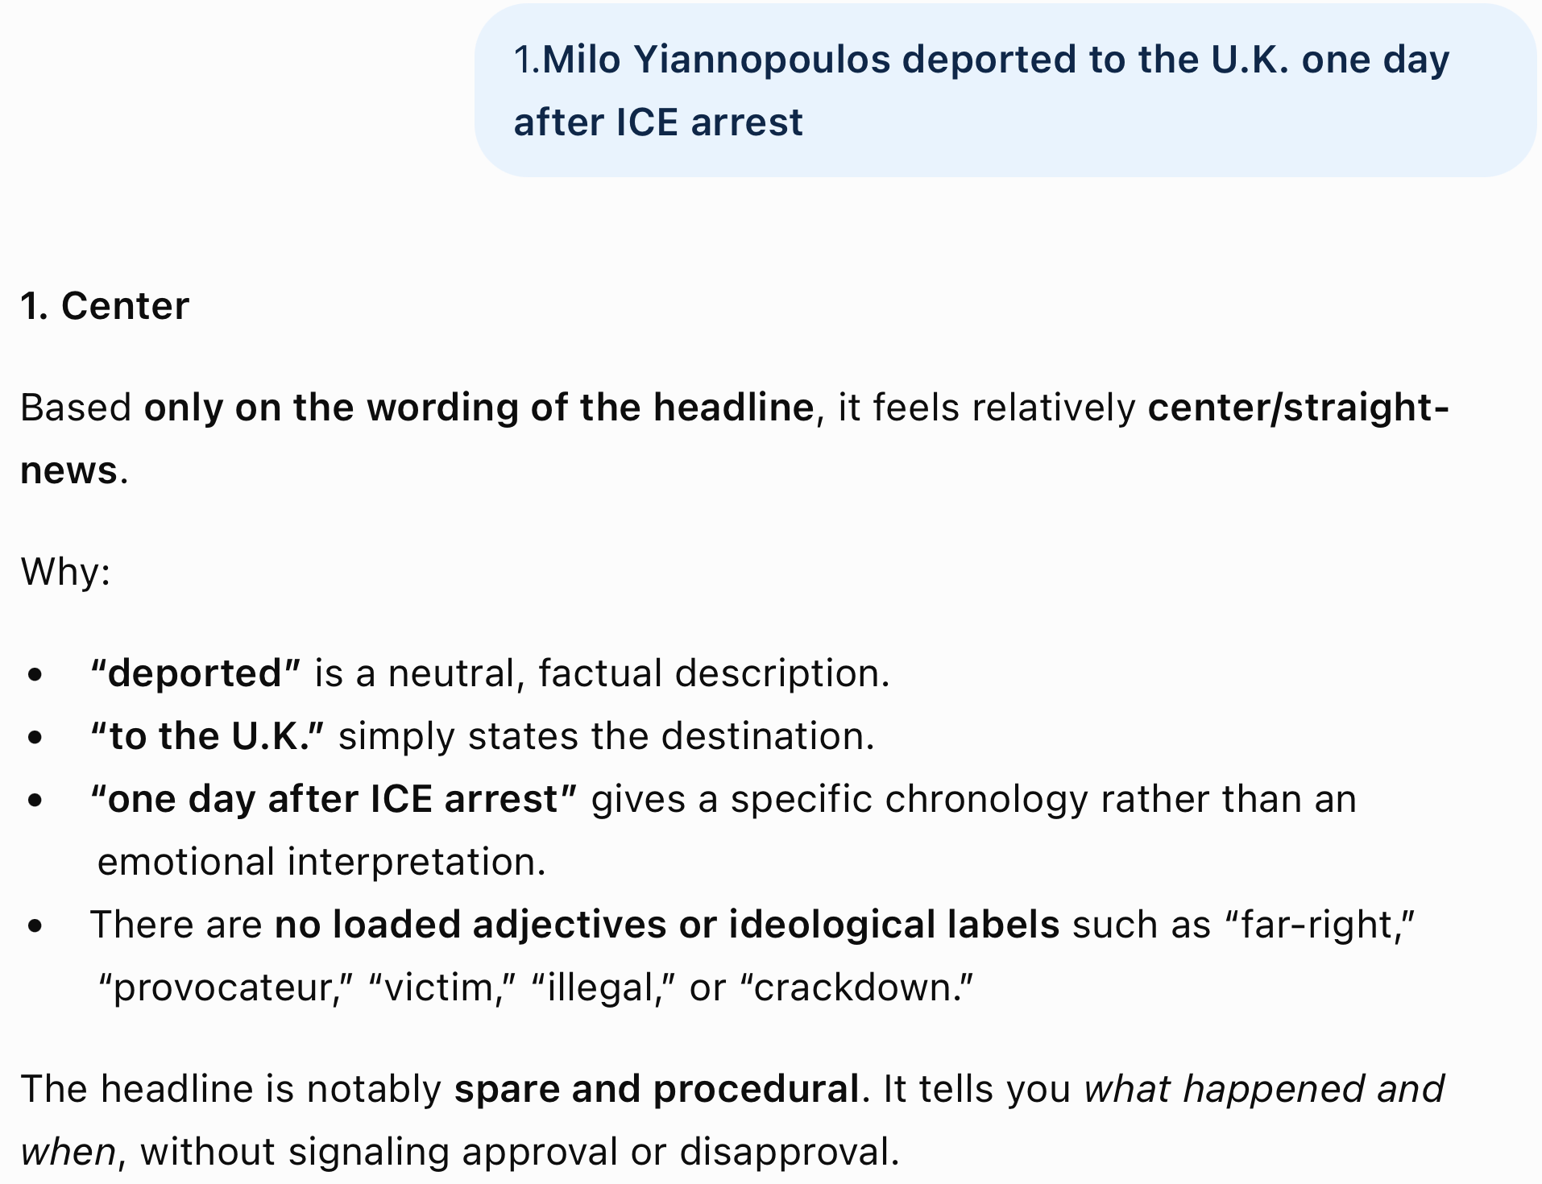
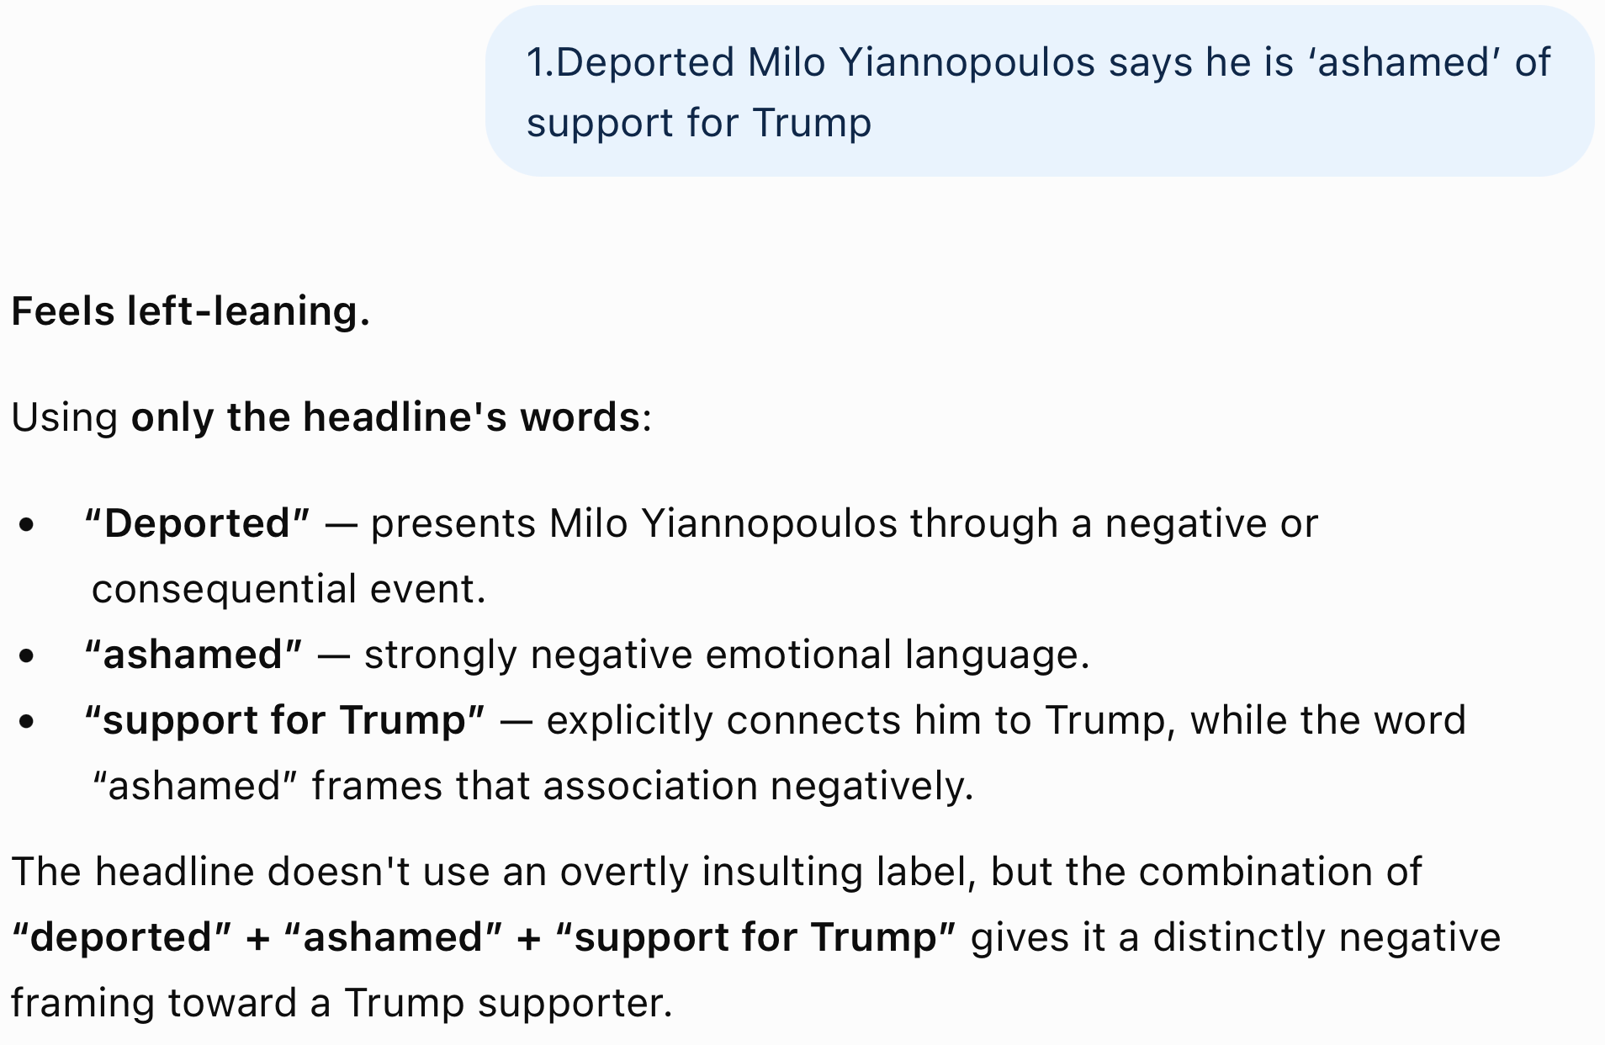
Homework 7 Review
3 for 6

Slide 13
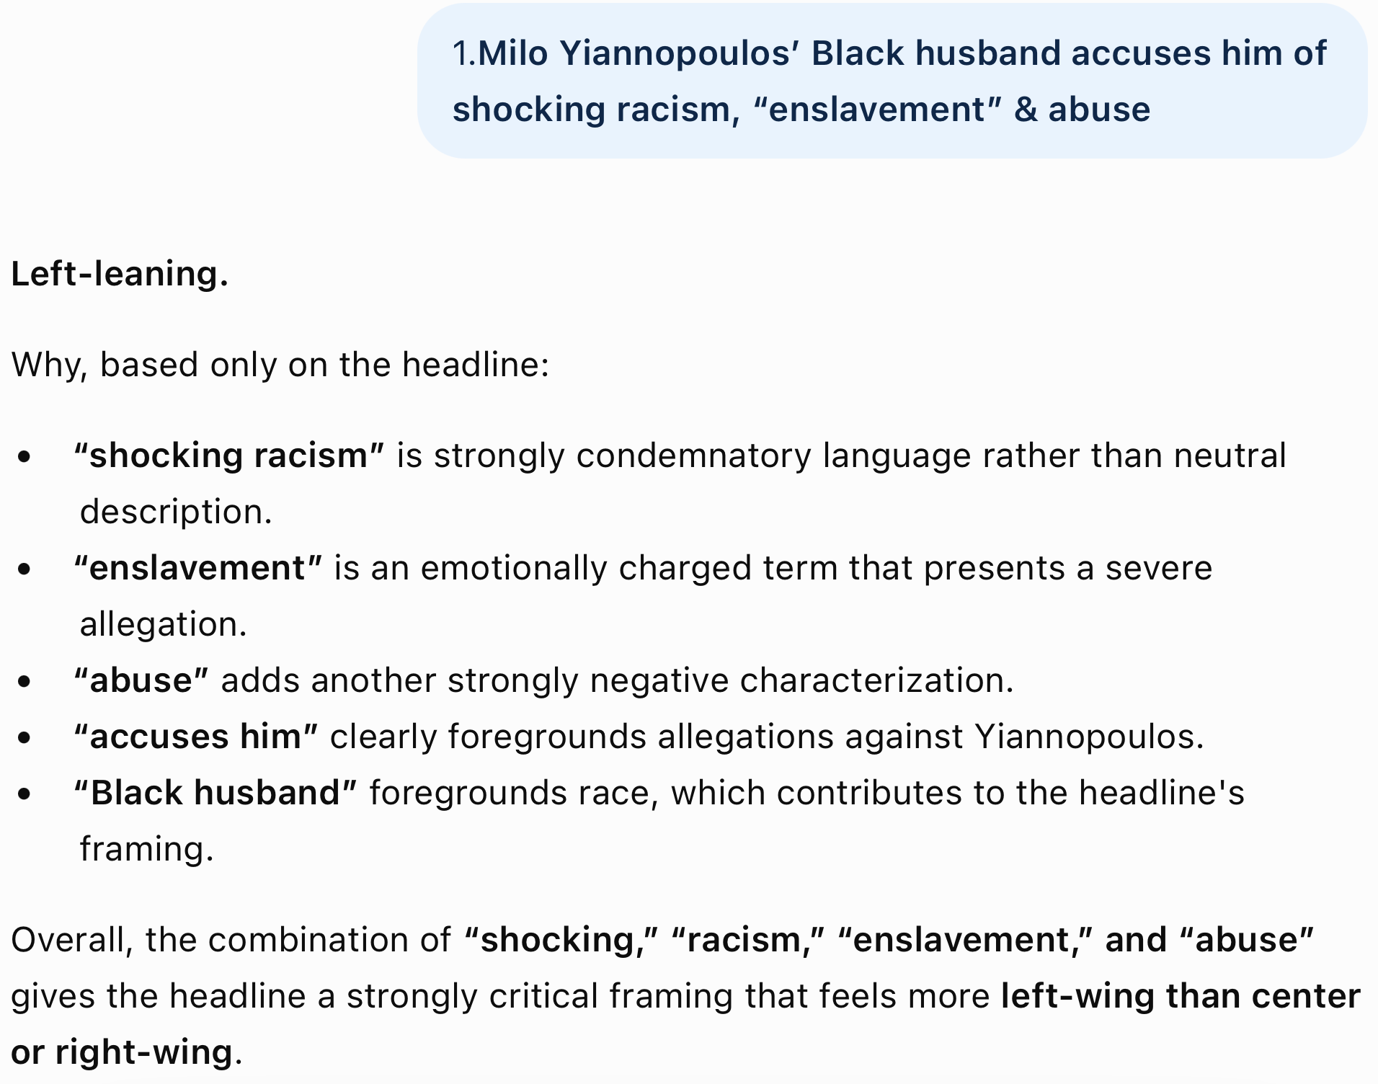
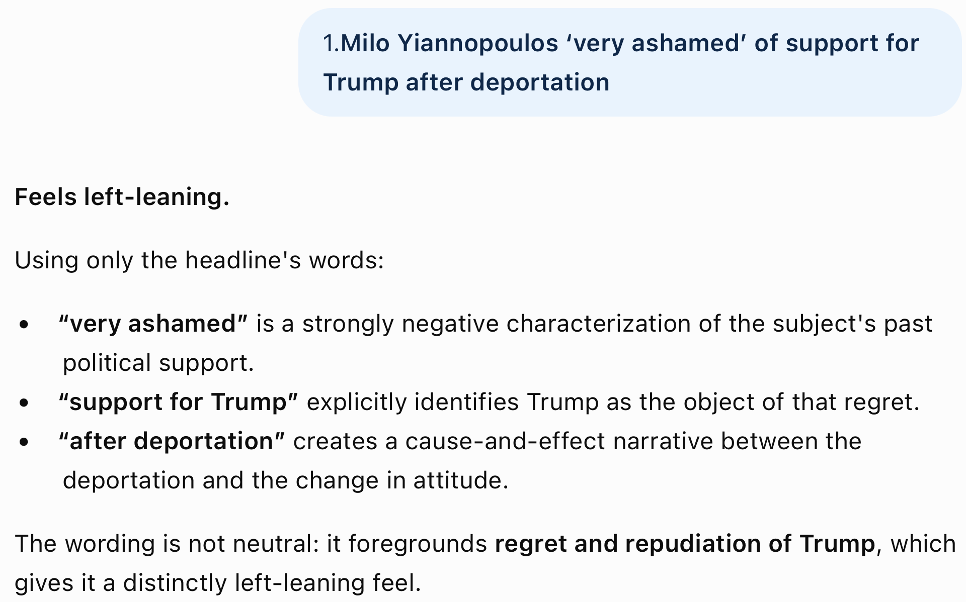
Homework 7 Review
5 for 8

Slide 14
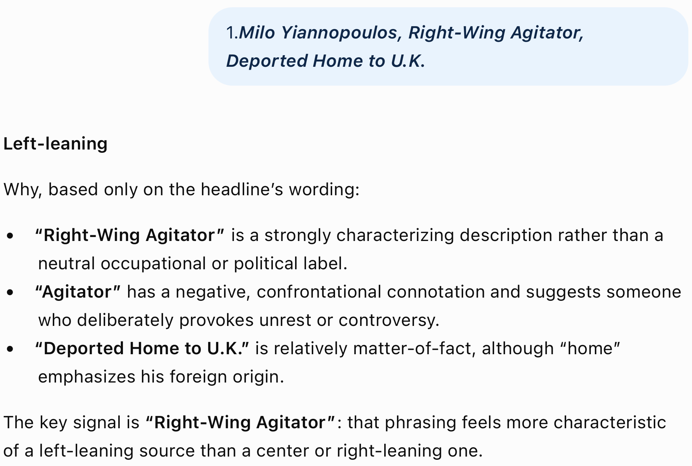
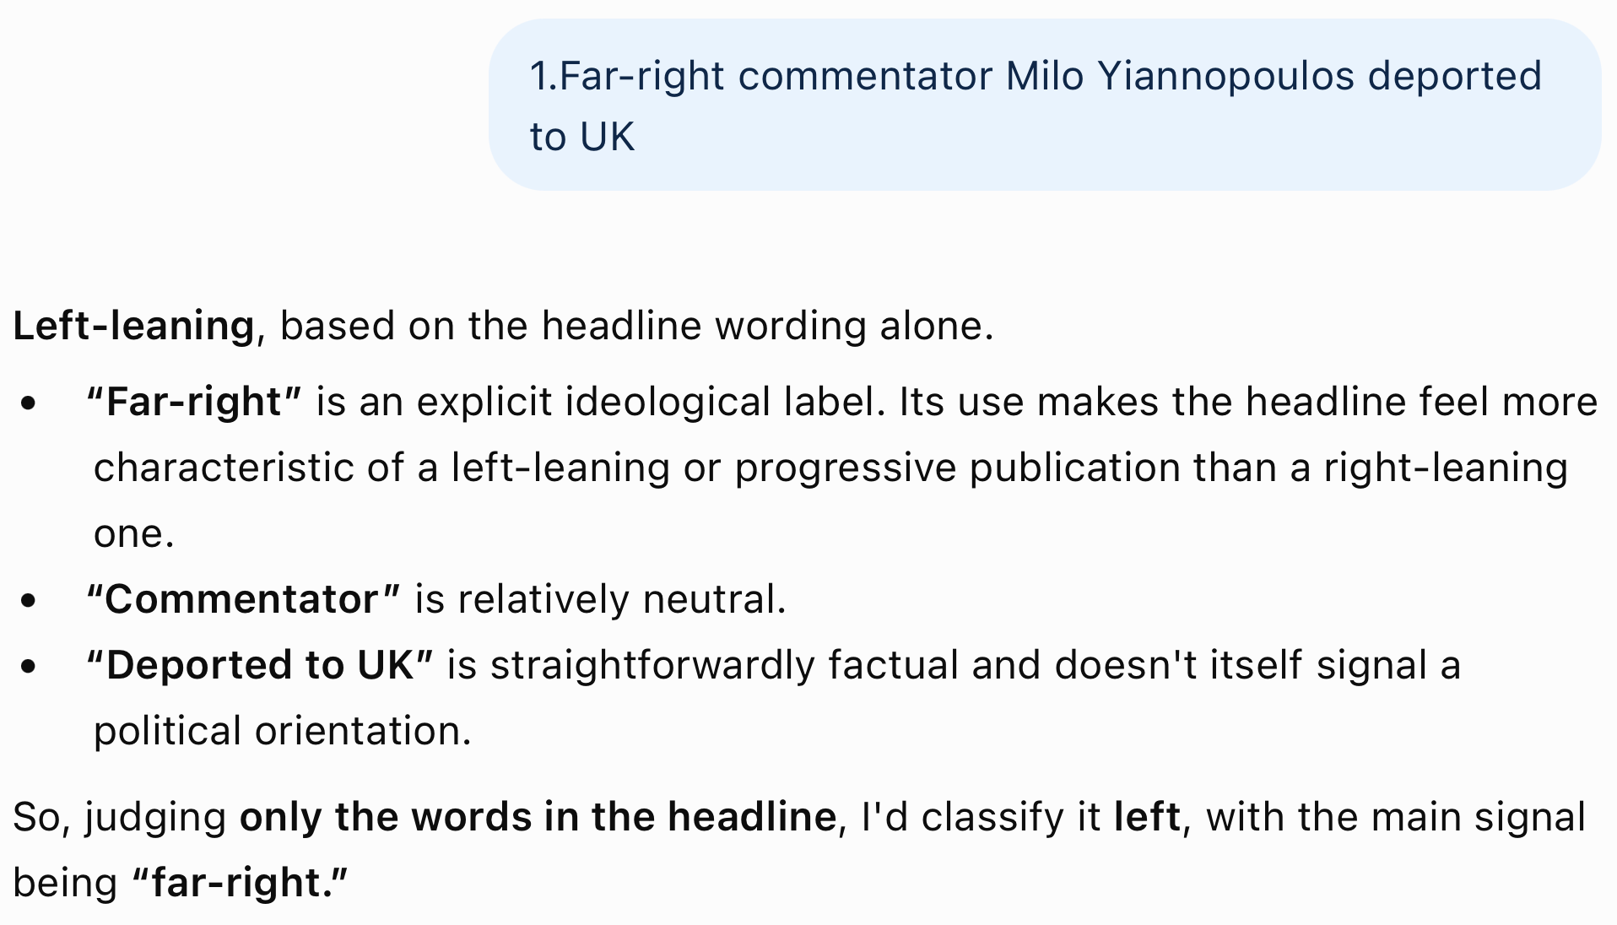
Homework 7 Review
6 for 10

Slide 15
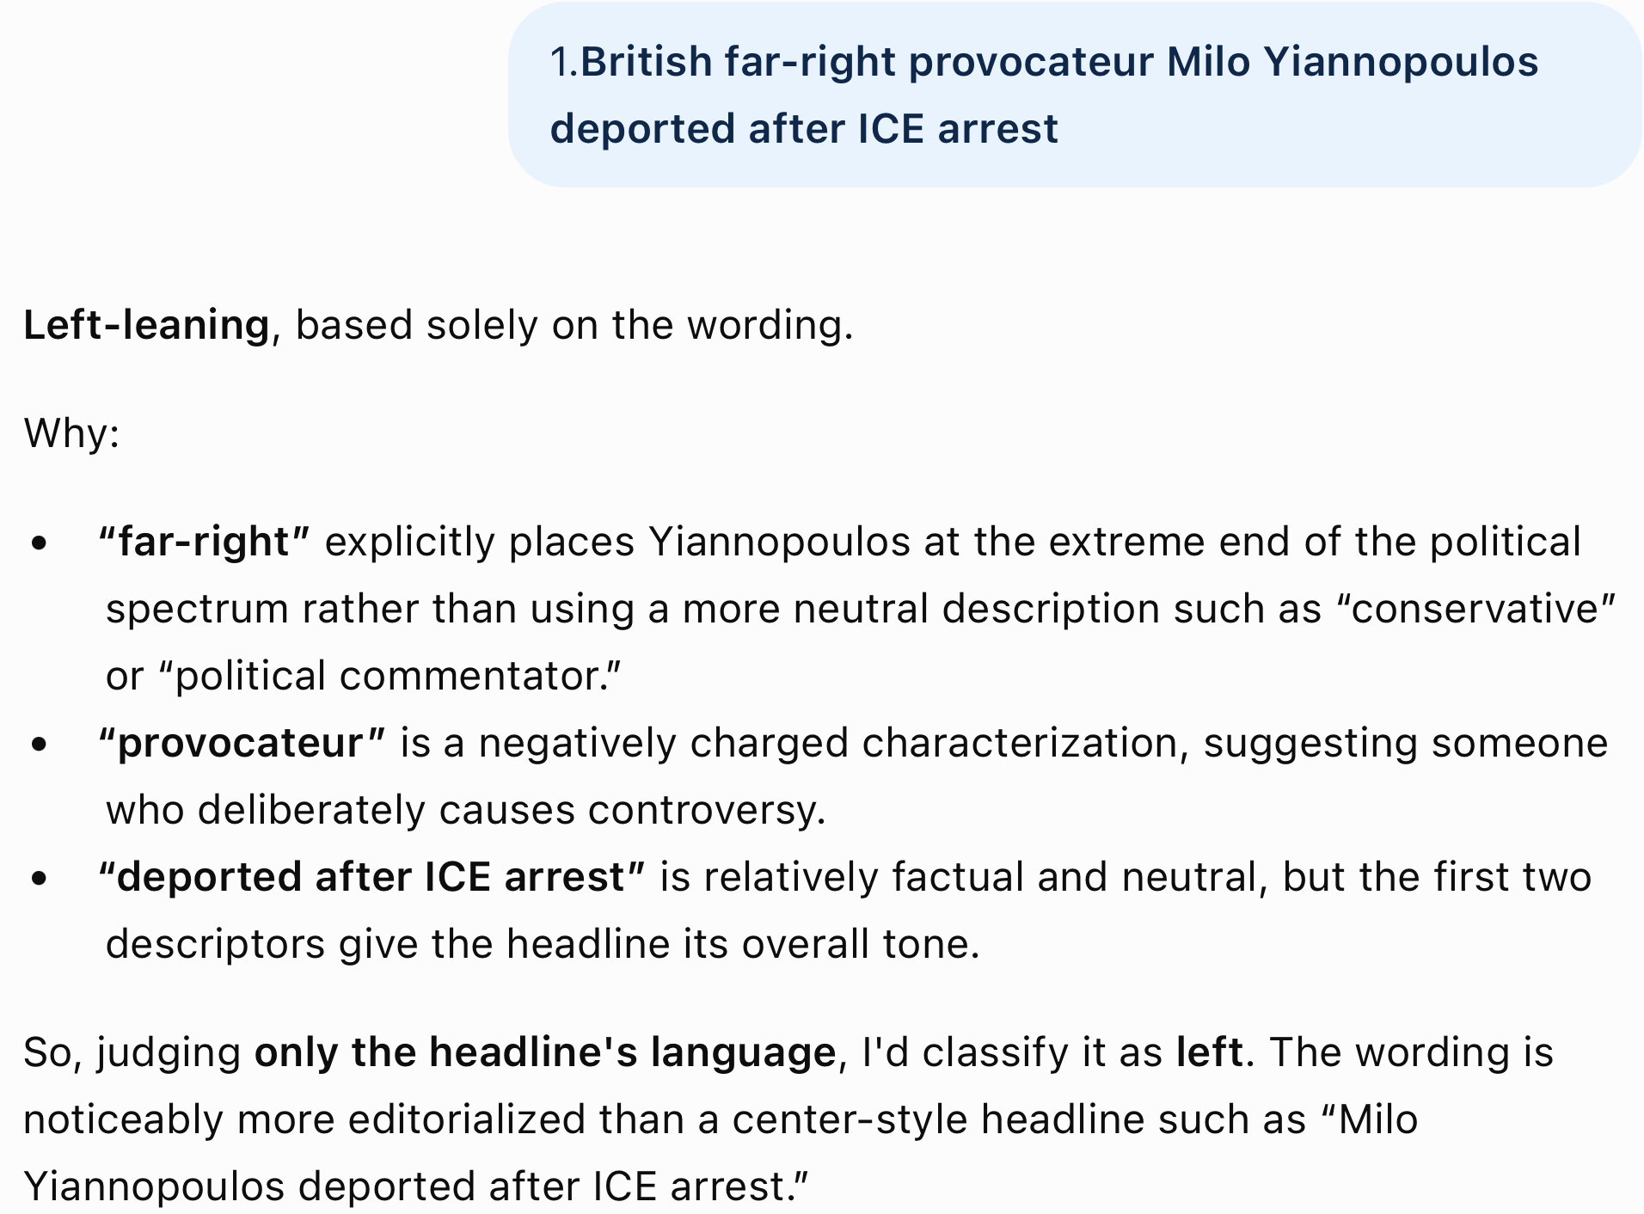
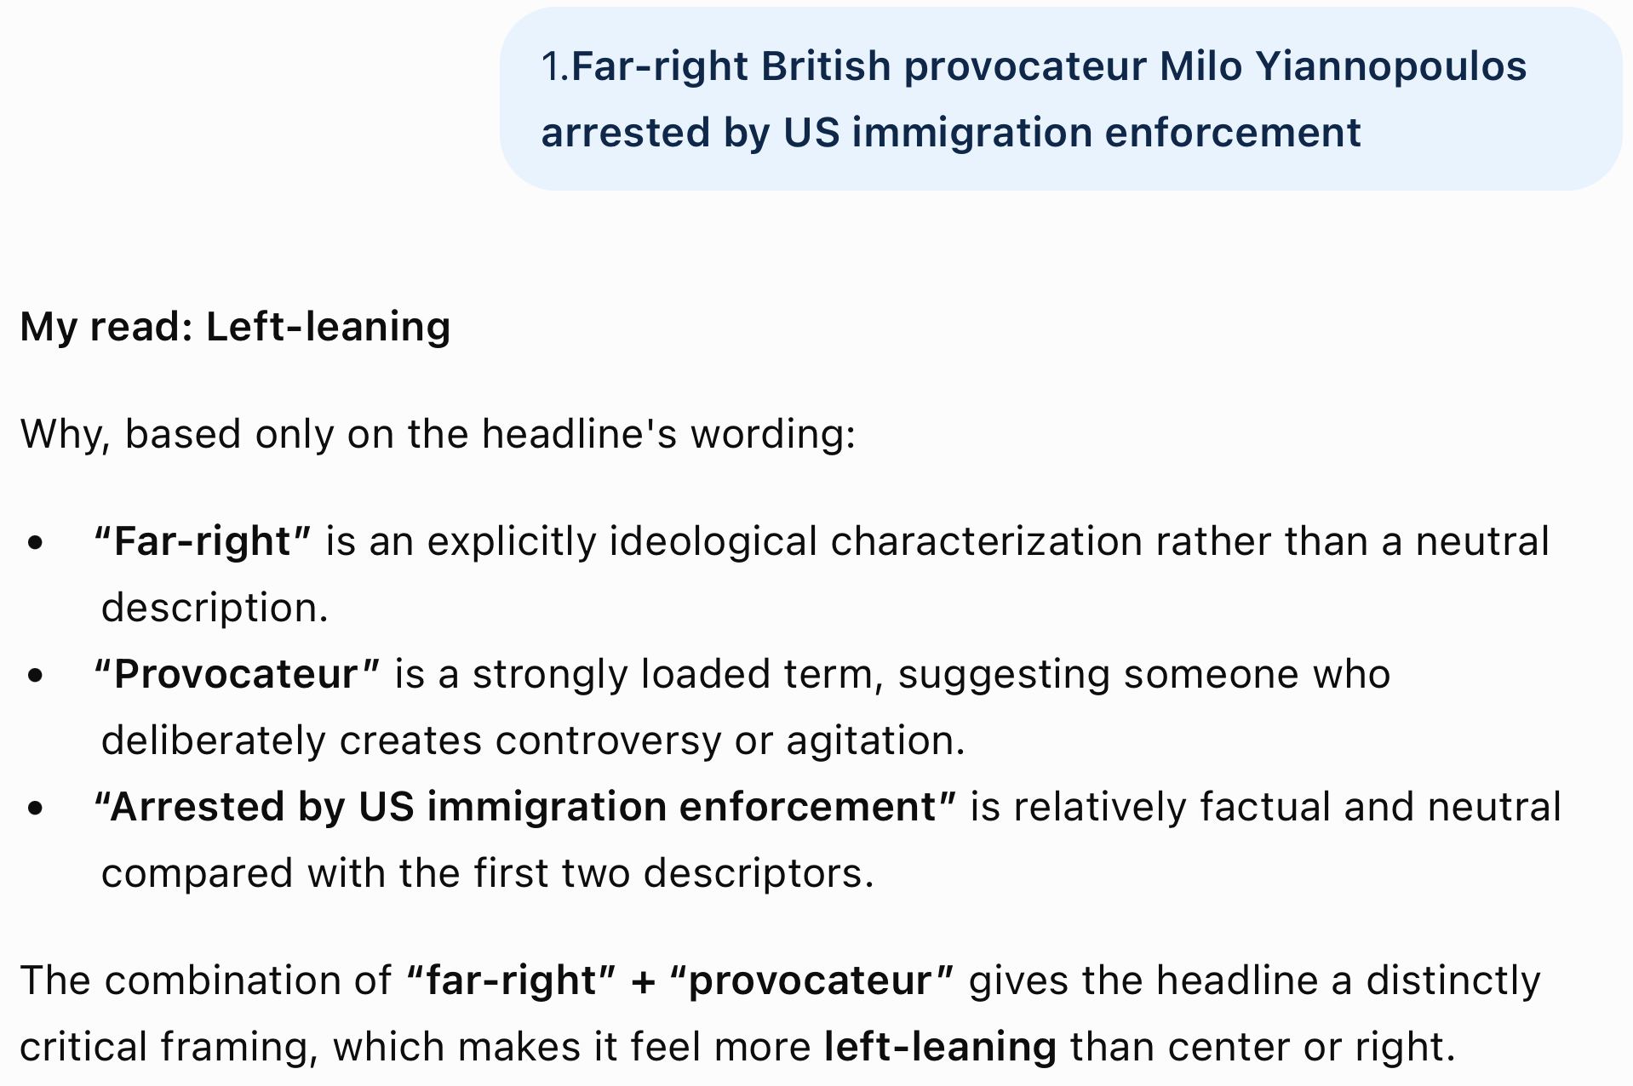
Homework 7 Review
8 for 12

Slide 16
Homework 7 Review
ChatGPT

Slide 17
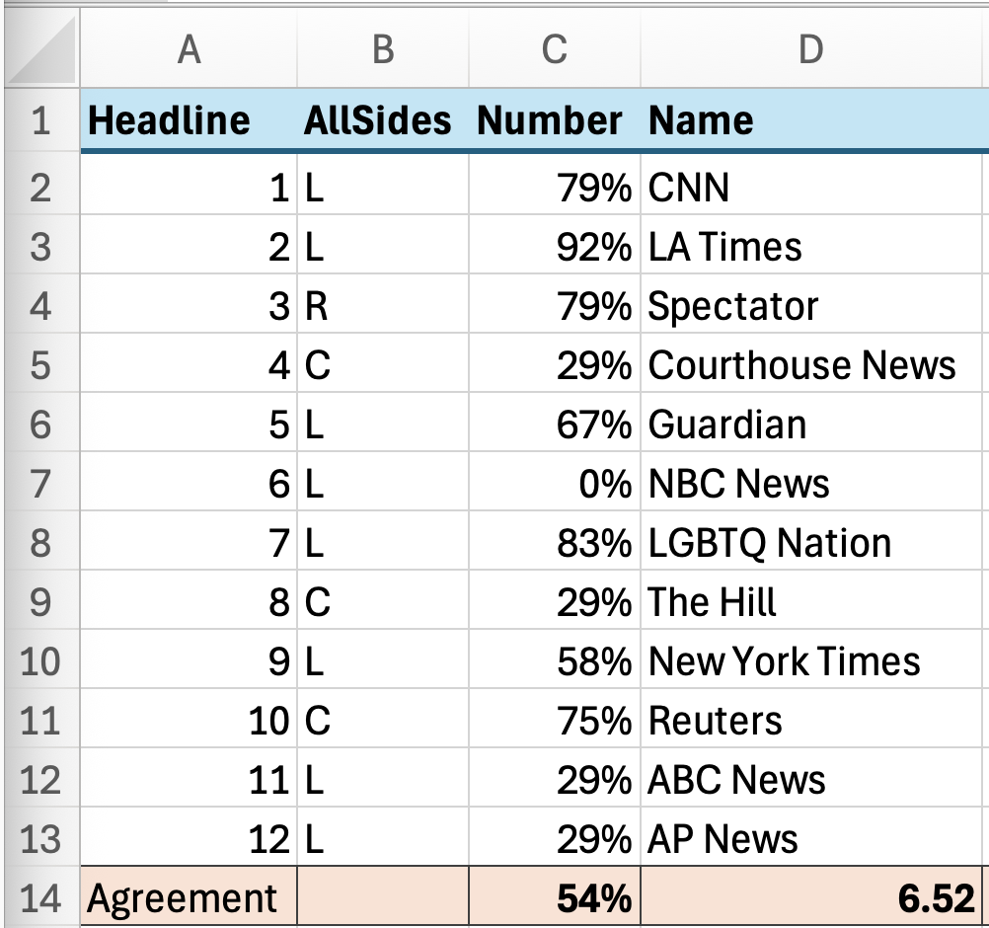
Homework 7 Review

Slide 18
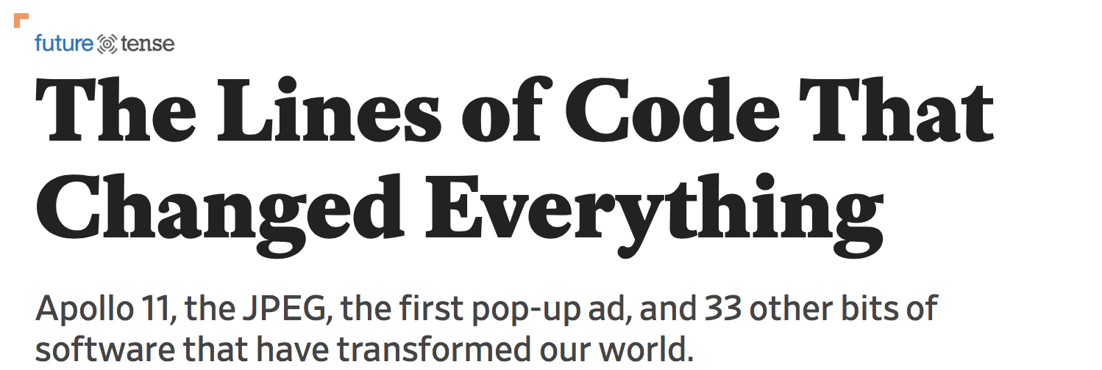
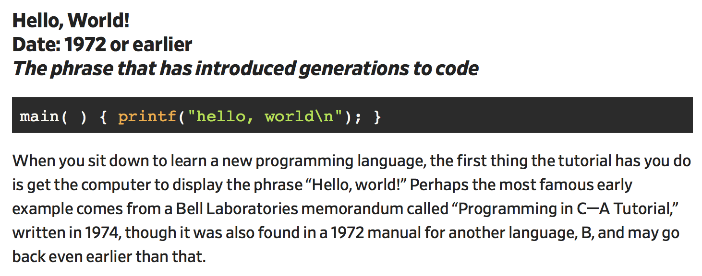
Interesting read
https://slate.com/technology/2019/10/consequential-computer-code-software-history.html

Slide 19
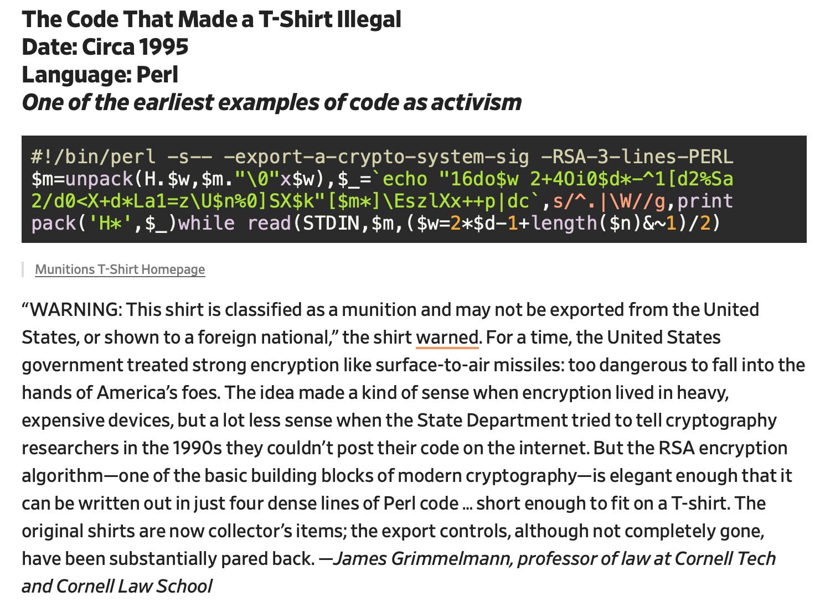
Perl code and History

Slide 20
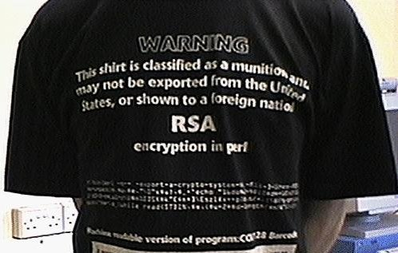
Perl code and History
http://www.cypherspace.org/adam/rsa/rsa-details.html
#!/bin/perl -sp0777i<X+d*lMLa^*lN%0]dsXx++lMlN/dsM0<j]dsj $/=unpack('H*',$_);$_=`echo 16dio\U$k"SK$/SM$n\EsN0p[lN*1 lK[d2%Sa2/d0$^Ixp"|dc`;s/\W//g;$_=pack('H*',/((..)*)$/)

Slide 21
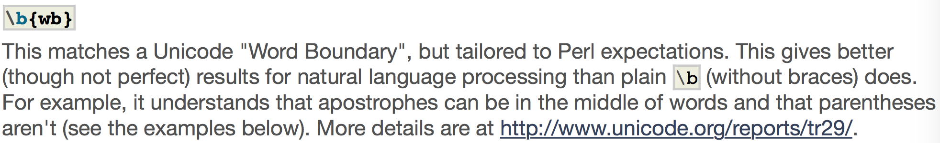
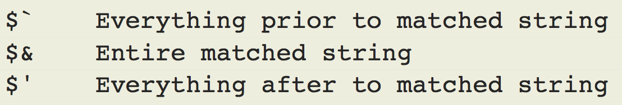
Perl regex
\b or \b{wb}
Perl global variables set during regex matching:
other boundary metacharacters: ^ (beginning of line), $ (end of line)

Slide 22
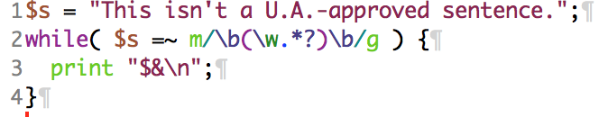
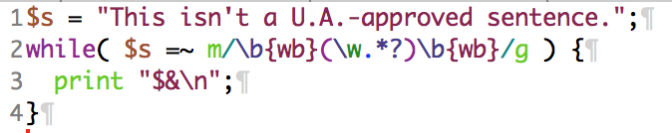
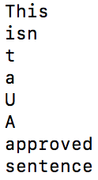
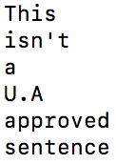
Perl regex: Unicode and \b
\b
\b{wb}
Note: global match in while-loop
Note: .*? is the non-greedy version of .*

Slide 23
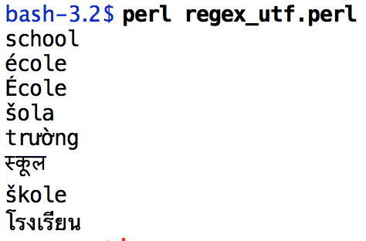

Perl regex: Unicode and \w
list context
\w is [0-9A-Za-z_]
Definition is expanded for Unicode:
use utf8;
use open qw(:std :utf8);
my $str = "school école École šola trường स्कूल škole โรงเรียน";
@words = ($str =~ /(\w+)/g);
foreach $word (@words) { print "$word\n" }
use pragma: https://perldoc.perl.org/open.html

Slide 24
Perl regex: Unicode and \w
list context
\w is [0-9A-Za-z_]
Definition is expanded for Unicode:
use utf8;
use open qw(:std :utf8);
my $str = "school école École šola trường स्कूल škole โรงเรียน";
@words = ($str =~ /(\w+)/g);
foreach $word (@words) { print "$word\n" }
use pragma: https://perldoc.perl.org/open.html

Slide 25
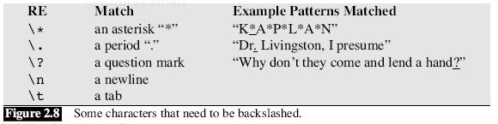
Chapter 2: JM
Why is a backslash needed?
* means zero or more repetitions of the previous char/expr
. means any single character
? means previous char/expr is optional (zero or one occurrence)

Slide 26

Chapter 2: JM
Precedence of operators
  Example: Column 1 Column 2 Column 3 …
  /Column [0-9]+ */
  /(Column [0-9]+ *)*/
  /house(cat(s|)|)/ (| = disjunction; ? = optional)
Perl:
  the regex matched by within the pair of parentheses (…) is stored/captured in global variables $1 (and $2 and so on).
  (?: … ) group but exclude from $n variable storage
Precedence Hierarchy:
space

Slide 27
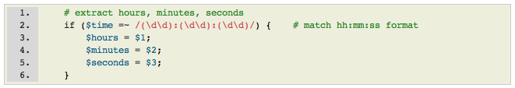
Perl regex
Recall earlier lecture about time?
http://perldoc.perl.org/perlretut.html
returns 1 (true) or "" (empty if false)
A shortcut: list context for matching
returns a list

Slide 28
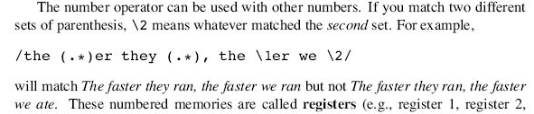
Chapter 2: JM
what does this do?
s/([0-9]+)/<\1>/
Backreferences give Perl regexs more expressive power than Finite State Automata (FSA)

Slide 29
Shortest vs. Greedy Matching
default behavior
  in Perl regex matching:
    take the longest possible matching string
    and see if it works
    if so, ok
    if not, backtrack (take a shorter match and try again)
  aka greedy matching
    This behavior can be changed, see next slide

Slide 30
Shortest vs. Greedy Matching
  from http://www.perl.com/doc/manual/html/pod/perlre.html
Example:
  $_ = "The food is under the bar in the barn.";
  if ( /foo(.*?)bar/ ) {
  print ”matched <$1>\n";
  }
Output:
  greedy (.*): matched <d is under the bar in the >
  shortest (.*?): matched <d is under the >
Notes:
  ? immediately following a repetition operator like * (or +) makes the operator work in non-greedy mode
  + immediately following a repetition operator makes it non-backtracking greedy
(.*?)
(.*)

Slide 31
Regex: exponential time
Regex search is supposed to be fast
  but searching is not necessarily proportional to the length of the string (or corpus) being searched
  in fact, Perl RE matching can can take exponential time (in length)
non-deterministic
  may need to backtrack (revisit last choice point) if it matches incorrectly part of the way through
  Let's consider a?a?a?aaa matching against the string aaa
exponential
time
linear
time
length
length

Slide 32
Regex: exponential time
Consider a?a?a?aaa matching against the string aaa
  For expository purposes: a₁ a₂ a₃
  red a = failure to match (causes backtracking)
Tries:
a₁? a₂? a₃?aaa
a₁? a₂? ? a₃ aa
a₁? ? a₂ ? a₃ aa
a₁? ? ? a₂ a₃ a
? a₁ ? a₂ ? a₃ aa
? a₁ ? ? a₂ a₃ a
? ? a₁ ? a₂ a₃ a
? ? ? a₁ a₂ a₃
success!

Slide 33
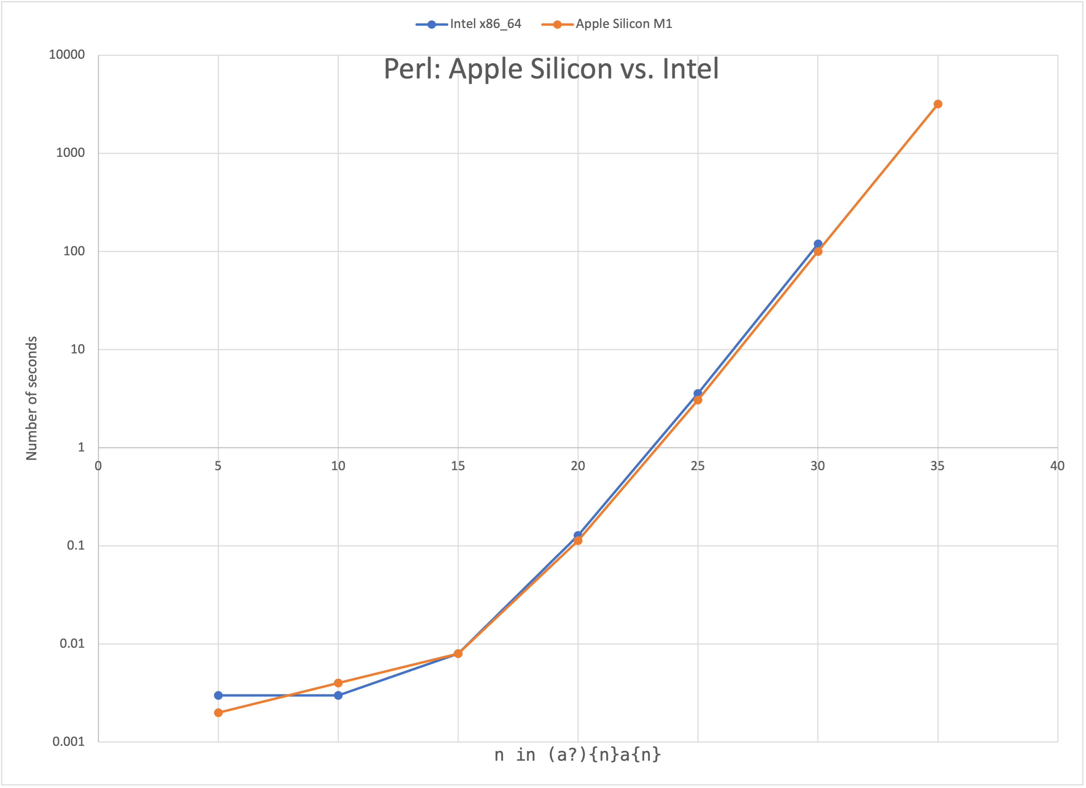
Perl implementations
Now consider scaling up a?a?a?aaa, i.e. (a?)^{n}a^{n} matching against a^{n}
perl 5, version 28, subversion 3 (v5.28.3) built for darwin-thread-multi-2level
  /opt/local/bin/perl: Mach-O 64-bit executable x86_64
perl 5, version 34, subversion 1 (v5.34.1) built for darwin-thread-multi-2level
  /opt/local/bin/perl: Mach-O 64-bit executable arm64
log scale
Reference:
https://swtch.com/~rsc/regexp/regexp1.html

Slide 34
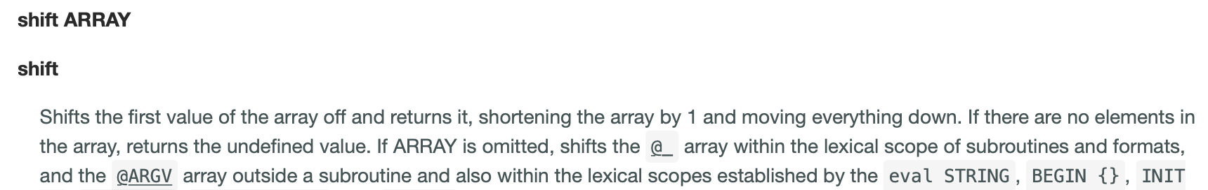
Regex: exponential time
regex(a?)^{n}a^{n} matching against a^{n} for a range of values for n
  time perl -e '$n = shift; $na = "a" x $n; print $na =~ /(a?){$n}a{$n}/' 25
  real 0m3.201s
  user 0m3.190s
  sys 0m0.007s
Note:
  shift defaults to working on @ARGV, that's how $n gets 25 above.

